Slide 1
C Language Programming for the 8051
هاجر ملکیان(81130029)
فاطمه مظاهری(81130028)

Slide 2
Overview
C for microcontrollers
  Review of C basics
  Compilation flow for Cygnal
  C extensions
  In-line assembly
  Interfacing with C
Examples
Arrays and Pointers
I/O Circuitry
Functions and Header Files
Multitasking and multithreading

Slide 3
C for Microcontrollers
Of higher level languages, C is the closest to assembly languages
  bit manipulation instructions
  pointers (indirect addressing)
Most microcontrollers have available C compilers
Writing in C simplifies code development for large projects.

Slide 4
Available C Compilers
Reads51 – detailed in textbook
Cygnal – integrated with the IDE we have been using for labs.

Slide 5
Compilation Process (Cygnal)
program.c
compile
no SRC option
program.LST
program.OBJ
build/make
program.M51

Slide 6
Modular Programming
Like most high level languages, C is a modular programming language (but NOT an object oriented language)
Each task can be encapsulated as a function.
Entire program is encapsulated in “main” function.

Slide 7
Basic C Program Structure
Compiler directives and include files
Declarations of global variables and constants
Declaration of functions
Main function
Sub-functions
Interrupt service routines

Slide 8
Back to C Basics
All C program consists of:
  Variables
  Functions (one must be “main”)
    Statements
To define the SFRs as variables:
  #include <c8051F020.h>

Slide 9
Variables
All variables must be declared at top of program, before the first statement.
Declaration includes type and list of variables.
  Example: void main (void) {
  int var, tmp;
Types:
  int (16-bits in our compiler)
  char (8-bits)
  short (16-bits)
  long (32-bits)
  sbit (1-bit)
  others that we will discuss later
must go HERE!
not standard C – an 8051 extension

Slide 10
Variables
The following variable types can be signed or unsigned:
signed char (8 bits) –128 to +127
signed short (16 bits) –32768 to +32767
signed int (16 bits) –32768 to +32767
signed long (32 bits) –2147483648 to +2147483648
unsigned char (8 bits) 0 to + 255
unsigned short (16 bits) 0 to + 65535
unsigned int (16 bits) 0 to + 65535
unsigned long (32 bits) 0 to + 4294967295
NOTE: Default is signed – it is best to specify.

Slide 11
Statements
Assignment statement:
  variable = constant or expression or variable
  examples: upper = 60;
  I = I + 5;
  J = I;

Slide 12
Operators
Arithmetic: +, -, *, /
Relational: >, >=, <, <=
Equality: ==, !=
Logical: && (and), || (or)
Increment and decrement: ++, --
Example:
  if (x != y) && (c == b)
  {
  a=c + d*b;
  a++;
  }

Slide 13
Example – Adder program
(add 2 16-bit numbers)
$INCLUDE (C8051F020.inc)
XL equ 0x78
XH equ 0x79
YL equ 0x7A
YH equ 0x7B
cseg at 0
ljmp Main
cseg at 100h
; Disable watchdog timer
Main: mov 0xFF, #0DEh
mov 0xFF, #0ADh
mov a, XL
add a, YL
mov XL, a mov a, XH
addc a, YH
mov XH, a
nop
end
#include <c8051f020.h>
void main (void) {
int x, y, z;
// disable watchdog timer
WDTCN = 0xde;
WDTCN = 0xad;
z = x + y;
}
The C version
The assembly version

Slide 14
Compilation Process (Cygnal)
Use the #pragma CODE compiler directive to get assembly code generated in LST file.
adder.c
compile
look here in RAM
when debugging
adder.LST
adder.OBJ
build/make
adder.M51
Map file shows where variables are stored. One map file is generated per project.
Symbol Table in M51 file:
------ DO
D:0008H SYMBOL x
D:000AH SYMBOL y
D:000CH SYMBOL z
------- ENDDO

Slide 15
Bitwise Logic Instructions
AND
OR
XOR
left shift
right shift
1’s complement
Examples:
&
|
^
<<
>>
~
n = n & 0xF0;
n = n & (0xFF << 4)
n = n & ~(0xFF >> 4)

Slide 16
Example – Logic in Assembly and C
Main:
mov WDTCN, #0DEh
mov WDTCN, #0ADh
xrl a, #0xF0 ; invert bits 7-4
orl a, #0x0C ; set bits 3-2
anl a, #0xFC ; reset bits 1-0
mov P0, a ; send to port0
void main (void) {
char x;
WDTCN = 0xDE;
WDTCN = 0xAD;
x = x ^ 0xF0;
x = x | 0x0C;
x = x & 0xFC;
P0 = x;
}
The assembly version
The C version

Slide 17
Loop Statements - While
While loop:
  while (condition) { statements }
  while condition is true, execute statements
  if there is only one statement, we can lose the {}
  Example: while (1) ; // loop forever

Slide 18
Loop Statements - For
For statement:
  for (initialization; condition; increment) {statements}
  initialization done before statement is executed
  condition is tested, if true, execute statements
  do increment step and go back and test condition again
  repeat last two steps until condition is not true

Slide 19
Example: for loop
for (n = 0; n<1000; n++)
n++ means n = n + 1
Be careful with signed integers!
for (i=0; i < 33000; i++) LED = ~LED;
Why is this an infinite loop?

Slide 20
Loops: do - while
do
statements
while (expression);
Test made at the bottom of the loop

Slide 21
Decision – if statement
if (condition1)
  {statements1}
  else if (condition2)
  {statements2}
  …
  else
  {statementsn}

Slide 22
Decision – switch statement
switch (expression) {
case const-expr: statements
case const-expr: statements
default: statements
}

Slide 23
Example: switch
Need a statement like “return” or “break” or execution falls through to the next case (unlike VHDL)
switch (unibble) {
case 0x00 : return (0xC0);
case 0x01 : return (0xF9);
case 0x02 : return (0xA4);
case 0x03 : return (0xC0);
default : return (0xFF);
}

Slide 24
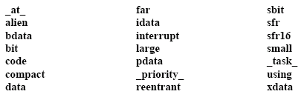
C Extensions: Additional Keywords
For accessing SFRs
Specify where variables go
in memory

Slide 25
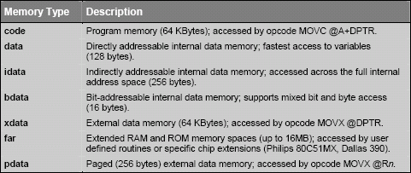
Accessing Specific Memory

Slide 26
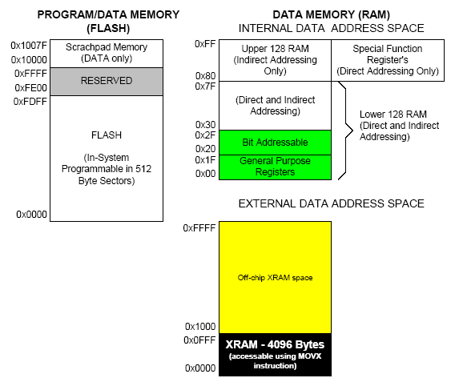
C Access to 8051 Memory
code: program memory accessed by movc @a + dptr
data
bdata
idata
xdata

Slide 27
تغيير ناحيه ذخيره سازی متغير در حافظه به طور صريح
کلمات کليدی برای تعيين کردن ناحيه حافظه متغير:
Data
Idata
bdata
Xdata

Slide 28
data
نشاندهنده ان است که مکان متغير در رم داخلی است و دسترسی به ان از طريق ادرس دهی مستقيم امکان پذير است.
مثال:
Data char I; The C version
I =2;
Mov I,#02h The assembly version

Slide 29
Idata
نشاندهنده ان است که مکان متغير در رم داخلی است و دسترسی به ان از طريق ادرس دهی غير مستقيم امکان پذير است.
مثال:
Idata char I; The C version
I =2;
Mov R0,#I
Mov @R0,#02h The assembly version

Slide 30
Pdata
نشاندهنده ان است که مکان متغير دريک صفحه 256 بايتی از حافظه رم خارجی است.
pdata char I; The C version
I =2;
Mov a,#02h
Mov R0,#I The assembly version
Movx @R0,a

Slide 31
Xdata
نشاندهنده ان است که مکان متغير در64 کيلو بايت از حافظه رم خارجی است.
xdata char I; The C version
I =2;
Mov dptr ,#I
Mov a, #02h The assembly version
Movx @dptr , a

Slide 32
Code
نشاندهنده ان است که عدد به صورت ثابت در حافظه رام بوده و قابل تغيير نيست.
به عنوان مثال اجرای اعلان زير باعث ميشود که ثابت در مکانی از حافظه رام قرار گيردو مقدار 2 را دارا باشد.
Code char I =2; The C version
Data char c;
C=I;
Mov dptr ,#I
Clr a
Movc a, @a+dptr The assembly version
Mov c,a

Slide 33
Bdata
برای متغير هايي به کار ميرود که ادرس دهی انها هم به صورت بايت وهم به صورت بيت امکان پذير است .
مثال:
Int bdata ibase ;
Char bdata barray[4];
:sbit امکان دسترسی مستقيم و تغيير بيت های مجزا از طريق
Sbit mybit0=ibase^0;
Sbit array07=barray[0]^7;
در ما جول های ديگر به روش زير : sbit دسترسی به متغير نو
extern bit mybit0;
extern bit array07;
: Ibaseو barray تغییر بیتهای
mybit0=1;

Slide 34
C Extensions for 8051 (Cygnal)
New data types:
    Example:
  bit bit new_flag; //stored in 20-2F
  sbit sbit LED = P1^6;
  sfr sfr SP = 0x81; //stack pointer
  sfr16 sfr16 DP = 0x82; // data pointer
$INCLUDE (c8051F020.h)

Slide 35
sbit مثالی از
Sbit switch =p1^3;
//متغير سوييچ به بيت 3 از پورت 1 انتساب داده شده است.
Switch =0;
//بيت 3 از پورت 1 صفر ميشود.

Slide 36
SFR
اين نوع داده مشابه متغير قبلی است با اين تفاوت که
برای تعريف متغيرهای 8بيتی استفاده ميشود
و ادرس بعد از علامت “=” بايد يک ثابت عددی باشد قرارگيرد.(0x80-0xff) هاSfr ودر محدوده ادرس

Slide 37
Sfr مثالی از
Sfr p1= 0x90 ;
Sfr p2=0xA0;
Unsigned char my_data;
my_data=p1;
P2=my_data++;

Slide 38
Sfr16
اين نوع داده مشابه قبلی است با اين تفاوت که برای تعريف متغيرهای 16 بيتی به کار میرود
وقتی ازاين نوع داده استفاده ميشود بايت پايين بايد قبل از بايت بالا اورده شود.

Slide 39
sfr16 مثالی از
Sfr16 T2=0xcc; //Timer 2,T2l=cc & T2h=CD
T2=0xAE01;
تايمر 2 در 8052 از ادرس های
به ترتیب برای بایتهای پایین و بالا استفاده میکند0xCC و 0xCD

Slide 40
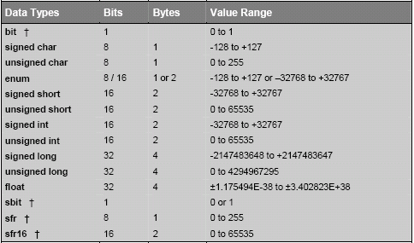
C Data Types With Extensions

Slide 41
Declaring Variables in Memory
char data temp;
char idata varx;
int xdata array[100];
char code text[] = “Enter data”;

Slide 42
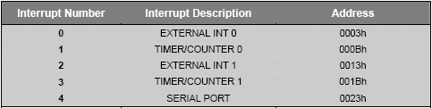
Interrupts – Original 8051
Specify register bank 2
void timer0 (void) interrupt 1 using 2 {
if (++interruptcnt == 4000) { /* count to 4000 */
second++; /* second counter */
interruptcnt = 0; /* clear int counter */
}
}

Slide 43
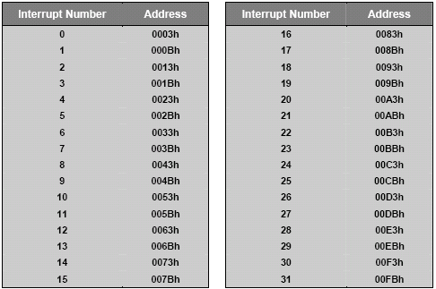
Other Interrupt Numbers
Interrupt number is same as “Priority Order” in datasheet

Slide 44
In-line Assembly
When it is more efficient, or easier, can insert assembly code in C programs.
  #pragma asm
  put your assembly code here
  #pragma endasm

Slide 45
Compilation Process (Cygnal)
program.c
.OBJ or .SRC can
be generated, not both
compile
no SRC option
with SRC option
program.LST
program.OBJ
program.SRC
build/make
rename file
program.M51
program.asm
build/make
assemble
program.OBJ
Must use this path for C programs with in-line assembly
It is also necessary to add #pragma SRC to code

Slide 46
Interfacing with C
Example: Temperature Sensor program
  Configures the external oscillator
  Configures the ADC0 for temp. sensor
  Configures Port1 so LED can be used
  Configures Timer3 to synch the ADC0
  Uses ADC0 ISR to take temperature samples and averages 256 of them and posts average to global variable
  Main program compares average temp. to room temp. and lights LED if temp is warmer.
  Temp_2.c

Slide 47
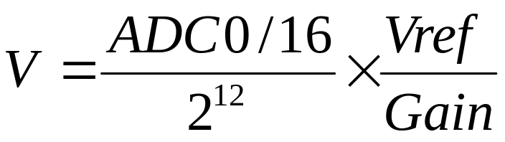
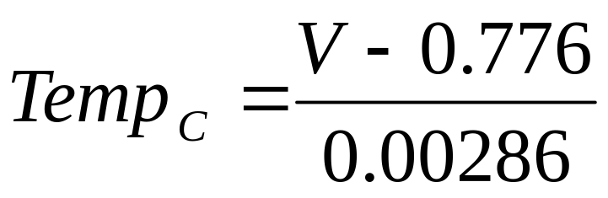
Converting to Real Values
C makes it easier to implement equations
Example: Temperature conversion
For analog to digital conversion – assuming left justified:
The temperature sensor:

Slide 48
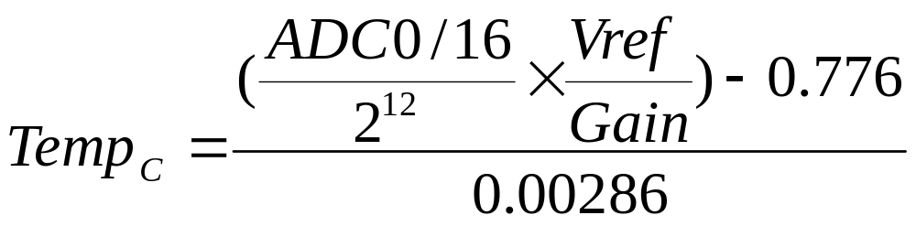
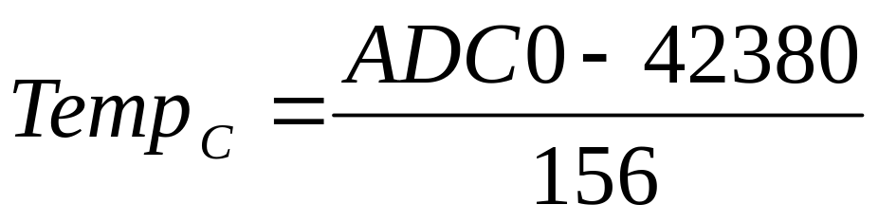
Temperature Conversion
Let Vref = 2.4V, Gain = 2

Slide 49
C for the Equation
…
unsigned int result, temperature;
…
result = ADC0; //read temperature sensor
temperature = result - 42380;
temperature = temperature / 156;
* Must be careful about range of values expected and variable types

Slide 50
Arrays in C
Useful for storing data
  type arr_name[dimension]
  int temp_array[256]
  Array elements are stored in adjacent locations in memory.
temp_array[0]
temp_array[1]
temp_array[2]
temp_array[3]
...
temp_array[253]
temp_array[254]
temp_array[255]

Slide 51
Pointers in C
Pointers are variables that hold memory addresses.
Specified using * prefix.
int *pntr; // defines a pointer, pntr
pntr = &var; // assigns address of var to pntr
Data char *s ; //ptr is stored in data memory
Xdata int * number; //ptr is stored in xdata memory
Char data * str ; // ptr to string in data
Int xdata * numtab ; //ptr to int in xdata

Slide 52
Pointers and Arrays
Note: the name of an array is a pointer to the first element:
*temp_array is the same as temp_array[0]
So the following are the same:
  n = *temp_array;
  n = temp_array[0];
and these are also the same:
  n = *(temp_array+5);
  n = temp_array[5];
temp_array[0]
temp_array[1]
temp_array[2]
temp_array[3]
...
temp_array[253]
temp_array[254]
temp_array[255]

Slide 53
C for Large Projects
Use functions to make programs modular
Break project into separate files if the programs get too large
Use header (#include) files to hold definitions used by several programs
Keep main program short and easy to follow
Consider multi-tasking or multi-threaded implementations

Slide 54
Functions
The basis for modular structured programming in C.
return-type function-name(argument declarations)
{
declarations and statements
}

Slide 55
Example – no return value or arguments
void SYSCLK_Init (void) {
// Delay counter
int i;
// Start external oscillator with 22.1184MHz crystal
OSCXCN = 0x67;
// Wait for XTLVLD blanking interval (>1ms)
for (i = 0; i < 256; i++) ;
// Wait for crystal osc. to settle
while (!(OSCXCN & 0x80)) ;
// Select external oscillator as SYSCLK
OSCICN = 0x88;
}

Slide 56
Example – with arguments
void Timer3_Init (int counts) {
// Stop timer, clear TF3, use SYSCLK as timebase
TMR3CN = 0x02;
// Init reload value
TMR3RL = -counts;
// Set to reload immediately
TMR3 = 0xffff;
// Disable interrupts
EIE2 &= ~0x01;
// Start timer
TMR3CN |= 0x04;
}

Slide 57
Example – with return value
char ascii_conv (char num) {
return num + 30;
}

Slide 58
Header Files
Use to define global constants and variables
// 16-bit SFR Definitions for 'F02x
  sfr16 TMR3RL = 0x92; // Timer3 reload value
  sfr16 TMR3 = 0x94; // Timer3 counter
  sfr16 ADC0 = 0xbe; // ADC0 data
  sfr16 DAC0 = 0xd2; // DAC data
  sfr16 DAC1 = 0xd5;
// Global CONSTANTS
  #define SYSCLK 22118400 // SYSCLK frequency in Hz
  sbit LED = P1^6; // LED='1' means ON
  sbit SW1 = P3^7; // SW1='0' means switch pressed
  #define MAX_DAC ((1<<12)-1) // Maximum value of the DAC register 12 bits
  #define MAX_INTEGRAL (1L<<24) // Maximum value of the integral
// Function PROTOTYPES
  void SYSCLK_Init (void);
  void PORT_Init (void);
  void ADC0_Init (void);
  void DAC_Init (void);
  void Timer3_Init (int counts);
  void ADC0_ISR (void);

Slide 59
Multitasking and Multithreading
Multitasking: Perception of multiple tasks being executed simultaneosly.
  Usually a feature of an operating system and tasks are separate applications.
  Embedded systems are usually dedicated to one application.
Multithreading: Perception of multiple tasks within a single application being executed.
  Example: Cygnal IDE colors code while echoing characters you type.

Slide 60
Multitasking and Multithreading
A “thread”
void main (void) {
long temperature;
WDTCN = 0xde;
WDTCN = 0xad;
SYSCLK_Init():
PORT_Init ();
Timer3_Init (SYSCLK/SAMPLE_RATE);
AD0EN = 1;
EA = 1;
while (1) {
temperature = result;
if (temperature < 0xB230) LED = 0;
else LED = 1;
}
}
void SYSCLK_Init (void){
int i;
OSCXCN = 0x67;
for (i=0; i < 256; i++) ;
while (!(OSCXCN & 0x80)) ;
OSCICN = 0x88; }
void PORT_Init (void) {
XBR0 = 0x04;
XBR1 = 0x00;
XBR2 = 0x40;
P0MDOUT |= 0x01;
P1MDOUT |= 0x40;}
void Timer3_Init (int counts) {
TMR3CN = 0x02;
TMR3RL = -counts;
TMR3 = 0xffff;
EIE2 &= ~0x01;
TMR3CN |= 0x04; }

Slide 61
Multi-tasking/threading Implementations
Cooperative multi-tasking – each application runs for a short time and then yields control to the next application.
Timer-based multi-tasking – on each timer interrupt, tasks are switched.
When switching between tasks, state of processor (internal registers, flags, etc) must be saved and previous state from last task restored. This is the “overhead” of multitasking. Also called “context switching”.

Slide 62
Multithreading with Interrupts
Interrupt Service Routine
reti
Foreground thread
Main program
Subroutines
ret
Background thread
Interrupt Service Routine
reti
Background thread

Slide 63
Real-Time Operating Systems (RTOS)
Usually a timer-based task switching system that can guarantee a certain response time.
Low level functions implement task switching.
High level functions create and terminate threads or tasks.
Each task might have its own software stack for storing processor state.

Slide 64
Example – Switch/LED Program
#include <c8051F020.h>
#pragma SRC // Need this to generate .SRC file
void PORT_Init (void);
char Get_SW(void) {
#pragma ASM
mov a, P3
anl a, #80h ; mask all but P3.7
mov R7, a ; function value (char) returned in R7
#pragma ENDASM
}
void Set_LED(void) {
#pragma ASM
setb P1.6
#pragma ENDASM
}
void Clr_LED(void) {
#pragma ASM
clr P1.6
#pragma ENDASM
}
void PORT_Init (void){ XBR2 = 0x40; // Enable crossbar and enable P1.6 (LED) as push-pull output}
P1MDOUT |= 0x40; // enable P1.6 (LED) as push-pull output
}
Functions can be implemented in assembly language

Slide 65
برنامه های کاربردی
چرخان lED مدار
آژير الکترونيکی(بااستفاده از وقفه تايمر)
برنامه يک ماشين حساب ساده

Slide 66
چرخان lEDمدار
LED اين پروژه
ای وصل شده به درگاه 1 ميکرو کنترلر را به ترتيب روشن ميکند در نتيجه
به صورت چرخان ديده ميشوند :

Slide 67
#include<AT892051.h>
Void wait_a_second()
{
unsigned int x;
for(x=0;x<33000;x++);
}
Main()
{
Unsigned char LED =128;
for(;;)
{
P1=~LED;
LED=LED>>1;
If(LED==0)LED=128;
Wait_a_second();
}
}

Slide 68
آژير الکترونيکی(بااستفاده از وقفه تايمر)
اين پروژه نشان ميدهد که چگونه ميتوانيم صدای اژيرتوليد کنيم
وقتی تغذيه مدار وصل گردد با استفاده از يک بلندگوی ساده ميتوان صدای پيوسته اژير را شنيد و هر دو تايمر 0و 1 ميکرو کنترلر برای توليد فرکانس های صوتی مورد نياز به کار برده ميشوند .

Slide 69
فركانس موج صوتي ايجاد شده از 500 هرتز تا 10 كيلو هرتز براي ايجاد صداي شبيه آژير
تايمر1 در حالت 8 بيتي با بار گذاري خودكار
رجيستر تايمر : 50 ميكرو ثانيه (عدد 206)
چك كردن مقدار يك شمارنده با متغير int_rate
تغيير حالت خروجي در صورت برابري
freq=10/int_rate مثلا: فركانس= 10 كيلو هرتز براي int_rate=1
(مقدار int_rate از 100 تا 1 ) پس فركانس از 100 هرتز تا 10 كيلو هرتز

Slide 70
تايمر 0 جهت تغيير فركانس با استفاده از int_rate
در حالت 8 بيتي با بار گذاري خودكار
رجيستر تايمر :56 پس در هر 200 ميكرو ثانيه يك وقفه
استفاده از يك شمارنده كه پس از 200 شمارش يك واحد از int_rate كم ميكند
پس كاهش int_rate پس از 40000=200*200

Slide 71
برنامه اصلي:
Start
turn oFF speaker
initialize timer 1 for auto_reload 50 interrupt
initialize timer 0 for auto_reload 200 interrupt
set int_rate for 100 HZ
Do FOREVER
wait for timer interrupts
End

Slide 72
برنامه پيكر بندي تايمر:
Start
if 40 has elapsed then
decrement int_rate
if int_rate=0 then
set int_rate for 100HZ
end if
end if
end

Slide 73
#include<AT892051.h>
Sbit speaker=p1^7;
int count,timer1_overflow,int_rate;
/*timer initialization routine */
Void init_timers()
{
ET1=1; //enable timer1 interrupt
TMOD=0x20; //timer1 mode 2
TH1=206; //timer1 50 microsec
ET0=1; //enable timer0
TMODE=TMODE|2; //timer 0 mode 2
TH0=56; //timer0 200 microsec
EA=1; //enable interrupts
TR1=1; //turn on timer1
TR0=1; //turn on timer0
}

Slide 74
/*timer 1 interrupt service routine */
Timer1() interrupt 3{
Count++;
if(count==int_rate){
count=0;
speaker=~speaker;
}}
/* timer 0 interrupt service routine */
Timer0() interrupt 1{
timer1_overflow=0;
if(timer_overflow=200) //if 40 ms (after 200 decrease ine_rate)
{
timer1_overflow=0;
int_rate--;
count=0;
if(int_rate==0){int_rate=100;}
}
}

Slide 75
/*start of main program*/
main(){
count=0;
timer1_overflow=0;
speaker=10
int_rate=100;
init_timers()
for(;;){} //enable loop
}

Slide 76
برنامه يك ماشين حساب با استفاده از RS232
مبتني بر ميكروكنترلر 89c51
89c51 به MAX232 كه يك آي سي مبدل RS232
EA پايه فعال كردن حافظه برنامه بيروني
اتصال پايه هاي RXD,TXD در 8059 به پايه هاي 10و 9
در MAX232
اتصال پايه هاي8و9 در 8059 به پايه هاي ترمينال

Slide 77
Start
initialize serial port
display heading
get number 1
get number 2
While operation is not valid
get operation to beperformed
When
if operation=‘+’
else if ……

Slide 78
#include<stadio.h>
#include<AT892051.h>
/*function to initialize the RS232 serial port*/
Void serial_init(){
SCON=0x50; //setup for 8-bit data
TMODE=0x20; //setup timer 1 for outo-reload
TH1=0xF3; //setup for 2400 baund
TR1=1; //turn on timer 1
}
/*start of main program*/
main()
{
int num1,num2,result;
char c,opr;
serial_init(); //initialize serial port
for(;;) //start of loop
{

Slide 79
Printf(‘\n\n A MICROCONTROLLER BASED CALCULATOR\n’);
Printf(‘=============================================’);
Printf(‘enter 2 integer number and operation\n’);
Printf(to be performed valid operation are\n);
Printf(‘+ADD\n’);
Printf(‘*multiply\n’);
Printf(‘-subtract\n’);
Printf(/divide\n);
Printf(‘enter first number:’);
Scan(%d,&num1);
C=getchar();
Oper=‘’;
While(oper!=‘+’ && oper!=‘-’ && oper!=‘*’ && oper!=‘/’)
{
printf(‘enter operation’);
oper=getchar;
printf(‘\n’);
}

Slide 80
Switch(oper){
case ‘+’:
result=num1+num2;
break;
case ‘-’:
result=num1-num2;
break;
case ‘*’:
result=num1*num2;
break;
case ‘/’:
result=num1/num2;
break;
}
Printf(‘result=%d\n,result’);
}

Slide 81
ميخواهيم برنامه اي بنويسيم كه پورت سريال را براي نرخ 1200 بيت بر ثانيه اماده كرده و از طريق پايه تي ايكس دي پيغامي را به صورت رشته ارسال كند

Slide 82
#include <stdio.h>
#include<reg52.h>
#define f_crystal 8000000
#define BOUDE_RATE 1200
#define TH1_LOAD (0x00)-(F_crystal/12)/(BOUD_RATE*32)
Void serial_init(void){
Scon=0x52;
TMOD=0x20;
TH1=TH!_load;
TCON=0x60;
}
Main()
{
Serial_init();
Printf(“serial port ok”);
While(1);
}

Slide 83
#include <stdio.h>
#include<reg52.h>
#define f_crystal 8000000
#define BOUDE_RATE 1200
#define TH1_LOAD (0x00)-(F_crystal/12)/(BOUD_RATE*32)
#define start_address 0x3000
#define end_address 0x3fff
#define costraint_byte 0x49
Main()
{
Unsigned int i=0;
Serial_init();
While(ptr<=end_address)
*ptr=constraint_byte;
Ptr++;
}
Ptr=(unsigned char xdata*)start_address;
While(ptr<=end_address){
If(*ptr!=constraint_byte){
Printf(“ram_check error at address :%xh\n\a”,(unsigned)ptr);
Break;
}
Ptr++;
}
If(ptr==(end_address+1))
Printf(“\nram_check ok..”);
While(1);
}

Slide 84
خارجي ram برنامه امتحان فضاي حافظه
يكي از معمول ترين برنامه هايي كه براي امتحان صحت سخت افزار يك سيستم مينيمم به كار ميرود.
برنامه به شرح زير است:
در يك حلقه مكان هاي حافظه رم خارجي از ادرس شروع تا پايان توسط يك عدد ثابت نگهداري ميشوندو سپس در حلقه ديگر اين مكان هاي حافظه خوانده ميشوند و با همان عدد ثابت مقايسه ميشوندودر صورت برابر نبودن پيغام خطا صادر ميشود:

Slide 85
#include <stdio.h>
#include<reg52.h>
#define freq 8
#define second (4000/(12/freq))
#define period(-250)
Unsigned int count;
Struct time{
Unsigned char hour;
Unsigned char min;
Unsigned char sec;
};
Struct tine click_time
Void main()
{
Clock_time.hour=0;
Clock_time.min=0;
Clock_time.sec=0;

Slide 86
برنامه ساعت
اين برنامه با استفاده از وقفه تايمر صفرزمان را به صورت ثانيه ودقيقه و ساعت محاسبه كرده و به پورت سريال ارسال مي كند.

Slide 87
Th0=period;
Tl0=period;
Tmod=tmod| 0x02;
Tr0=1;
Et0=1
Ea=1
While(1){
Prinf(“\rhh:mm:ss %02bd:%02bd”,
Clock_time.hour,
Clock_time.min,
Clock_time.sec);
}}
Timer0()intrrupt 1 using 2
If(++count==second){
Count=0;
If(++clock_time.sec==60){
Clock_time.sec=0;
If(++clock_time.min==60){
Clock_time.min=0
If(++clock_time.hour==25){
Clock_time.hour=1;}

