Slide 1

Python
Part 1
-- Sunil Sharma P
26th Nov, 2016
© Mirafra Technologies

Slide 2
Python
Table of Contents
An Informal Introduction to Python
  Python Interpreter CLI / IDE
  Memory Management
  Data Types / Data Structures
Modules
Control Flow
Regular Expressions
Classes
Brief Tour of the Standard Library
© Mirafra Technologies

Slide 3
Python
Agenda:
What is Python ? An Informal Introduction to Python
Writing & Running a Python Script
Data types:
  Numbers, String, List, Sets, Tuple, Dictionary
Operators:
Arithmetic, Comparison (Relational), Assignment,
Logical, Bitwise, Membership, Identity
Decision Making Statements
Loops
© Mirafra Technologies

Slide 4
Python
Table of Contents – Part 2
Modules
File Handling
Regular Expressions
Classes & Objects
© Mirafra Technologies

Slide 5
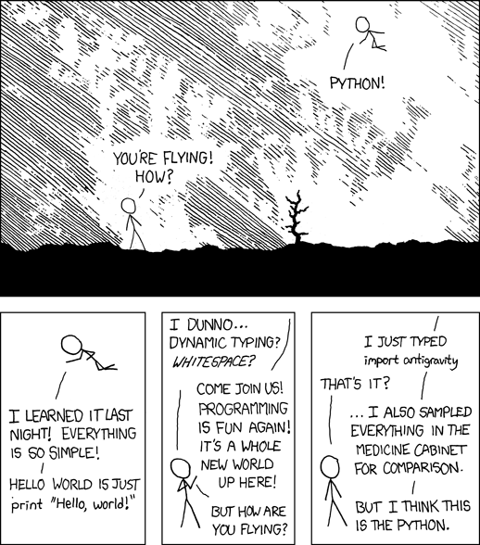
Python
© Mirafra Technologies

Slide 6
Python
What is Python ? An Informal Introduction to Python :
Python was created by Guido van Rossum in the late eighties and early nineties
Python code can invoke C/C++ libraries and can be called from C/C++
It can integrate with Java and .Net components
Python gives us interfaces to all RDBS – Sybase,
Oracle, MySQL, PostgreSQL, and SQLite
GUI – Python/tkinter
Internet Scripting – sockets. server-side CGI scripts,
Communicate over XML-RPC, SOAP, and Telnet
Python's built-in interfaces to OS services
© Mirafra Technologies

Slide 7
Python
Writing & Running a Python Script :
Writing & Running a Python Script :
Python files will have extension “.py”
Three ways we can proceed with Python scripting
  Interactive Way
  Shebang - #!/usr/bin/python
  IDE
Comments
  # - for single line comment
  '''....''' - for multi line comment
Indentation – There is no { } for staring and end of memory block / functions.
  Its just the indentation.
© Mirafra Technologies

Slide 8
Python
Writing & Running a Python Script :
#!/usr/bin/python #This is not a comment
# First comment
print "Hello, Python!" # second comment
This produces the following result − Hello, Python!
You can comment multiple lines as follows −
#!/usr/bin/python
'''First comment
showing how to write multi-line
Commments in Python. '''
print "Hello, Python!"
This also produces the following result − Hello, Python!
Example:
if True:
print "Answer"
print "True"
else:
print "Answer"
print "False"
This is an error...!!!
if True:
print "Answer"
print "True"
else:
print "Answer"
print "False"
© Mirafra Technologies

Slide 9
Python
Variables :
Variables are nothing but reserved memory locations to store values. This means that when you create a variable you reserve some space in memory.
• Python variables do not have to be explicitly declared to reserve memory space. The declaration happens automatically when you assign a value to a variable. The equal sign (=) is used to assign values to variables.
#!/usr/bin/python
counter = 100 # An integer assignment
miles = 1000.50 # A floating point
name = "John“ # A string with “.... ”
name_1 = 'Adam' # A string with '....'
print counter # 100
print miles # 1000.50
print name # 'John'
print name_1 # 'Adam'
© Mirafra Technologies

Slide 10
Python
Numbers - Using Python as a Calculator :
Number data types store numeric values.
Number objects are created when you assign a value to them. For example:
var1 = 1 # print var1 1
var2 = 10.1005 # print var2 10.1005
You can also delete the reference to a number object by using the del statement.
Ex: del var1, var2
Note: Python has garbage collection. Not neccessarly you need to delete object. But when scope ends, python automatically deletes the variable / object.
© Mirafra Technologies

Slide 11
Python
Numbers - Using Python as a Calculator :
Numbers - Using Python as a Calculator .....
#!/usr/bin/python
import math
A, B, C = 80, 10.5, 100
print max(A, B, C)
print math.ceil(B)
print math.floor(B)
print math.sqrt(C)
Python Memory Management
A = 10
B = 20
OR
A, B = 10, 20
B = A ????
id(A) – returns address of A
...................100
...................11.0
...................10.0
...................10.0
© Mirafra Technologies

Slide 12
Python
Arithmetic Operators:
+ - * / % ** //
a = 5
b = 2
print('a + b = ', a + b)
print('a - b = ', a - b)
print('a * b = ', a * b)
print('a / b = ', a / b)
print('a % b = ', a % b)
print('a ** b = ', a ** b)
print('a // b = ', a // b)
print (“1 + 2 – 3 * 2 = ”, 1 + 2 – 3 * 2) 1 + 2 – 3 * 2 = -3
print (“(1 + 2 – 3) * 2 = ”, (1 + 2 – 3) * 2) (1 + 2 – 3) * 2 = 0
a + b = 7
a - b = 3
a * b = 10
a / b = 2.5 (in 2.7 python, its '2')
a % b = 1
a ** b = 25
a // b = 2
© Mirafra Technologies

Slide 13
Python
Strings :
We can create them simply by enclosing characters in quotes.
Python treats single quotes the same as double quotes.
  str1 = 'String with single quotes'
str2 = "String with double quotes"
str3 = 'mirafra'
print str3 ..........
print str3[0] ..........
print str3[1:5] ..........
print str3[2:] ..........
print str3[-3] ..........
0 | 1 | 2 | 3 | 4 | 5 | 6
m | i | r | a | f | r | a
-7 | -6 | -5 | -4 | -3 | -2 | -1
mirafra
m
iraf
rafra
f
© Mirafra Technologies

Slide 14
Python
Strings....
str1 = "this is string example....wow!!!";
print str.capitalize() # This is string example....wow!!!
str2 = "123456";
print str.isdigit(); # True
str3 = "THIS IS STRING EXAMPLE....WOW!!!";
print str.lower(); # this is string example....wow!!!
name, age = 'John', 20
print 'He is %s and his age is %d' % (name, age)
#He is John and his age is 20
str.capitalize()
str.isalpha()
str.isdigit()
str.islower()
str.isspace()
str.isupper()
len(str)
str.upper()
str.split('..', count)
replace(old, new [, max])
© Mirafra Technologies

Slide 15
Python
Lists:
Lists are similar ot arrays but contain more than 1 data type but usually the items all have the same type.
Elements are separated by comma and enclosed within [ ]
Index starts with 0
Values are assigned using [ ] or [ : ]
Lists can be indexed and sliced
list_ex = ['A', 1, 'aeiou', 3.142]
print squares = [1, 4, 9, 16, 25] # [1, 4, 9, 16, 25]
print squares[0] # 1
print squares[-1] # 25
print squares[-3:] # [9, 16, 25]
print squares[:] # [1, 4, 9, 16, 25]
© Mirafra Technologies

Slide 16
Python
Lists......
cubes = [1, 8, 27, 65, 125]
cubes[3] = 64 # replace the wrong value
print (cubes) # [1, 8, 27, 64, 125]
cubes.append(6 **3) # add the cube of 6
print (cubes) # [1, 8, 27, 64, 125, 216]
A = [1,2,3] B = [4,5,6]
C = A + B # [1, 2, 3, 4, 5, 6]
C = A*2 # [1, 2, 3, 1, 2, 3]
cmp(list1,list2)
len(list)
max(list)
min(list)
list.append(obj)
list.count(obj)
list.extend(seq)
list.index(obj)
list.remove(obj)
list.reverse
© Mirafra Technologies

Slide 17
Python
Lists.....
Append: appends the object
Example:
x = [1, 2, 3]
x.append([4, 5])
Print (x) # [1, 2, 3, [4, 5]]
Extend: appends the elements
Example:
x = [1, 2, 3]
x.extend([4, 5])
print (x) # [1, 2, 3, 4, 5]
What is the Output ?
A = [1,2,3]
B = [4,5,6]
C = A
C.extend (B)
print (A, B, C)
© Mirafra Technologies

Slide 18
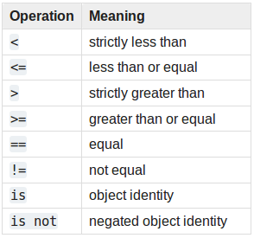
Python
Comparison / Relational Operators:
A = 10 b = 20
print (a < b) # True
print (a <= b) # True
print (a > b) # False
print (a >= b) # False
print (a == b) # False
print (a != b) # True
print (a is b) # False
print (a is not b) # True
© Mirafra Technologies

Slide 19
Python
Numbers - Using Python as a Calculator :
© Mirafra Technologies

Slide 20
Python
Numbers - Using Python as a Calculator :
© Mirafra Technologies

Slide 21
Python
Numbers - Using Python as a Calculator :
© Mirafra Technologies

Slide 22
Python
Numbers - Using Python as a Calculator :
© Mirafra Technologies

Slide 23
Python
Numbers - Using Python as a Calculator :
© Mirafra Technologies

Slide 24
Python
Numbers - Using Python as a Calculator :
© Mirafra Technologies

Slide 25
Python
Numbers - Using Python as a Calculator :
© Mirafra Technologies

Slide 26
Python
Python
Assignments:
© Mirafra Technologies

