Slide 1
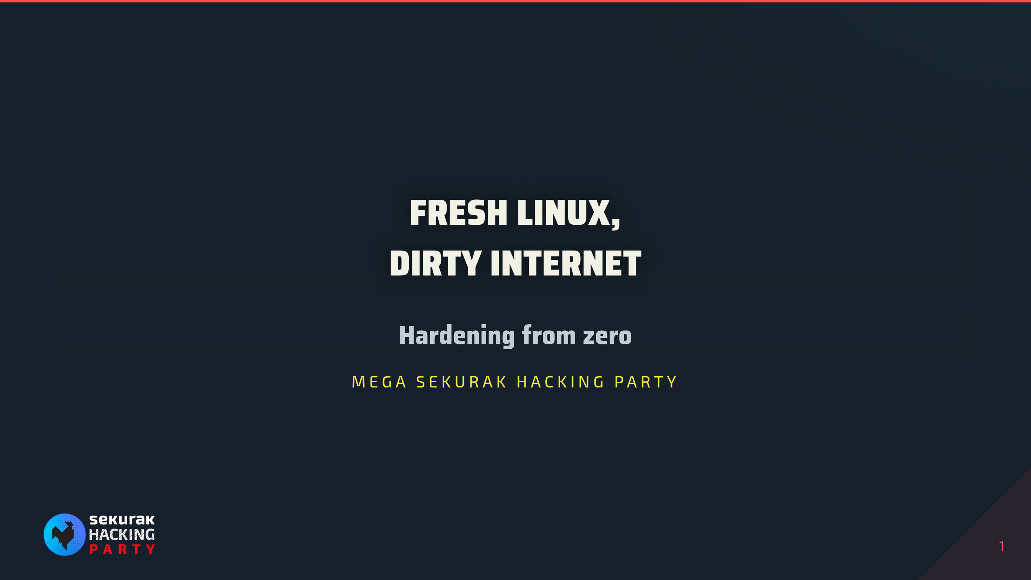
Notes:
00:00–00:30. Title, then the acquisition handover scenario. Use README.md as the hardening learning guide.

Slide 2
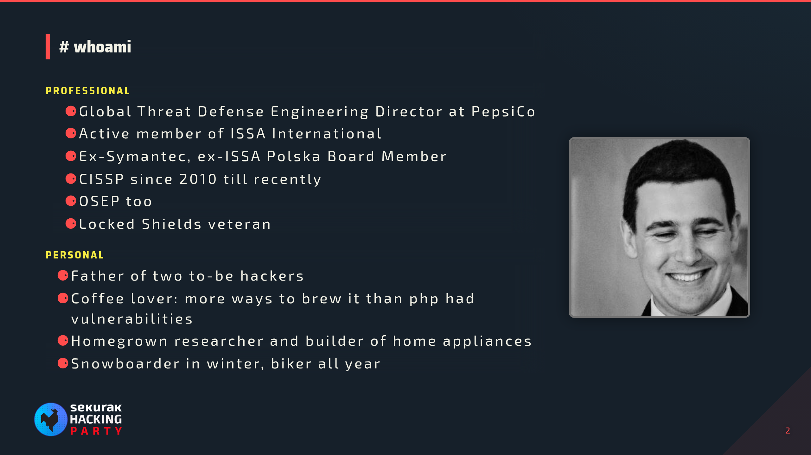
Notes:
30 s. Short intro only; move straight on.

Slide 3
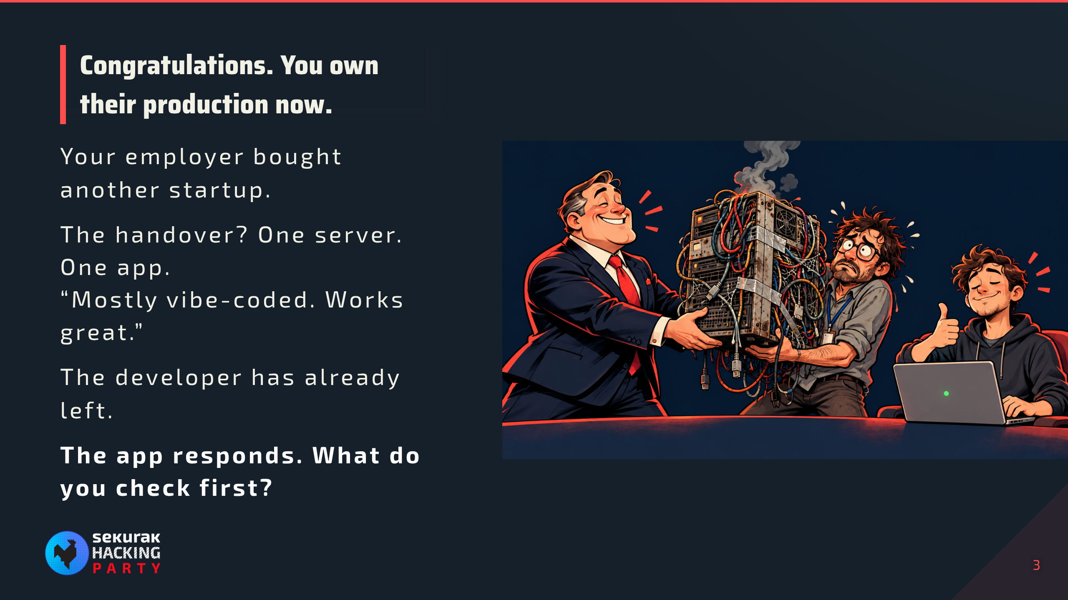
Notes:
00:30–02:00. SAY: “Management bought a startup for the synergies. You got the server. The developer says the app works, sends you the root password, and disappears into their notice period. Congratulations: you are now the documentation.” Pause for the picture. We know an app is running; everything else is an assumption. Ask the audience for the first check, take two answers, then switch to the README.md recon commands. This is the fictional setup for the deliberately misconfigured lab, not a claim about a real acquisition. Keep intro within three minutes total.

Slide 4
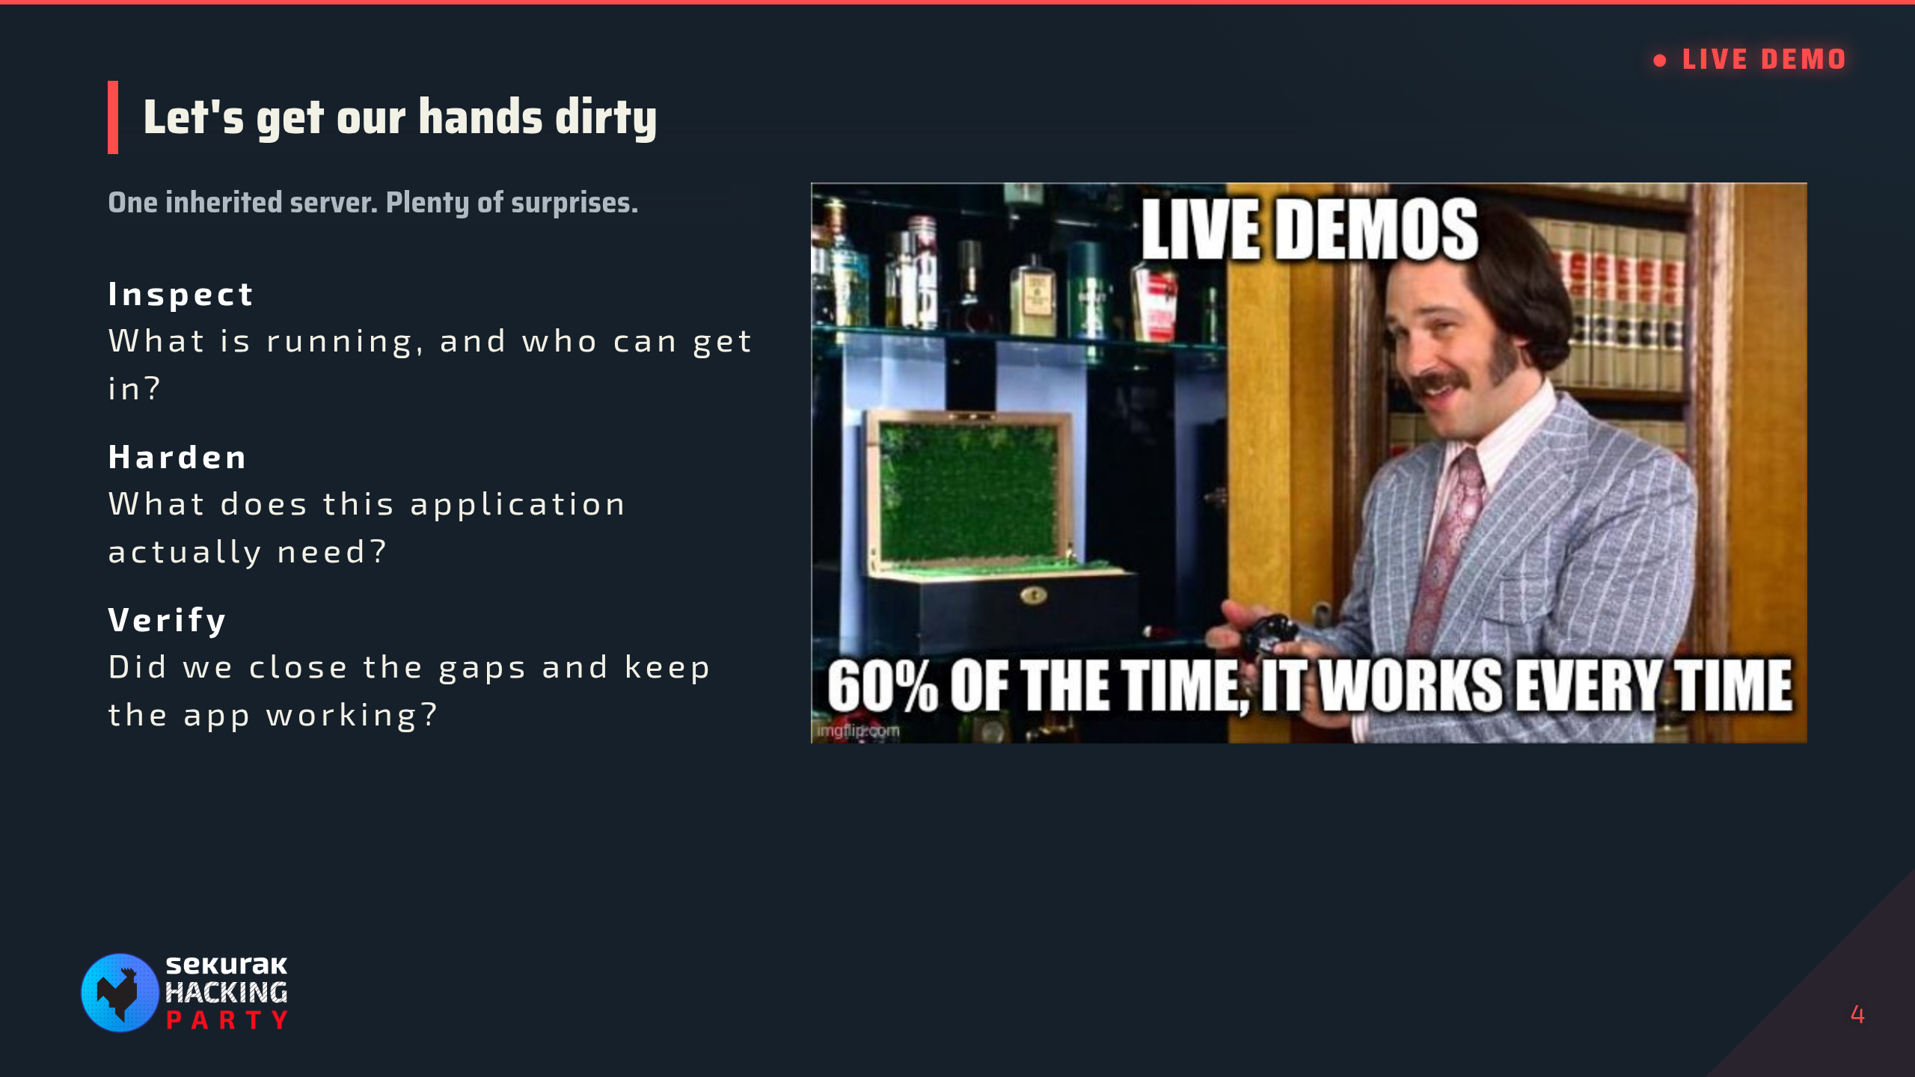
Notes:
Hand off to README.md. Leave this slide up throughout the live demo, then return to the final thought.

Slide 5
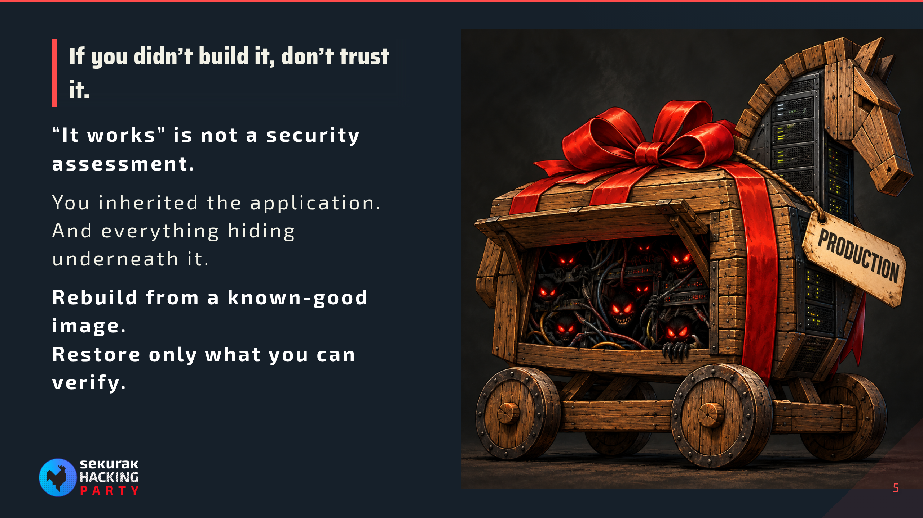
Notes:
Final thought after the live demo. Call back to the startup handover: we improved the controls, but hardening an inherited installation does not establish its provenance or rule out a prior compromise. Building it yourself is not a guarantee either: use trusted images and a repeatable build process. Preserve evidence first if compromise is suspected, rebuild, rotate inherited credentials, and validate application code and data before restoring them. SAY: “There are things out there that can kill you. Some of them come with a handover document.”

Slide 6
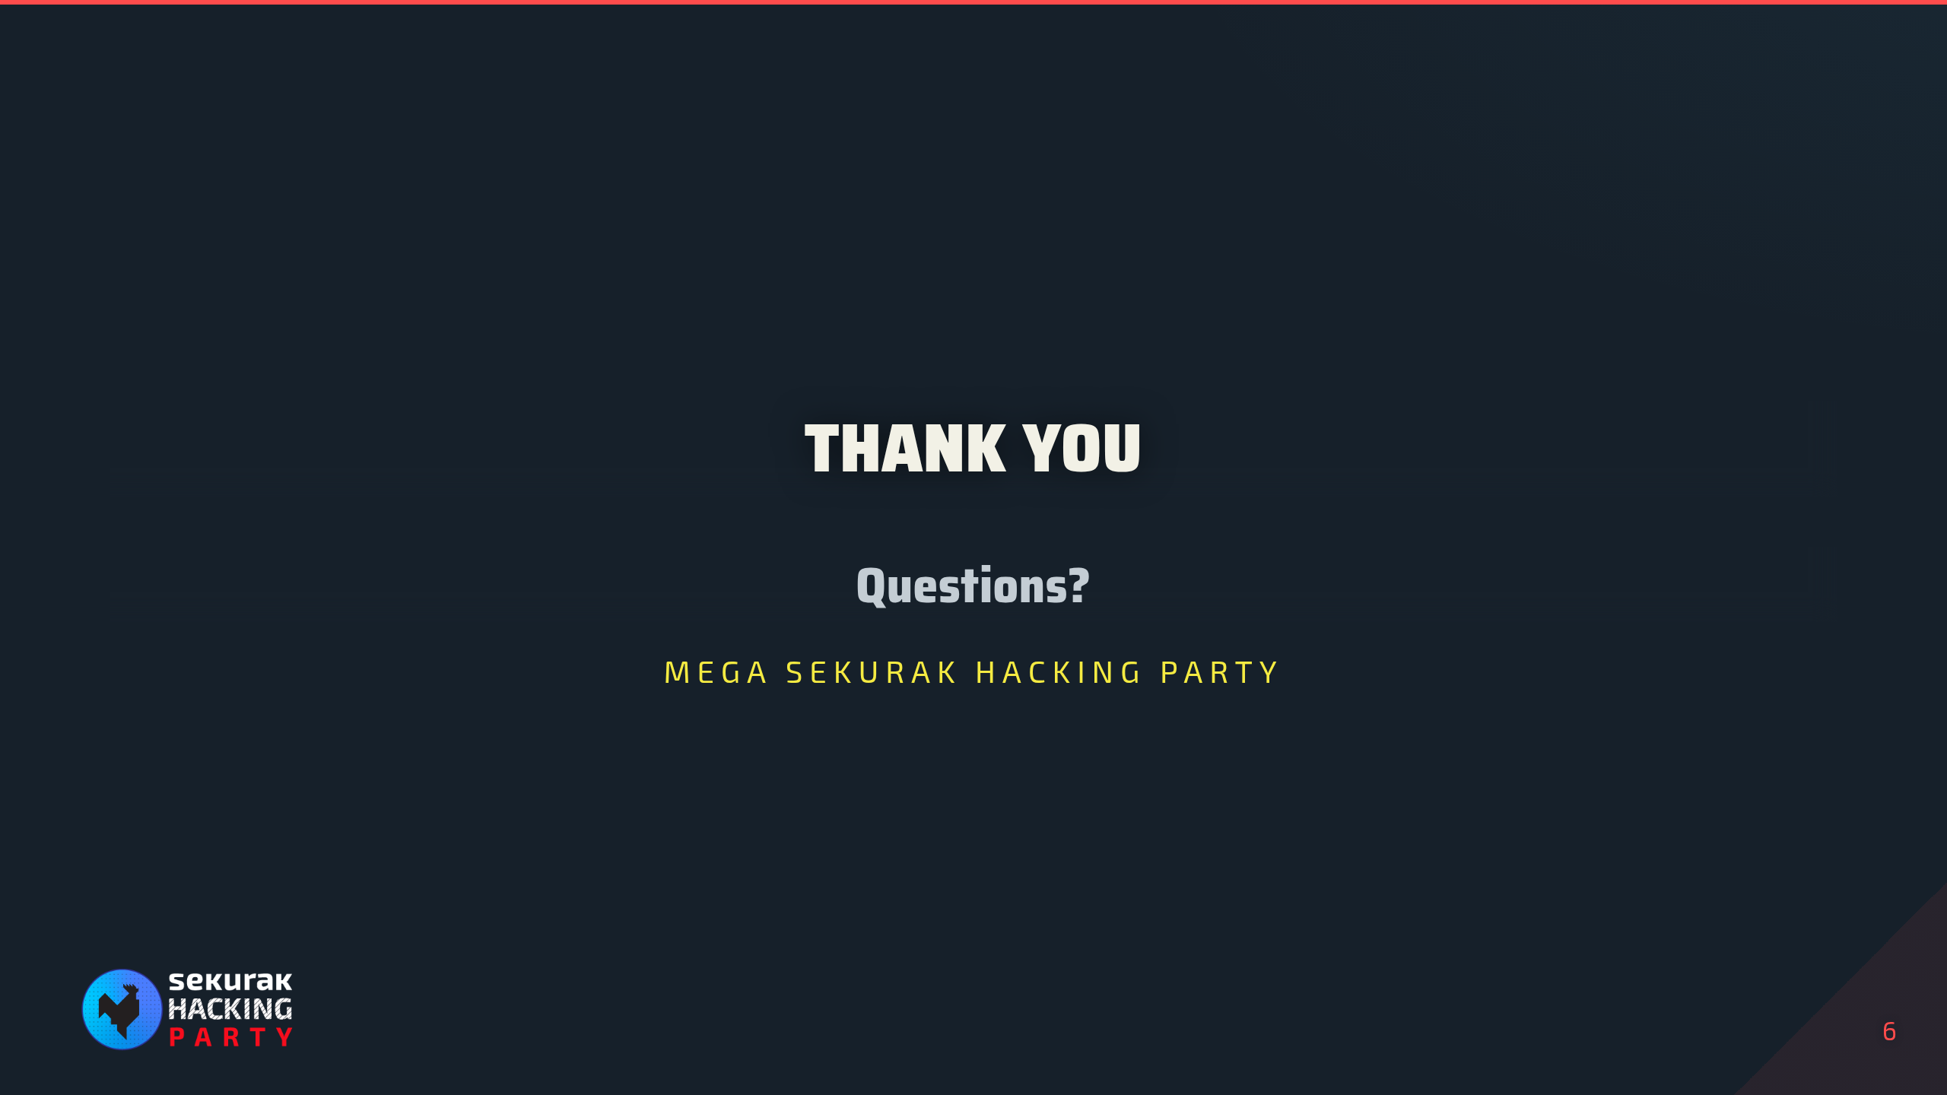
Notes:
Leave this up during questions after the live demo.

