Slide 1
OFFICIAL SCIENTIFIC COMMITTEE ANALYTICAL REPORT
Groningen Sustainability Conference 2027
Comprehensive Abstract Submissions, Thematic Landscape & Global Country Mapping
Rigorous empirical analysis of 690 conference submissions across 78 primary nations • Data as of 27 October 2026, 04:05:02 • Sequential Thematic Deep-Dives (Themes 1 to 5) • Discrete Global Mapping & Abstract Lexical Clusters
690
TOTAL ABSTRACTS
78
PRIMARY NATIONS
5
CORE THEMES
545
ORAL PRESENTATIONS
University of Groningen, Netherlands • Data Source: adminPapersBrowse_2026-10-27_04-05-02.doc • Data as of 27 October 2026, 04:05:02

Slide 2
EXECUTIVE DASHBOARD
Executive Overview: Core Submission Metrics at a Glance
690
Total Submissions
100% processed dataset
78
Primary Countries
85 participating in total
5
Core Themes
Sequential 1 to 5 tracks
25
Subtopics Covered
Extensive interdisciplinary range
79.0%
Oral Presentations
545 individual talks requested
Geographic Breadth & Inclusivity
Sequential Thematic Balance
Session Architecture & Planning
• Unprecedented Global Reach: Submissions received from 78 primary countries across all 6 inhabited continents.
• Global South Leadership: Over 58% of all abstracts originate from Asia and Africa, led by India, China, Indonesia, Nepal, Ghana, and South Africa.
• Strong European Anchor: Leading European contributors: Netherlands (132), Germany (45), UK (27), Belgium (11) represent major scholarly leadership.
• Theme 1 (SDGs Beyond 2030): 155 abstracts (22.5%), the 3rd largest track, focused heavily on SDG localization, multi-stakeholder governance, and post-2030 indicator systems.
• Theme 2 (Resilience Across Systems): 171 abstracts (24.8%), the largest track, anchored by the Food-Water-Energy nexus and circular economy.
• Theme 3 (Climate Nexus): 166 abstracts (24.1%), the 2nd largest track, highlighting climate adaptation, governance, finance, and equitable net-zero transitions.
• Theme 4 (Health) & Theme 5 (AI): 106 (15.4%) and 92 (13.3%) abstracts respectively, providing human health foundations and digital enablement tools.
• Massive Oral Demand: 545 abstracts (79.0%) request Oral Presentations, requiring robust multi-parallel track scheduling (4-5 concurrent tracks).
• Targeted Poster Track: 91 submissions (13.2%) designated for Poster Presentations across interactive exhibition areas.
• High-Impact Panels: 54 curated sessions (29 Innovative Sessions and 25 Full Panel Sessions) proposed by premier research networks and consortia.

Slide 3
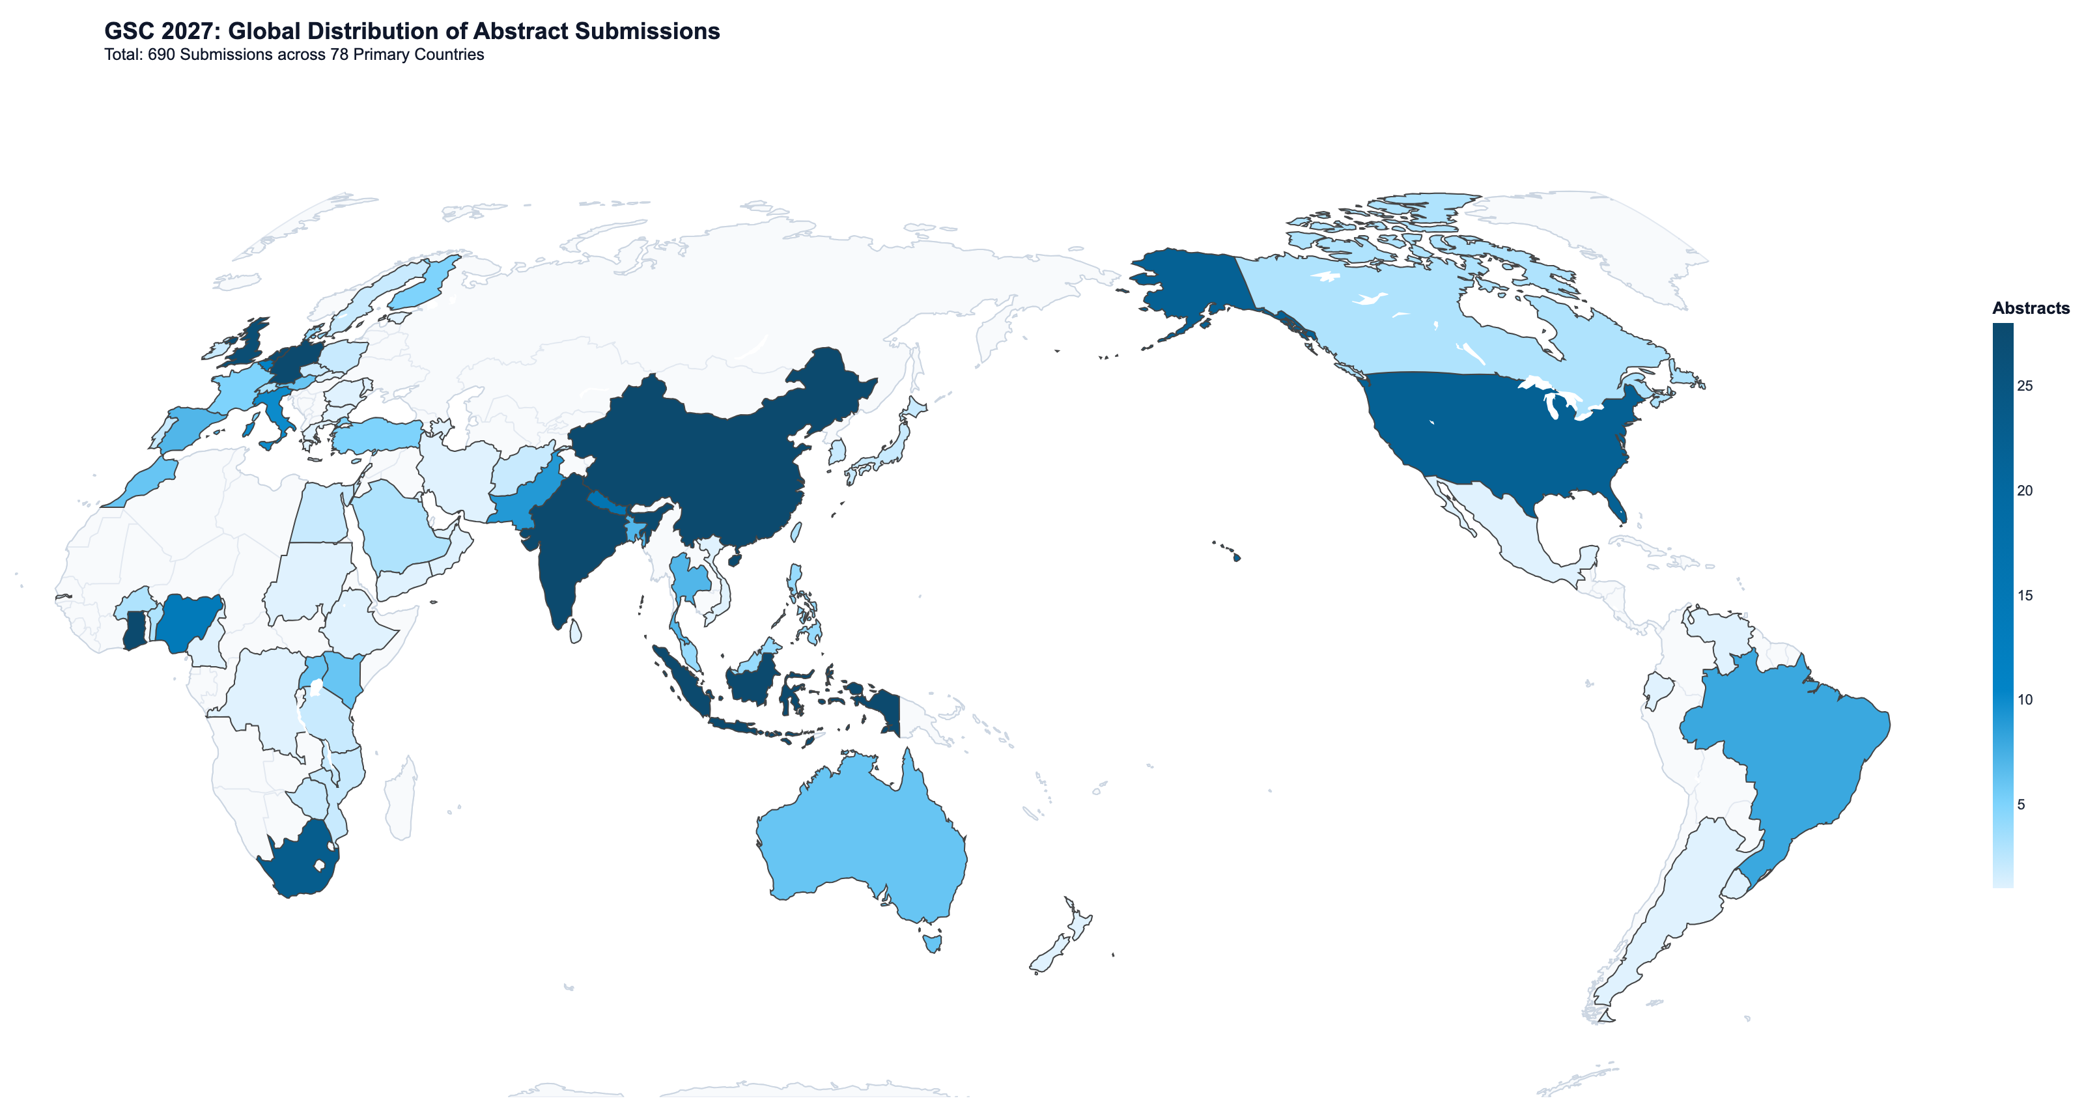
GEOGRAPHIC REACH
Global Geographic Footprint: 78 Primary Submitting Nations
Global Distribution Highlights
• Host Nation Leading: Netherlands leads with 26 submissions (43 including international co-authorships).
• Global South Strength: India (64), China (58), Indonesia (32), Nepal (16) and Ghana (28), South Africa (23) demonstrate high research activity.
• Broad African Engagement: 15 African countries submitted abstracts, reflecting intense interest in climate resilience and just transitions.
• Multi-Country Consortia: 85 countries participate when including international co-authors and panel speakers.
• Discrete HTML Map: Interactive browser map includes discrete binned legends and dynamic theme filters.
Distribution of 690 abstracts across 78 primary submitting countries. Natural Earth projection.

Slide 4
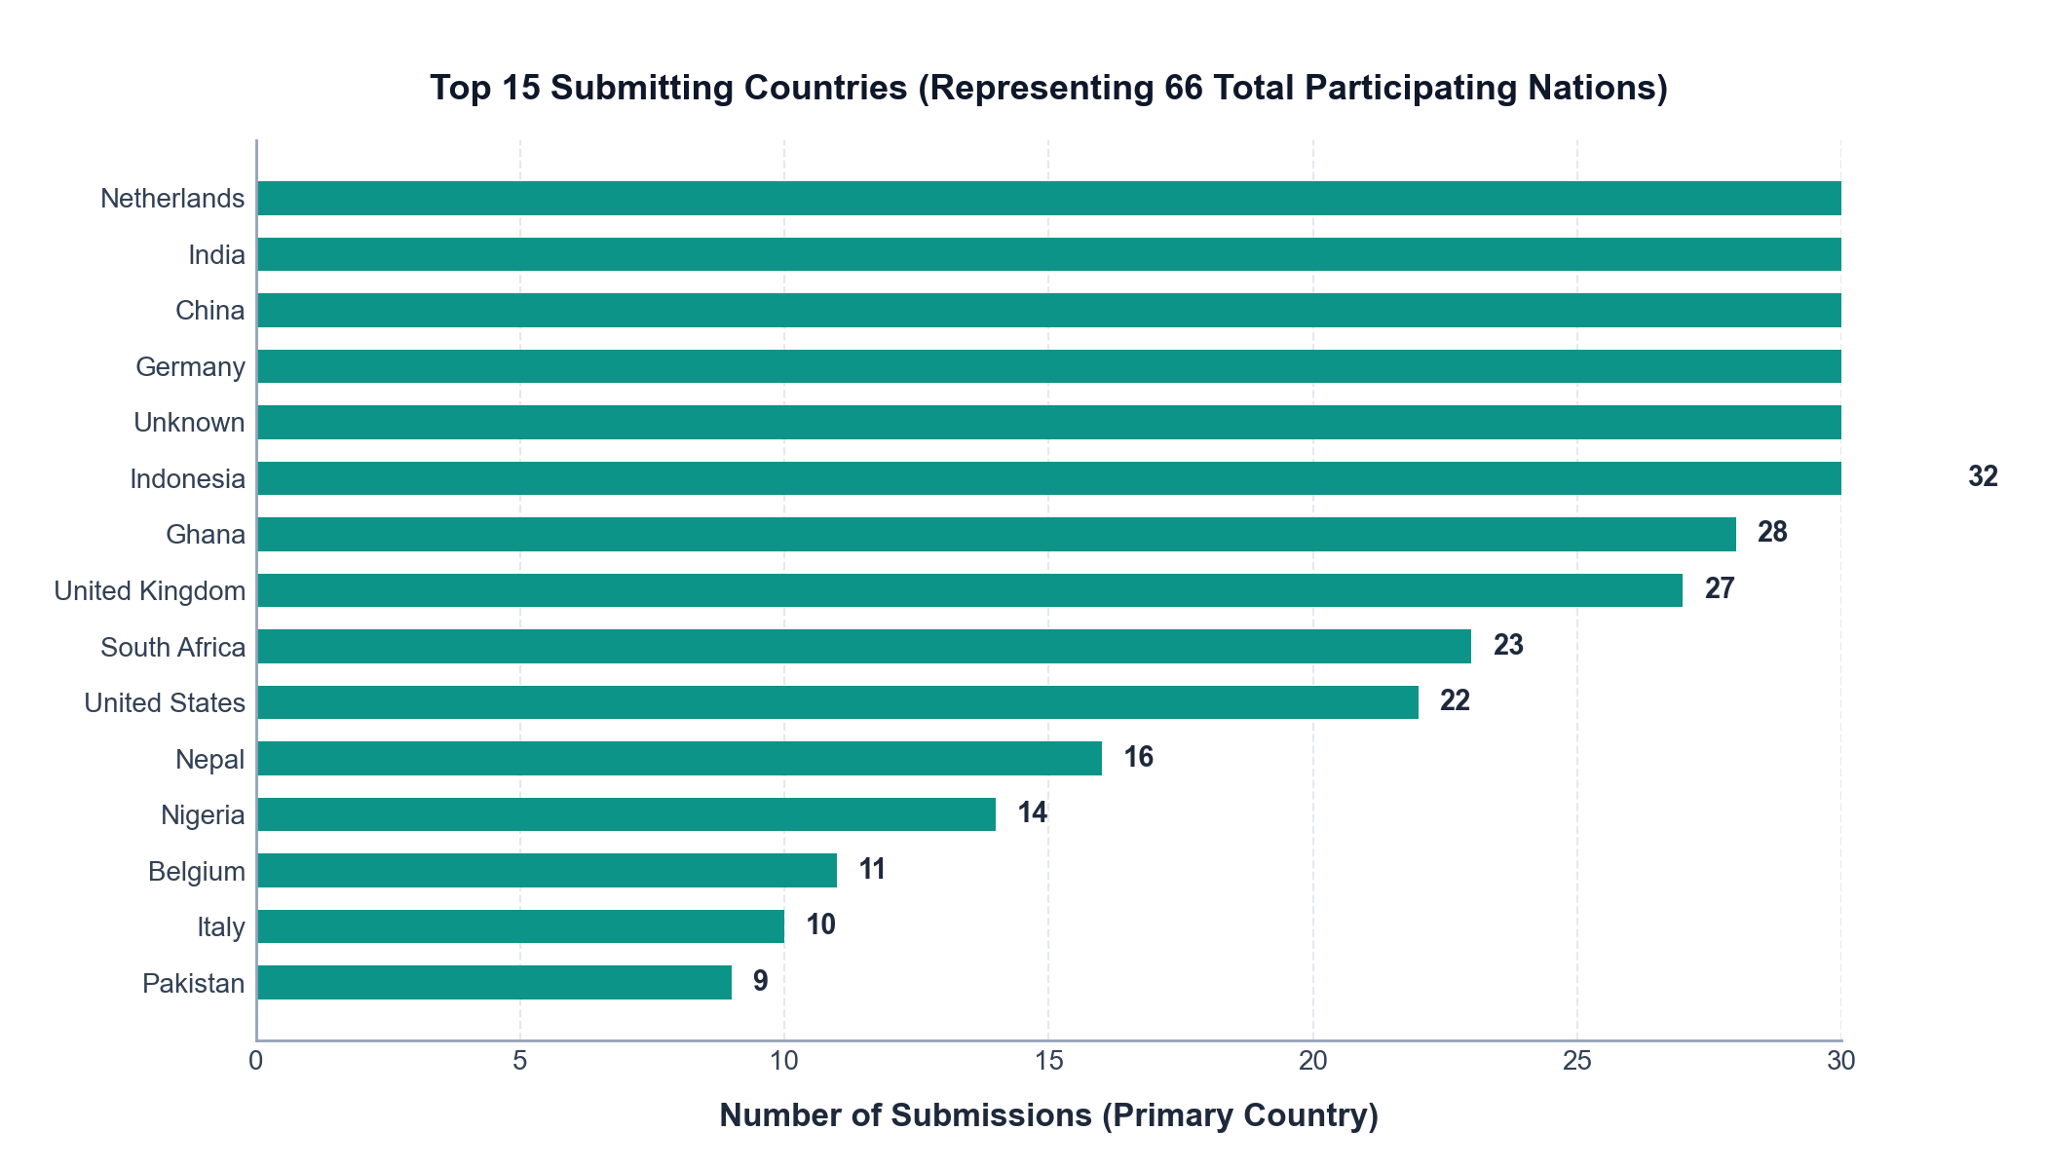
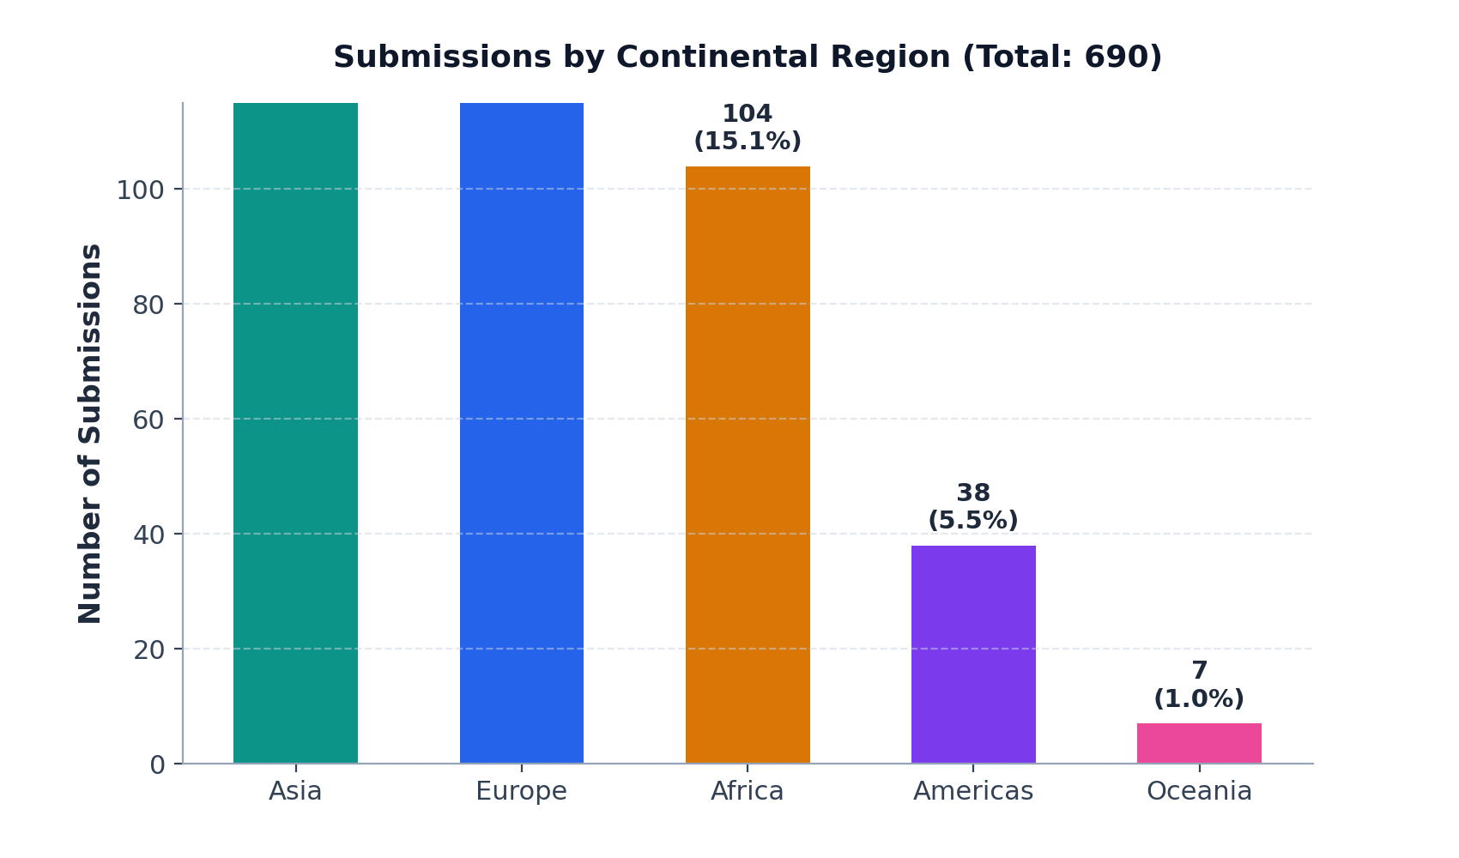
GEOGRAPHIC ANALYSIS
Regional Breakdown & Top Contributing Nations Leaderboard
Asia: 225 Submissions (32.6%)
India (64), China (58), Indonesia (32), Nepal (16), Pakistan (9), Thailand (7). Strong focus on agrarian adaptation, WEF nexus, and twin transition.
Europe: 274 Submissions (39.7%)
Netherlands (132), Germany (45), UK (27), Belgium (11), Italy (10), Spain (7). Centered on post-2030 governance, circular economy modeling, and planetary boundaries.
Africa: 104 Submissions (15.1%)
Ghana (28), South Africa (23), Nigeria (14), Uganda (6), Morocco (6), Kenya (6). Critical focus on climate justice, Loss & Damage, health equity, and rural resilience.

Slide 5
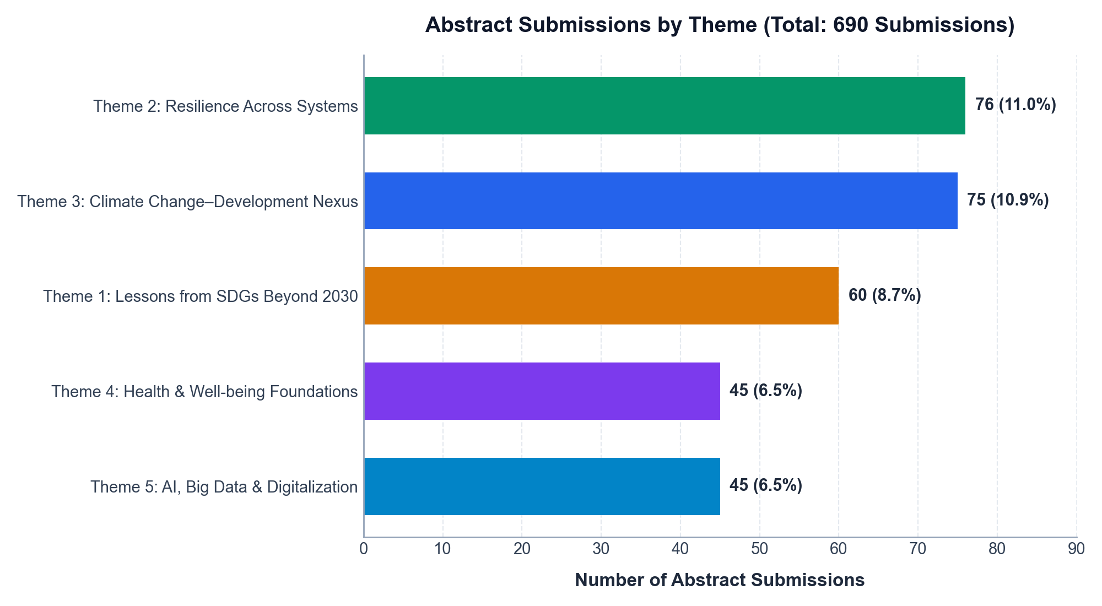
THEMATIC LANDSCAPE
Thematic Distribution: Across 5 Core Pillars (Theme 1 to 5)
Theme | Focus Description | Papers | Share (%)
Theme 1 | Lessons from SDGs Beyond 2030 | 155 | 22.5%
Theme 2 | Building Resilience Across Systems | 171 | 24.8%
Theme 3 | Climate Change–Development Nexus | 166 | 24.1%
Theme 4 | Health, Well-being & Social Foundations | 106 | 15.4%
Theme 5 | AI, Big Data & Digitalization | 92 | 13.3%
KEY THEMATIC TAKEAWAYS
• Themes 1 through 5 provide an integrated systemic continuum from post-2030 governance (Theme 1), natural-human resilience (Theme 2), and climate justice (Theme 3) to health equity (Theme 4) and digital enablers (Theme 5).
• Themes 2 and 3 represent 48.8% of all submissions, highlighting immense research interest in resource resilience and climate action.

Slide 6
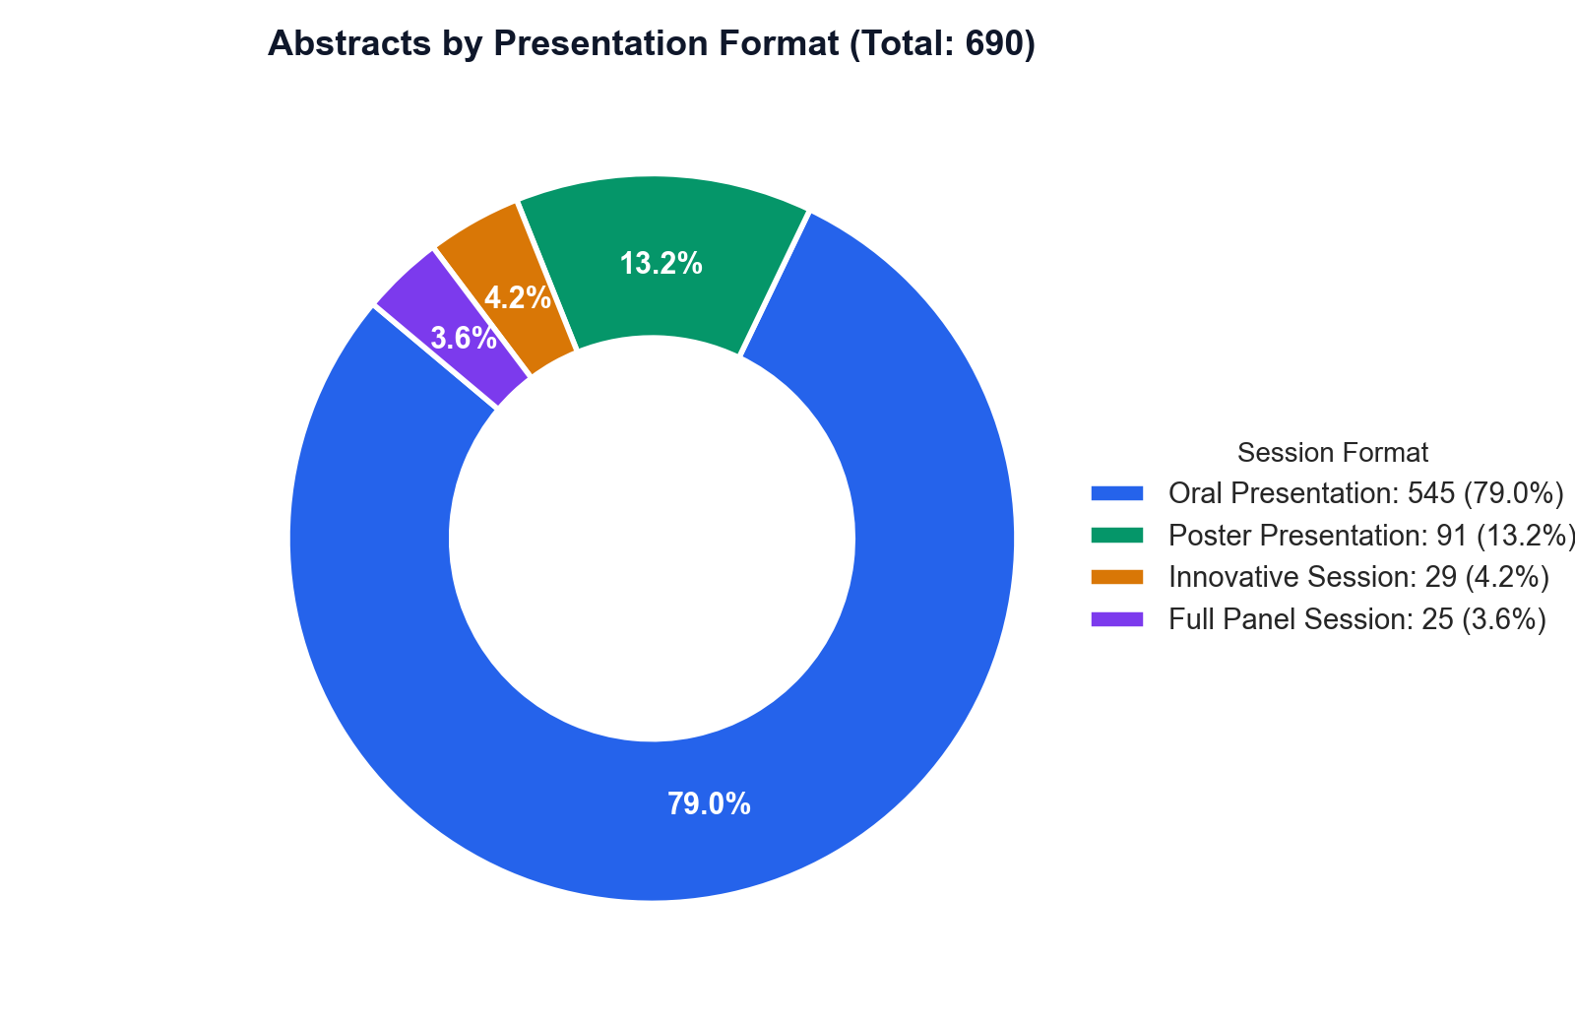
PROGRAM SCHEDULING
Presentation Formats & Session Architecture
Oral Presentations • 545 Submissions (79.0%)
Requires approximately 40 to 45 standard oral sessions (5-6 papers per 90-minute session). Suggest scheduling across 4 parallel thematic tracks over 3 full conference days.
Poster Presentations • 91 Submissions (13.2%)
Ideal for two dedicated interactive poster reception slots. Posters cluster around empirical fieldwork in Themes 1, 2, and 3, plus pilot models in AI and health analytics.
Innovative Sessions • 29 Submissions (4.2%)
Interactive workshops, co-design labs, and policy dialogues (e.g. decarbonization co-design, nature relationship index, participatory stakeholder modeling). High engagement value.
Full Panel Sessions • 25 Submissions (3.6%)
Curated multi-institutional expert panels (e.g. EU-China modeling consortium, water-energy-food governance, open data for SDG 6, regenerative supply chains). Prime plenary candidates.
PROGRAM COMMITTEE RECOMMENDATION
• Designate 4 continuous parallel oral presentation streams (Stream A: Climate Nexus; Stream B: Integrated Resilience; Stream C: SDGs Beyond 2030; Stream D: Digital & Health).
• Schedule the 15 special panel and innovative sessions in non-overlapping 90-minute prime conference blocks to maximize cross-disciplinary attendance.

Slide 7
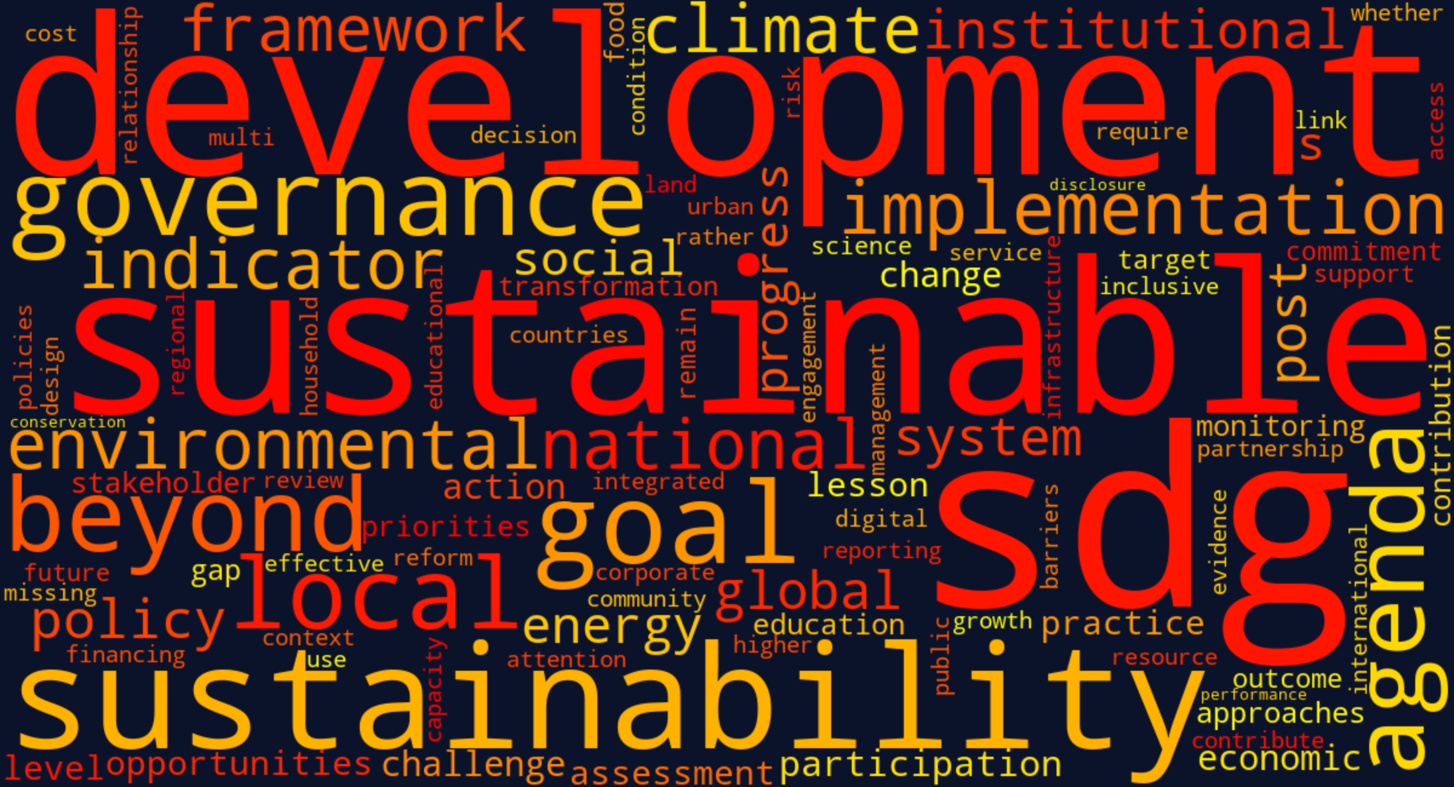
THEME 1 ANALYSIS
Theme 1 Deep-Dive: Lessons from SDGs for Sustainable Development Beyond 2030
Theme 1 Metrics & Subtopics Breakdown
• Volume & Representation: 155 Submissions (22.5% of conference, 3rd largest theme). 119 Oral, 21 Posters, 3 Panels, 12 Innovative Sessions. Contributing countries led by Netherlands (32), India (13), Germany (11), China (9), Unknown (9).
• 1.1 National & Local SDG Implementation (57 papers, 36.8%): Analyzing institutional barriers, municipal Voluntary Local Reviews (VLRs), and grassroots community alignment.
• 1.5 Methods & Processes for Post-2030 (19 papers, 12.3%): Proposals for next-generation indicator frameworks, dynamic targets, and participatory foresight methodologies beyond the 2030 horizon.
• 1.2 SDG Governance & Partnerships (26 papers, 16.8%): Multi-stakeholder partnerships, public-private pacts, and accountability structures.
• 1.4 Missing Links & Post-2030 Reforms (33 papers, 21.3%): Critiques of current SDG gaps: planetary boundaries, indigenous sovereignty, and degrowth.
• 1.3 Integrated SDG Progress Assessment (20 papers, 12.9%): Cross-goal trade-offs, spillover indices, and quantitative evaluation tools.
THEME 1 ABSTRACT WORD CLUSTER & TOP KEYWORDS
• Top Abstract Words: development (247), sustainable (229), sustainability (196), sdgs (125), beyond (103), local (95), governance (93), implementation (90), goals (83), national (82), agenda (82).
• Key Author Keywords: sustainable development goals (18), post-2030 agenda (7), sdgs (5), sustainable development (5), sdg localization (4), sustainability (4), sustainability reporting (4).

Slide 8
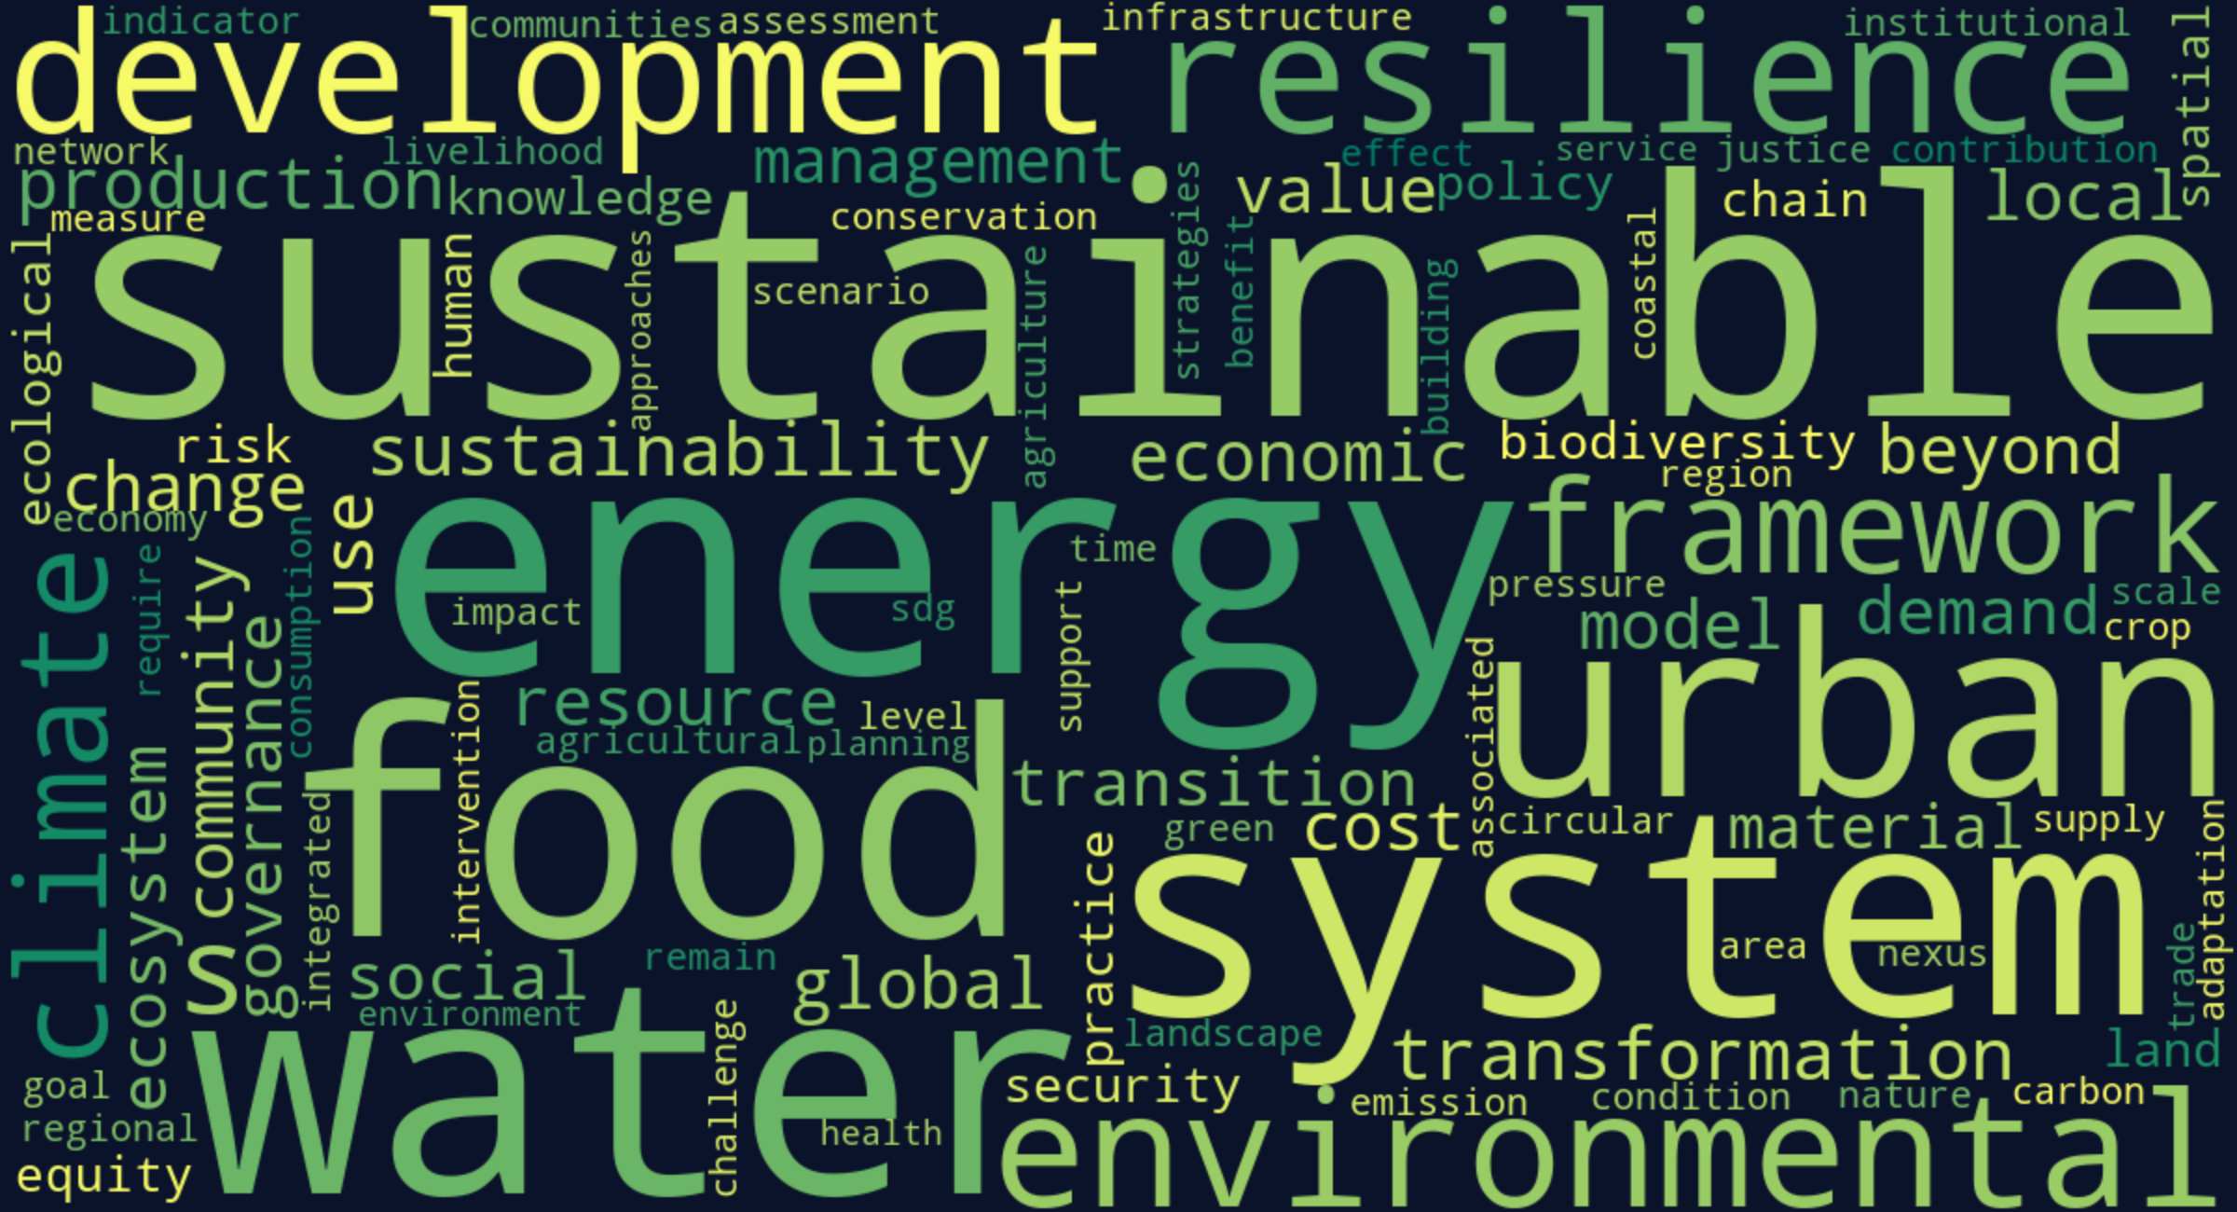
THEME 2 ANALYSIS
Theme 2 Deep-Dive: Building Resilience across Natural & Human Systems
Theme 2 Metrics & Subtopics Breakdown
• Volume & Dominance: 171 Submissions (24.8% of conference, largest theme). 143 Oral, 18 Posters, 5 Panels, 5 Innovative Sessions. Top countries: Netherlands (27), China (20), India (14), Germany (14), Unknown (11).
• 2.1 Food-Water-Energy Nexus (45 papers, 26.3%): Focuses on agricultural food systems, watershed governance, clean energy access, and resource interdependencies.
• 2.5 Beyond GDP & Circularity (30 papers, 17.5%): Circular economy models, regenerative supply chains, industrial symbiosis, and bioeconomy innovations.
• 2.3 Roles of Equity & Justice (38 papers, 22.2%): Environmental justice, indigenous land stewardship, social vulnerability, and community resilience.
• 2.2 Landscapes & Seascapes (29 papers, 17.0%): Ecosystem service valuations, coastal mangrove restoration, marine biodiversity conservation.
• 2.4 Urban Transformation & Mobility (29 papers, 17.0%): Low-carbon urban transit, resilient urban planning, and infrastructure retrofitting.
THEME 2 ABSTRACT WORD CLUSTER & TOP KEYWORDS
• Top Abstract Words: sustainable (179), energy (147), water (126), food (118), environmental (117), urban (115), development (112), resilience (95), framework (93), sustainability (89), global (83).
• Key Author Keywords: community resilience (7), business models (6), biodiversity (6), equity (5), social equity (5), sustainable resource management (5), food system transformation (5).

Slide 9
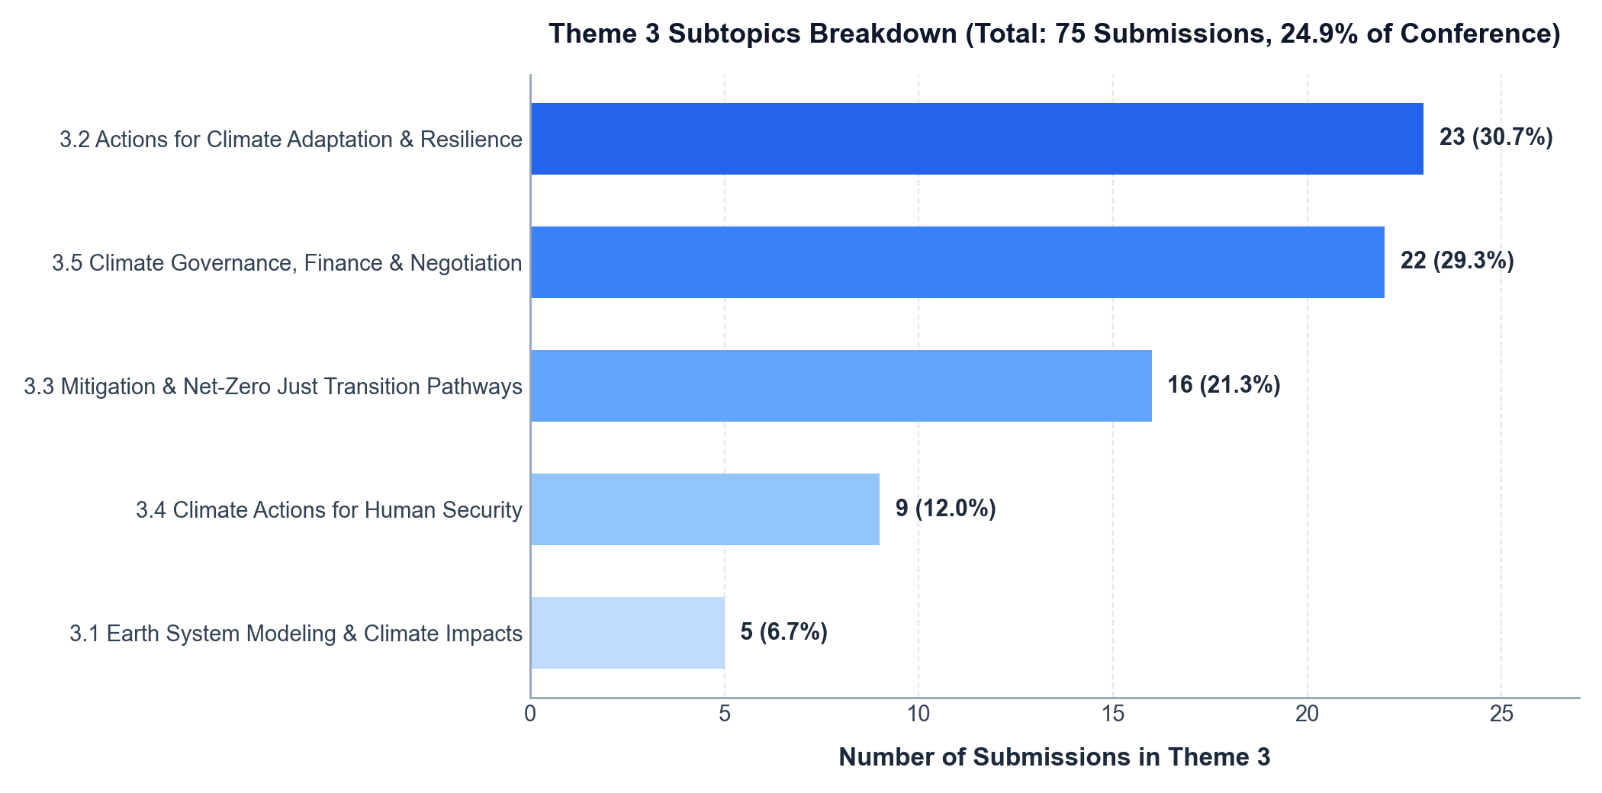
THEME 3 SPOTLIGHT
Theme 3 Deep-Dive: Navigating the Climate Change–Development Nexus
Theme 3 Structure & Subtopics
Theme 3 captures the intersection of climate action and equitable human progress. 166 abstracts make it the 2nd largest track, covering 5 distinct subtopics:
• 3.2 Actions for Climate Adaptation (40 papers, 24.1%): Focuses on building societal resilience, grassroots agricultural adaptations, and nature-based solutions.
• 3.5 Climate Governance & Finance (48 papers, 28.9%): Examines international negotiations, carbon pricing, Article 6, Loss & Damage funds, and multi-level climate policies.
• 3.3 Mitigation & Net-Zero Pathways (51 papers, 30.7%): Explores renewable transitions, industrial decarbonization, and socially just phase-out of fossil fuels.
• 3.4 Climate Actions for Human Security (17 papers, 10.2%): Addresses climate migration, conflict vulnerabilities, displacement, and livelihood security.
• 3.1 Earth System Modeling & Impacts (10 papers, 6.0%): Quantitative climate forecasting, tipping point analytics, and localized socio-ecological impact simulations.
166
Submissions (24.1%)
39
Contributing Nations
135
Oral Presentations
20
Poster Presentations
11
Special Sessions (4 Inn, 7 Pan)

Slide 10
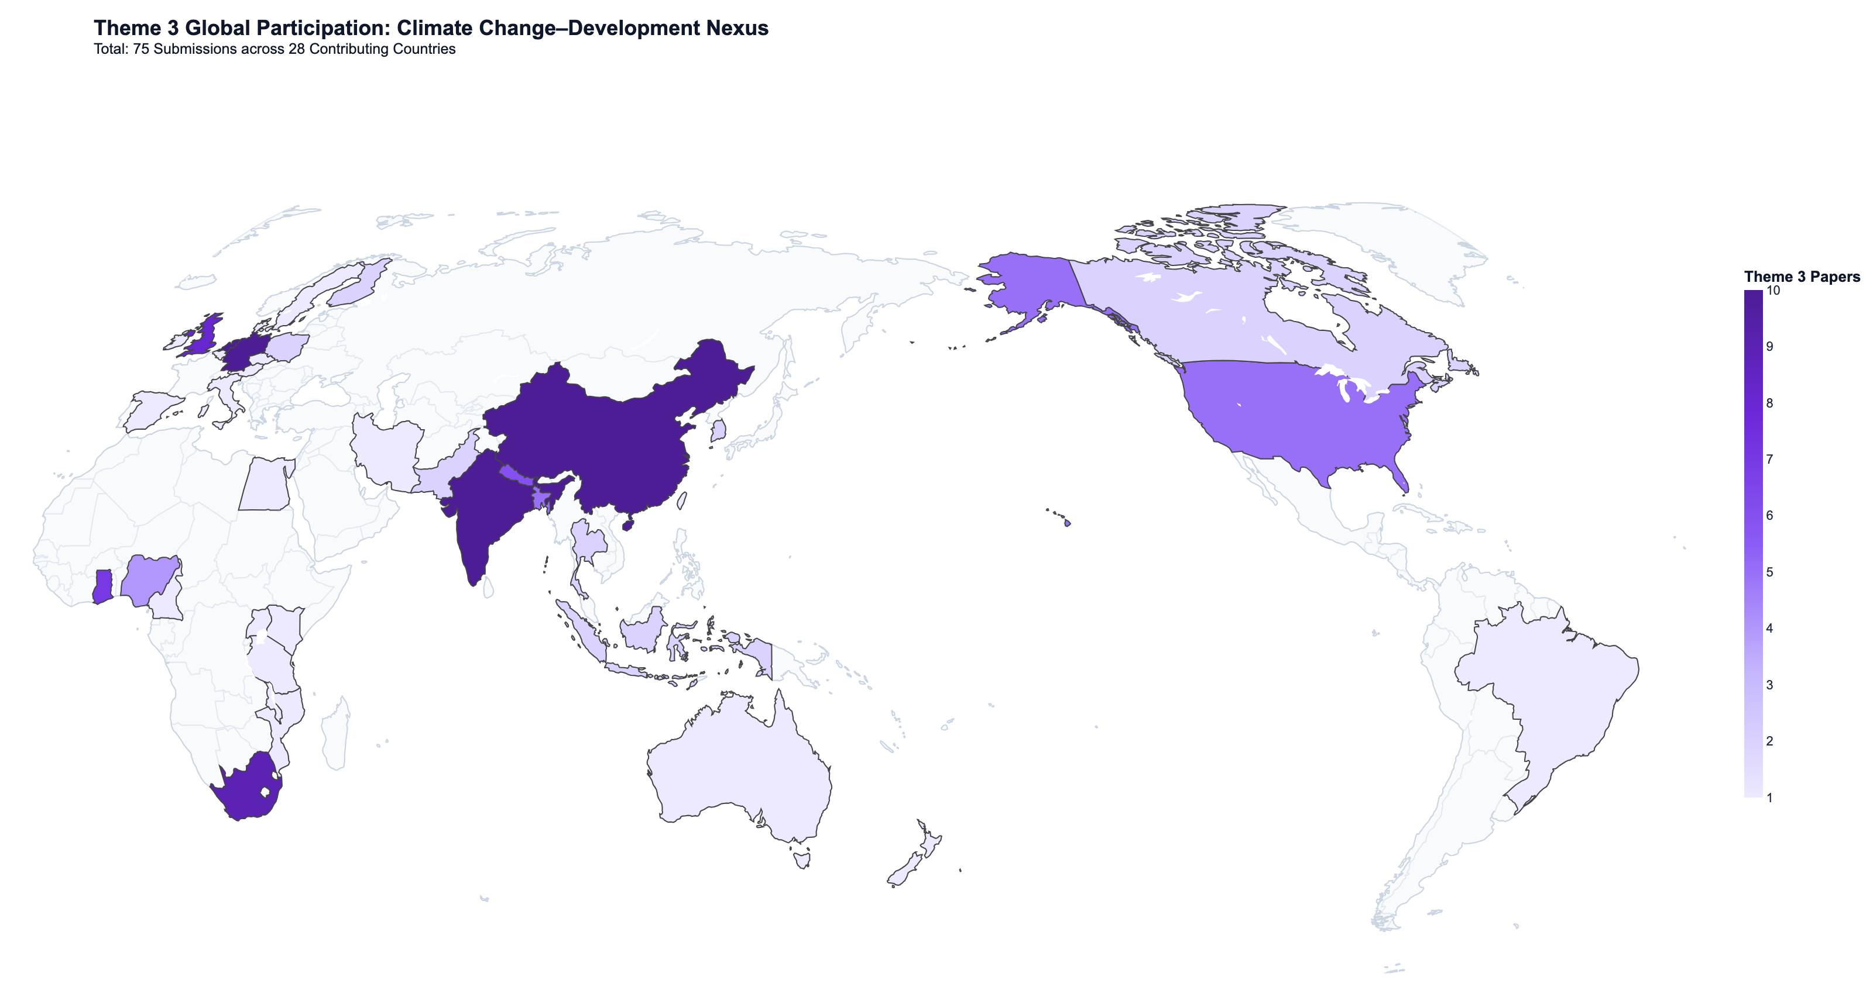
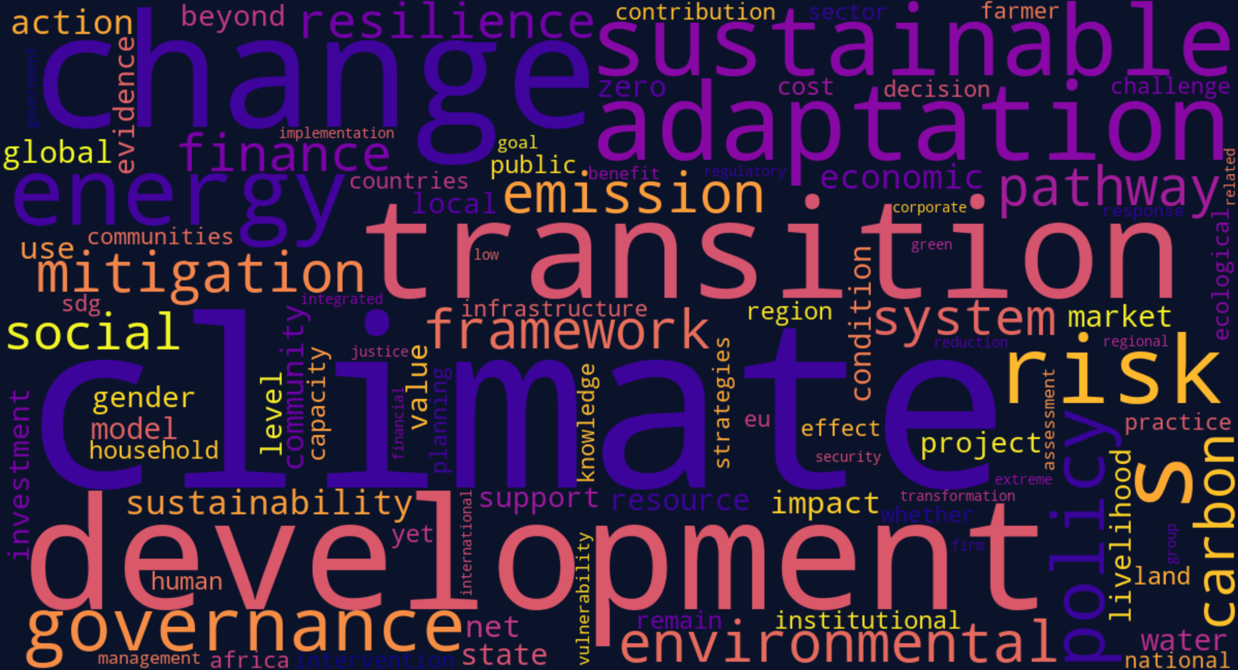
THEME 3 ANALYSIS
Theme 3 Global Geography & Abstract Word Cluster
THEME 3 GEOGRAPHIC & LEXICAL SUMMARY
• Top Contributing Nations (39 total): Netherlands (33), India (25), Germany (10), China (10), Unknown (10), South Africa (9), UK (8), Ghana (7), Nepal (6), Bangladesh (5).
• Top Abstract Words: climate (379), development (151), change (128), adaptation (108), sustainable (100), transition (98), energy (88), governance (87), environmental (84).
• Key Author Keywords: climate change (12), climate finance (8), just transition (6), climate adaptation (5), climate change adaptation (4).

Slide 11
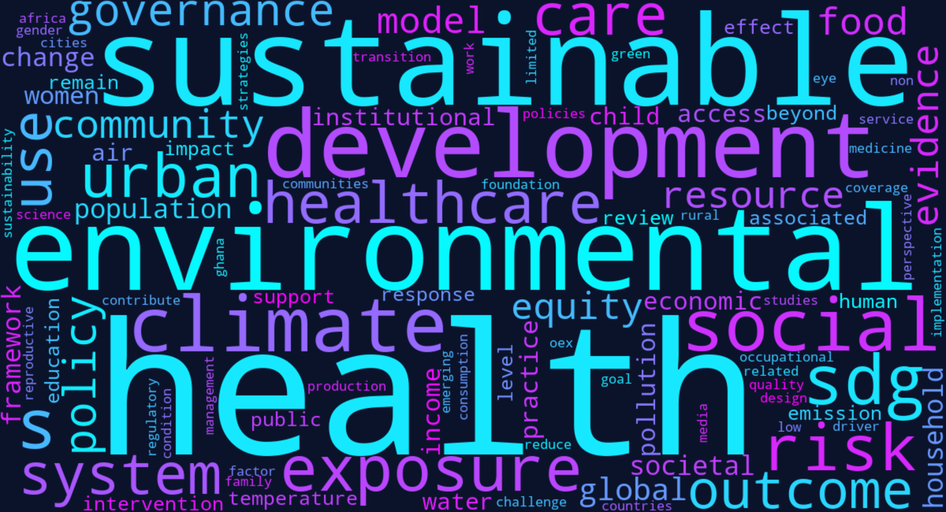
THEME 4 ANALYSIS
Theme 4 Deep-Dive: Health, Well-being, and Societal Foundations
Theme 4 Metrics & Subtopics Breakdown
• Volume & Geographic Diversity: 106 Submissions (15.4% of conference, 4th largest theme). 76 Oral, 21 Posters, 5 Panels, 4 Innovative Sessions. Top countries: Netherlands (24), China (12), Indonesia (11), Ghana (10), India (9).
• 4.4 Health Equity & Societal Outcomes (41 papers, 38.7%): Evaluates inner development, mental health, gender disparities, social determinants, and community well-being.
• 4.5 Health as Outcome & Driver of Sustainability (25 papers, 23.6%): Economic productivity linkages, universal health coverage (UHC), and social foundation resilience.
• 4.3 Solutions & Innovations for Healthier Societies (13 papers, 12.3%): Community-based healthcare interventions, digital health tools, and indigenous medical practices.
• 4.2 Environmental Health & Exposure Science (21 papers, 19.8%): Air pollution exposure (e.g. Max Planck Mainz particulate analysis), microplastics, chemical toxins.
• 4.1 One Health Nexus & Ecological Ceilings (6 papers, 5.7%): Zoonotic disease emergence, animal-human-ecosystem health integration.
THEME 4 ABSTRACT WORD CLUSTER & TOP KEYWORDS
• Top Abstract Words: health (237), sustainable (89), environmental (86), development (79), well-being (69), social (61), climate (45), exposure (42), healthcare (41), urban (38), policy (37).
• Key Author Keywords: sustainable development (4), well-being (4), climate change (3), nigeria (3), sustainability (3), health equity (3), population health (3).

Slide 12
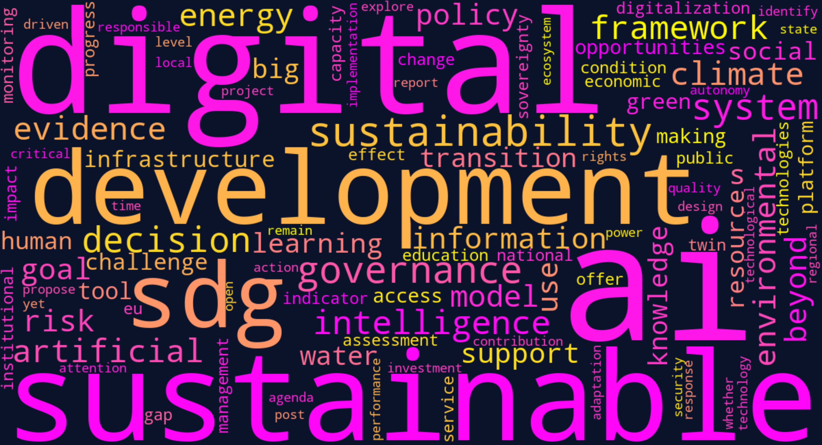
THEME 5 ANALYSIS
Theme 5 Deep-Dive: AI, Big Data & Digitalization as Enablers
Theme 5 Metrics & Subtopics Breakdown
• Volume & Frontier Scope: 92 Submissions (13.3% of conference, smallest theme). 72 Oral, 11 Posters, 5 Panels, 4 Innovative Sessions. Top contributing nations: Netherlands (16), Indonesia (7), China (7), South Africa (6), Unknown (6).
• 5.5 AI & Digitalization by/beyond 2030 (39 papers, 42.4%): Exploring macro-level digital transformation, sustainable smart cities, and AI in SDG achievement.
• 5.2 Twin Transition (Green + Digital) (9 papers, 20.0%): Investigating how digitalization and green transition intersect, rebound effects, and energy consumption of data infrastructure.
• 5.1 AI Methods & Analytics (11 papers, 12.0%): Machine learning algorithms, remote sensing earth observation, and satellite data analytics for ecological monitoring.
• 5.4 Trustworthy AI & Governance (16 papers, 17.4%): Algorithmic bias in sustainability policy, digital public goods, data sovereignty, and ethical AI safeguards.
• 5.3 AI Tools for Decision-Making (13 papers, 14.1%): Decision-support systems for municipal resource allocation and disaster management.
THEME 5 ABSTRACT WORD CLUSTER & TOP KEYWORDS
• Top Abstract Words: digital (151), sustainable (133), development (120), sustainability (90), governance (70), intelligence (52), environmental (52), beyond (51), climate (50), framework (49), artificial (48).
• Key Author Keywords: artificial intelligence (14), sustainable development (6), big data (5), digitalization (5), sustainability (4), responsible innovation (4), data governance (4).

Slide 13
CROSS-CUTTING ANALYSIS
Cross-Thematic Synergies & Thematic Intersection Matrix
Theme | Papers | Countries | Top Subtopic | Dominant Word Cluster | Cross-Theme Synergy
Theme 1 (SDGs) | 155 (22.5%) | 48 | 1.1 SDG Local Implementation (57) | development, institutional, localization, governance | Feeds governance frameworks into Themes 2 & 3
Theme 2 (Resilience) | 171 (24.8%) | 39 | 2.1 Food-Water-Energy Nexus (45) | water, food, energy, circular, biodiversity | Supplies ecological baselines for Health (T4) & Climate (T3)
Theme 3 (Climate) | 166 (24.1%) | 39 | 3.2 Climate Adaptation (40) | climate, adaptation, policy, just transition | Intersects with AI analytics (T5) & Human Security (T4)
Theme 4 (Health) | 106 (15.4%) | 26 | 4.4 Health Equity & Well-being (41) | health, well-being, exposure, urban, equity | Bridges pollution data with climate extreme impacts
Theme 5 (AI/Digital) | 92 (13.3%) | 31 | 5.5 AI by/beyond 2030 (39) | digital, intelligence, systems, twin transition | Enables data monitoring across ALL themes (1, 2, 3, 4)
STRATEGIC CROSS-THEMATIC CONVERGENCES
• The 'Twin Transition' Interface: Strong natural convergence between Theme 3 (Climate mitigation) and Theme 5 (AI & big data), specifically in digital carbon accounting, satellite earth observation, and smart grid optimization.
• The Ecological Health Nexus: Theme 2 (Water/Food) and Theme 4 (Health) share critical empirical ground regarding agricultural pesticides, clean water access, and urban microclimates.
• Justice & Just Transition as the Universal Thread: Social equity is prominently featured in Theme 1 (indigenous voices), Theme 2 (fair resource allocation), and Theme 3 (just transition in coal/fossil regions).

Slide 14
PROGRAM RECOMMENDATIONS
Actionable Conference Planning & Track Allocation Guidance
Track Allocation & Parallel Rooms
Poster Sessions & Exhibition
Curated Panels & Interactive Labs
• Establish 4 Dedicated Parallel Streams: Stream A (Climate Nexus), Stream B (Natural-Human Systems), Stream C (SDGs & Governance), Stream D (AI & Health).
• Room Sizing by Volume: Allocate the largest auditorium facilities to the two biggest themes: Theme 2 (171 papers) and Theme 3 (166 papers), which will draw peak delegate interest.
• Session Granularity: Plan approximately 45 oral sessions with 5-6 papers each (15 min presentation + Q&A).
• Thematic Clustering of 91 Posters: Cluster posters into 4 thematic islands matching the main conference pillars.
• Two Dedicated Unopposed Poster Slots: Schedule two 60-minute reception slots (e.g., late afternoon Day 1 and Day 2) with refreshments to guarantee high delegate interaction.
• Rapid Poster Pitch Competition: Provide 60-second lightning pitches for early-career scholars prior to the poster session.
• Elevate 15 Special Sessions: The 7 Full Panels and 8 Innovative Sessions involve multi-institutional consortia (e.g. EU-China, SDSN, Jagiellonian, CAS, Max Planck).
• Semi-Plenary Positioning: Schedule panels in prominent mid-morning slots to anchor plenary debates and foster cross-theme dialogue.
• Workshop Co-Design Rooms: Equip innovative session rooms with flexible round-table seating rather than standard theater style.

Slide 15
CONCLUSION & RESOURCES
Analytical Package & Deliverables Summary
PowerPoint Report (PPTX) — GSC2027_Abstract_Submissions_Analysis_Report.pptx
15 comprehensive widescreen slides featuring discrete maps, sequential thematic deep-dives (Themes 1 to 5), and scheduling recommendations.
Interactive World Map Dashboard (HTML) — gsc2027_interactive_world_map.html
Clean white academic dashboard with discrete binned map tiers, dynamic theme selector (Strict 1 to 5), pie charts, word clusters, and sortable table.
Master Submissions Database (Excel & CSV) — GSC2027_Abstract_Submissions_Master.xlsx / .csv
Complete cleaned dataset of all 690 abstracts with ID, title, author lists, organizations, verified country, subtopic codes, keywords, and text.
High-Res Visual Assets Suite — visuals/ directory (13 High-DPI Assets)
Includes global and Theme 3 choropleth maps, theme distribution charts, subtopic bars, format breakdowns, and 6 specialized NLP word clouds.
Groningen Sustainability Conference 2027 (GSC 2027) • University of Groningen, Netherlands • Scientific Advisory & Analytics Desk

