Slide 1
EGB1221-DATABASE MANAGEMENT SYSTEMS PROJECT REVIEW-0
DEPARTMENT OF ECE
Academic Year: 2025 – 2026 (Even Semester)
Batch :2024-2028
Year : II
Semester : IV
Date : 12.02.2026

Slide 2
EGB1221-DATABASE MANAGEMENT SYSTEMS PROJECT REVIEW-0
DEPARTMENT OF ECE
Academic Year: 2025 – 2026 (Even Semester)
Batch No :4
SIH_ID / Year :SIH25010
Team Members : PON SANMUGA VISHAL G(927624BEC154)
: NIVASH S(927624BEC153)
: SANTHOSH R(927624BEC198)
: SHARVESH J(927624BEC206)

Slide 3
Title of the Project
Smart Crop Advisory System for Small and Marginal Farmers

Slide 4
Problem Statement
A majority of small and marginal farmers in India rely on traditional knowledge, local shopkeepers, or guesswork for crop selection, pest control, and fertilizer use. They lack access to personalized, real-time advisory services that account for soil type, weather conditions, and crop history.
This often leads to poor yield, excessive input costs, and environmental degradation due to overuse of chemicals. Language barriers, low digital literacy, and absence of localized tools further limit their access to modern agri-tech resource Why the problem is important?

Slide 5
Project Objectives
Aim: To build a smart farming system using ESP32 sensors, a database, and a web platform to provide real-time, personalized agricultural advice based on soil and environmental data.
Expected Outcome: The system will deliver accurate crop, fertilizer, and irrigation recommendations, improving yield, reducing costs, and promoting sustainable farming practices.

Slide 6
DBMS Concepts Involved
The system uses the ER model and relational model to structure data into tables like Farmer, Field, and SensorData. Primary and foreign keys maintain relationships, while normalization reduces redundancy. CRUD operations manage data, constraints ensure integrity, indexing speeds retrieval, and ACID transactions guarantee reliable storage.

Slide 7
Technology Identification
HARDWARE COMPONENTS:
ESP32.
DTH22 Temperature and Humidity Sensor.
Soil PH Sensor
Soil Moisture Sensor
NPK Soil Sensor
Rain Sensor
SOFTWARE COMPONENTS:
Arduino IDE
Python
MySQL
HTML ,CSS , Java Script

Slide 8
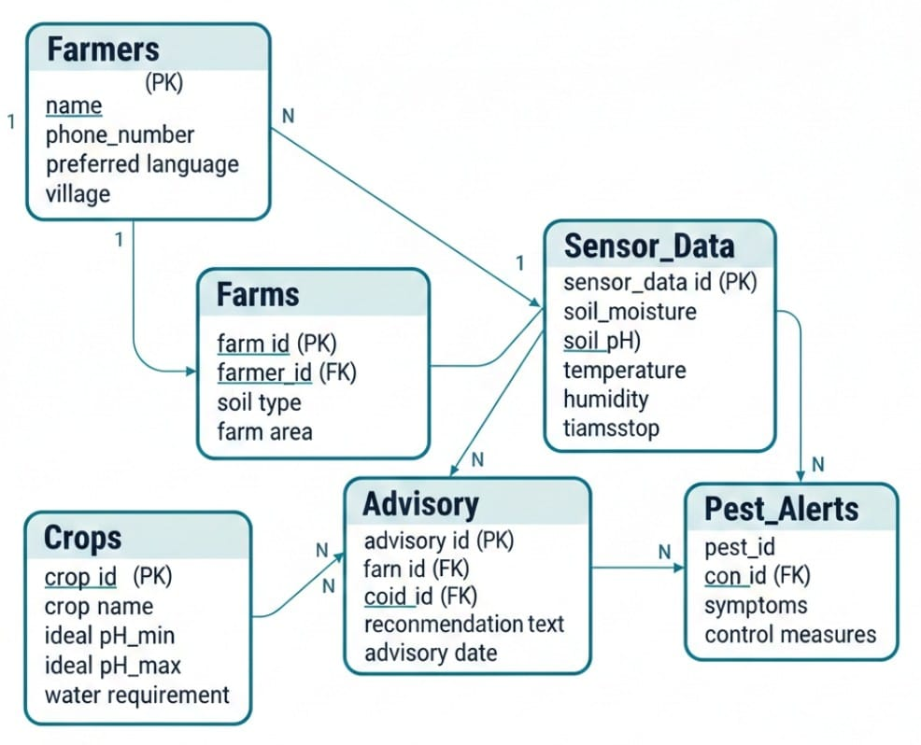
ER Diagram

Slide 9
Thank You
ANY QUERIES???

