Slide 1
New work item proposal Exchange formats for the Audit Data Collection Standard: XBRL
Semantic XBRL for Granular Data
SAMBUICHI, Nobuyuki
nobuyuki@sambuichi.jp
ISO/TC 295 Audit data services
Head of delegate Japanese Industrial Standards Committee (JISC)
April 19, 2021
19:00-21:00 Beijing time (GMT+8)

Slide 2
Meeting Agenda
1. Proposal on“Exchange formats for the Audit Data Collection Standard: XBRL”
presented by Mr. Nobuyuki Sambuichi
2. Discussions on data modeling
3. Other business

Slide 3
Prerequisite knowledge
-5
It is advisable to study history of the standard and be well prepared.
-4 Core Component Technical Specification
-3 Business Process defined in UBL
-2 Business Process defined in EN 16931
-1 eXtensible Business Reporting Language (XBRL) 2.1

Slide 4


Things to consider before writing a standard Don’t climb mountain (ISO) in high heels
-5
It is advisable to study history of the standard and be well prepared.
Colorado hiker climbs Mount Elbert in high heels
“A hiker in the US is proving no mountain is too tough, by throwing away her boots and replacing with a pair of heels instead. “
Kenneth Garger, New York Post OCTOBER 23, 2020 9:24AM
Even if it looks strange in the city, this is the clothes that safely reach the summit within the scheduled time.

Slide 5
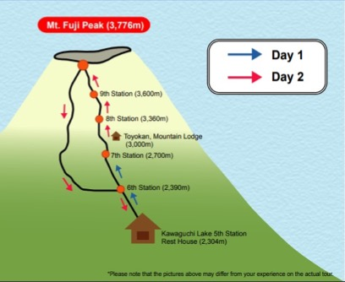
Standing on the shoulders of giants
-5
Day 1 Semantic modeling is defined based on following standards:
1) CCS defined in ISO 15000-5 Electronic Business Extensible Markup Language (ebXML) -- Part 5: Core Components Specification (CCS);
2) Business rule definition for Core Invoice Usage Specification (CIUS) in EN 16931-1 Electronic Invoicing - Semantic data model of the core elements of an electronic invoice; and
3) Business process modeling in UBL
4) Extensible Business Reporting Language (XBRL) 2.1. Business rules can be validated using formula linkbase defined in taxonomy.
Day 2 We are standing on the shoulders of giants and defining new standards for new business domains for audit.
NOTE Wikipedia says that it is a metaphor of dwarfs standing on the shoulders of giants and expresses the meaning of "discovering truth by building on previous discoveries". This concept has been traced to the 12th century, attributed to Bernard of Chartres. Its most familiar expression in English is by Isaac Newton in 1675: "If I have seen further, it is by standing on the shoulders of Giants."
Essential carry-on items
CCTS, UN/CEFACT CCL, UBL and XBRL
Semantic modeling as a lodge on the first day
ISO 21378:2019 Audit data collection

Slide 6
Industry doesn’t need to reinvent the wheel
-5
ISO/IEC Directives, Part 2
Principles and rules for the structure and drafting of ISO and IEC documents
5.7 Avoidance of duplication and unnecessary deviations
Before standardizing any item or subject, the writer shall determine whether an applicable standard already exists.
If it is necessary to invoke a requirement that appears elsewhere, this should be done by reference, not by repetition – see Clause 10.
“Trusted standards mean that industry doesn’t need to reinvent the wheel, that innovations will be compatible and work with existing technology, and that products and services will be trusted too.
Governments use standards as trusted solutions to complement regulation, and they give peace of mind to consumers who know they are not putting themselves or their families at risk.”
NO TRUST IN WORLD WITHOUT STANDARDS, Maria Lazarte, October 2016 (https://www.iso.org/news/2016/10/Ref2128.html)

Slide 7
History of Standard Formats
-5
91
17
EUROPEAN COMMITTEE FOR STANDARDIZATION
CEN: COMITÉ EUROPÉEN DE NORMALISATION
EN 16931-1:2017Electronic invoicing - Part 1: Semantic data model of the core elements of an electronic invoice
The Vienna Agreement
CEN/TS 16931-3-2:2017 Electronic invoicing – Part 3-2: Syntax bindings for ISO/IEC 19845 (UBL 2.1) invoice and credit note
Memorandum of Understanding between IEC, ISO and UN/ECE
MoU on electronic business between IEC, ISO, ITU and UN/ECE
CEN/TS 16931-3-3:2017 Electronic invoicing – Part 3-3: Syntax bindings for UN/CEFACT XML Industry Invoice D16B
OASIS joined above
98
02
04
06
13
18
21
OASIS
Universal Business Language v1.0
Universal Business Language v2.1 (UBL v2.1)
Universal Business Language v2.0
Universal Business Language v2.2 (UBL v2.2)
Universal Business Language v2.3
94
00
02
03
06
16
UNECE
UN/CEFACT
Core Component Technical Specification (CCTS)
CCL 16B
ISO 21378:2019 Audit data collection
Core Component Library (CCL) 06A
91
94
00
02
05
14
15
19
ISO
ISO/TS 15000-5:2005 Electronic Business Extensible Markup Language (ebXML) — Part 5: ebXML Core Components Technical Specification, Version 2.01(ebCCTS)
91
ISO 15000-5:2014 Electronic Business Extensible Markup Language (ebXML) – Part 5: Core Components Specification (CCS)
HTTP 0.9
ISO/IEC 19845:2015 Universal Business Language v2.1
94
00
01
04
10
12
14
20
W3C
XML 1.0 (Second Edition)
XML Schema 1.0
XML Schema 1.0 (Second Edition)
XMLSchema Definition Language (XSD) 1.1
XML Linking Language (XLink) 1.0
JSON-LD 1.0
JSON-LD 1.1
XML Linking Language (XLink) 1.1
00
01
02
03
06
07
09
10
21
XBRL
XBRL Specification 1.0
XBRL Dimensions 1.0
Open Information Model 1.0
Candidate recommendation
XBRL Specification 2.0
XBRL Formula 1.0
XBRL Specification 2.0a
XBRL Inline 1.0
XBRL Specification 2.1
XBRL GL taxonomy 1.21
XBRL Global Ledger Framework

Slide 8
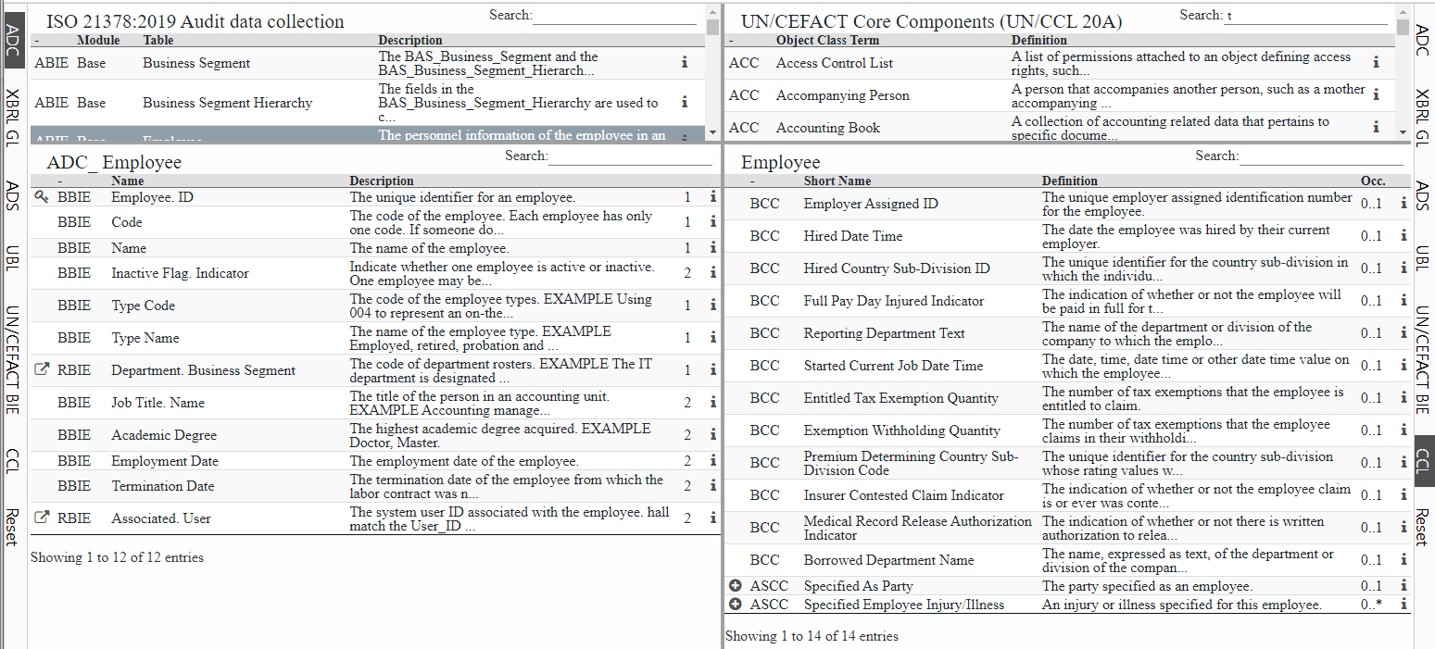
Core Component Technical Specification
-5
Audit
Data
Services
UN/CEFACT
UNECE
UBL
OASIS
CCTS
Both Universal Business Language (UBL) by OASIS and UN/CEFACT by UNECE are based on Core Component Technical Specification (CCTS).
ISO 15000-5:2014 Electronic Business Extensible Markup Language (ebXML) — Part 5:
Core Components Specification (CCS)
CCL
XBRL GL
XBRL Int.
Audit Data Standard
AICPA
Preliminary findings are at the following site.
https://www.wuwei.space/iso/tc295/

Slide 9
UBL Conformance to ebXML CCTS ISO/TS 15000-5:2005 Version 1.0 [SOURCE: http://docs.oasis-open.org/ubl/UBL-conformance-to-CCTS/v1.0/UBL-conformance-to-CCTS-v1.0.html]
-5
Does UBL conform to CCTS?
We believe the answer is “YES”.
The UBL TC believes that there is a broad consensus in the standards and user community that UBL is a valid implementation of the CCTS. UBL was an early adopter of CCTS (probably the first) and was actually used as implementation verification for the CCTS standard itself.
Summary
The UBL TC believes that the CCTS is a valuable tool for creating eBusiness vocabularies and UBL has contributed to its development.
We believe we are fully conformant to the normative clauses in the CCTS and have been for several years.
We believe UBL has helped raise the profile of CCTS and promoted its adoption in other domains. We have also stimulated the development of open-source tools and technologies to support CCTS users
On at least two occasions in the past 11 years (2003 and 2007) the UBL TC has had to justify our claims of conformance to the Core Components Technical Specification (CCTS) . This Committee Note makes the informal responses given in the past formal and makes them available to interested parties so as to avoid misunderstandings in the future.
It should also be understood that all references to CCTS in UBL are to ISO/TS 15000-5:2005 published by UN/CEFACT in 2003 as the “Core Components Technical Specification – Part 8 of the ebXML Framework”. UBL makes no claims with respect to the recently published ISO 15000-5:2014 version but have been assured by its authors that ISO 15000-5:2014 retains backward compatibility with ISO/TS 15000-5:2005.

Slide 10
UBL 2.1 JSON Alternative Representation Version 1.0 Committee Note Draft 02 12 April 2017
-5
http://docs.oasis-open.org/ubl/UBL-2.1-JSON/v1.0/cnd02/UBL-2.1-JSON-v1.0-cnd02.html
For users of JSON syntax, this note publishes a suite of JSON schemas with which one can validate the structural content of a JSON document against the constraints of the UBL 2.1 vocabulary. Also included is a transliteration of all of the UBL 2.1 example documents in JSON syntax with which one can test a number of the JSON schemas.
The structural patterns exhibited by JSON schemas that conform to the OASIS Business Document Naming and Design Rules Version 1.1 [BDNDR] are distinctive as document interchange structures. As such, their intent is only to convey in syntax the information content reflecting the same abstract model of the UN/CEFACT Core Component Technical Specification 2.01 [CCTS] with which the document model was designed. Accordingly, and in parallel to an application’s use of XML syntax, the JSON syntax used is generic in nature and is neither streamlined nor optimized for any particular application’s objectives.
As one would undertake the unmarshalling of XML syntax into internal application data structures suitable for processing, one must also undertake the unmarshalling of JSON interchange syntax into whatever internal application data structures (or other JSON representations) of the content that are suitable for the task at hand. Of note, it has been observed that there are commercial JSON database tools unable to ingest this JSON interchange syntax directly without an application massaging the content first to suit the database schema necessary to enable a particular arbitrary use. Nevertheless, the JSON syntax used does conform to the published standard [ISO 21778 - ECMA JSON] and has been successfully demonstrated to be ingested by Python and Node.js applications and so is not a barrier to use for application developers.

Slide 11
Core Component Technical Specification
-4
The first version ISO/TS 15000-5:2005/AMD 1:2011
Electronic Business Extensible Markup Language (ebXML) — Part 5: ebXML Core Components Technical Specification, Version 2.01(ebCCTS) — Amendment 1 HAS BEEN REVISED BY
ISO 15000-5:2014 Electronic Business Extensible Markup Language (ebXML) — Part 5: Core Components Specification (CCS)
-3 Business Process defined in UBL
-2 Business Process defined in EN 16931
-1 eXtensible Business Reporting Language (XBRL) 2.1

Slide 12
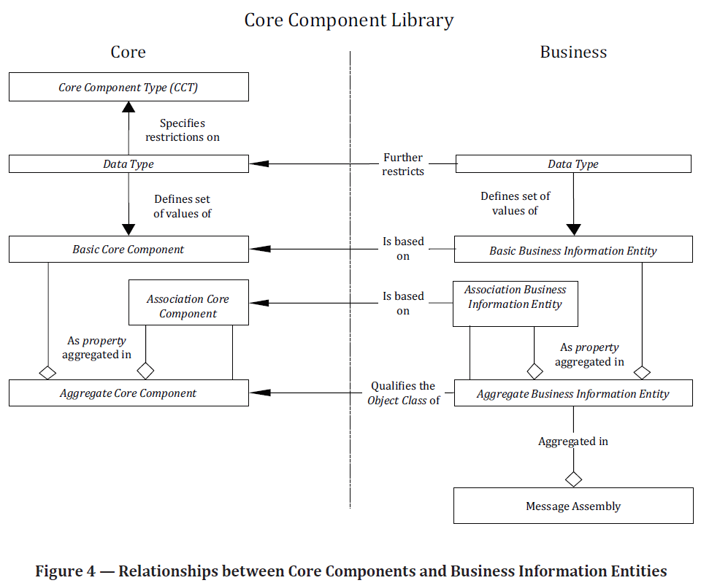
Core Components Specification
-4
Core Components Specification (CCS) is defined in ISO 15000-5 Electronic Business Extensible Markup Language (ebXML) — Part 5: Core Components Specification (CCS).
There are 4 different categories of Core Components:
1) Basic Core Component (BCC);
2) Association Core Component (ASCC);
3) Core Component Type (CCT);
4) Aggregate Core Component (ACC);
Aggregate Business Information Entity qualifies the Object Class of Aggregate Core Component.
Basic Business Information Entity is based on Basic Core Component.
Association Business Information Entity is based on Association Core Component.

Slide 13
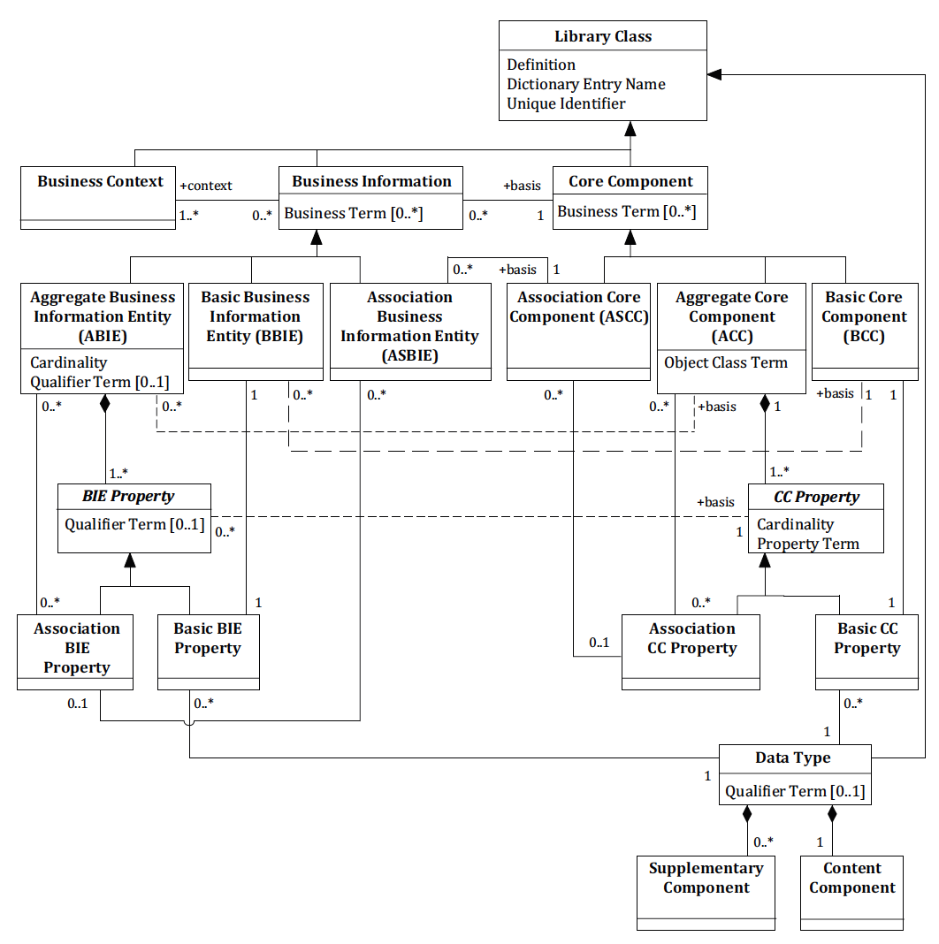
Business Information Entities Basic Definition Model
-4
Business information Entities are based on Core Components and are defined in the context defined in the business context.

Slide 14
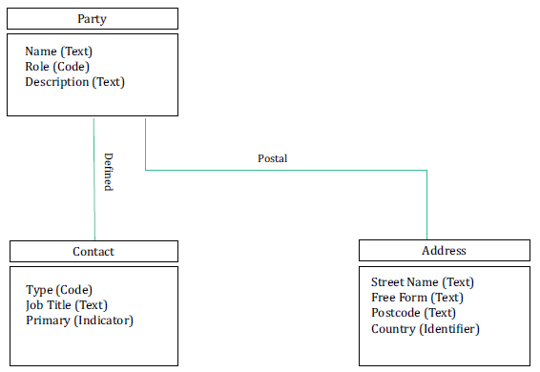
Association Core Component
-4
— three Aggregate Core Components: “Party. Details”; “Contact. Details” and “Address. Details”;
— each Aggregate Core Component has a number of Properties (i.e. business characteristics);
— the Aggregate Core Component “Party. Details” has five Properties (“Name”, “Role”, “Description”, “Defined. Contact” and “Postal. Address”);
— the Aggregate Core Component “Contact. Details” has three Properties (“Type”, “Job Title” and “Primary”);
— the Aggregate Core Component “Address. Details” has four Properties (“Street Name”, “Free Form”, “Postcode” and “Country”).
“Party. Defined. Contact” and “Party. Postal. Address” are both
Association Core Components. The structures of these associated Aggregate Core Components are defined by the Aggregate Core Components “Contact. Details” and “Address. Details”, respectively.

Slide 15
Example: Aggregate Core Component Party
-4
No | ID | D | Business Term | Semantic data type | O
0 | BG-0 | 0 | Party | Aggregation | 0..n
1 | BT-1 | 1 | Name | Text | 1..1
2 | BT-2 | 1 | Role | Code | 0..n
3 | BT-3 | 1 | Description | Text | 0..1
4 | BG-1 | 1 | Postal Address | Association | 1..1
5 | BT-4 | 2 | Street Name | Text | 1..1
6 | BT-5 | 2 | Postcode | Code | 0..1
7 | BT-6 | 2 | Country | Code | 0..1
8 | BG-2 | 1 | Defined Contact | Association | 0..n
9 | BT-7 | 2 | Email | Code | 1..1
10 | BT-8 | 2 | Job Title | Text | 0..n
11 | BT-9 | 2 | Primary | Indicator | 1..1
Key D: Depth O: Occurrence
ID |  |  |  | BT-1 | BT-2 | BT-3 | BT-4 | BT-5 | BT-6 | BT-7 | BT-8 | BT-9
BG-0 | 1 |  |  | SS Ltd. | Customer
BG-0 | 1 | BG-1 |  |  |  |  | First St. | 1234 | JA
BG-0 | 1 | BG-2 | 1 |  |  |  |  |  |  | sam@ss.com |  | true
BG-0 | 2 |  |  | XYZ Co. | Customer
BG-0 | 2 | BG-1 |  |  |  |  | Second St. | 4567 | US
BG-0 | 2 | BG-2 | 1 |  |  |  |  |  |  | peter@xyz.com | manager | true
BG-0 | 2 | BG-2 | 2 |  |  |  |  |  |  | mary@zyz.com | staff | false
BG-0 | 3 |  |  | JD Co. | Provider | Gold
BG-0 | 3 | BG-1 |  |  |  |  | Third Ave. | 8765 | CN
BG-0 | 3 | BG-2 | 1 |  |  |  |  |  |  | john@jg.com | staff | false
BG-0 | 3 | BG-2 | 2 |  |  |  |  |  |  | beth@jg.com | manager | true

Slide 16
Semantic datatypes
-4
Primitive types
Semantic data type content may be of the following primitive types. These primitive types were taken from ISO 15000-5:2014, Annex A.
Semantic data types
The semantic data types are described in the tables on following slides, where various features such as attributes, format, and decimals as well as the basic type are defined for each semantic data type.
They are based on 15000-5:2014.
Primitive type | Definition
Binary | A set of finite-length sequences of binary digits.
Date | Time point representing a calendar day on a time scale consisting of an origin and a succession of calendar ISO 8601:2004.
Decimal | A subset of the real numbers, which can be represented by decimal numerals.
String | A finite sequence of characters.
Amount
Numeric
Quantity
Code
Identifier
Indicator
Date
Time
Text

Slide 17
Semantic datatype
-4
Semantic data type | Component | Primitive Type | Description
Amount | Amount. Content | Decimal | A number of monetary units specified in a currency where the unit of currency is explicit or implied.
 | Amount. Currency. Identifier | String
Numeric | Numeric. Content | Decimal | Numeric information that is assigned or is determined by calculation, counting, or sequencing. It does not require a unit of measure.
Quantity | Quantity. Content | Decimal | Quantities are used to state a number of units such as for items. The code for the Unit of Measure (Quantity Unit. Code) is explicit or implicit.
 | Quantity Unit. Code | String
 | Quantity Unit. Code List. Identifier | String
 | Quantity Unit. Code List Agency. Identifier | String
Code | Code. Content | String | Codes are used to specify allowed values in elements as well as for lists of options. Code is different from Identifier in that allowed values have standardized meanings that can be known by the recipient.
 | Code List. Identifier | String
 | Code List. Agency. Identifier | String
 | Quantity Unit. Code List Agency. Identifier | String
 | Code List. Version. Identifier | String

Slide 18
Semantic datatype (contd.)
-4
Semantic data type | Component | Primitive Type | Description
Identifier | Identifier. Content | String | Identifiers (IDs) are keys that are issued by the sender or recipient of a document or by a third party.
 | Identification Scheme. Identifier | String
 | Identification Scheme Agency. Identifier | String
 | Identification Scheme. Version. Identifier | String
Indicator | Indicator. Content | String | A list of exactly two mutually exclusive values that express the only possible states of a Property.
Date | Date. Content | Date | Dates shall be in accordance with the " Complete representation of a calendar date" as specified by ISO 8601-1:2019, format YYYY-MM-DD.
Time | Time. Content | Time | Time shall be in accordance with the "Complete representation of a time of day" as specified by ISO 8601-1:2019, format hh:mm:ss
Text | Text. Content | String | Text is the actual wording of anything written or printed. Line breaks in the text may be present, and any line breaks should be preserved and respected by the receiver's system
 | Language. Identifier | String

Slide 19
Naming rules for Dictionary Entry Name
-4
The Business Information Entity naming rules are also based on the following concepts as defined in ISO15000-5.
— Object Class: this represents the logical data grouping or aggregation (in a logical data model) to which a data element belongs. The Object Class is expressed as an Object Class Term. The Object Class is thus the part of a Business Information Entity's Dictionary Entry Name that represents an activity or object in a specific Context. Object Classes have explicit boundaries and meaning, and their Properties and behaviour follow the same rules.
— Property Term: this represents the distinguishing characteristic or Property of the Object Class and shall occur naturally in the definition.
— Representation Term: an element of the Business Information Entity name which describes the form in which the Business Information Entity is represented.
— Qualifier Term: a word or words which help define and differentiate a business information next table provides a list of permissible representation terms.
The Dictionary Entry Name shall consist of the following components in the specified order:
— the Object Class Term of the corresponding Basic Core Component;
— the Property Term of the corresponding Basic Core Component;
— the Representation Term of the Data Type.

Slide 20
Naming rules for Dictionary Entry Name
-4
Core Component naming rules are based on the rules as defined in ISO 15000-5.
[R1] The Dictionary Entry Name of a Basic Core Component shall consist of the following parts in the
order specified:
— the Object Class Term of the Aggregate Core Component owning the corresponding Basic Core Component Property;
— the Property Term of the corresponding Basic Core Component Property;
— the Representation Term of the Data Type on which the corresponding Basic Core Component Property is based.
[R2] The Dictionary Entry Name of an Association Core Component shall consist of the following parts in the order specified:
— the Object Class Term of the Aggregate Core Component owning the corresponding Association Core Component Property;
— the Property Term of the corresponding Association Core Component Property;
— the Object Class Term of the Aggregate Core Component on which the corresponding Association Core Component Property is based.

Slide 21
Permissible Representation Terms
-4
Primary Representation Term | Definition | Related CCT | Secondary Representation Terms
Amount | A number of monetary units specified in a currency where the unit of currency is explicit or implied. | Amount. Type
Numeric | Numeric information that is assigned or is determined by calculation, counting or sequencing. | Numeric. Type | Value, Rate, Percent
Quantity | A counted number of non-monetary units. Quantities may be specified with a unit of quantity. | Quantity. Type
Code | A character string (letters, figures or symbols) that for brevity and / or language independence may be used to represent or replace a definitive value or text of a Property. | Code. Type
Identifier | A character string used to establish the identity of, and distinguish uniquely, one instance within an identification scheme from all others within the same scheme. | Identifier. Type
Indicator | A list of exactly two mutually exclusive values that express the only possible states of a Property. | Indicator. Type
Date Time | A particular point in the progression of time (ISO 8601). | Date Time. Type | Date, Time

Slide 22
Business Process defined in UBL
-3
The UBL library and documents support an increased range of different business processes.
-2 Business Process defined in EN 16931
-1 eXtensible Business Reporting Language (XBRL) 2.1

Slide 23
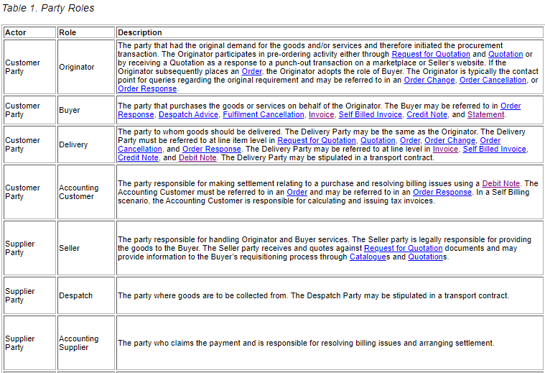
Party Roles in UBL
-3
“In the UBL supply chain processes, two main actors, Customer and Supplier, represent the key organizations or people involved in the processes. Each of these actors may play various roles. Some processes may also involve supplementary roles that may be provided by different parties.”
Only part of this table is quoted here.

Slide 24
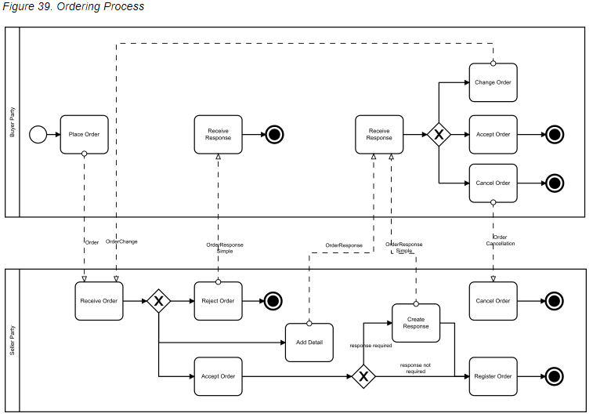

Order Process in UBL
-3
Ordering Business Rules
The Order may specify allowance and charge instructions (e.g., freight, documentation, etc.) that identify the type of charge and who pays which charges. The Order may be placed “on account” against a trading credit account held by the Seller, or against a credit/debit card account, or against a direct debit agreement. The Order allows for an overall currency defining a default for all pricing and also a specific currency to be used for Invoicing. Within an Order, additional currencies may be specified both for individual item pricing and for any allowances or charges.
Trade discount may be specified at the Order level. The Buyer may not know the trade discount, in which case it is not specified. This makes a detailed response from the Seller necessary; see Section 2.3.3.4.4, “Order Response”.
The Order provides for multiple Order Lines.
The Order may specify delivery terms, while the Order Line may provide instructions for delivery.
The Buyer may indicate potential acceptable alternatives.
Change
Order
Buyer Party
Place Order
Receive Response
Receive Response
Accept Order
Cancel
Order
Order
Order Response Simple
Order Response
Order Response Simple
Order Change
Order Cancellation
Receive Order
Reject
Order
Cancel
Order
Change
Response
Add
Detail
Response Required
Seller Party
Response Not Required
Accept
Order
Register
Order
Ordering is the collaboration that creates a contractual obligation between the Seller Supplier Party and the Buyer Customer Party.
Document types in these processes are Order, Order Response, Order Response Simple, Order Change, and Order Cancellation.
Only part of business process is quoted here.

Slide 25
Business Process defined in EN 16931
-2
Electronic Invoicing
- Semantic data model of the core elements of an electronic invoice
Core Invoice Usage Specification (CIUS)
and its invoicing service Open Peppol
-1 eXtensible Business Reporting Language (XBRL) 2.1

Slide 26
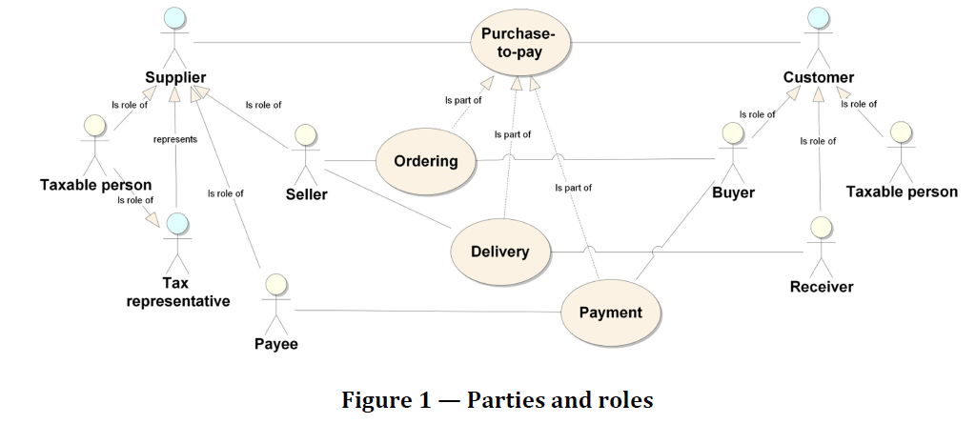
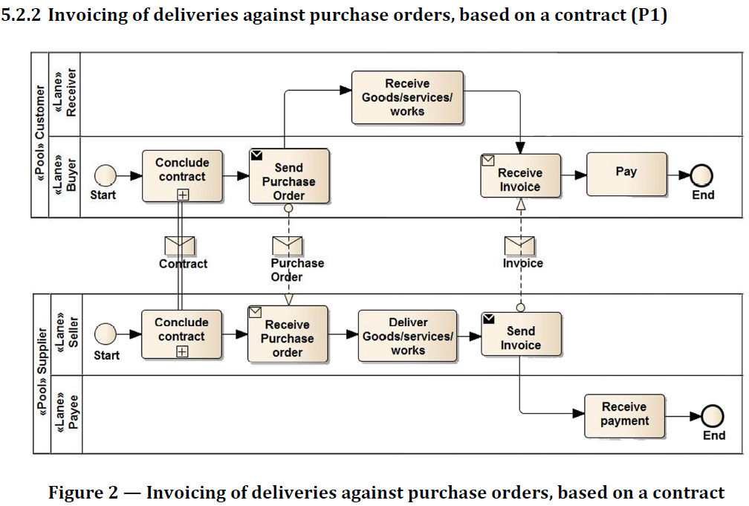
Parties, roles and business process in EN 16931-1
-2

Slide 27
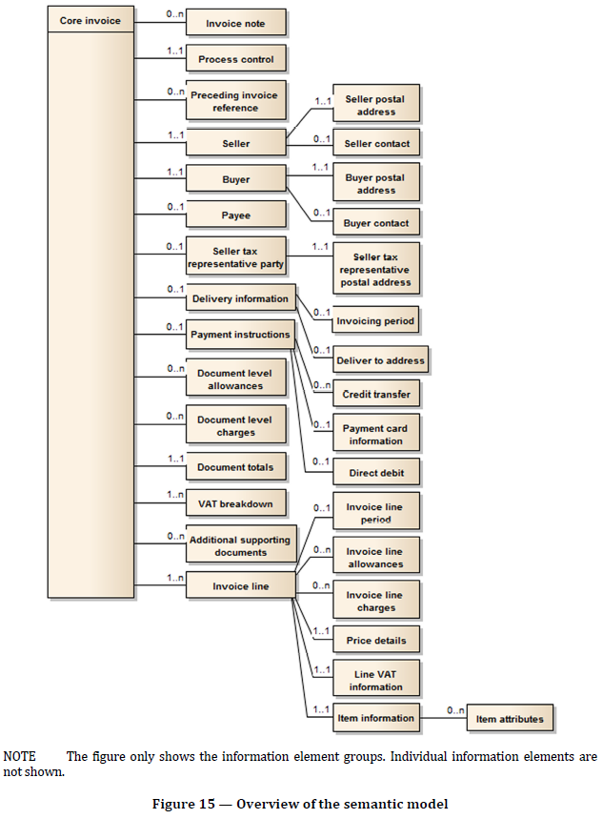
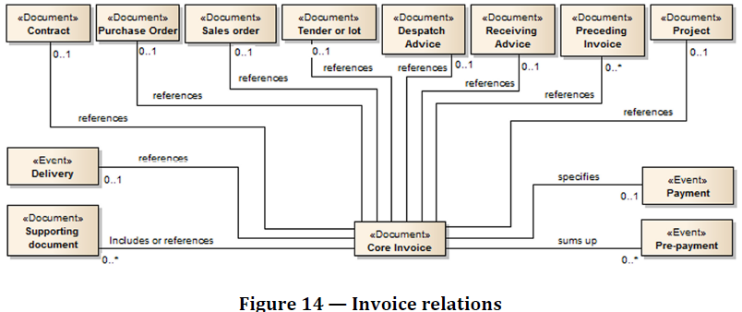
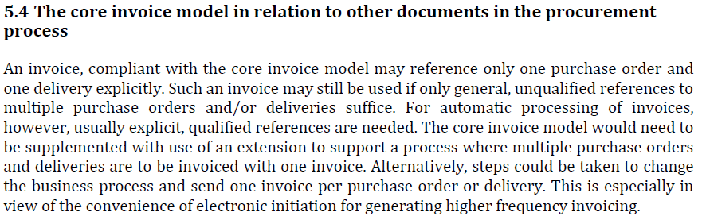
Overview of the semantic model of Core Invoice in EN 16931-1
-2

Slide 28
Example: Auditing requirement for Invoice
-2
Source: PEPPOL BIS Billing https://docs.peppol.eu/poacc/billing/3.0/bis/
Auditing requirements
Id | Requirement (depending, as applicable, on the respective business case)
R56 | sufficient information to support the auditing process with regard to: Identification of the invoice; Identification of the date of issue of the invoice; Identification of the products and services traded, including their description, value and quantity; Information for relating the invoice to its settlement; Information for relating the invoice to relevant documents such as a contract, a purchase order and a despatch advice;
R57 | identification of the parties that fulfil the following roles at the invoice level, including their legal name and address: The Seller (including the Seller’s trade name); The Buyer; The Deliver to party (if different from the Buyer); The Payee (if different from the Seller); The Tax representative of the Supplier;
Payment requirements
Id | Requirement (depending, as applicable, on the respective business case)
R58 | identification of the means of settlement;
R59 | the requested amount due for payment;
R60 | the date on which payment is due;
R61 | necessary details to support bank transfers in accordance with SEPA and national systems;
R62 | a reference number and any additional reference data to be included in the payment;
R63 | reference number and any additional reference data to be included in the payment, in order to relate the payment to the invoice;
R64 | information for relating an invoice to a payment card used for settlement;
R65 | basic information to support national payment systems for use in domestic trade;
R66 | information about the amount that was pre-paid;
R67 | invoices that have a total amount of zero;
R68 | invoices that have an amount to pay of zero;
R69 | necessary details to support direct debits.
R70 | pre-payment invoices

Slide 29
Example: Calculation of totals
-2
Source: PEPPOL BIS Billing https://docs.peppol.eu/poacc/billing/3.0/bis/
id | Term name | Calculation
BT-106 | Sum of invoice line net amounts | ∑(BT-131: Invoice line net amount)
BT-107 | Sum of allowances on document level | ∑(BT-92: Document level allowance amount)
BT-108 | Sum of charges on document level | ∑(BT-99: Document level charge amount)
BT-109 | Invoice total amount without VAT | BT-106: Sum of invoice line net amounts − BT-107: Sum of allowances on document + BT-108: Sum of charges on document level
BT-110 | Invoice total VAT amount | ∑(BT-117: VAT category tax amount)
BT-112 | Invoice total amount with VAT | BT-109: Invoice total amount without VAT + BT-110: Invoice total VAT amount
BT-115 | Amount due for payment | BT-112: Invoice total amount with VAT − BT-113: Paid amount + BT-114: Rounding amount

Slide 30
eXtensible Business Reporting Language (XBRL) 2.1
-1
An XBRL taxonomy defines the reporting concepts that may be used in instance documents and can also provide a wide range of structured meta-data about the concepts and how they should be used.

Slide 31

How to extend the new intermediate aggregation item
-1
Original
Extended
Item A
Item A
Link A-D
HOW TO EXTEND ?
Item D
Link A-B
Link A-C
Link D-B
Link D-C
XML Schema has NO answer.
Only XLink can solve this problem.
eXtensible Business Reporting language (XBRL)
Item B
Item C
Item B
Item C
31

Slide 32

XBRL style extension method Use of XLink in Taxonomy
-1
Item A
Item A
Extended
Item A
x
③ XLink
A-D
XLink
A-B
XLink
A-C
② Prohibit
XLink
A-B
x
②Prohibit XLink
A-C
① Item D
① Item D
③ XLink
D-B
③ XLink
D-C
Item B
Item C
Item B
Item C
Item B
Item C
Base
Base Taxonomy
XML Schema defines items
and XLink defines relationships
between items
Extended Taxonomy
Item A
Item B
Item C
Item A –XLink– Item B
Item A –XLink– Item C
XML Schema
① Item D
② Item A –XLink prohibit- Item B
② Item A –XLink prohibit- Item C
③ Item A –XLink– Item D
③ Item D –XLink– Item B
③ Item D –XLink– Item C
XLink
①Add Item D, ②Remove links, and ③Add links
32

Slide 33
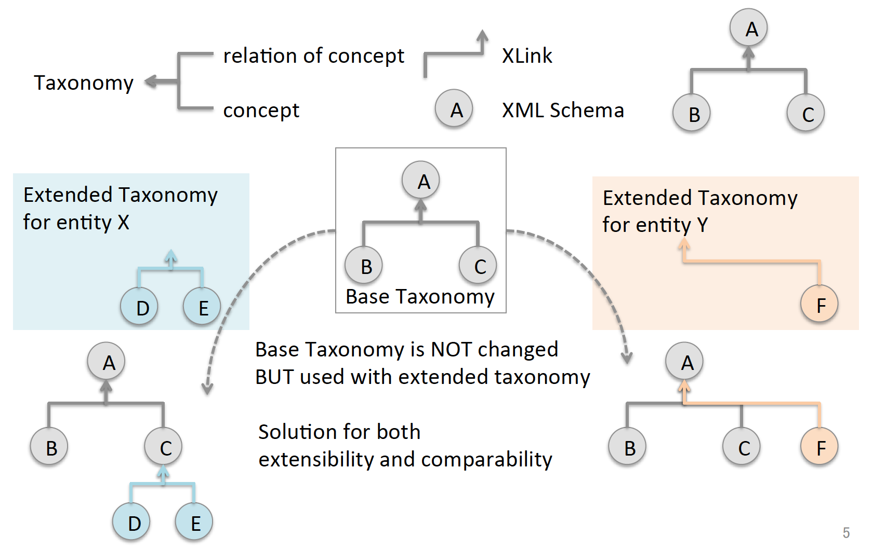
Extensibility and Comparability (contd.)
-1

Slide 34
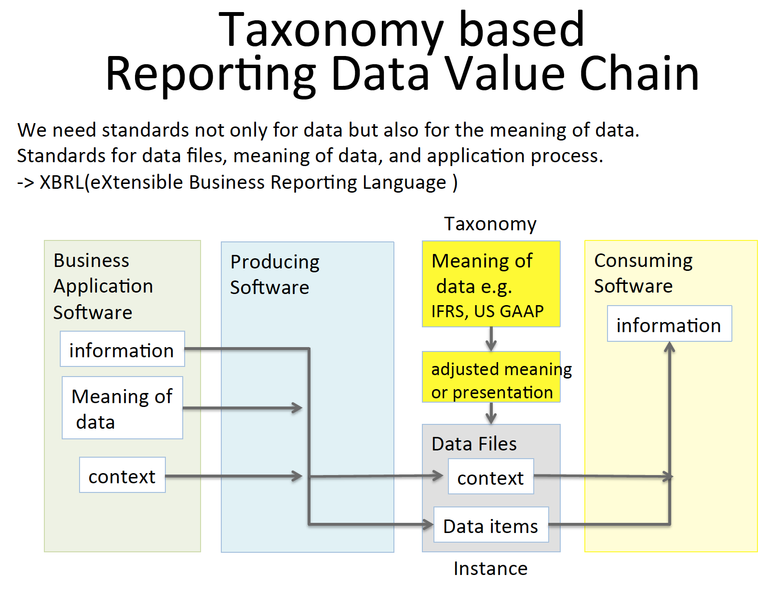
-1
34

Slide 35
XBRL Specifications
-1
An XBRL taxonomy defines the reporting concepts that may be used in instance documents and can also provide a wide range of structured meta-data about the concepts and how they should be used.
Meta-data that can be defined using the core specifications include:
Labels Taxonomies can provide a variety of different labels. For example, "standard labels" provide a general- purpose label for a concept, whereas "documentation labels" can provide a more verbose description defining the purpose of the concept. All labels can be provided in multiple languages.
References References provide structured meta-data, which can be used to provide links to authoritative reference material containing concept definitions.
Hierarchies Concepts can be arranged into hierarchies that provide an organized presentation of concepts in the taxonomy (presentation relationships) or that capture certain arithmetic relationships between them (calculation relationships).
Dimensions Taxonomies can use the specification to define hierarchies of dimensions that can be associated with concepts in order to report multi-dimensional data. Meta-data is primarily contained in linkbases, which form part of the taxonomy:
Linkbase A linkbase is an XML document that defines relationships using the W3C's XLink standard. Relationships are typically between concepts and other concepts, or between concepts and other resources such as labels. A number of additional specifications have been developed in order to further enhance the ability of XBRL to define and manage reporting requirements.
Internationalization and Translations
XBRL is an international standard and has been designed from the outset to support multiple languages and localized characters. All components in XBRL can be labelled in multiple languages, and the use of the linkbase mechanism makes it easy for third parties to define their own translations of taxonomies
Business rules validation
Reporting requirements often translate into business rules to which all reports are expected to conform. XBRL makes it possible for many of these rules to be defined and published in a standard format.
Source: Defining Reporting Requirements https://specifications.xbrl.org/reporting-requirements.html

Slide 36
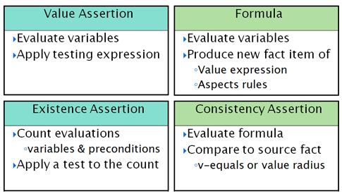
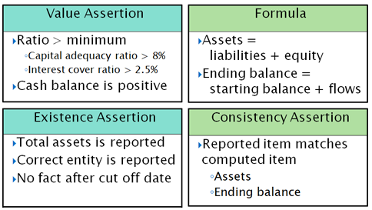
Formula Overview
-1
The first column has the value and existence assertions, which operate on the input XBRL instance data and provide evaluation feedback (as a boolean successful or not successful result, along with possible message detailing cause and ancillary data).
The right column has formula which provides a resulting output fact when it is processed, and below is consistency assertion, which is used when it is desired to compare the formula's output fact with a matching one expected in the input XBRL instance.
Simple examples of each of these four models
Source: https://www.xbrl.org/wgn/xbrl-formula-overview/pwd-2011-12-21/xbrl-formula-overview-wgn-pwd-2011-12-21.html

