Slide 1
New work item proposal Exchange formats for the Audit Data Collection Standard: XBRL
Semantic XBRL for Granular Data
SAMBUICHI, Nobuyuki
nobuyuki@sambuichi.jp
ISO/TC 295 Audit data services
Head of delegate Japanese Industrial Standards Committee (JISC)
April 19, 2021
19:00-21:00 Beijing time (GMT+8)

Slide 2
Meeting Agenda
1. Proposal on“Exchange formats for the Audit Data Collection Standard: XBRL”
presented by Mr. Nobuyuki Sambuichi
2. Discussions on data modeling
3. Other business

Slide 3
Exchange formats for the Audit Data Collection Standard: XBRL
Semantic data modeling and syntax binding for XBRL

Slide 4
Normative References
0
Business parties involved and their roles and relationships
Employee roles and activities
ISO/IEC 19505-1:2012 Information technology — Object Management Group Unified Modeling Language (OMG UML) — Part 1: Infrastructure
ISO/IEC 19505-2:2012 Information technology — Object Management Group Unified Modeling Language (OMG UML) — Part 2: Superstructure
Semantic datatypes
ISO/IEC 11179-4:2004 Information technology — Metadata registries (MDR) — Part 4: Formulation of data definitions
ISO/IEC 11179-5:2015 Information technology — Metadata registries (MDR) — Part 5: Naming principles
ISO 15000-5:2014 Electronic Business Extensible Markup Language (ebXML) — Part 5:
Core Components Specification (CCS)
Business processes
ISO/IEC 19845:2015 Information technology — Universal business language version 2.1 (UBL v2.1)
Business controls and audit trails
CEN EN 16931-1:2017+A1:2019 Electronic invoicing - Part 1: Semantic data model of the core elements of an electronic invoice
CEN/TS 16931-3-2:2020 Electronic invoicing - Part 3-2: Syntax binding for ISO/IEC 19845 (UBL 2.1) invoice and credit note

Slide 5
Bibliography
0
[1] Core Component Library, UN/CCL version 20A https://unece.org/trade/uncefact/unccl
[2] Extensible Business Reporting Language (XBRL) 2.1, Recommendation 31 December 2003 with errata corrections to 20 February 2013 http://www.xbrl.org/Specification/XBRL-2.1/REC-2003-12-31/XBRL-2.1-REC-2003-12-31+corrected-errata-2013-02-20.html
[3] XBRL Dimensions 1.0, Recommendation 18 September 2006 with errata corrections to 25 January 2012 https://www.xbrl.org/specification/dimensions/rec-2012-01-25/dimensions-rec-2006-09-18+corrected-errata-2012-01-25-clean.html
[4] XBRL Formula Overview 1.0, Public Working Draft 21 December 2011 https://www.xbrl.org/wgn/xbrl-formula-overview/pwd-2011-12-21/xbrl-formula-overview-wgn-pwd-2011-12-21.html
[5] Formula 1.0, Recommendation 22 June 2009 http://www.xbrl.org/Specification/formula/REC-2009-06-22/formula-REC-2009-06-22.html
[6] Open Information Model 1.0, Candidate Recommendation 16 February 2021, http://www.xbrl.org/Specification/oim/CR-2021-02-16/oim-CR-2021-02-16.html
[7] xBRL-XML: XML Mappings for the Open Information Model 1.0, Candidate Recommendation 16 February 2021 http://www.xbrl.org/Specification/xbrl-xml/CR-2021-02-16/xbrl-xml-CR-2021-02-16.html
[8] xBRL-CSV: mapping from Open Information Model 1.0, Candidate Recommendation 3 February 2021 https://www.xbrl.org/Specification/xbrl-csv/CR-2021-02-03/xbrl-csv-CR-2021-02-03.html
[9] Open Information Model 1.0, Candidate Recommendation 14 October 2020 https://www.xbrl.org/Specification/oim/CR-2020-10-14/oim-CR-2020-10-14.html
[10] XBRL Global Ledger Taxonomy Framework 2017, Public Working Draft 01 December 2016 https://www.xbrl.org/int/gl/2016-12-01/gl-framework-2017-PWD-2016-12-01.html

Slide 6
Semantic data modeling and syntax binding for XBRL
0
TC 295 is intended for stakeholders, including tax and financial reporting regulators who already require reporting in XBRL format.
The syntactic binding of granular audit data to XBRL helps these stakeholders collect data in a consistent manner.
Semantic XBRL for Granular Data

Slide 7
Semantic XBRL for Granular Data
0
Even if unusual signs can be detected from machine learning patterns in the data exchanged, it is difficult to explain what the problem is and deal with it.
What do you think if you were arrested for accounting fraud and when asked why you were told that AI had decided so?
Semantic XBRL can be used to define firm business rules as internal control, detect abnormalities against them, deal with problems, and, depending on the type of problem, improve internal control rules.

Slide 8
Exchange formats for the Audit Data Collection Standard: XBRL
0
1. Parties involved and their roles and relationships
2. Employee roles and user activities
3. Business processes
4. Business controls and audit trails
5. Semantic data modeling
6. Business rules
7. Syntax binding for XBRL

Slide 9
1. Parties involved and their roles and relationships

Slide 10
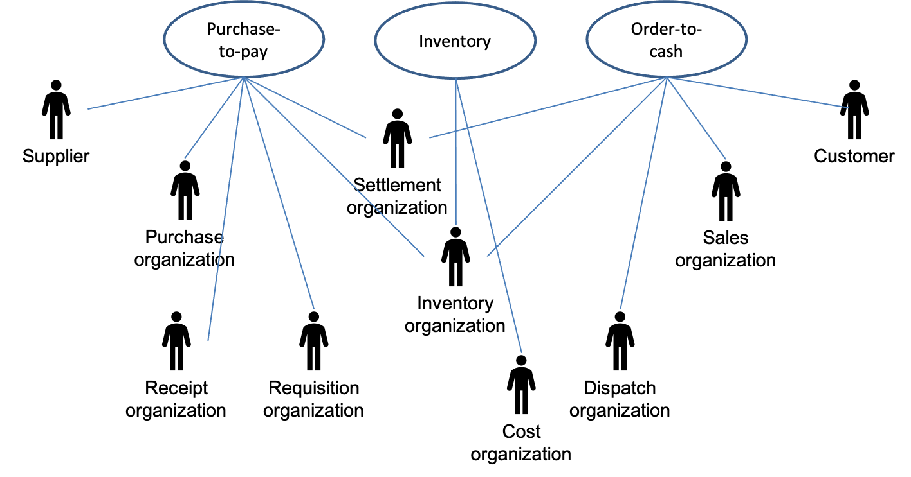
Parties involved and their roles and relationships
1
For example, EN 16931 defines following party and roles.
Parties
Customer The customer is the legal person or organization who is in demand of a product or service.
Supplier The supplier is the legal person or organization who provides a product or service.
Roles
Creditor One to whom a debt is owe. The party that claims the payment and is responsible for resolving billing issues and arranging settlement. The party that sends the invoice or credit note.
Debtor One who owes debt. The party responsible for making settlement relating to a purchase. The party that receives the invoice or credit note.

Slide 11
2. Employee roles and user activities

Slide 12
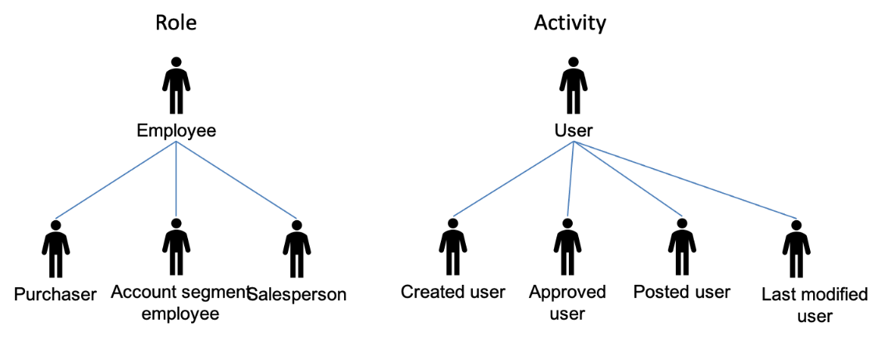
Employee roles and user activities
2
The users managing the ERP system shall have unique identification data, enabling job identification and authentication of the users. The identification and authentication data shall be revoked without delay in case of the cessation of user rights. Each employee shall have the necessary education, practice and professional experience for the provision of his scope of activities.
The party shall log every transactional event that can provide information on activity, changes happened in the ERP system, every verification activity performed related to transaction and / or accounting.
In case of every log entry, the following data shall be stored:
the date and time of the activity;
the type of the event;
the success or failure of the implementation;
the identification of the user or the system who/what triggered the event

Slide 13
3. Business processes

Slide 14
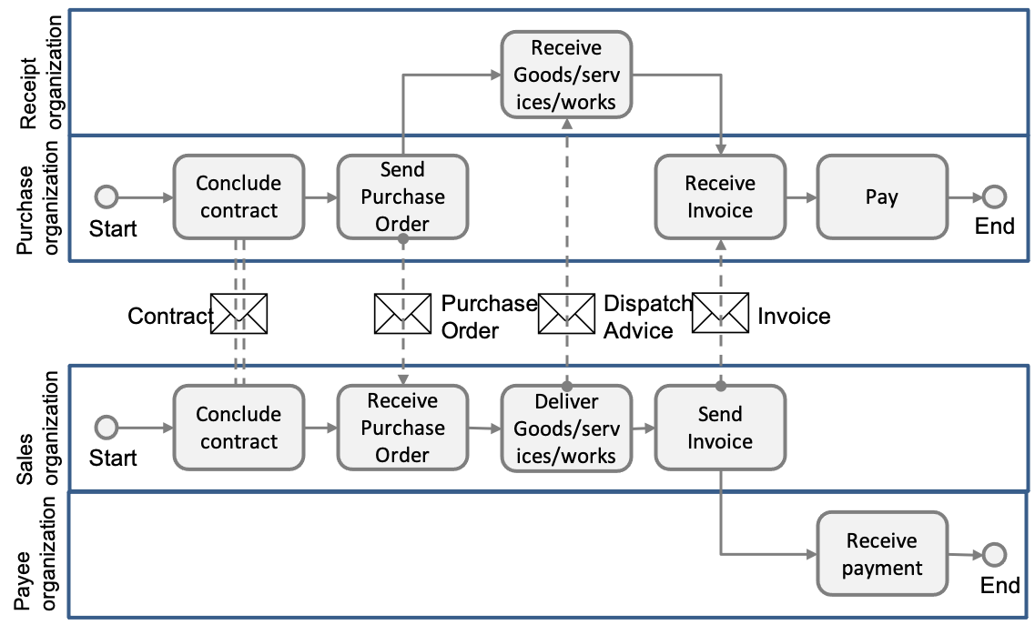
Business processes
3
Invoicing of deliveries against purchase orders, based on a contract
In this process the Buyer and the Seller conclude a formal contract (or there is an assumed contract by legal definition) in which the terms and conditions are stated under which goods and services will be delivered and are paid for. The Buyer orders the goods and services, stating the specifications for goods and services, the quantities and the place and time for delivery. The Seller delivers the ordered goods and services to the Receiver as specified on the purchase order. This delivery is then invoiced by the Seller to the Buyer. Finally, the Buyer pays the Payee.

Slide 15
4. Business controls and audit trails

Slide 16
Definitions
4
Business Control
The COSO Model defines “business control” as:
a process, effected by an entity’s board of directors, management and other personnel, designed to provide reasonable assurance regarding the achievement of objectives in effectiveness and efficiency of operations, reliability of financial reporting, and compliance with applicable laws and regulations.
Audit Trail
An audit trail is:
a paper and/or electronic record that gives a step by step documented history of a transaction, which can validate or invalidate accounting entries. Components of an audit trail include:
(i) source records,
(ii) list of transactions processed and
(iii) transaction identifiers so that reference can be made to the source of a transaction.
Source: CEN WORKSHOP AGREEMENT CWA 16460 May 2012 Good Practice: e-Invoicing Compliance Guidelines - The Commentary

Slide 17
Business controls and audit trails
4
An electronic record of each of these events will usually be created in the ERP system. This record may directly contain values relating to the event, e.g. quantities, or reference master data to provide or derive content, e.g. pricing. It is this record of the sequence of events in the process that contributes to an audit trail. An audit trail will consist of documents outside the ERP and a transaction record within the ERP. For example, the audit trail for the ‘procure-to-pay’ cycle will often take the following form.
Procure-to-Pay
This represents the process that supports purchase of goods or services where the 3-way match control is implemented, typically: purchase order → goods received note → purchase invoice → payment.
Left is the equivalent audit trail for an ‘order-to-cash’ cycle.
ERP Transaction Record
Purchase Order
Goods Received Note
Invoice
Payment
External Documents
Purchase Order
Dispatch Advice
Invoice
Bank Statement
External Documents
Sales Order
Goods Dispatch Note
Invoice
Receipt
ERP Transaction Record
Order-to-Cash
Source: CEN WORKSHOP AGREEMENT CWA 16460 May 2012 Good Practice: e-Invoicing Compliance Guidelines - The Commentary
Partially modified by SAMBUICHI, Nobuyuki

Slide 18
5.1. Extend Core Components Specification definition for audit data collection
5. Semantic data modeling

Slide 19
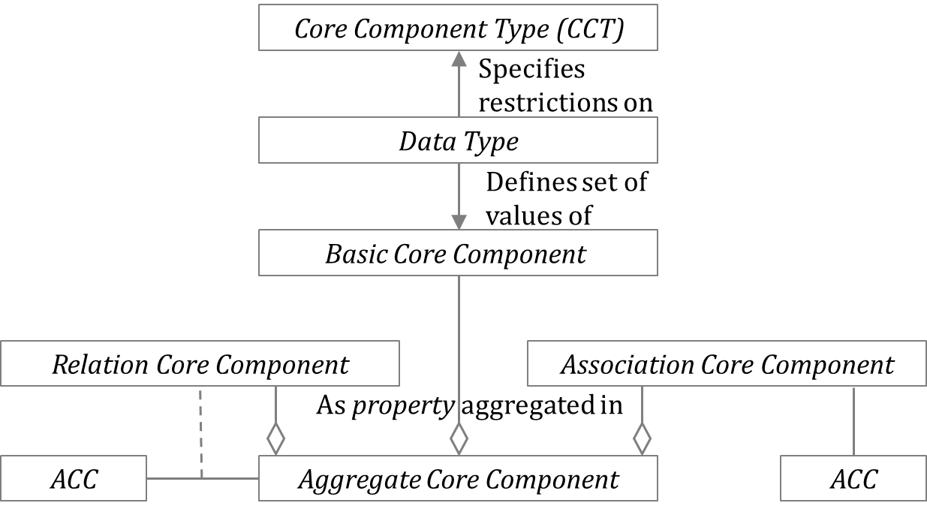
Extend Core Components
5.1
Semantic data modeling of ADS is based on the Core Components Specification (CCS) defined in ISO 15000-5 Electronic Business Extensible Markup Language (ebXML) — Part 5: Core Components Specification (CCS).
Add 2 categories of Core Components:
- Basic Core Component (BCC);
- Association Core Component (ASCC);
- Core Component Type (CCT);
- Aggregate Core Component (ACC);
a) Identifier Core Component (IDCC); and
b) Relation Core Component (RLCC).
NOTE Audit data collection requires a concept to clearly define the relationships between ACCs using identifier (primary key) and reference identifier.

Slide 20
Extend Semantic data types
5.1
Primitive types
Semantic data type content may be of the following primitive types. These primitive types were taken from ISO 15000-5:2014, Annex A.
Semantic data types
The different semantic data types are described in the tables below, where various features such as attributes, format, and decimals as well as the basic type are defined for each semantic data type. They are based on ISO 15000-5:2014
Add new Semantic data type
Reference Identifier
Primitive type | Definition
Binary | A set of finite-length sequences of binary digits.
Date | Time point representing a calendar day on a time scale consisting of an origin and a succession of calendar ISO 8601:2004.
Decimal | A subset of the real numbers, which can be represented by decimal numerals.
String | A finite sequence of characters.
Amount
Code
Date
Identifier
Numeric
Quantity
Reference Identifier
Text
The same

Slide 21
Extend Semantic data types Reference Identifier
5.1
Add new semantic data type Reference Identifier
Semantic data type | Component | Primitive Type | Description
Reference Identifier | Identifier. Content | String | Reference Identifiers (IDs) are identifiers that were assigned to a document or document line to reference another document or document line.
 | Identification Scheme. Identifier | String
 | Identification Scheme Agency. Identifier | String
 | Identification Scheme. Version. Identifier | String

Slide 22
Extend naming rules for Dictionary Entry Name
5.1
The following naming rules are extended to the rules defined in ISO 15000-5.
[R3] The Dictionary Entry Name of a Relation Core Component shall consist of the following parts in the order specified:
— the Object Class Term of the Aggregate Core Component owning the corresponding Association Core Component Property;
— the Property Term of the corresponding Relation Core Component Property;
— the Object Class Term of the Aggregate Core Component to which the corresponding Relation Core Component is referencing.

Slide 23
5.2. Core Components
5. Semantic data modeling

Slide 24
Legend
5.2
No | CC | Business Term | Definition | ID | Dictionary Entry Name
Each information element that constitutes the semantic data model of the Core Components is described as a row in the table documented in the following sub-clause where the following information is provided.
No: A sequence number for the information element.
CC: Specifies which category of Core Component the information element belongs to.
ACC: Aggregate Core Component
ASCC: Association Core Component
BCC: Basic Core Component
IDCC: Identifier Core Component
RLCC: Relation Core Component
Business Term: A synonym used in business where a Core is commonly known.
Definition: A definition of the information element.
ID: A unique identifier uniquely assigned by the United Nations are numberd UNnnnnnnnn.
The Core Components defined in this standard are numberd ADCS-nnnnn.
Dictionary Entry Name: A unique official name of a Core Component registered by the United Nations. If there is no corresponding registered information element, named according to the naming convention defined in ISO 15000-1.

Slide 25
Extension Methodology
5.2
This standard defines extendable Core Component with [ ].
Following is an example definition of Basic Core Component in Code.Detail. We can define the "Function Code" by replacing [Specified] with "Function" and resulting Dictionary Entry Name is "Code. Function. Code".
EXAMPLE Base definition
No | CC | Business Term | Definition | ID | Dictionary Entry Name
 | BCC | [Specified] Code | A [Specified] code of this code. |  | Code. [Specified]. Code
EXAMPLE Extended definition
No | CC | Business Term | Definition | ID | Dictionary Entry Name
 | BCC | Function Code | A Function code of this code. |  | Code. Function. Code

Slide 26
Relation Core Component [New]
5.2
Although UN/CEFACT Core Component Library contains little ACC which contains BCC specifying reference identifier for another ACC, Audit data requires relationship among documents based on identifiers.
Core Components for Code
No | CC | Business Term | Definition | ID | Dictionary Entry Name
0 | ACC | Code | A code. | ADCS-00008 | Code. Details
1 | RLCC | Parent ID | A reference identifier for the parent code. | ADCS-00009 | Code. Parent. Code
2 | IDCC | Code ID | A unique identifier for this code. A code of this code. | ADCS-00010 | Code. Identification. Identifier
3 | BCC | Name | A name, expressed as text, of this code. | ADCS-00011 | Code. Name. Text
4 | BCC | Description | A description, expressed as text, for this code. | ADCS-00012 | Code. Description. Text
Parent ID
Code ID
Name
Description
Parent
Code
Parent ID
Code ID
Name
Description
Code

Slide 27
Document and line item
5.2
There are two types of business documents. One is a list of data and the other is a header and line item.
The list of data includes customer masters, supplier masters, subledgers such as accounts payable, trial balance and journal entries.
Most business transactions consist of headers and list items.
There are two ways to represent a business document that consists of headers and line items:
One is a format in which the header contains line items and is expressed in single document.
The other is to represent it as two documents, a header document and a line-item document.

Slide 28
Two approaches to represent Header and Line items
5.2
Header
H1 | D11 | D12
H2 | D21 | D22
Line item
L1 | L1a | L1b
L2 | L2a | L2b
L3 | L3a | L3b
L4 | L4a | L4b
L5 | L5a | L5b
Transaction documents
Semantic model
Header
Line item
identifier
reference identifier
ID | d1 | d2 | Association
 |  |  | L_id | La | L2
H1 | D11 | D12
H1 |  |  | L1 | L1a | L1b
H1 |  |  | L2 | L2a | L2b
H2 | D21 | D22
H2 |  |  | L3 | L3a | L3b
H2 |  |  | L4 | l4a | L4b
H2 |  |  | L5 | L5a | L5b
Header
Line item
RL | L_id | La | Lb
H1 | L1 | L1a | L1b
H1 | L2 | L2a | L2b
H2 | L3 | L3a | L3b
H2 | L4 | L4a | L4b
H2 | L5 | L5a | L5b
ID | d1 | d2
H1 | D11 | D12
H2 | D21 | D22
Two instances bound by the relationship between the reference identifier and the identifier.
Single instance

Slide 29
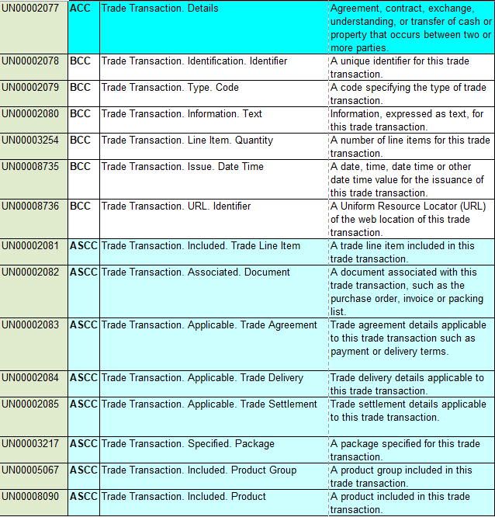
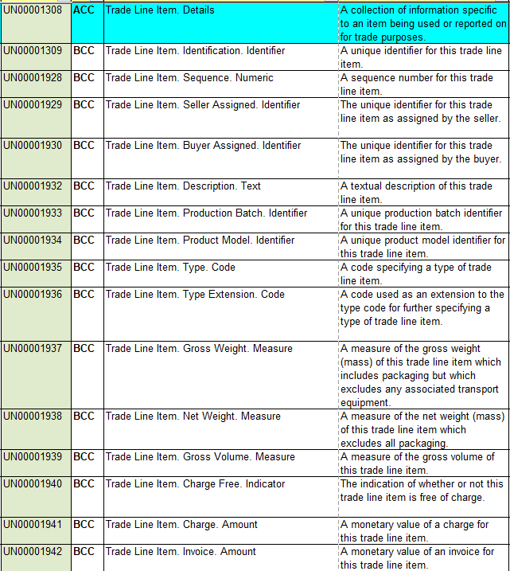
Step 1 Select Trade Transaction (UN00002077) & Trade Line Item (UN00001308)
5.2
“TradeTransaction” and “TradeLine Items” are Aggregate Core Components selected from the 2020 version of the Core Component Library (CCL). The CCL is defined by UN/CEFACT. CCL contains 596 Aggregate Core Components and over 8,000 Core Components.

Slide 30
Step 2 Extend CCL in ADCS Trade Transaction (ADCS-00152) & Trade Line Item (ADCS-00160)
5.2
No | CC | Business Term | Definition | Dictionary Entry Name
0 | ACC | Trade Transaction |  | Trade Transaction. Details
1 | IDCC | Trade Transaction ID | A unique identifier for this trade transaction. | Trade Transaction. Identification. Identifier
2 | BCC | Type Code | A code specifying the type of trade transaction. | Trade Transaction. Type. Code
5 | BCC | Issue Date | A date, time, date time or other date time value for the issuance of this trade transaction. | Trade Transaction. Issue. Date Time
12 | ASCC | Specified Period | A period specified in this trade transaction. | Trade Transaction. Defined. Period
13 | ASCC | [Specified] Monetary Value | A monetary value [specified] in this trade transaction. | Trade Transaction. [Spedified]. Monetary Value
14 | ASCC | Trade Line Item | A trade line item included in this trade transaction. | Trade Transaction. Included. Trade Line Item
No | CC | Business Term | Definition | Dictionary Entry Name
0 | ACC | Trade Line Item |  | Trade Line Item. Details
1 | RLCC | Trade Transaction ID | A specified reference identifier for trade transaction including this trade line item. | Trade Line Item. Header. Trade Transaction
2 | IDCC | Trade Line Item ID | A unique identifier for this trade line item. | Trade Line Item. Identification. Identifier
3 | BCC | Sequence Number | A sequence number for this trade line item. | Trade Line Item. Sequence. Numeric
65 | BCC | Tax excluded Amount | A tax excluded amount for this trade line item. | Trade Transaction. Tax Excluded. Amount
65 | BCC | Tax Included Amount | A tax included amount for this trade line item. | Trade Transaction. Tax Included. Amount
67 | BCC | Transaction Amount | An amount for this trade line item intarnsaction currency. | Trade Transaction. Transaction Currency. Amount
40 | ASCC | Accounting Account | An accounting account for this trade line item. | Trade Line Item. Account. Accounting Account
Add #13 “[Specified] Monetary Value” in “Trade Transaction” (ADCS-00152) to record monetary values.
Add #1 “Trade Transaction ID” in “Trade Line Item” (ADCS-00160) to specify the reference identifier for “Trade Transaction” including this “Trade Line Item”.

Slide 31
5.3. Business Information Entities
5. Semantic data modeling

Slide 32
Legend
5.3
No | BIE | D | Business Term | Semantic data type | O | Description | Dictionary Entry Name
Each information element that constitutes the semantic data model of the Business Information Entity is described as a row in the table documented in the following sub-clause where the following information is provided.
No: A sequence number for the information element.
BIE: Specifies which category of Business Information Entity the information element belongs to.
ABIE: Aggregate Business Information Entity
ASBIE: Association Business Information Entity
BBIE: Basic Business Information Entity
IDBIE: Identifier Business Information Entity
RLBIE: Relation Business Information Entity
D: Depth. Indicates on which depth in the model the information element occurs:
0: The first depth of the model;
1: the second depth of the model. The information element (or the group of information elements) is part of a group of information elements which is defined at the first depth of the model.
2: the third depth of the model. The information element (or the group of information elements) is part of a group of information elements which is defined at the second depth of the model.
3: the fourth depth of the model. The information element (or the group of information elements) is part of a group of information elements which is defined at the third depth of the model.
Business Term: A synonym used in business where a Business Information Entity is commonly known.
Semantic data type: The data format that applies to the information element.
O: Occurence
Description: A description of the information element.

Slide 33
Base architecture type A ASBIE for line items
5.3
In the first method, the line items are defined as ASBIE in the header ABIE. The following example illustrates this approach.
No | BIE | D | Business Term | Semantic data type | O | Description | Dictionary Entry Name
0 | ABIE | 0 | Header | — | — | The document header. | ADS Header_ Trade Transaction. Details
1 | IDBIE | 1 | Header ID | Identifier | 1..1 | The unique identifier for the he document header. | ADS Header_ Trade Transaction.
x | ASBIE | 1 | Line Item | —. | 1..n | line items of this document | ADS Header_ Trade Transaction. Defined. ADS Line Item_ Trade Line Item
x+1 | IDBIE | 2 | Line Item ID | Identifier | 1..1 | The unique identifier for the document line item. | ADS Line Item_Trade Line Item. Identification. Identifier
No | BIE | D | Business Term | Semantic data type | O | Description | Dictionary Entry Name
0 | ABIE | 0 | Line Item | — | — | The document line item. | ADS Line Item_ Trade Line Item. Details
1 | IDBIE | 1 | Line Item ID | Identifier | 1..1 | The unique identifier for the document line item. | ADS Line Item_Trade Line Item. Identification. Identifier

Slide 34
Base architecture type B RLBIE for the header
5.3
In the second method, the line-item ABIE contains the RLBIE for the header ABIE . In such cases, there are two lists. One is a list of headers and the other is a list of line items.
No | BIE | D | Business Term | Semantic data type | O | Description | Dictionary Entry Name
0 | ABIE | 0 | Header | — | — | The document header. | ADS Header_ Trade Transaction. Details
1 | IDBIE | 1 | Header ID | Identifier | 1..1 | The unique identifier for the document header. | ADS Header_ Trade Transaction.
No | BIE | D | Business Term | Semantic data type | O | Description | Dictionary Entry Name
0 | ABIE | 0 | Line Item | — | — | The document line item. | ADS Line Item_ Trade Line Item. Details
1 | RLBIE | 1 | Header ID | Reference identifier | 1..1 | The reference identifier for the document header. | ADS Line Item_Trade Line Item. Header. ADS Header_ Trade Transaction
2 | IDBIE | 1 | Line Item ID | Identifier | 1..1 | The unique identifier for the document line item. | ADS Line Item_Trade Line Item. Identification. Identifier

Slide 35
Extend Trade Transaction and Trade Line Item Invoices Received & Line Item
5.3
Syntax mappings to physical files are defined from business information entities.
No | BIE | D | Business Term | Semantic data type | O | Dictionary Entry Name
0 | ABIE | 0 | Invoices Received | — | — | ADS Invoices Received_ Trade Transaction. Details
1 | IDBIE | 1 | Invoice ID | Identifier | 1..1 | ADS Invoices Received_ Trade Transaction. Identification. Identifier
2 | BBIE | 1 | Invoice Number | Text | 1..1 | ADS Invoices Received_ Trade Transaction. Number_ Information. Text
3 | ASBIE | 1 | Period | — | 1..1 | ADS Invoices Received_ Trade Transaction. Defined. ADS_ Fiscal Period
4 | BBIE | 2 | Fiscal Year | Numeric | 1..1 | ADS_ Fiscal Period. Fiscal Year. Code
5 | BBIE | 2 | Accounting Period | Code | 1..1 | ADS_ Fiscal Period. Accounting ADS_ Period. Code
6 | BBIE | 1 | Official Invoice Code | Code | 0..1 | ADS Invoices Received_ Trade Transaction. Official. Code
No | BIE | D | Business Term | Semantic data type | O | Dictionary Entry Name
0 | ABIE | 0 | Invoices Received Line Item | — | — | ADS Invoices Received_ Trade Line Item. Detail
1 | RLBIE | 1 | Invoice ID | Reference Identifier | 1..1 | ADS Invoices Received_ Trade Line Item. Header. ADS Invoices Received_ Trade Transaction
2 | IDBIE | 1 | Invoice Line ID | Identifier | 1..1 | ADS Invoices Received_ Trade Line Item. Identification. Identifier
3 | BBIE | 1 | Sequence Number | Numeric | 0..1 | ADS Invoices Received_ Trade Line Item. Sequence. Numeric
4 | RLBIE | 1 | Purchase Order ID | Reference Identifier | 1..1 | ADS Invoices Received_ Trade Line Item. Defined. ADS Purchase Order_ Trade Transaction
5 | RLBIE | 1 | Purchase Order Line ID | Reference Identifier | 1..1 | ADS Invoices Received_ Trade Line Item. Defined. ADS Purchase Order_ Trade Line Item
6 | ASBIE | 1 | Product | — | 1..1 | ADS Invoices Received_ Trade Line Item. Defined. ADS_ Product
7 | IDBIE | 2 | Product ID | Identifier | 1..1 | ADS_ Product. Identification. Identifier
8 | BBIE | 2 | Unit of Measurement Code | Code | 1..1 | ADS_ Product. Measurement. Code
11 | BBIE | 2 | Basic UOM Quantity | Quantity | 0..1 | ADS_ Product. Basic UOM. Quantity
12 | RLBIE | 2 | Basic UOM Code | Reference Identifier | 0..1 | ADS_ Product. Defined. ADS Measurement Unit_ Code
20 | ASBIE | 1 | Created Activity | — | 0..1 | ADS Invoices Received_ Trade Transaction. Specified. ADS Created_ Activity
21 | BBIE | 2 | Created Date | Date | 1..1 | ADS_ Created_ Activity. Occurred. Date
22 | BBIE | 2 | Created Time | Time | 0..1 | ADS_ Created_ Activity. Occurred. Time
38 | RLBIE | 1 | Business Segment [X]ª | Reference Identifier | 1..1 | ADS Invoices Received_ Trade Transaction. [X]. ADS Business Segment_ Code
39 | ASBIE | 1 | Invoices Received Line Item | — | 0..n | ADS Invoices Received_ Trade Transaction. Defined. ADS Invoices Received_ Trade Line Item. Detail

Slide 36
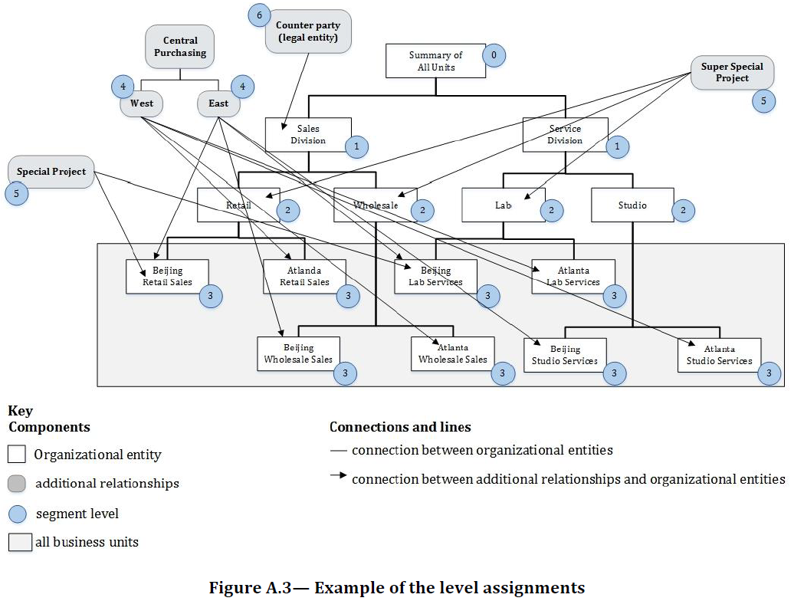
Another example extend Code ISO 21378:2019 Annex A Business Segment
5.3

Slide 37

Business Segment Code
5.3
No | BIE | D | Business Term | O | Dictionary Entry Name
0 | ABIE | 0 | Business Segment | — | ADS Business Segment_ Code. Details
1 | IDBIE | 1 | Business Segment ID | 1..1 | ADS Business Segment_ Code. Identification. Identifier
2 | BBIE | 1 | Organization Type | 1..1 | ADS Business Segment_ Code. Organization Type. Code
3 | BBIE | 1 | Business Segment Code | 1..1 | ADS Business Segment_ Code. Business Segment Code
4 | BBIE | 1 | Name | 1..1 | ADS Business Segment_ Code. Name. Text
5 | BBIE | 1 | Reference Level Code | 1..1 | ADS Business Segment_ Code. Reference Level Code
6 | RLBIE | 1 | Parent ID | 0..1 | ADS Business Segment_ Code. Parent. ADS Business Segment_ Code
BS-1
ID | Organization Type | Code | Name | L | Parent ID
BS-1 | Consolidated business |  | All Units Segment | 0
BS-2 | Division | 100 | Sales Division Segment | 1 | BS-1
BS-3 | Division | 200 | Service Division Segment | 1 | BS-1
BS-4 | Department | 110 | Retail Segment | 2 | BS-2
BS-5 | Department | 120 | Wholesale Segment | 2 | BS-2
BS-6 | Department | 210 | Lab Segment | 2 | BS-3
BS-7 | Department | 220 | Studio Segment | 2 | BS-3
BS-8 | Business Unit | 111 | Beijing Retail Sales Segment | 3 | BS-4
BS-9 | Business Unit | 112 | Atlanta Retail Sales Segment | 3 | BS-4
BS-10 | Business Unit | 121 | Beijing Wholesale Sales Segment | 3 | BS-5
BS-11 | Business Unit | 122 | Atlanta Wholesale Sales Segment | 3 | BS-5
BS-12 | Business Unit | 211 | Beijing Lab Services Segment | 3 | BS-6
BS-13 | Business Unit | 212 | Atlanta Lab Services Segment | 3 | BS-6
BS-14 | Business Unit | 221 | Beijing Studio Services Segment | 3 | BS-7
BS-15 | Business Unit | 222 | Atlanta Studio Services Segment | 3 | BS-7
BS-16 | Purchasing Org | West | Central Purchasing West Segment | 4
BS-17 | Purchasing Org | East | Central Purchasing East Segment | 4
BS-18 | Project | A123 | Special Project Segment | 5
BS-19 | Project | C543 | Super Special Project Segment | 5
BS-20 | Legal Entity | 43278 | Counterparty Segment | 6
100
BS-2
200
BS-3
110
BS-4
120
BS-5
210
BS-6
220
BS-7
111
BS-8
112
BS-9
121
BS-10
211
BS-12
221
BS-14
122
BS-11
212
BS-13
222
BS-15

Slide 38
6. Business rules

Slide 39
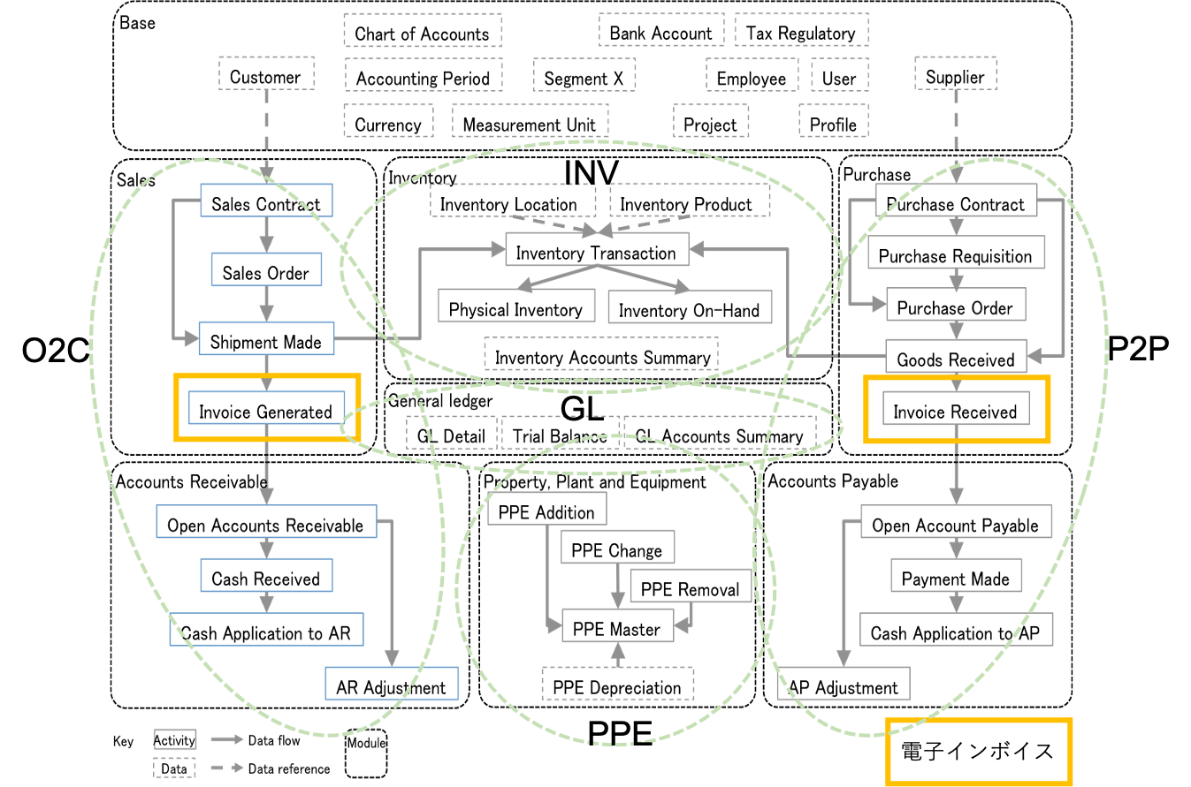
ISO 21378:2019 Audit data collection
6
Electric Invoice

Slide 40
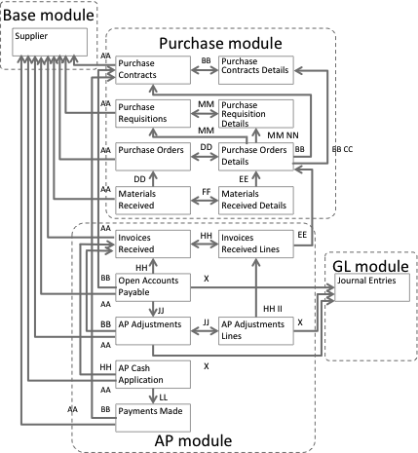
Procure to pay
6
AA Supplier BB Purchase Contract ID DD Purchase Order ID FF Materials Receipt ID HH Invoice ID JJ AR Adjustment ID LL Payment ID NN Requisition Line ID | CC Purchase Contract Line ID EE Purchase Order Line ID GG Materials Receipt Line ID II Invoice Line ID KK AR Adjustment Line ID MM Requisition ID X GL Detail ID

Slide 41
Procure to Pay (3-way matching)
6
No | Audit Trail | Invoice Component
 |  |  | Integrity
 |  | Authenticity | VAT ID Supplier | Supplier (Name & Address) | VAT ID Customer | Customer (Name & Address) | Invoice Date | Date of Supply | Invoice Number | Nature of Supply | Quantity | Taxable Amount | VAT Rate | VAT Amount | Currency
 |  |  | a | b | c | d | e | f | g | h | i | j | k | l | m
1 | Purchase Contract | 3001 |  | 3001 | 3007 | 3007 |  |  |  | 3012 |  | 3017 |  |  | 3021
2 | Purchase Order | 3002 |  | 3005 | 3008 | 3008 |  |  |  | 3013 | 3015 | 3018 |  |  | 3022
3 | Goods / Service Received Note |  |  |  |  |  |  | 3010 |  | 3014 | 3016
4 | Invoice |  |  |  |  |  | 3009
5 | Payment | 3005 |  | 3006 |  |  |  |  | 3011 |  |  | 3019 |  | 3020 | 3023
Audit Trail Contribution to Authenticity and Integrity in Purchasing Processes.

Slide 42
Business rules for P2P 3-way match
6
Invoice Component | No | Audit Trail | Rule ID | Audit trail component contribution to Integrity
Authenticity | 1 | Purchase Contract | P2P-3001 | Will identify the supplier for a particular supply.
 | 2 | Purchase Order | P2P-3002 | Will identify the supplier for a particular supply.
 | 5 | Payment | P2P-3003 | Will identify the supplier for a particular supply.
a) VAT ID Supplier b) Supplier (Name & Address) | 1 | Purchase Contract | P2P-3001 | Will identify the supplier for a particular supply.
 | 2 | Purchase Order | P2P-3005 | Business records will contain a supplier account reference providing a link back to ERP supplier master data.
 | 5 | Payment | P2P-3006 | Payments allocated to invoices will identify the payee.
c) VAT ID Customer d) Customer (Name & Address) | 1 | Purchase Contract | P2P-3007 | Purchase contract will identify the purchasing company.
 | 2 | Purchase Order | P2P-3008 | Purchase order will identify the purchasing company.
e) Invoice Date | 4 | Invoice | P2P-3009 | There will be a correlation between invoice date and posting date of the invoice record in the ERP.
f) Date of Supply | 3 | Goods / Service Received Note | P2P-3010 | Date of goods / service receipt will correlate with the date of supply.
g) Invoice Number | 5 | Payment | P2P-3011 | Payment remittance advice may reference invoice number.
h) Nature of Supply | 1 | Purchase Contract | P2P-3012 | Will contain a record of what is to be supplied.
 | 2 | Purchase Order | P2P-3013 | Will contain a record of what is to be supplied.
 | 3 | Goods / Service Received Note | P2P-3014 | Will contain a record of what has been supplied.
i) Quantity | 2 | Purchase Order | P2P-3015 | Will contain a record of quantity requested.
 | 3 | Goods / Service Received Note | P2P-3016 | Will contain a record of quantity delivered.
Authenticity and Integrity in a Procure-to-Pay (goods 3-way matching) Cycle.

Slide 43
7. Syntax binding for XBRL
Semantic XBRL for Granular Data

Slide 44
7. Syntax binding for XBRL
7
7.1 Audit data binding for XBRL taxonomy
Enable extension based on jurisdictional and/or agency requirements
Internationalization
7.2 Business rules
Validation with formula linkbase
Business rules
Integrity constraints
data profiling report
data questionnaire
7.3 Syntax binding for xBRL-XML
7.4 Syntax binding for xBRL-CSV

Slide 45
XBRL can define computer-readable business rules for data profiling report and data questionnaire in ISO 21378, as well as more general rules for business processes.
7
Data profiling report
AR standard data questionnaire
c) Are ARs tracked by customer invoice or in aggregate for the customer?
d) How are partial payments processed? Is the original invoice retained in the subledger with a remaining balance due when a partial payment is processed? Or is a new invoice raised with the remaining balance recorded at the time of partial payment? If new invoices are created, how are those identified in the system?
e) How are transactions with related parties identified? For example, transactions with wholly or partially owned subsidiaries.
f) What is the organizational policy to maintaining invoices in the open item table once the balance is paid off?
g) What is the policy for cash application? Is cash applied only to specific documents, to oldest balances, to customer account?
h) How do you differentiate non-customer receivables from customer receivables?
Test | Description
Date ranges | Minimum and maximum dates for the following dates
Control totals | Record count and total sum of amount fields
Missing data | Number of missing or blank values listed by field.
Invalid data | Count of records by field that do not comply with field format requirements.
Data profiling reports SHALL be processed with computer-readable rules for calculation and / or validation.
XBRL can define computer-readable business rules for calculation and / or validation in taxonomy with formula and other linkbase.
Data questionnaire answers SHALL be defined in a computer-readable way for automatic processing.

Slide 46

https://www.Sambuichi.jp
Q&A
SAMBUICHI, Nobuyuki
nobuyuki@sambuichi.jp
ISO/TC 295 Audit data services
Head of delegate Japanese Industrial Standards Committee (JISC)

