Slide 1
New work item proposal Exchange formats for the Audit Data Collection Standard: XBRL
Semantic XBRL for Granular Data
SAMBUICHI, Nobuyuki
nobuyuki@sambuichi.jp
ISO/TC 295 Audit data services
Head of delegate to ISO/TC 295 from Japanese Industrial Standards Committee (JISC)

Slide 2
Rationales

Slide 3
Resolutions and Acclamations of ISO/TC 295 1st Plenary Meeting
TC 295 welcomes the proposal to have organization XBRL International joining as Category A liaison and asks Mr. Nobuyuki Sambuichi (JISC) to kindly establish a contact with this organization and invite them to request a liaison with TC 295.

Slide 4
XBRL in ISO/TC 295 Strategic business plan
Developing technical specifications for different file output formats, such as XML, JSON and XBRL. The new project "Exchange formats for the Audit Data Collection: XML and JSON" is under developing by TC 295/WG 1, which shall be completed by Sep 1, 2022. Proposals related to other formats are welcomed.
TC 295 will build liaisons with ISO/IEC technical committees and related international organizations and improve the harmonization of existing standards.
Gradually initiate communication and cooperation with other relevant international organizations. It is suggested to give priority to OECD and IMF, and follow status of EU, the World Bank, the World Customs Organization and XBRL.

Slide 5
New work item proposal Semantic data modeling and syntax binding for XBRL
In ISO 21378:2019, flat file in CSV is defined as the only output file format. Without separating the semantic data modeling of physical file formats and syntactic bindings, it is difficult to consistently define mapping between flat file and structured file formats (XML, JSON, XBRL, and new emerging file formats, etc.). Semantic data modeling of audit data based on business process analysis enables clear and complete definition of syntax bindings for XBRL and leverages XBRL capabilities.
TC 295 scope covers the content specification as well as the collection, pre-processing, management and analysis techniques for identification, communication, receipt, preparation and use of audit data.
Semantic data modeling independent from syntax detail will make it simple and clear to define these requirements.
In ISO 21378:2019, data profiling report and data questionnaire are provided as textual explanations for auditors.
XBRL helps automate audit processes by checking the integrity of historical audit trail data and validating business rules against the collected data.

Slide 6
New work item proposal (contd.) Semantic data modeling and syntax binding for XBRL
TC 295 is intended for stakeholders, including tax and financial reporting regulators who already require reporting in XBRL format.
The syntactic binding of granular audit data to XBRL helps these stakeholders collect data in a consistent manner.
XBRL for Granular Data

Slide 7
Semantic XBRL for Granular Data
Even if unusual signs can be detected from machine learning patterns in the data exchanged, it is difficult to explain what the problem is and deal with it.
What do you think if you were arrested for accounting fraud and when asked why you were told that AI had decided so?
Semantic XBRL is used to define firm business rules as internal control, detect abnormalities against them, deal with problems, and, depending on the type of problem, improve internal control rules.

Slide 8
Proof of Concept by XBRL Japan Technical Working Group
POC: E-INVOICE AND XBRL
We are not trying to translate EDI message with XBRL.
XBRL can be a gateway for handling different EDI system’s transaction.
WHY CONSIDER A DIMENSION ONLY APPROACH FOR XBRL GL – PART 1 –
XBRL GL Working group published “XBRL Dimensions and XBRL GL: Why or Why Not (An Apologetic) 1.0” as a working group note on 03 June 2009. I’d like to comment on this paper.
My answer to this is, “Why not use Dimension to represent highly hierarchical data? The typed Dimension can represent highly hierarchical data”.
Currently, most XBRL technologies do not support tuples. Without tuples, you can take full advantage of XBRL features.
WHY CONSIDER A DIMENSION ONLY APPROACH FOR XBRL GL – PART 2 –
The current XBRL GL uses the element and the SRCD module (The Summary Reporting Contextual Data (SRCD) module) to define correspondences in order to aggregate detailed data into FR. In order to interpret this definition, it had to be processed by special software. It was verified that even in XBRL GL defined by the taxonomy of XBRL in a format that does not use tuples, it is possible to define the correspondence with FR using the formula link base of XBRL and aggregate detailed data.

Slide 9
Proof of Concept by XBRL Japan XBRL for e-Invoice
Standard Data Conversion
Business Data
XBRL for Granular Data
Business Application
Eligible Invoice
Eligible Return Invoice
Eligible Simple Invoice
Japanese
Core Invoice
Taxonomy
Japanese
PINT
Data Validation
E-Invoice
Open Peppol
EN 16931-1
Core Invoice Usage Specification
E-Invoice SME
Common EDI
Japanese Core Invoice
Data Aggregation
Tax Report
E-Invoice
BMS
O2C
Sales
E-Invoice
ECALGA
P2P
E-Receipt
ARTS etc.
Accounting
Financial Report
INV
E Documents
E-Contract
Tax
EDI Specific Data

Slide 10
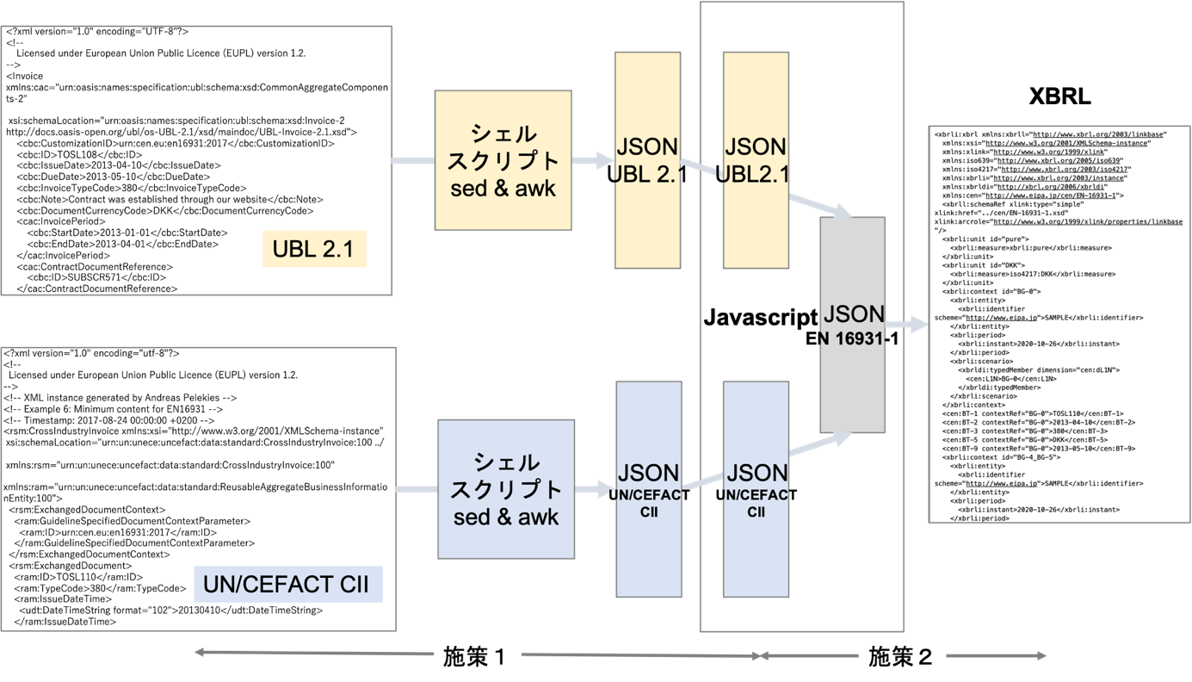
Conversion from e-Invoice to XBRL
施策1(Step 1)
Read electronic invoice (XML) files in different syntax, namely UBL 2.1 syntax and UN/CEFACT CII syntax, into a common javascript object that represents the EN 16931-1 Core Invoice Model.
(1) Shell scripts (sed & awk) read test data in UBL2.1 syntax and UN/CEFACT CII syntax and convert them to JSON files.
(2) Ingest the JSON file to memory with Javascript.
(3) Convert them to an EN 16931-1 core invoice model object.
施策2(Step 2)
Output the EN 16931-1 core invoice object as an XBRL instance document. The logical relationships between items, dependencies between items, and numerical relationships (multiply the total value of detailed items by a rate). The rounded numbers are the total items, etc.) can be described with formula linkbase.
The PoC developed two types of XBRL taxonomy, the first is simply an EN-16931-1 core invoice model and the second is defined by extending the XBRL GL vocabulary.
XBRL GL provides general accounting-related vocabulary. Transaction data is supported in UBL and internal reports are supported in XBRL.

Slide 11
Semantic XBRL for Granular Data
Semantic data modeling and syntax binding for XBRL

Slide 12
1. Semantic data modeling
1.1 Business parties involved and their roles and relationships
1.2 Employee roles and activities
1.3 Business processes
1.5 Semantic datatypes
1.6 Core audit data model
1.4 Business controls and audit trails
1.7 Business rules to-be validated

Slide 13
Industry doesn’t need to reinvent the wheel
ISO/IEC Directives, Part 2
Principles and rules for the structure and drafting of ISO and IEC documents
5.7 Avoidance of duplication and unnecessary deviations
Before standardizing any item or subject, the writer shall determine whether an applicable standard already exists. If it is necessary to invoke a requirement that appears elsewhere, this should be done by reference, not by repetition – see Clause 10.
“Trusted standards mean that industry doesn’t need to reinvent the wheel, that innovations will be compatible and work with existing technology, and that products and services will be trusted too.
Governments use standards as trusted solutions to complement regulation, and they give peace of mind to consumers who know they are not putting themselves or their families at risk.”
NO TRUST IN WORLD WITHOUT STANDARDS, Maria Lazarte, October 2016 (https://www.iso.org/news/2016/10/Ref2128.html)

Slide 14
Reference standard
Business parties involved and their roles and relationships
Employee roles and activities
ISO/IEC 19505-1:2012 Information technology — Object Management Group Unified Modeling Language (OMG UML) — Part 1: Infrastructure
ISO/IEC 19505-2:2012 Information technology — Object Management Group Unified Modeling Language (OMG UML) — Part 2: Superstructure
Semantic datatypes
ISO/IEC 11179-4:2004 Information technology — Metadata registries (MDR) — Part 4: Formulation of data definitions
ISO/IEC 11179-5:2015 Information technology — Metadata registries (MDR) — Part 5: Naming principles
ISO 15000-5:2014 Electronic Business Extensible Markup Language (ebXML) — Part 5:
Core Components Specification (CCS)
Business processes
ISO/IEC 19845:2015 Information technology — Universal business language version 2.1 (UBL v2.1)
Business controls and audit trails
CEN EN 16931-1:2017+A1:2019 Electronic invoicing - Part 1: Semantic data model of the core elements of an electronic invoice
CEN/TS 16931-3-2:2020 Electronic invoicing - Part 3-2: Syntax binding for ISO/IEC 19845 (UBL 2.1) invoice and credit note

Slide 15
XBRL Specifications
An XBRL taxonomy defines the reporting concepts that may be used in instance documents and can also provide a wide range of structured meta-data about the concepts and how they should be used. Meta-data that can be defined using the core specifications include:
Labels Taxonomies can provide a variety of different labels. For example, "standard labels" provide a general- purpose label for a concept, whereas "documentation labels" can provide a more verbose description defining the purpose of the concept. All labels can be provided in multiple languages.
References References provide structured meta-data, which can be used to provide links to authoritative reference material containing concept definitions.
Hierarchies Concepts can be arranged into hierarchies that provide an organized presentation of concepts in the taxonomy (presentation relationships) or that capture certain arithmetic relationships between them (calculation relationships).
Dimensions Taxonomies can use the specification to define hierarchies of dimensions that can be associated with concepts in order to report multi-dimensional data. Meta-data is primarily contained in linkbases, which form part of the taxonomy:
Linkbase A linkbase is an XML document that defines relationships using the W3C's XLink standard. Relationships are typically between concepts and other concepts, or between concepts and other resources such as labels. A number of additional specifications have been developed in order to further enhance the ability of XBRL to define and manage reporting requirements.
Internationalization and Translations
XBRL is an international standard and has been designed from the outset to support multiple languages and localized characters. All components in XBRL can be labelled in multiple languages, and the use of the linkbase mechanism makes it easy for third parties to define their own translations of taxonomies
Business rules validation
Reporting requirements often translate into business rules to which all reports are expected to conform. XBRL makes it possible for many of these rules to be defined and published in a standard format.
Source: Defining Reporting Requirements
https://specifications.xbrl.org/reporting-requirements.html

Slide 16
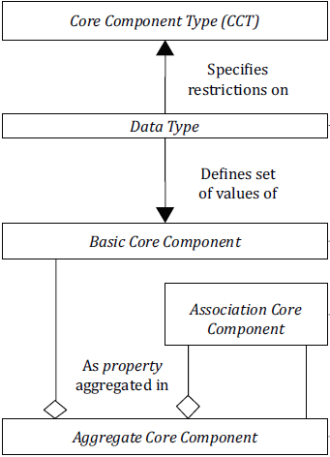
Semantic data modeling based on ISO 15000-5 The Core Component
We are currently investigating other standards to clarify the data architecture of the audit data collection (ADC).
The goal is to define an ADC semantic data model based on the Core Components Specification (CCS) defined in ISO 15000-5 Electronic Business Extensible Markup Language (ebXML) — Part 5: Core Components Specification (CCS).
Key Core Component Concepts
The central concept of this International Standard is the Core Component. The Core Component is a semantic building block, which is used as a basis to construct all electronic business messages.
There are four different categories of Core Components:
a) Basic Core Component;
b) Association Core Component;
c) Core Component Type;
d) Aggregate Core Component.
3.2 Aggregate Core Component (ACC)
collection of related pieces of business information that together convey a distinct business meaning, independent of any specific Business Context
3.5 Association Core Component (ASCC)
Core Component which constitutes a complex business characteristic of a specific Aggregate Core Component that represents an Object Class
3.10 Basic Core Component (BCC)
core component has a unique Business Semantic definition and it constitutes a singular business characteristic of a specific Aggregate Core Component that represents an Object Class.

Slide 17
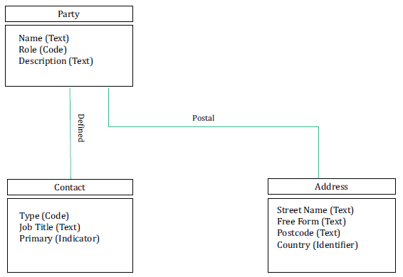
Semantic data modeling based on ISO 15000-5 (contd.) Association Core Component
— three Aggregate Core Components: “Party. Details”; “Contact. Details” and “Address. Details”;
— each Aggregate Core Component has a number of Properties (i.e. business characteristics);
— the Aggregate Core Component “Party. Details” has five Properties (“Name”, “Role”, “Description”, “Defined. Contact” and “Postal. Address”);
— the Aggregate Core Component “Contact. Details” has three Properties (“Type”, “Job Title” and “Primary”);
— the Aggregate Core Component “Address. Details” has four Properties (“Street Name”, “Free Form”, “Postcode” and “Country”).
“Party. Defined. Contact” and “Party. Postal. Address” are both
Association Core Components. The structures of these associated Aggregate Core Components are defined by the Aggregate Core Components “Contact. Details” and “Address. Details”, respectively.

Slide 18
Semantic data modeling based on ISO 15000-5 (contd.) Naming Convention
A Naming Convention is necessary to gain consistency in the naming and defining of all Core Components, Data Types and Business Information Entities. The resulting consistency facilitates comparison during the discovery and analysis process, and precludes ambiguity, such as the development of multiple Core Components with different names that have the same semantic meaning.
The Naming Convention is derived from the guidelines and principles described in ISO/IEC 11179-5. In certain instances, these guidelines have been adapted to the Core Component environment. In particular, the guidelines have been extended to cover the naming and defining of Core Component Types, Data Types and Business Information Entities.
[Source: ISO 15000-5 4.5]

Slide 19

1.1 Business parties
Business parties involved and their roles and relationships
Purchase-to-pay
Inventory
Order-to-cash
Supplier
Customer
Settlement organization
Purchase organization
Sales organization
Inventory organization
Receipt organization
Requisition organization
Dispatch organization
Cost organization

Slide 20
1.2 Employee roles and activities
Role
Activity
Employee
User
Purchaser
Account segment employee
Salesperson
Created user
Approved user
Posted user
Last modified user

Slide 21

1.3 Business processes Invoicing of deliveries against purchase orders, based on a contract
Source: EN 16931-1 Electrotonic invoicing – Part 1: Semantic data model of the core elements of an electronic invoice
Partially modified by SAMBUICHI, Nobuyuki
Receipt organization
Receive Goods/services/works
Purchase organization
Conclude contract
Send Purchase Order
Receive Invoice
Pay
Start
End
Contract
Purchase Order
Dispatch Advice
Invoice
Sales organization
Conclude contract
Receive Purchase Order
Deliver Goods/services/works
Send Invoice
Start
Payee organization
Receive payment
End
In this process the Buyer and the Seller conclude a formal contract (or there is an assumed contract by legal definition) in which the terms and conditions are stated under which goods and services will be delivered and are paid for. The Buyer orders the goods and services, stating the specifications for goods and services, the quantities and the place and time for delivery. The Seller delivers the ordered goods and services to the Receiver as specified on the purchase order. This delivery is then invoiced by the Seller to the Buyer. Finally, the Buyer pays the Payee.

Slide 22
1.3 Business processes (contd.) Spot payment
Source: EN 16931-1 Electrotonic invoicing – Part 1: Semantic data model of the core elements of an electronic invoice
Partially modified by SAMBUICHI, Nobuyuki
Receipt organization
Receive Goods/services/works
Purchase organization
Order
Pay
Receive Invoice
Start
End
Invoice (Receipt)
Sales organization
Receive Order
Deliver Goods/services/works
Send Invoice
End
Start
Payee organization
Receive Payment
The Buyer purchases goods and services without any prior purchase order or contract (e.g. by ordering over the telephone, internet or over the counter). Payment is made in advance of the invoice, e.g. by means of a credit, debit or payment card or through a payment service provider. Note that sufficient business controls should be present in the administration of both parties given the absence of written purchase orders. Invoicing may take place before, after or at the same time as the delivery. The invoice refers to the account or card number used for payment and states the amount paid in advance.
Source: EN 16931-1 Electrotonic invoicing – Part 1: Semantic data model of the core elements of an electronic invoice
Partial modification by SAMBUICHI, Nobuyuki

Slide 23
1.4 Business Control and Audit Trail
Source: CEN WORKSHOP AGREEMENT CWA 16460 May 2012 Good Practice: e-Invoicing Compliance Guidelines - The Commentary
Definitions
Business Control: The COSO Model defines “business control” as:
a process, effected by an entity’s board of directors, management and other personnel, designed to provide reasonable assurance regarding the achievement of objectives in effectiveness and efficiency of operations, reliability of financial reporting, and compliance with applicable laws and regulations.
(b) Audit Trail: An audit trail is:
a paper and/or electronic record that gives a step by step documented history of a transaction, which can validate or invalidate accounting entries. Components of an audit trail include:
(i) source records,
(ii) list of transactions processed and
(iii) transaction identifiers so that reference can be made to the source of a transaction.

Slide 24
1.4 Business controls and audit trails (contd.)
Source: CEN WORKSHOP AGREEMENT CWA 16460 May 2012 Good Practice: e-Invoicing Compliance Guidelines - The Commentary
Partially modified by SAMBUICHI, Nobuyuki
An electronic record of each of these events will usually be created in the ERP system. This record may directly contain values relating to the event, e.g. quantities, or reference master data to provide or derive content, e.g. pricing. It is this record of the sequence of events in the process that contributes to an audit trail. An audit trail will consist of documents outside the ERP and a transaction record within the ERP. For example, the audit trail for the ‘procure-to-pay’ cycle will often take the following form.
Procure-to-Pay
This represents the process that supports purchase of goods or services where the 3-way match control is implemented, typically: purchase order → goods received note → purchase invoice → payment.
Left is the equivalent audit trail for an ‘order-to-cash’ cycle.
ERP Transaction Record
Purchase Order
Goods Received Note
Invoice
Payment
External Documents
Purchase Order
Dispatch Advice
Invoice
Bank Statement
External Documents
Sales Order
Goods Dispatch Note
Invoice
Receipt
ERP Transaction Record
Order-to-Cash

Slide 25
1.5 Semantic datatypes
Source: PEPPOL BIS Billing (https://docs.peppol.eu/poacc/billing/3.0/bis/#_semantic_datatypes)
Primitive types
Semantic data type content may be of the following primitive types. These primitive types were taken from ISO 15000-5:2014, Annex A.
Primitive type | Definition
Binary | A set of finite-length sequences of binary digits.
Date | Time point representing a calendar day on a time scale consisting of an origin and a succession of calendar ISO 8601:2004.
Decimal | A subset of the real numbers, which can be represented by decimal numerals.
String | A finite sequence of characters.
Semantic data types
The different semantic data types are described in the tables below, where various features such as attributes, format, and decimals as well as the basic type are defined for each semantic data type. They are based on ISO 15000-5:2014
Amount
Unit Price Amount
Percentage
Quantity
Code
Identifier
Date
Reference Identifier
Text
Binary objects

Slide 26
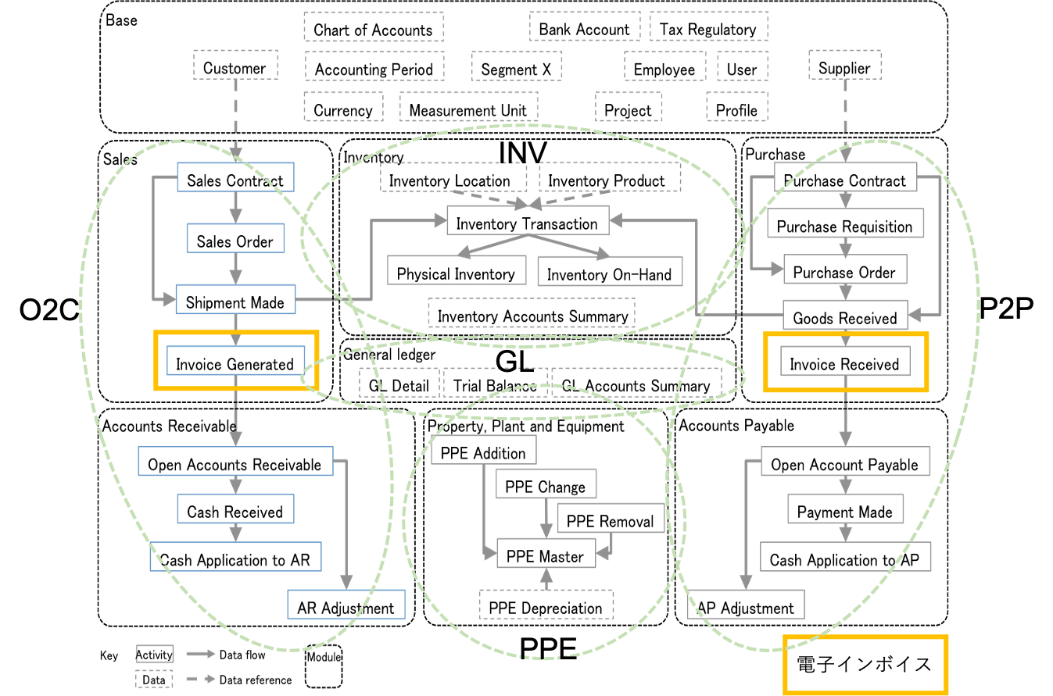
1.6 Core audit model ISO 21378:2019 Audit data collection
Electric Invoice

Slide 27
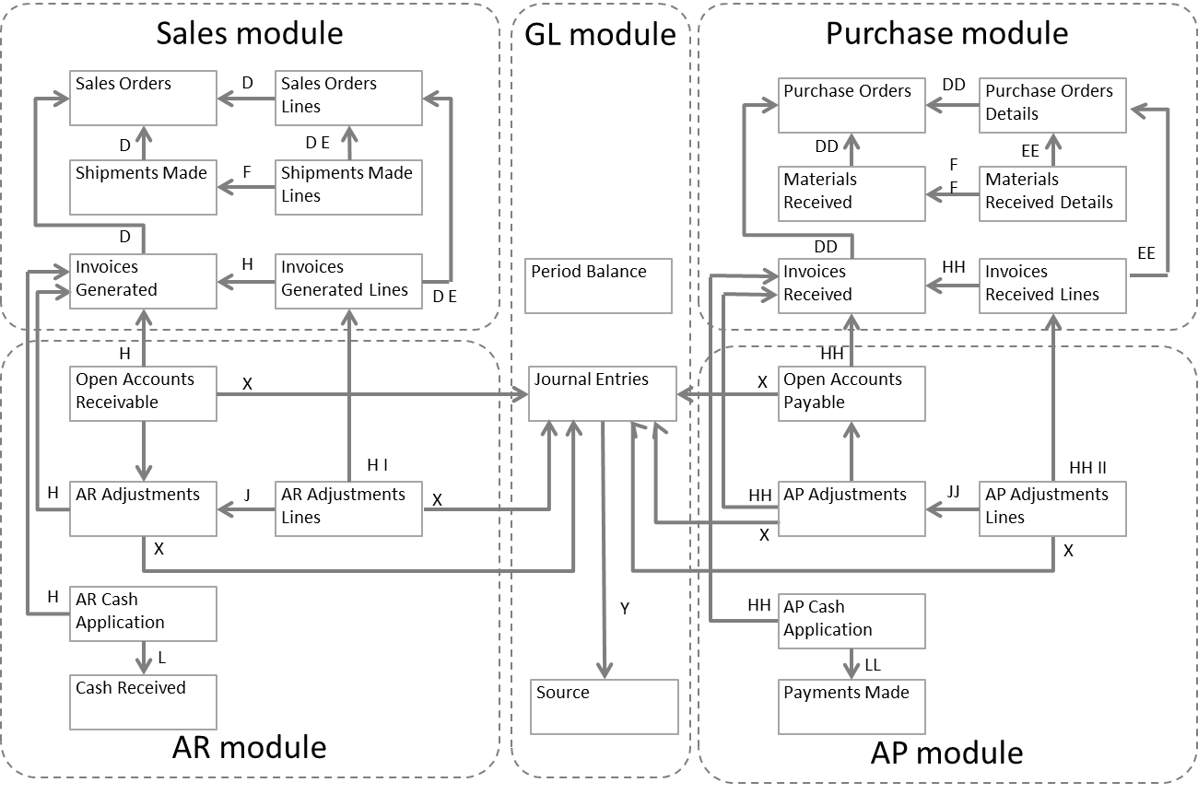
1.6 Core audit model (contd.) Document identifier relationships between modules

Slide 28
1.7 Business rules to-be validated Data profiling report and data questionnaire in ISO 21378
Data profiling report
AR standard data questionnaire
c) Are ARs tracked by customer invoice or in aggregate for the customer?
d) How are partial payments processed? Is the original invoice retained in the subledger with a remaining balance due when a partial payment is processed? Or is a new invoice raised with the remaining balance recorded at the time of partial payment? If new invoices are created, how are those identified in the system?
e) How are transactions with related parties identified? For example, transactions with wholly or partially owned subsidiaries.
f) What is the organizational policy to maintaining invoices in the open item table once the balance is paid off?
g) What is the policy for cash application? Is cash applied only to specific documents, to oldest balances, to customer account?
h) How do you differentiate non-customer receivables from customer receivables?
Test | Description
Date ranges | Minimum and maximum dates for the following dates
Control totals | Record count and total sum of amount fields
Missing data | Number of missing or blank values listed by field.
Invalid data | Count of records by field that do not comply with field format requirements.

Slide 29
1.7 Business rules to-be validated (contd.) Example: Auditing requirement for Invoice
Source: PEPPOL BIS Billing https://docs.peppol.eu/poacc/billing/3.0/bis/
Table 4. Auditing requirements
Id | Requirement (depending, as applicable, on the respective business case)
R56 | sufficient information to support the auditing process with regard to: Identification of the invoice; Identification of the date of issue of the invoice; Identification of the products and services traded, including their description, value and quantity; Information for relating the invoice to its settlement; Information for relating the invoice to relevant documents such as a contract, a purchase order and a despatch advice;
R57 | identification of the parties that fulfil the following roles at the invoice level, including their legal name and address: The Seller (including the Seller’s trade name); The Buyer; The Deliver to party (if different from the Buyer); The Payee (if different from the Seller); The Tax representative of the Supplier;
Table 5. payment requirements
Id | Requirement (depending, as applicable, on the respective business case)
R58 | identification of the means of settlement;
R59 | the requested amount due for payment;
R60 | the date on which payment is due;
R61 | necessary details to support bank transfers in accordance with SEPA and national systems;
R62 | a reference number and any additional reference data to be included in the payment;
R63 | reference number and any additional reference data to be included in the payment, in order to relate the payment to the invoice;
R64 | information for relating an invoice to a payment card used for settlement;
R65 | basic information to support national payment systems for use in domestic trade;
R66 | information about the amount that was pre-paid;
R67 | invoices that have a total amount of zero;
R68 | invoices that have an amount to pay of zero;
R69 | necessary details to support direct debits.
R70 | pre-payment invoices

Slide 30
1.7 Business rules to-be validated (contd.) Example: Calculation of totals
Source: PEPPOL BIS Billing https://docs.peppol.eu/poacc/billing/3.0/bis/
id | Term name | Calculation
BT-106 | Sum of invoice line net amounts | ∑(BT-131: Invoice line net amount)
BT-107 | Sum of allowances on document level | ∑(BT-92: Document level allowance amount)
BT-108 | Sum of charges on document level | ∑(BT-99: Document level charge amount)
BT-109 | Invoice total amount without VAT | BT-106: Sum of invoice line net amounts − BT-107: Sum of allowances on document + BT-108: Sum of charges on document level
BT-110 | Invoice total VAT amount | ∑(BT-117: VAT category tax amount)
BT-112 | Invoice total amount with VAT | BT-109: Invoice total amount without VAT + BT-110: Invoice total VAT amount
BT-115 | Amount due for payment | BT-112: Invoice total amount with VAT − BT-113: Paid amount + BT-114: Rounding amount

Slide 31
Semantic XBRL for Granular Data
Even if unusual signs can be detected from machine learning patterns in the data exchanged, it is difficult to explain what the problem is and deal with it.
Semantic XBRL is used to define firm business rules as internal control, detect abnormalities against them, deal with problems, and, depending on the type of problem, improve internal control rules.
It' Semantic XBRL for Granular Data.

Slide 32


2. Syntax binding for XBRL
XBRL for Granular Data

Slide 33
2. Syntax binding for XBRL
2.1 Syntax binding for XBRL taxonomy
Enable extension based on jurisdictional and/or agency requirements
Internationalization
2.2 Business rules validation
Validation with formula linkbase
Business rules
Integrity constraints
data profiling report
data questionnaire
2.3 Example instance documents

Slide 34
Syntax binding for XBRL taxonomy Common data element group
Table A. 1 - Data elements of Address
No | Data element name | Semantic data type | Description | M/O/C
1 | Street Address1 | Text | Line 1 of the party's street address. | M
2 | Street Address2 | Text | Line 2 of the party’s street address. | M
3 | City | Text | The city where the party is located. | M
4 | State Province | Code | The state or province where the customer is located. "State Province" may not be reported when "Postal Code" is reported. Recommend ISO 3166-2. | C
5 | Postal Code | Code | The postal code where the customer is located. | M
6 | Country | Code | The country code where the customer is located. | M
Key M/O/C: The data element is mandatory (M) or optional (O) or conditional (C)

Slide 35
Syntax binding for XBRL taxonomy (contd.) Syntax binding for XBRL taxonomy
Table B. 1- Syntax binding of Address
No | Data element name | XBRL
1 | Street Address1 | gl-bus:identifierStreet
2 | Street Address2 | gl-bus:identifierAddressStreet2
3 | City | gl-bus:identifierCity
4 | State Province | gl-bus:identifierStateOrProvince
5 | Postal Code | gl-bus:identifierZipOrPostalCode
6 | Country | gl-bus:identifierCountry

Slide 36
Q&A
SAMBUICHI, Nobuyuki
nobuyuki@sambuichi.jp
ISO/TC 295 Audit data services
Head of delegate from Japanese Industrial Standards Committee (JISC)

