Slide 1
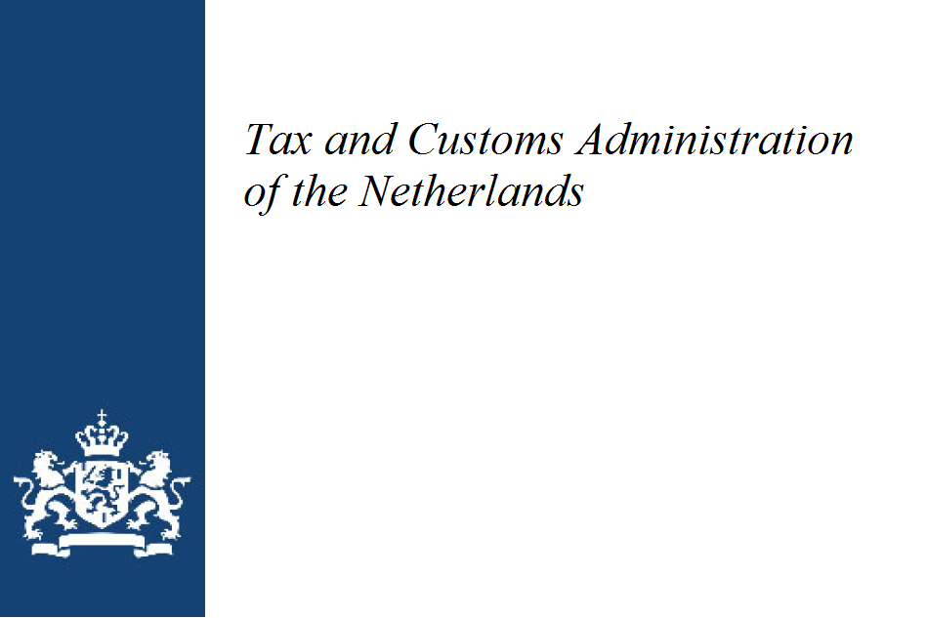


Actionable insights from overview Piggybacking on ADCS
Customs and Indirect Taxes Extension

Slide 2
ISO/WD 5401 ‘Audit Data Collection-Customs and Indirect Taxes Extension
From the project leader:
Address the extension of ISO 21378 Audit Data Collection
Deliverable: Extension for Customs and Indirect Taxes

Slide 3
Scope
From the project leader:
Basis for the extension of the data model is the information need for indirect taxes. As indirect taxes by nature are transaction based. The data required should be at granular level and related to the taxable event involving goods or services. Summary data can be calculated on the basis of granular data.
The current standard already covers the need for information to a large extent, but not completely. The technical workgroup will focus on missing indirect tax relevant data elements. Indirect taxes consist of a range of different types of loads. Some of them are widely and internationally applied (e.g. VAT, GST, custom duties, excise levies), some are specific local taxes. There are also developments in which new types are emerging, such as digital rights, carbon emissions rights and energy taxes. We note that even for widely used taxes, there are sometimes local specific requirements that are not used elsewhere.
The working group aims to develop a data model/extension of the framework that can be widely used, at least for the internationally widely used forms of indirect taxation such as GST/VAT/custom duties, while at the same time allowing for smaller, regional taxes and specific requirements; e.g. by using placeholders.
Limitation: the scope covered partly depends on the knowledge and experience of the participants within the working group. Preferably the members have a diverse background.

Slide 4
Working method
From the project leader:
The current standard: the starting point is that the standard already provides the required data elements to fulfil the information need for indirect taxes to avoid redundancy. We do accept that complex and compute-intensive data processing might be needed
Only after extensive study new data elements can be proposed to include in the extension; members have to agree whether this is the case. A split can be made to:
Data elements required for reporting indirect tax events - main characteristics (minimum level)
Data elements required for validate the indirect tax events - supporting characteristics (desired, but not always achievable)
Example to illustrate the distinction between main and support characteristics. For EU-VAT a cross border transaction between member states have to be reported on supplementary returns. The data report is per customer the Tax Identification Number, the base amount for supply of goods, for services and for so-called triangulation deals. These are the main characteristics; the Tax Identification Number and base amounts might already be covered in the standard (no need for extension), but the distinction between goods and supply not fully. An extension in the article master might be needed. Supporting characteristics are data elements like ship-from-country, ship-to-country, sold-to-country and incoterms.
We will use iterations to further develop and test the extensions of the data model in conjunction with the current standard.

Slide 5
Kick-start
From the project leader:
The Dutch Customs, working closely with other EU Customs, have developed an extension to the standard for reporting and auditing customs related transactions as a proof of concept. We can leverage on this extension by including:
Services
Additional data elements

Slide 6
Draft project plan
From the project leader:
2021-02-01
First meeting
2021-06-01
1st Working Draft circulated to experts
2022-12-01
DIS submission
2022-04-01
Committee Draft ballot (if any)
2023-12-01
Publication

Slide 7


Yesteryear 's Normal
Auditing has come a long way from “holler and tick” approach: where one person from an audit team would call from the ledger and the other person would tick and then the search would be made for unticked transactions.

Slide 8

Today 's Normal
The world is digitized, and accountants and regulators are faced with a myriad of different systems, each with their own database structure, storage idiosyncrasies, languages, etc.
Which means that ≥ 80% of their job is to gather the information they need to do their real job.

Slide 9
ADCS solves that data collection problem.
It defines a dataset containing all the data elements accountants need for their work.
No more puzzling for hours and days to find out how the necessary data is stored in the system, how you can access it and how you can get it into your own systems, spreadsheets. No more error-prone selecting, extracting, copying and pasting.
That work is placed with the developers of the software. And they only must do it once.
Just like the car manufacturers once developed and implemented a standard in which the data from the engine management system can be read in one go. Via 1 plug from any car in any country in the world.

Slide 10
But Dutch Customs officers lacked data
Data elements they need to be able to audit the flow of goods.
So ADCS was inventoried and placed next to their own wish list, data model.
No aerospace technology, but just contentious and meticulous work, by seasoned experts with extensive field experience, supported by specially developed software and mentored by experienced Data Modeling experts.
ADCS consists of 75 tables, containing the data to pass judgment on the Correctness, Completeness, Timeliness and Authorization of the financial situation.
21 of those 75 tables were found to contain most of their data needs, they only needed to add 3 tables.

Slide 11
The 3 extra tables ^{(not set-in stone)}:
INV_PRODUCT_CHARACTERISTICS
Describes characteristics of a product or product-batch combination that are specifically required for the requesting supervisor (not only customs), mostly included in this table when goods are placed in storage and are typical fixed data, little subject to change)
INV_TRANSACTION_CHARACTERISTICS
Attach characteristics to a transaction, which are specifically required for the questioning auditor (not only customs), These characteristics are related to a transaction and are unique for that transaction.
INV_TRANSACTION__ASS_REF_DOCUMENT
Attach (reference to) documents to a transaction, related to that transaction (e.g. declarations, preferential documents, permits, inspection reports, etc.)

Slide 12
Proof of concept (PoC)
Because of the need to replace an existing tool, Customs of the Netherlands allocated budget for a PoC to create an Auditfile inventory, with the main purpose of supporting customs sampling, audits. When China took the initiative for ADCS, it was quickly decided to piggybag on that world standard and not to create a national standard.
The PoC only covers customs audits, but already has the attention of other government regulators. They find the possibility of analyzing money and goods flows within the context of the annual accounts very interesting.
Participants in this proof of concept: Customs Netherlands, a few software providers, a few logistical service providers
Current situation of the proof of concept:

Slide 13
Steps Followed
29 % modelled
Already during the assembly of the gigantic ADCS-jigsaw puzzle:
Digitect built a semantic repository, data model, that is also understood by computers, software.
Digitect wrote an ADCS data extraction instruction for the software developers that describes exactly which data elements must be extracted from their database.
A Proof-of-Concept Reference Group, consisting of a cross-section of "customers" of customs (POC-RG) has been put together.
The POC-RG provided data that was extracted from their systems according to the extraction instruction.
This data was passed through a validation tool specially written by Digitect that checks whether the data is correct and immediately translates it into the agreed formats: comma-separated values (CSV), XML and JSON.
The software also considers the processing of very, very, large data volumes and is therefore future-proof.
This data is read into suitable analysis software. (This case: Power BI, but all other known BI tools can handle it)

Slide 14
Typology POC-Reference Group:
Current reference group:
Logistical Services providers
Foreseen towards the ADCS Customs and Indirect Taxes extension:
Terminals and airport logistics companies
All kind of service providers
…

Slide 15

Guess what:
Proof of Concept, first impressions are good, budget completely exhausted.
What extra data elements do other auditing organisations want to have added and why?
What are the next steps and how are they funded. (71 % still needs to be modelled)

Slide 16
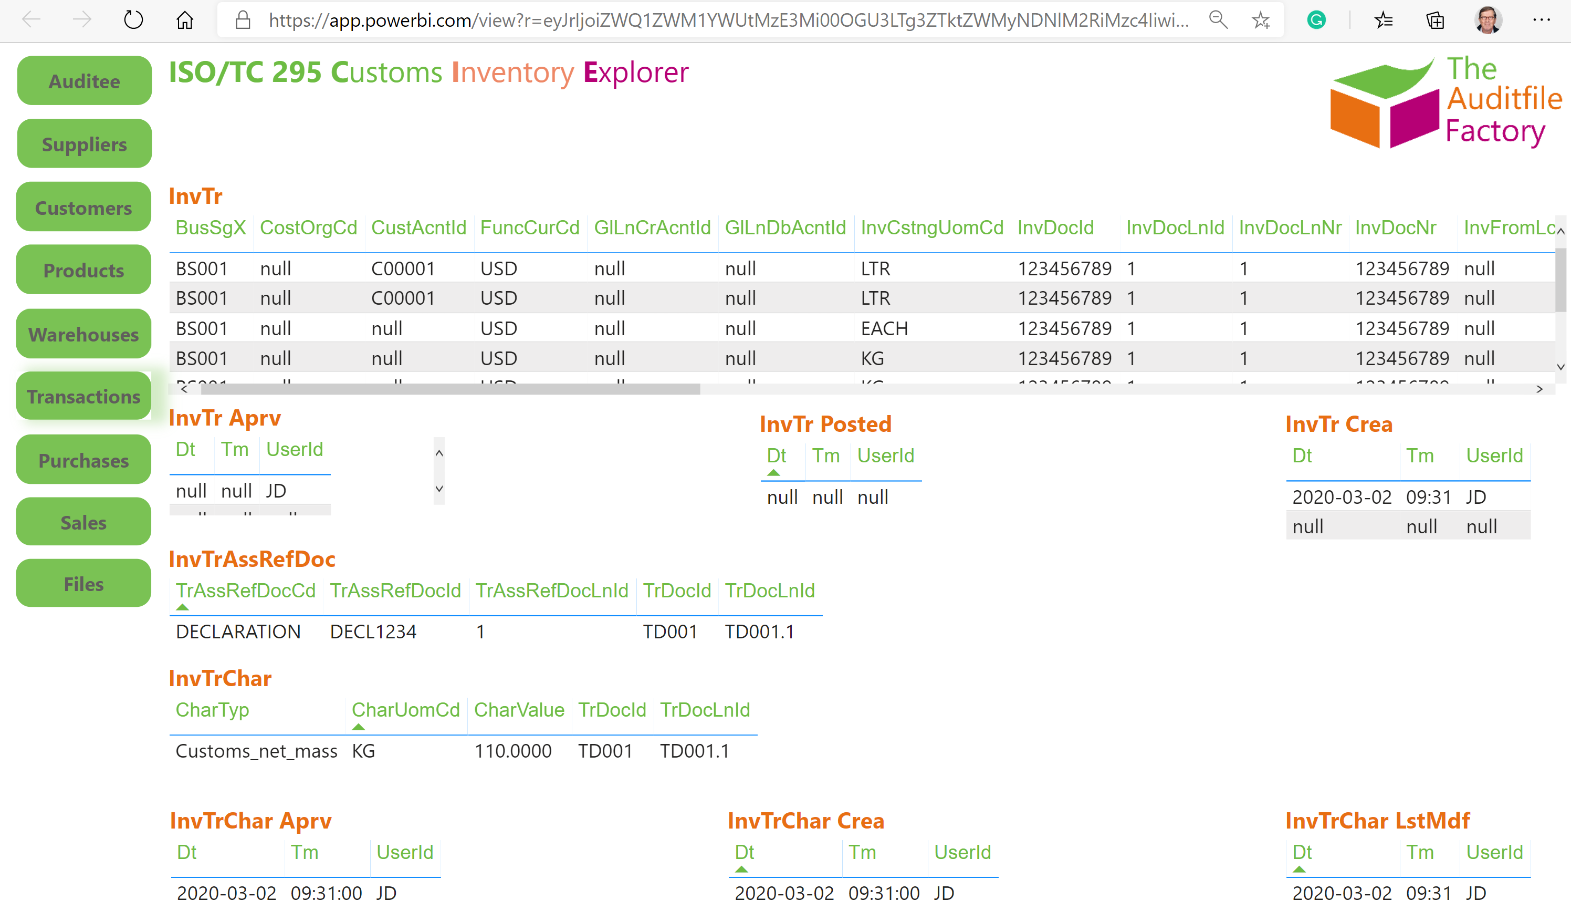
Proof of the pudding is in the eating:

Slide 17
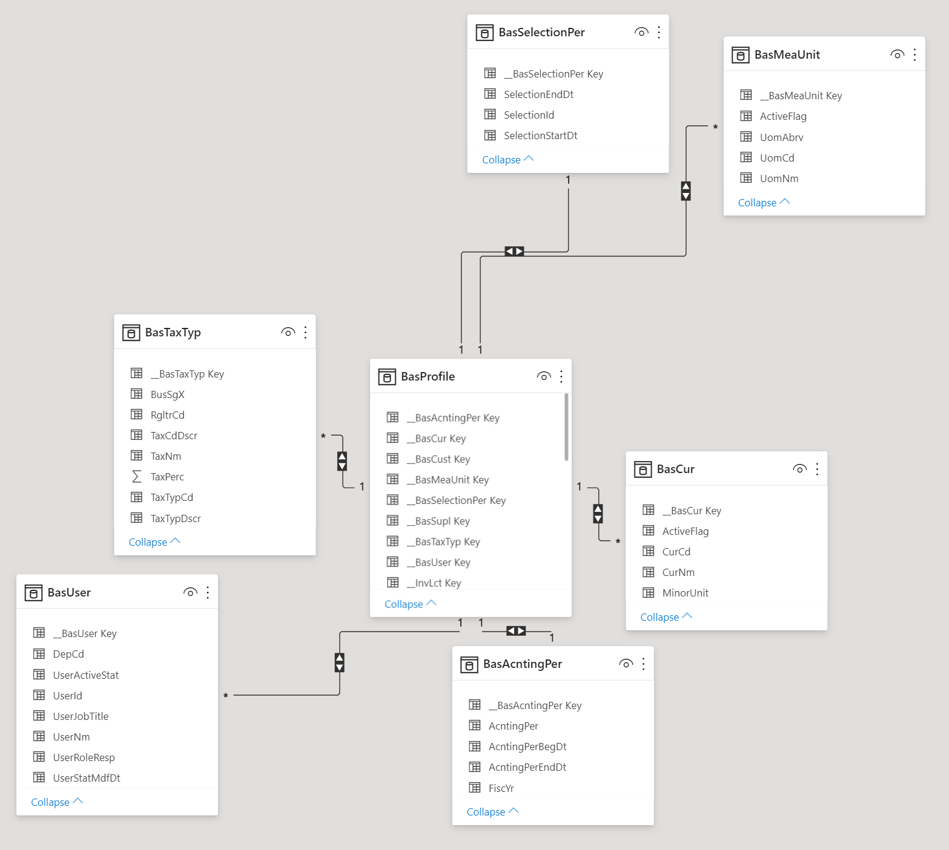
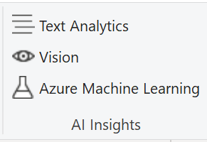
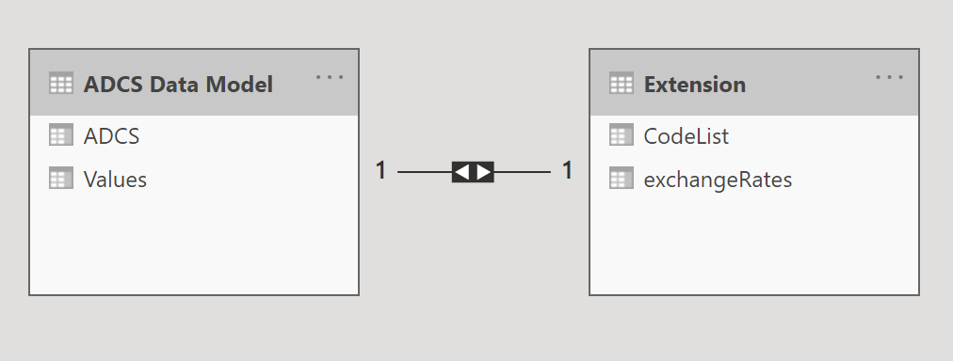
Future-proof and expandable:
As long as the data is properly modeled, tables with relevant information, exchange rates, country lists, actually deducted taxes, etc. can be added effortlessly.
And use can be made of the computing power, Artificial Intelligence, that the Cloud offers us.
There are sufficient options to guarantee the privacy and security of the data.

Slide 18
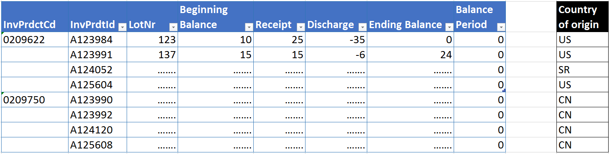
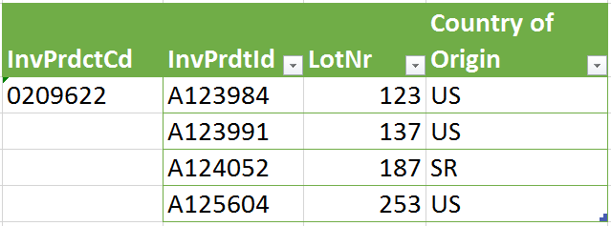

Key Takeaways: Analyses
Presume:
8 productids, 8 lot numbers
covering two productcodes: 0209662 and 0209750
Containing beginning balance, receipts, discharges
Goods movement is conclusive in quantity per productid / the level of lot number
(recent ADCS)
The different lots of product 0209662 show different countries of origin on the customs declaration
Product 0209750 show all lots having country of origin CN, so that is consistent
Customs extension:
Adding the Country of Origin on (lot level) characteristics
The analyses must show (ONLY) products with not-consistent Country of origin
Product 0209622 remains on this report
Possible results: permit requirement, incorrect duties, etc.

Slide 19

Questions
“No matter how complex things are,
basically everything is simple.”

Slide 20


