Slide 1
New work item proposal Exchange formats for the Audit Data Collection Standard: XBRL
Semantic XBRL for Granular Data
SAMBUICHI, Nobuyuki
nobuyuki@sambuichi.jp
ISO/TC 295 Audit data services
Head of delegate Japanese Industrial Standards Committee (JISC)

Slide 2
Industry doesn’t need to reinvent the wheel
0
ISO/IEC Directives, Part 2
Principles and rules for the structure and drafting of ISO and IEC documents
5.7 Avoidance of duplication and unnecessary deviations
Before standardizing any item or subject, the writer shall determine whether an applicable standard already exists. If it is necessary to invoke a requirement that appears elsewhere, this should be done by reference, not by repetition – see Clause 10.
“Trusted standards mean that industry doesn’t need to reinvent the wheel, that innovations will be compatible and work with existing technology, and that products and services will be trusted too.
Governments use standards as trusted solutions to complement regulation, and they give peace of mind to consumers who know they are not putting themselves or their families at risk.”
NO TRUST IN WORLD WITHOUT STANDARDS, Maria Lazarte, October 2016 (https://www.iso.org/news/2016/10/Ref2128.html)

Slide 3
Standing on the shoulders of giants
0
Semantic modeling is defined based on following standards:
a) CCS defined in ISO 15000-5 Electronic Business Extensible Markup Language (ebXML) -- Part 5: Core Components Specification (CCS);
b) Business rule definition for Core Invoice Usage Specification (CIUS) in EN 16931-1 Electronic Invoicing - Semantic data model of the core elements of an electronic invoice; and
c) Extensible Business Reporting Language (XBRL) 2.1.
Business rules can be validated using formula linkbase defined in taxonomy. We are standing on the shoulders of giants and defining new standards for new business domains for auditing.
NOTE Wikipedia says that it is a metaphor of dwarfs standing on the shoulders of giants (Latin: nanos gigantium humeris insidentes) and expresses the meaning of "discovering truth by building on previous discoveries". This concept has been traced to the 12th century, attributed to Bernard of Chartres. Its most familiar expression in English is by Isaac Newton in 1675: "If I have seen further, it is by standing on the shoulders of Giants."

Slide 4
References
0
Business parties involved and their roles and relationships
Employee roles and activities
ISO/IEC 19505-1:2012 Information technology — Object Management Group Unified Modeling Language (OMG UML) — Part 1: Infrastructure
ISO/IEC 19505-2:2012 Information technology — Object Management Group Unified Modeling Language (OMG UML) — Part 2: Superstructure
Semantic datatypes
ISO/IEC 11179-4:2004 Information technology — Metadata registries (MDR) — Part 4: Formulation of data definitions
ISO/IEC 11179-5:2015 Information technology — Metadata registries (MDR) — Part 5: Naming principles
ISO 15000-5:2014 Electronic Business Extensible Markup Language (ebXML) — Part 5:
Core Components Specification (CCS)
Business processes
ISO/IEC 19845:2015 Information technology — Universal business language version 2.1 (UBL v2.1)
Business controls and audit trails
CEN EN 16931-1:2017+A1:2019 Electronic invoicing - Part 1: Semantic data model of the core elements of an electronic invoice
CEN/TS 16931-3-2:2020 Electronic invoicing - Part 3-2: Syntax binding for ISO/IEC 19845 (UBL 2.1) invoice and credit note

Slide 5
Semantic XBRL for Granular Data
0
Even if unusual signs can be detected from machine learning patterns in the data exchanged, it is difficult to explain what the problem is and deal with it.
What do you think if you were arrested for accounting fraud and when asked why you were told that AI had decided so?
Semantic XBRL can be used to define firm business rules as internal control, detect abnormalities against them, deal with problems, and, depending on the type of problem, improve internal control rules.

Slide 6
Exchange formats for the Audit Data Collection Standard: XBRL
0
1. Parties involved and their roles and relationships
2. Employee roles and user activities
3. Business processes
4. Business controls and audit trails
5. Semantic data modeling
6. Business rules
7. Syntax binding for XBRL

Slide 7
1. Parties involved and their roles and relationships 2. Employee roles and user activities 3. Business processes

Slide 8
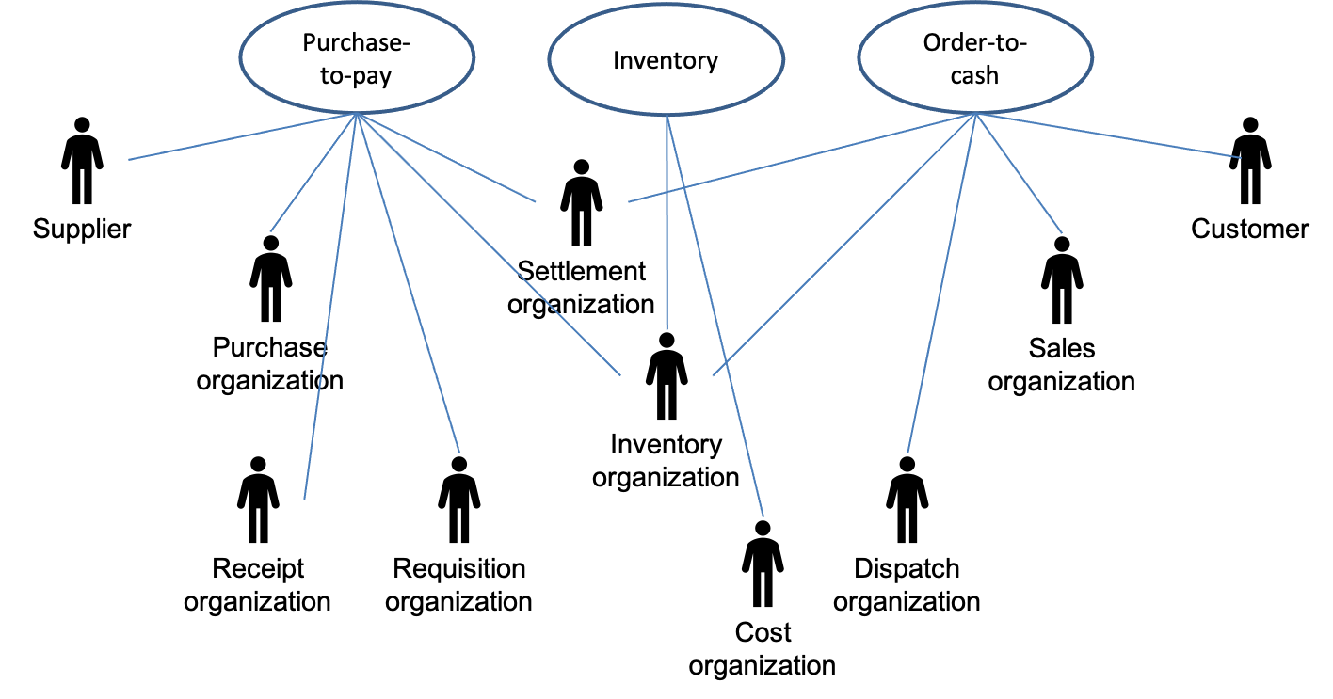
1. Parties involved and their roles and relationships
1
For example, EN 16931 defines following party and roles.
Parties
Customer The customer is the legal person or organization who is in demand of a product or service.
Supplier The supplier is the legal person or organization who provides a product or service.
Roles
Creditor One to whom a debt is owe. The party that claims the payment and is responsible for resolving billing issues and arranging settlement. The party that sends the invoice or credit note.
Debtor One who owes debt. The party responsible for making settlement relating to a purchase. The party that receives the invoice or credit note.

Slide 9
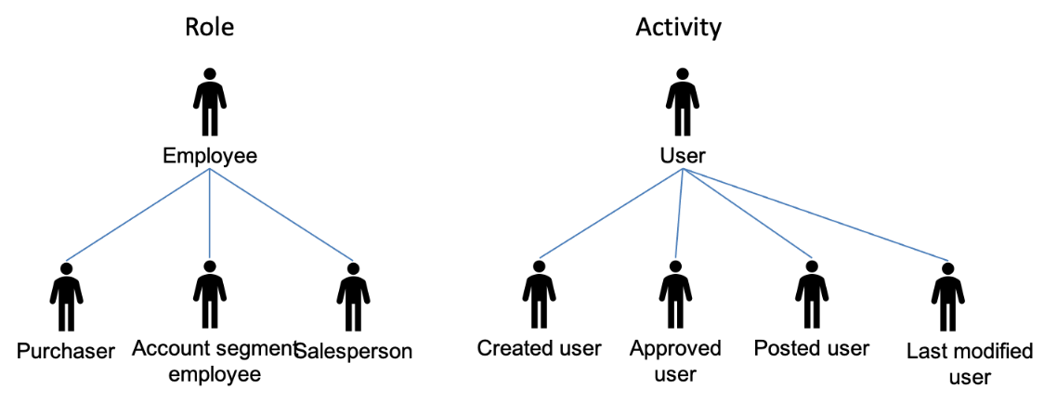
2. Employee roles and user activities
2
The users managing the ERP system shall have unique identification data, enabling job identification and authentication of the users. The identification and authentication data shall be revoked without delay in case of the cessation of user rights. Each employee shall have the necessary education, practice and professional experience for the provision of his scope of activities.
The Party shall log every transactional event that can provide information on activity, changes happened in the ERP system, every verification activity performed related to transaction and / or accounting. In case of every log entry, the following data shall be stored:
the date and time of the activity;
the type of the event;
the success or failure of the implementation;
the identification of the user or the system who/what triggered the event

Slide 10
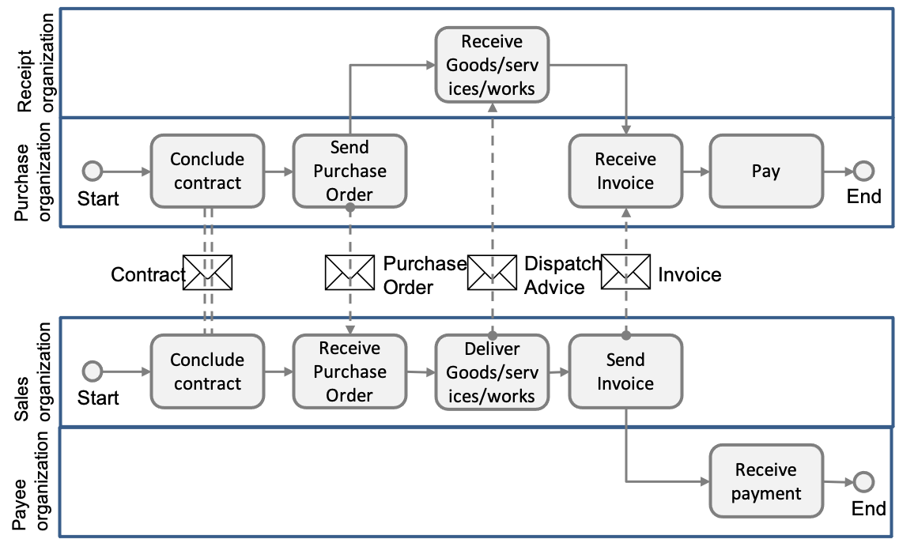
3. Business processes
3
Invoicing of deliveries against purchase orders, based on a contract
In this process the Buyer and the Seller conclude a formal contract (or there is an assumed contract by legal definition) in which the terms and conditions are stated under which goods and services will be delivered and are paid for. The Buyer orders the goods and services, stating the specifications for goods and services, the quantities and the place and time for delivery. The Seller delivers the ordered goods and services to the Receiver as specified on the purchase order. This delivery is then invoiced by the Seller to the Buyer. Finally, the Buyer pays the Payee.

Slide 11
4. Business controls and audit trails

Slide 12
Definitions
4
Business Control
The COSO Model defines “business control” as:
a process, effected by an entity’s board of directors, management and other personnel, designed to provide reasonable assurance regarding the achievement of objectives in effectiveness and efficiency of operations, reliability of financial reporting, and compliance with applicable laws and regulations.
Audit Trail
An audit trail is:
a paper and/or electronic record that gives a step by step documented history of a transaction, which can validate or invalidate accounting entries. Components of an audit trail include:
(i) source records,
(ii) list of transactions processed and
(iii) transaction identifiers so that reference can be made to the source of a transaction.
Source: CEN WORKSHOP AGREEMENT CWA 16460 May 2012 Good Practice: e-Invoicing Compliance Guidelines - The Commentary

Slide 13
4. Business controls and audit trails
4
An electronic record of each of these events will usually be created in the ERP system. This record may directly contain values relating to the event, e.g. quantities, or reference master data to provide or derive content, e.g. pricing. It is this record of the sequence of events in the process that contributes to an audit trail. An audit trail will consist of documents outside the ERP and a transaction record within the ERP. For example, the audit trail for the ‘procure-to-pay’ cycle will often take the following form.
Procure-to-Pay
This represents the process that supports purchase of goods or services where the 3-way match control is implemented, typically: purchase order → goods received note → purchase invoice → payment.
Left is the equivalent audit trail for an ‘order-to-cash’ cycle.
ERP Transaction Record
Purchase Order
Goods Received Note
Invoice
Payment
External Documents
Purchase Order
Dispatch Advice
Invoice
Bank Statement
External Documents
Sales Order
Goods Dispatch Note
Invoice
Receipt
ERP Transaction Record
Order-to-Cash
Source: CEN WORKSHOP AGREEMENT CWA 16460 May 2012 Good Practice: e-Invoicing Compliance Guidelines - The Commentary
Partially modified by SAMBUICHI, Nobuyuki

Slide 14
5. Semantic data modeling
5.1. Core Components Specification(ISO 15000-1)

Slide 15
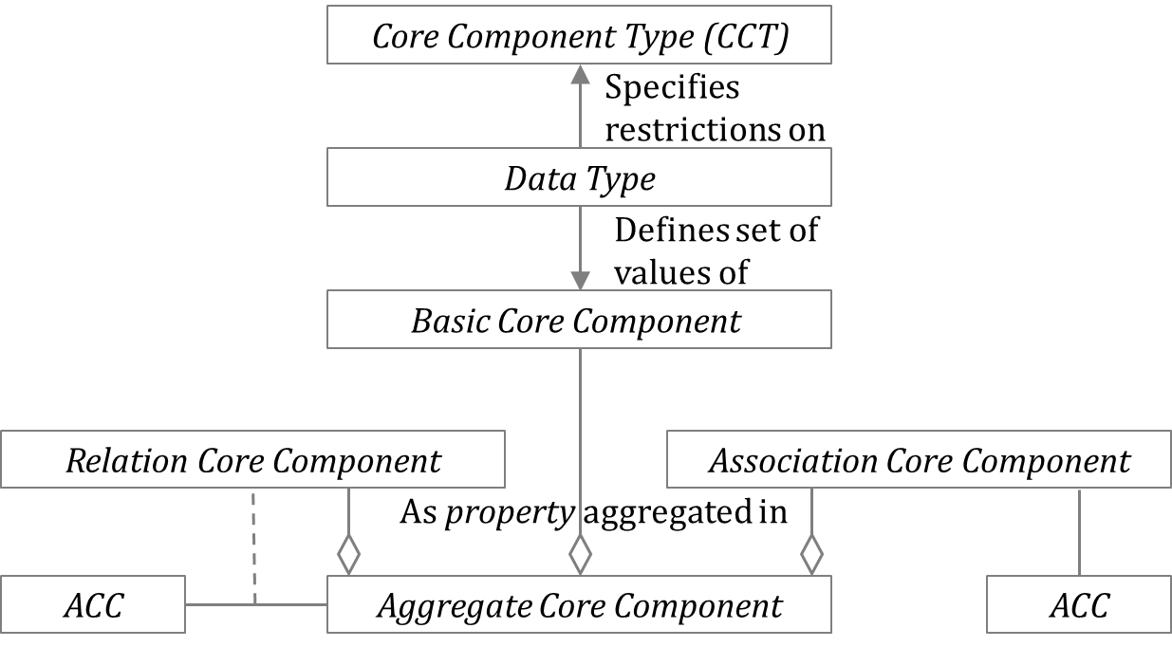
Core Component
5.1
Semantic data modeling of ADS is based on the Core Components Specification (CCS) defined in ISO 15000-5 Electronic Business Extensible Markup Language (ebXML) — Part 5: Core Components Specification (CCS).
There are six different categories of Core Components:
a) Basic Core Component (BCC);
b) Association Core Component (ASCC);
c) Core Component Type (CCT);
d) Aggregate Core Component (ACC);
e) Identifier Core Component (IDCC). and
f) Relation Core Component (RLCC).
NOTE Audit data collection requires a concept to clearly define the relationships between ACCs.

Slide 16
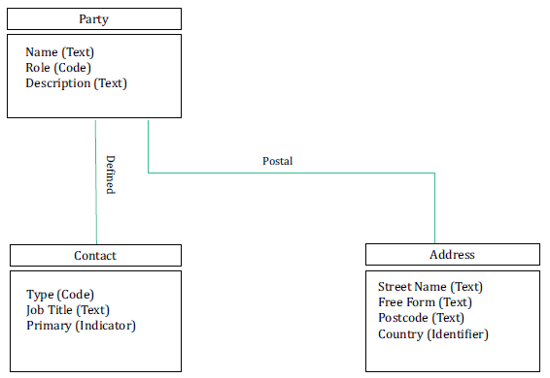
Association Core Component
5.1
— three Aggregate Core Components: “Party. Details”; “Contact. Details” and “Address. Details”;
— each Aggregate Core Component has a number of Properties (i.e. business characteristics);
— the Aggregate Core Component “Party. Details” has five Properties (“Name”, “Role”, “Description”, “Defined. Contact” and “Postal. Address”);
— the Aggregate Core Component “Contact. Details” has three Properties (“Type”, “Job Title” and “Primary”);
— the Aggregate Core Component “Address. Details” has four Properties (“Street Name”, “Free Form”, “Postcode” and “Country”).
“Party. Defined. Contact” and “Party. Postal. Address” are both
Association Core Components. The structures of these associated Aggregate Core Components are defined by the Aggregate Core Components “Contact. Details” and “Address. Details”, respectively.

Slide 17
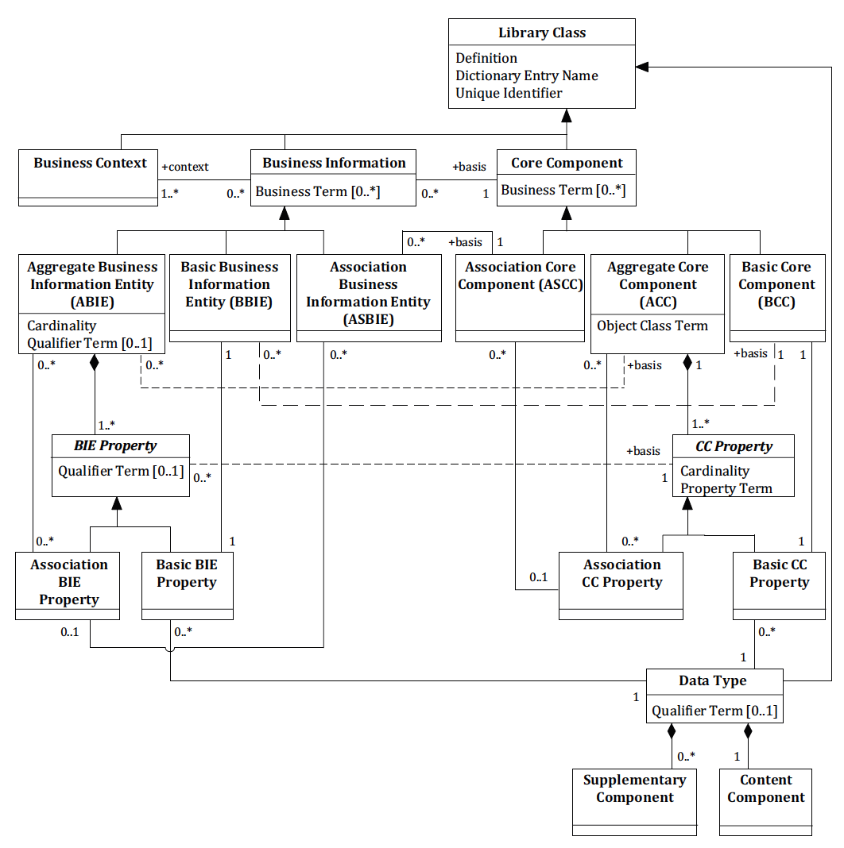

Business Information Entity
5.1
Business information is based on Core Components and is defined in the context defined in the business context. We use "ADS" as a qualifier term for "Audit data service" business context. An Aggregate Business Information Entity is defined by selecting the appropriate properties defined in the base Aggregate Core Component and adding the required properties in this standard.
Business Information Entities Basic Definition Model

Slide 18
Semantic datatypes
5.1
Primitive types
Semantic data type content may be of the following primitive types. These primitive types were taken from ISO 15000-5:2014, Annex A.
Semantic data types
The different semantic data types are described in the tables below, where various features such as attributes, format, and decimals as well as the basic type are defined for each semantic data type. They are based on ISO 15000-5:2014
Primitive type | Definition
Binary | A set of finite-length sequences of binary digits.
Date | Time point representing a calendar day on a time scale consisting of an origin and a succession of calendar ISO 8601:2004.
Decimal | A subset of the real numbers, which can be represented by decimal numerals.
String | A finite sequence of characters.
Amount
Unit Price Amount
Percentage
Quantity
Code
Identifier
Date
Reference Identifier
Text

Slide 19
Primitive types
5.1
Primitive type | Definition
Date | Time point representing a calendar day on a time scale consisting of an origin and a succession of calendar ISO 8601-1:2019.
Time | Time point representing a time of day on a time scale consisting of an origin and a succession of calendar ISO 8601-1:2019.
Decimal | A subset of the real numbers, which can be represented by decimal numerals.
String | A finite sequence of characters.
primitive data type definitions taken from ISO 15000-5:2014 Annex A.

Slide 20
Semantic datatype (1/2)
5.1
Semantic data type | Component | Primitive Type | Description
Amount | Amount. Content | Decimal | A number of monetary units specified in a currency where the unit of currency is explicit or implied.
 | Amount. Currency. Identifier | String
Unit Price | Amount. Content | Decimal | A unit price amount states a numerical monetary amount value for Business Information Entities that contain item prices that may be multiplied by item quantities. The currency of the amount is explicit or implied.
 | Amount. Currency. Identifier | String
Percentage | Numeric. Content | Decimal | Percentages are given as fractions of a hundred (per cent) e. g. the value 34,78 % in percentage terms is given as 34,78.
Numeric | Numeric. Content | Decimal | Numeric information that is assigned or is determined by calculation, counting, or sequencing. It does not require a unit of measure.
Quantity | Quantity. Content | Decimal | Quantities are used to state a number of units such as for items. The code for the Unit of Measure (Quantity Unit. Code) is explicit or implicit.
 | Quantity Unit. Code | String
 | Quantity Unit. Code List. Identifier | String
 | Quantity Unit. Code List Agency. Identifier | String
Code | Code. Content | String | Codes are used to specify allowed values in elements as well as for lists of options. Code is different from Identifier in that allowed values have standardized meanings that can be known by the recipient.
 | Code List. Identifier | String
 | Code List. Agency. Identifier | String
 | Quantity Unit. Code List Agency. Identifier | String
 | Code List. Version. Identifier | String

Slide 21
Semantic datatype (2/2)
5.1
Semantic data type | Component | Primitive Type | Description
Amount | Amount. Content | Decimal | A number of monetary units specified in a currency where the unit of currency is explicit or implied.
 | Code List. Version. Identifier | String
Identifier | Identifier. Content | String | Identifiers (IDs) are keys that are issued by the sender or recipient of a document or by a third party.
 | Identification Scheme. Identifier | String
 | Identification Scheme Agency. Identifier | String
 | Identification Scheme. Version. Identifier | String
Indicator | Indicator. Content | String | A list of exactly two mutually exclusive values that express the only possible states of a Property.
Date | Date. Content | Date | Dates shall be in accordance with the " Complete representation of a calendar date" as specified by ISO 8601-1:2019, format YYYY-MM-DD.
Time | Time. Content | Time | Time shall be in accordance with the "Complete representation of a time of day" as specified by ISO 8601-1:2019, format hh:mm:ss
Reference Identifier | Identifier. Content | String | Reference identifier Types are identifiers that were assigned to a document or document line.
Text | Text. Content | String | Text is the actual wording of anything written or printed. Line breaks in the text may be present, and any line breaks should be preserved and respected by the receiver's system
 | Language. Identifier | String

Slide 22
Permissible Representation Terms
5.1
Primary Representation Term | Definition | Related CCT | Secondary Representation Terms
Amount | A number of monetary units specified in a currency where the unit of currency is explicit or implied. | Amount. Type
Unit Price | A number of monetary units specified in a currency where the unit of currency is explicit or implied for unit price. | Unit Price. Type
Code | A character string (letters, figures or symbols) that for brevity and / or language independence may be used to represent or replace a definitive value or text of a Property. | Code. Type
Date Time | A particular point in the progression of time (ISO 8601). | Date Time. Type | Date, Time
Identifier | A character string used to establish the identity of, and distinguish uniquely, one instance within an identification scheme from all others within the same scheme. | Identifier. Type
Indicator | A list of exactly two mutually exclusive values that express the only possible states of a Property. | Indicator. Type
Numeric | Numeric information that is assigned or is determined by calculation, counting or sequencing. | Numeric. Type | Value, Rate, Percent
Quantity | A counted number of non-monetary units. Quantities may be specified with a unit of quantity. | Quantity. Type
Text | A character string (i.e. a finite set of characters) generally in the form of words of a language. | Text. Type | Name

Slide 23
Core Component Types (CCT)
5.1
Dictionary Entry Name | Definition
Amount. Type | A number of monetary units specified in a currency where the unit of currency is explicit or implied.
Code. Type | A character string ( letters, figures, or symbols ) that for brevity and/or language independence may be used to represent or replace a definitive value or text of an Attribute together with relevant supplementary information.
Date Time. Type | A particular point in the progression of time together with relevant supplementary information.
Identifier. Type | A character string to identify and distinguish uniquely, one instance of an object in an identification scheme from all other objects in the same scheme together with relevant supplementary information.
Indicator. Type | A list of two mutually exclusive values that express the only possible states of a Property
Numeric. Type | Numeric information that is assigned or is determined by calculation, counting, or sequencing. It does not require a unit of quantity or unit of measure.
Quantity. Type | A counted number of nonmonetary units possibly including fractions.
Text. Type | A character string (i. e. a finite set of characters) generally in the form of words of a language.

Slide 24
Rules for Dictionary Entry Name
5.1
Core Component naming rules are based on the rules as defined in ISO 15000-5. [R3] is added for RLCC.
[R1] The Dictionary Entry Name of a Basic Core Component shall consist of the following parts in the
order specified:
— the Object Class Term of the Aggregate Core Component owning the corresponding Basic Core Component Property;
— the Property Term of the corresponding Basic Core Component Property;
— the Representation Term of the Data Type on which the corresponding Basic Core Component Property is based.
[R2] The Dictionary Entry Name of an Association Core Component shall consist of the following parts in the order specified:
— the Object Class Term of the Aggregate Core Component owning the corresponding Association Core Component Property;
— the Property Term of the corresponding Association Core Component Property;
— the Object Class Term of the Aggregate Core Component on which the corresponding Association Core Component Property is based.
[R3] The Dictionary Entry Name of a Relation Core Component shall consist of the following parts in the order specified:
— the Object Class Term of the Aggregate Core Component owning the corresponding Association Core Component Property;
— the Property Term of the corresponding Relation Core Component Property;
— the Object Class Term of the Aggregate Core Component to which the corresponding Relation Core Component is referencing.

Slide 25
Rules for Dictionary Entry Name (contd.)
5.1
The Business Information Entity naming rules are also based on the following concepts as defined in ISO15000-5.
— Object Class: this represents the logical data grouping or aggregation (in a logical data model) to which a data element belongs. The Object Class is expressed as an Object Class Term. The Object Class is thus the part of a Business Information Entity's Dictionary Entry Name that represents an activity or object in a specific Context. Object Classes have explicit boundaries and meaning, and their Properties and behaviour follow the same rules.
— Property Term: this represents the distinguishing characteristic or Property of the Object Class and shall occur naturally in the definition.
— Representation Term: an element of the Business Information Entity name which describes the form in which the Business Information Entity is represented.
— Qualifier Term: a word or words which help define and differentiate a Business Information next table provides a list of permissible Representation Terms.
The Dictionary Entry Name shall consist of the following components in the specified order:
— the Object Class Term of the corresponding Basic Core Component;
— the Property Term of the corresponding Basic Core Component;
— the Representation Term of the Data Type.

Slide 26
5. Semantic data modeling
5.2. Core Components

Slide 27
Legend
5.2
Each information element that constitutes the semantic data model of the Core Components is described as a row in the table documented in the following sub-clause where the following information is provided.
No: A sequence number for the information element.
CC: Specifies which category of Core Component the information element belongs to.
ACC: Aggregate Core Component
ASCC: Association Core Component
BCC: Basic Core Component
IDCC: Identifier Core Component
RLCC: Relation Core Component
Business Term: A synonym used in business where a Core is commonly known.
Definition: A definition of the information element.
ID: A unique identifier uniquely assigned by the United Nations are numberd UNnnnnnnnn.
The Core Components defined in this standard are numberd ADCS-nnnnn.
Dictionary Entry Name: A unique official name of a Core Component registered by the United Nations. If there is no corresponding registered information element, named according to the naming convention defined in ISO 15000-1.
No | CC | Business Term | Definition | ID | Dictionary Entry Name

Slide 28
Extension Methodology
5.2
This standard defines extendable Core Component with [].
Following is an example definition of Basic Core Component in Code.Detail. We can define the "Function Code" by replacing [Specified] with "Function" and resulting Dictionary Entry Name is "Code. Function. Code".
EXAMPLE Base definition
No | CC | Business Term | Definition | ID | Dictionary Entry Name
 | BCC | [Specified] Code | A [Specified] code of this code. |  | Code. [Specified]. Code
EXAMPLE Extended definition
No | CC | Business Term | Definition | ID | Dictionary Entry Name
 | BCC | Function Code | A Function code of this code. |  | Code. Function. Code

Slide 29
Header and Line items
5.2
Association
Relation
ID | d1 | d2 | Line-item
 |  |  | L_id | La | L2
H1 | D11 | D12
 |  |  | L1 | L1a | L1b
 |  |  | L2 | L2a | L2b
H2 | D21 | D22
 |  |  | L3 | L3a | L3b
 |  |  | L4 | l4a | L4b
 |  |  | L5 | L5a | L5b
RL | L_id | La | Lb
H1 | L1 | L1a | L1b
H1 | L2 | L2a | L2b
H2 | L3 | L3a | L3b
H2 | L4 | L4a | L4b
H2 | L5 | L5a | L5b
ID | d1 | d2
H1 | D11 | D12
H2 | D21 | D22
Header
Line item
Header
Line item
Single instance
Two instances

Slide 30
Trade Transaction / Trade Line Item Only some elements are listed
5.2
No | CC | Business Term | Definition | Dictionary Entry Name
0 | ACC | Trade Transaction |  | Trade Transaction. Details
1 | IDCC | Trade Transaction ID | A unique identifier for this trade transaction. | Trade Transaction. Identification. Identifier
2 | BCC | Type Code | A code specifying the type of trade transaction. | Trade Transaction. Type. Code
5 | BCC | Issue Date | A date, time, date time or other date time value for the issuance of this trade transaction. | Trade Transaction. Issue. Date Time
12 | ASCC | Specified Period | A period specified in this trade transaction. | Trade Transaction. Defined. Period
13 | ASCC | [Specified] Monetary Value | A monetary value [specified] in this trade transaction. | Trade Transaction. [Spedified]. Monetary Value
14 | ASCC | Trade Line Item | A trade line item included in this trade transaction. | Trade Transaction. Included. Trade Line Item
No | CC | Business Term | Definition | Dictionary Entry Name
0 | ACC | Trade Line Item | A collection of information specific to an item being used or reported on for trade purposes. | Trade Line Item. Details
1 | RLCC | Trade Transaction ID | A specified reference identifier for trade transaction including this trade line item. | Trade Line Item. Header. Trade Transaction
1 | IDCC | Trade Line Item ID | A unique identifier for this trade line item. | Trade Line Item. Identification. Identifier
2 | BCC | Sequence Number | A sequence number for this trade line item. | Trade Line Item. Sequence. Numeric
65 | BCC | Tax excluded Amount | A tax excluded amount for this trade line item. | Trade Transaction. Tax Excluded. Amount
65 | BCC | Tax Included Amount | A tax included amount for this trade line item. | Trade Transaction. Tax Included. Amount
67 | BCC | Transaction Amount | An amount for this trade line item intarnsaction currency. | Trade Transaction. Transaction Currency. Amount
40 | ASCC | Accounting Account | An accounting account for this trade line item. | Trade Line Item. Account. Accounting Account
Agreement, contract, exchange, understanding, or transfer of cash or property that occurs between two or more parties.

Slide 31
5. Semantic data modeling
5.3. Business Information Entities

Slide 32
Legend
5.3
Each information element that constitutes the semantic data model of the Business Information Entity is described as a row in the table documented in the following sub-clause where the following information is provided.
No: A sequence number for the information element.
BIE: Specifies which category of Business Information Entity the information element belongs to.
a) ABIE: Aggregate Business Information Entity
b) ASBIE: Association Business Information Entity
c) BBIE: Basic Business Information Entity
d) IDBIE: Identifier Business Information Entity
e) RLBIE: Relation Business Information Entity
D: Depth. Indicates on which depth in the model the information element occurs:
f) 0: The first depth of the model;
g) 1: the second depth of the model. The information element (or the group of information elements) is part of a group of information elements which is defined at the first depth of the model.
h) 2: the third depth of the model. The information element (or the group of information elements) is part of a group of information elements which is defined at the second depth of the model.
i) 3: the fourth depth of the model. The information element (or the group of information elements) is part of a group of information elements which is defined at the third depth of the model.
Business Term: A synonym used in business where a Business Information Entity is commonly known.
Semantic data type: The data format that applies to the information element.
O: Occurence
Description: A description of the information element.
No | BIE | D | Business Term | Semantic data type | O | Description | Dictionary Entry Name

Slide 33
Document and line item
5.3
There are two types of business documents. One is a list of data and the other is a header and line item. The list of data includes customer masters, supplier masters, and subledgers such as accounts payable and trial balance. Most business transactions consist of headers and list items.
There are two ways to represent a business document that consists of headers and line items:
One is a format in which the header contains line items and is expressed in single document. The other is to represent it as two documents, a header document and a line-item document.

Slide 34
Using ASBIE
5.3
In the first method, the line items are defined as ASBIE in the header ABIE. The following example illustrates this approach.
No | BIE | D | Business Term | Semantic data type | O | Description | Dictionary Entry Name
0 | ABIE | 0 | Header | — | — | The document header. | ADS Header_ Trade Transaction. Details
1 | IDBIE | 1 | Header ID | Identifier | 1..1 | The unique identifier for the he document header. | ADS Header_ Trade Transaction.
x | ASBIE | 1 | Line Item | —. | 1..n | line items of this document | ADS Header_ Trade Transaction. Defined. ADS Line Item_ Trade Line Item
x+1 | IDBIE | 2 | Line Item ID | Identifier | 1..1 | The unique identifier for the document line item. | ADS Line Item_Trade Line Item. Identification. Identifier
No | BIE | D | Business Term | Semantic data type | O | Description | Dictionary Entry Name
0 | ABIE | 0 | Line Item | — | — | The document line item. | ADS Line Item_ Trade Line Item. Details
1 | IDBIE | 1 | Line Item ID | Identifier | 1..1 | The unique identifier for the document line item. | ADS Line Item_Trade Line Item. Identification. Identifier

Slide 35
RLBIE for the header ABIE
5.3
In the second method, the line-item ABIE contains the RLBIE for the header ABIE . In such cases, there are two lists. One is a list of headers and the other is a list of line items.
No | BIE | D | Business Term | Semantic data type | O | Description | Dictionary Entry Name
0 | ABIE | 0 | Header | — | — | The document header. | ADS Header_ Trade Transaction. Details
1 | IDBIE | 1 | Header ID | Identifier | 1..1 | The unique identifier for the document header. | ADS Header_ Trade Transaction.
No | BIE | D | Business Term | Semantic data type | O | Description | Dictionary Entry Name
0 | ABIE | 0 | Line Item | — | — | The document line item. | ADS Line Item_ Trade Line Item. Details
1 | RLBIE | 1 | Header ID | Reference identifier | 1..1 | The reference identifier for the document header. | ADS Line Item_Trade Line Item. Header. ADS Header_ Trade Transaction
2 | IDBIE | 1 | Line Item ID | Identifier | 1..1 | The unique identifier for the document line item. | ADS Line Item_Trade Line Item. Identification. Identifier

Slide 36
6. Business rules

Slide 37
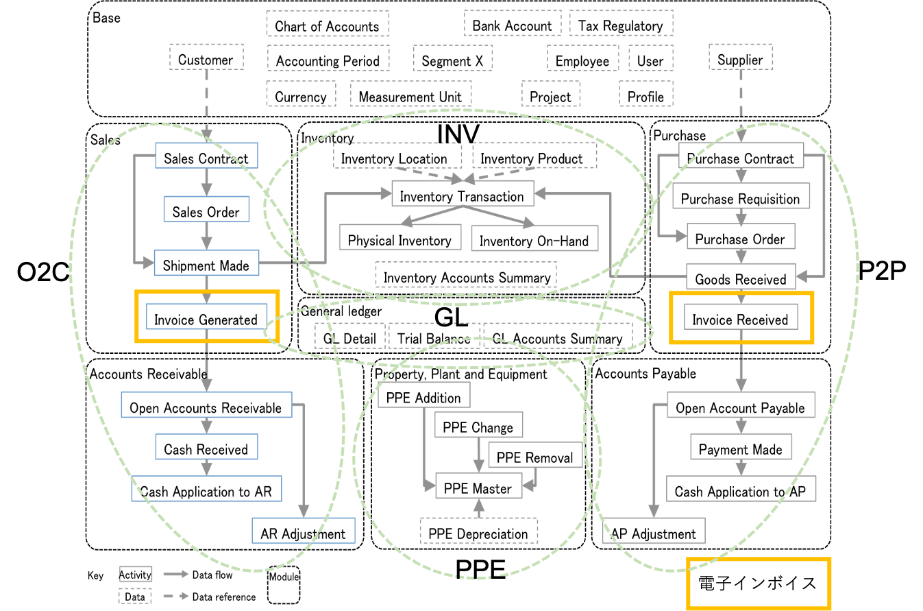
ISO 21378:2019 Audit data collection
6
Electric Invoice

Slide 38
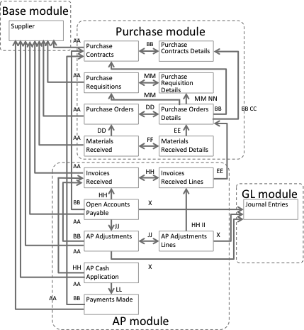
Procure to pay
6
AA Supplier BB Purchase Contract ID DD Purchase Order ID FF Materials Receipt ID HH Invoice ID JJ AR Adjustment ID LL Payment ID NN Requisition Line ID | CC Purchase Contract Line ID EE Purchase Order Line ID GG Materials Receipt Line ID II Invoice Line ID KK AR Adjustment Line ID MM Requisition ID X GL Detail ID

Slide 39
Procure to Pay (3-way matching)
6
No | Audit Trail | Invoice Component
 |  |  | Integrity
 |  | Authenticity | VAT ID Supplier | Supplier (Name & Address) | VAT ID Customer | Customer (Name & Address) | Invoice Date | Date of Supply | Invoice Number | Nature of Supply | Quantity | Taxable Amount | VAT Rate | VAT Amount | Currency
 |  |  | a | b | c | d | e | f | g | h | i | j | k | l | m
1 | Purchase Contract | 3001 |  | 3001 | 3007 | 3007 |  |  |  | 3012 |  | 3017 |  |  | 3021
2 | Purchase Order | 3002 |  | 3005 | 3008 | 3008 |  |  |  | 3013 | 3015 | 3018 |  |  | 3022
3 | Goods / Service Received Note |  |  |  |  |  |  | 3010 |  | 3014 | 3016
4 | Invoice |  |  |  |  |  | 3009
5 | Payment | 3005 |  | 3006 |  |  |  |  | 3011 |  |  | 3019 |  | 3020 | 3023
a matrix of Audit Trail Contribution to Authenticity and Integrity in Purchasing Processes.

Slide 40
Business rules for P2P 3-way match
6
Invoice Component | No | Audit Trail & Master Data | Rule ID | Audit trail component contribution to Integrity
Authenticity | 1 | Purchase Contract | P2P-3001 | Will identify the supplier for a particular supply.
 | 2 | Purchase Order | P2P-3002 | Will identify the supplier for a particular supply.
 | 5 | Payment | P2P-3003 | Will identify the supplier for a particular supply.
a) VAT ID Supplier b) Supplier (Name & Address) | 1 | Purchase Contract | P2P-3001 | Will identify the supplier for a particular supply.
 | 2 | Purchase Order | P2P-3005 | Business records will contain a supplier account reference providing a link back to ERP supplier master data.
 | 5 | Payment | P2P-3006 | Payments allocated to invoices will identify the payee.
c) VAT ID Customer d) Customer (Name & Address) | 1 | Purchase Contract | P2P-3007 | Purchase contract will identify the purchasing company.
 | 2 | Purchase Order | P2P-3008 | Purchase order will identify the purchasing company.
e) Invoice Date | 4 | Invoice | P2P-3009 | There will be a correlation between invoice date and posting date of the invoice record in the ERP.
f) Date of Supply | 3 | Goods / Service Received Note | P2P-3010 | Date of goods / service receipt will correlate with the date of supply.
g) Invoice Number | 5 | Payment | P2P-3011 | Payment remittance advice may reference invoice number.
h) Nature of Supply | 1 | Purchase Contract | P2P-3012 | Will contain a record of what is to be supplied.
 | 2 | Purchase Order | P2P-3013 | Will contain a record of what is to be supplied.
 | 3 | Goods / Service Received Note | P2P-3014 | Will contain a record of what has been supplied.
i) Quantity | 2 | Purchase Order | P2P-3015 | Will contain a record of quantity requested.
 | 3 | Goods / Service Received Note | P2P-3016 | Will contain a record of quantity delivered.
a list of Authenticity and Integrity in a Procure-to-Pay (goods 3-way matching) Cycle.

Slide 41
Data profiling report and data questionnaire in ISO 21378
6
Data profiling report
AR standard data questionnaire
c) Are ARs tracked by customer invoice or in aggregate for the customer?
d) How are partial payments processed? Is the original invoice retained in the subledger with a remaining balance due when a partial payment is processed? Or is a new invoice raised with the remaining balance recorded at the time of partial payment? If new invoices are created, how are those identified in the system?
e) How are transactions with related parties identified? For example, transactions with wholly or partially owned subsidiaries.
f) What is the organizational policy to maintaining invoices in the open item table once the balance is paid off?
g) What is the policy for cash application? Is cash applied only to specific documents, to oldest balances, to customer account?
h) How do you differentiate non-customer receivables from customer receivables?
Test | Description
Date ranges | Minimum and maximum dates for the following dates
Control totals | Record count and total sum of amount fields
Missing data | Number of missing or blank values listed by field.
Invalid data | Count of records by field that do not comply with field format requirements.

Slide 42
Example: Auditing requirement for Invoice
6
Source: PEPPOL BIS Billing https://docs.peppol.eu/poacc/billing/3.0/bis/
Auditing requirements
Id | Requirement (depending, as applicable, on the respective business case)
R56 | sufficient information to support the auditing process with regard to: Identification of the invoice; Identification of the date of issue of the invoice; Identification of the products and services traded, including their description, value and quantity; Information for relating the invoice to its settlement; Information for relating the invoice to relevant documents such as a contract, a purchase order and a despatch advice;
R57 | identification of the parties that fulfil the following roles at the invoice level, including their legal name and address: The Seller (including the Seller’s trade name); The Buyer; The Deliver to party (if different from the Buyer); The Payee (if different from the Seller); The Tax representative of the Supplier;
Payment requirements
Id | Requirement (depending, as applicable, on the respective business case)
R58 | identification of the means of settlement;
R59 | the requested amount due for payment;
R60 | the date on which payment is due;
R61 | necessary details to support bank transfers in accordance with SEPA and national systems;
R62 | a reference number and any additional reference data to be included in the payment;
R63 | reference number and any additional reference data to be included in the payment, in order to relate the payment to the invoice;
R64 | information for relating an invoice to a payment card used for settlement;
R65 | basic information to support national payment systems for use in domestic trade;
R66 | information about the amount that was pre-paid;
R67 | invoices that have a total amount of zero;
R68 | invoices that have an amount to pay of zero;
R69 | necessary details to support direct debits.
R70 | pre-payment invoices

Slide 43
Example: Calculation of totals
6
Source: PEPPOL BIS Billing https://docs.peppol.eu/poacc/billing/3.0/bis/
id | Term name | Calculation
BT-106 | Sum of invoice line net amounts | ∑(BT-131: Invoice line net amount)
BT-107 | Sum of allowances on document level | ∑(BT-92: Document level allowance amount)
BT-108 | Sum of charges on document level | ∑(BT-99: Document level charge amount)
BT-109 | Invoice total amount without VAT | BT-106: Sum of invoice line net amounts − BT-107: Sum of allowances on document + BT-108: Sum of charges on document level
BT-110 | Invoice total VAT amount | ∑(BT-117: VAT category tax amount)
BT-112 | Invoice total amount with VAT | BT-109: Invoice total amount without VAT + BT-110: Invoice total VAT amount
BT-115 | Amount due for payment | BT-112: Invoice total amount with VAT − BT-113: Paid amount + BT-114: Rounding amount

Slide 44

7. Syntax binding for XBRL
XBRL for Granular Data

Slide 45
XBRL Specifications
7
An XBRL taxonomy defines the reporting concepts that may be used in instance documents and can also provide a wide range of structured meta-data about the concepts and how they should be used. Meta-data that can be defined using the core specifications include:
Labels Taxonomies can provide a variety of different labels. For example, "standard labels" provide a general- purpose label for a concept, whereas "documentation labels" can provide a more verbose description defining the purpose of the concept. All labels can be provided in multiple languages.
References References provide structured meta-data, which can be used to provide links to authoritative reference material containing concept definitions.
Hierarchies Concepts can be arranged into hierarchies that provide an organized presentation of concepts in the taxonomy (presentation relationships) or that capture certain arithmetic relationships between them (calculation relationships).
Dimensions Taxonomies can use the specification to define hierarchies of dimensions that can be associated with concepts in order to report multi-dimensional data. Meta-data is primarily contained in linkbases, which form part of the taxonomy:
Linkbase A linkbase is an XML document that defines relationships using the W3C's XLink standard. Relationships are typically between concepts and other concepts, or between concepts and other resources such as labels. A number of additional specifications have been developed in order to further enhance the ability of XBRL to define and manage reporting requirements.
Internationalization and Translations
XBRL is an international standard and has been designed from the outset to support multiple languages and localized characters. All components in XBRL can be labelled in multiple languages, and the use of the linkbase mechanism makes it easy for third parties to define their own translations of taxonomies
Business rules validation
Reporting requirements often translate into business rules to which all reports are expected to conform. XBRL makes it possible for many of these rules to be defined and published in a standard format.
Source: Defining Reporting Requirements https://specifications.xbrl.org/reporting-requirements.html

Slide 46
New work item proposal Semantic data modeling and syntax binding for XBRL
7
TC 295 is intended for stakeholders, including tax and financial reporting regulators who already require reporting in XBRL format.
The syntactic binding of granular audit data to XBRL helps these stakeholders collect data in a consistent manner.
XBRL for Granular Data

Slide 47
7. Syntax binding for XBRL
7
7.1 Audit data binding for XBRL taxonomy
Enable extension based on jurisdictional and/or agency requirements
Internationalization
7.2 Business rules
Validation with formula linkbase
Business rules
Integrity constraints
data profiling report
data questionnaire
7.3 Syntax binding for xBRL-XML
7.4 Syntax binding for xBRL-CSV

Slide 48
Q&A
SAMBUICHI, Nobuyuki
nobuyuki@sambuichi.jp
ISO/TC 295 Audit data services
Head of delegate Japanese Industrial Standards Committee (JISC)

