Slide 1
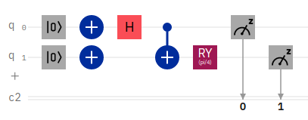
Invert both qubits (they are now |1⟩)
Rotate measurement axis 45 degrees
Hadamard gate on first qubit
First qubit now (|0⟩-|1⟩)/√2
CNOT gate entangles qubits
System now (|10⟩-|01⟩)/√2
Initialize both qubits to |0⟩
Measure

