Slide 1
Week 1: Introduction to Databases
INFO 605 – Database Management Systems
Stephen Frein

Slide 2
Overview
Who cares? (Why study databases?)
Basic concepts
Database examples
Why use a database (and why not)?
Data models
Schemas vs state

Slide 3
Why study databases?
You will most likely interact heavily with databases during your professional career (80% of applications, per some estimates)
Core database concepts and practices are extremely durable, and are likely to serve you for years to come (this course would not have been very different 20 years ago)
Data is the real asset of an organization

Slide 4
Basic concepts
Data:
Known facts that can be recorded and have an understood meaning.
Database:
A collection of related data – generally in support of some organization, process, problem, etc
Organized for easy storage and retrieval
Usually in electronic form

Slide 5
Basic concepts (continued)
Database Management System (DBMS):
A software package/ system to facilitate the creation and maintenance of a computerized database.
Relational Database Management System (RDBMS):
DBMS that uses the relational model to store data; that is, it stores its data in tables, which are referred to as relations (Oracle, SQL Server, and DB2 are all RDBMS systems)

Slide 6
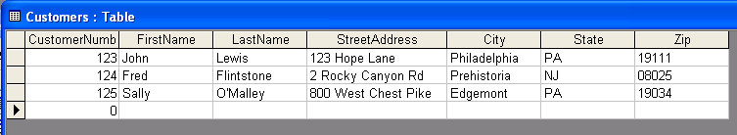
Tables
A relation (table) represents entities of interest as rows and descriptive attributes of those entities as columns – a uniform structure for the things being recorded in the rows
Here is an example relation (table):

Slide 7
Representing Reality
The database tries to model / represent some slice of the real world.
Entities – things that need to be described and about which data will be tracked
Relationships – connections between and among those entities that document how they interact

Slide 8
Example database
Real world situation being modeled:
UNIVERSITY environment.
Some entities from that situation:
STUDENTs
COURSEs
SECTIONs (of COURSEs)
(academic) DEPARTMENTs
INSTRUCTORs

Slide 9
Example relationships
Some associated relationships:
SECTIONs are of specific COURSEs
STUDENTs take SECTIONs
COURSEs have prerequisite COURSEs
INSTRUCTORs teach SECTIONs
COURSEs are offered by DEPARTMENTs
STUDENTs major in DEPARTMENTs
Next week, we’ll see how to document the entities and relationships from this “mini-world” with an entity-relationship (ER) model; for now, we’ll just describe them textually

Slide 10
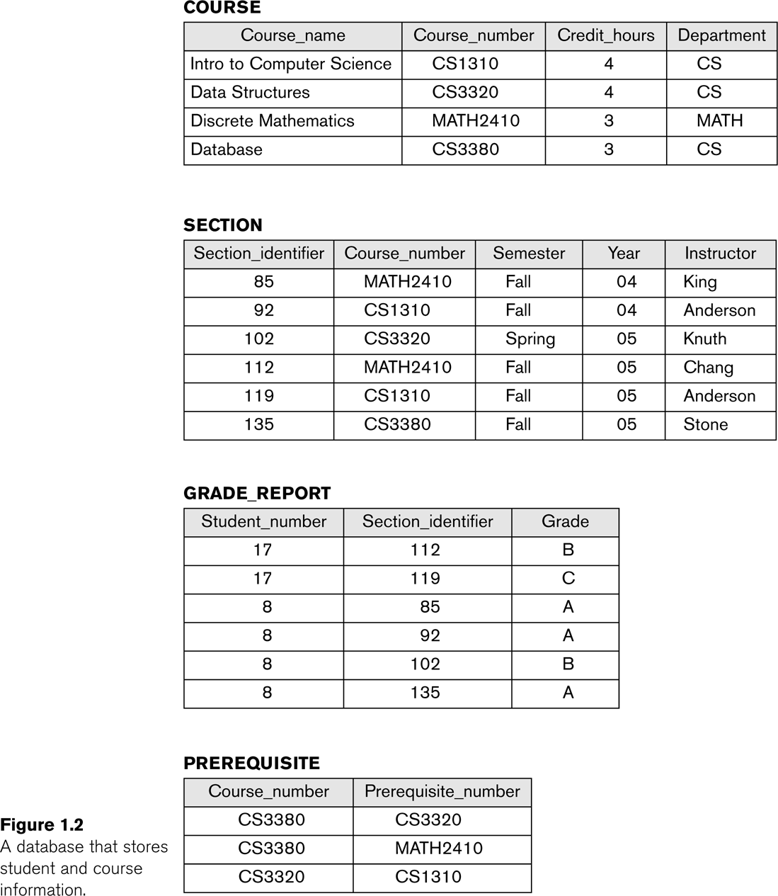
Sample data values

Slide 11
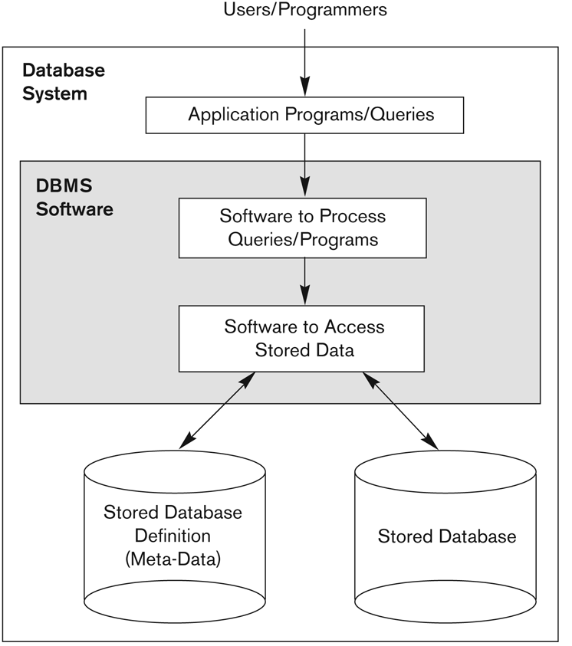
Simple database environment

Slide 12
When are databases used?
Sales transactions at a large store
Registering for courses
EZ Pass (electronic toll payment)
Library management
(We could go on for a long time . . . )
Bottom line: databases are everywhere, because almost any organization of appreciable complexity has information management requirements that are hard to satisfy without using a database (and a DBMS)

Slide 13
Database vs custom storage
Rather than keep your data in a database managed by a DBMS, you could always “roll your own” by having application programs maintain their own data files
This makes sense in some circumstances, but it can introduce a number of problems
Such decisions must be weighed carefully

Slide 14
Sample custom file

Slide 15
Sample custom file
Any special formatting rules
or validations here?
What values can
we have here? Is
there a fixed list?
Why so many spaces
after what seems like
a fixed-length field?
What is this? Is it a 5-digit zip followed by a ten-digit phone number? Is it
a nine-digit zip followed by a 6-digit something else? None of the above?
Humans can “eyeball” much of this data to figure out what it means, but even we
have trouble at the end of each record. If some new piece of software needs to use
this data, how easily could it do that?

Slide 16
Drawbacks of custom storage
File-based approaches often have the following drawbacks:
Data is useful to only those applications responsible for defining its structure
This spawns incompatible file formats, which leads to redundancy (can’t re-use and so must re-create)
Little centralized control of data – everything aspect of the data must be controlled through applications, and these may not be consistent in their approach, or able to coordinate well

Slide 17
Solution: be logical, not physical
The solution to this is to lift basic data management responsibilities out of particular application programs and centralize these responsibilities in a single system, the DBMS
Application programs ask the DBMS to perform functions based on logical characteristics of the data (e.g. delete the customer with customer number 123) as opposed to physical characteristics (e.g., delete the record residing at a certain location in memory or on disk)

Slide 18
Focus on what, not how
This arrangement allows a number of different kinds of applications to work with the same set of data
All these applications have to do is to make logical requests (requests tied to data meanings and values, as opposed to physical storage characteristics) in a language that the DBMS understands
For an RDBMS, this language is some flavor of SQL (Structured Query Language), which we will cover extensively later in the course

Slide 19
Other advantages
Once we push data management functions off to a central location and point of control, we gain certain other advantages:
Enforcement of logical constraints (ensure that the data must always meet certain conditions, such as “the same telephone number can’t be entered twice,” regardless of the application manipulating it)
Security (control who is authorized to manipulate what)
Concurrency (govern what types of activities can take place at the same time)

Slide 20
Other advantages (continued)
Backup and disaster recovery (prevent data loss)
Self-description (metadata describing what is kept in the database)
Can change physical organization of data without needing to rewrite the applications that use it
Can present different users with customized views of the same data

Slide 21
Why avoid a database?
Main inhibitors (costs) of using a DBMS:
Higher initial investment and possible need for additional hardware.
Overhead for providing security, concurrency control, recovery, integrity, and other functions.
When a DBMS may not be called for:
If the database and applications are simple, well defined, and not expected to change much
If there are stringent real-time requirements that may not be met because of DBMS overhead.
If the data management need is highly specialized (but assume that yours isn’t until you know otherwise)

Slide 22
Other kinds of databases
This course focuses on “relational” (table-centric) databases, but we also may have reasons to use other kinds of databases:
If they are a better fit for the kind of data we are storing, because of irregular structure or close ties to some programming language
E.g., XML and object-oriented databases
If we are solving an unusual problem and need special performance, scalablity, or usability characteristics
E.g., No-SQL databases
However, these needs are generally niche / rare – most applications will work best with relational databases, which are flexible, well-understood, widely used, and well-supported

Slide 23
XML Document (Not a Table)
<CATALOG>
<CD>
<TITLE>Empire Burlesque</TITLE>
<ARTIST>Bob Dylan</ARTIST>
<COMPANY>Columbia</COMPANY>
<YEAR>1985</YEAR>
</CD>
<CD>
<TITLE>Hide your heart</TITLE>
<ARTIST>Bonnie Tyler</ARTIST>
<COMPANY>CBS Records</COMPANY>
<YEAR>1988</YEAR>
</CD>
</CATALOG>

Slide 24
JSON Object (Not a Table)
{"CATALOG":
{"CD":[
{"TITLE":"Empire Burlesque",
"ARTIST":"Bob Dylan",
"COMPANY":"Columbia",
"YEAR":"1985“},
{"TITLE":"Hide your heart",
"ARTIST":"Bonnie Tyler",
"COMPANY":"CBS Records",
"YEAR":"1988"}
]
}
}

Slide 25
Data models
Data Model:
A set of concepts to describe the structure of a database, constraints that the database should obey, and operations that can be performed on the data.
Structure and Constraints:
Structure typically includes elements (the specific pieces of data we will store, like “LastName”) as well as groups of elements (e.g. entity, record, table), and relationships among such groups
Constraints specify some restrictions on valid data; these constraints must be enforced at all times
Operations tell us what we can do to the data (create it, compare it, and so on)

Slide 26
Three kinds of data models
Conceptual – describes the “real world” entities and relationships that the database is meant to reflect, and should be relatively intelligible to end users; this is basically ER modeling, which we will begin next week
Logical (Implementation) – describes the database in terms of a series of table definitions and keys (column constraints) that represent aspects of the conceptual model; this the creation of relational schemas, which we will cover later in the term
Physical – describes how the logical/implementation model will be concretely embodied in some particular DBMS (e.g., how things will be stored on disk)

Slide 27
Schema vs State
Basically, this is structure vs content
Database Schema:
The structural description of a particular database.
Includes descriptions of the tables, columns, data types, and the constraints on the database.
Schema Diagram:
A graphical display of (most aspects of) a database schema. (We’ll see one in a minute.)

Slide 28
Schema vs State
Database State:
The actual data stored in a database at a particular moment in time. A snapshot that includes the collection of all the data in the database.

Slide 29
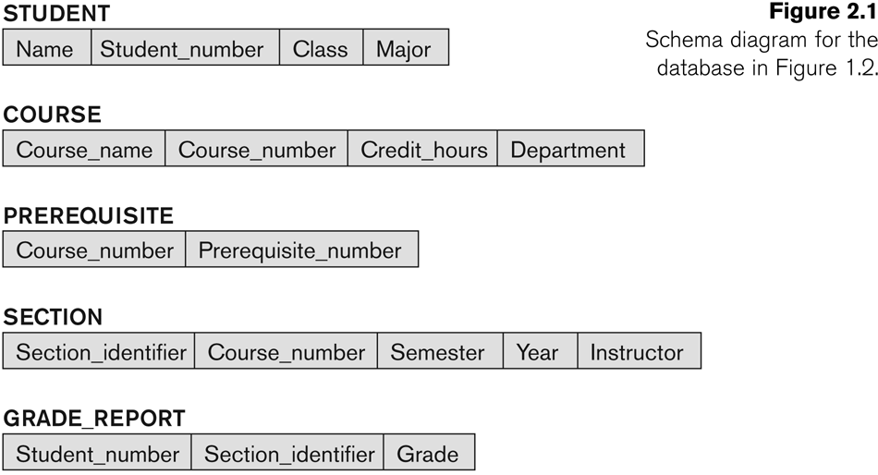
Example Database Schema

Slide 30
Corresponding State
Look back at slide 10 for an example of state (values) that align with this schema (Student isn’t shown there, but the other constructs are)

Slide 31
Next Week
We’ll take a look at ER modeling, which is a kind of conceptual data model, and see how to translate business requirements into ER notation

Slide 32
Review
Who cares? (Why study databases?)
Basic concepts
Database examples
Why use a database (and why not)?
Data models
Schemas vs state

Slide 33
Questions?
Thank you!

