Slide 1
What is Python?
Python is a cross-platform programming language, meaning, it runs on multiple platforms like Windows, Mac OS X, Linux, Unix and has even been ported to the Java and .NET virtual machines.
It is free and open source. Even though most of today’s Linux and Mac have Python preinstalled in it, the version might be out-of-date.

Slide 2
Introduction to Python
Python is an object-oriented programming language created by Guido Rossum in 1989.
It is ideally designed for rapid prototyping of complex applications.
It has interfaces to many OS system calls and libraries and is extensible to C or C++.
Many large companies use the Python programming language include NASA, Google, YouTube, BitTorrent, etc.
Python is widely used in Artificial Intelligence, Natural Language Generation, Neural Networks and other advanced fields of Computer Science.

Slide 3
Python Features
Easy-to-learn − Python has few keywords, simple structure, and a clearly defined syntax.
Easy-to-read − Python code is more clearly defined and visible to the eyes.
Easy-to-maintain − Python's source code is fairly easy-to-maintain.
A broad standard library − Python's bulk of the library is very portable and cross-platform compatible on UNIX, Windows, and Macintosh.
Interactive Mode − Python has support for an interactive mode which allows interactive testing and debugging of snippets of code.
Portable − Python can run on a wide variety of hardware platforms and has the same interface on all platforms.
Extendable − You can add low-level modules to the Python interpreter. These modules enable programmers to add to or customize their tools to be more efficient.
Databases − Python provides interfaces to all major commercial databases.

Slide 4
GUI Programming − Python supports GUI applications that can be created and ported to many system calls, libraries and windows systems, such as Windows MFC, Macintosh, and the X Window system of Unix.
Scalable − Python provides a better structure and support for large programs than shell scripting.
Apart from the above-mentioned features, Python has a big list of good features−
It supports functional and structured programming methods as well as OOP.
It can be used as a scripting language or can be compiled to byte-code for building large applications.
It provides very high-level dynamic data types and supports dynamic type checking.
It supports automatic garbage collection.
It can be easily integrated with C, C++, COM, ActiveX, CORBA, and Java.

Slide 5
Python Applications
Web Application: Python can be used to develop scalable and secure web applications. Frameworks like Django, Flask, Pyramid etc are amazing to design and develop web based applications.
Computer Software or Desktop Applications: As python can be used to develop GUI too, hence it is a great choice for developing desktop applications. Tk is an open source widget toolkit which can be used to develop desktop applications with python. Kivy is another such platform.
Scientific Computing Application: For its amazing computational power and simple syntax, python is used for scientific computing applications. Python libraries like SciPy and NumPy are best suited for scientific computations.
AI and ML(Artificial Intelligence and Machine Learning): Python is at the fore front of the paradigm shift towards Artificial Intelligence and Machine Learning.
Image Processing: Python is known for its image processing capabilities, which includes traversing and analysing any image pixel by pixel. There are numerous python libraries available for image processing, for example: Pillow, scikit-image etc.

Slide 6
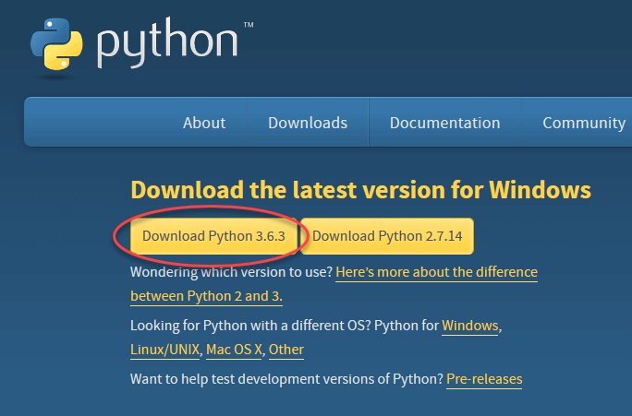

Slide 7
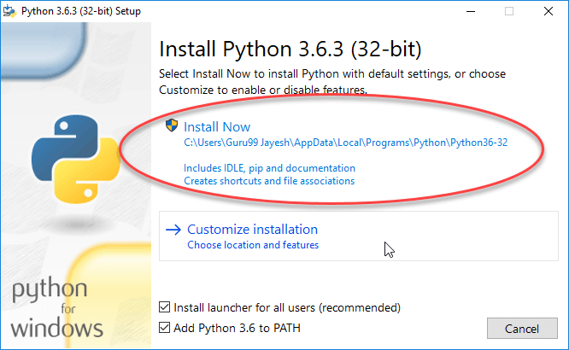

Slide 8
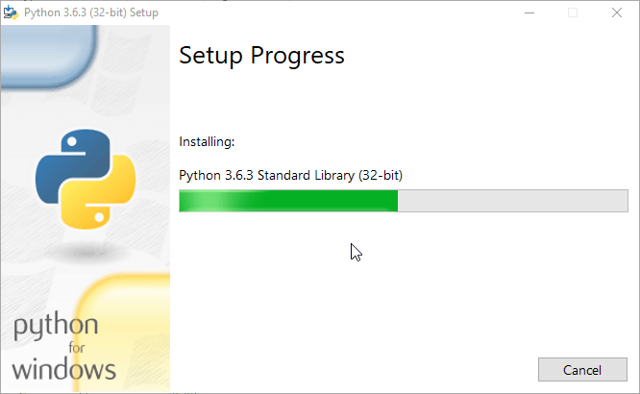

Slide 9
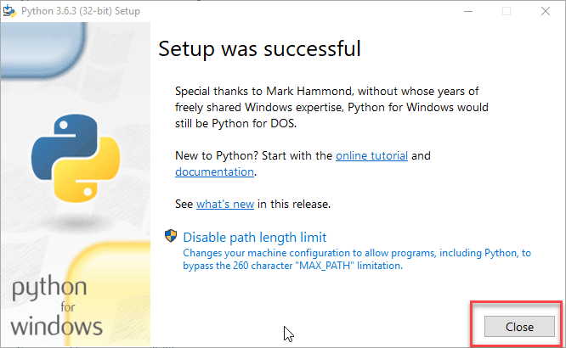

Slide 10
Variables
variables are used to store information to be referenced and manipulated in a computer program.
A variable name must start with a letter or the underscore character
A variable name cannot start with a number
A variable name can only contain alpha-numeric characters and underscores (A-z, 0-9, and _ )
Variable names are case-sensitive (age, Age and AGE are three different variables)

Slide 11
Examples:
x = 5
y = "John"
print(x)
print(y)
p = pow(5, 2)
import math
q = math.log(x)
x = "awesome"
print("Python is " + x)

Slide 12
Keywords
Keywords are special words which are reserved and have a specific meaning.
Python has a set of keywords that cannot be used as variables in programs.
All keywords in Python are case sensitive.

Slide 13
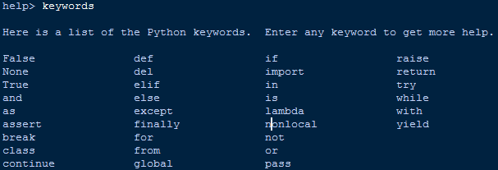

Slide 14
Example
import keyword
keyword.iskeyword("technology")
keyword.iskeyword("try")

Slide 15
Identifiers
Python Identifier is the name we give to identify a variable, function, class, module or other object. That means whenever we want to give an entity a name, that’s called identifier.
Sometimes variable and identifier are often misunderstood as same but they are not.
Identifiers can be combination of uppercase and lowercase letters, digits or an underscore(_). So myVariable, variable_1, variable_for_print all are valid python identifiers.
An Identifier can not start with digit. So while variable1 is valid, 1variable is not valid.
We can’t use special symbols like !,#,@,%,$ etc in our Identifier.
Identifier can be of any length.

Slide 16
Literals
Literal is a raw data given in a variable or constant. In Python, there are various types of literals they are as follows:Numeric Literals,String literals,Boolean literals,Special literals,Literal Collections
strings = "This is Python"
char = "C"
multiline_str = """This is a multiline string with more than one line code."""
print(strings)
print(char)
print(multiline_str)

Slide 17
Operators: Arithematic Operators
Operator | Name | Example
+ | Addition | x + y
- | Subtraction | x - y
* | Multiplication | x * y
/ | Division | x / y
% | Modulus | x % y
** | Exponentiation | x ** y
// | Floor division | x // y

Slide 18
Example
a=100
b=200
print(a+b)
print(a-b)
print(a*b)
print(b/a)
print(a%b)
print(a**b)
prints (a^b)

Slide 19
Assignment Operators
Operator | Example | Same As
= | x = 5 | x = 5
+= | x += 3 | x = x + 3
-= | x -= 3 | x = x - 3
*= | x *= 3 | x = x * 3
/= | x /= 3 | x = x / 3
%= | x %= 3 | x = x % 3
//= | x //= 3 | x = x // 3
**= | x **= 3 | x = x ** 3
&= | x &= 3 | x = x & 3
|= | x |= 3 | x = x | 3
^= | x ^= 3 | x = x ^ 3
>>= | x >>= 3 | x = x >> 3
<<= | x <<= 3 | x = x << 3

Slide 20
a=3
b=4
print("a: "+str(a))
print("b: "+str(b))
a+=b
print("a: "+str(a))
print("b: "+str(b))
a*=b
print("a: "+str(a))
print("b: "+str(b))

Slide 21
a/=b
print("a: "+str(a))
print("b: "+str(b))
a%=b
print("a: "+str(a))
print("b: "+str(b))
a**=b
print("a: "+str(a))
print("b: "+str(b))
a//=b
print("a: "+str(a))
print("b: "+str(b))
myVariable1="hello world"
myVariable2=100
myVariable3=12.23

Slide 22
Comparison Operators
a=100
b=200
print(a==b)
print(a!=b)
print(a>b)
print(a<b)
print(a>=b)
print(a<=b)

Slide 23
Logical Operators
a=int(input())
if a%4==0 and a%3==0:
print("divided by both 4 and 3")
if a%4==0 or a%3==0:
print("either divided by 4 or 3")
if not(a%4==0 or a%3==0):
print("neither divided by 4 nor 3")

Slide 24
Identity Operators
Operator | Description | Example
is | Returns true if both variables are the same object | x is y
is not | Returns true if both variables are not the same object | x is not y

Slide 25
Example
x = ["apple", "banana"]
y = ["apple", "banana"]
z = x
print(x is z)
print(x is y)

Slide 26
Membership Operators
Operator | Description | Example
in | Returns True if a sequence with the specified value is present in the object | x in y
not in | Returns True if a sequence with the specified value is not present in the object | x not in y

Slide 27
Example
x = ["apple", "banana"]
print("banana" in x)

Slide 28
Bitwise Operators
Operator | Name | Description
& | AND | Sets each bit to 1 if both bits are 1
| | OR | Sets each bit to 1 if one of two bits is 1
^ | XOR | Sets each bit to 1 if only one of two bits is 1
~ | NOT | Inverts all the bits
<< | Zero fill left shift | Shift left by pushing zeros in from the right and let the leftmost bits fall off
>> | Signed right shift | Shift right by pushing copies of the leftmost bit in from the left, and let the rightmost bits fall off

Slide 29
Comments
Python Comment are statements that are not part of your program.
One can understand a program done a long time a ago simply from the comments of the program.
In Python there are two types of comments- Single line comments and Multiple lines comments.
Single line commenting is commonly used for a brief and quick comment.
On the other hand we use the Multiple lines comments to note down something much more in details or to block out an entire chunk of code.

Slide 30
Example
#this is a comment. I can write whatever I want here
#print("I will not be executed")
print("I will be executed")

Slide 31
Example
'''
print("I am in Multiple line comment line 1")
print ("I am in Multiple line comment line 2")
'''
print("I am out of Multiple line comment")

Slide 32
Python If
Suppose we want to write a program, that will determine whether a number is odd or even.
If the number is odd, we want to print – “the number is odd” and if the number is even we want to print – “the number is even”.

Slide 33
Example
n=input()
n=int(n)
if n%2==0:
print("the number is even")
if n%2==1:
print("the number is odd")

Slide 35
Python If-else
Well, in the above scenario, the condition we have put, n%2, which has only two possible outcome.
Either it’s zero or one. So here we can use else for the second condition. In that case we don’t have to write the second condition manually. We can write the first condition using a if and use else for other case.

Slide 36
Example
n=input()
n=int(n)
if n%2==0:
print("the number is even")
else
print("the number is odd")

Slide 37
Python elif
The elif keyword is pythons way of saying "if the previous conditions were not true, then try this condition".

Slide 38
Example
n=input()
n=int(n)
if n>=1 and n<=10:
print("too low");
elif n>=11 and n<=20:
print("medium");
elif n>=21 and n<=30:
print("large");
else:
print("too large")

Slide 39
For loop
Python for loop is used to iterate over a list, tuple or strings.
Syntax:
for itarator_variable in sequence_name:
Statements
. . .
Statements

Slide 40
Example
word="anaconda"
for letter in word:
print (letter)
words= ["Apple", "Banana", "Car", "Dolphin" ]
for word in words:
print (word)

Slide 41
Nested For loop
You can also write one for loop in between another for loop.
But in this case, you have to maintain the indentation properly.

Slide 42
Example
words= ["Apple", "Banana", "Car", "Dolphin" ]
for word in words:
print ("The following lines will print each letters of "+word)
for letter in word:
print (letter)
print("")

Slide 43
While loop
Python while loop is used to repeatedly execute some statements till the condition is true.
Syntax:
While condition :
#Start of the statements
Statement
. . . . . . .
Statement
#End of the Statements
else :
#this scope is optional
#This statements will be executed if the condition
#written to execute while loop is false

Slide 44
Example
cnt=1
while cnt < 5 :
print (cnt),
print ("This is inside of while loop")
cnt+=1;
else :
print (cnt),
print("This is outside of while loop")

Slide 45
Example
word="anaconda"
pos=0 #initial position is zero
while pos < len(word) :
print (word[pos])
#increment the position after printing the letter of that position
pos+=1

Slide 46
Nested while loop
line=1
while line <= 5 :
pos = 1
while pos < line:
print pos,
pos += 1
else:
print pos
line += 1

Slide 47
Python Break
This statement is used to break the loop
number = 1
while True :
print (number)
number+=2
if number > 10:
break;
print (number)

Slide 48
Example
words = ["rain", "sun", "moon", "exit", "weather"]
for word in words:
if word == "exit" :
break;
print (word)

Slide 49
Python Continue
Python continue statement is used to skip the statement of the loop and iterate to the next step.
numbers = [ 1, 2, 4, 3, 6, 5, 7, 10, 9 ]
pos = 0
while pos < len(numbers):
if numbers[pos] % 2 == 0 :
pos = pos + 1
continue
print (numbers[pos])
pos = pos + 1

Slide 50
Example
numbers = range(1,11)
''‘
the range(a,b) function creates a list of number 1 to (b-1)
So, in this case it would generate
numbers from 1 to 10
''‘
for number in numbers:
if number == 7:
print("7 is skipped")
continue
print ("This won't be printed")
print (number*2),
print ("is double of"),
print (number)

Slide 51
Python pass statement
You can consider python pass statement as no operation statement.
The difference between Python comments and pass statement is; comments are being eliminated while interpreting the program but pass statement does not.
It consumes execution cycle like a valid statement.

Slide 52
Example
List <- a list of number
for each number in the list:
if the number is even,
then, do nothing
else
print odd number

Slide 53
Example
numbers = [ 1, 2, 4, 3, 6, 5, 7, 10, 9 ]
for number in numbers:
if number % 2 == 0:
pass
else:
print (number),

Slide 54
What is String in Python?
A string is a sequence of characters.
How to create a string in Python?
Strings can be created by enclosing characters inside a single quote or double quotes.
Even triple quotes can be used in Python but generally used to represent multiline strings and docstrings.

Slide 55
Example
my_string = 'Hello‘
print(my_string)my_string = "Hello“
print(my_string)my_string = '''Hello''‘
print(my_string)
my_string = """Hello, welcome to the world of Python""“
print(my_string)

Slide 56
How to access characters in a string?
We can access individual characters using indexing and a range of characters using slicing.
Index starts from 0.
Trying to access a character out of index range will raise an IndexError .

Slide 57
Example
str = 'programiz‘
print('str = ', str)
#first character
print('str[0] = ', str[0])
#last character
print('str[-1] = ', str[-1])
#slicing 2nd to 5th character
print('str[1:5] = ', str[1:5])
#slicing 6th to 2nd last character
print('str[5:-2] = ', str[5:-2])

Slide 58
String Operators
Get the character at position 1 (remember that the first character has the position 0):
a = "Hello, World!" print(a[1])
Substring. Get the characters from position 2 to position 5 (not included):
b = "Hello, World!" print(b[2:5])
The strip() method removes any whitespace from the beginning or the end:
a = " Hello, World! " print(a.strip()) # returns "Hello, World!"

Slide 59
The len() method returns the length of a string:
a = "Hello, World!" print(len(a))
The lower() method returns the string in lower case:
a = "Hello, World!" print(a.lower())
The upper() method returns the string in upper case:
a = "Hello, World!" print(a.upper())
The replace() method replaces a string with another string:
a = "Hello, World!" print(a.replace("H", "J"))
The split() method splits the string into substrings if it finds instances of the separator:
a = "Hello, World!" print(a.split(",")) # returns ['Hello', ' World!']

Slide 60
Python Lists
List is a collection which is ordered and changeable. Allows duplicate members.
Print the second item of the list:
thislist = ["apple", "banana", "cherry"] print(thislist[1])
Change Item Value
To change the value of a specific item, refer to the index number:
Change the second item:
thislist = ["apple", "banana", "cherry"] thislist[1] = "blackcurrant" print(thislist)

Slide 61
Loop Through a List
You can loop through the list items by using a for loop:
Print all items in the list, one by one:
thislist = ["apple", "banana", "cherry"]
for x in thislist:
print(x)

Slide 62
Check if Item Exists
To determine if a specified item is present in a list use the in keyword:
thislist = ["apple", "banana", "cherry"]
if "apple" in thislist:
print("Yes, 'apple' is in the fruits list")

Slide 63
List Length
To determine how many items a list have, use the len() method:
Print the number of items in the list:
thislist = ["apple", "banana", "cherry"]
print(len(thislist))

Slide 64
Add Items
To add an item to the end of the list, use the append() method:
Using the append() method to append an item:
thislist = ["apple", "banana", "cherry"] thislist.append("orange") print(thislist)

Slide 65
To add an item at the specified index, use the insert() method:
Insert an item as the second position:
thislist = ["apple", "banana", "cherry"] thislist.insert(1, "orange") print(thislist)

Slide 66
Remove Item
There are several methods to remove items from a list:
The remove() method removes the specified item:
thislist = ["apple", "banana", "cherry"]
thislist.remove("banana")
print(thislist)

Slide 67
The pop() method removes the specified index, (or the last item if index is not specified):
thislist = ["apple", "banana", "cherry"]
thislist.pop()
print(thislist)

Slide 68
The del keyword removes the specified index:
thislist = ["apple", "banana", "cherry"]
del thislist[0]
print(thislist)

Slide 69
The del keyword can also delete the list completely:
thislist = ["apple", "banana", "cherry"]
del thislist
print(thislist) #this will cause an error because "thislist" no longer exists

Slide 70
The clear() method empties the list:
thislist = ["apple", "banana", "cherry"]
thislist.clear()
print(thislist)

Slide 71
It is also possible to use the list() constructor to make a list.
Using the list() constructor to make a List:
thislist = list(("apple", "banana", "cherry")) # note the double round-brackets
print(thislist)

Slide 72
List Methods
Method | Description
append() | Adds an element at the end of the list
clear() | Removes all the elements from the list
copy() | Returns a copy of the list
count() | Returns the number of elements with the specified value
extend() | Add the elements of a list (or any iterable), to the end of the current list
index() | Returns the index of the first element with the specified value
insert() | Adds an element at the specified position
pop() | Removes the element at the specified position
remove() | Removes the item with the specified value
reverse() | Reverses the order of the list
sort() | Sorts the list

Slide 73
Append
fruits = ["apple", "banana", "cherry"]
fruits.append("orange")
print(fruits)
a = ["apple", "banana", "cherry"]
b = ["Ford", "BMW", "Volvo"]
a.append(b)
print(a)

Slide 74
Clear
fruits = ["apple", "banana", "cherry"]
fruits.clear()
print(fruits)

Slide 75
Copy
fruits = ["apple", "banana", "cherry"]
x = fruits.copy()
print(x)

Slide 76
Count
fruits = [1, 4, 2, 9, 7, 8, 9, 3, 1]
x = fruits.count(9)
print(x)

Slide 77
Extend
fruits = ['apple', 'banana', 'cherry']
points = (1, 4, 5, 9)
fruits.extend(points)
print(fruits)

Slide 78
Index
fruits = [4, 55, 64, 32, 16, 32]
x = fruits.index(32)
print(x)

Slide 79
Insert*
fruits = ['apple', 'banana', 'cherry']
x = fruits.insert(1, "orange")
print(x)

Slide 80
Reverse
fruits = ['apple', 'banana', 'cherry']
fruits.reverse()
print(fruits)

Slide 81
Sort
cars = ['Ford', 'BMW', 'Volvo']
cars.sort()
print(cars)

Slide 82
Pop
fruits = ['apple', 'banana', 'cherry']
fruits.pop(1)
print(fruits)

Slide 83
Remove()
fruits = ['apple', 'banana', 'cherry']
fruits.remove("banana")
print(fruits)

Slide 84
Python Tuples
A tuple is a collection which is ordered and unchangeable. In Python tuples are written with round brackets.
thistuple = ("apple", "banana", "cherry")
print(thistuple)
Access Tuple Items
You can access tuple items by referring to the index number:
Return the item in position 1:
thistuple = ("apple", "banana", "cherry") print(thistuple[1])

Slide 85
Change Tuple Values
Once a tuple is created, you cannot change its values. Tuples are unchangeable.
You cannot change values in a tuple:
thistuple = ("apple", "banana", "cherry") thistuple[1] = "blackcurrant" # The values will remain the same: print(thistuple)

Slide 86
Loop Through a Tuple
You can loop through the tuple items by using a for loop.
Iterate through the items and print the values:
thistuple = ("apple", "banana", "cherry")
for x in thistuple:
print(x)

Slide 87
Check if Item Exists
To determine if a specified item is present in a tuple use the in keyword:
Check if "apple" is present in the tuple:
thistuple = ("apple", "banana", "cherry")
if "apple" in thistuple:
print("Yes, 'apple' is in the fruits tuple")

Slide 88
Tuple Length
To determine how many items a list have, use the len() method:
Print the number of items in the tuple:
thistuple = ("apple", "banana", "cherry")
print(len(thistuple))

Slide 89
Add Items
Once a tuple is created, you cannot add items to it. Tuples are unchangeable.
You cannot add items to a tuple:
thistuple = ("apple", "banana", "cherry") thistuple[3] = "orange" # This will raise an error print(thistuple)

Slide 90
Remove Items
Note: You cannot remove items in a tuple.
Tuples are unchangeable, so you cannot remove items from it, but you can delete the tuple completely:
The del keyword can delete the tuple completely:
thistuple = ("apple", "banana", "cherry")
del thistuple
print(thistuple) #this will raise an error because the tuple no longer exists

Slide 91
The tuple() Constructor
It is also possible to use the tuple() constructor to make a tuple.
Using the tuple() method to make a tuple:
thistuple = tuple(("apple", "banana", "cherry")) # note the double round-brackets print(thistuple)

Slide 92
Tuple Methods
Method | Description
count() | Returns the number of times a specified value occurs in a tuple
index() | Searches the tuple for a specified value and returns the position of where it was found

Slide 93
Count
thistuple = (1, 3, 7, 8, 7, 5, 4, 6, 8, 5)
x = thistuple.count(5)
print(x)

Slide 94
Index
thistuple = (1, 3, 7, 8, 7, 5, 4, 6, 8, 5)
x = thistuple.index(8)
print(x)

Slide 95
Dictionary
A dictionary is a collection which is ordered, changeable and indexed. In Python dictionaries are written with curly brackets, and they have keys and values.
thisdict = {
"brand": "Ford",
"model": "Mustang",
"year": 1964
}
print(thisdict)

Slide 96
Accessing Items
You can access the items of a dictionary by referring to its key name:
Get the value of the "model" key:
thisdict = {
"brand": "Ford",
"model": "Mustang",
"year": 1964
}
x = thisdict["model"]
print(x)

Slide 97
thisdict = {
"brand": "Ford",
"model": "Mustang",
"year": 1964
}
x = thisdict.get("model")
print(x)

Slide 98
Change Values
You can change the value of a specific item by referring to its key name:
thisdict = {
"brand": "Ford",
"model": "Mustang",
"year": 1964
}
thisdict["year"] = 2018
print(thisdict)

Slide 99
Loop Through a Dictionary
When looping through a dictionary, the return value are the keys of the dictionary, but there are methods to return the values as well.
thisdict = {
"brand": "Ford",
"model": "Mustang",
"year": 1964
}
for x in thisdict:
print(x)

Slide 100
Check if Key Exists
To determine if a specified key is present in a dictionary use the in keyword:
thisdict = {
"brand": "Ford",
"model": "Mustang",
"year": 1964
}
if "model" in thisdict:
print("Yes, 'model' is one of the keys in the thisdict dictionary")

Slide 101
Dictionary Length
To determine how many items (key-value pairs) a dictionary have, use the len() method.
thisdict = {
"brand": "Ford",
"model": "Mustang",
"year": 1964
}
print(len(thisdict))

Slide 102
Adding Items
Adding an item to the dictionary is done by using a new index key and assigning a value to it:
thisdict = {
"brand": "Ford",
"model": "Mustang",
"year": 1964
}
thisdict["color"] = "red"
print(thisdict)

Slide 103
Removing Items
There are several methods to remove items from a dictionary:
thisdict = {
"brand": "Ford",
"model": "Mustang",
"year": 1964
}
thisdict.pop("model")
print(thisdict)

Slide 104
thisdict = {
"brand": "Ford",
"model": "Mustang",
"year": 1964
}
thisdict.popitem()
print(thisdict)

Slide 105
thisdict = {
"brand": "Ford",
"model": "Mustang",
"year": 1964
}
del thisdict["model"]
print(thisdict)

Slide 106
The dict() Constructor
It is also possible to use the dict() constructor to make a dictionary:
thisdict = dict(brand="Ford", model="Mustang", year=1964)
# note that keywords are not string literals
# note the use of equals rather than colon for the assignment
print(thisdict)

Slide 107
Dictionary Methods
Method | Description
clear() | Removes all the elements from the dictionary
copy() | Returns a copy of the dictionary
fromkeys() | Returns a dictionary with the specified keys and values
get() | Returns the value of the specified key
items() | Returns a list containing the a tuple for each key value pair
keys() | Returns a list contianing the dictionary's keys
pop() | Removes the element with the specified key
popitem() | Removes the last inserted key-value pair
setdefault() | Returns the value of the specified key. If the key does not exist: insert the key, with the specified value
update() | Updates the dictionary with the specified key-value pairs
values() | Returns a list of all the values in the dictionary

Slide 108
Clear
car = {
"brand": "Ford",
"model": "Mustang",
"year": 1964
}
car.clear()
print(car)

Slide 109
Copy
car = {
"brand": "Ford",
"model": "Mustang",
"year": 1964
}
x = car.copy()
print(x)

Slide 110
fromkeys
x = ('key1', 'key2', 'key3')
y = 0
thisdict = dict.fromkeys(x, y)
print(thisdict)

Slide 111
get
car = {
"brand": "Ford",
"model": "Mustang",
"year": 1964
}
x = car.get("model")
print(x)

Slide 112
items
car = {
"brand": "Ford",
"model": "Mustang",
"year": 1964
}
x = car.items()
print(x)

Slide 113
car = {
"brand": "Ford",
"model": "Mustang",
"year": 1964
}
x = car.items()
car["year"] = 2018
print(x)

Slide 114
keys
car = {
"brand": "Ford",
"model": "Mustang",
"year": 1964
}
x = car.keys()
print(x)

Slide 115
pop
car = {
"brand": "Ford",
"model": "Mustang",
"year": 1964
}
car.pop("model")
print(car)

Slide 116
popitem
car = {
"brand": "Ford",
"model": "Mustang",
"year": 1964
}
car.popitem()
print(car)

Slide 117
setdefault
car = {
"brand": "Ford",
"model": "Mustang",
"year": 1964
}
x = car.setdefault("color", "White")
print(x)

Slide 118
Update
car = {
"brand": "Ford",
"model": "Mustang",
"year": 1964
}
car.update({"color": "White"})
print(car)

Slide 119
values
car = {
"brand": "Ford",
"model": "Mustang",
"year": 1964
}
x = car.values()
car["year"] = 2018
print(x)

Slide 120
Functions
A function is a block of code which only runs when it is called.
You can pass data, known as parameters, into a function.
A function can return data as a result.

Slide 121
Creating a Function
In Python a function is defined using the def keyword:
Example
def my_function(): print("Hello from a function")

Slide 122
Calling a Function
To call a function, use the function name followed by parenthesis:
def my_function():
print("Hello from a function")
my_function()

Slide 123
Parameters
Information can be passed to functions as parameter.
Parameters are specified after the function name, inside the parentheses. You can add as many parameters as you want, just separate them with a comma.
def my_function(fname):
print(fname + " Refsnes")
my_function("Emil")
my_function("Tobias")
my_function("Linus")

Slide 124
Default Parameter Value
If we call the function without parameter, it uses the default value:
Example
def my_function(country = "Norway"):
print("I am from " + country)
my_function("Sweden")
my_function("India")
my_function()
my_function("Brazil")

Slide 125
Return Values
To let a function return a value, use the return statement:
def my_function(x):
return 5 * x
print(my_function(3))
print(my_function(5))
print(my_function(9))

Slide 126
Files I/O
File handling is an important part of any web application.
Python has several functions for creating, reading, updating, and deleting files.

Slide 127
The key function for working with files in Python is the open() function.
The open() function takes two parameters; filename, and mode.

Slide 128
There are four different methods (modes) for opening a file:
"r" - Read - Default value. Opens a file for reading, error if the file does not exist
"a" - Append - Opens a file for appending, creates the file if it does not exist
"w" - Write - Opens a file for writing, creates the file if it does not exist
"x" - Create - Creates the specified file, returns an error if the file exists

Slide 129
Open a File on the Server
Assume we have the following file, located in the same folder as Python:
demofile.txt
Hello! Welcome to demofile.txt This file is for testing purposes. Good Luck!
The open() function returns a file object, which has a read() method for reading the content of the file:
f = open("demofile.txt", "r")
print(f.read())

Slide 130
Read Lines
You can return one line by using the readline() method:
f = open("demofile.txt", "r")
print(f.readline())
f = open("demofile.txt", "r")
print(f.readline())
print(f.readline())

Slide 131
Write to an Existing File
To write to an existing file, you must add a parameter to the open() function:
"a" - Append - will append to the end of the file
"w" - Write - will overwrite any existing content

Slide 132
Example
Open the file "demofile.txt" and append content to the file:
f = open("demofile.txt", "a") f.write("Now the file has one more line!")
Example
Open the file "demofile.txt" and overwrite the content:
f = open("demofile.txt", "w") f.write("Woops! I have deleted the content!")

Slide 133
Create a New File
To create a new file in Python, use the open() method, with one of the following parameters:
"x" - Create - will create a file, returns an error if the file exist
"a" - Append - will create a file if the specified file does not exist
"w" - Write - will create a file if the specified file does not exist

Slide 134
Example
Create a file called "myfile.txt":
f = open("myfile.txt", "x")
Result: a new empty file is created!
Example
Create a new file if it does not exist:
f = open("myfile.txt", "w")

Slide 135
Delete a File
To delete a file, you must import the OS module, and run its os.remove() function:
Example
Remove the file "demofile.txt":
import os
os.remove("demofile.txt")

Slide 136
Check if File exist:
To avoid getting an error, you might want to check if the file exist before you try to delete it:
Example
Check if file exist, then delete it:
import os if os.path.exists("demofile.txt"): os.remove("demofile.txt") else: print("The file does not exist")

Slide 137
Delete Folder
To delete an entire folder, use the os.rmdir() method:
Example
Remove the folder "myfolder":
import os
os.rmdir("myfolder")

Slide 138
Modules
A file containing a set of functions you want to include in your application.

Slide 139
Create a Module
To create a module just save the code you want in a file with the file extension .py:
Example
Save this code in a file named mymodule.py
def greeting(name):
print("Hello, " + name)

Slide 140
Use a Module
Now we can use the module we just created, by using the import statement:
Example
Import the module named mymodule, and call the greeting function:
import mymodule
mymodule.greeting("Jonathan")

Slide 141
Variables in Module
The module can contain functions, as already described, but also variables of all types (arrays, dictionaries, objects etc):
Example
Save this code in the file mymodule.py
person1 = {
"name": "John",
"age": 36,
"country": "Norway"
}

Slide 142
import mymodule
a = mymodule.person1["age"]
print(a)

Slide 143
Naming a Module
You can name the module file whatever you like, but it must have the file extension .py
Re-naming a Module
You can create an alias when you import a module, by using the as keyword:

Slide 144
import mymodule as mx
a = mx.person1["age"]
print(a)

Slide 145
Built-in Modules
There are several built-in modules in Python, which you can import whenever you like.
Example
Import and use the platform module:
import platform
x = platform.system()
print(x)

Slide 146
Using the dir() Function
There is a built-in function to list all the function names (or variable names) in a module. The dir() function:
Example
List all the defined names belonging to the platform module:
import platform
x = dir(platform)
print(x)

Slide 147
Import From Module
You can choose to import only parts from a module, by using the from keyword.
Example
The module named mymodule has one function and one dictionary:

Slide 148
def greeting(name):
print("Hello, " + name)
person1 = {
"name": "John",
"age": 36,
"country": "Norway"
}
from mymodule import person1
print(person1["age"])

Slide 149
Exception Handling
The try block lets you test a block of code for errors.
The except block lets you handle the error.
The finally block lets you execute code, regardless of the result of the try- and except blocks.

Slide 150
Many Exceptions
You can define as many exception blocks as you want, e.g. if you want to execute a special block of code for a special kind of error:

Slide 151
#The try block will generate a NameError, because x is not defined:
try:
print(x)
except NameError:
print("Variable x is not defined")
except:
print("Something else went wrong")

Slide 152
Finally
The finally block, if specified, will be executed regardless if the try block raises an error or not.

Slide 153
Example
#The finally block gets executed no matter if the try block raises any errors or not:
try:
print(x)
except:
print("Something went wrong")
finally:
print("The 'try except' is finished")

Slide 154
#The try block will raise an error when trying to write to a read-only file:
try:
f = open("demofile.txt")
f.write("Lorum Ipsum")
except:
print("Something went wrong when writing to the file")
finally:
f.close()
#The program can continue, without leaving the file object open

Slide 155
Custom Exception Class
Python allow programmers to create their own exception class. Exceptions should typically be derived from the Exception class, either directly or indirectly.
In the following example, we create custom exception class UnderAge that is derived from the base class Exception.
Again, in another method we raised the UnderAge exception if the condition is not met.

Slide 156
class UnderAge(Exception):
pass
def verify_age(age):
if int(age) < 18:
raise UnderAge
else:
print('Age: '+str(age))
# main program
verify_age(23) # won't raise exception
verify_age(17) # will raise exception

Slide 157
Python Date and Time
A date in Python is not a data type of its own, but we can import a module named datetime to work with dates as date objects.
import datetime
x = datetime.datetime.now()
print(x)

Slide 158
Date Output
2018-10-25 16:38:04.203568
The date contains year, month, day, hour, minute, second, and microsecond.
The datetime module has many methods to return information about the date object.

Slide 159
import datetime
x = datetime.datetime.now()
print(x.year)
print(x.strftime("%A"))

Slide 160
Creating Date Objects
To create a date, we can use the datetime() class (constructor) of the datetime module.
The datetime() class requires three parameters to create a date: year, month, day.
import datetime
x = datetime.datetime(2020, 5, 17)
print(x)

Slide 161
The datetime() class also takes parameters for time and timezone (hour, minute, second, microsecond, tzone), but they are optional, and has a default value of 0, (None for timezone).

Slide 162
strftime() Method
The datetime object has a method for formatting date objects into readable strings.
The method is called strftime(), and takes one parameter, format, to specify the format of the returned string:
import datetime
x = datetime.datetime(2018, 6, 1)
print(x.strftime("%B"))

Slide 163
A reference of all the legal format codes:
Directive | Description | Example
%a | Weekday, short version | Wed
%A | Weekday, full version | Wednesday
%w | Weekday as a number 0-6, 0 is Sunday | 3
%d | Day of month 01-31 | 31
%b | Month name, short version | Dec
%B | Month name, full version | December
%m | Month as a number 01-12 | 12
%y | Year, short version, without century | 18
%Y | Year, full version | 2018
%H | Hour 00-23 | 17
%I | Hour 00-12 | 05

Slide 164
%p | AM/PM | PM
%M | Minute 00-59 | 41
%S | Second 00-59 | 08
%f | Microsecond 000000-999999 | 548513
%z | UTC offset | +0100
%Z | Timezone | CST
%j | Day number of year 001-366 | 365
%U | Week number of year, Sunday as the first day of week, 00-53 | 52
%W | Week number of year, Monday as the first day of week, 00-53 | 52
%c | Local version of date and time | Mon Dec 31 17:41:00 2018
%x | Local version of date | 12/31/18
%X | Local version of time | 17:41:00
%% | A % character | %

Slide 165
x = datetime.datetime.now()
print(x.strftime("%a"))
x = datetime.datetime.now()
print(x.strftime("%A"))
x = datetime.datetime.now()
print(x.strftime("%w"))

Slide 166
x = datetime.datetime.now()
print(x.strftime("%d"))
x = datetime.datetime.now()
print(x.strftime("%b"))
x = datetime.datetime.now()
print(x.strftime("%B"))
x = datetime.datetime.now()
print(x.strftime("%m"))

