Slide 1
Selecting a Translation Management System for DalcomSoft
Shivani Balachandar & Michelle Lee

Slide 2

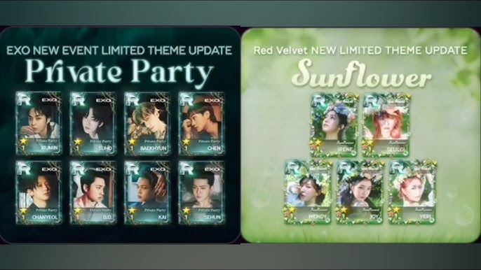
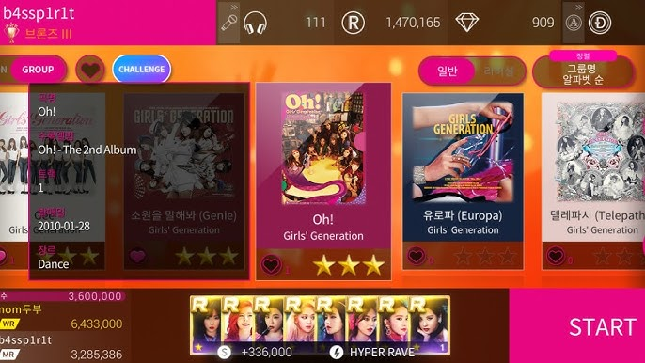
DalcomSoft’s Localization Challenges
Frequent live updates
Multiple languages
Fast turnaround requirements
UI + event localization
Need for automation & AI workflows

Slide 3
Stakeholder Requirements
Stakeholder | Priority
Project Management | Workflow Automation
Translation | Easy-to-use CAT tool
QA | Automated Checks
Engineering | API/Git Integration
Marketing | Fast releases/events following artist schedule
Executives | Scalability and ROI
Players | High Quality Localization/UI

Slide 4
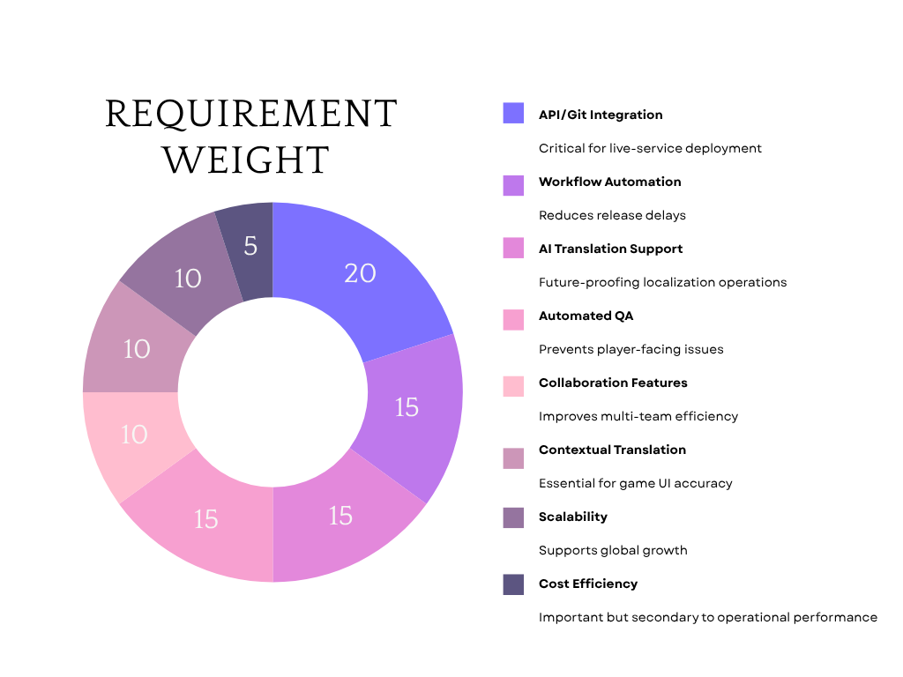
Scorecard
Weighted Evaluation Criteria
Requirement | Weight
API/Git Integration | 20%
Workflow Automation | 15%
AI Features | 15%
Automated QA | 15%
Collaboration | 10%
Context Support | 10%
Scalability | 10%
Cost | 5%

Slide 5
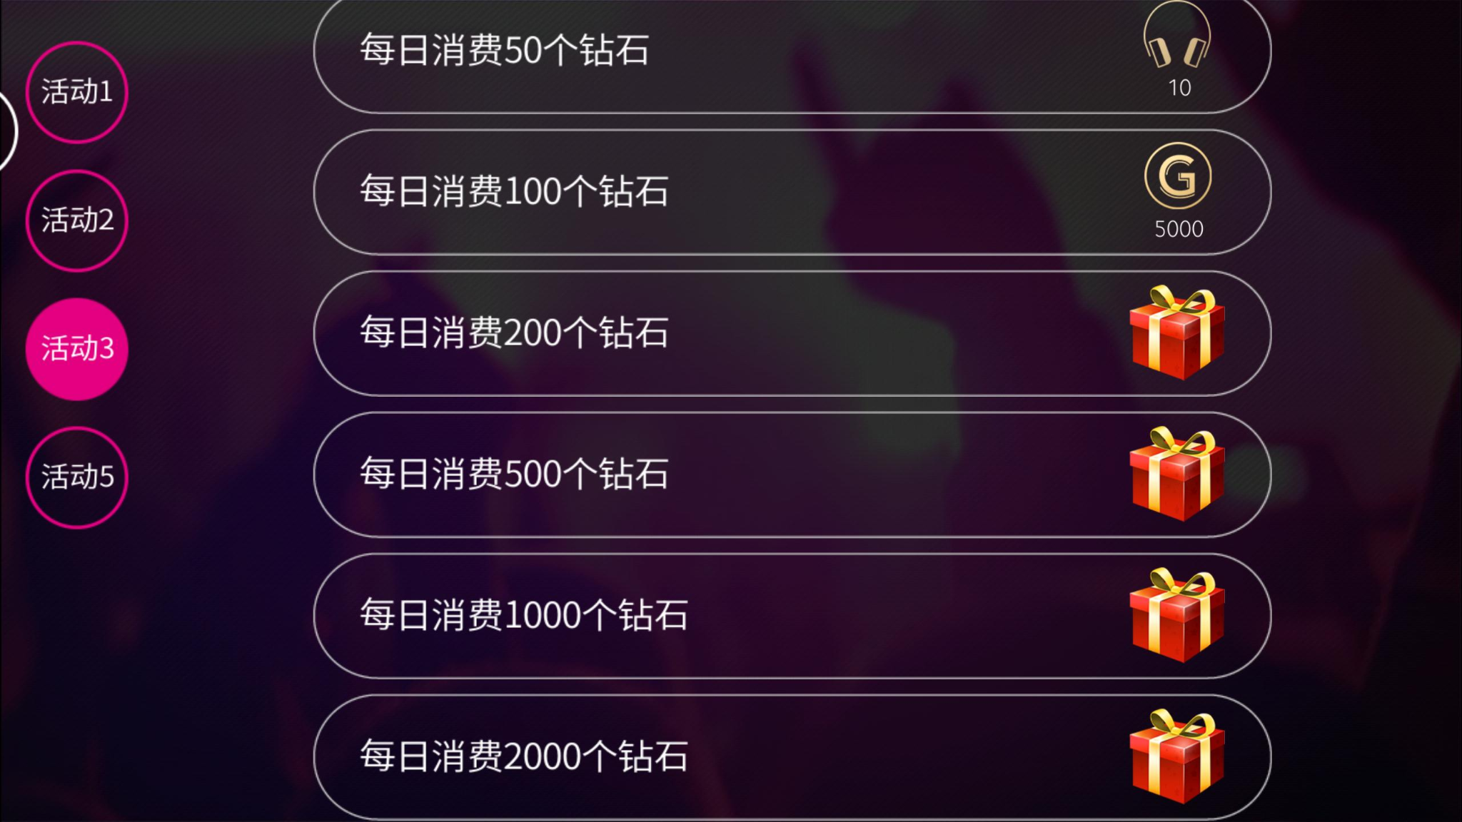
Pilot Project
2-Week Evaluation
Test Content:
UI strings
Event missions
Push notifications
Store banners
Languages:
English
Japanese
Simplified Chinese
Participants:
Translators
QA reviewer
PM
Developer

Slide 6


Platform Comparison
Crowdin | Phrase
Strong game workflow support | Strong enterprise scalability
Excellent contextual tools | Advanced orchestration
Easy collaboration | Powerful automation
Faster onboarding | Higher complexity

Slide 7

Final Decision
470
470
WHY CROWDIN:
✔ Better fit for live-service games
✔ Faster localization workflow
✔ Strong contextual tools
✔ Easier team collaboration
FINAL RECOMMENDATION: CROWDIN

Slide 8
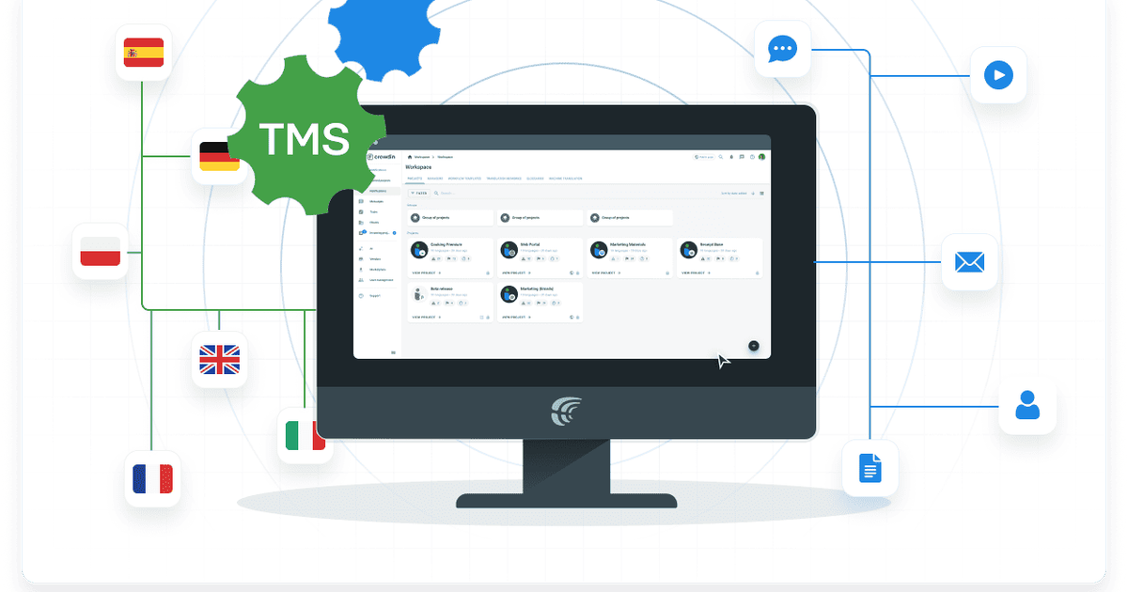
Conclusion
Faster live-service workflows
Better collaboration
Strong AI readiness
Easier implementation
Built for continuous localization

Slide 9
Thank You!

