Slide 1

자유연제 10: 임상 AI: 만성질환·신경·예후 예측
Comparison of Treatment Effect Estimation Methods for Federated Target Trial Emulation
이동근
경북대학교

Slide 2

Why Do We Need FL-TTE?
In treatment effect estimation, single-site data may have limited sample size
Multi-site data can improve generalizability
However, patient-level data cannot be easily shared across institutions
Issue
FL-TTE estimates treatment effects across multiple sites while minimizing the exchange of patient-level information
FL-TTE = Federated Learning + Target Trial Emulation
FedProx vs FedECA

Slide 3
Randomized Controlled Trial (RCT)
Patients
Randomization
Treatment
Control
Compared Outcomes
RCTs are the gold standard for estimating treatment effects.
Treatment effects can be compared under a fair study design.
However, they are costly and time-consuming because of strict criteria.

Slide 4
Real-World Data (RWD)
RWD is an information from routine clinical practice
What is RWD?
Collected from real clinical data
Includes a broader and more diverse patient population
RWD analyzes can be affected by confounding and post-hoc design choices
Limitation
Treatment is not randomly assigned
Imbalanced covariate distributions can be lead to confounding
Post-hoc analysis may lead to results that favor the researcher

Slide 5
Example of Protocol
What to define | Example
Who? | Heart failure patients
Compare what? | Treatment vs Control
Start when? | Discharge date
Follow how long? | 180 days
Measure what? | Death
Estimate what? | Treatment effect
Analyze how? | IPTW + Cox regression

Slide 6
Target Trial Emulation (TTE)
Define the target trial protocol before analysis
TTE
Enable fair comparison between groups
Adjust remaining confounding using IPW or matching
Define protocol
Real-world data
Treatment effect estimation

Slide 7
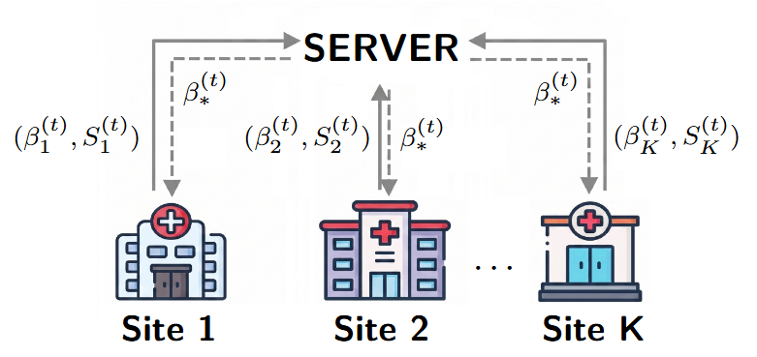
FL-TTE Framework
All sites follow the federated protocol
Therefore, all sites use the same data structure and statistical model
Local model information is sent to the server
The server aggregates updates
Global parameter is sent back to sites

Slide 8

FedProx Algorithm
① Server initializes global parameter $β_{∗}^{(1)}$
② Each site solves
$$β_{k}^{\left(t+1\right)}=\arg{\max_{β}\left\{ℓ_{k}\left(β\right)−\frac{μ}{2}{\left\|β−β_{∗}^{\left(t\right)}\right\|}^{2}\right\}}$$
$$ℓ_{k}\left(β\right):local log−lieklihood, β_{∗}^{\left(t\right)}:global parameter, μ: proximal hyperparamter$$
③ Sites send $β_{k}^{\left(t+1\right)}$ to the server
④ Server aggregates
$$β_{∗}^{\left(t+1\right)}=\sum_{k=1}^{K}{\frac{n_{k}}{N}β_{k}^{\left(t+1\right)}}$$
$$n_{k}: sample size at site k, N=\sum_{k=1}^{K}{n_{k}}$$
Repeat Steps 2-4 until convergence $\left(\left|β_{∗}^{\left(t−1\right)}−β_{∗}^{\left(t\right)}\right|<ε\right)$

Slide 9

FedECA Algorithm
① Server initializes global parameter $β_{∗}^{(1)}$
② At round $t$, each site computes
$$S_{k}\left(β_{∗}^{\left(t\right)}\right), H_{k}\left(β_{∗}^{\left(t\right)}\right) \\ S_{k}\left(β\right):score vector at site k, H_{k}\left(β\right):Hessian matrix at site k$$
③ Sites send $S_{k}$ and $H_{k}$ to the server
④ Server aggregates
$$S\left(β_{∗}^{\left(t\right)}\right)=\sum_{k=1}^{K}{S_{k}\left(β_{∗}^{\left(t\right)}\right)}, H\left(β_{∗}^{\left(t\right)}\right)=\sum_{k=1}^{K}{H_{k}\left(β_{∗}^{\left(t\right)}\right)}$$
Server updates
$$β_{∗}^{\left(t+1\right)}=β_{∗}^{\left(t\right)}−H{\left(β_{∗}^{\left(t\right)}\right)}^{−1}S\left(β_{∗}^{\left(t\right)}\right)$$
$⑥$ Repeat Steps 2-4 until convergence $\left(\left|β_{∗}^{\left(t−1\right)}−β_{∗}^{\left(t\right)}\right|<ε\right)$

Slide 10
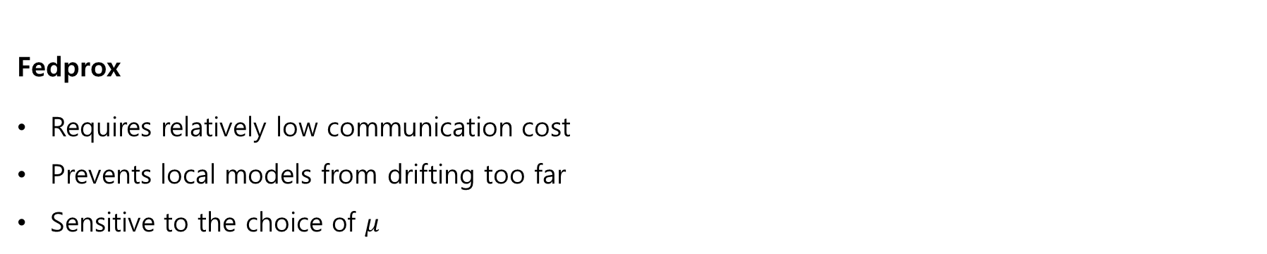
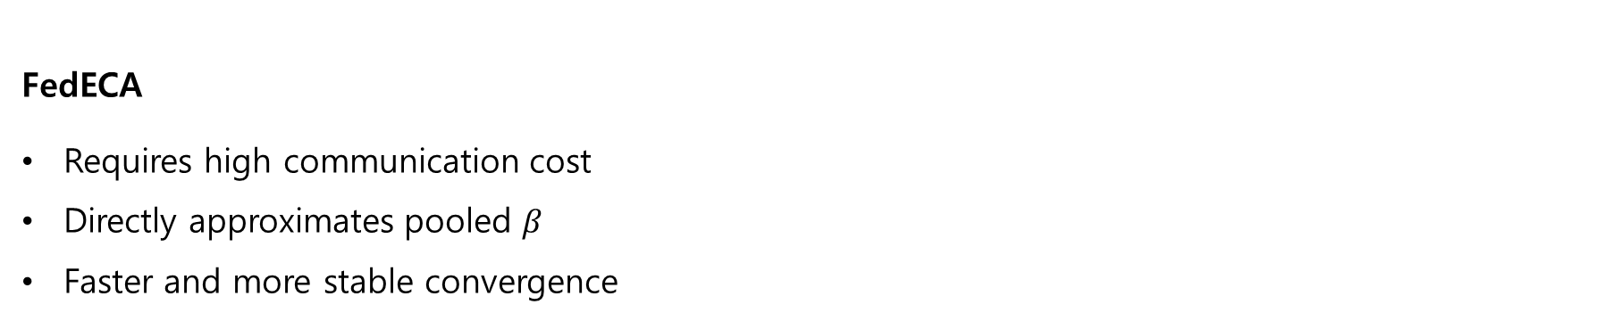
Fedprox and FedECA
Fedprox
Requires relatively low communication cost
Prevents local models from drifting too far
Sensitive to the choice of $μ$
FedECA
Requires high communication cost
Directly approximates pooled $β$
Faster and more stable convergence

Slide 11
Comparison between FedProx and FedECA
Which federated method provides more stable treatment effect estimation under the IPTW + Cox regression framework?
Comparison
Compare hazard ratio estimates
Compare confidence intervals
Compare convergence stability
Compare communication efficiency

Slide 12

Simulation and Application Pipeline
Propensity Score Estimation(multivariate) → IPTW
→ Weighted Cox Regression(univariate) $→$ $\hat{HR}$
Overall Procedure
FedProx and FedECA are used to estimate the propensity score
The estimated propensity score is used to compute IPTW
The final treatment effect is estimated using weighted Cox regression using FedProx and FedECA
Communication rounds are evaluated only for the federated logistic regression step
Key point: differences in PS estimation can affect the final hazard ratio

Slide 13
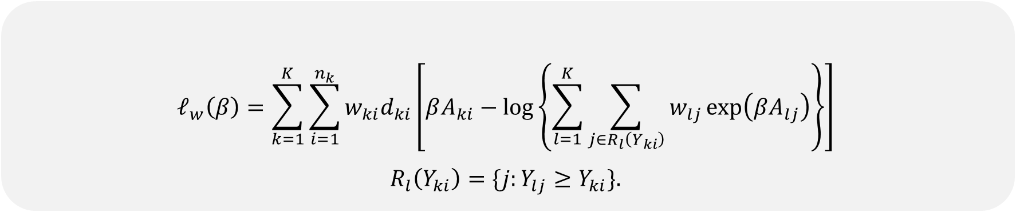
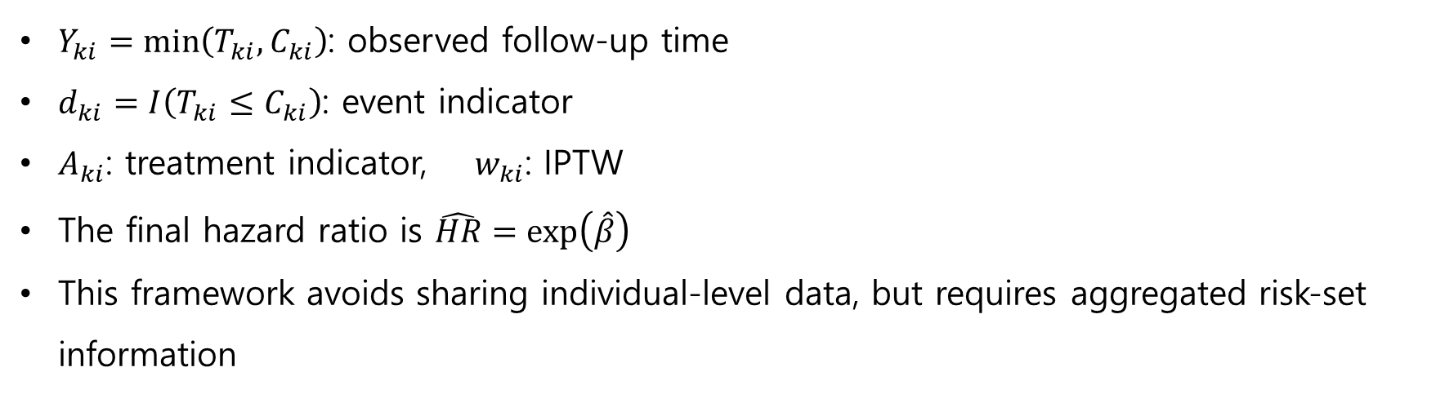
Simulation and Application Pipeline
$$ℓ_{w}\left(β\right)=\sum_{k=1}^{K}{\sum_{i=1}^{n_{k}}{w_{ki}d_{ki}}}\left[βA_{ki}−\log\left\{\sum_{l=1}^{K}{\sum_{j∈R_{l}\left(Y_{ki}\right)}{w_{lj}\exp\left(βA_{lj}\right)}}\right\}\right]$$
$$R_{l}\left(Y_{ki}\right)=\{j:Y_{lj}≥Y_{ki}\}.$$
Weighted partial log-likelihood of Cox regression
$Y_{ki}=\min\left(T_{ki},C_{ki}\right)$: observed follow-up time
$d_{ki}=I\left(T_{ki}≤C_{ki}\right)$: event indicator
$A_{ki}$: treatment indicator, $w_{ki}$: IPTW
The final hazard ratio is $\hat{HR}=\exp\left(\hat{β}\right)$
This framework avoids sharing individual-level data, but requires aggregated risk-set information

Slide 14
Simulation Setting
Simulation is used to evaluate method behavior under controlled multi-site heterogeneity
Data Structure
10 Sites and 5,000 patients
Site-level heterogeneity in age, sex distribution and treatment preference
Covariates
100 treatment-related covariates and 100 treatment-unrelated covariates
To mimic Heart Failure patients, STRONG-HF like clinical covariates were included
Example : cardio metabolic, renal, hemodynamic stress and age

Slide 15
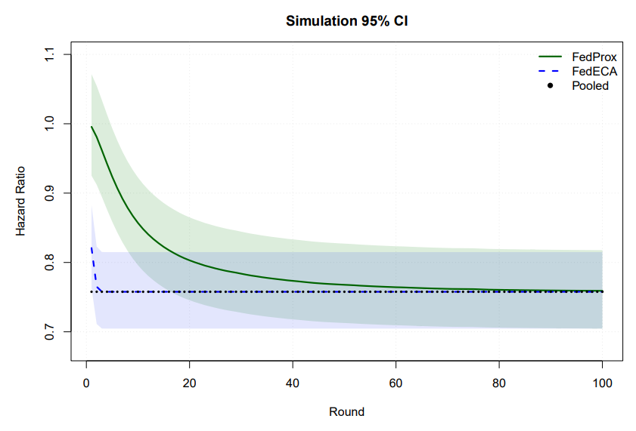
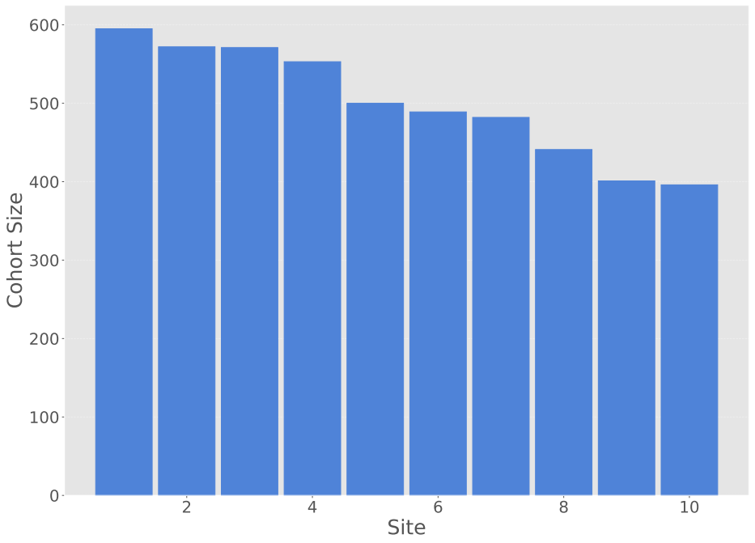
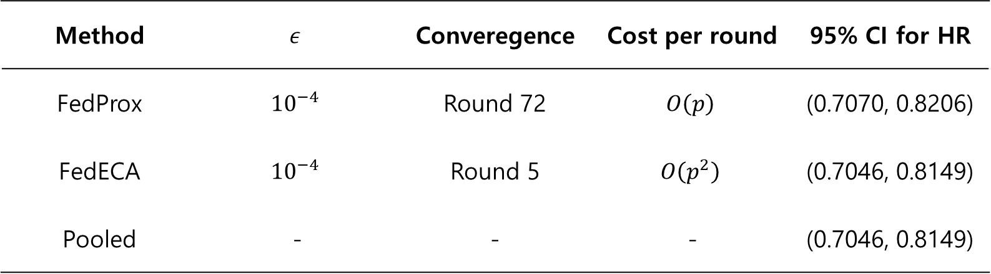
Simulation
Method | $$ε$$ | Converegence | Cost per round | 95% CI for HR
FedProx | $${10}^{−4}$$ | Round 72 | $$O\left(p\right)$$ | (0.7070, 0.8206)
FedECA | $${10}^{−4}$$ | Round 5 | $$O\left(p^{2}\right)$$ | (0.7046, 0.8149)
Pooled | - | - | - | (0.7046, 0.8149)

Slide 16
Data Application: eICU and MIMIC-IV
Datasets
eICU Collaborative Research Database (191 Sites)
MIMIC-IV Database (1 Site)
ICU patients with Sepsis
Treatment and Covariates
Treatment: Corticosteroid treatment
39 Covariates
Primary outcome: 28-day mortality
Covariates: age, male, race, sepsis prior, creatinine and etc

Slide 17
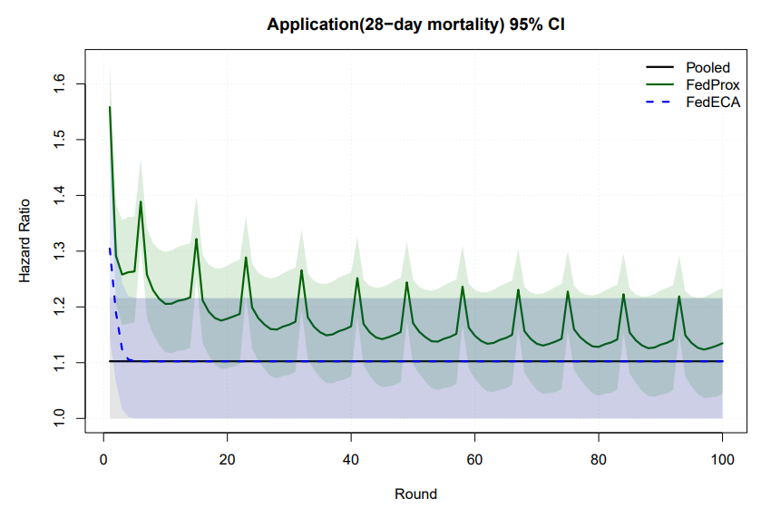
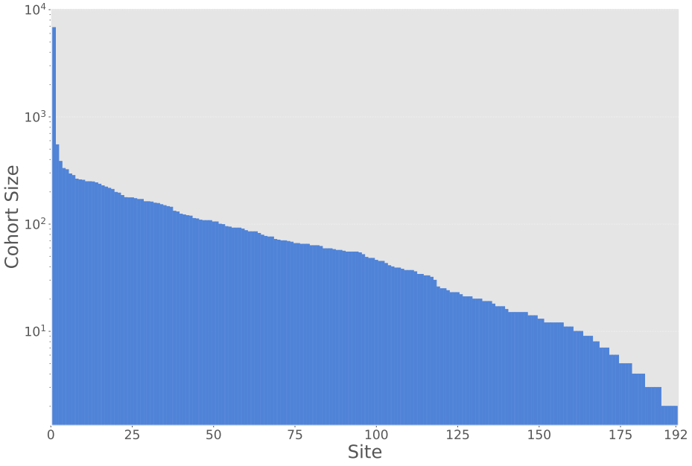
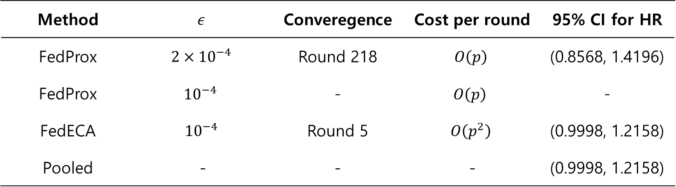
Data Application: eICU and MIMIC-IV
Method | $$ε$$ | Converegence | Cost per round | 95% CI for HR
FedProx | $$2×{10}^{−4}$$ | Round 218 | $$O\left(p\right)$$ | (0.8568, 1.4196)
FedProx | $${10}^{−4}$$ | - | $$O\left(p\right)$$ | -
FedECA | $${10}^{−4}$$ | Round 5 | $$O\left(p^{2}\right)$$ | (0.9998, 1.2158)
Pooled | - | - | - | (0.9998, 1.2158)

Slide 18
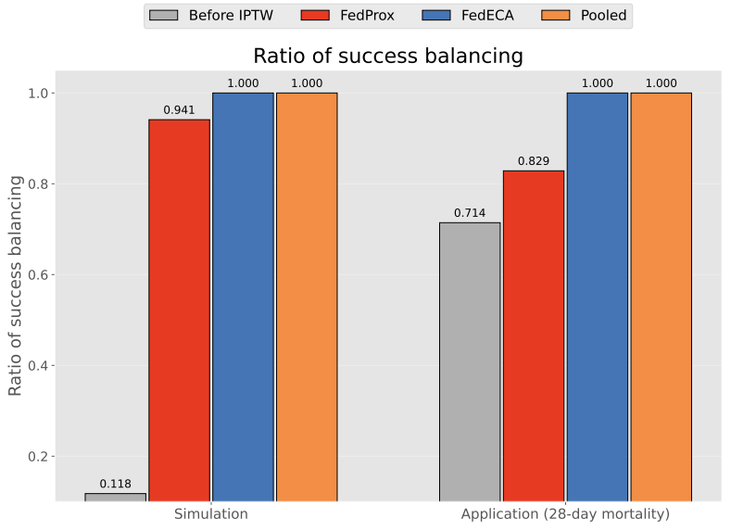
Ratio of success balancing
Treatment and Covariates
Balance success ratio: proportion of covariates with |SMD| < 0.1 between treatment and control groups.
FedECA achieved nearly the same balancing performance as the Pooled.
FedProx showed improvement, but remained less stable than FedECA

Slide 19

Conclusion
In FL-TTE, different optimization methods may lead to different treatment effect estimates.
To examine this issue, this study compared FedProx and FedECA using the same IPTW-Cox freamework.
Both methods avoid directly pooling patient-level data by sharing model-level or aggregated information
FedProx was sensitive to the proximal hyperparameter $μ$ and sample size of each site.
FedECA has a trade-off: it converges faster, but requires larger communication cost due to Hessian transmission

