Slide 1

Name :B.Pooja
Register no :36324u18045 Department :BSC(Computer Science) College :Sree Abiraami Art and Science College For Women Email ID :poojabalu14@gmail.com

Slide 2

PROJECT TITTLE
DIGITAL PORTFOLIO

Slide 3
AGENDA
Problem statement
Project overview
End users
Tools and technology
Portfolio design and layout
Features and functionality
Result and overview
Conclusion
Git Hub link

Slide 4

Problem Statement
Many people struggle to keep their daily spending and savings
The portfolio Website needed to cases the project clearly,but the layout felt cluttered and packed hierarchy

Slide 5

Project Overview
Here’s how you can write a project overview for your portfolio — clear, professional, and adaptable to HTML/CSS. The goal is to summarize what the project is, why you built it, and what makes it stand out.

Slide 6
End Users
Managers – People evaluating your skills, experience, and projects.
Clients – Potential clients who might want to hire you for freelance or contract work.
Collaborators and Peers – Other developers, designers, or teammates interested in your work.
Mentors or Educators – People reviewing your progress, projects, or learning journey.
General Audience – Anyone curious about your skills or looking for inspiration

Slide 7
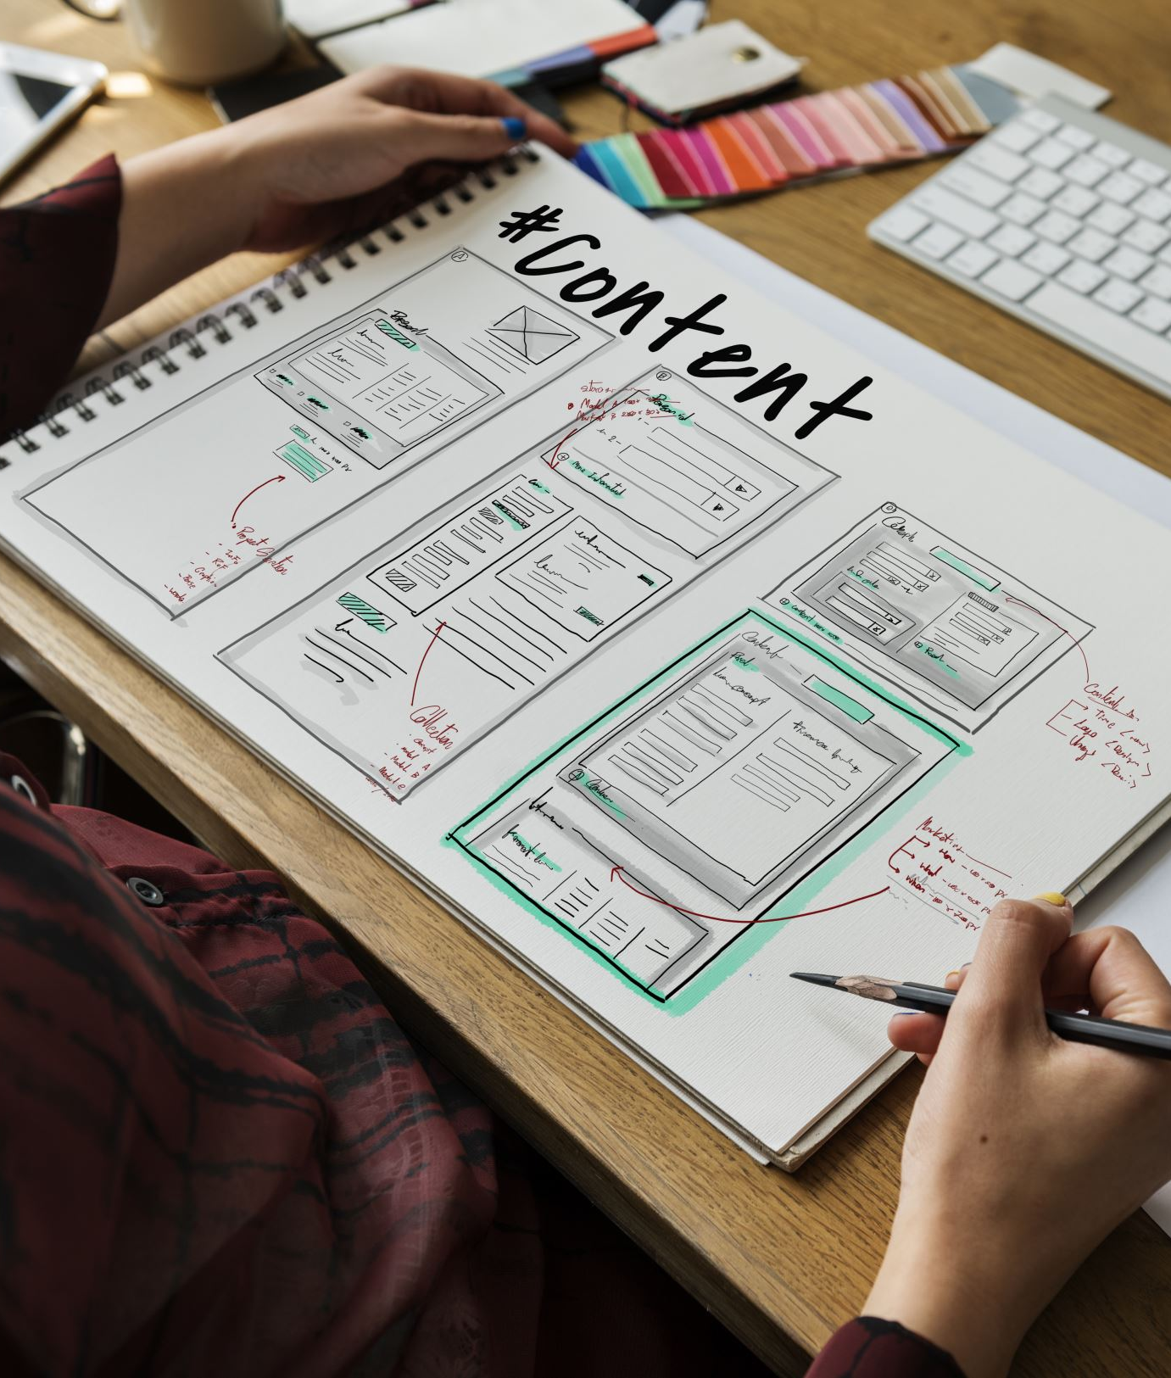
Tools and Technology
Website builders: Workpress,wix,google sites and github
Coding languages:html,CBS,javascript

Slide 8
Portfolio Design and Layout
Home:Engaging in introduction with professional photo and a brief tagline
About me:Short bio detailing background, interest and career good
Certificate:Display of earned certification with visual are downloading links
Skills:Visual skills bar or icons for technical and soft skill
Conference:Details of conference attend are present
Layou:Clean Grid based formet

Slide 9
Features and Functionality
Home page with introduction and personal branding
About me section (boi,skills,certificate)
Responsive design:Mobile friendly
Portfolio project:(image,link,features)

Slide 10

Result and screenshot
About me:Hello I am B.Pooja a passionate and professional with a strong focus on html,python c++.I enjoy turning complex challenge into simple.
Skills
Html
C++
Python
JavaScript

Slide 11

Conclusions
A conclusion section in a digital portfolio is where you wrap up your presentation of skills, projects, and value. It should feel confident, professional, and invite further action — like contacting ,hiring you or collaborating.

Slide 12

Git hub link
https://github.com/pooj2006

Slide 13
Portfolio project link
https://pooj2006.github.io/pooja/

Slide 14


