Slide 1
Performance Analysis of Different ML/DL Algorithms for Detecting Web Attcks

Slide 2
Abstract
Web applications are common targets for cyber-attacks due to their network accessibility and inherent vulnerabilities. Intrusion detection systems (IDS) monitor these applications and issue alerts when attacks are detected. However, existing IDS often rely on manually selected features, which is time-consuming and requires extensive domain knowledge. Furthermore, obtaining large amounts of labeled data for training supervised learning algorithms is often expensive and impractical. This paper explores the use of unsupervised/semi-supervised approaches for web attack detection, demonstrating that low-dimensional representations of raw features can effectively detect anomalies like SQL injection, cross-site scripting, and deserialization with minimal domain knowledge and labeled data.

Slide 3
Introduction
Web application security is a critical concern as these applications are frequently targeted by cyber-attacks due to their accessibility and potential vulnerabilities. Traditional intrusion detection systems (IDS) rely on manually selecting features and require large amounts of labeled data for training, which can be impractical in real-world applications. This paper explores innovative approaches to web attack detection, focusing on unsupervised and semi-supervised methods that require minimal domain expertise and labeled data. The goal is to enhance the efficiency and accuracy of detecting attacks and deserialization with reduced dependency on manual feature selection and extensive training datasets.

Slide 4
Existed Method
Support Vector Machine

Slide 5
Disadvantages:
Less Accuracy
Less Efficiency
More Complexity

Slide 6
Proposed Method
Autoencoder
LSTM

Slide 7
Advantages:
Enhanced Accuracy
Adaptability to Diverse Data
Scalability

Slide 8

Results: Interface

Slide 9
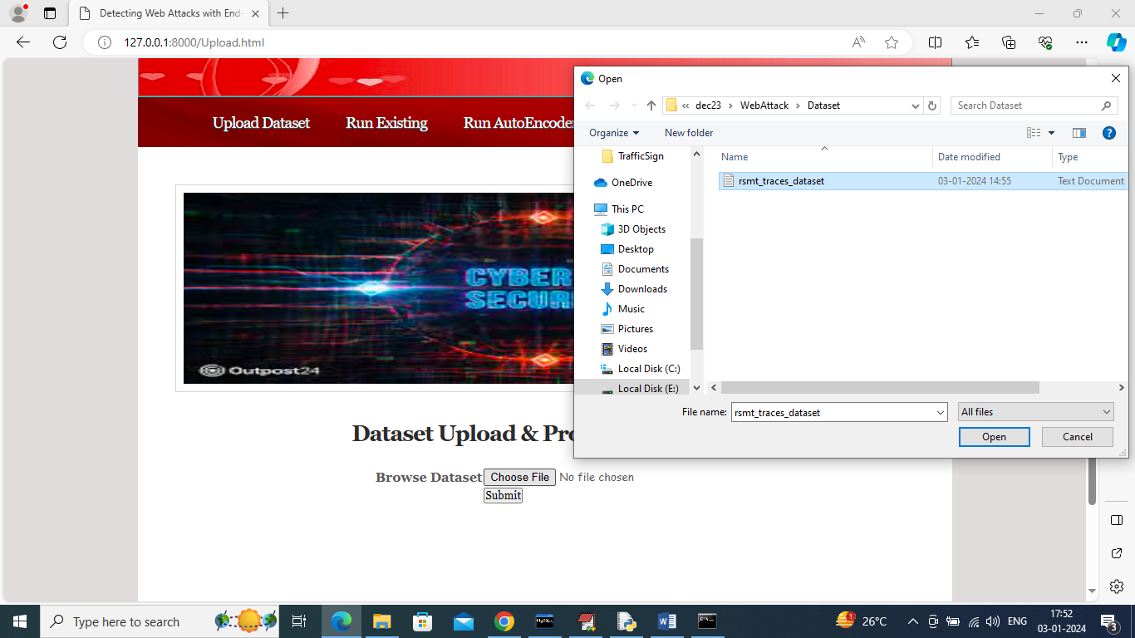
Upload Dataset

Slide 10
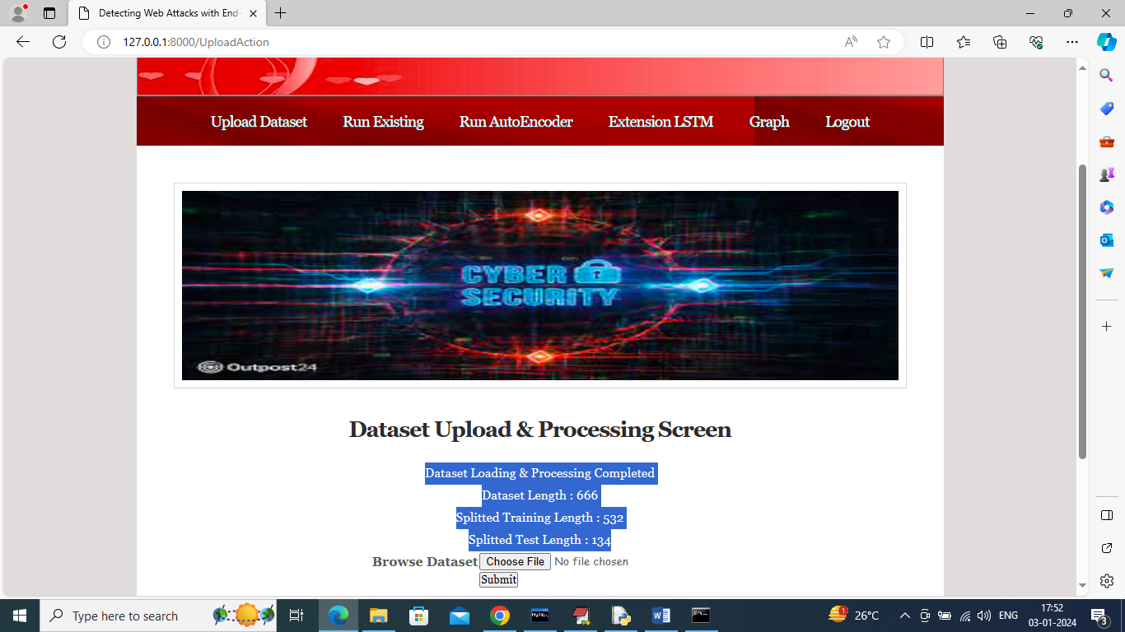
Dataset Upload And Processing

Slide 11

OTP Validation Screen

Slide 12
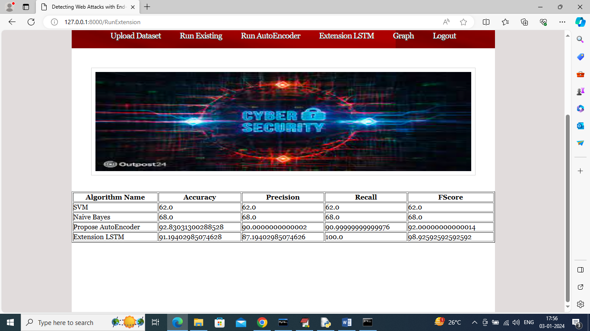
Algorithm Performance

Slide 13
Conclusion
Web applications are frequent targets for cyber-attacks due to their accessibility and vulnerabilities. Traditional intrusion detection systems often rely on manually selected features and require large amounts of labeled data, which is costly and impractical. This paper explores an unsupervised/semi-supervised approach for web attack detection using a stacked denoising autoencoder, which detects anomalies by reconstructing raw feature data with minimal labeled training. The results demonstrate that this approach can effectively detect attacks like SQL injection, cross-site scripting, and deserialization with minimal domain expertise and labeled data.

