Slide 1


QUIZZER

Slide 2

A
project on
“QUIZZER”
Submitted to Sinhgad Institute Of Management, Pune
Master Of Computer Application (MCA)
Submitted by
Miss. Pooja Mahendra Kothawade (22332)
Project Guide
Prof Mrs. Rupali Taware
Department of MCA

Slide 3

INTRODUCTION

Slide 4
Introduction
The “Quizzer Application” has been developed to override the problems prevailing in the practicing manual system. This software is support to eliminate and in some cases reduce the hardships face by this existing system. Moreover this system is designed for the particular need of the company to carry out operations in a smooth and effective manner.

Slide 5

SYSTEM

Slide 6
Existing System
Existing system is a manual one in which users are maintaining books to store the information like Student Details, Instructor Details, Schedule Details and feedbacks about students who attempted exam as per schedule.. It is very difficult to maintain historical data.

Slide 7
Disadvantages of existing system
The following drawbacks of existing system emphasize the need for Computerization:
1. A lot of copies of question papers have to be made
2. A lot of correction work hence delay in giving the results
3. A lot of tabulation work for each subject results

Slide 8
PROPOSED SYSTEM
This application is used to conduct examination on android mobile app. The Students can sit at individual terminals to write the exam in the given duration. The Questions have to be given to the students. This app will perform correction, display the result and also store it in database.
It may help collecting perfect management in details. In a very short time, the collection will be obvious, simple and sensible. It will help a person to know the management of passed year perfectly and vividly.

Slide 9
SCOPE OF SYSTEM
“QUIZZER” can be used in private institutes as well as educational institution. As it is user android base application it can be used anywhere and anytime.

Slide 10
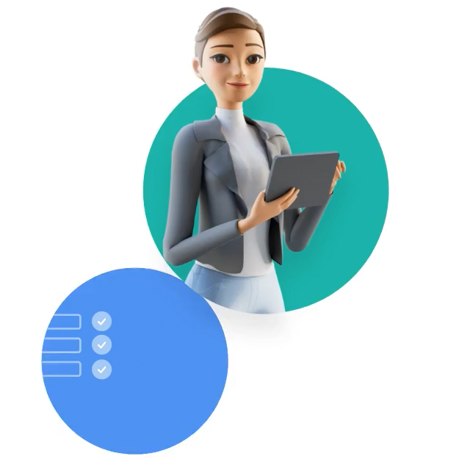
OPERATING REQUIREMENTS

Slide 11
HARDWARE REQUIREMENT
1. Smartphone with Android OS version 4.4 (Kitkat) or higher
2. Minimum 512 MB of RAM
3. A processor with speeds above 1.2 GHz (any make)
4. 16 MB of storage for the app and extra for the data stored, the size of the app increases as the number of entries are increased
5. Android API version 19 6. Permission to install applications over USB and installation from unknown sources from Developer Options

Slide 12

SOFTWARE REQUIREMENTS
    1. Operating System : Windows 7 and above

Slide 13

Advantages

Slide 14
Advantages
It saves paper
It saves time
It’s more secure.

Slide 15

MODULES

Slide 16
``````````````Student````````````````````````````````````````````````````````````````````````````````````````````````````````````````````````````````````````````````````````````````````````````````````````````````````````````````````````````````````````````````````````````````````````````````````````````````````````````````````````````````````````````````````````````````````````````````````````````````````````````````````````````````````````````````````````````````````````````````````````````````````````````````````````````````````````````````````````````````````````````````````````````````````````````````````````````````````````````````````````````````````````````````````````````````````````````````````````````````````````````````````````````````````````````````````````````````````````````````````````````````````````````````````````````````````````````````````````````````````````````````````````````````````````````````````````````````````````````````````````````````````````````````````````````````````````````````````````````````````````````````````````````````````````````````````````````````````````````````````````````````````````````````````````````````````````````````````````````````````````````````````````````````````````````````````````````````````````````````````````````````````````````````````````````````````````````````````````````````````````````````````````````````````````````````````````````````````````````````````````````````````````````````````````````````````````````````````````````````````````````````````````````````````````````````````````dent```````````````````````````````````````````````````````````````````````````````````````````````````````````````````````````````````````````````````````````
Modules
````````````````Teacher````````````````
    1.Register
    2.Login
    3.Quiz
    4.Answers
    5.Score
    1.Register
    2.Login
    3.Create New Quiz
    4.Add Questions
    5.Delete Questions
    6.Store Score

Slide 17
Thanks!!

