Slide 1
Capstone Project-2 Supervised ML (Regression) - Capstone Project
Ds Chargers: Bike Sharing Demand Prediction Team Member Chetan Jadhav Meghana Rs Pooja Parsana Robin Rego

Slide 2
Outline
VALUE
DATA
PROCESSING
Modeling
Selection
Sourcing
Synthesis
Operationalizing
Visualization
Cleaning
Preprocessing

Slide 3

Data Summary
Currently Rental bikes are introduced in many urban cities for the enhancement of mobility comfort. It is important to make the rental bike available and accessible to the public at the right time as it lessens the waiting time. Eventually, providing the city with a stable supply of rental bikes becomes a major concern. The crucial part is the prediction of bike count required at each hour for the stable supply of rental bikes.

Slide 4
Feature
Date: year-month-day
Rented Bike Count -Count of bikes rented at each hour
Hour: Hour of the day
Temperature: (in Celsius)
Humidity: (in %)
Windspeed: m/s
Visibility: 10m
Dew Point Temperature (in celsius)
Solar Radiation: MJ/m2
Rainfall: mm
Snowfall: cm
Seasons : Winter, Spring, Summer,
Autumn
Holiday - No Holiday/ Holiday
Functional Day - Yes/No

Slide 5
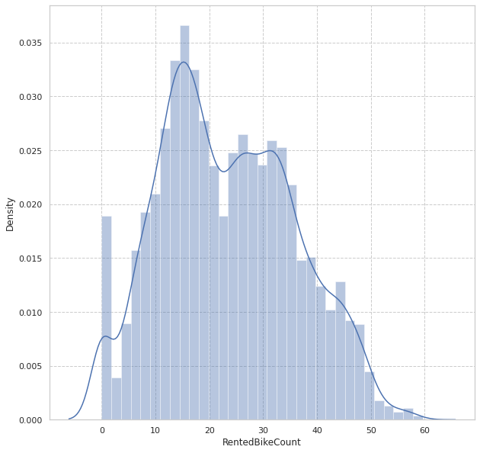
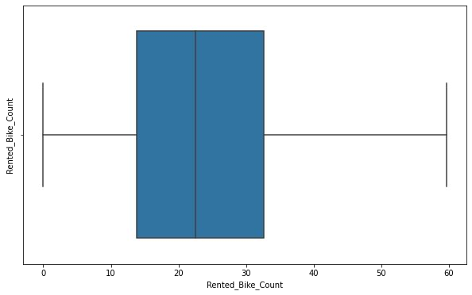
Analysis Of Rented Bike Column

Slide 6
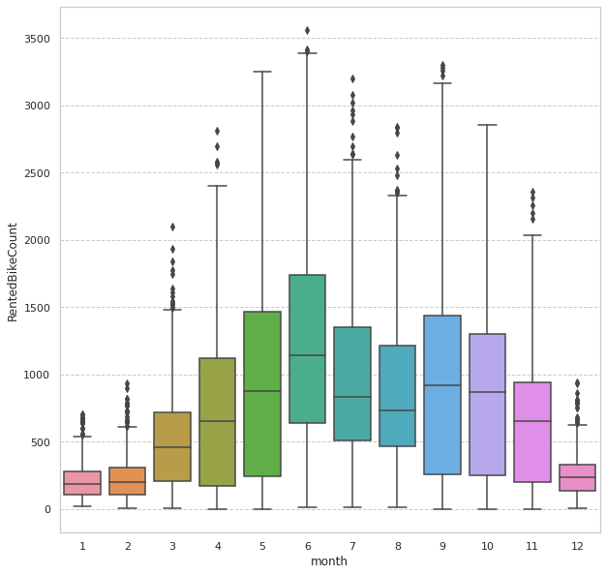
Exploratory Data Analysis
Month vs Rental Bike Count

Slide 7
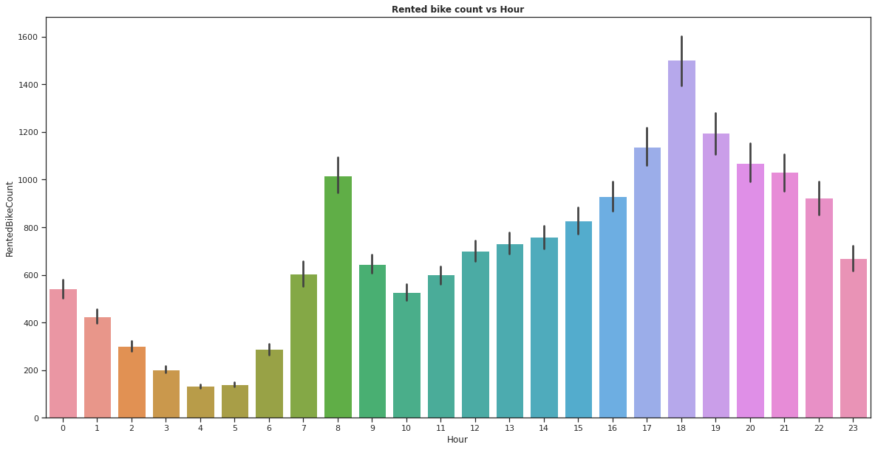
Hour vs Rental Bike Count

Slide 8
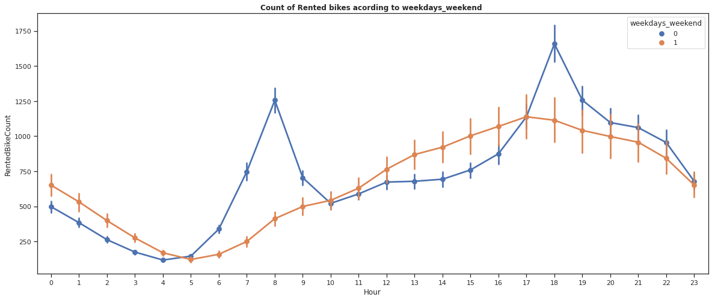
Weekdays and weekend vs Rental Bike Count

Slide 9
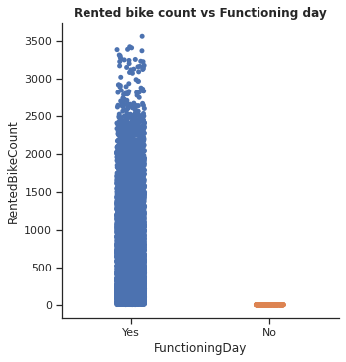
Functioning Day vs Rented bike count

Slide 10
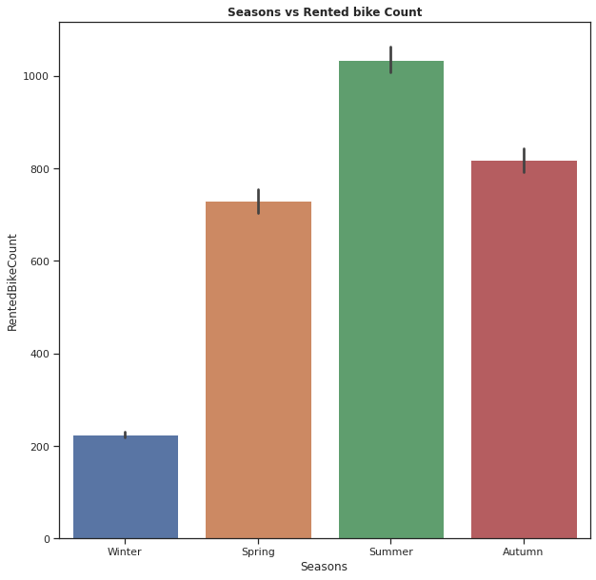
Analysis Of Season Variable

Slide 11
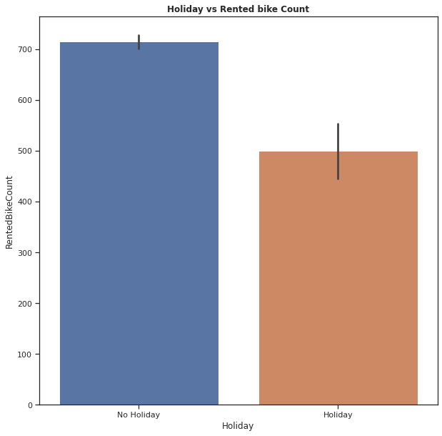
Analysis of Holiday Variable

Slide 12
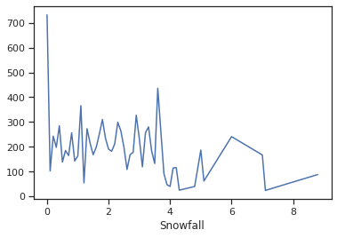
Snowfall vs Rented Bike Count

Slide 13
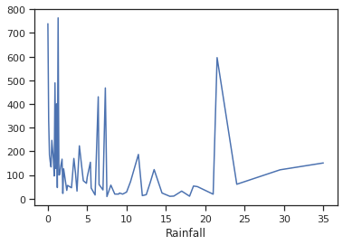
Rainfall vs Rented Bike Count

Slide 14
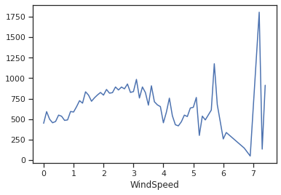
Windspeed vs Rented Bike Count

Slide 15
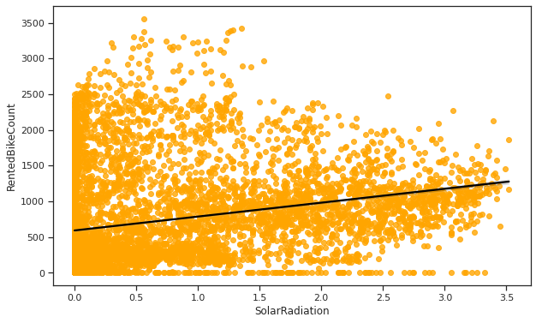
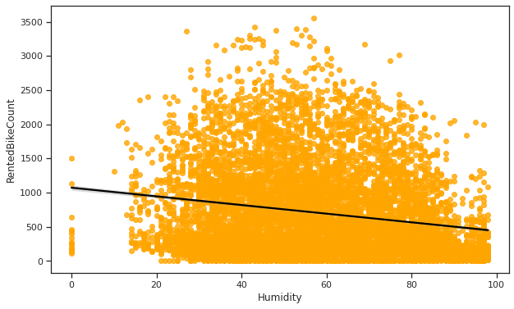
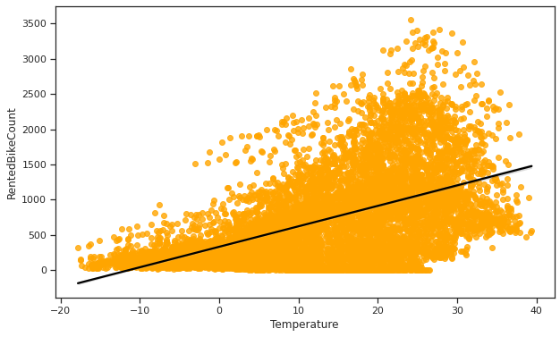
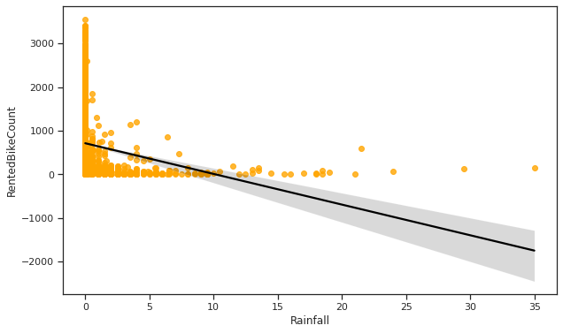
Regression plots for numerical variable

Slide 16
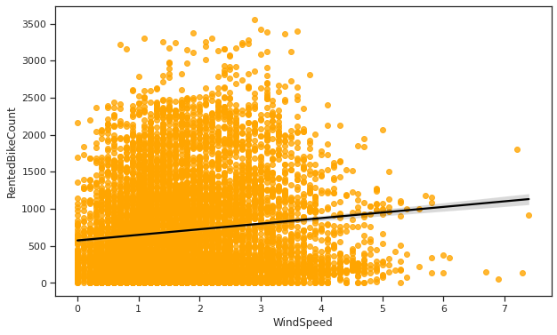
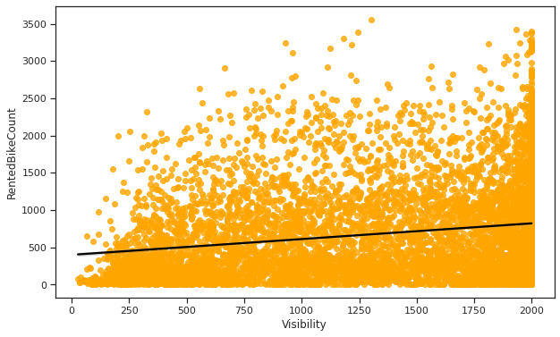
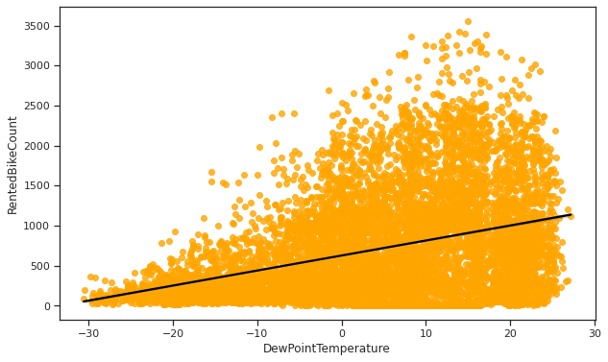
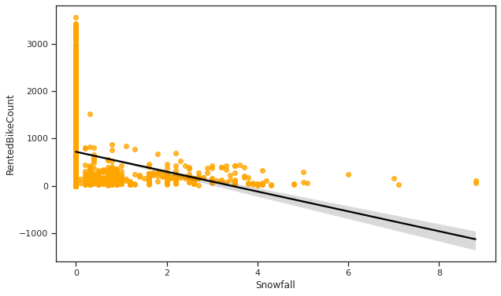

Slide 17
Model Conclusion
level_0 | level_1 | Model | MAE | MSE | RMSE | R2_score | Adjusted R2
Training set | 0 | Linear regression | 5.609 | 53.397 | 7.307 | 0.657 | 0.65
Training set | 1 | Lasso regression | 6.714 | 81.671 | 9.037 | 0.475 | 0.47
Training set | 2 | Ridge regression | 5.609 | 53.397 | 7.307 | 0.657 | 0.65
Training set | 3 | Decision tree regression | 3.502 | 23.668 | 4.865 | 0.848 | 0.85
Training set | 4 | Elastic net regression | 6.095 | 64.433 | 8.027 | 0.586 | 0.58
Training set | 5 | Gradient boosting regression | 2.821 | 15.54 | 3.942 | 0.9 | 0.9
Training set | 6 | Gradient Boosting grid search cv | 1.452 | 4.687 | 2.165 | 0.97 | 0.97
Test set | 0 | Linear regression | 5.545 | 51.969 | 7.209 | 0.661 | 0.66
Test set | 1 | Lasso regression | 6.695 | 82.832 | 9.101 | 0.459 | 0.46
Test set | 2 | Ridge regression | 5.545 | 51.97 | 7.209 | 0.661 | 0.66
Test set | 3 | Decision tree regression | 3.721 | 27.205 | 5.216 | 0.822 | 0.82
Test set | 4 | Elastic net regression Test | 6.079 | 64.581 | 8.036 | 0.578 | 0.58
Test set | 5 | Gradient boosting regression | 2.945 | 17.071 | 4.132 | 0.889 | 0.89
Test set | 6 | Gradient Boosting grid search cv | 1.872 | 9.003 | 3.0 | 0.941 | 0.94

Slide 18
Conclusion
We analysis that Hour is the most important feature.
Rented bike count is mostly related with the time of the day as it is peak at 10 am and 8pm.
Also we observed that rented bike count is high during working days compared to nonworking days.
We see that people generally prefer to bike at moderate to high temperatures, and when little windy.
It is observed that highest number bike rentals counts in Autumn & Summer seasons & the lowest in winter season. We observed that the highest number of bike rentals on a clear day and the lowest on a snowy or rainy day. We observed that with increasing humidity, the number of bike rental counts decreases.

Slide 19
All metrics were evaluated for each model, MSE(Mean Squared Error), MAE (Mean Absolute Error), RMSE(Root Mean squared Error),R2 Score, Adjusted R2 Score.
At the end, comparison of models stated that some models showed improvement or were able to handle the overfitting issues when hyperparameter tuning was performed.
Adjusted R2 score was used to compare models as it is a special form of R2 score. Adjusted R2 indicates how well terms fit a curve or line, and also adjusts for the number of terms in a model.

