Slide 1
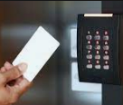
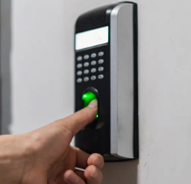
ACCESS CONTROL DEVICES
Control access both physically and virtually until and unless the correct credentials are provided
Authentication may be based on the following elements:
Something you have e.g., RFID access cards
Something you know e.g., Pin or password
Something you are e.g., assessing a person's physical characteristics like face recognition or fingerprints
Examples of such devices are: Key fobs, keypads, smart cards, biometric devices etc.

Slide 2
SIGNIFICANCE OF ACCESS CONTROL DEVICES
TO THE SUBJECT
These may be hacked by the subject and used to gain unauthorized access to a physical location.
Get access to sensitive data like how a building or a specific site is being used such as frequency and time trends.
In worst case it may be used to create a false alibi implying a that people were somewhere where they were not.
TO THE INVESTIGATORS
Investigators can use these devices to monitor any malicious activity according to the pattern of use.
The presence or absence of an individual at a controlled location may be established.

Slide 3

SPECIAL INVESTIGATORY CONSIDERATIONS AND LIMITATIONS
• The logs for a device may be unreliable as the key fobs, smart cards, and passwords may be stolen or compromised. These also have a high probability of getting demagnetized.
• Biometrics have defined failure rates and may also be affected by physical injury and alteration (e.g., retinal patterns change during pregnancy) so these may or may not establish presence/ absence of an individual.
• If the database is hacked the data may be easily overwritten and remotely purged even if suspect is at large.

Slide 4
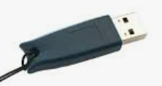
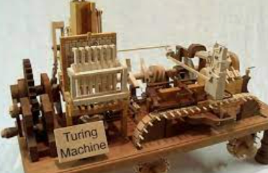
ENCRYPTION TOOLS AND PASSPHRASE PROTECTION
Cryptographic tools are hardware-based, software-based, or a combination of both, and protect your data by making it inaccessible without using one or more of the following: a password, a passphrase, a “software key,” or a physical access device
EXAMPLES: Dongles, key cards, or biometric devices are examples of encryption tools that can be employed on physical devices

Slide 5
SIGNIFICANCE OF ENCRYPTION TOOLS
TO THE SUBJECTS
Criminals can use encryption to circumvent law enforcement detection Contraband or evidence such as:
Child pornography.
Details of counterfeit currency.
The stolen credit card number.
Email or chat file.
Intellectual property information.
Organizations use cryptographic tools to do the following:
Protect yourself from theft of your intellectual property.
Protect customer data from unauthorized access due to network intrusion or hardware theft
TO THE INVESTIGATORS
Encryption is used by the law enforcement agencies to protect evidence and other sensitive information.
Decryption by law enforcement may be required to achieve the following:
Recover evidence from hidden/ encrypted logs.
To prove the intent of the criminal/ suspect.

Slide 6
SPECIAL INVESTIGATORY CONSIDERATIONS AND LIMITATIONS
While carrying out an investigation, the purpose for using encryption tools must be carefully examined as possession of these tools may be legally allowed but their use may/ may not be.
Detection of encryption of encryption tools at the scene may lead to seizure of original hardware carefully without damaging or losing data in the process. Further necessary actions must be taken to recover the key/ passphrase which may require a more detailed search so a search warrant may be required. Also, high tech tools to bypass passphrase may be required in case the passphrase is not known.

Slide 7
CASE STUDY: ENCRYPTION TOOLS AND THEIR IMPACT DURING WW2
The main source of secret communication for the Germans during World War II was the ENIGMA machine.
The ADFGX cipher, a cryptosystem previously used in Germany, was broken by Allied cryptographers During World War I.
Every message sent started with a three-letter keyword, which was not encoded.
This keyword was used to indicates the rotational position of each rotor. The next 6 letters were scrambled to include a 3-letter codeword that was repeated twice to ensure accuracy. When the target audience received the message, the operator typed the following six characters into the machine after the key to reveal the codeword

Slide 8
The Germans thought their machines were indestructible, and it seems that was the case for some time.
the Germans didn’t make the most of this machine. German troops usually had rotors in the same position with each other for up to 3 months.
In 1939 Poland knew that Germany would soon invade the country. Polish cryptographers and the government decided to hand over all the knowledge they had about Enigma and the replicas they made to France and the British government
Many of the intercepted messages contained cilies, allowing Allied cryptographers to guess what the first three characters were decrypted by the Enigma. A cryptographer who knew this only had to check the settings to encrypt his first three letters of the suspicious key.
Designed by Alan Turing and known as a bombe, this machine worked by circulating hundreds of possible settings at once. Bombe rotor spins at high speed and checks All positions that encode an encrypted 3-character key into an expected 3-character key. If a possible match is found, the rotor will stop spinning.
The messages that the Allies were able to intercept resulted in several major victories that contributed to the outcome of the war.

