Slide 1
Semantic Similarity for Identifying Similar Questions on Quora
• Pooja Bhathaluri
• Harshitha Pasupuleti
• Jayanth Kumar Kotni
• Venkata Bhaskara Tetali

Slide 2
Topics to be covered
Introduction
Problem statement/Hypothesis
Methodology
Dataset
Exploratory data analysis
Feature Engineering
Results
Project Management
References
Implementation
Summary

Slide 3

Introduction
As we all know Quora is a platform to ask and answer questions on different type of topics like business, technology, innovation, personal life, and sports…etc. Quora is a driven by community to share the knowledge among the groups. Any one can answer any question and any one can answer in their own style.
The main issue these kinds of platforms face is same question is being asked multiple times though the answer may already exist to it. To improve user experience, it is suggested to reduce the count of duplicate questions. With millions of questions being asked daily on Quora it’s difficult to identify duplicate questions manually.
The prime focus of this project is to identify duplicate questions on Quora using machine learning and NLP capabilities so that we can improve user experience by saving users time and resources which in turn improves overall platform efficiency.

Slide 4

Introduction cont..
Area of Study: This project comes under the domain of NLP and ML As the input data is of type textual information, we leverage the NLP techniques to solve this problem. Using the NLP techniques, we extract features from textual question data and then we apply predictive ML models to train our model on the features extracted.
Motivation: Being a Quora user, many times felt difficulty to find relevant information related to my question. Identifying duplicate questions not just solves difficulties faced by users, but also enables the ways to give aggregated information to a question so that user experience will be much better with efficiency. It is kind of a practical application where NLP and ML capabilities can be utilized a solve a real word problem which also gives an opportunity to understand and utilize these techniques.
Significance:This project important because it can change the ways to handle duplicate questions handled in the question answering platforms. It targets the long-term outcomes of the platforms in terms of underlying resources being used for this platform and also user experience as already mentioned. Moreover, we can extend this methodology to other platforms like stack overflow, Reddit…etc.

Slide 5
Problem statement/Hypothesis
This project aims to develop a machine learning model that can identify question pairs with the same intent, even if the wording differs.
Redundant questions clutter the Quora platform so need to build an automated system to identify the duplicate question pairs. We hypothesize that it is possible to create a predictive model to identify two questions are similar or not based on various features extracted using NLP. Then creating a predictive model with high accuracy in identifying duplicate questions.
This will improve the user experience on Q&A platforms by:
• Reducing duplicate questions
• Helping users find existing answers to their questions faster
• Leading to more efficient knowledge sharing

Slide 6
Methodology
Phase1: Data Extraction
We started with finding out the Semantic Similarity checker for Quora Dataset
Pre-processing the dataset like handling missing values
Basic Analysis
Phase2: Exploratory Data Analysis
Target Variable Distribution and handling class imbalance
Unique questions details
Each question occurrences count
Phase3: Feature Engineering, Model Building and Performance Metrics
Vectorization
Word2vec-Tf-idf - Question-1
Word distribution of questions
Character distribution
Unigrams
Word2vec-Tf-idf - Question-2
Test-train split
Logistic Regression
Quora Dataset
Sentence1
Sentence2
Processing
Similarity Measures
Similarity Score

Slide 7
Dataset
For this project we are going to use a publicly available dataset of question pairs from Quora. This dataset will contain questions labelled as duplicate or not. Here are some details about the dataset:
• Source: https://quoradata.quora.com/First-Quora-Dataset-Release-Question-Pairs
• Type: Labeled text data
• Size: 404290 rows, 6 columns
• Preprocessing: The data will be preprocessed by cleaning (removing noise) and tokenization (splitting text into words)

Slide 8
Dataset cont..
Columns:
Id: This column represents a unique identifier for each data point or pair of questions in the database
Qid1: This column contains the unique identifier for the first question in the pair. Each question is assigned a unique ID for reference within the dataset.
Qid2: Similar to the Qid1 column, this column contains the unique identifier for the second question in the pair.
Question1: This column contains the full text of the first question in the pair.
Question 2: Similar to the Question1 column, this column contains the full text of the second question in the pair.
Is_duplicate: This binary column indicates whether the pair of questions are considered duplicates or not.

Slide 9
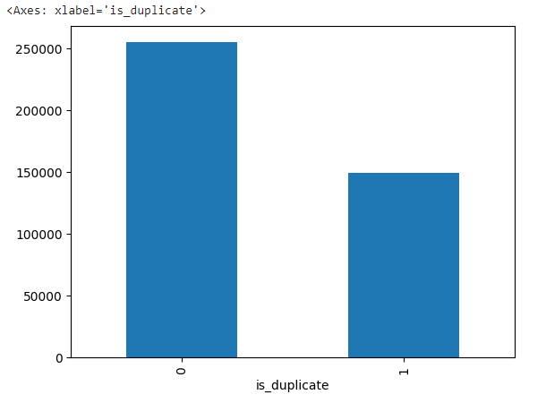
Exploratory data analysis
Target Variable Distribution:
We have 63% of non-similar question pairs and 37% of similar question pairs from the calculations above
This indicates that possibly our dataset is imbalanced and we need to handle this case in order to get accurate model performance

Slide 10
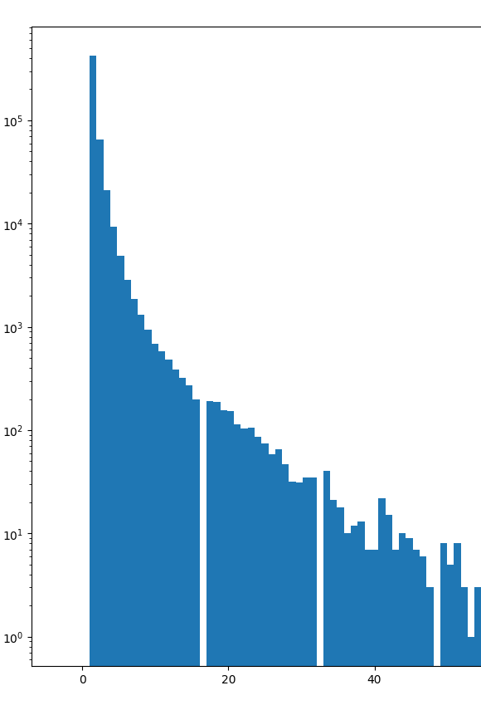
Exploratory data analysis Cont..
Each question occurrences count:
From the above histogram graph we can see that most of the questions repeated maximum of 50 times. Other questions those appeared more than 60 times are very less. As we know the most repeated question appeared to be 161 times.

Slide 11
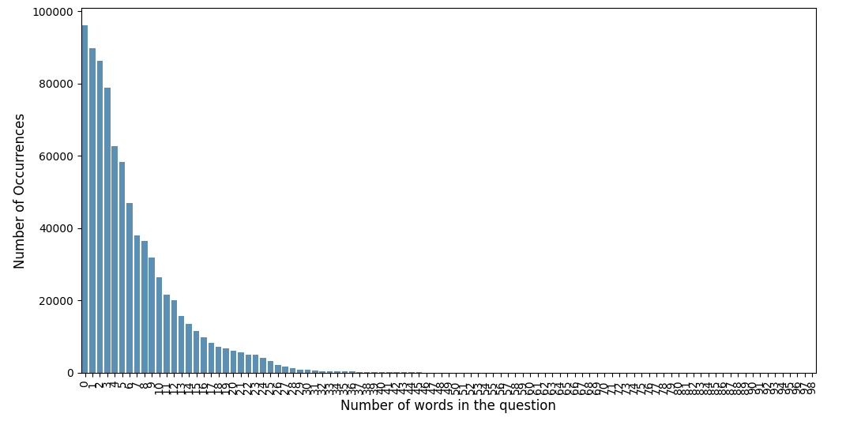
Exploratory data analysis Cont..
Word distribution of questions

Slide 12
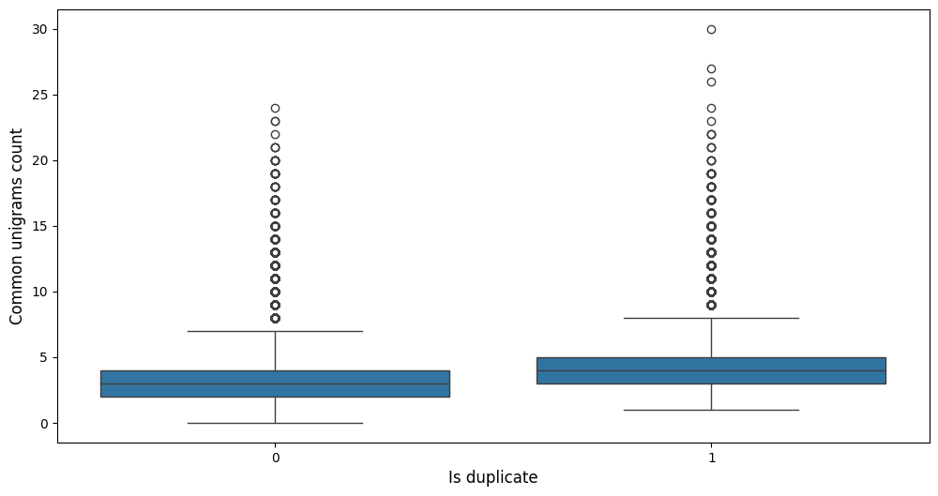
Exploratory data analysis Cont..
Unigrams

Slide 13
Feature Engineering
Data is in text format so model wouldn’t understand it, so need to create features.
Cleaning the text data
Remove stopwords
Stemming
Punctuation, contraction expansion
Different feature extraction strategies using the different NLP techniquesl
Basic Text Features
Length of question
Common words
Frequency of words
Word & Char count

Slide 14
Feature Engineering cont..
Similarity related features
Cosine
Manhattan
Jaccard
Fuzz ratio
Substring matching related features
Fuzz full ratio

Slide 15
Feature Engineering cont..
freq_qid1
freq_qid2
len_q1
len_q2
diff_len
q1_n_words
q2_n_words
word_Common
word_Total
word_share
freq_q1+q2
freq_q1-q2
len_char_q1
len_char_q2
len_word_q1
len_word_q2
common_unigrams
fuzz_qratio
fuzz_WRatio
cosine_distance
cityblock_distance
jaccard_distance
canberra_distance
euclidean_distance
minkowski_distance
braycurtis_distance

Slide 16
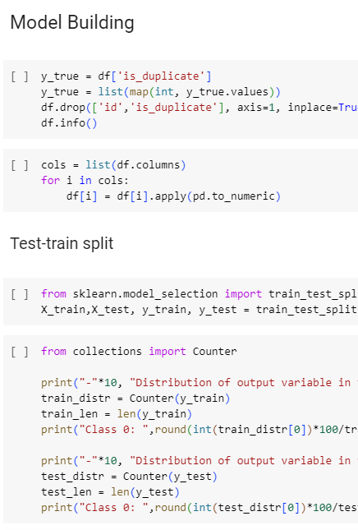
Implementation
Features extracted are independent variables
Target variable is ‘is_duplicate’
Convert all our features and target variables to numeric to feed to the model
Split the data into train and test – 80:20% ratio
Making sure that the test train distribution of target variable is aligned properly so that model evaluation metrics are not inclined towards particular class.

Slide 17
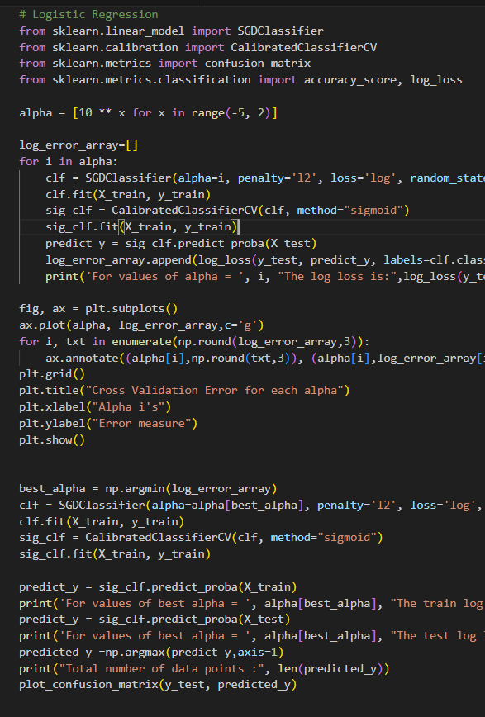
Implementation cont..
Train Logistic Regression on the training data
SGD Classifier – Linear classifier with SGD optimization
Calibration – probability matching with data
Hyper parameters tuning for the best model
Training loss increasing with alpha value
Predict the model probabilities for test data
Confusion matrix to get the classification report of the test set

Slide 18
Implementation cont..
Techniques and Libraries used:
NLP:
Basic String Functions, Word2vec, Unigrams, Distance measures (Cosine and Jaccard similarity), Stop words, Stemmeing
ML:
Logistic Regression (SGD Classifier)
Libraries Used:
Pandas, Numpy, NLTK, Gensim, SKLearn, Matplotlib, Seaborn, Scipy, Re, FuzzyWuzzy

Slide 19
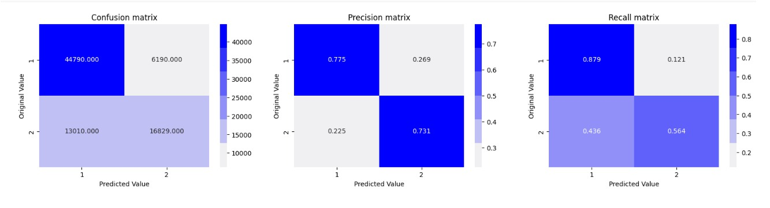
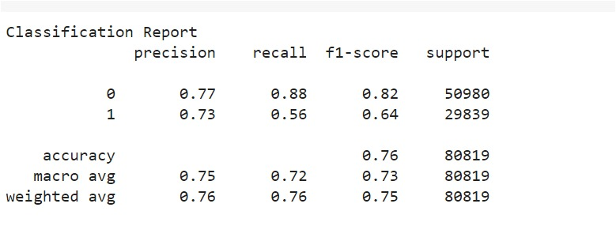
Results

Slide 20
Results Cont..
Precision: The precision for detecting duplicate question pairs (class 0) was 0.73, means that among the pairs classified as non-duplicates, 73% were correctly identified.
Recall: The recall for duplicate question pairs was 0.60, suggesting that out of all actual non-duplicate pairs, 60% were correctly classified by the model.
F1-Score: The F1-score, which balances precision and recall, was 0.64 for duplicate pairs.
Accuracy: The overall accuracy of the model was 0.76, indicating the proportion of correctly classified pairs out of the total dataset.

Slide 21
Project Management
Implementation status report
▪ Work completed: This is final stage of the project where we concentrated more on detailed description of the chosen model architecture, training process, and evaluation methodology.
• Description: This project follows sentence embedding techniques to represent questions as numerical vectors. These vectors will capture the semantic meaning of the question, allowing for comparison based on meaning rather than just keywords.
• Responsibility (Task, Person): We divided our project to each member in the group
Dataset Finding, Extraction – All the group members
Pre-processing – Jayanth Kumar Kotni
Exploratory Data Analysis – Harshitha Pasupuleti
Feature Engineering – Venkata Bhaskara Tetali
Model Building and performance metrics – Pooja Bhathaluri

Slide 22
Project Management cont..
Implementation status report
• Contributions (members/percentage):
Pooja Bhathaluri 25%
Harshitha Pasupuleti 25%
Jayanth Kumar Kotni 25%
Venkata Bhaskara Tetal 25%
• Issues/Concerns:
Running time – It took very long time to run while using word2vec library to convert test to numeric features from the dataset.
Long training time, convergence time for deep learning models.

Slide 23
Summary
Conclusion:
Our model achieved moderate performance in detecting duplicate question pairs in the Quora dataset. While it demonstrated relatively high precision and recall for non-duplicate pairs, there is chance for improvement particularly in identifying duplicate pairs (class 1). Further optimization of feature engineering, model selection, and hyperparameter tuning could potentially enhance the model’s performance.
Future Directions:
Future work could focus on exploring advanced natural language processing techniques, such as deep learning architectures like Siamese networks or BERT-based models, to capture more intricate semantic relationships between question pairs and improve classification accuracy. Additionally, incorporating external knowledge sources or domain-specific features may further enhance the model’s robustness in detecting duplicate questions.

Slide 24
References
https://www.kaggle.com/c/quora-question-pairs
https://towardsdatascience.com/identifying-duplicate-questions-on-quora-top-12-on-kaggle-4c1cf93f1c30
https://medium.com/@princebari01/quora-question-pair-similarity-8955e3d2664
https://arxiv.org/pdf/2004.11694

