Slide 1
FRAUD ANALYTICS CASE STUDY
Suspicious Claims
An Internal Fraud Analysis of
Long-Term Care Insurance Policies
Analyst Pooja Srivastava
Domain Long-Term Care Insurance Fraud Detection
Tools Python · SQL · Tableau · Excel · PowerPoint
Dataset 2,000 LTC Claims · 300 Patients · 60 Providers

Slide 2
EXECUTIVE SUMMARY
LTC Insurance Fraud Analytics
2,000
300
$271K
15%
Total Claims
Analyzed
Fraudulent
Claims Found
Total Dollars
At Risk
Fraud Rate
Detected
💀 Deceased Patient Billing
⏰ Inflated Hours Fraud
💰 Phantom Round Amounts
👻 Ghost Providers
$27,335
$222,465
$146,002
$92,100
83 claims filed after patient death · 13 patients affected
167 claims · worst case 98.9 hrs billed in one day
108 claims · $500, $1K, $2.5K fabricated bills
8 shell providers · all registered on the same day

Slide 3
4 Fraud Patterns Detected
01
02
03
04
⏰
💰
💀
👻
Inflated Hours
Phantom Round Amounts
Deceased Patient Billing
Ghost Providers
167 claims · $222,465
108 claims · $146,002
83 claims · $27,335
8 providers · $92,100
Detection Rule:
Detection Rule:
Detection Rule:
Detection Rule:
Care hours > 16 in a single day
Billed amount divisible by $250
Claim date after patient death
Registered <90 days, billing heavily
⚡ 98.9 hours billed in ONE claim
⚡ Real bills are never perfectly round
⚡ 1 patient billed 7 years after death
⚡ All 8 registered on the exact same day

Slide 4
HOW WE FOUND IT
The Full Analyst Workflow
Python
SQL
Python EDA
Tableau
Excel
Data Generation
Fraud Detection
Deep Analysis
Dashboard
Risk Scorer
Built 2,000 synthetic LTC claims using Faker. Injected 4 fraud types with known ground truth labels.
Wrote 12 targeted queries — velocity checks, round-amount clustering, deceased patient joins.
6 charts + Benford's Law digit analysis. Fraudulent claims average 3.3× higher than legitimate.
4-chart interactive dashboard with live KPIs, action filters, and provider drill-down published online.
Automated workbook — any analyst pastes claims, gets Low / Medium / High risk scores instantly.

Slide 5
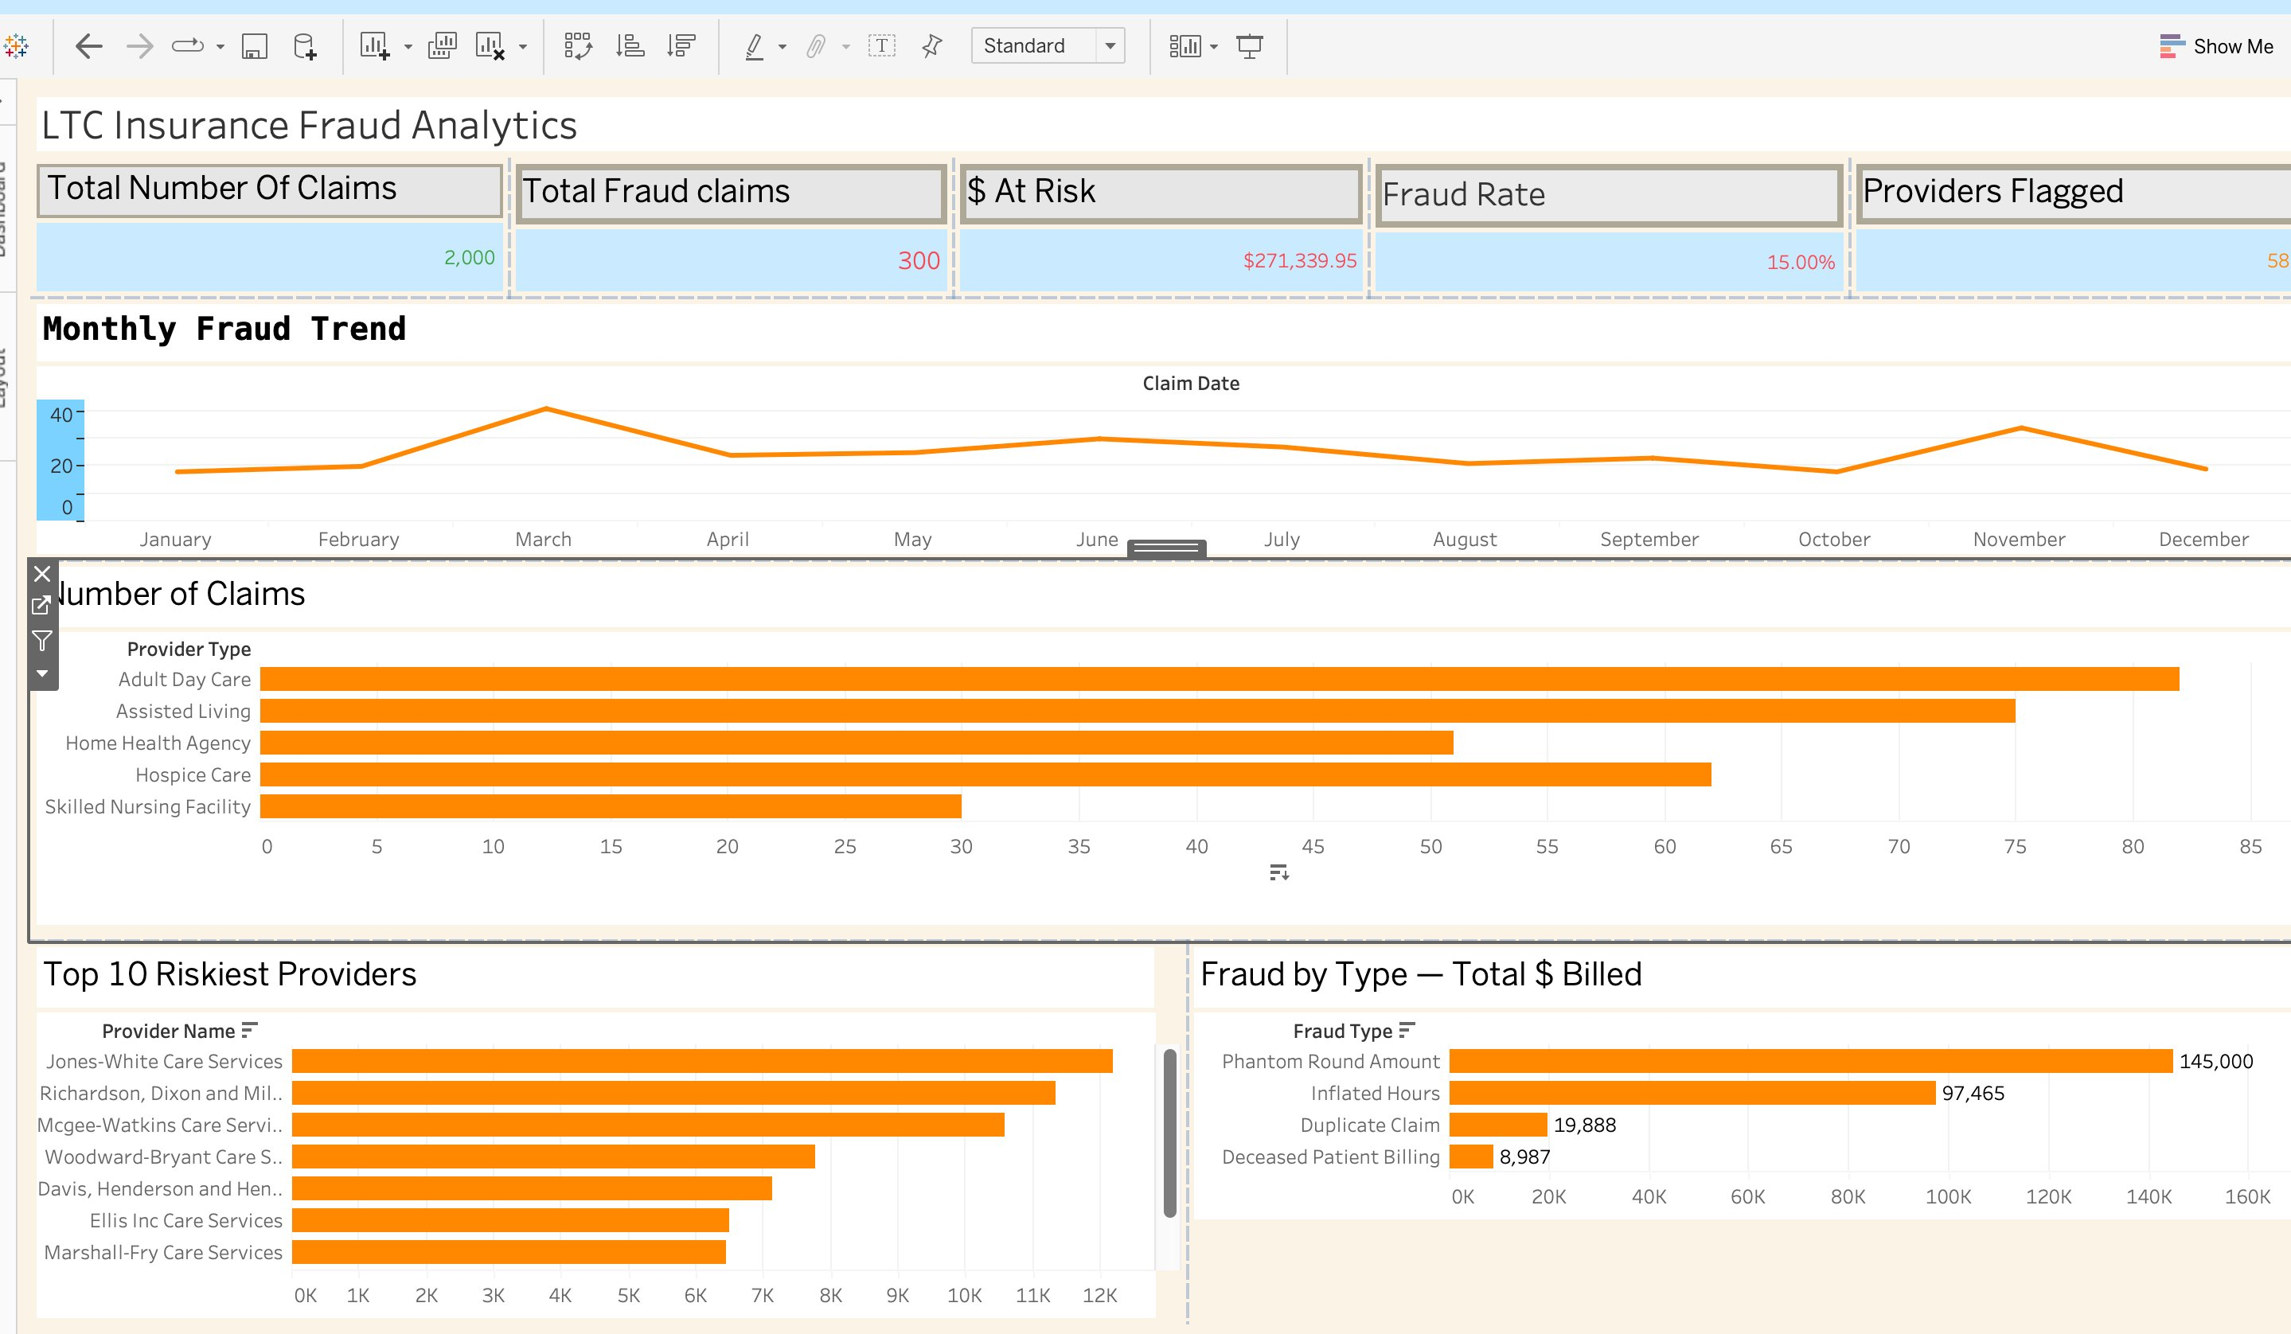
LIVE DASHBOARD
Interactive Tableau Dashboard — LTC Fraud Analytics
📊 5 Live KPIs
Total claims, fraud count, $ at risk, fraud rate, providers — all update on filter
📈 Monthly Trend
March & November are peak fraud months across the dataset
🏥 Provider Drill-down
Click any bar to filter all 4 charts simultaneously
💰 Fraud by Type
Phantom round amounts = $146K — highest $ damage fraud type
🔗 Live Dashboard:
public.tableau.com/app/profile/pooja.sriavastava/viz/MonthlyFraudTrend/LTCInsuranceFraudAnalytics

Slide 6
The Most Shocking Findings
What the data revealed that no one expected
98.9 hrs
19 years
billed in a single day
of ghost billing after death
PRV0027 billed 98.9 care hours for one patient on one day. A day has 24 hours. This is not a rounding error — it is deliberate fraud.
PAT0124 died in 2005. 13 different providers continued billing for their care through 2024. $4,153 stolen from a deceased patient's policy.
Same day —
3.3×
8 ghost providers registered
higher average fraud bill
All 8 fraudulent ghost providers registered on the exact same date and immediately began billing heavily. A coordinated fraud ring.
Legitimate claims average $277. Fraudulent claims average $904. The financial signature of fraud is unmistakable — inflated bills are the pattern.

Slide 7
RECOMMENDATIONS
4 Actions to Take Today
01
Block claims with care hours > 16
Prevents $222,465 in fraud
Add a real-time validation gate before claim approval. This single rule catches 167 fraudulent claims — the highest volume fraud type.
02
Flag round-amount billing for review
Prevents $146,002 in fraud
Legitimate bills are never round numbers. Any claim divisible by $250 should trigger mandatory analyst review before payment.
03
Automate deceased patient cross-check
Prevents $27,335 in fraud
Cross-reference every claim date against CMS death registry data. Stops ghost billing that continued for up to 19 years undetected.
04
90-day new provider watch list
Catches fraud rings early
Any provider registered less than 90 days ago with >20 claims should trigger an audit. All 8 ghost providers would have been caught early.

Slide 8
Thank You
Pooja Srivastava
Data Analyst · Richmond, VA
📊 Tableau public.tableau.com/app/profile/pooja.sriavastava
💼 LinkedIn linkedin.com/in/pooja-srivastava03
🐙 GitHub github.com/pooja123123
📧 Email poojasrivastava03@gmail.com
"This project mirrors the day-to-day work of a fraud data analyst at a long-term care insurance company — from raw data to executive insight."

