Slide 1

BOOTCAMP18-Drone Technology And Applications
Sardar Vallabhbhai National Institute Of Technology Surat
Drone-Assisted Leaf Disease Detection System
Presented By : Pooja Dave
Sidharth Kanojiya
July 2025
NIT Surat
1
Notes:
*
Chandra prakash
RAMAN LAB

Slide 2
Introduction
🤔 Farmers struggle with early, accurate disease detection
🌾 Agriculture is the backbone of Indian economies.
🦠 Plant diseases reduce crop yield and quality.
🤔 Farmers struggle with early, accurate disease detection
🤖 We will use ML/DL + 🚁 drone-based leaf image capture
⚡ Enables real-time, large-scale monitoring and 🌱 precision farming
NIT Surat

Slide 3
Problem Statement
🧍‍♂️ Traditional systems rely on manual leaf image capture by farmers or researchers.
This process is time-consuming, inconsistent, and prone to human error.
Poor lighting, angle, or resolution in manual images affects model accuracy
🎯 Results in lower accuracy and limited scalability for diverse, real-world farming scenarios
🚁 There is a need for a scalable, automated, and structured approach to crop disease detection
NIT Surat

Slide 4
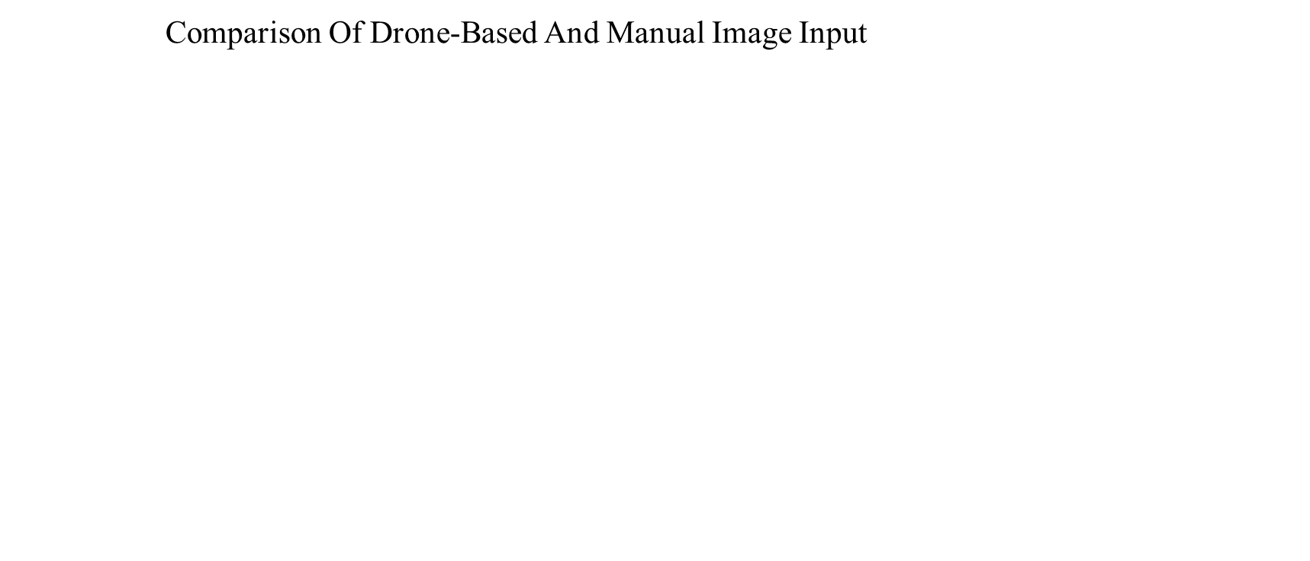
Solution
🔍 Aspect | 🧍‍♂️ Manual Image Input | 🚁 Drone-Based Image Input
Coverage | Limited to few plants | Scans entire field in one flight
Accuracy of Capture | Varies due to angle, lighting, device | High-resolution, consistent quality
Time Efficiency | Slow, labor-intensive | Rapid, autonomous, covers hectares quickly
Human Error | High (incorrect plant, angle, etc.) | Minimal – pre-programmed flight & auto-capture
Real-Time Monitoring | Not possible | Yes, with live feed & fast image transfer
Scalability | Low | Highly scalable to large farms
NIT Surat
*

Slide 5
Drone-Based Approach
📸 Drone Image Capture
↓
🔧 Image Preprocessing
↓
🧠 CNN Model
↓
🦠 Disease Classification
↓
📊 Output / Storage
NIT Surat
*

Slide 6
Tools And Technology
Image Collection
– Drone with RGB camera (for leaf capture + GPS tagging)
🖼️ Preprocessing
– OpenCV, PIL – Resize, normalize, augment leaf images
🧠 Model Building
– TensorFlow / Keras – Simple CNN architecture (Conv →Pool → Dense →Softmax)
📊 Evaluation
– scikit-learn, Matplotlib – Accuracy, F1-score, Confusion Matrix
💻 Development Environment
– Python 3.x, Jupyter/Colab/Vs Code – Model training & testing interface
NIT Surat

Slide 7
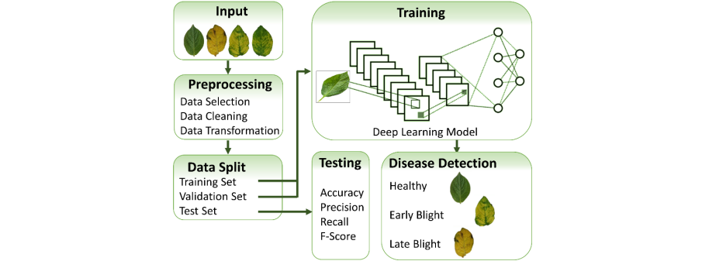
WorkFlow
NIT Surat
*

Slide 8
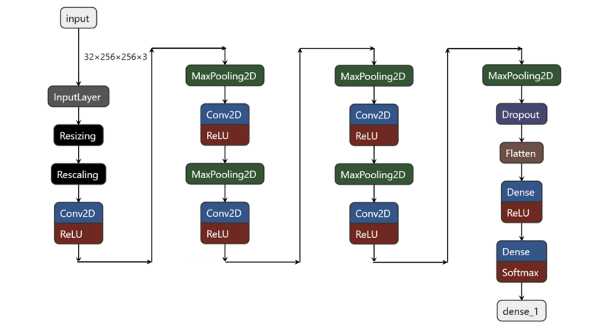
CNN -Architecture
NIT Surat
*

Slide 9
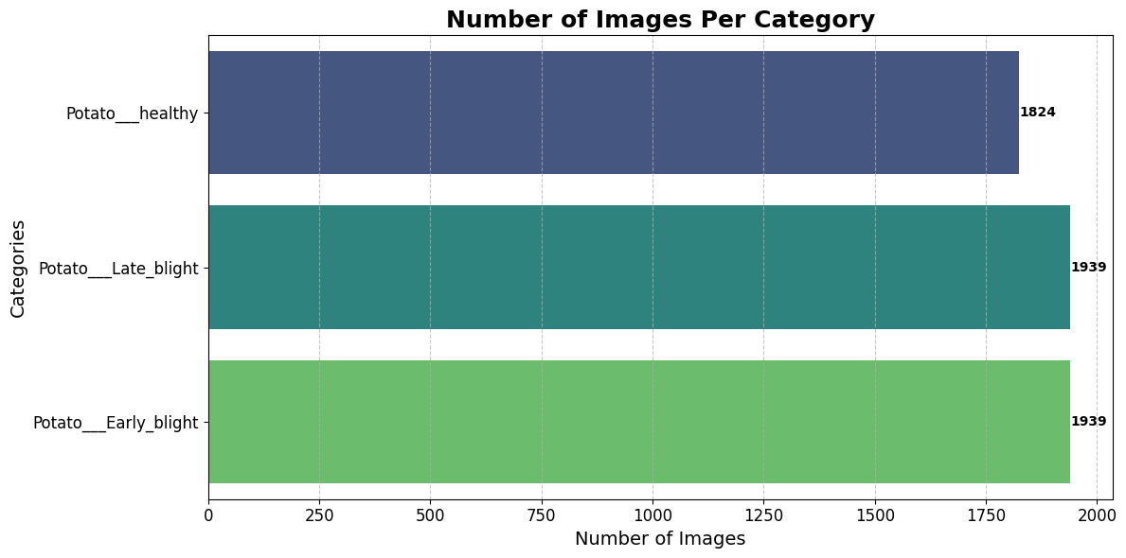
Dataset
Potato
NIT Surat
*

Slide 10
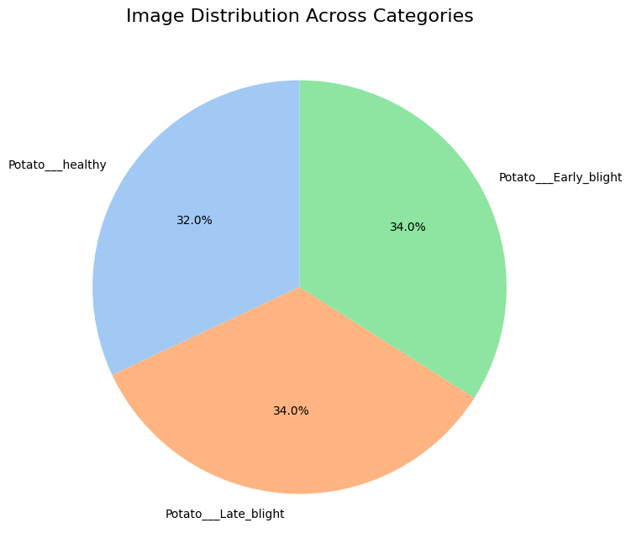
Dataset
Potato
NIT Surat
*

Slide 11
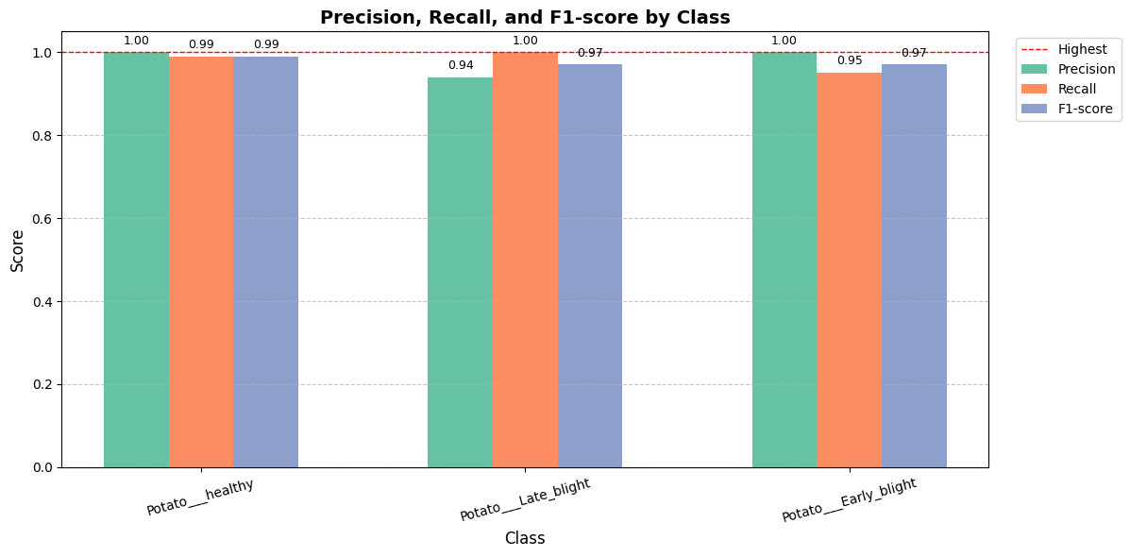
Classification Report
Potato
NIT Surat
*

Slide 12
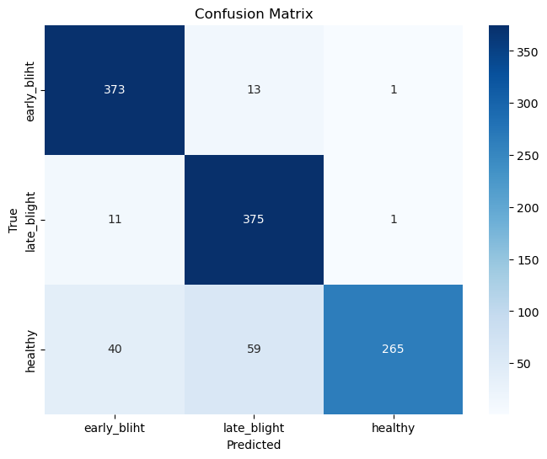
Performance Metrics(Confusion Metrics)
Potato
NIT Surat
*

Slide 13
What’s Next?
🛰️ Live Drone Surveillance
– Auto leaf image capture from fields
📍 Geo-Tagged Mapping
– Detect & locate disease-affected zones
📐 Leaf Morphology from Above
– Analyse leaf size & shape aerially
📦 On-Drone AI Inference
– Run CNN model on drone for quick results
🌦️ Weather + Soil Fusion
– Use APIs for region-aware suggestions
NIT Surat
*

Slide 14
References
[1] A Akinyelu and L Abualigah. Revolutionizing crop disease detectionwith computational deep learning. Environmental Monitoring and As-sessment, 196(3):1–15, 2024.
[2] Gabriel Batista, Luciana Silva, Felipe Costa, and Camila Lima. Agrichat:An ai-powered agricultural chatbot for real-time crop disease diagnosis.Agricultural AI Journal, 2(3):45–60, 2020.
[3] Timur Khusainov, Anton Ivanov, and Yuri Sergeev. A chatbot for de-tecting and diagnosing crop diseases based on image classification andexpert system. Computational Intelligence and Agriculture, 5(2):98–112,2022.
[4] Vijay Madhavan, Sandeep Kumar, Gauri Rao, and Pooja Sharma. Cropdisease detector: A deep learning approach for early disease detectionin crops. Journal of Agricultural Technology and Innovation, 4(2):45–56,2021.
[5] Ramesh Patel, Vikas Sharma, and Ruchi Chauhan. Development ofa smart agricultural chatbot for crop disease prediction and diagnosis.Journal of Agricultural Engineering Technology, 29(3):233–245, 2021.
[6] MJ Piran and D Han. Crop-saving with ai: Latest trends in deep learn-ing techniques for plant disease detection. Frontiers in Plant Science,14:1224709, 2023.
[7] Edgar Romero, Javier Perez, and Santiago Lopez. Crop diseasebot: Aconversational agent for diagnosing and classifying crop diseases usingdeep learning models. Agricultural Robotics and AI Journal, 8(2):88–98,2019.
[8] Sofuoglu C I, Birant D (2023). Potato Plant Leaf Disease Detection Using Deep Learning Method. Journal of Agricultural Sciences (Tarim Bilimleri Dergisi), 30(1):153-165. DOI: 10.15832/ankutbd.1276722
NIT Surat
*

Slide 15
Q & A
NIT Surat

Slide 16
Thank You!
NIT Surat

