Slide 1

Protect your teeth
Your text has been concise and beautiful, but the information is inextricably inextricable and needs to be expressed in more words; but please refine the essence of your thought as much as possible.
PPT template

Slide 2
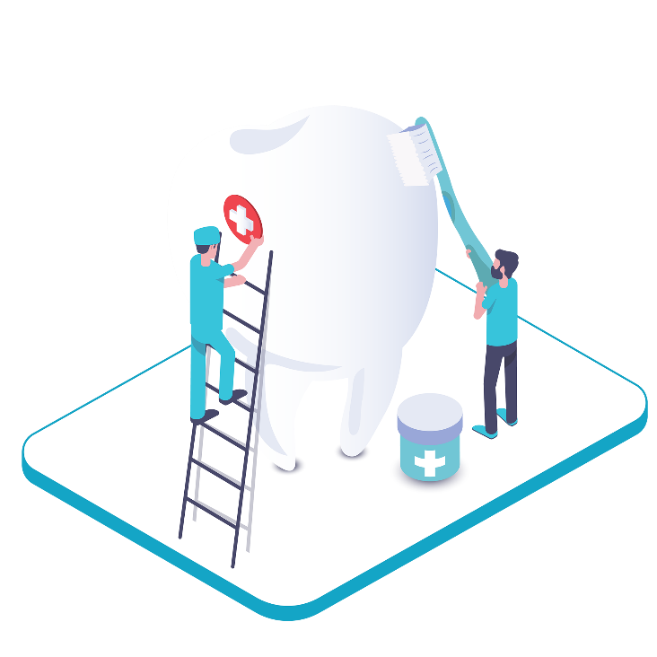
Software Requirements
Web Technology: ANGULAR
Middle-end Technology: JAVA SPRING
Back-end Technology: SQL
Operating system: Windows

Slide 3

Part 02
Protect your teeth
Your text has been concise and beautiful, but the information is inextricably inextricable and needs to be expressed in more words; but please refine the essence of your thought as much as possible.
PPT template

Slide 4

Add title here
Click here to add the text, the text is the extraction of your thought, in order to finally demonstrate the good effect of the release, please try to be concise and concise; if necessary, you can add or subtract the text as needed .
Add title here
Click here to add the text, the text is the extraction of your thought, in order to finally demonstrate the good effect of the release, please try to be concise and concise; if necessary, you can add or subtract the text as needed .
Add title here
Click here to add the text, the text is the extraction of your thought, in order to finally demonstrate the good effect of the release, please try to be concise and concise; if necessary, you can add or subtract the text as needed .

Slide 5




Add title here
Click here to add the text, the text is the extraction of your thought, in order to finally demonstrate the good effect of the release, please try to be concise and concise; if necessary, you can add or subtract the text as needed .
Text here
Text here
Text here
Click here to add the text, the text is the extraction of
Click here to add the text, the text is the extraction of
Click here to add the text, the text is the extraction of

Slide 6
Part 01
Protect your teeth
Your text has been concise and beautiful, but the information is inextricably inextricable and needs to be expressed in more words; but please refine the essence of your thought as much as possible.
PPT template

Slide 7


Add title here
Click here to add the text, the text is the extraction of your thought, please try to explain the point of view as succinctly as possible.
Add title here
Click here to add the text, the text is the extraction of your thought, please try to explain the point of view as succinctly as possible.

Slide 8






Add title here
Add title here
Add title here
Click here to add the text, the text is the extraction of your thought, please try to explain the point.
Click here to add the text, the text is the extraction of your thought, please try to explain the point.
Click here to add the text, the text is the extraction of your thought, please try to explain the point.
Add title here
Add title here
Add title here
Click here to add the text, the text is the extraction of your thought, please try to explain the point.
Click here to add the text, the text is the extraction of your thought, please try to explain the point.
Click here to add the text, the text is the extraction of your thought, please try to explain the point.

Slide 9
Part 03
Protect your teeth
Your text has been concise and beautiful, but the information is inextricably inextricable and needs to be expressed in more words; but please refine the essence of your thought as much as possible.
PPT template

Slide 10


Title here
Title here
If you express your views properly, you can often get twice the result with half the effort.
If you express your views properly, you can often get twice the result with half the effort.
Title here
Title here
If you express your views properly, you can often get twice the result with half the effort.
If you express your views properly, you can often get twice the result with half the effort.

Slide 11


ENTER TITLE HERE
Click here to add the text, the text is the extraction of your thought .
Title here
Click here to add the text, the text is the extraction of your thought, in order to finally present the good effect of the release, please try to be concise and concise; if necessary, add or subtract the text as needed, so that the viewer can accurately understand the message you convey.
Key words
Key words

Slide 12
Part 04
Protect your teeth
Your text has been concise and beautiful, but the information is inextricably inextricable and needs to be expressed in more words; but please refine the essence of your thought as much as possible.
PPT template

Slide 13

Title
Title
Title
If you express your views properly, you can often get twice the result with half the effort.
If you express your views properly, you can often get twice the result with half the effort.
If you express your views properly, you can often get twice the result with half the effort.

Slide 14
Text here
Text here
Text here
Text here
70%
60%
50%
45%
Click here to add the text, the text is the extraction of your thought, in order to finally present the good effect of the release, please try to be concise and concise; if necessary, add or subtract the text as needed, so that the viewer can accurately understand the message you convey.

Slide 15
Part 05
Protect your teeth
Your text has been concise and beautiful, but the information is inextricably inextricable and needs to be expressed in more words; but please refine the essence of your thought as much as possible.
PPT template

Slide 16

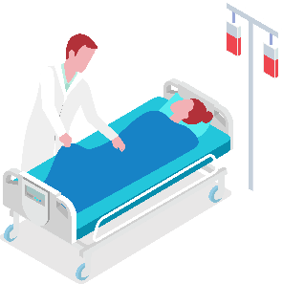
Title here
Title here
If you express your views properly, you can often get twice the result with half the effort.
If you express your views properly, you can often get twice the result with half the effort.
Protect your teeth
Click here to add the text, the text is the extraction of your thought, in order to finally present the good effect of the release, please try to be concise and concise; if necessary, add or subtract the text as needed, so that the viewer can accurately understand the message you convey.

Slide 17
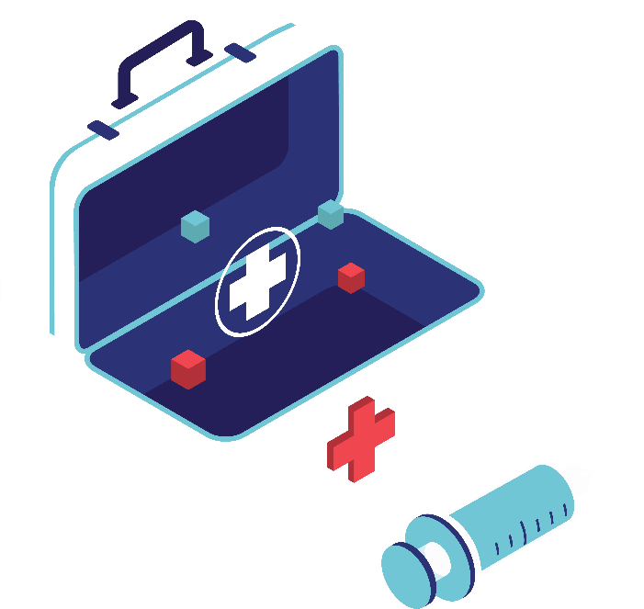
Text here
Text here
Just as we all want to change the world and bring light to others, but more often we just need to sow a seed, naturally there is a breeze, rain and dew nourish.
Just as we all want to change the world and bring light to others, but more often we just need to sow a seed, naturally there is a breeze, rain and dew nourish.
Text here
Text here
Just as we all want to change the world and bring light to others, but more often we just need to sow a seed, naturally there is a breeze, rain and dew nourish.
Just as we all want to change the world and bring light to others, but more often we just need to sow a seed, naturally there is a breeze, rain and dew nourish.

Slide 18
Thanks
Your text has been concise and beautiful, but the information is inextricably inextricable and needs to be expressed in more words; but please refine the essence of your thought as much as possible.
PPT template

