Slide 1






TOXIC COMMENT CLASSIFIER

Slide 2



Introduction
Online forums and social media platforms have provided individuals with the means to put forward their thoughts and freely express their opinion on various issues and incidents. In some cases, these online comments contain explicit language which may hurt the readers. Comments containing explicit language can be classified into myriad categories such as Toxic, Severe Toxic, Obscene, Threat, Insult, and Identity Hate. The threat of abuse and harassment means that many people stop expressing themselves and give up on seeking different opinions.

Slide 3

Problem Statement
Toxic comments in a workplace environment can lead to reduced productivity, low morale, and high turnover rates. This can have a negative impact on the organization's bottom line.
Toxic comments can have a wide range of negative impacts on individuals and communities, including emotional distress, cyberbullying, damage to reputation, discrimination, and loss of productivity. It is crucial to address toxic comments and promote a safe and respectful online and offline environment.

Slide 4
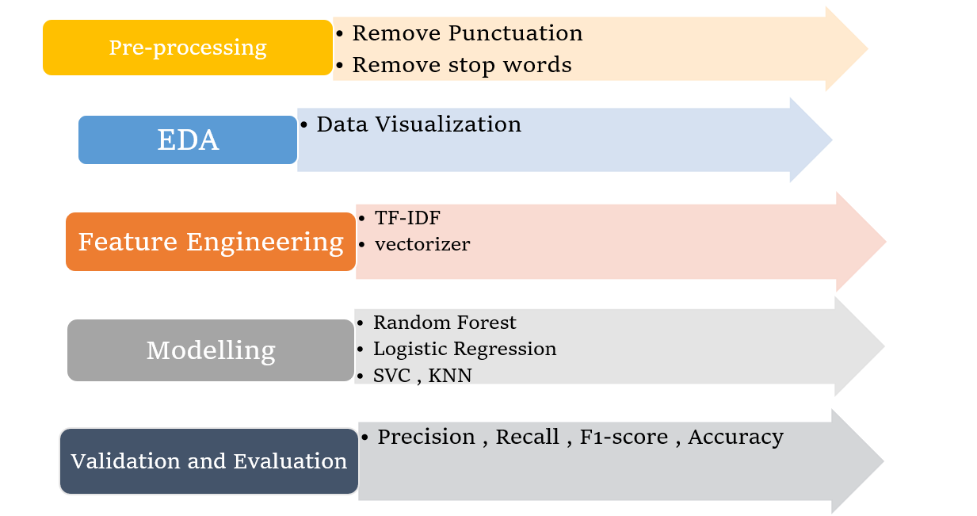
Approach:
Add a main point
Add a main point
Add a main point
Add a main point
Elaborate on what you want to discuss.
Elaborate on what you want to discuss.
Elaborate on what you want to discuss.
Elaborate on what you want to discuss.

Slide 5

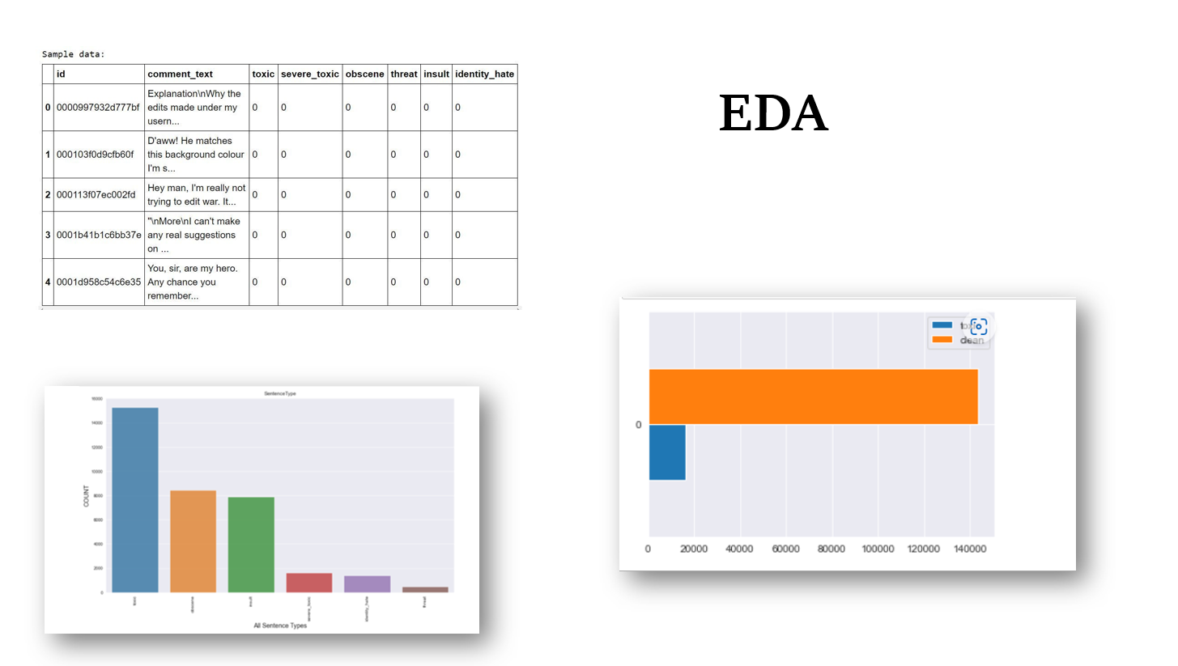

Slide 6
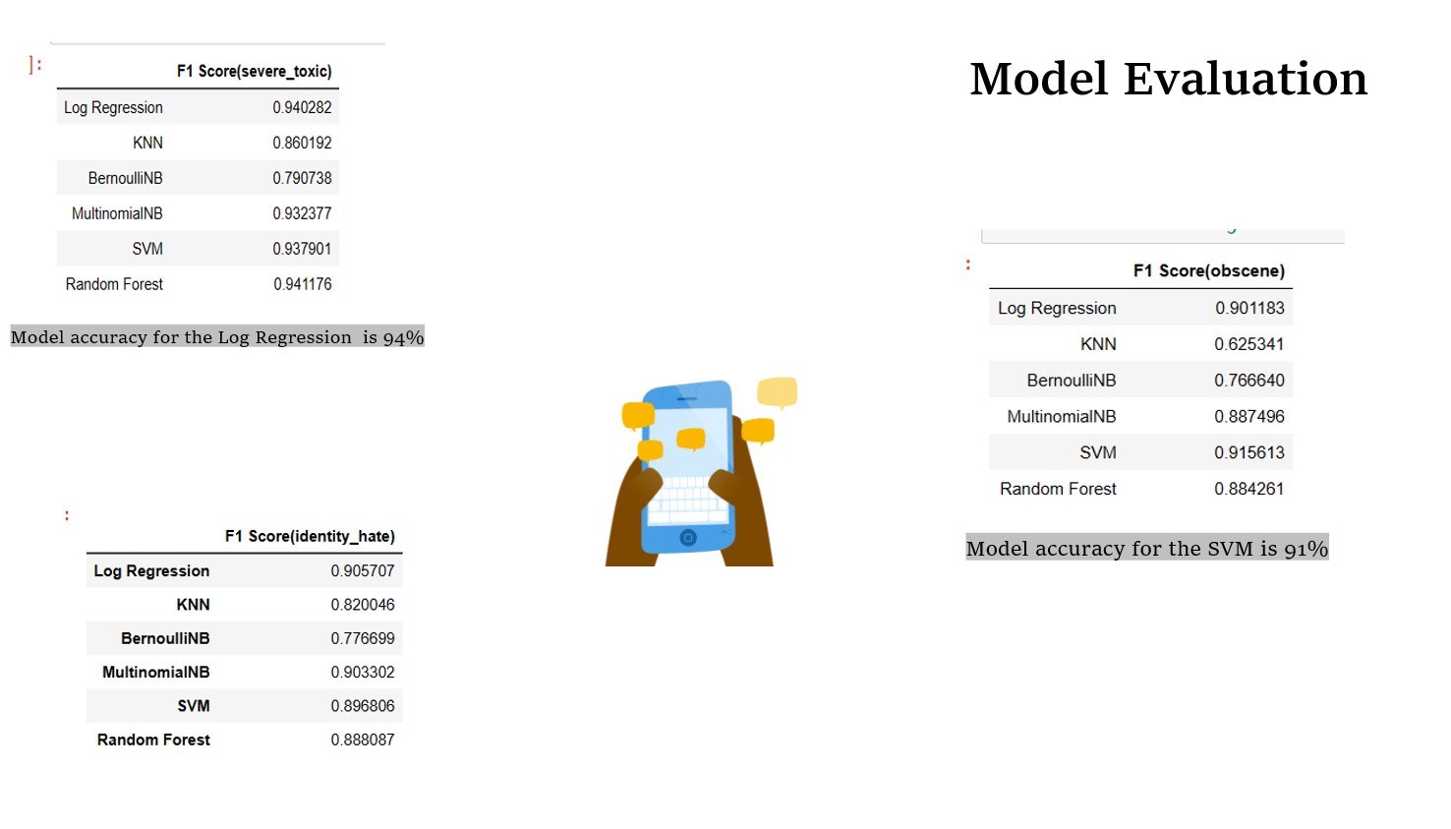

Slide 7
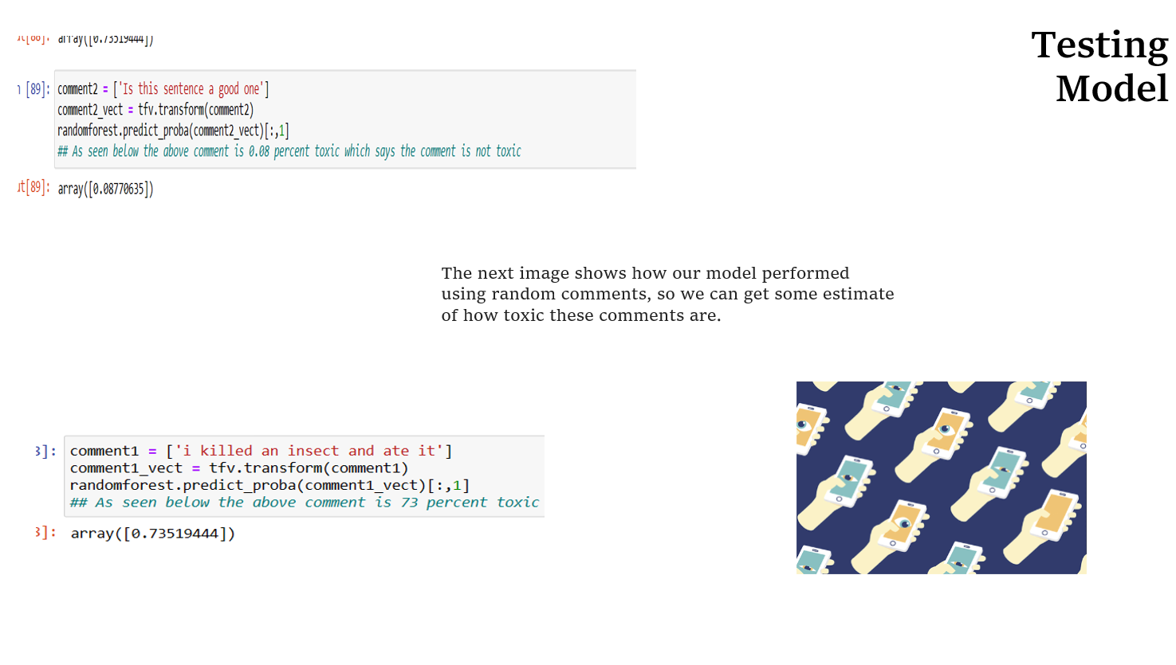

Slide 8

Thank you!

