Slide 1
CRUD Operations
Read Operations: Queries are the core operations that return data in MongoDB.
Cursors: Queries return iterable objects, called cursors, that hold the full result set.
Write operations: Insert, update, or remove documents in MongoDB. Introduces data create and modify operations, their behavior, and performances.
Atomicity and Transactions: Describes write operation atomicity in MongoDb.

Slide 2
CRUD Operations
Commands Used to Create Document:
db.collection.insert()
db.collection.insertOne();
db.collection.insert();
Example to Insert Query: db.bank_data.insertOne({"first_name" : "John", "last_name" : "Cena", "accounts" : [ { "account_type" : "Investment", "account_balance" : 6123524974.110823463, "currency" : "USD" }, { "account_type" : "Savings", "account_balance" : 132933272.569229168, "currency" : "EURO" } ]});
Command Used to Read Documents:
db.collection.find();
Db.collection.findOne();
Example for reading : db.bank_data.findOne({"last_name":"SMITH"});
Projections: In Mongo DB projection meaning is selecting only necessary data rather than selecting whole of the data of a document
$
$elemMatch
$limit
Example: db.bank_data.findOne({"last_name":"Cena"},{"first_name":1,"_id":0});

Slide 3
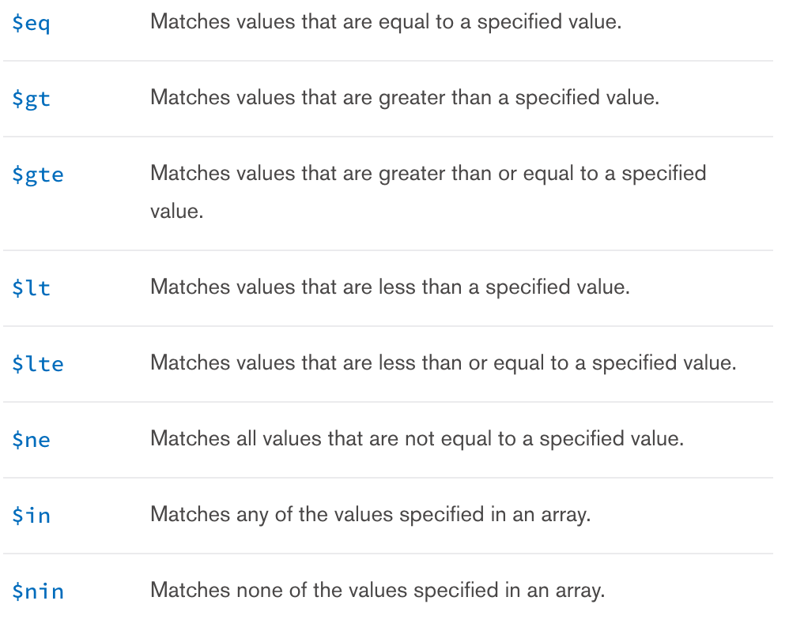
Comparison Operators
Example: $eq: db.bank_data.find({ "accounts.account_balance": {$eq:132933272.569229168}}).pretty()
$gte,$lte: db.bank_data.find({ "accounts.account_balance": {$gte:8554996,$lte:9000000}}).pretty()[4];

Slide 4
Logical Operators
Name | Description
$or | Joins query clauses with a logical OR returns all documents that match the conditions of either clause.
$and | Joins query clauses with a logical AND returns all documents that match the conditions of both clauses.
$not | Inverts the effect of a query expression and returns documents that do not match the query expression.
$nor | Joins query clauses with a logical NOR returns all documents that fail to match both clauses.
Examples:
$and db.bank_data.find({$and:[{"accounts.account_type":"Checking"}, { "accounts.account_balance": {$gte:8554996,$lte:9000000}}]}).pretty()[4];
$or db.bank_data.find({$and:[{"accounts.account_type":"Investment"},{"accounts.account_type":"Savings"}]}).pretty()[4];

Slide 5
Array and Regex Operator
Name | Description
$all | Matches arrays that contain all elements specified in the query.
$elemMatch | Selects documents if element in the array field matches all the specified $elemMatchconditions.
$size | Selects documents if the array field is a specified size.
Example $elemMatch: db.bank_data.find({last_name: "SMITH", "accounts.account_type": "Savings" }, { first_name: 1, last_name: 1, accounts: { $elemMatch : { 'account_type' : 'Savings' } } } ).pretty();
$regex: Provides regular expression capabilities for pattern matching strings in queries. MongoDB uses Perl compatible regular expressions (i.e. “PCRE” ) version 8.38 with UTF-8 support.
Example: db.bank_data.find({"first_name":{$regex:/^RI.*/}},{"first_name":1,"last_name":1,"_id":0}).pretty();

Slide 6
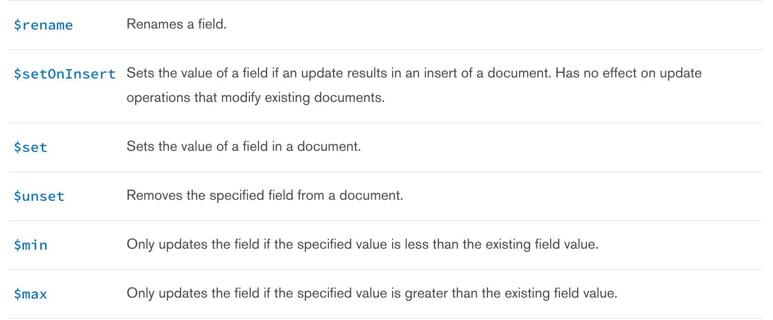
Update and Remove Queries
MongoDB's update() and save() methods are used to update document into a collection. The update() method update values in the existing document while the save() method replaces the existing document with the document passed in save() method.
MongoDB's remove() method is used to remove document from the collection. remove() method accepts two parameters. One is deletion criteria and second is justOne flag
Example: db.collection.remove({”last_name”:”SMITH”});

