Slide 1
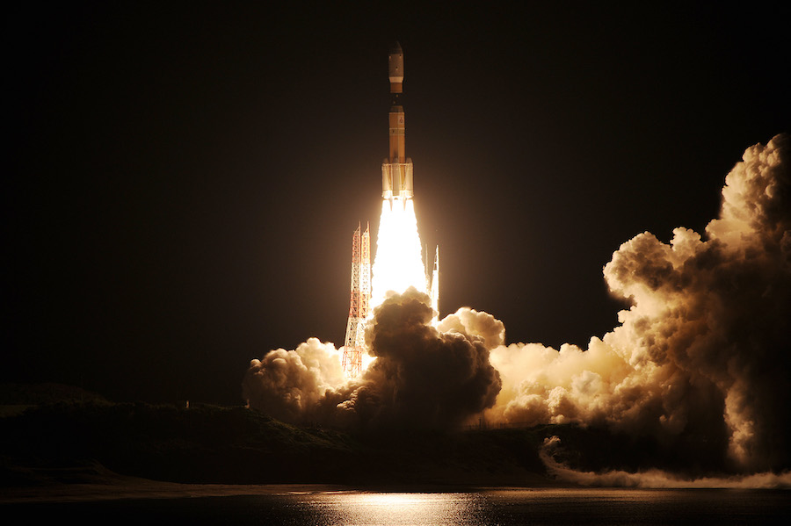
IBM DATA SCIENCE CAPSTONE PROJECT
Space X Falcon 9 Landing Analysis
Pooja Karmokar
10th Jan 2023

Slide 2
OUTLINE
Executive Summary
Introduction
Methodology
Results
Visualization – Charts
Dashboard
Discussion
Findings & Implications
Conclusion
Appendix

Slide 3
EXECUTIVE SUMMARY
Methodologies in use:
The project is followed by collecting data using:
Data collection using API
Data Wrangling
Followed by EDA (Exploratory Data Analysis) using:
SQL
Pandas and Matplotlib
Performing Data Analysis and Visualization by:
Folium
Plotly
And finally applying classification methodologies of:
Predictive Analysis

Slide 4
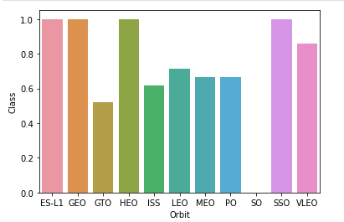
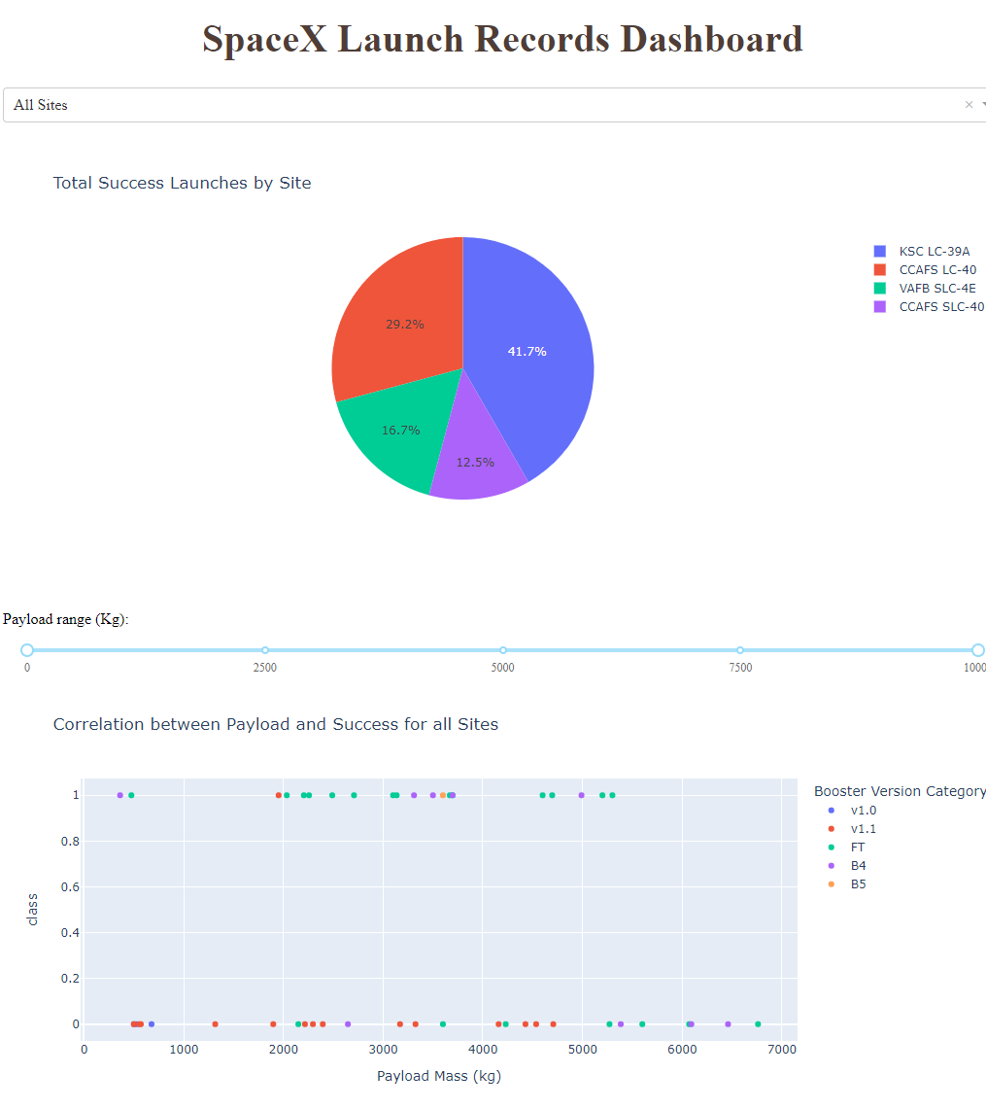
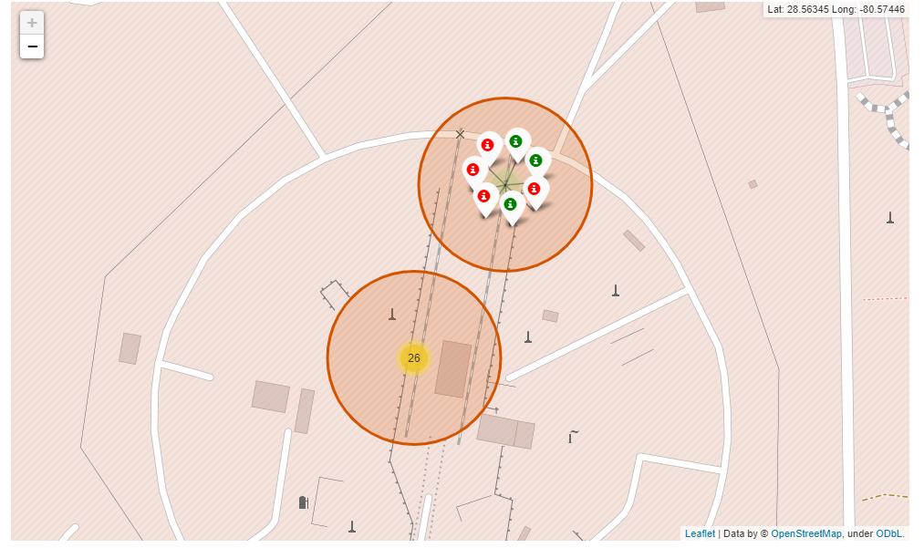
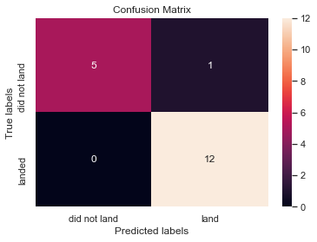
Summary of Results:
The project produced below results:
Exploratory Data Analysis (EDA) observations
Geospatial Analysis
Interactive Dashboards
Classification models outcomes by Predictive Analysis
1
3
2
4

Slide 5
Introduction
Falcon 9 rocket launches by SpaceX cost about $62 million. This is significantly less expensive than other providers (which typically cost more than $165 million), and a large portion of the savings is due to SpaceX's ability to land and reuse the rocket's first stage.
We can estimate the cost of a launch and use this data to decide whether or not a different company should compete against SpaceX for a rocket launch if we can anticipate whether the first stage will land. In the end, this project will be able to forecast if the Space X Falcon 9 first stage will land safely.

Slide 6
Section 1
Applied Methodology

Slide 7
Applied Methodology
Data Collection
GET requests to the SpaceX REST API
Web Scraping
Data Wrangling
Used .value_counts() method to determine the following:
Number of launches on each site
Number and occurrence of each orbit
Number and occurrence of mission outcome per orbit type
Creating a landing outcome label that shows the following:
0 when the booster did not land successfully
1 when the booster did land successfully

Slide 8
Applied Methodology Contd.
Exploratory Data Analysis
Evaluation of SpaceX datasets using SQL queries
Making use of Pandas and Matplotlib libraries to determine relationship between patterns and variables
Interactive Visuals
Using folium for Geospatial Analysis
Using plotly to prepare interactive Dashboards
Data Model Evaluation
Plotting confusion matrices for each classification model
Assessing the accuracy of each classification model
Using sci-kit learn library to train models

Slide 9
Data Collection – An overview
Data collection process involved a combination of API requests from Space X public API and web scraping data from a table in Space X’s Wikipedia entry.
Make a GET response to the SpaceX REST API
Convert response into .json file then fitting date to a Pandas DataFrame
Using custom logic to clean the data
Define lists to store data sets
Calling custom functions to retrieve data and fill the lists
Use defined lists as values in a dictionary and construct the dataset
Create a Pandas DataFrame from the constructed dictionary dataset
Filter the DataFrame to only include Falcon 9 launches
Reset the FlightNumber column
Replace missing values of PayloadMass with the mean PayloadMass value
Github link: https://github.com/pooja420/practrepo/blob/7de65758ac5938796a34d4734f032af57d7f3389/jupyter-labs-spacex-data-collection-api.ipynb

Slide 10
Data Collection – Webscraping
Web scraping Falcon 9 and Falcon Heavy Launches Records from Wikipedia to fetch details like Flight No., Launch site, Payload, PayloadMass, Orbit, Customer, Launch outcome, Version Booster, Booster landing, Date, Time
Request the HTML page from the static URL
Assign the response to an object
Create a BeautifulSoup object from the HTML response object
Find all tables within the HTML page
Collect all column header names from the tables found within the HTML page
Use the column names as keys in a dictionary
Use custom functions and logic to parse all launch tables (see Appendix) to fill the dictionary values
Convert the dictionary to a Pandas DataFrame ready for export
Github link: https://github.com/pooja420/practrepo/blob/7de65758ac5938796a34d4734f032af57d7f3389/jupyter-labs-webscraping.ipynb

Slide 11
Data Wrangling
Perform some Exploratory Data Analysis (EDA) to find some patterns in the data and determine what would be the label for training supervised models. Convert below outcomes into Training Labels:
True Ocean - means the mission outcome was successfully landed to a specific region of the ocean
False Ocean - means the mission outcome was unsuccessfully landed to a specific region of the ocean
True RTLS - means the mission outcome was successfully landed to a ground pad
False RTLS - means the mission outcome was unsuccessfully landed to a ground pad
True ASDS - means the mission outcome was successfully landed on a drone ship
False ASDS - means the mission outcome was unsuccessfully landed on a drone ship
Github link: https://github.com/pooja420/practrepo/blob/d1896c5281dcd099c707f5d7e4a5f68713afd4b0/labs-jupyter-spacex-data_wrangling_jupyterlite.jupyterlite.ipynb

Slide 12
Exploratory data analysis (EDA) – SQL
The SQL queries performed on the data set were used to:
Display the names of the unique launch sites in the space mission
Display 5 records where launch sites begin with the string ‘CCA’
Display the total payload mass carried by boosters launched by NASA (CRS)
Display the average payload mass carried by booster version F9 v1.1
List the date when the first successful landing outcome on a ground pad was achieved
List the names of the boosters which had success on a drone ship and a payload mass between 4000 and 6000 kg
List the total number of successful and failed mission outcomes
List the names of the booster versions which have carried the maximum payload mass
List the failed landing outcomes on drone ships, their booster versions, and launch site names for 2015
Rank the count of landing outcomes (such as Failure (drone ship) or Success (ground pad)) between the date 2010-06-04 and 2017-03-20, in descending order
Github link: https://github.com/pooja420/practrepo/blob/d1896c5281dcd099c707f5d7e4a5f68713afd4b0/jupyter-labs-eda-sql-coursera_sqllite.ipynb

Slide 13

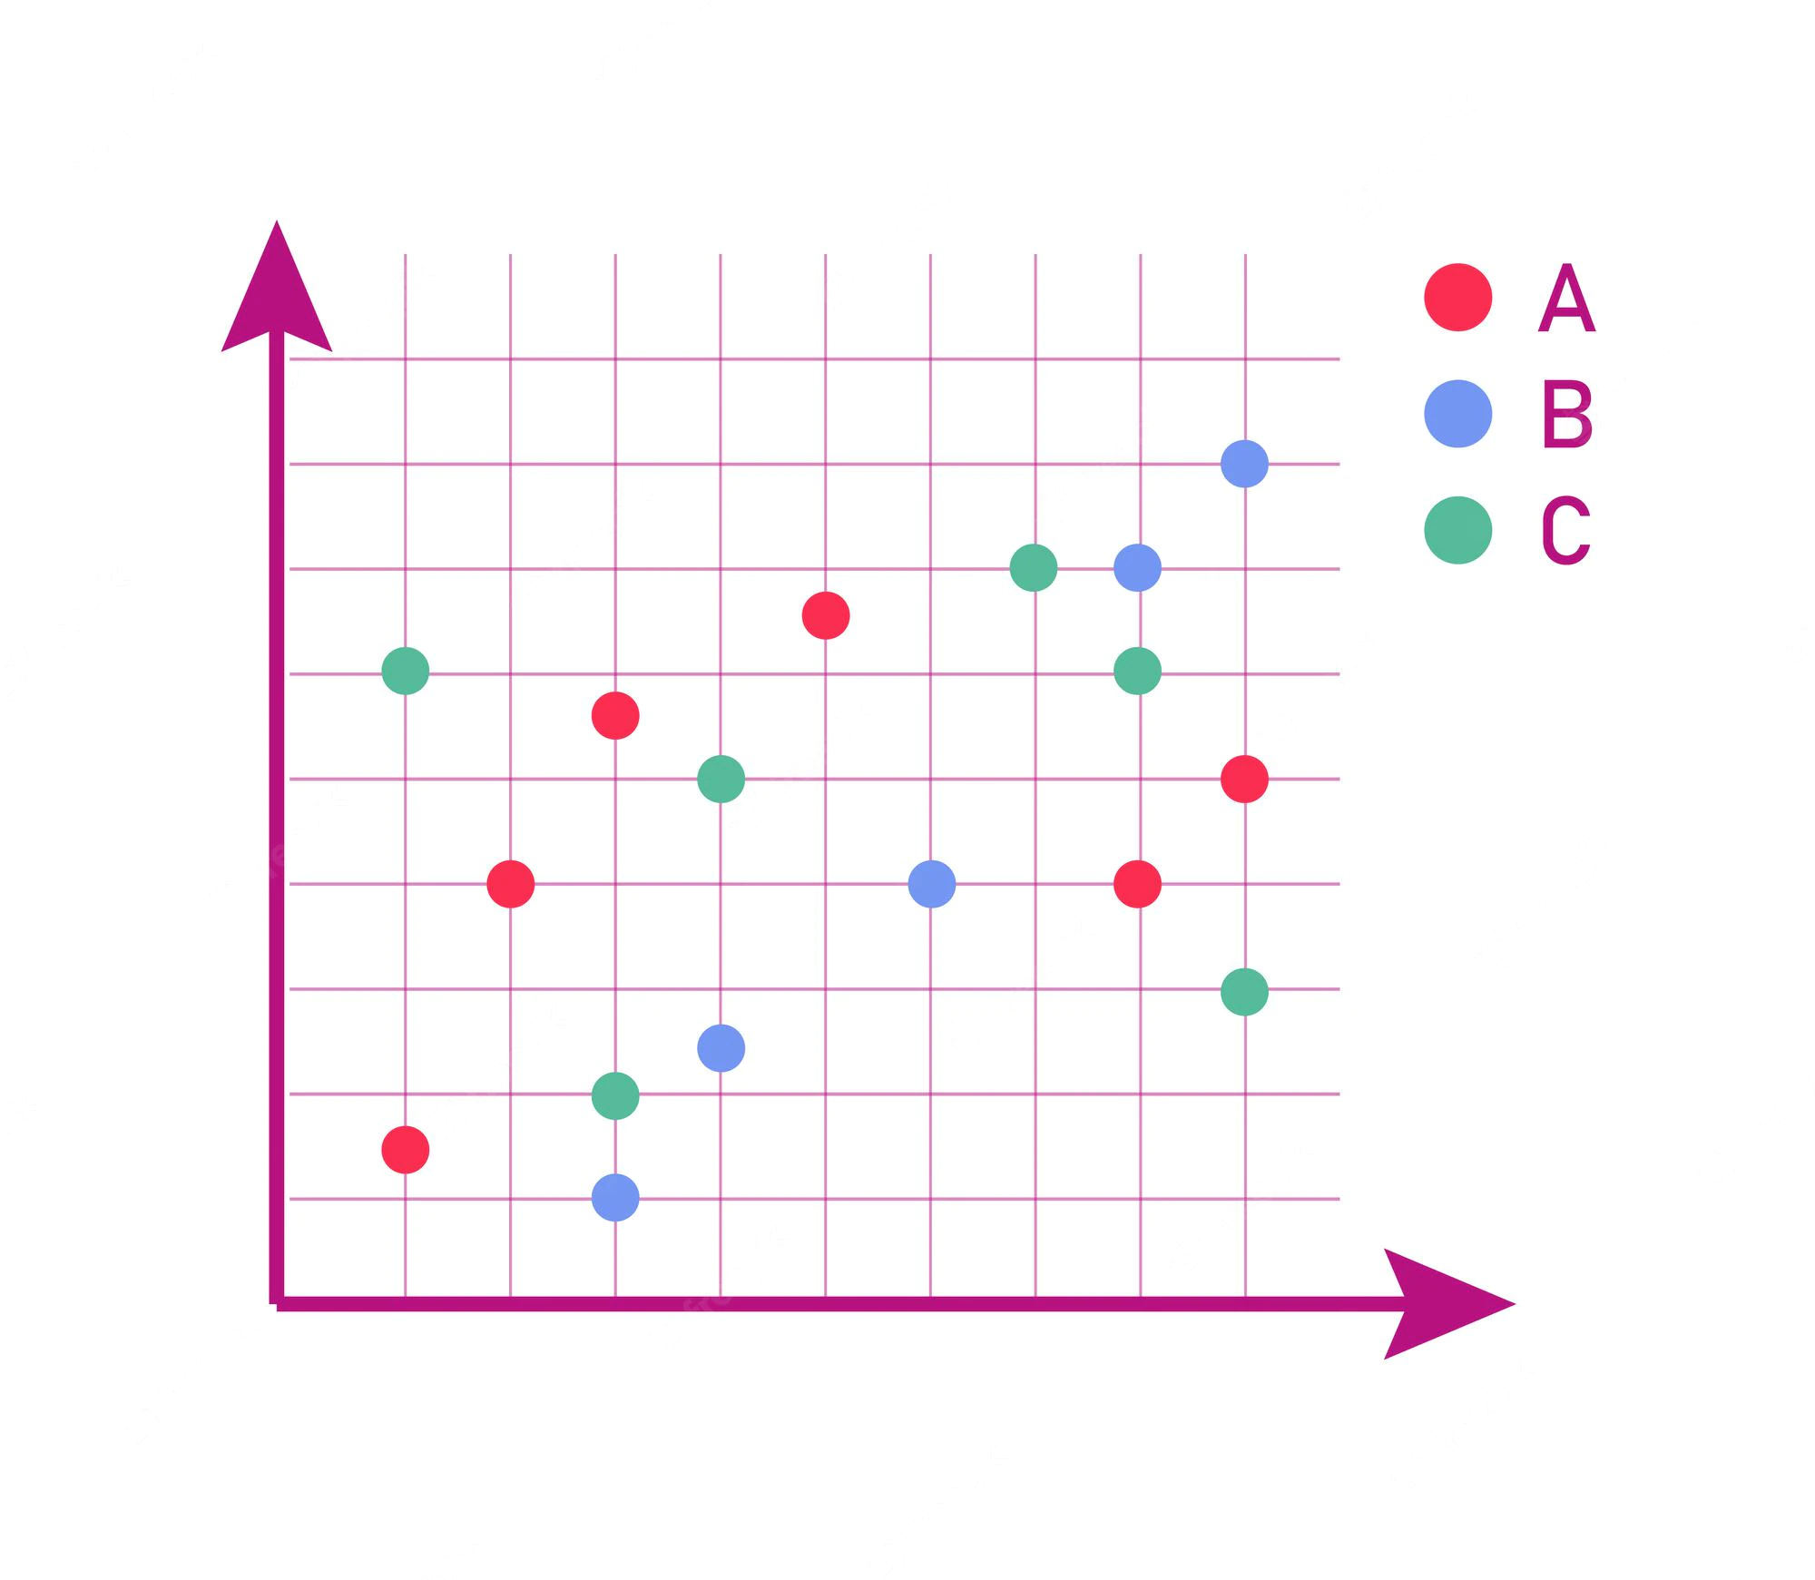

Exploratory data analysis (EDA) – Visual
Use Scatter charts, Bar and Line charts to predict if the Falcon 9 first stage will have land successful or not.
Scatter charts are useful to observe relationships, or correlations, between two numeric variables. Here it was used to visualize the relationship between Flight Number and Launch Site, Payload and Launch Site.
Bar charts are used to compare a numerical value to a categorical variable. Horizontal or vertical bar charts can be used, depending on the size of the data. It was used to visualize relationship between success rate of each orbit type.
Line charts contain numerical values on both axes, and are generally used to show the change of a variable over time. It was used to identify success trends.
Github link: https://github.com/pooja420/practrepo/blob/d1896c5281dcd099c707f5d7e4a5f68713afd4b0/jupyter-labs-eda-dataviz.ipynb.jupyterlite.ipynb

Slide 14
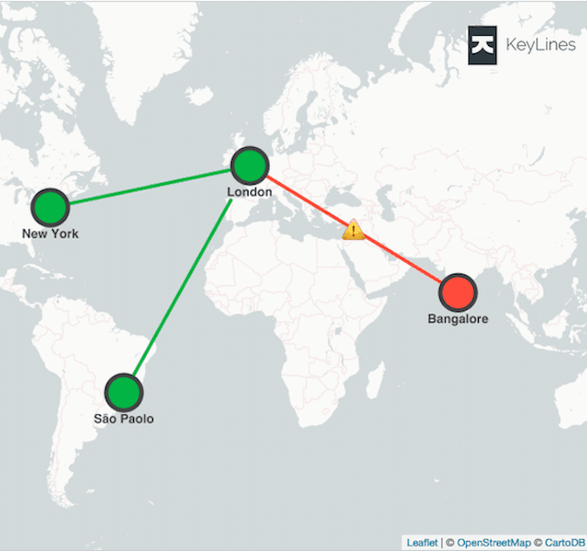
Geospatial analysis – folium
Mark all launch sites on map using NASA co-ordinates, initialize the map afterwards add folium circle and marker for each provided launch-site.
Identify and mark success and failure launch-sites by provding dummy variables like 1 for success and 0 for failure, creating clusters, creating icon as text label, and assigning icon colour.
Calculating distance between a launch site and its proximities by exploring launch sites and calculating distance between latitude and longitude, creating folium marker to show the distance and adding these features to map.
Github link: https://github.com/pooja420/practrepo/blob/d1896c5281dcd099c707f5d7e4a5f68713afd4b0/lab_jupyter_launch_site_location.jupyterlite.ipynb

Slide 15
Interactive Dash using PLOTLY
The following plots were added to a Plotly Dash dashboard to have an interactive visualization of the data:
Pie chart (px.pie()) showing the total successful launches per site
This makes it clear to see which sites are most successful
The chart could also be filtered (using a dcc.Dropdown() object) to see the success/failure ratio for an individual site
Scatter graph (px.scatter()) to show the correlation between outcome (success or not) and payload mass (kg)
This could be filtered (using a RangeSlider() object) by ranges of payload masses
It could also be filtered by booster version
Github link:
https://github.com/pooja420/practrepo/blob/d1896c5281dcd099c707f5d7e4a5f68713afd4b0/spacex_dash_app.py

Slide 16
Classification Model – Predictive Analysis
The following steps were taking to develop, evaluate, and find the best performing classification model:
Model Development:
Load dataset
Perform necessary data transformations (standardise and pre-process)
Split data into training and test data sets, using train_test_split()
Decide which type of machine learning algorithms are most appropriate
Create a GridSearchCV object and a dictionary of parameters
Fit the object to the parameters
Use the training data set to train the model
Model Evaluation:
Using the output GridSearchCV object, check the tuned hyperparameters (best_params_) and accuracy (score and best_score_)
Plot and examine the Confusion Matrix
Finding best FIT Classification model:
Review the accuracy scores for all chosen algorithms
The model with the highest accuracy score is determined as the best performing model
Github link:
https://github.com/pooja420/practrepo/blob/d1896c5281dcd099c707f5d7e4a5f68713afd4b0/SpaceX_Machine_Learning_Prediction_Part_5.jupyterlite.ipynb

Slide 17
Results
Exploratory data analysis results
Interactive analytics demo in screenshots
Predictive analysis results

Slide 18
Section 2
Insights drawn from EDA

Slide 19
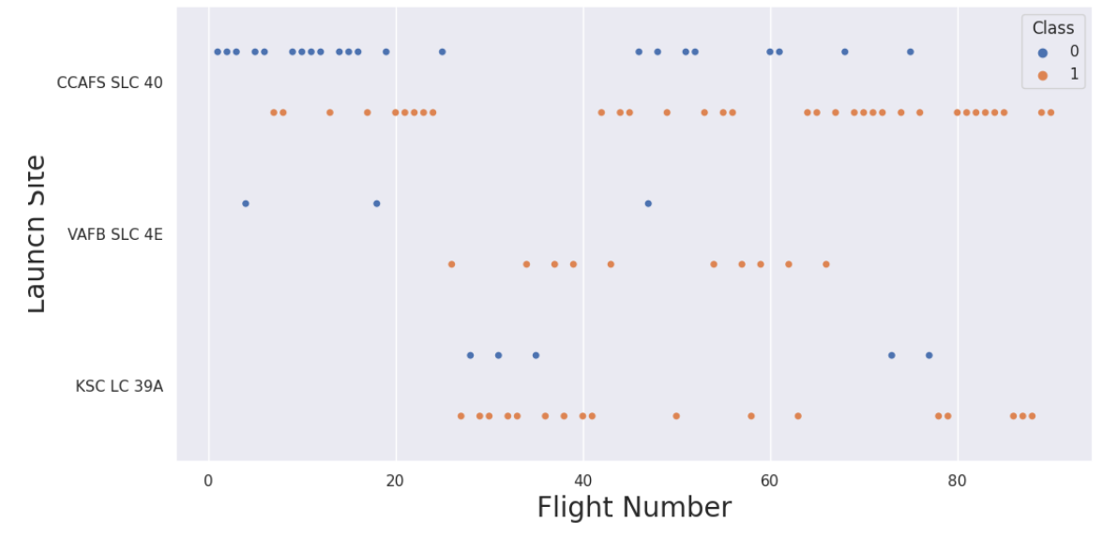
Flight Number vs. Launch Site
With the increase of flight number, the success rate is increasing as well in the launch sites

Slide 20
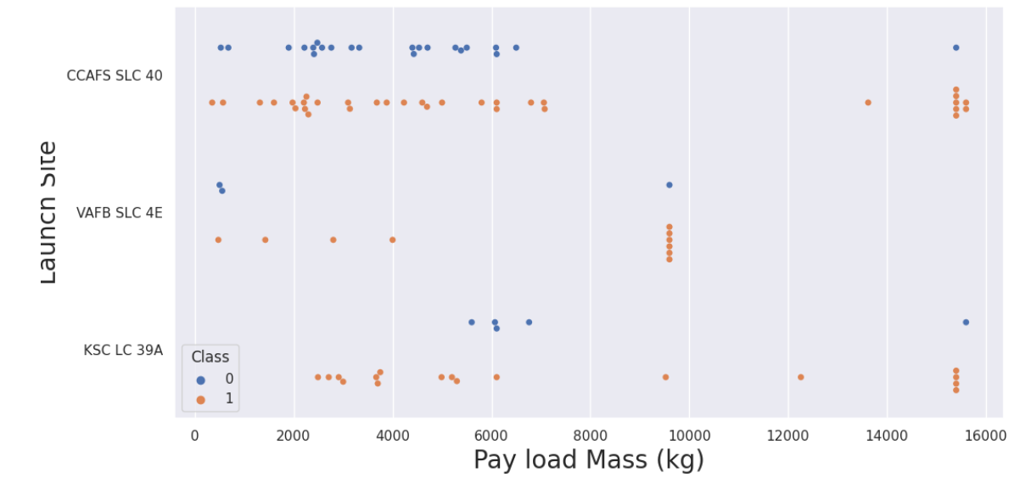
Payload vs. Launch Site
With the increase of Pay load Mass, the success rate is increasing as well in the launch sites

Slide 21
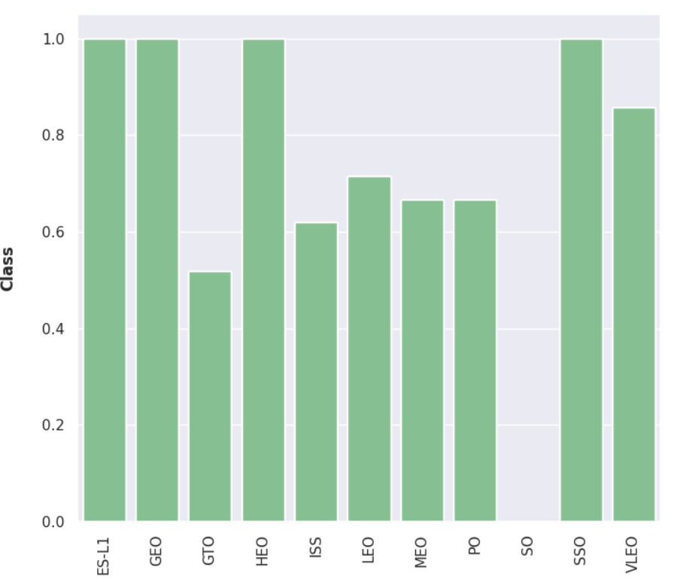
Success Rate vs. Orbit Type
ES-L1, GEO, HEO, and SSO have a success rate of 100%
SO has a success rate of 0%

Slide 22
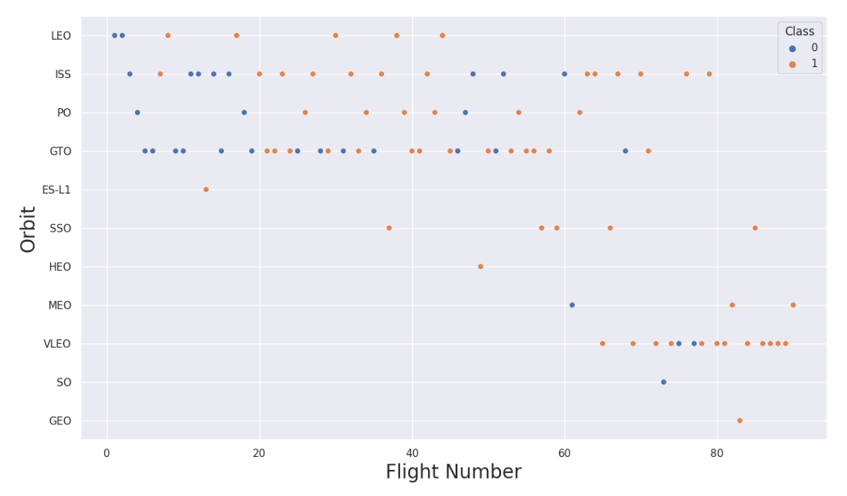
Flight Number vs. Orbit Type
It’s hard to tell anything here, but we can say there is no actual relationship between flight number and GTO.

Slide 23
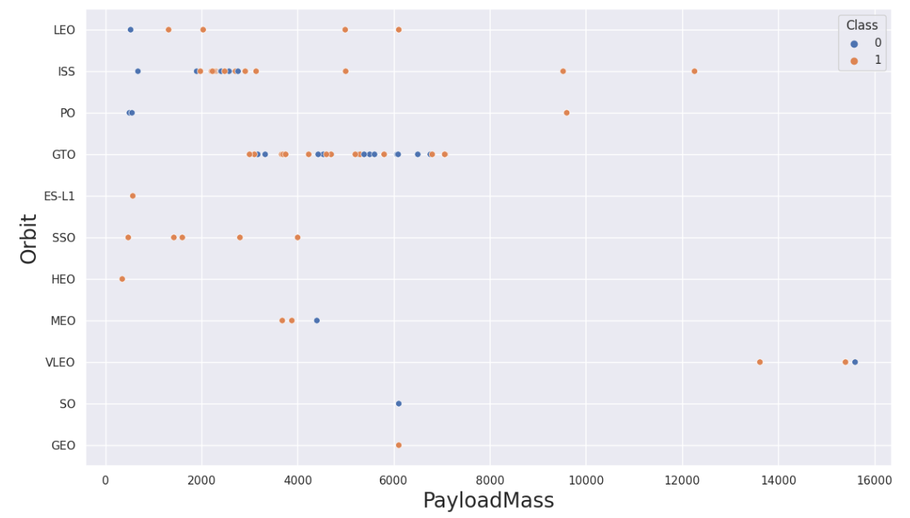
Payload vs. Orbit Type
First thing to see is how the Pay load Mass between 2000 and 3000 is affecting ISS.
Similarly, Pay load Mass between 3000 and 7000 is affecting GTO.

Slide 24
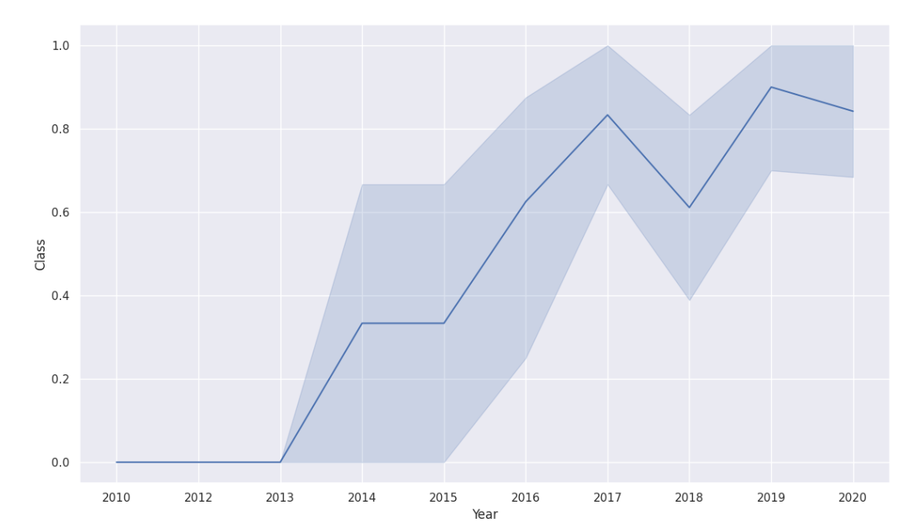
Launch Success Yearly Trend
Since the year 2013, there was a massive increase in success rate. However, it dropped little in 2018 but later it got stronger than before.

Slide 25
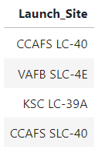
All Launch Site Names
We can get the unique values by using “DISTINCT”

Slide 26
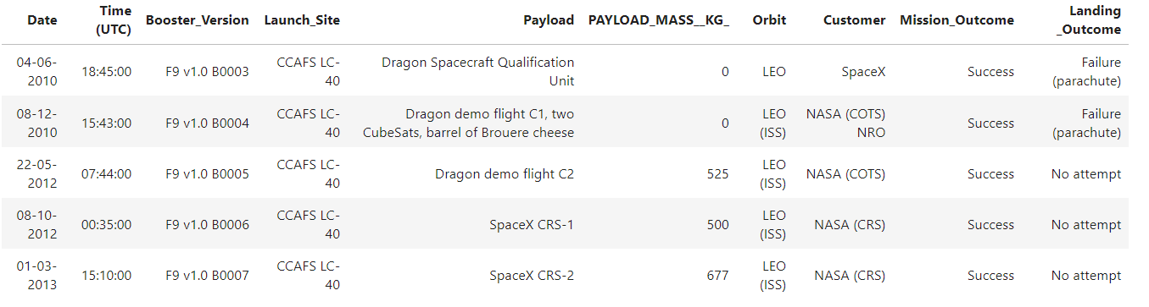
Name of 5 Launch Site Names starting with “CCA”
We can get only 5 rows by using “LIMIT”

Slide 27

Calculate – TOTAL PAYLOAD MASS
We can get the sum of all values by using “SUM”

Slide 28

Calculate – Average payload mass carried by booster version F9 v1.1
We can get the average of all values by using “AVG”

Slide 29

To Find out First Successful Ground Landing Date
We can get the first successful data by using “MIN”, because first date is same with the minimum date

Slide 30
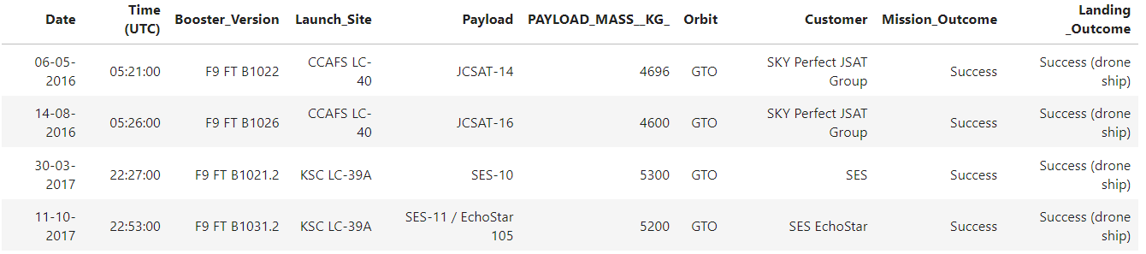
To Find out Successful Drone Ship Landing with Payload between 4000 and 6000
The payload mass data was taken between 4000 and 6000 only, and the landing outcome was determined to be “success drone ship”

Slide 31
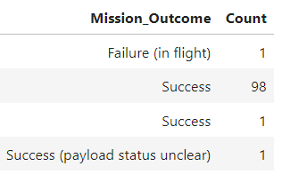
To Find out Total Number of Successful and Failure Mission Outcomes
We can get the number of all the successful mission by using “COUNT” and LIKE “Success%”

Slide 32
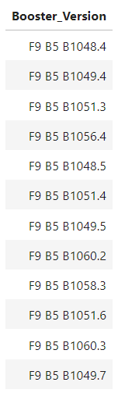
To Find out Boosters Carried Maximum Payload
We can get the maximum payload masses by using “MAX”

Slide 33
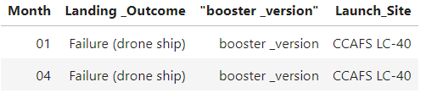
To Find out 2015 Launch Records
We can get the months by using month(DATE) and in the WHERE function we assigned the year value to “2015”

Slide 34
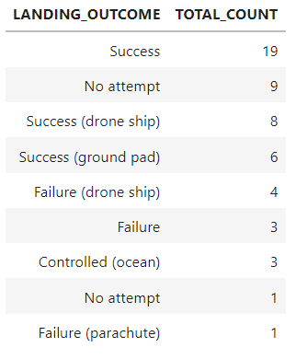
To Find out Rank Landing Outcomes Between 2010-06-04 and 2017-03-20
By using “ORDER” we can order the values in descending order, and with “COUNT” we can count all numbers as we did previously

Slide 35
Section 3
Launch Sites Proximities Analysis

Slide 36
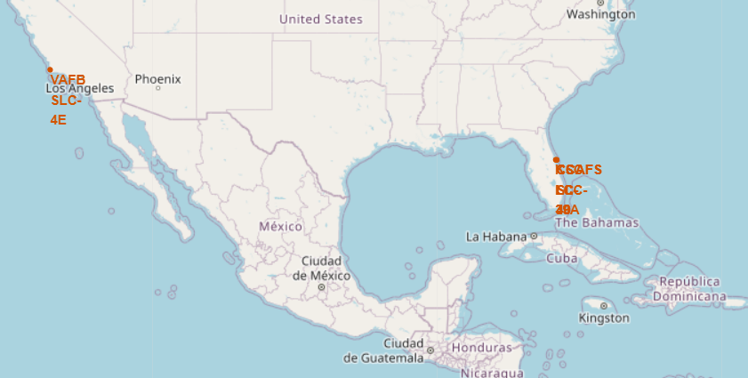
All Launch Sites’ Location Markers
All the launches are near USA, Florida, and California

Slide 37
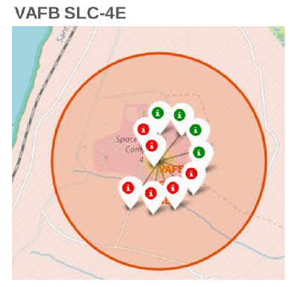
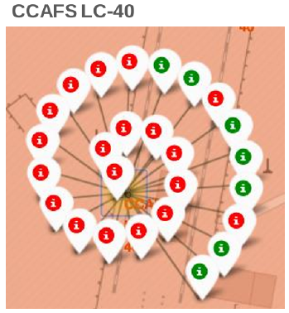
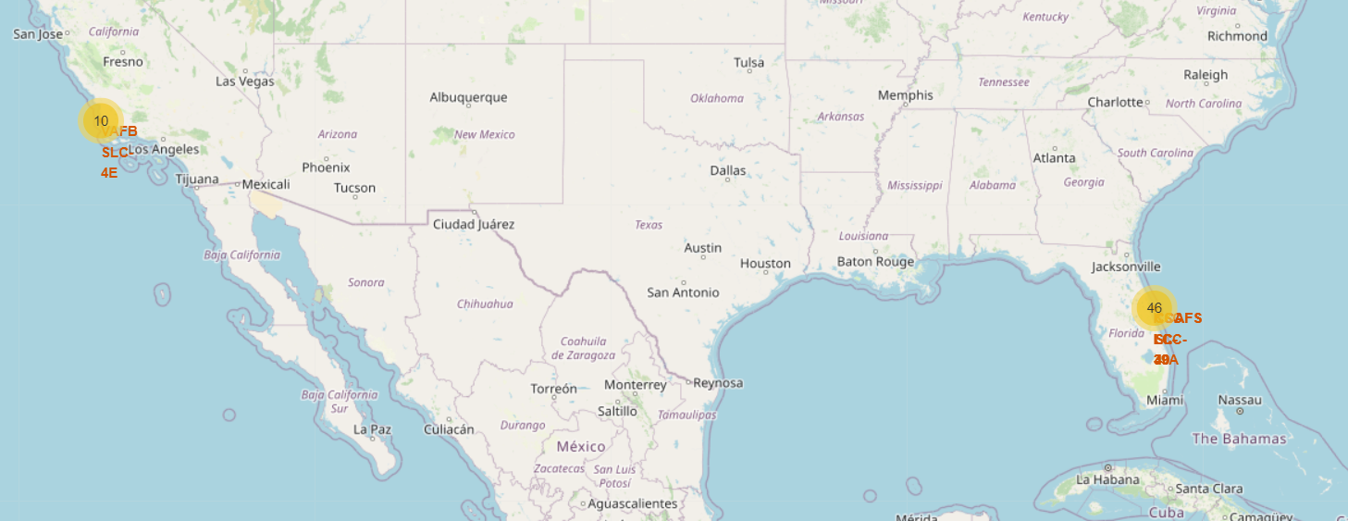
Color-labeled Launch Outcomes
Green means successful
Red means Failure

Slide 38
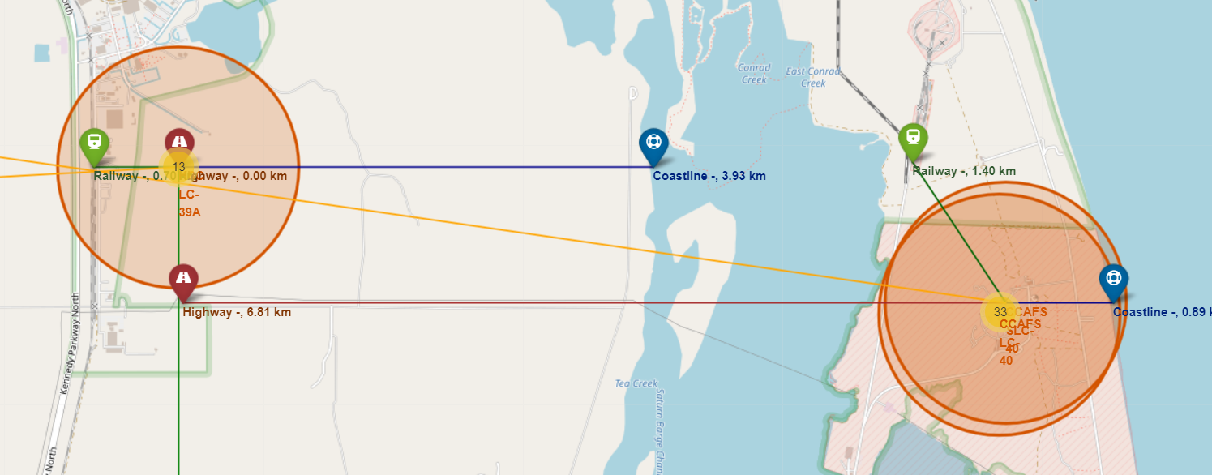
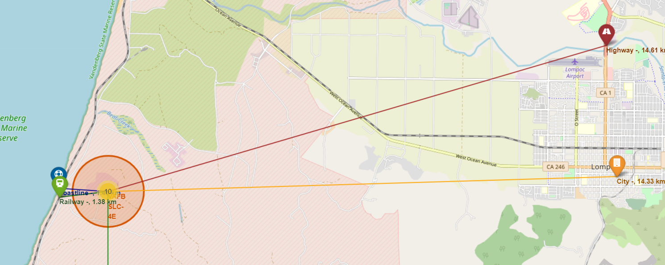
Launch Sites to its Proximities
All distances from launch sites to its proximities, they weren’t far from railway tracks.

Slide 39
Section 4
Interactive Dashboard with Plotly

Slide 40
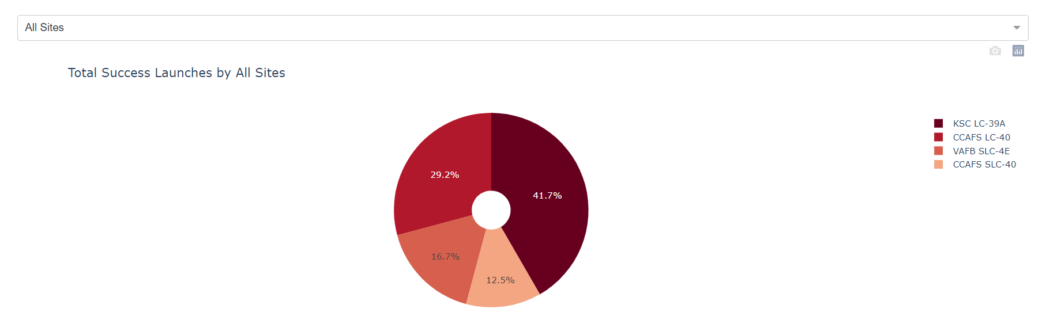
Launch Success Count
KSC LC-39A has the highest success score with 41.7%
CCAFS LC-40 comes next with 29.2%
Finally, VAFB SLC-4E and CCAFS SLC-40 with 16.7% and 12.5% respectively

Slide 41
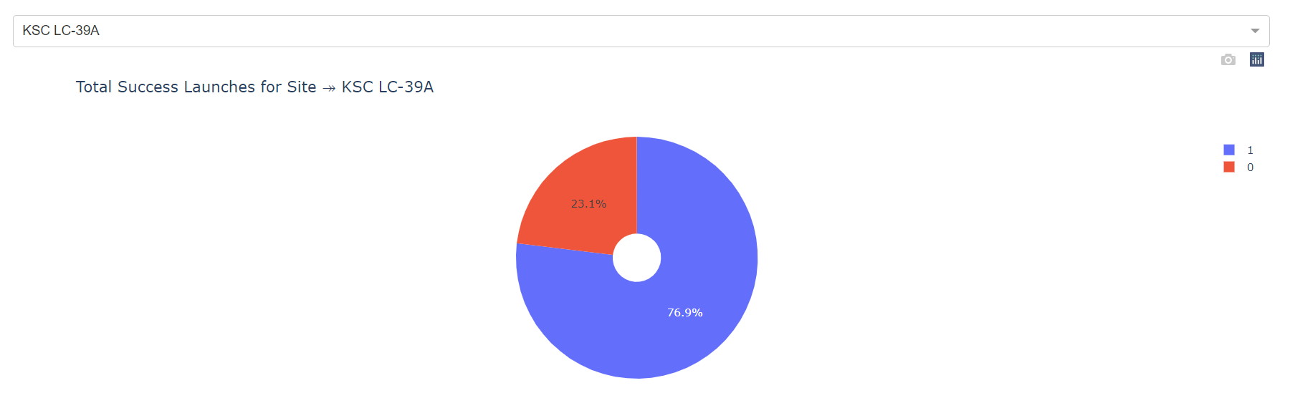
Launch Site with Highest Score
KSC LC-39A has the highest score with 76.9% with payload range of 2000 kg – 10000 kg, and FT booster version has the highest score

Slide 42
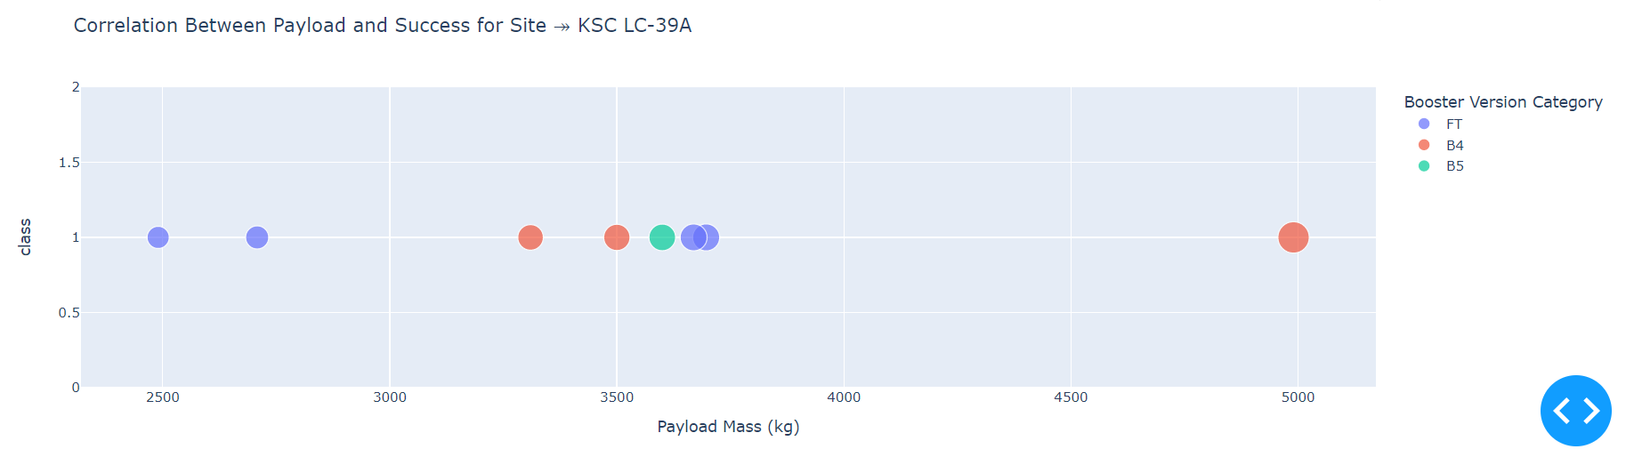
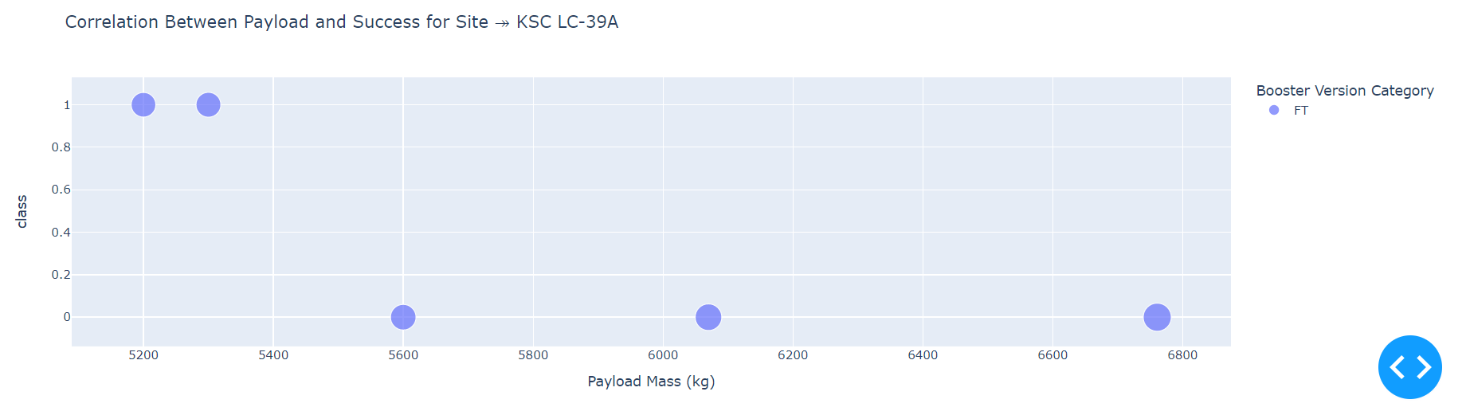
Launch Outcome V/s Payload
Payload 0 kg – 5000 kg (first half)
Payload 6000 kg – 10000 kg (second half)

Slide 43
Section 5
Predictive Analysis - Classification

Slide 44
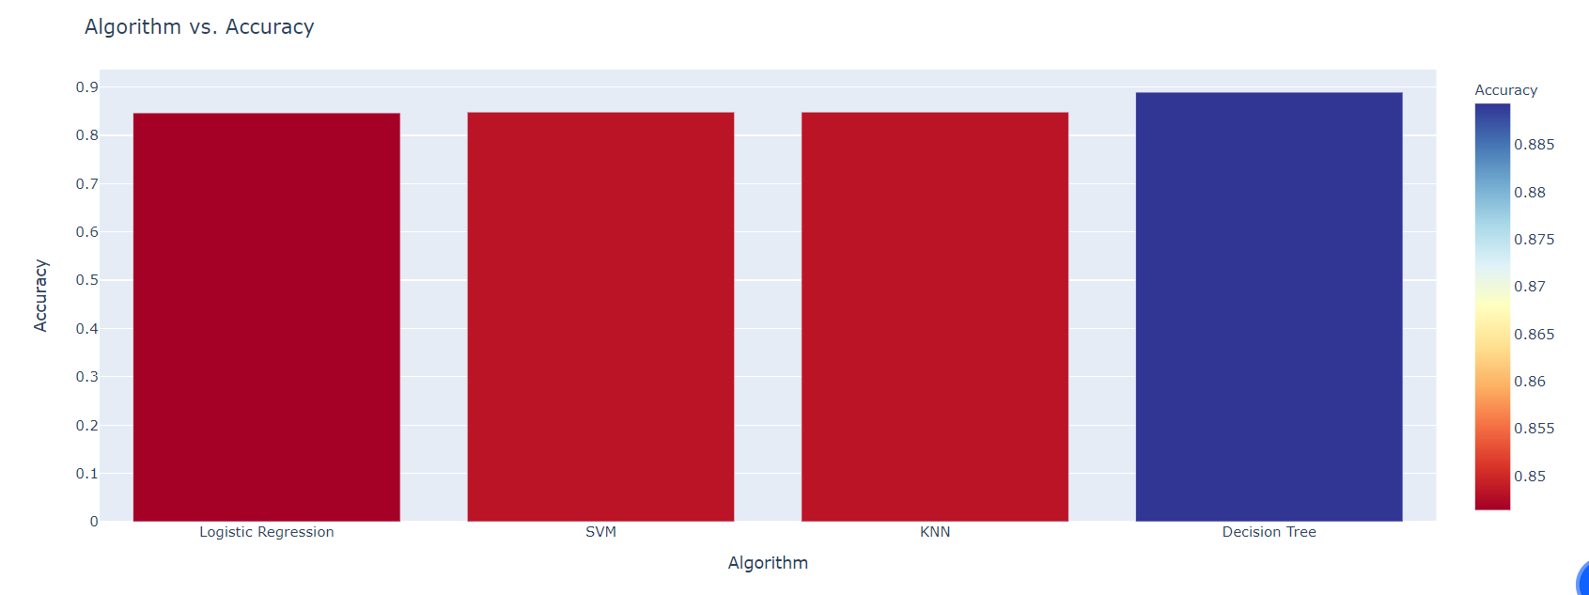
Accuracy of Classification
Decision Tree has the highest accuracy with almost 0.89, then comes the remaining models with almost same accuracy of 0.84

Slide 45
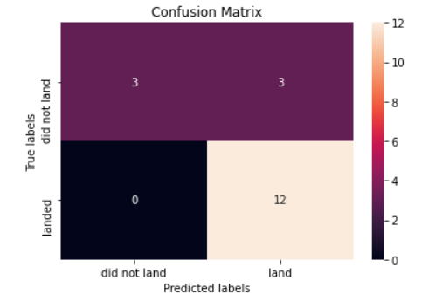
Confusion Matrix
Sensitivity = 1.00, formula: TPR = TP / (TP + FN)
Specificity = 0.50, formula: SPC = TN / (FP + TN)
Precision = 0.80, formula: PPV = TP / (TP + FP)
Accuracy = 0.83, formula: ACC = (TP + TN) / (P + N)
F1 Score = 0.89, formula: F1 = 2TP / (2TP + FP + FN)
False Positive Rate = 0.50, formula: FPR = FP / (FP + TN)
False Discovery Rate = 0.20, formula: FDR = FP / (FP + TP)

Slide 46
Conclusions Drawn
We found the site with highest score which was KSC LC-39A
The payload of 0 kg to 5000 kg was more diverse than 6000 kg to 10000 kg
Decision Tree was the optimal model with accuracy of almost 0.89
We calculated the launch sites distance to its proximities

Slide 47
Appendix
Relevant codes are uploaded in below provided Github link:
https://github.com/pooja420/IBM_Data_Science_Capstone.git

