Slide 1
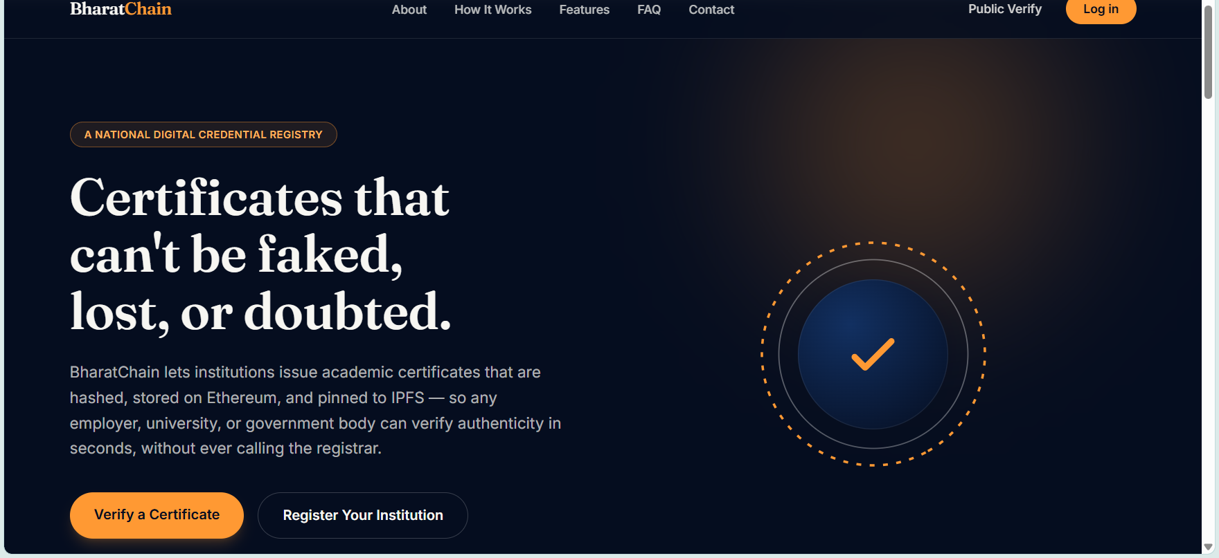
HackITon'26 · Review 1
CREDO
Tamper-evident digital credentials you can verify anywhere, and students truly own.
Verified
Team TechKins
SHA-256
IPFS
Ethereum
Hash → store → anchor → verify

Slide 2




02 · THE PROBLEM
Certificates are easy to fake and hard to trust
WHO IS AFFECTED
Students
lose control of their own credentials
Institutions
cannot prove what they issued
Verifiers
cannot cheaply tell real from fake
CURRENT PAIN POINTS
Editable PDFs
Tampered certificates can pass a quick look
Fragile file hashes
A genuine re-rendered copy fails a hash-of-bytes check
Fake issuers
No proof an institution controls its identity
No key revocation
A compromised issuing key keeps working
Credentials gate jobs and admissions, so trust has to be verifiable, not assumed.

Slide 3

03 · USERS & EXISTING APPROACH
Who it is for, and where today's approach falls short
Institution
issues & revokes
Student
owns & shares
Verifier
checks authenticity
Platform admin
approves issuers
CURRENT APPROACH
LIMITATIONS
OPPORTUNITY
Static PDF certificates
Hash-only verification
Trust in how a file looks
Re-rendered genuine copy rejected
Fake issuer undetected
No key revocation, replayable QR
Guessable IDs (~27-bit space)
Verify signed data, not the file
Registry-backed issuer identity
Student-controlled sharing

Slide 4




04 · PROPOSED SOLUTION
CREDO: anchor it, sign it, let the student share it
PROBLEM
OUR SOLUTION
BENEFIT
Forgeable, hard-to-verify credentials with no issuer trust
Certificate hash anchored on Ethereum, PDF on IPFS, public verify by ID or QR
Tamper-evident, publicly verifiable, owned by the student
WHAT MAKES IT DIFFERENT
Ed25519-signed credentials
Issuer registry & key revocation
Selective sharing, expiry, revoke
Offline signed pass

Slide 5


05 · SYSTEM BLUEPRINT
From issuance to verification
1 Institution
2 Issue
3 Store & anchor
4 Student
5 Verifier
Registers; admin approves it as issuer on-chain
Data → PDF with QR → SHA-256 hash
PDF to IPFS · hash to Ethereum · record in MongoDB
Download, share selected fields, offline pass
ID / QR, hash, PDF upload, share link, pass
RESULT
Issuer or owner can revoke on-chain, and revocation shows up at verification.
Valid
Revoked
Mismatch / not found

Slide 6




06 · TECHNOLOGY & COMPONENTS
Software-only stack, every piece already in the repo
Frontend
Backend
Blockchain
React 19 · Vite · Tailwind CSS · Framer Motion · Recharts
Node.js · Express · JWT · PDFKit · QRCode · ExcelJS / csv-parse
Solidity contract · Hardhat · ethers v6 · Ethereum testnet (Sepolia / Amoy)
Data & storage
Security
Deployment
MongoDB (Mongoose) · IPFS via Pinata
SHA-256 · Ed25519 · bcrypt · Helmet · rate limiting · input sanitising · RBAC
Vercel / AWS · Hardhat contract tests · attack suite
No hardware · No AI/ML in this build

Slide 7
07 · CHALLENGES & IMPACT
Honest about the gaps, clear on the payoff
TECHNICAL CHALLENGES
EXPECTED IMPACT
PDF is public on IPFS
→ Encrypt before upload
Public verification by ID or QR
Students control fields, expiry and revocation of shares
Bulk issuance and per-institution certificate branding
Attack suite: Shield core caught 100/100 in each of 10 scenarios (logic-level); hash-only baseline scored 0/100 on 6
Issuer authenticity
→ Domain-proof registry; AISHE / UGC check next
One key signs all passes; one owner wallet
→ Per-institution keys; multisig owner before mainnet
Signed-credential core not yet on API routes
→ Wire into routes, models, contract
Next: Merkle batching, encrypted storage, custom fonts

Slide 8

08 · WHY THIS SOLUTION
CREDO at a glance
Problem
Solution
Forgeable PDFs, fragile hash checks, unverified issuers
Hash on Ethereum, PDF on IPFS, public verify by ID or QR
Differentiator
Expected impact
Signed credentials, issuer registry, student-controlled sharing, offline pass
Verifiable trust for students, institutions and employers
Verify the credential, not the paper.

