Slide 1




🛡️
FinGuard Analytics
& Intelligence
AI-Powered Credit Risk & KYC Platform · Know Your Customer Before You Lend
Presented by:
Harshita Pooja Ridhima Riya

Slide 2
Table of Contents
Project Modules & Sections
01
Project Introduction
02
Financial Analytics (EDA)
Overview, Team & Problem Statement
Data Exploration, Distributions & Correlations
03
Risk & Compliance
04
Fraud Detection & Anomaly
VaR Analysis, AML Engine & Regulatory Checklist
Isolation Forest, Scoring & Customer Segmentation
05
KYC Verification
06
Credit Profiling Engine
Computer Vision & YOLO-Based ID Verification
Individual Risk Assessment & Loan Decision
07
Batch Scoring & Portfolio Reports
08
Use Cases & Conclusion
Stress Tests, Portfolio Analytics & Export
Real-World Applications & Future Scope

Slide 3
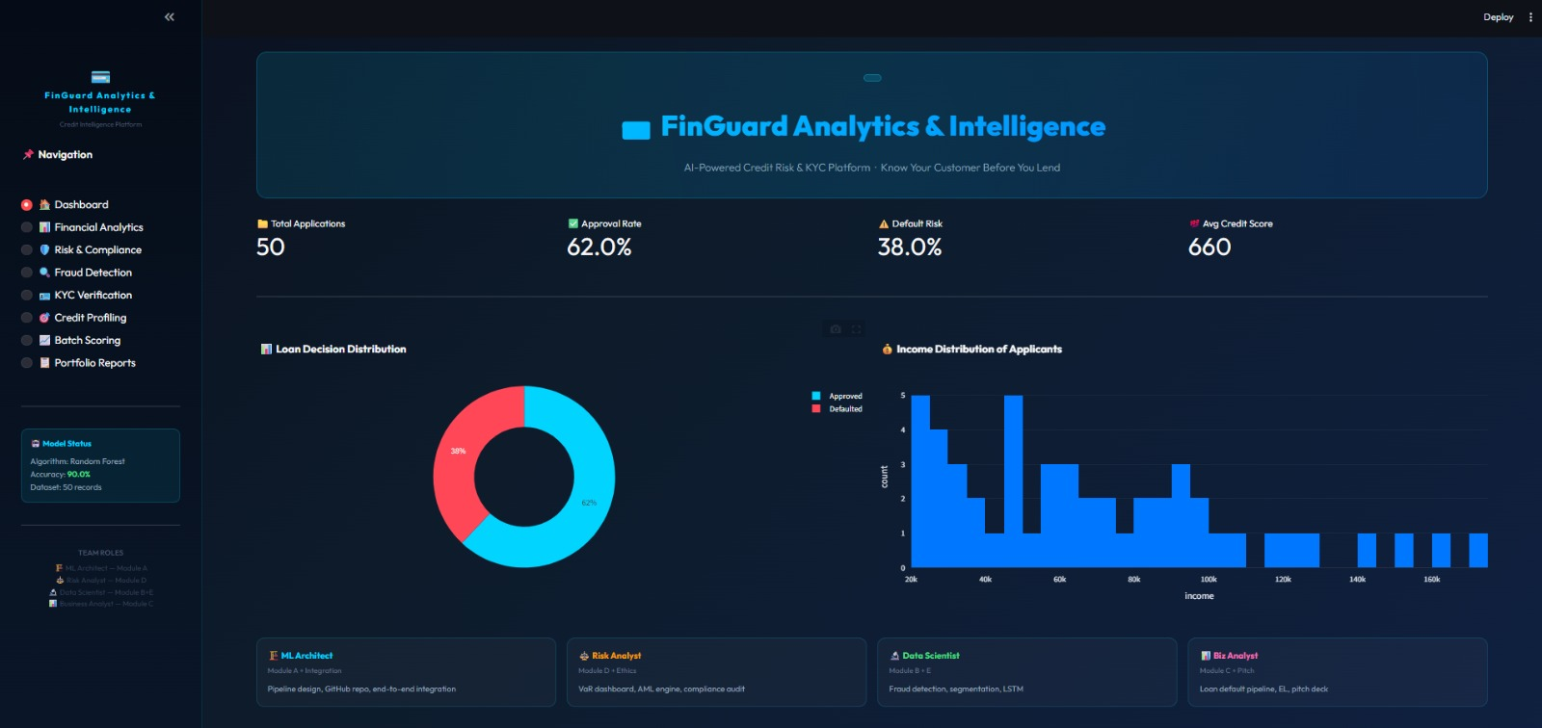
Project Introduction
FinGuard Analytics & Intelligence — AI-Powered Credit Risk & KYC Platform
What is FinGuard?
FinGuard is a full-stack AI-powered Credit Risk & KYC platform built to help financial institutions make smarter, faster, and safer lending decisions.
It combines Machine Learning models, real-time analytics, fraud detection algorithms, and regulatory compliance tools under one unified platform.
Team Members & Roles
H
Harshita — ML Architect
Module A + Integration — Pipeline design, GitHub repo, end-to-end integration
P
Pooja — Risk Analyst
Module D + Ethics — VaR dashboard, AML engine, compliance audit
R
Ridhima — Data Scientist
Modules B, C— Fraud detection, credit profiling
R
Riya —Biz Analyst
Modules E —Pitch deck, EL pipeline

Slide 4
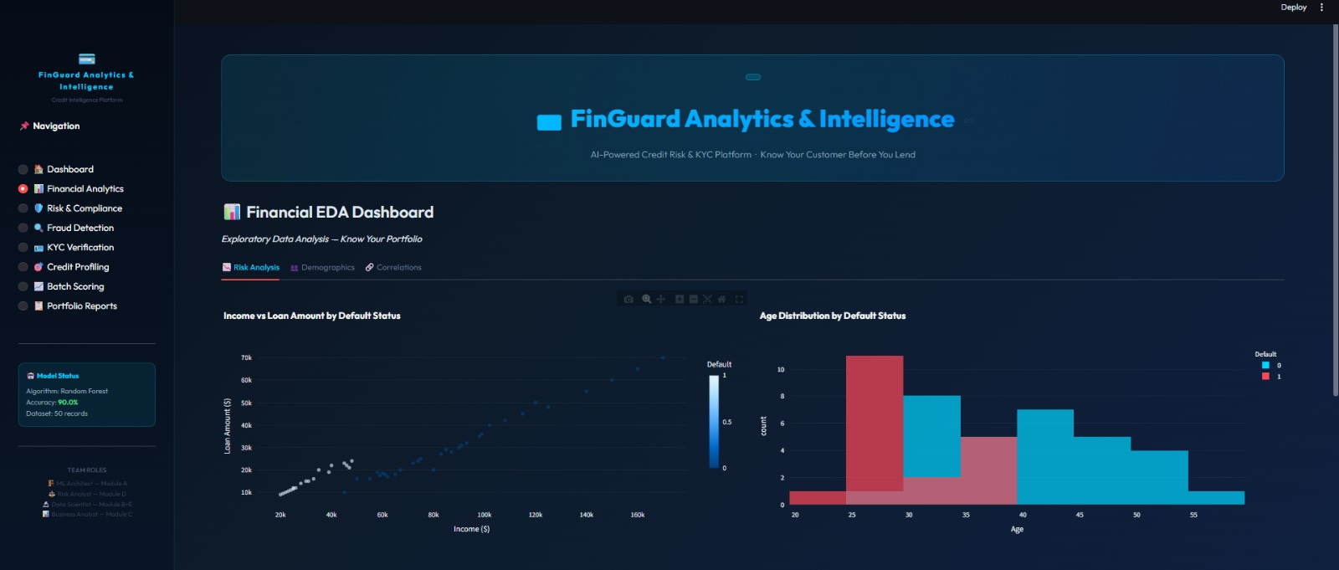
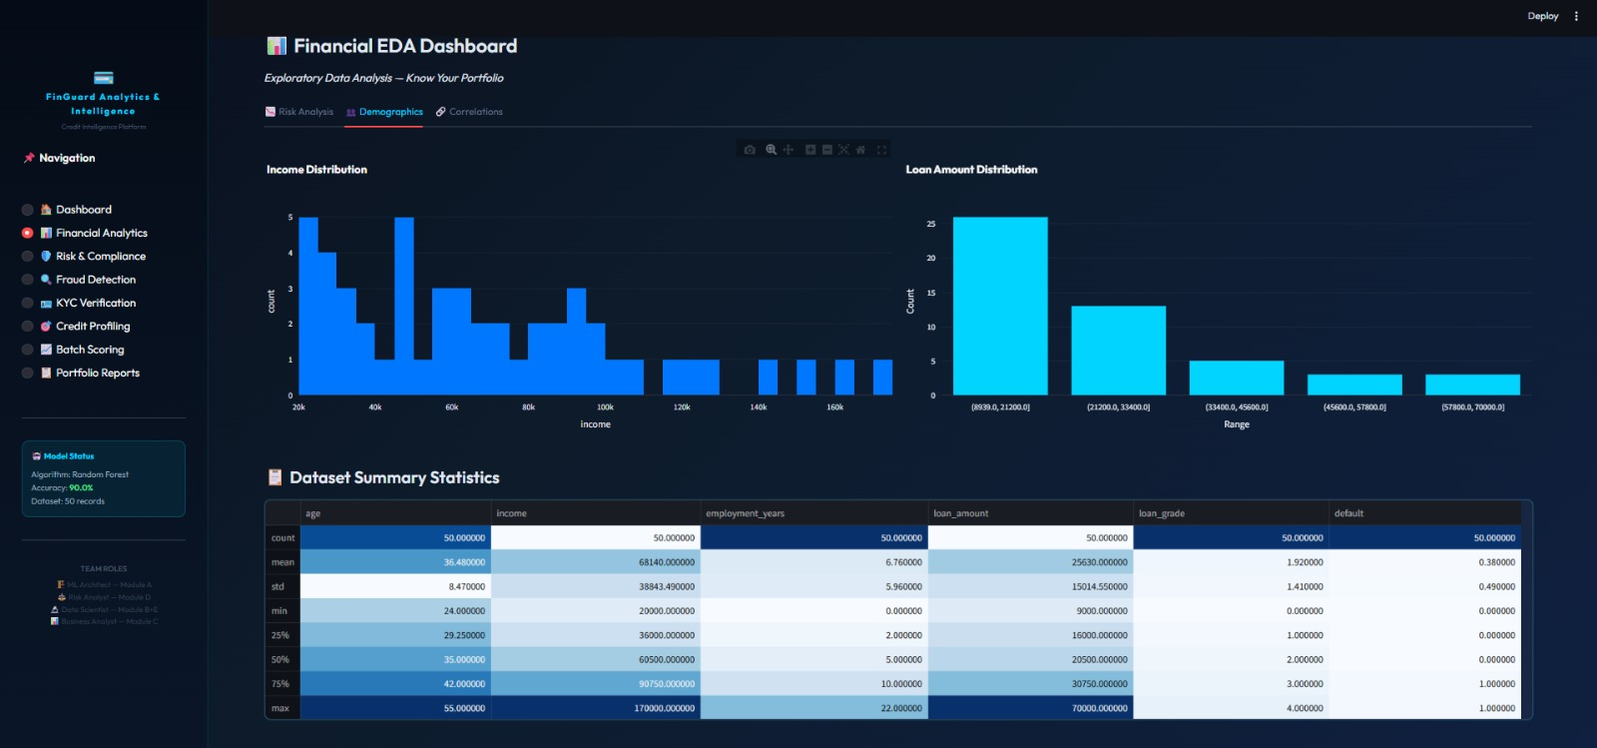
Financial EDA Dashboard
Module A — Exploratory Data Analysis — Know Your Portfolio
Risk Analysis — Income vs Loan Amount & Age Distribution by Default
Demographics — Income Distribution, Loan Amount Distribution & Summary Stats
50
90%
38%
3 Tabs
Total Loan Records
Model Accuracy (Random Forest)
Default Rate
Risk / Demographics / Correlations

Slide 5
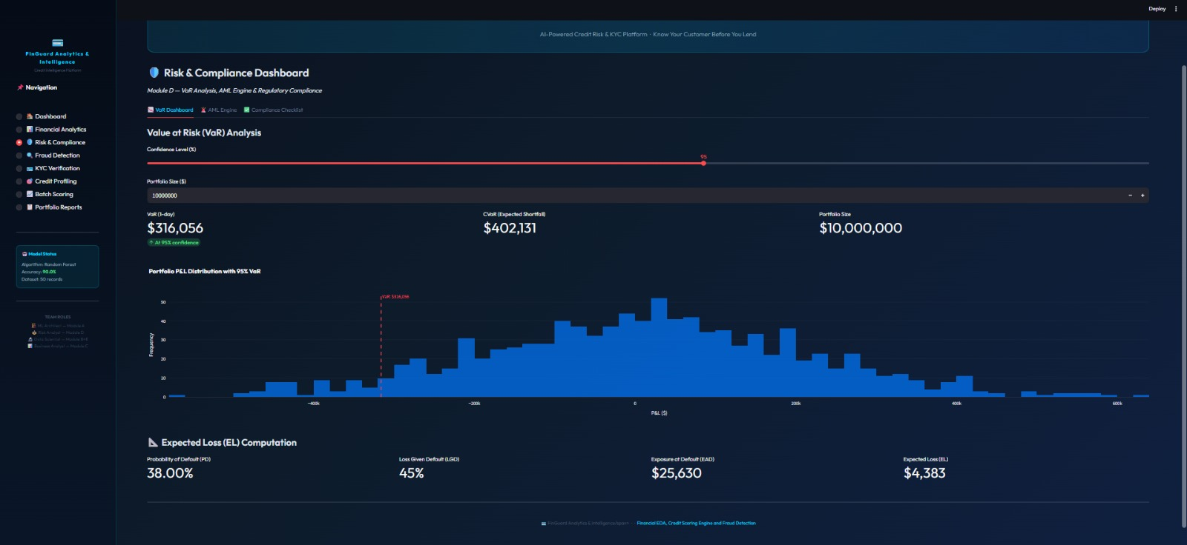
Risk & Compliance Dashboard
Module D — VaR Analysis, AML Engine & Regulatory Compliance
📊 Value at Risk (VaR)
1-day VaR computed at configurable confidence levels (95%+). Portfolio P&L distribution visualised with VaR cut-off line.
💰 Expected Shortfall (CVaR)
Beyond-VaR risk: CVaR gives average loss in worst-case scenarios, providing a fuller tail-risk picture.
📉 Expected Loss (EL)
EL = PD × LGD × EAD. Computes the expected credit loss for individual borrowers and portfolios.
$316,056
$402,131
$10M
38%
$4,383
VaR (1-day @ 95%)
CVaR (Exp. Shortfall)
Portfolio Size
Default Prob.
Expected Loss

Slide 6
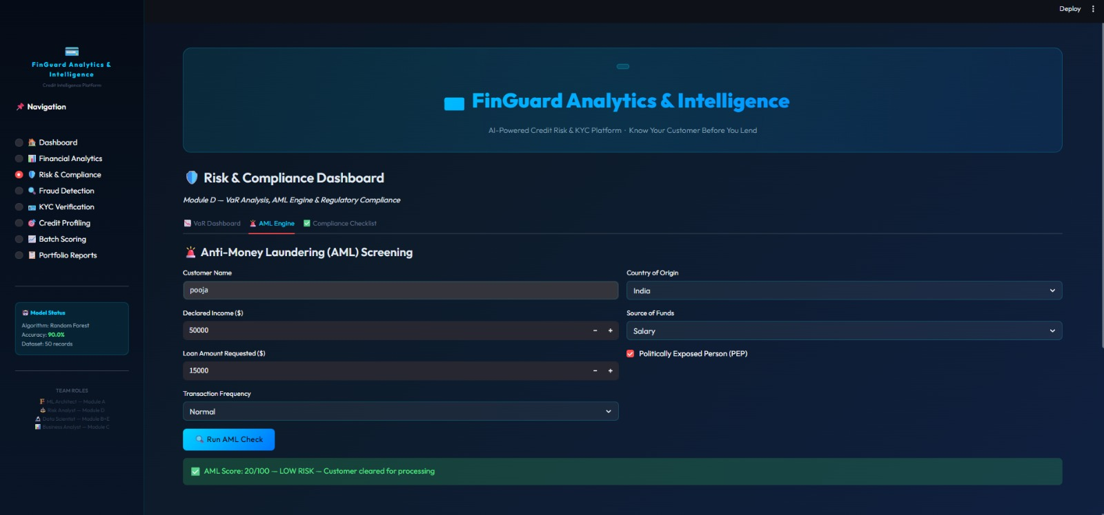
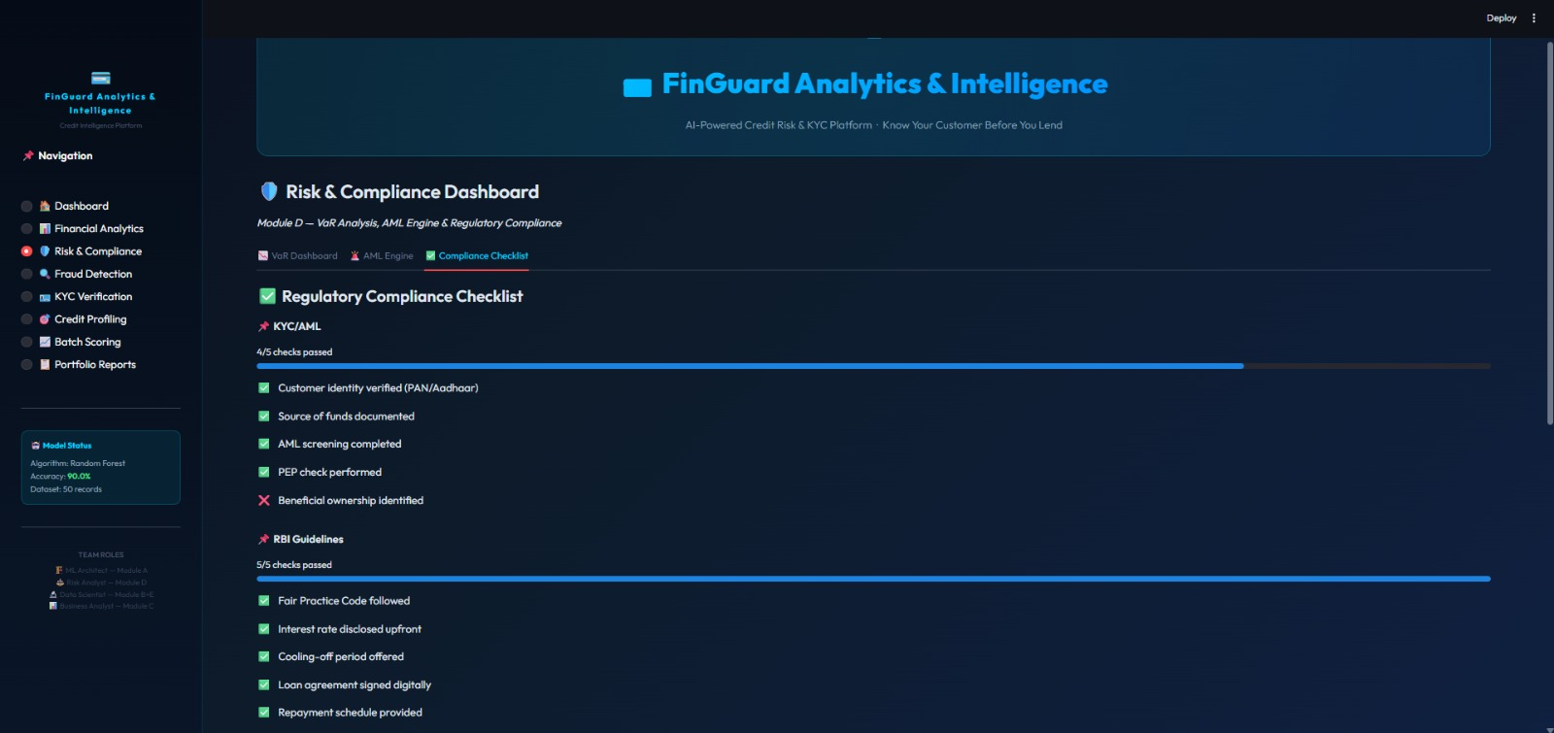
AML Engine & Regulatory Compliance
Anti-Money Laundering Screening + KYC/RBI Compliance Checklist
AML Engine
Compliance Checklist
Screens customers against risk factors: declared income, loan size, country of origin, transaction frequency, and Politically Exposed Person (PEP) status.
Returns an AML score 0–100 with risk classification (LOW / MEDIUM / HIGH).
KYC/AML checks: PAN/Aadhaar identity, source of funds, AML screening, PEP check (4/5 passed).
RBI Guidelines: Fair Practice Code, interest disclosure, cooling-off period, digital loan agreement — all 5/5 passed.

Slide 7
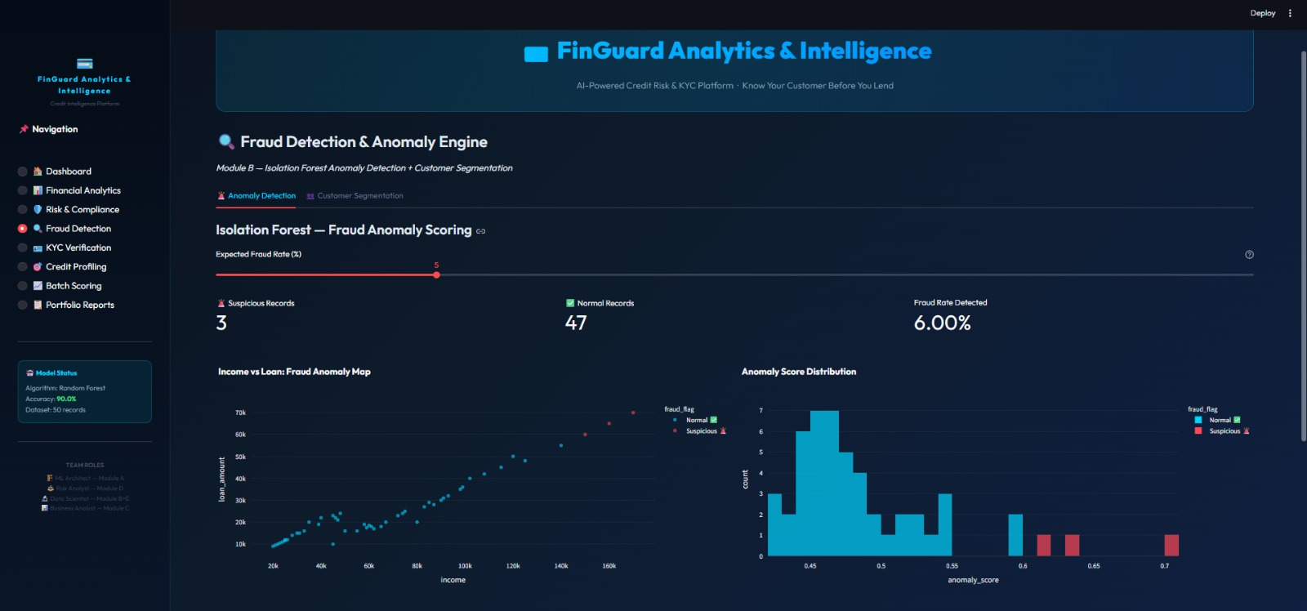
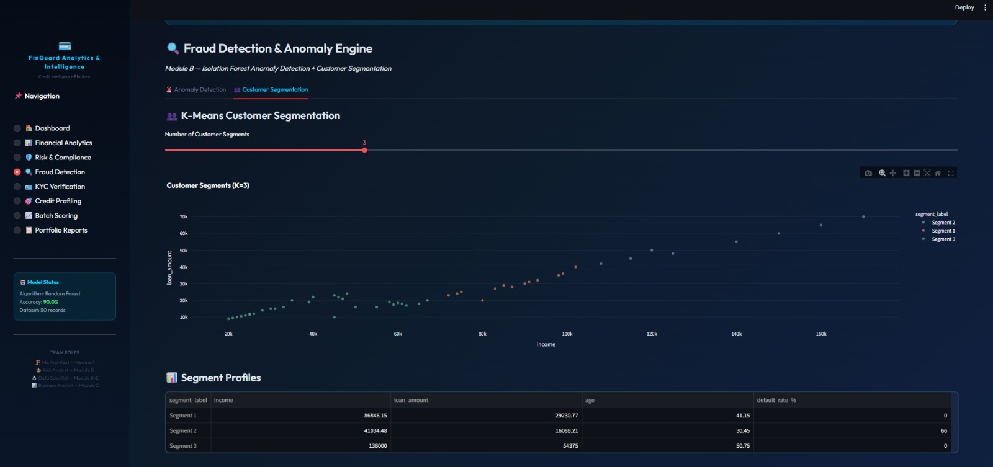
Fraud Detection & Anomaly Engine
Module B — Isolation Forest Anomaly Detection + K-Means Customer Segmentation
Isolation Forest Anomaly Scoring
K-Means Customer Segmentation
Isolation Forest algorithm detects anomalous credit profiles from normal applicants.
Income vs Loan Anomaly Map shows suspicious records as red dots.
Configurable Expected Fraud Rate slider (default 5%).
Outputs: Suspicious = 3, Normal = 47, Fraud Rate = 6%.
Segments customers into behavioural clusters using K-Means (K=3 default).
Segment 1: High income (₹86K), low default (0%) — Premium Clients.
Segment 2: Mid income (₹41K), high default (66%) — Risk Group.
Segment 3: Very high income (₹136K), no default — Safe High-Value.

Slide 8
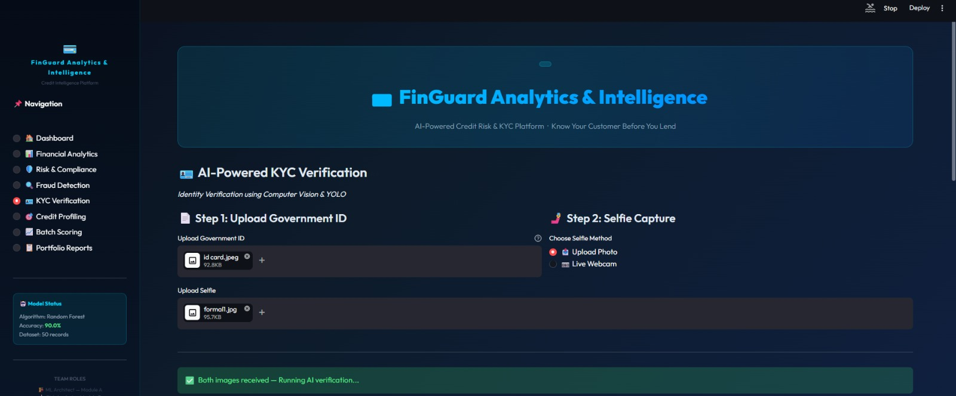
AI-Powered KYC Verification
Module E — Identity Verification using Computer Vision & YOLO
🪪 Government ID Upload
Accepts any government-issued ID (PAN, Aadhaar, Passport). File is parsed and validated against declared customer data.
🤳 Selfie Capture / Upload
Customer uploads a live photo or selfie. AI compares face with government ID photo for identity matching.
🔍 YOLO-Based Detection
YOLO (You Only Look Once) object detection model identifies and extracts document regions and facial landmarks.
✅ Instant Verification Result
System returns pass/fail with confidence score in real time. Prevents fake IDs and impersonation fraud.

Slide 9
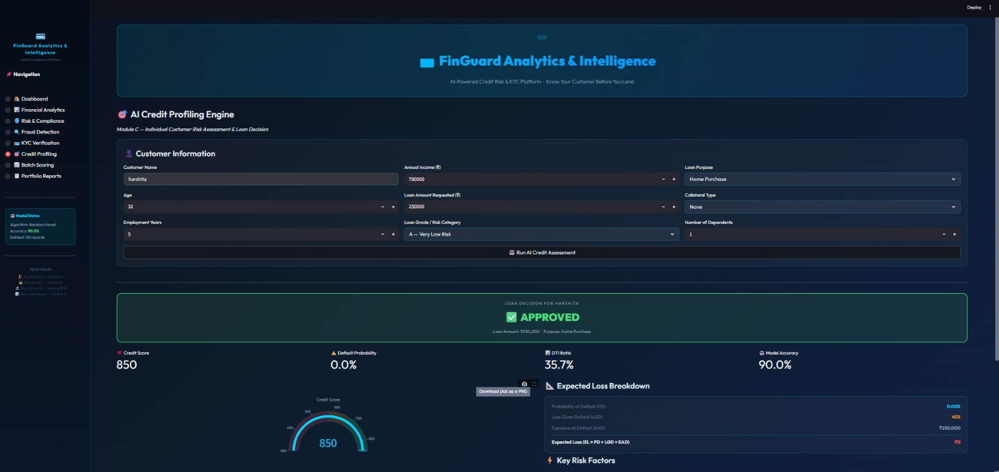
AI Credit Profiling Engine
Module C — Individual Customer Risk Assessment & Loan Decision
Credit Score Meter
Dynamic gauge shows score (300–900). Score of 850 = APPROVED with 0% default probability.
Random Forest Classifier
90% accuracy ML model trained on applicant features: income, age, employment, loan grade, DTI ratio.
Loan Decision Output
Clear APPROVED / REJECTED banner with amount, purpose, and DTI ratio displayed prominently.
Expected Loss Breakdown
Shows PD, LGD, EAD and computes Expected Loss. Full risk transparency for underwriters.
Harshita
850
APPROVED
90.0%
35.7%
Sample Customer
Credit Score
Decision
Model Accuracy
DTI Ratio

Slide 10
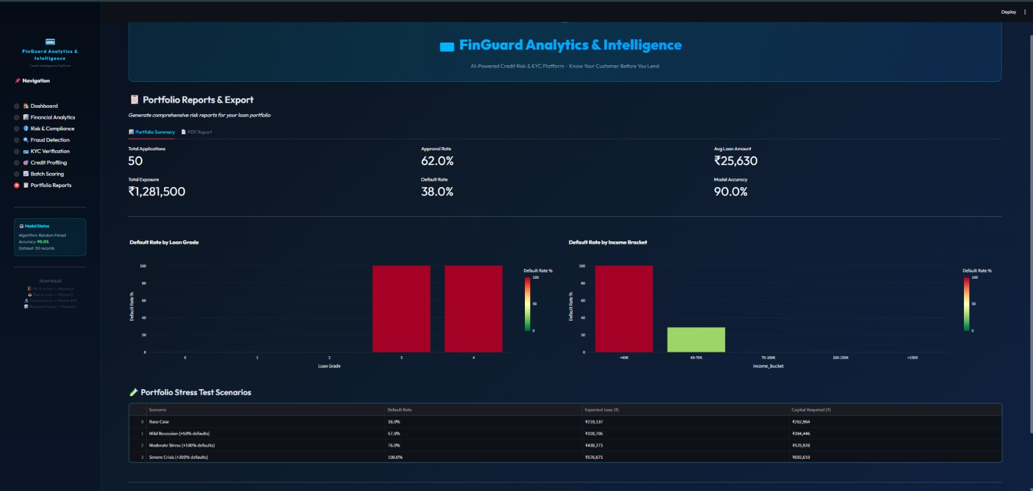
Portfolio Reports & Batch Scoring
Module E — Stress Testing, Portfolio Analytics & Export
📋 Portfolio Summary
50 applications, 62% approval, 38% default. Total exposure ₹12.8 lakh. Avg loan ₹25,630.
🔥 Stress Test Scenarios
Base Case → Mild Recession → Moderate Stress → Severe Crisis. Capital requirements up to ₹8.9 lakh.
📈 Default by Loan Grade
Heatmap of default rate across grades and income brackets — identifies risk concentration.
📄 PDF Report Export
One-click full portfolio report export as PDF for regulators, audit, and investor presentations.
50
₹12.8L
₹8.93L
4 Levels
Total Applications
Total Exposure
Severe Crisis Capital
Stress Test Scenarios

Slide 11
Real-World Use Cases
Where FinGuard Creates Value Across the Financial Ecosystem
🏦 Banks & NBFCs
🔍 Fraud Investigation Teams
📜 Compliance & Audit Departments
Automate retail loan decisions in real time
Reduce manual underwriting cost by 60–80%
Ensure 100% RBI regulatory compliance
Flag anomalous profiles before loan disbursement
Visualise fraud patterns across income-loan map
Score each application with an Isolation Forest risk rating
AML screening against PEP lists
One-click regulatory checklist (KYC/AML/RBI)
Generate audit-ready PDF compliance reports
📊 Risk Management Desks
🤳 Digital Onboarding Platforms
📈 Portfolio Analytics Teams
Compute VaR and CVaR for lending portfolios
Run 4-level stress tests on entire portfolio
Expected Loss breakdown for capital provisioning
AI-powered KYC with computer vision
Match selfie to government ID using YOLO
Zero manual ID verification — fully automated
Segment borrowers into profitable risk clusters
Track default rates by loan grade & income bracket
Export institutional-grade portfolio reports as PDF

Slide 12
Conclusion &
🚀 Future Scope
Future Scope
Deep learning models (LSTM) for time-series default prediction
Real-time transaction monitoring with streaming data
Bank statement PDF parser using OCR + NLP
Credit bureau API integration (CIBIL, Experian)
WhatsApp / SMS loan status bot
Multi-language support for rural banking
Explainability layer (SHAP / LIME) for RBI compliance
FinGuard unifies Credit Risk, Fraud Detection, KYC, Compliance and Portfolio Analytics into one platform.
Random Forest model achieves 90% accuracy with real-time individual loan scoring.
Isolation Forest detects anomalous profiles with configurable fraud-rate thresholds.
VaR / CVaR / EL computations give full financial risk transparency.
YOLO-powered KYC eliminates manual identity verification.
Portfolio stress tests & PDF export enable institutional-grade reporting.

Slide 13
THANK YOU

