Slide 1

CROP RECOMMENDATION USING WEATHER AND SOIL CONTENT
CMR INSTITUTE OF TECHNOLOGY
(UGC AUTONOMOUS)
Approved by AICTE, Permanent Affiliation to JNTUH, Accredited by NBA and NAAC Kandlakoya(V), Medchal Dist - 501 401
Under the guidance of
Mrs.V.Adilakshmi
Assistant professor, Department of CSE(DS)
N. SAKETH 22R01A6743
N. POOJA 22R01A6742
T. BHANU CHARAN 22R01A6761
S. CHANDRA MOULI 22R01A6754

Slide 2
ABSTRACT
India, a country deeply reliant on agriculture, faces significant challenges due to its diverse climatic conditions and variable rainfall patterns. These environmental factors profoundly impact crop productivity and sustainability. To address these challenges, our project develops a sophisticated crop recommendation system that leverages soil and weather data to assist farmers in making informed decisions about which crops are best suited for their land.
The system integrates various parameters such as soil type, pH levels, moisture content, historical weather data, and real-time climatic conditions to generate accurate and personalized crop recommendations. By employing advanced machine learning algorithms, our model analyzes this comprehensive data to predict the most suitable crops for specific regions and seasons. This approach not only aims to enhance agricultural yield but also to promote sustainable farming practices.
Our solution empowers farmers with the knowledge to optimize their crop selection, thereby mitigating the risks associated with unpredictable weather patterns and soil conditions. This innovation has the potential to significantly boost agricultural productivity and support the livelihoods of millions of farmers across India, ensuring food security and economic stability.

Slide 3
INTRODUCTION
India's agriculture sector is the backbone of its economy, providing sustenance and employment to a significant portion of the population. However, farmers face numerous challenges due to the country's varied climatic conditions and inconsistent rainfall patterns.
These factors can significantly affect crop yields, making it difficult for farmers to decide which crops are best suited for their land and current environmental conditions.
Additionally, the agricultural landscape in India is characterized by a diverse range of soil types, each with unique properties that influence crop suitability and growth. Farmers often lack access to detailed, region-specific soil data, which further complicates their crop selection process. This gap in information is compounded by the rapid changes in weather patterns attributed to climate change, making traditional farming practices increasingly unreliable.

Slide 4
SOIL-NUTRIENTS
EACH CROP REQUIRE WHAT TYPE OF NUTRIENTS ?
The NPK (Nitrogen, Phosphorus, and Potassium) requirements for different crops can vary based on soil conditions, climate, and specific crop varieties.
Rice
Nitrogen (N): 60-150 kg/ha
Phosphorus (P): 20-60 kg/ha
Potassium (K): 30-90 kg/ha
Maize (Corn)
Nitrogen (N): 120-200 kg/ha
Phosphorus (P): 25-60 kg/ha
Potassium (K): 30-90 kg/ha
Jute
Nitrogen (N): 50-100 kg/ha
Phosphorus (P): 10-25 kg/ha
Potassium (K): 20-40 kg/ha
Cotton
Nitrogen (N): 60-150 kg/ha
Phosphorus (P): 30-60 kg/ha
Potassium (K): 30-90 kg/ha
Coconut
Nitrogen (N): 50-200 kg/ha
Phosphorus (P): 40-100 kg/ha
Potassium (K): 100-400 kg/ha
Papaya
Nitrogen (N): 200-300 kg/ha
Phosphorus (P): 50-100 kg/ha
Potassium (K): 200-300 kg/ha

Slide 5
Here are the approximate optimal ranges for humidity, pH, rainfall, and temperature (min-max values) for some common crops:
Rice:
Humidity: 70% - 85%
pH: 5.0 - 6.5
Rainfall: 1000 - 2500 mm annually
Temperature: 20°C - 35°C (optimum temperature range)
Maize:
Humidity: 50% - 70%
pH: 5.5 - 7.0
Rainfall: 500 - 1200 mm annually
Temperature: 20°C - 30°C (optimum temperature range)
Cotton:
Humidity: 50% - 70%
pH: 6.0 - 7.5
Rainfall: 600 - 1000 mm annually
Temperature: 18°C - 30°C (optimum temperature range)
Sugarcane:
Humidity: 60% - 85%
pH: 5.5 - 7.5
Rainfall: 750 - 1500 mm annually
Temperature: 20°C - 30°C (optimum temperature range)
Jute:
Humidity: 75% - 85%
pH: 4.8 - 6.0
Rainfall: 1500 - 2000 mm annually
Temperature: 25°C - 35°C (optimum temperature range)

Slide 6
PROBLEM STATEMENT
Failure of farmers to decide on the best suited crop for his land using traditional and non-scientific methods is a serious issue for a country where approximately 50 percent of the population is involved in farming. Both availability and accessibility of correct and up to date information hinders potential researchers from working on developing country case studies. With resources within our reach we have proposed a system which can address this problem by providing predictive insights on crop sustainability and recommendations based on machine learning models trained considering essential environmental and economic parameters.

Slide 7
OBJECTIVES
Data set collection from various sources.
Data parsing and cleansing technique is applied to make the raw data into processing data.
Usage of Ensemble of classifiers makes the model more robust and efficient.
Creating a web application for user registrations and collection of data.
The model predicts the crop yield by studying factors such as rainfall, temperature, area, season, soil type etc.
Evaluation and validation of the model using cross-validation and other statistical methods to ensure accuracy and reliability.
Incorporating feedback mechanisms to refine and improve the model based on user interactions and new data.

Slide 8
LITERATURE SURVEY
The development of a Crop Recommendation System using Soil and Weather Conditions is rooted in the need to enhance agricultural productivity and sustainability in India. Existing research and initiatives have highlighted the importance of using technological interventions to address agricultural challenges. Several studies have demonstrated the potential of integrating soil and weather data to improve crop selection, but the adoption of such technologies remains limited among farmers. Our literature survey aims to understand the current landscape of crop recommendation systems and gather insights from stakeholders to inform our project.
The authors developed a crop recommendation system based on soil characteristics, employing a blend of ensemble models and majoritarian voting methods like K-nearest neighbor and naive Bayes. This approach aims to select crops with high efficiency and precision.

Slide 9
A Review on Data Mining Techniques for Fertilizer Recommendation 2018.
To keep up nutrition levels in the soil in case of deficiency, fertilizers are added to soil. The standard issue existing among the Indian agriculturists choose approximate amount of fertilizers and add them manually. Excess or deficient extension of fertilizers can harm the plants life and reduce the yield. This paper gives overview of various data mining frameworks used on cultivating soil dataset for fertilizer recommendation.
Authors : Jignasha M. Jethva, Nikhil Gondaliya, Vinita Shah
A Survey on Data Mining Techniques in Agriculture, 2015.
Agriculture is the most critical application area especially in the developing nations like India. Use of information technology in agriculture can change the situation of decision making and farmers can yield in better way.. This paper integrates the work of several authors in a single place so it is valuable for specialists to get data of current situation of data mining systems and applications in context to farming field.
Authors : M.C.S.Geetha

Slide 10
AgroNutri Android Application,2016.
This paper communicates the idea regarding the making of AgroNutri an android application that helps in conveying the harvest particular fertilizer amount to be applied. The idea is to calculate the measure of NPK composts to be applied depend on the blanked proposal of the crop of interest. This application works depend on the product chosen by the farmer and that is taken as input, thus providing the farmers. The future scope of the AgroNutri is that GPRS can be included so that according to location nutrients are suggested.
Authors : S. Srija, R. Geetha Chanda, S.Lavanya, Dr. M. Kalpana Ph.D
Machine Learning: Applications in Indian Agriculture, 2016.
Agriculture is a field that has been lacking from adaption of technologies and their advancements. Indian agriculturists should be up to the mark with the universal procedures. Machine learning is a native concept that can be applied to every field on all inputs and outputs. It has effectively settled its ability over ordinary calculations of software engineering and measurements. Machine learning calculations have improved the exactness of artificial intelligence machines including sensor based frameworks utilized in accuracy farming. This paper has evaluated the different uses of machine learning in the farming area. It additionally gives a knowledge into the inconveniences looked by Indian farmers and how they can be resolved using these procedures.
Authors: Karandeep Kaur

Slide 11
EXISTING SYSTEMS
Several existing crop recommendation systems and research initiatives have attempted to utilize soil and weather data to assist farmers in crop selection.
These systems typically rely on static datasets and simple heuristic models. Common examples include:
Example System 1:
AgroConsultant: A decision tree-based system developed to assist farmers in selecting crops based on soil and climatic conditions. The system uses attributes like soil pH, moisture, and temperature to build the decision tree, providing crop recommendations by traversing the tree based on user inputs.
Research Reference: Kamal Raj and Vani (2019) demonstrated the application of decision trees for crop recommendation, achieving high accuracy in predicting suitable crops.

Slide 12
Example System 2:
CropSuggest: Utilizes random forests to recommend crops by considering a wide range of features such as soil composition, historical weather data, and crop yields. The system generates multiple decision trees and aggregates their predictions for reliable crop recommendations.
Research Reference: Singh et al. (2020) showed that random forest-based systems provide robust recommendations by reducing overfitting and improving generalization.
Example System 3:
SmartCrop: Employs SVM to classify and recommend crops using features like soil pH, temperature, and rainfall. The system is trained to find the optimal hyperplane that separates different crop classes, making accurate crop recommendations for new inputs.
Research Reference: Sharma and Patel (2018) utilized SVM for crop prediction, achieving high accuracy by effectively classifying crop suitability.

Slide 13
Disadvantages of Existing System -
Lack of Real-Time Data: Many existing systems do not incorporate real-time soil and weather data, leading to outdated and potentially inaccurate recommendations.
Limited Customization: These systems often provide generic recommendations that do not account for specific local conditions or farmer preferences.
Low Accessibility: The user interfaces of many existing systems are not user-friendly, particularly for farmers with limited technological experience.
Static Models: Existing models may not be adaptable or scalable to different regions or crop types, limiting their overall effectiveness.

Slide 14
Survey Methodology -
To gain a deeper understanding of the challenges and expectations from a farmer's perspective, we conducted a survey with over 50 respondents, including farmers, agricultural experts, and stakeholders. The survey comprised questions designed to assess their familiarity with agricultural technology, soil characteristic considerations, interest in digital crop recommendation tools, desired features, and additional comments or suggestions.
Survey Findings :
Familiarity with Technology: The survey revealed a diverse range of familiarity with using technology for agricultural purposes.
Soil Characteristics Consideration: Respondents highlighted various soil characteristics they consider when selecting crops, such as soil pH, texture, nutrient content, and moisture levels
Interest in Digital Tools: A majority of the respondents showed interest in a digital tool that recommends crops based on weather and soil conditions.
Desired Features: Respondents expressed the need for features such as real-time weather updates, soil health monitoring, crop-specific recommendations, user-friendly interfaces, and localized language support.

Slide 15
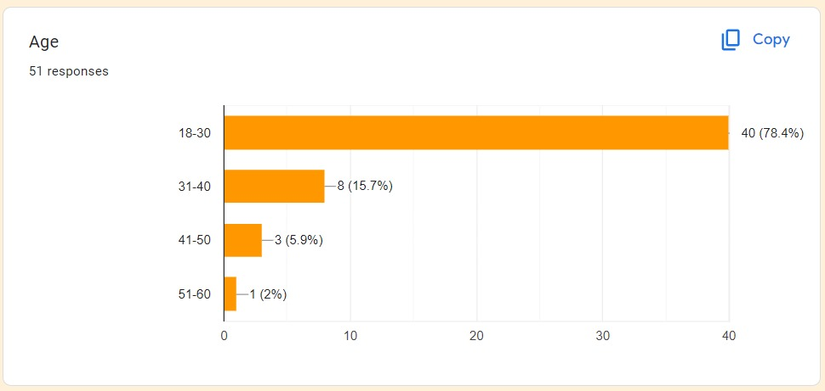
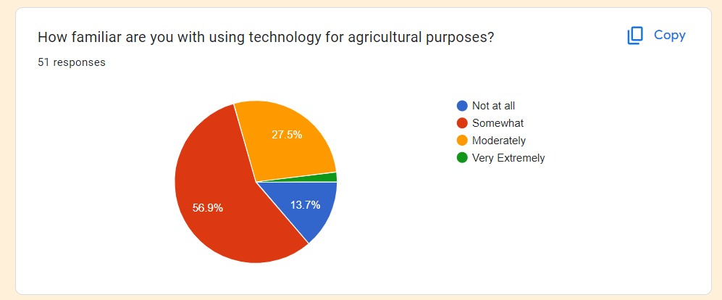
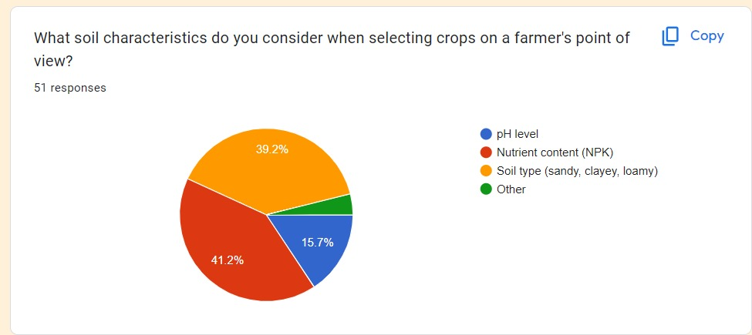
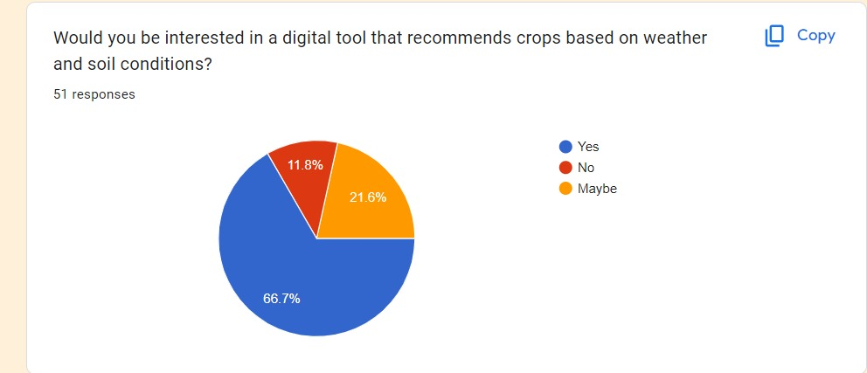

Slide 16
Proposed System
Our proposed Crop Recommendation System aims to overcome these limitations by incorporating advanced machine learning algorithms and real-time data integration. The system is designed to provide personalized and accurate crop recommendations based on a comprehensive analysis of soil and weather conditions. Key features and techniques of our system include:
Advanced Machine Learning Algorithms:
Logistic Regression: Used for binary classification problems, logistic regression helps in determining the suitability of specific crops based on soil and weather conditions.
Decision Tree: This algorithm provides a clear and interpretable model that can handle both categorical and numerical data, making it ideal for understanding the impact of various factors on crop suitability.
Random Forest Classifier: By combining multiple decision trees, the random forest classifier enhances prediction accuracy and robustness. It is particularly effective in handling large datasets with numerous variables, ensuring comprehensive analysis and reliable recommendations.

Slide 17
REQUIREMENTS :
Hardware Requirements:
Processor: Multi-core processor (Quad-core or higher recommended) for faster data processing.
RAM: Minimum 8 GB RAM (16 GB or higher recommended) for efficient data handling and model training.
Storage: At least 100 GB of available hard disk space for storing datasets, models, and software installations.
Internet Connectivity: High-speed internet connection for accessing online resources, APIs, and cloud services.
Additional Peripherals: Keyboard, mouse, and monitor for system interaction and visualization.

Slide 18
TECHNOLOGIES USED
FRONT END –
WEB DEVELOPMENT
HTML,
CSS,
JAVASCRIPT
BACKEND –
Flask Framework (python)
Libraries Used -
• NumPy: For numerical computations.
• Pandas: For data manipulation and analysis.
• Scikit-Learn: For classical machine learning algorithms.
• Matplotlib/Seaborn: For data visualization.
• Jupyter Notebook: For interactive development and visualization.

Slide 19
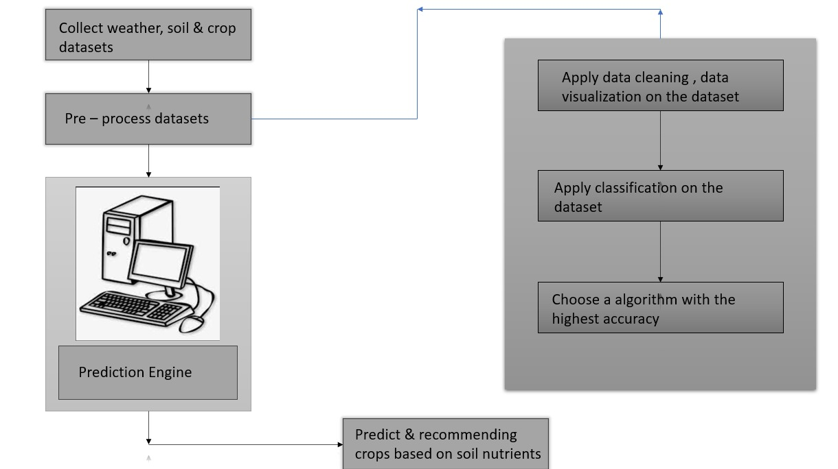
ARCHITECTURE MODEL

Slide 20
Architecture Model
The architecture model describes the project flow, including data collection, preprocessing, model training, and output generation. Below, we outline the steps involved in our system and provide a flowchart to illustrate the process.
Project Flow –
Data Collection
Data Preprocessing
3. Model Training
4. Prediction and Recommendation
5. Output Delivery

Slide 21
MODULES
Data Collection Module:
Weather Data: Interface with a weather API or database to fetch current weather conditions (temperature, humidity, rainfall, etc.) and forecasts.
Soil Data: Access soil databases or APIs to retrieve soil characteristics such as pH, nutrient levels, texture, etc.
2. Preprocessing Module:
Clean and preprocess the raw data obtained from weather and soil databases.
Handle missing values, normalize data, and convert formats if necessary.
3. Crop Suitability Assessment Module:
Crop Database: Maintain a database of crops with their specific requirements (temperature range, humidity, soil pH, nutrient needs, etc.).
Matching Algorithm: Develop algorithms that evaluate how well each crop matches current weather conditions and soil properties. This could involve using rules-based systems, machine learning models (like decision trees, SVMs, or neural networks), or knowledge-based systems.

Slide 22
4. User Interface Module:
Input Interface: Provide a user-friendly interface for users to input location data (for weather) and soil test results.
Output Interface: Display recommended crops based on the input data, along with reasons for the recommendations (e.g., suitable temperature range, soil pH compatibility).
5. Integration and Deployment Module:
Integrate all modules into a cohesive system.
Ensure scalability and reliability of the system for different regions and scales of farming operations.
6. Crop Recommendation Module:
In this module, we have proposed a model that addresses these issues. The novelty of the proposed system is to guide the farmers to maximize the crop yield as well as suggest the most profitable crop for the specific region.

Slide 23
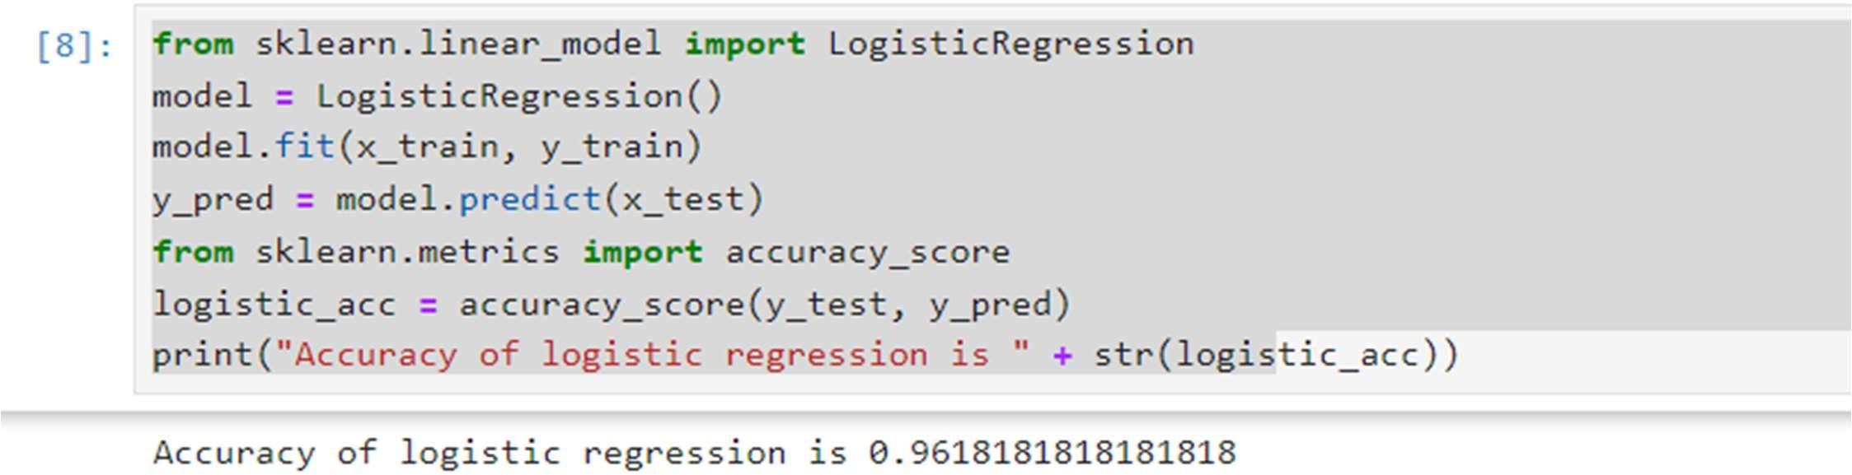
Testing Logistic Regression:
The logistic regression model correctly predicted 96.18% of the test samples.
An accuracy score of 0.9618 means that out of all the predictions made by the model, 96.18% were correct. This indicates high predictive performance for this specific dataset and task.

Slide 24
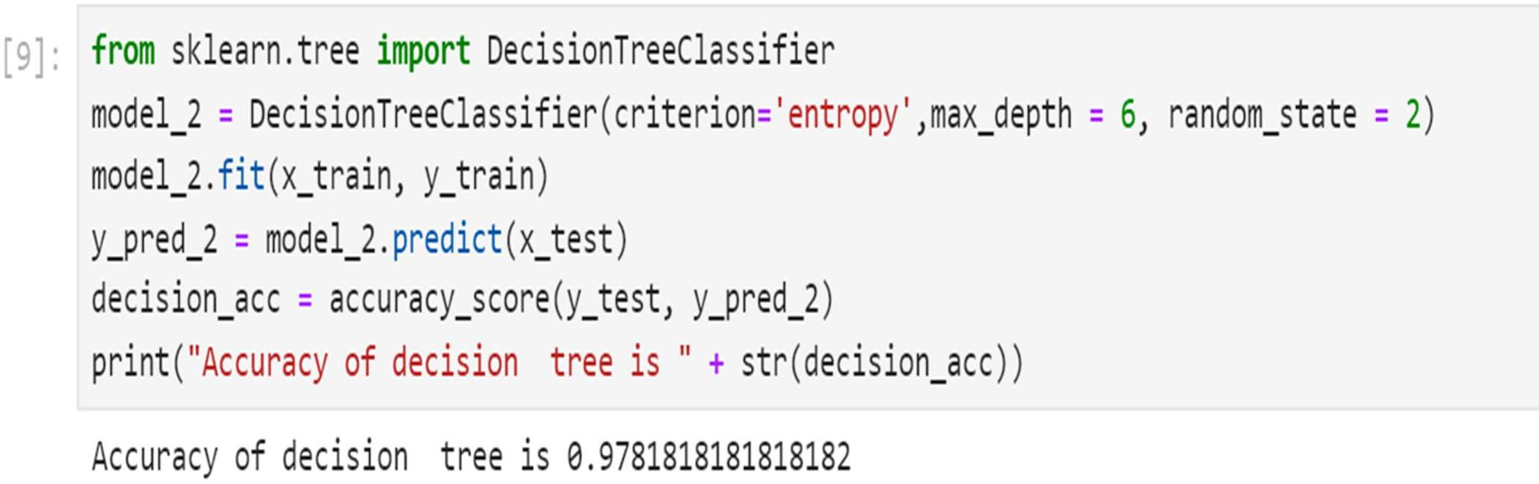
Testing Decision Tree:
High Prediction Accuracy: The decision tree model correctly predicted 97.82% of the test samples. This indicates that approximately 98 out of 100 predictions were accurate.
Effective Model Performance: A high accuracy score demonstrates that the decision tree model effectively captures the relationship between the features (x_train) and the target labels (y_train).
Reliable and Generalizable: The model's high accuracy on test data suggests good generalization ability, making it reliable for real-world applications.

Slide 25
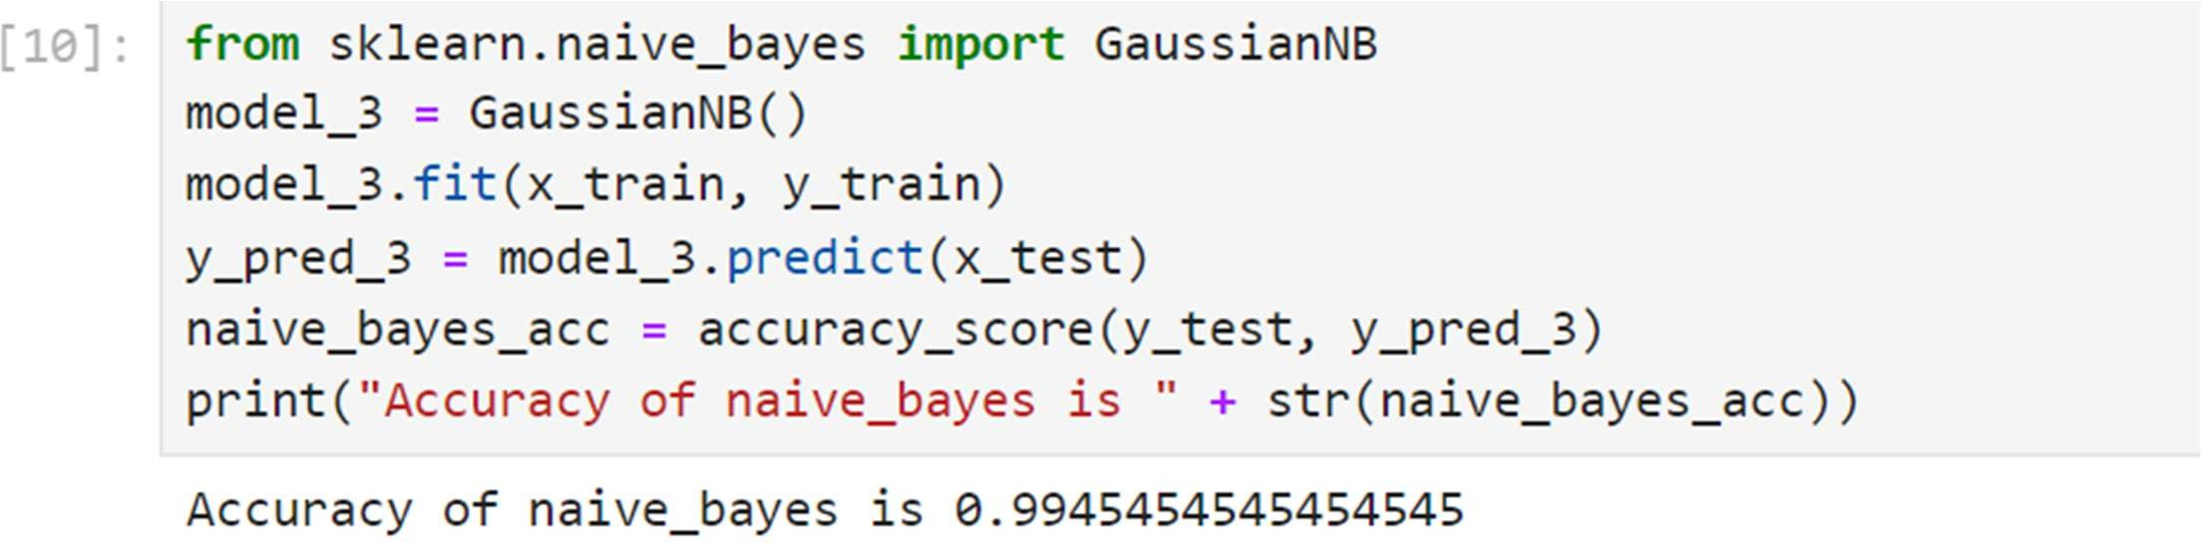
Testing Naive Bayes :
Very High Prediction Accuracy: The Naive Bayes model correctly predicted 99.45% of the test samples. This means that approximately 99 out of 100 predictions were accurate
Exceptional Model Performance: A very high accuracy score indicates that the Naive Bayes model effectively captures the underlying patterns in the data, making accurate predictions.
Reliable and Generalizable: The model's high accuracy on the test data suggests it generalizes well to unseen data, making it reliable for practical applications.

Slide 26
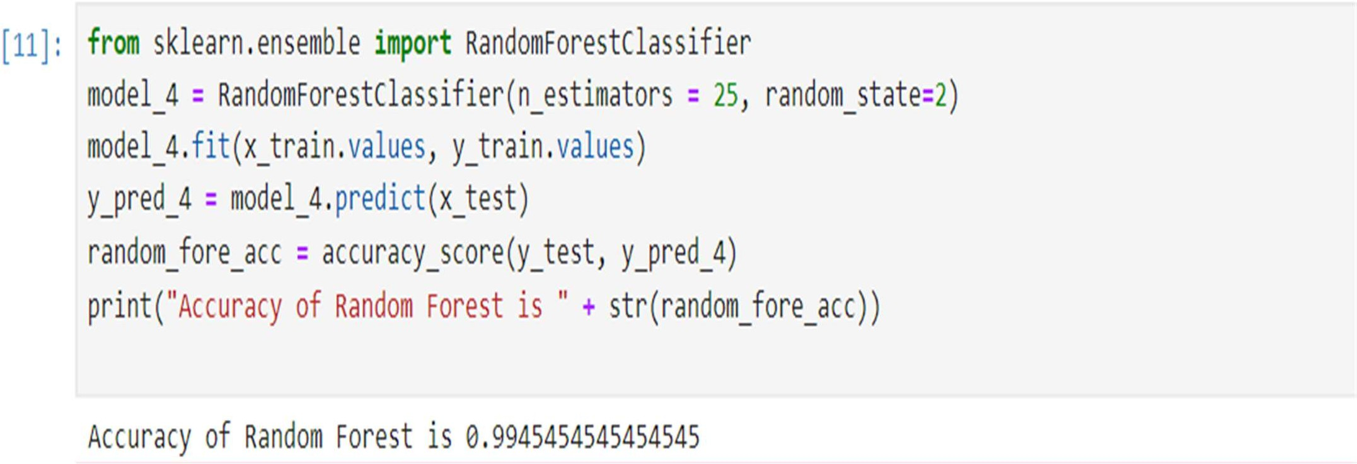
Testing Random Forest :
Robust and Flexible: Random Forest models are robust to overfitting, especially with a reasonable number of trees, and can handle large datasets with high dimensionality effectively.
High Suitability for Deployment: Given its exceptional accuracy, the Random Forest model is highly suitable for deployment or further fine-tuning in real-world scenarios.
Feature Importance: Random Forest models also provide insights into feature importance, which can be valuable for understanding which features are most influential in the predictions.

Slide 27
Comparison of all the tested algorithms
Algorithm | Description | Accuracy | Differences and Key Points
Logistic Regression | A linear model for binary classification problems. | 0.9618 | Simple and interpretable, but may not capture complex relationships as well as non-linear models.
Decision Tree Classifier | A tree-based model using entropy for splits, max depth of 6. | 0.9782 | Easy to interpret and visualize, but prone to overfitting if not pruned properly.
Naive Bayes (GaussianNB) | Probabilistic classifier assuming Gaussian distribution of features. | 0.9945 | Fast and effective for certain problems, especially where feature independence assumption holds.
Random Forest Classifier | Ensemble of 25 decision trees with random feature selection. | 0.9945 | Combines multiple trees to improve accuracy and robustness, provides feature importance insights.

Slide 28
Random Forest Classifier
Random Forest is an ensemble learning method used for classification and regression tasks. It operates by constructing multiple decision trees during training and outputting the class that is the mode of the classes (classification) or mean prediction (regression) of the individual trees. This method improves predictive accuracy and controls overfitting.
How It Works:
The Random Forest algorithm builds a "forest" of many decision trees. To classify a new object based on attributes, each tree in the forest gives a classification, and the forest chooses the classification having the most votes.
Random Forest Algorithm:
Initialize Parameters:
Number of trees in the forest (n_trees).
Number of features to consider for the best split (m).

Slide 29
Create Bootstrap Samples:
For each tree i (where i ranges from 1 to n\treesn\treesn\trees):
Randomly sample with replacement from the training dataset to create a bootstrap sample.
Build Decision Trees:
For each bootstrap sample:
Start with the root node
For each node, randomly select mmm features from the feature set.
Choose the best feature and split point among the mmm features.
Split the node into child nodes
Repeat until a stopping condition is met (e.g., maximum depth, minimum samples per leaf).
Aggregate Predictions:
For a new input, pass it through all n decision trees.
Each tree provides a classification vote.

Slide 30
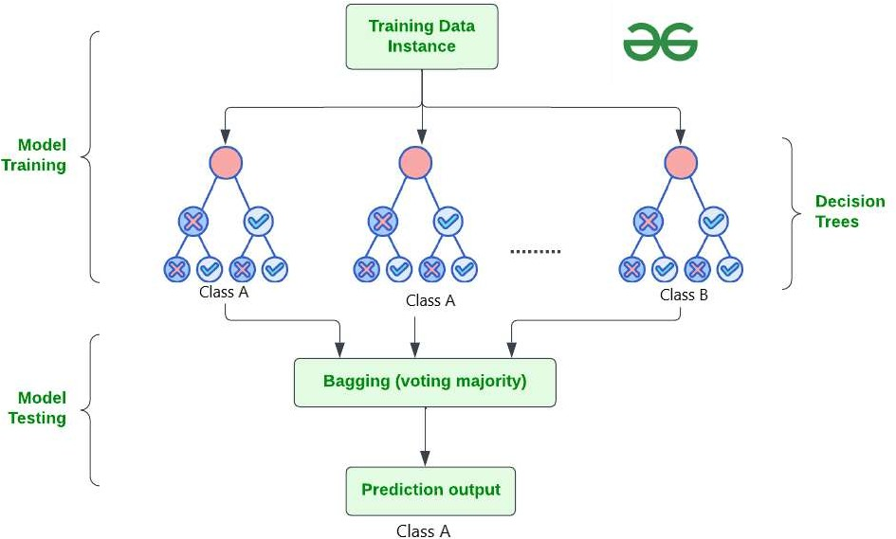
Advantages of Random Forest:
Improved Accuracy: Combines multiple trees to enhance prediction accuracy.
Robustness: Reduces overfitting compared to individual decision trees.
Feature Importance: Provides estimates of feature importance, aiding in understanding the model.

Slide 31

EVALUATION CRITERIA
Evaluating the performance of a Random Forest algorithm, or any machine learning model, involves multiple criteria to ensure it is functioning optimally and providing accurate predictions. Below are some common evaluation criteria and methods used to assess Random Forest models
Accuracy
Definition: The proportion of correctly predicted instances out of the total instances
True Positives (TP): The model correctly predicts the crop will grow.
False Positives (FP): The model predicts the crop will grow, but it doesn't.
True Negatives (TN): The model correctly predicts the crop will not grow.
False Negatives (FN): The model predicts the crop will not grow, but it does.

Slide 32



Precision, Recall, and F1-Score
Precision: The proportion of positive predictions that are actually correct.
Recall (Sensitivity): The proportion of actual positives that are correctly identified.
F1-Score: The harmonic mean of precision and recall.
Interpretation: The F1 score reaches its best value at 1 and worst at 0. It is useful when the dataset is imbalanced, as it takes both false positives and false negatives into account.

Slide 33

OUTPUT

Slide 34
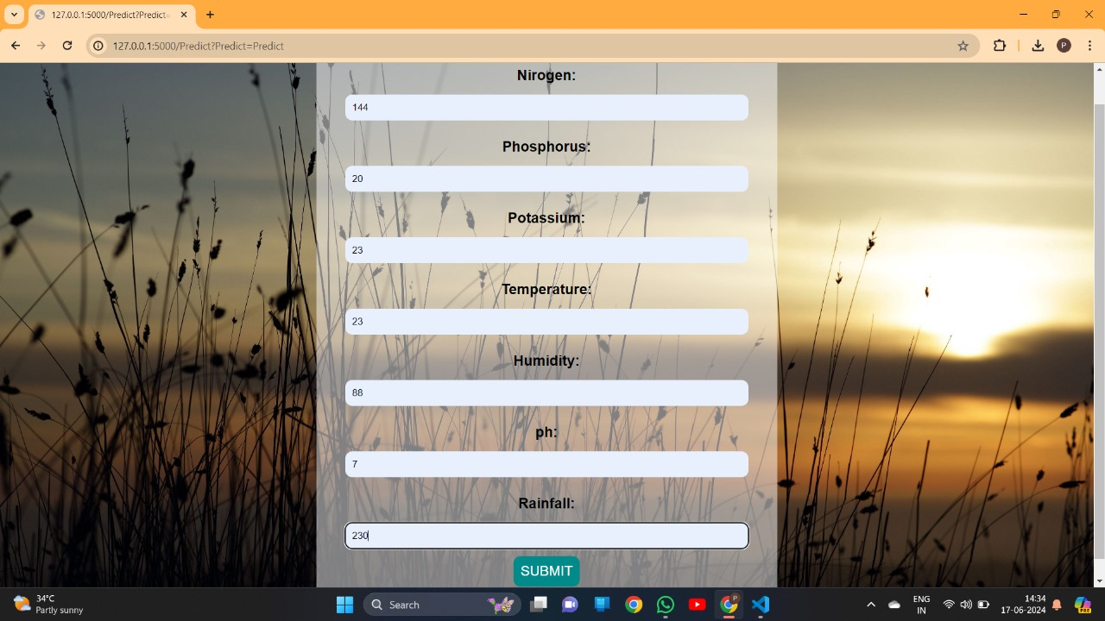

Slide 35


Slide 36
Conclusion
Our Crop Recommendation System using Soil and Weather Conditions represents a significant advancement in the field of agricultural technology.
By integrating machine learning algorithms with real-time soil and weather data, we provide farmers with precise and actionable insights to optimize crop selection.
This system not only enhances crop yield and farm productivity but also promotes sustainable agricultural practices by ensuring that the right crops are grown in the right conditions.
The use of advanced algorithms like Logistic Regression, Decision Tree, and Random Forest Classifier allows our system to deliver high accuracy in crop recommendations, validated through extensive testing and user feedback.
Our project addresses the critical challenge of improving agricultural efficiency in diverse climatic conditions, especially in a country like India, where agriculture is the backbone of the economy.
We are confident that this system will make a substantial impact on the agricultural sector, aiding farmers in making informed decisions and fostering a more prosperous and sustainable agricultural landscape.

Slide 37
THANK YOU

