Slide 1



The e-Yantra Robotics Competition (eYRC) hosted by e-Yantra, IIT Bombay
Hologlyph Bots
*Team Member Detail*
Pooja Ramani(22ce106)
Kaushal Bhanderi(22ce005)
Jalay Movaliya(22ce071)
Yash Nasit(22cd043)

Slide 2
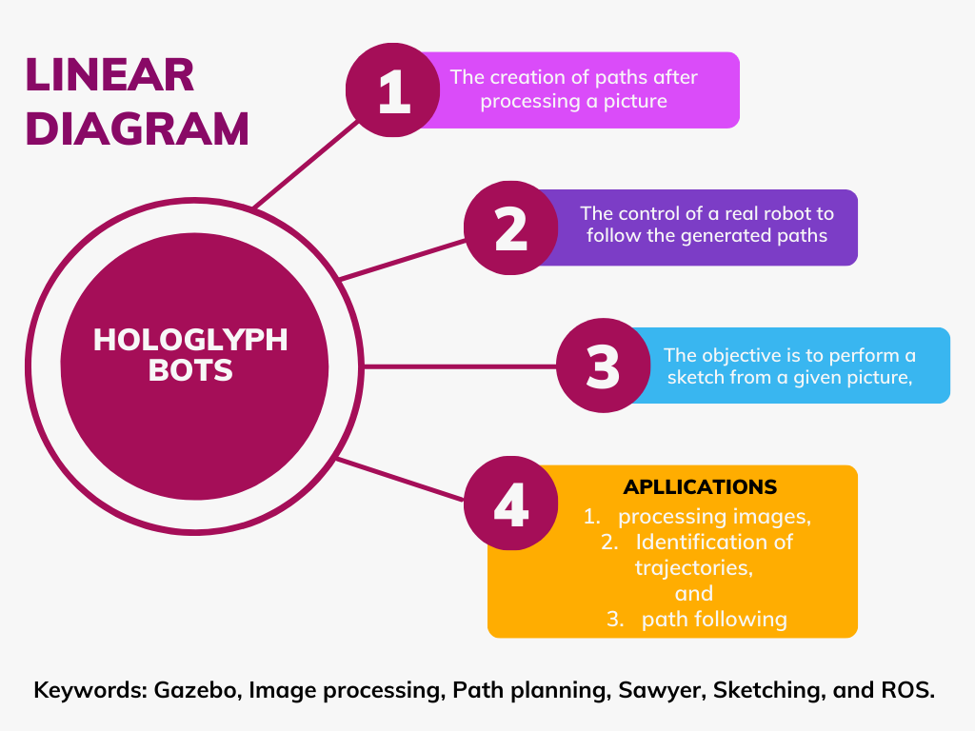

Slide 3
Problem Statement and motivation
This project aims to create a robotic drawing application based on path generation using 2D images. To complete it, some points have been proposed:
1. Image acquisition. This picture can be taken from the robot's cameras (head camera or arm camera) or uploaded from an external device. There should exist the possibility of switching between cameras or choosing an uploaded picture.
2 Once the picture has been taken, it will be processed by software to generate a path for the sketch or painting.
3 The robot must be able to calibrate itself on the surface where the sketch will be performed and the needs of the painting.
4 Finally, the robot must perform the sketch

Slide 4
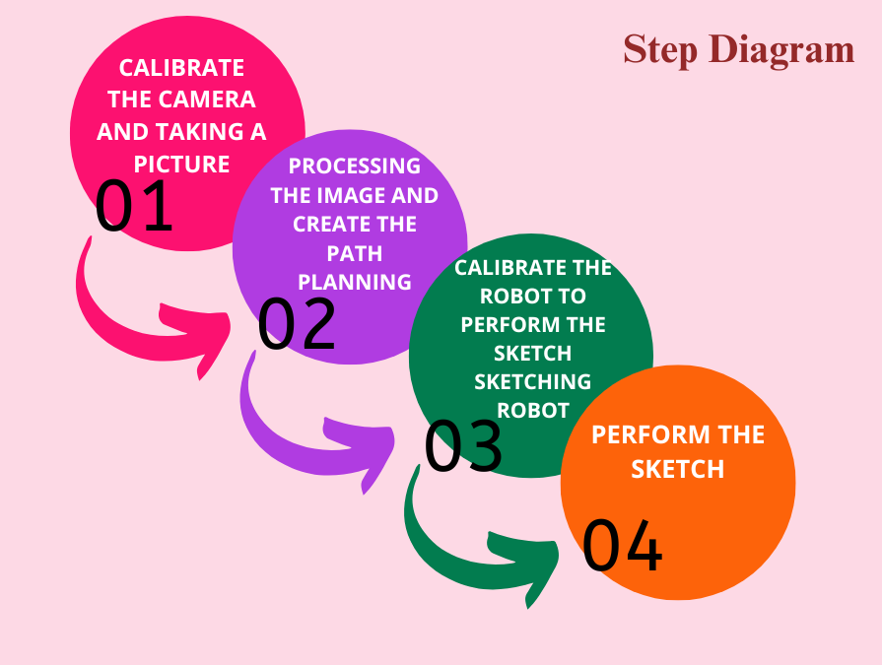

Slide 5
Software
For this project, it is also important to introduce the software that is going to be used. This software is not only important for the control of the robot but also is important for image processing and path planning.
Secondary Research
ROS
ROS
Open-CV
OpenCV

Slide 6
Vision System
To achieve the goal of this project, it is necessary to introduce what a vision system is and how the codification of an image works. Computer vision is a field that studies how to obtain and extract and analyse meaningful information from an image, video, or other inputs (IBM, 2019). To make this possible, different cameras, data and algorithms are used to identify key points of these images. A Vision system is a prebuilt solution that contains not only the sensors but also the processor and the software
Secondary Research

Slide 7
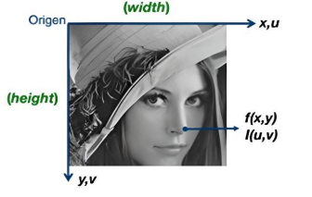
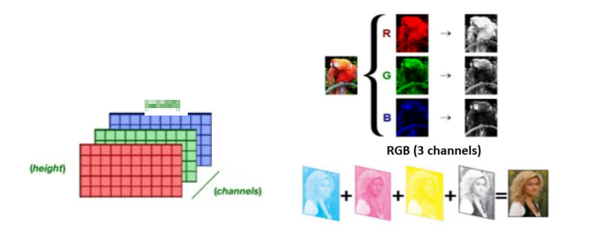

Slide 8
Image Processing Methods
During this project different image processing methods will be tried and implemented to get the meaningful characteristics associated with the image used. To understand the project is necessary to
introduce which methods are and how they work.
Secondary Research
Edge Detection Method
Segmentation Method
Corner Detection Method

Slide 9
Camera Calibration
Camera calibration is used to calculate the transformation between a series of points in a scene and a pixel point of a 2D image. To perform this calibration the mathematical model is established, and the parameters of the camera are calculated. These parameters are not only extrinsic such as the transformation matrix that defines the position and orientation of the camera from the coordinate system but also intrinsic such as the radial distortion coefficient, the focal length, the optical center, or tangential distortion coefficient that describes the geometry and optics of the camera. In traditional visual calibration, these intrinsic parameters are considered unchanged and will depend on the camera used (Long and Dongri, 2019).
Secondary Research

Slide 10
Movement And Control
Once the image has been processed, the robot must perform the movements along a path to draw the final sketch. To perform the movements in the best possible way, it is necessary to take into account concepts about how these movements are performed, how they are limited and how they are controlled.
Secondary Research
Sorts of Joints
Kinds of Movement
Interpolation of Movement
Controllers
Feedback

Slide 11
Path Planning
Once the image has been processed, the next step is to implement the route that the robotic arm will follow to make the sketch. This path planning is done by software using the detected key points of the
contour, the path is also going to change continuously because the robot must perform different sketches, therefore it needs to adapt the route to the draw.
The aim is to create the most efficient path, to obtain it different algorithms can help to obtain the
fastest way to join points.
Secondary Research

