Slide 1
Date: 20-April-25
AI-Driven Adaptive Security and Recovery Pipeline
Dabhade Pooja Bhanudas (2023MT93089) Supervisor: Rupam Kumar Kundu BITS ZG628T DISSERTATION

Slide 2
Problem statement
Cyber threats like ransomware, software attacks, and system hardware failures pose significant risks to organizations.
Traditional security systems lack the adaptive capability to handle evolving threats.
Objective: Build a robust AI-driven pipeline that offers continuous monitoring, threat detection, quarantine, and automated recovery.

Slide 3
Solution
The AI-driven pipeline will offer dynamic and intelligent security features for proactive defense and automated recovery.
Stages:
Monitoring: Continuous surveillance of the system.
Detection: Using AI to identify anomalous or malicious activities.
Quarantine: Isolating suspected threats to prevent further damage.
Resolution: Automated recovery using AI tools to restore systems to their normal state.

Slide 4
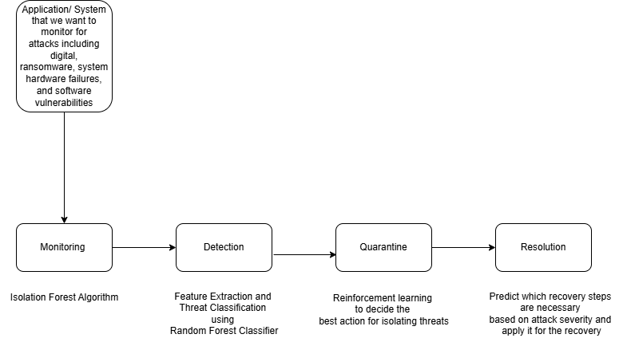
Block diagram of pipeline

Slide 5
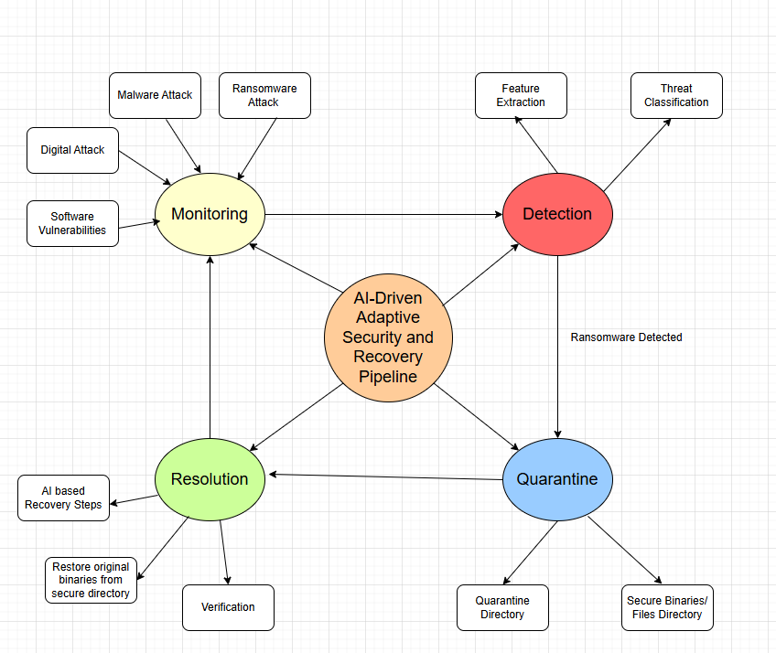
Modular representation of pipeline

Slide 6
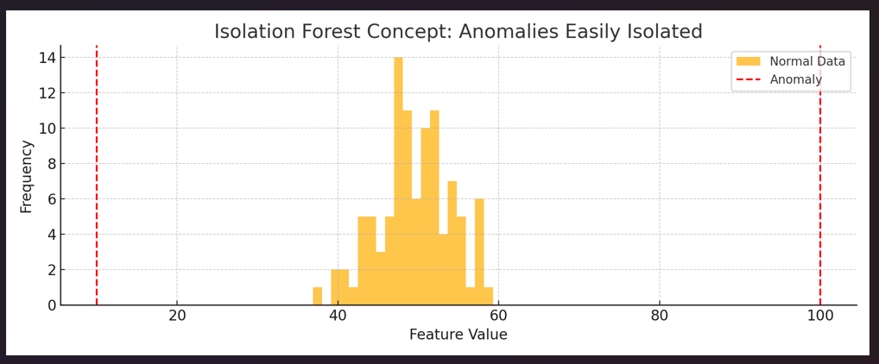
AI Algorithms used in different phases of pipeline
Monitoring phase – Isolation Forest algorithm
The Isolation Forest algorithm is a machine learning method specifically designed to detect anomalies (unusual patterns) in a dataset. It works by isolating data points that behave differently from the majority
This visual shows that outliers stand apart from regular patterns, and Isolation Forest quickly detects them based on how easy they are to isolate.

Slide 7
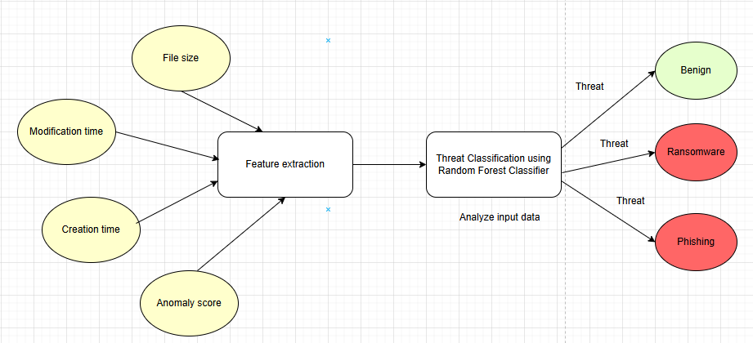
Detection phase – Random Forest Classifier
In the Detection Stage, the anomaly is classified into a specific threat category using a trained model.
If the model's confidence is low (e.g., <50%), the output should be treated with caution, and further analysis (e.g., manual review) might be required.
The stage adds context to the anomaly, helping you decide the next action:
- If ransomware is detected, the pipeline moves to the Quarantine Stage.
- If the anomaly is benign, no action is taken.

Slide 8
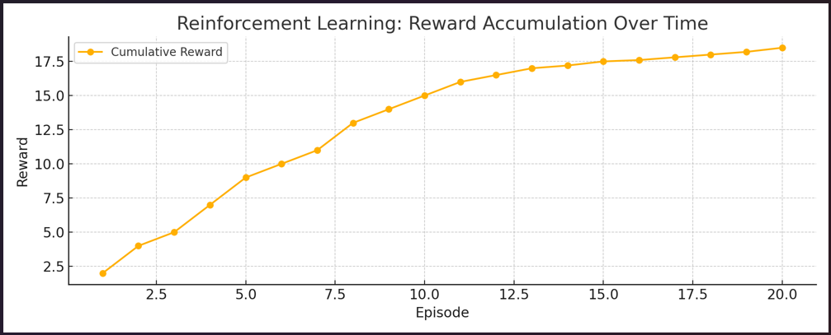
Quarantine phase – Reinforcement learning
The Quarantine Stage is responsible for isolating and neutralizing malicious files or processes to prevent further damage to the system.
Reinforcement Learning enables the system to learn optimal quarantine actions over time.

Slide 9
Resolution phase – Reinforcement learning
AI-Based Recovery Decision-Making
AI models analyse the severity and type of attack (ransomware, software corruption, unauthorized access, etc.) and recommend the most suitable recovery steps.
Simulation & Post-Recovery Validation
After restoring files from a pre-verified repository, AI models simulate the expected behaviour of the application (e.g., process patterns, resource usage).
Learning from Recovery History
AI can be trained using past recovery logs (e.g., attack types, actions taken, recovery success/failure).

Slide 10

Anomaly Injection output -

Slide 11
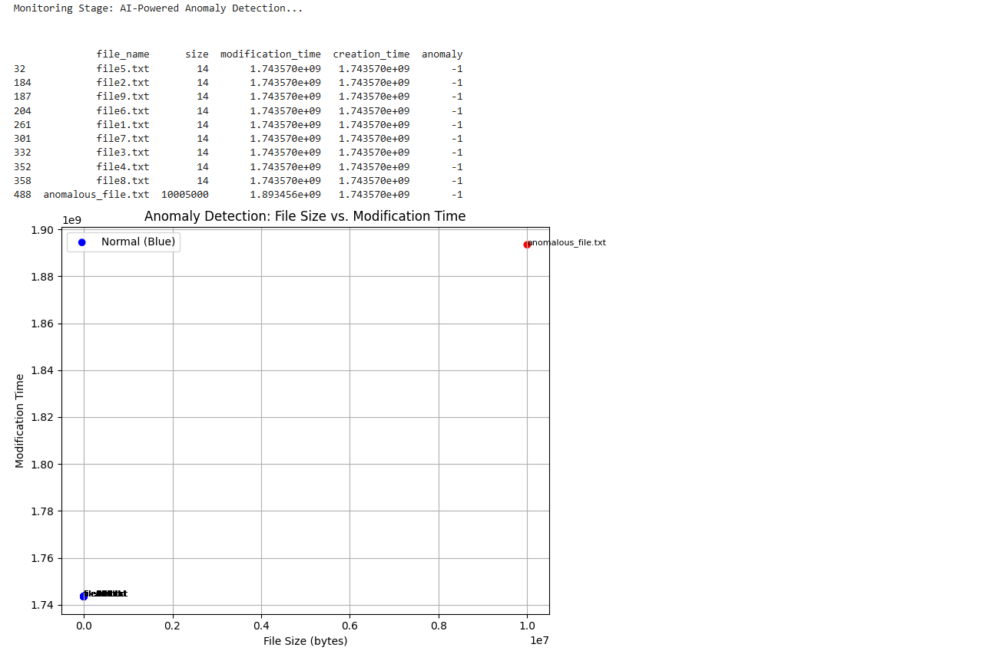
Monitoring phase output -

Slide 12
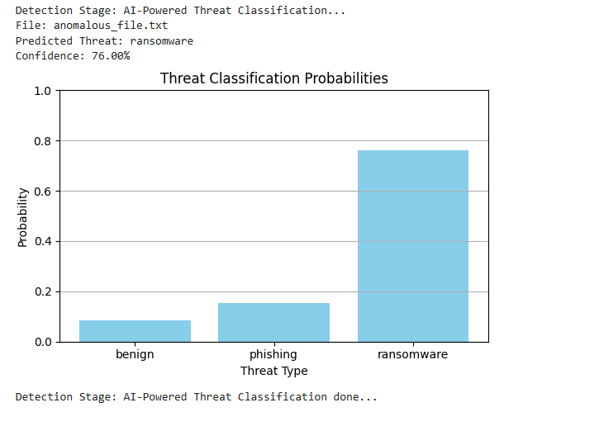
Detection phase output -

Slide 13
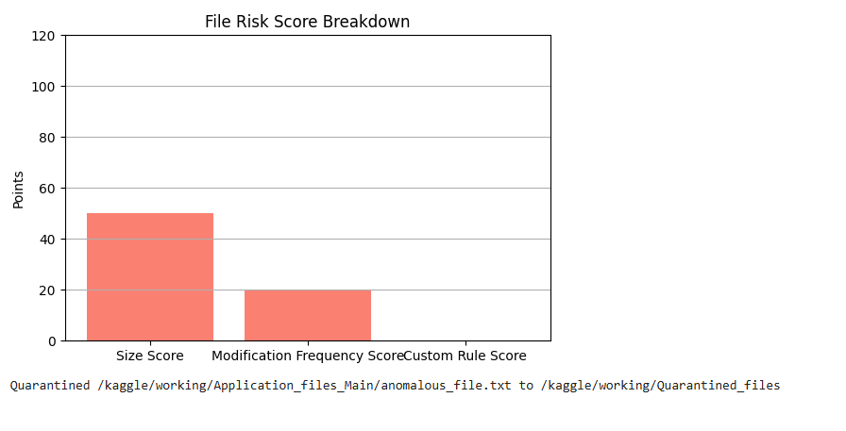
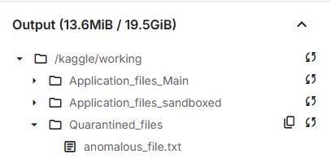
Quarantine phase output -

Slide 14
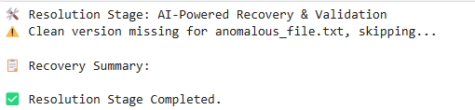
Resolution phase output -

Slide 15
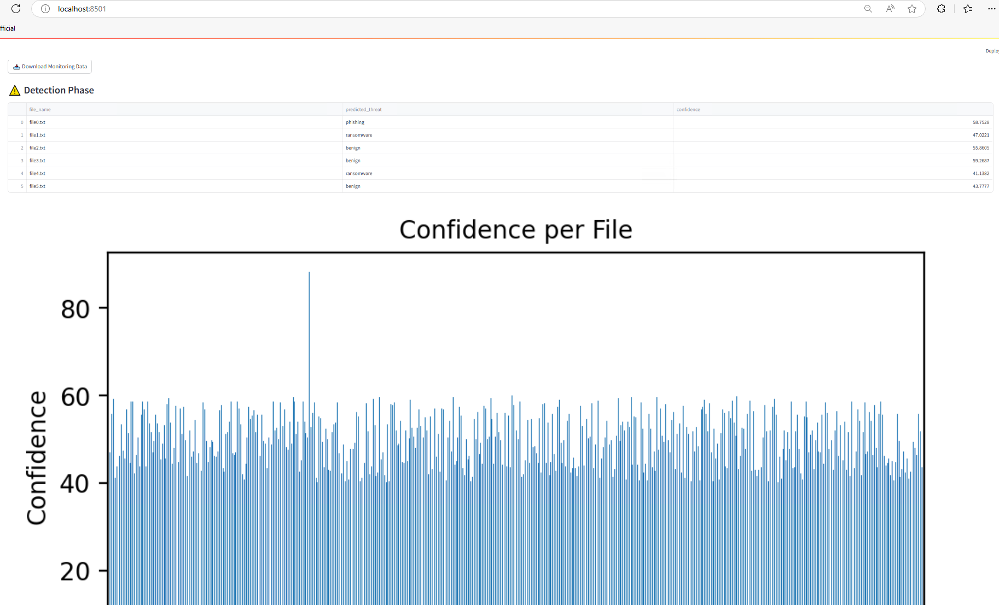
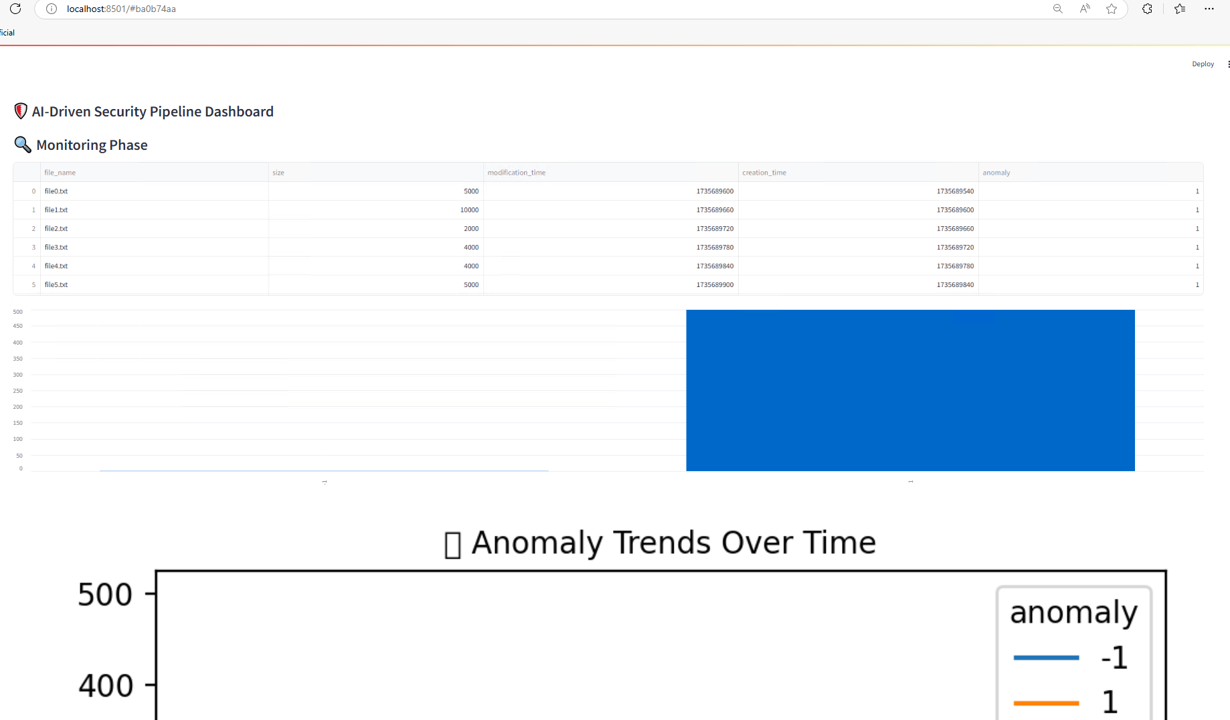
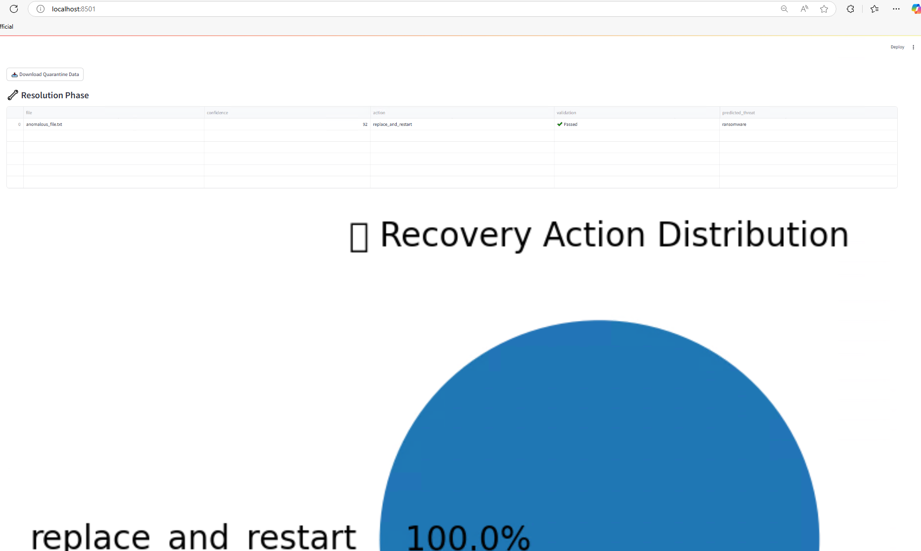
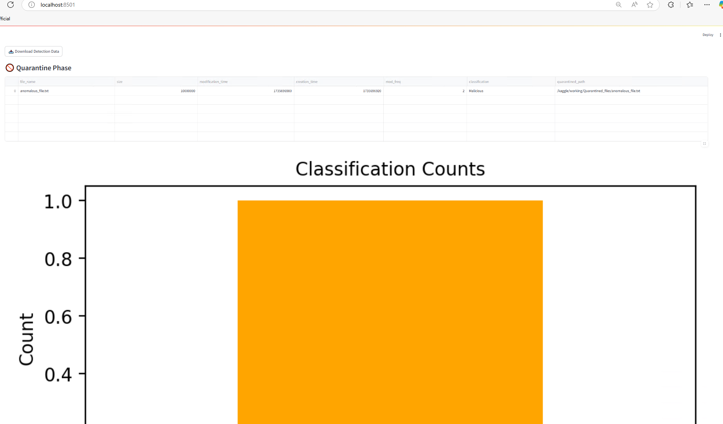
Dashboarding output -

Slide 16
Code
The GitHub code utilizes the trained model created using Kaggle notebook
GitHub: https://github.com/poojaDabhade23/AI-driven-Adaptive-Security-and-Recovery-Pipeline/tree/main/Development-Work
Kaggle Notebook: https://www.kaggle.com/code/dabhadepoojabhanudas/ai-driven-adaptive-security-and-recovery-pipeline

Slide 17
Real-World Applications
Enterprise Protection: AI-powered security systems for enterprise environments.
Ransomware Defense: Adaptive systems protecting against ransomware.
Automated Recovery: Swift system restoration after any attack, minimizing downtime.

Slide 18
Conclusion
The AI-Driven Adaptive Security and Recovery Pipeline offers an advanced, automated approach to cybersecurity.
Ensures real-time protection, adaptive threat response, and efficient recovery.
Reduces human intervention and enhances system resilience.

Slide 19
Future scope
Scalability to Enterprise Systems – Expand the framework to protect large-scale enterprise applications, cloud platforms, and critical infrastructure.
1
Advanced AI & Machine Learning Integration – Implement deep learning models for improved threat detection, anomaly analysis, and autonomous decision-making.
2
Enhanced Quarantine & Recovery Mechanisms – Utilize blockchain for data integrity, automate rollback processes, and strengthen zero-trust security models.
3
Real-Time Threat Intelligence & Adaptive Security – Incorporate real-world attack simulations, security event monitoring, and predictive analytics for proactive defence.
4
Industry Compliance & Customization – Ensure alignment with global cybersecurity standards (NIST, GDPR, ISO 27001) and adapt the system for healthcare, finance, and industrial applications.
5

Slide 20
Thank You!

