Slide 1
Test the REST
Testing RESTful web services using REST Assured
An open source workshop by …
Originally created by Bas Dijkstra – bas@ontestautomation.com – https://www.ontestautomation.com
Notes:
Please replace the … with your own name. I would really like it if you left the bottom line intact though, as a way of thanking me. That’s really all I’m asking for, the rest of the workshop is yours to butcher (erm, improve).
1

Slide 2
What are we going to do?
RESTful web services
REST Assured
Hands-on exercises
Notes:
First: an introduction to RESTful web services, how they work and where they are used
Then: an introduction to REST Assured, a Java library that can be used to write tests for RESTful web services
But most importantly: you are going to have to do some work yourself! There’s not better way to learn than by doing.
2

Slide 3
Preparation
Install JDK 1.8 (examples and exercises are not guaranteed to work on other JDK versions)
Install IntelliJ (or any other IDE)
Import Maven project into IDE
https://github.com/basdijkstra/rest-assured-workshop
Notes:
Depending on the way you deliver this workshop, this sheet can be altered or even removed. When I delivered it, I had participants bring in their own laptop and asked them to follow installation instructions. I only provided them for Eclipse and mentioned that whenever they wanted to use a different IDE, they were allowed to do so. I wanted to keep things simple and therefore did not provide installation instructions for other IDEs.
3

Slide 4
What are RESTful web services?
HTTP request methods (GET, POST, PUT, …)
URI’s
CRUD operations on data
POST Create
GET Read
PUT Update
DELETE Delete
Notes:
Explain the concept of RESTful web services and compare it to your browser retrieving web pages, images, etc. from a web server (or sending data back to it).
4

Slide 5
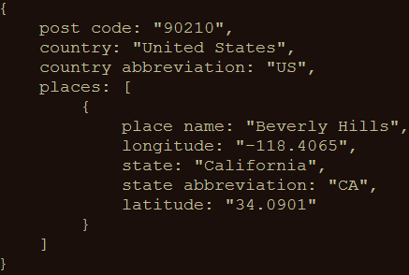
An example
GET http://api.zippopotam.us/us/90210
Result:
Notes:
A simple example. You could also perform this one live to show the participants how easy it is to invoke a RESTful web service using your browser (it really is no different from accessing a regular web page since it’s all done over HTTP)
5

Slide 6
Usage of RESTful web services
Mobile applications
Internet of Things
API Economy
Web applications
Notes:
Explain where RESTful web services are used.
API Economy relates to software development exposing (parts of) their applications to the outside world through APIs, so that other developers can easily integrate their applications with it. For example: Google’s Gmail API, Maps API or the PayPal or LinkedIn APIs.
6

Slide 7
Why I ♥ testing at the API level
Tests run much faster than UI-driven tests
Tests are much more stable than UI-driven tests
Tests have a broader scope than unit tests
Business logic is often exposed at the API level

Slide 8
Tools for testing RESTful web services
Browser (using plugins like Postman for Chrome)
Open source (SoapUI, REST Assured)
COTS (Parasoft SOAtest, SoapUI Pro)
Build your own (using HTTP libraries for your language of choice)
Notes:
Three levels of tools, ranging from the very simple to the powerful and from the free to the commercial
8

Slide 9
REST Assured
Java DSL for writing tests for RESTful APIs
Removes a lot of boilerplate code
Runs on top of common unit testing frameworks
JUnit, TestNG
Developed and maintained by Johan Haleby
Notes:
Explain what REST Assured is and why it was written
Explain how REST Assured can easily be made part of a bigger testing framework covering everything from unit to end-to-end and user interface testing
9

Slide 10
Configuring REST Assured
Download from http://rest-assured.io
Add as a dependency to your project
Maven
<dependency>
<groupId>io.rest-assured</groupId>
<artifactId>rest-assured</artifactId>
<version>3.3.0</version>
<scope>test</scope>
</dependency>
Notes:
Briefly discuss the options available for installing and configuring REST Assured (this should be trivial for anybody with a bit of Java development experience)
10

Slide 11
REST Assured documentation
Usage guide
https://github.com/rest-assured/rest-assured/wiki/Usage
Links to other documentation (JavaDoc, getting started, release notes)
http://rest-assured.io
Notes:
Notes on where to find additional information on REST Assured
11

Slide 12
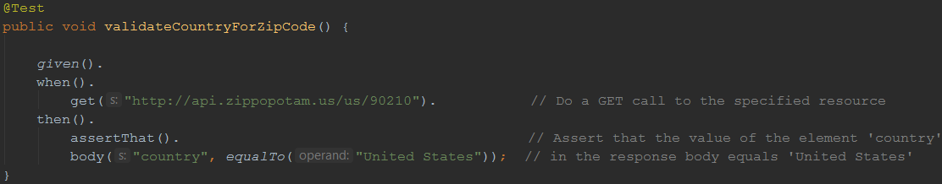
A sample test
Notes:
Demonstrate how easy it is to write a fully functional test on a RESTful web service with REST Assured. This is the only code you need. And it’s readable too!
12

Slide 13
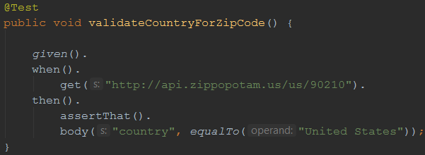
REST Assured features
Support for HTTP methods (GET, POST, PUT, …)
Support for BDD / Gherkin (Given/When/Then)
Use of Hamcrest matchers for checks (equalTo)
Use of Jsonpath/GPath for selecting elements from JSON response
Notes:
Using the example from the previous sheet, introduce some of the basic REST Assured features
13

Slide 14
About Hamcrest matchers
Express expectations in natural language
Examples:
http://hamcrest.org/JavaHamcrest/javadoc/1.3/org/hamcrest/Matchers.html
equalTo(X) | Does the object equal X?
hasItem(“Rome”) | Does the collection contain an item “Rome”?
hasSize(3) | Does the size of the collection equal 3?
not(equalTo(X)) | Inverts matcher equalTo()
Notes:
Go into a little more detail with regards to Hamcrest matchers – readable matchers for creating checks
14

Slide 15
About GPath
JsonPath is a query language for JSON documents
REST Assured using the GPath implementation
Similar aims and scope as XPath for XML
Documentation and examples:
http://groovy-lang.org/processing-xml.html#_gpath
http://groovy.jmiguel.eu/groovy.codehaus.org/GPath.html
Notes:
Go into a little more detail with regards to Gpath for effective selection of elements from XML and JSON responses
15

Slide 16
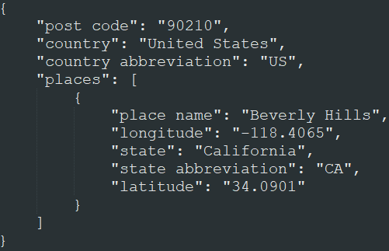
GPath example
body(“places[0].’place name’”, equalTo(“Beverly Hills”));
Notes:
Example – also explain the [0] needed since we’re dealing with a collection of Places here, and the single quotes to deal with the space in the JSON field name
16

Slide 17
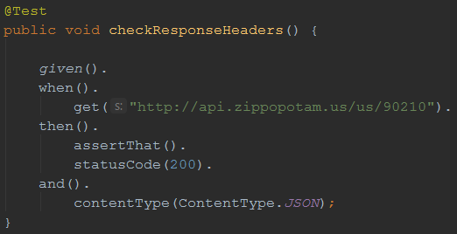
Validating technical response data
HTTP status code
MIME-type of received responses
Cookies and their value
…
Notes:
Explain how you can not only perform validations on response content, but also on response headers.
17

Slide 18

Our API under test
Zippopotam.us
Returns location data based
on country and zip code
http://api.zippopotam.us/
RESTful API
Notes:
Explain why this API was chosen (simple, very ‘real’ data, something lots of people can relate to)
Mocks are included in the project to avoid the risk of the API being unavailable during the workshop (this actually happened to me once), feel free to remove it and test against the actual API
Alternatively, you can always use your own API of course!
18

Slide 19
Demo
API documentation
Starting the stub server
How to use the test suite
Executing your tests
Reviewing test results
Notes:
A quick demo before the participants start with the first series of exercises might be helpful to ensure they’ve understood everything so far and are ready to go.
19

Slide 20
Now it’s your turn!
src > test > java > exercises > RestAssuredExercises1Test.java
Simple checks
Validating individual elements
Validating collections and items therein
Validating technical response properties
Stubs are predefined
You only need to write the tests using REST Assured
RestAssuredExamples contains the examples shown so far
Notes:
Speaks for itself, I think.
20

Slide 21
Parameters in RESTful web services
Path parameters
http://api.zippopotam.us/us/90210
http://api.zippopotam.us/ca/B2A
Query parameters
http://md5.jsontest.com/?text=testcaseOne
http://md5.jsontest.com/?text=testcaseTwo
There is no official standard!
Notes:
Explain the difference between path and query string parameters in RESTful web services
21

Slide 22
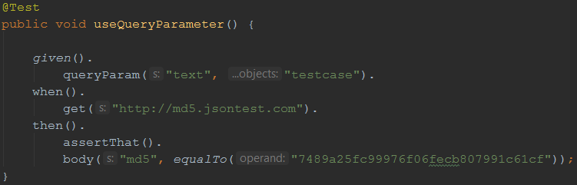
Using query parameters
GET http://md5.jsontest.com/?text=testcase
Notes:
Explain how you define query string parameters to be used when calling a service in REST Assured (using params() )
22

Slide 23
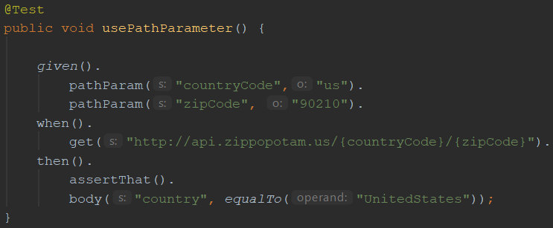
Using path parameters
GET http://api.zippopotam.us/us/90210
Notes:
Explain how you define path parameters to be used when calling a service in REST Assured (using pathParam() )
23

Slide 24
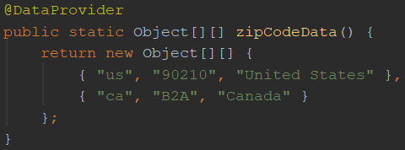
Using parameters in REST Assured
Create test data
country code and zip code are input values
country name is an value expected in the response
Notes:
Explain how to create data driven tests using the TestNG or JUnit @DataProvider and (path or query string) parameters
24

Slide 25
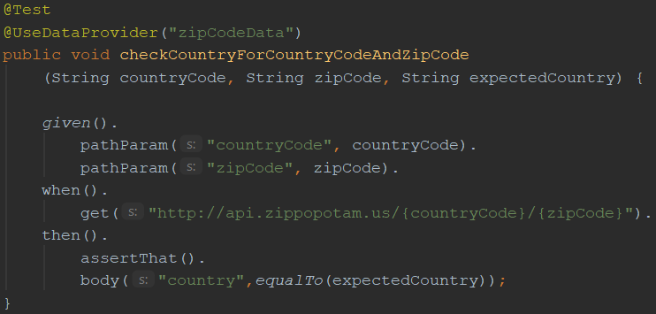
Using parameters in REST Assured
Use test data for input and output parameters:
Notes:
Explain how to create data driven tests using the TestNG or JUnit @DataProvider and (path or query string) parameters
25

Slide 26
Now it’s your turn!
src > test > java > exercises > RestAssuredExercises2Test.java
Data driven tests
Creating a test data object
Using test data to call the right URI
Using test data in assertions
RestAssuredExamples contains all examples from the presentation

Slide 27
Authentication
Securing web services
Most common authentication schemes:
Basic authentication (username / password)
OAuth(2)
Notes:
Explain why web services sometimes need to be secured and introduce the different authentication options for RESTful web services
27

Slide 28
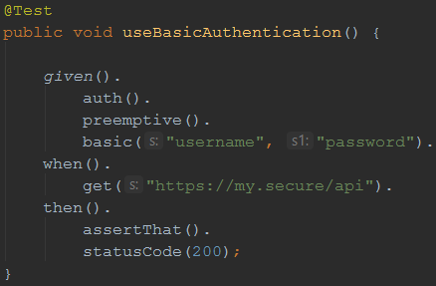
Basic authentication
Username/password sent in header for every request
In many APIs, Basic auth. is typically only used to retrieve an (OAuth) authentication token
Notes:
Explain Basic (username / password) authentication
28

Slide 29
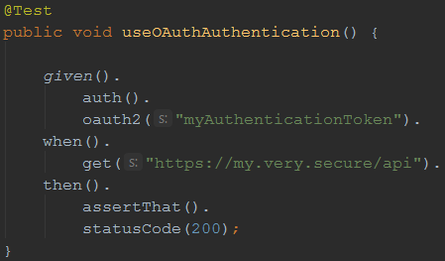
OAuth(2)
Request of authentication token based on username and password (Basic authentication)
Include authentication token in header of all subsequent requests
Notes:
Explain Oauth
Retrieve access token by calling endpoint (mostly secured using Basic authentication)
Include obtained authentication token in the header of all subsequent requests
Explain that authentication token is tied to a specific user and that it has an expiration time (after which a new token needs to be requested)
29

Slide 30
Sharing variables between tests
Example: authentication tests
Copy / paste required for OAuth2 token
This results in added maintenance burden
Preferably: store and retrieve for reuse!
Notes:
Refer to the exercise where you needed to manually copy and paste the OAuth authentication token. This is cumbersome, especially when you want to have your tests run unattended (which you want to ;). To be able to do so, you need a way to extract response values from a certain request (in this case the authentication token) and reuse it in subsequent tests.
30

Slide 31
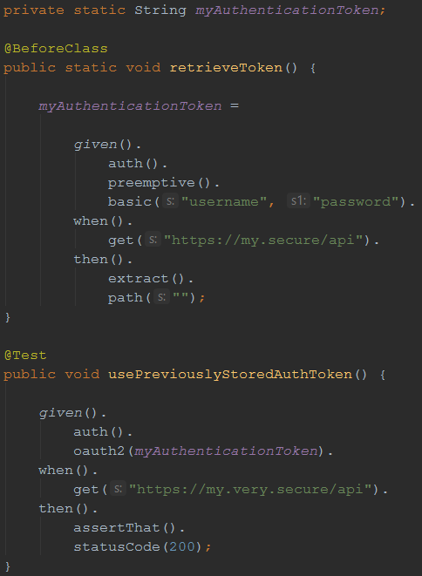
Sharing variables between tests
REST Assured
supports this
with extract()
Notes:
Explain the REST Assured extract() feature, which you can use (using GPath) to extract certain values from a response for later reuse.
31

Slide 32
Sharing checks between tests
Example: checking status code and MIME type for all responses
Another maintenance burden if specified individually for each test
What if we could specify this once and reuse throughout our tests?
Notes:
If you want the same check to be performed for a lot of different API calls, including them in each and every test (and having to update them X times when they require maintenance) is a waste of effort…
32

Slide 33
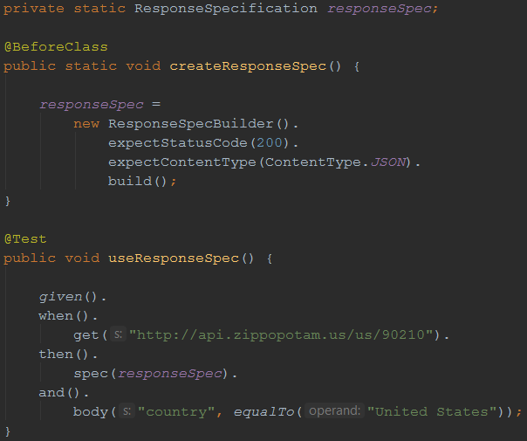
Sharing checks between tests
Solution: ResponseSpecification
Notes:
The ResponseSpecBuilder supports defining checks globally. You can then use these in your tests and combine them with test-specific checks.
33

Slide 34
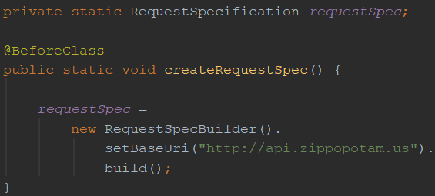
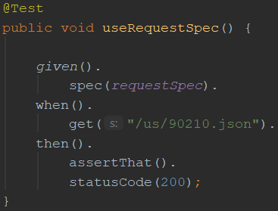
Reusing request properties
The same can be done for request properties
Example: set the base URI for the tests
Notes:
If you want the same check to be performed for a lot of different API calls, including them in each and every test (and having to update them X times when they require maintenance) is a waste of effort…
34

Slide 35
Now it’s your turn!
src > test > java > exercises > RestAssuredExercises3Test.java
Try it for yourself
Can you think of additional applications for reuse ?
RestAssuredExamples contains all examples from the presentation
Notes:
35

Slide 36
XML support
So far, we’ve only used REST Assured on APIs that return JSON
It works just as well with XML-based APIs
Identification of response elements uses XmlPath instead of JsonPath
No need for additional configuration
REST Assured uses response content type header value to determine how to process a response body

Slide 37
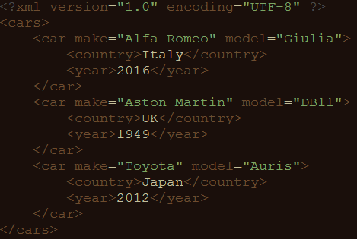
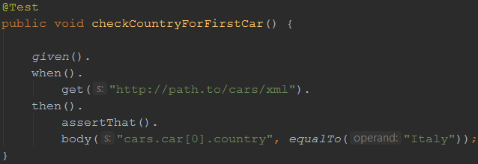
XmlPath – examples
Check country for the first car in the list

Slide 38
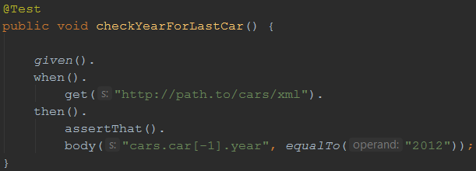
XmlPath – examples
Check year for the last car in the list

Slide 39
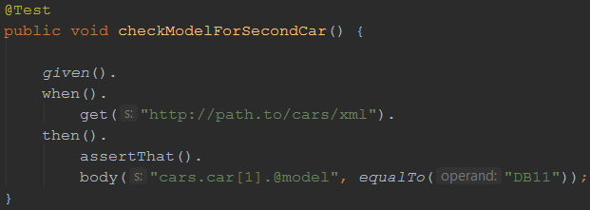
XmlPath – examples
Check model for the second car in the list

Slide 40
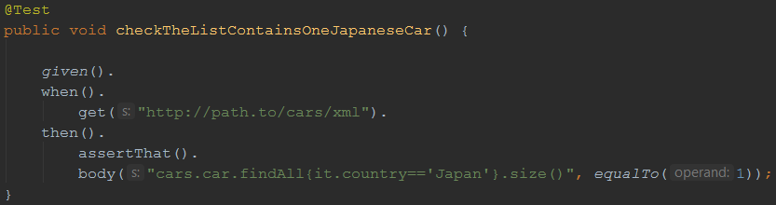
XmlPath – examples
Check there’s only one car from Japan in the list

Slide 41
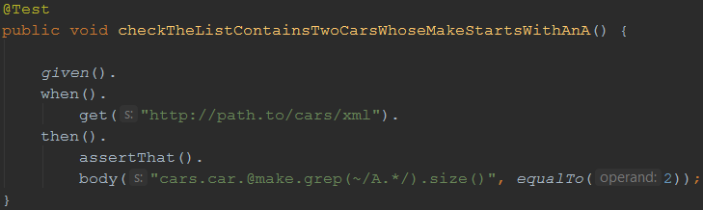
XmlPath – examples
Check there are two cars in the list whose make starts with ‘A’

Slide 42
Now it’s your turn!
src > test > java > exercises > RestAssuredExercises4Test.java
Communicating with an API returning an XML document
Use XmlPath to select the right nodes
Use filters, in, grep() where needed
All examples can be reviewed in RestAssuredExamplesXml.java

Slide 43
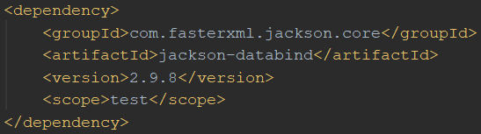
(De-)serialization of POJOs
REST Assured is able to convert POJO instances directly to XML or JSON (and back)
Useful when dealing with test data objects
Requires additional libraries on the classpath
Jackson or Gson for JSON
JAXB for XML

Slide 44
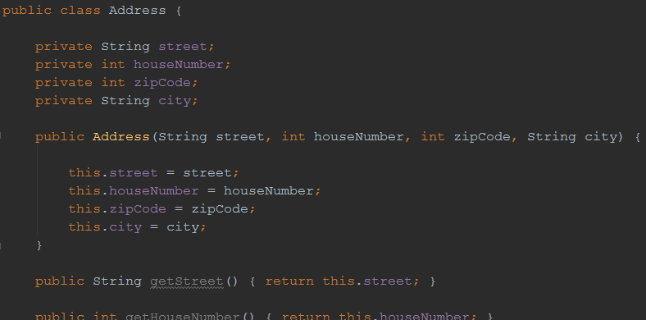
Example: serialization
POJO representing an address

Slide 45
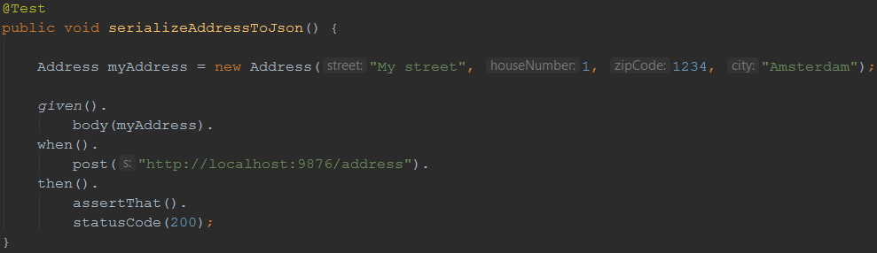
Example: serialization
Instantiating it in a test and sending it as a request body for a POST method:

Slide 46
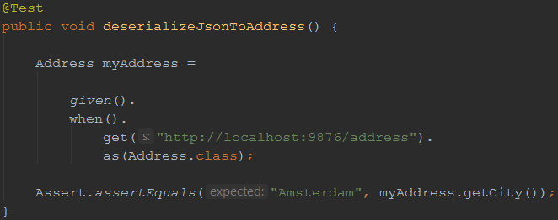
Example: deserialization
We can also convert a JSON (or XML) body back to an instance of a POJO
After that, we can do some verifications on it:

Slide 47
Now it’s your turn!
src > test > java > exercises > RestAssuredExercises5Test.java
Practice (de-)serialization for yourself
You don’t need to create or adapt the Car POJO
All examples can be reviewed in RestAssuredExamples.java

Slide 48
Now it’s your turn!
src > test > java > exercises > RestAssuredExercises6Test.java
Capstone assignment
Combines several concepts we have seen throughout this workshop
Extracting values from responses
Deserialization
Using filters
Parameterization, assertions, …

Slide 49
?
Notes:
Any questions?
49

Slide 50
https://testautomationu.applitools.com
/automating-your-api-tests-with-rest-assured/
Notes:
Any questions?
50

Slide 51
Contact
Email: bas@ontestautomation.com
Blog: https://www.ontestautomation.com
LinkedIn: https://www.linkedin.com/in/basdijkstra
Notes:
Here’s the part where you can shamelessly promote yourself (or give the participants your contact details in case they want more information or have any other questions, of course…). Feel free to replace this with your own contact details, you’re the one delivering the workshop after all!
51

