Slide 1
WILDLIFE CLASSIFICATION Authors: Pooja Reddy Gujju Ruchitha Lakshmi Sahithi Maram

Slide 2
Project Goal: The aim of this project was to develop three image classification models (CNN, SVM, CNN-LSTM) to classify images of animals (cats, dogs, and snakes) into their respective categories.
Approach:
Build and evaluate different architectures to determine the best-performing model for this task.
Compare models based on performance metrics like accuracy, precision, recall, and F1-score.
Dataset Structure:
The dataset consists of images of cats, dogs, and snakes.
The images are resized to 128x128 pixels for uniformity.
Kaggle Dataset Link: https://www.kaggle.com/datasets/borhanitrash/animal-image-classification-dataset
Data Split:
Training Set: 70% of the data.
Validation Set: 15% for model tuning.
Test Set: 15% for final evaluation.
Preprocessing:
Images are normalized by scaling pixel values to the range [0, 1].
Data augmentation is applied to prevent overfitting and improve generalization.

Slide 3
Models Used
CNN (Convolutional Neural Network):
Standard CNN architecture with convolutional, pooling, and dense layers.
Layers:
Convolution layers for feature extraction.
MaxPooling for down-sampling.
Dropout for regularization.
Dense layers for classification.
SVM (Support Vector Machine):
Support Vector Machine used with CNN-generated features.
SVM tries to find the best hyperplane to separate classes using a linear kernel.
CNN-LSTM (Convolutional Neural Network + Long Short-Term Memory):
CNN for feature extraction followed by LSTM for temporal sequence modeling.
LSTM helps in capturing sequential patterns from CNN-extracted features.

Slide 4
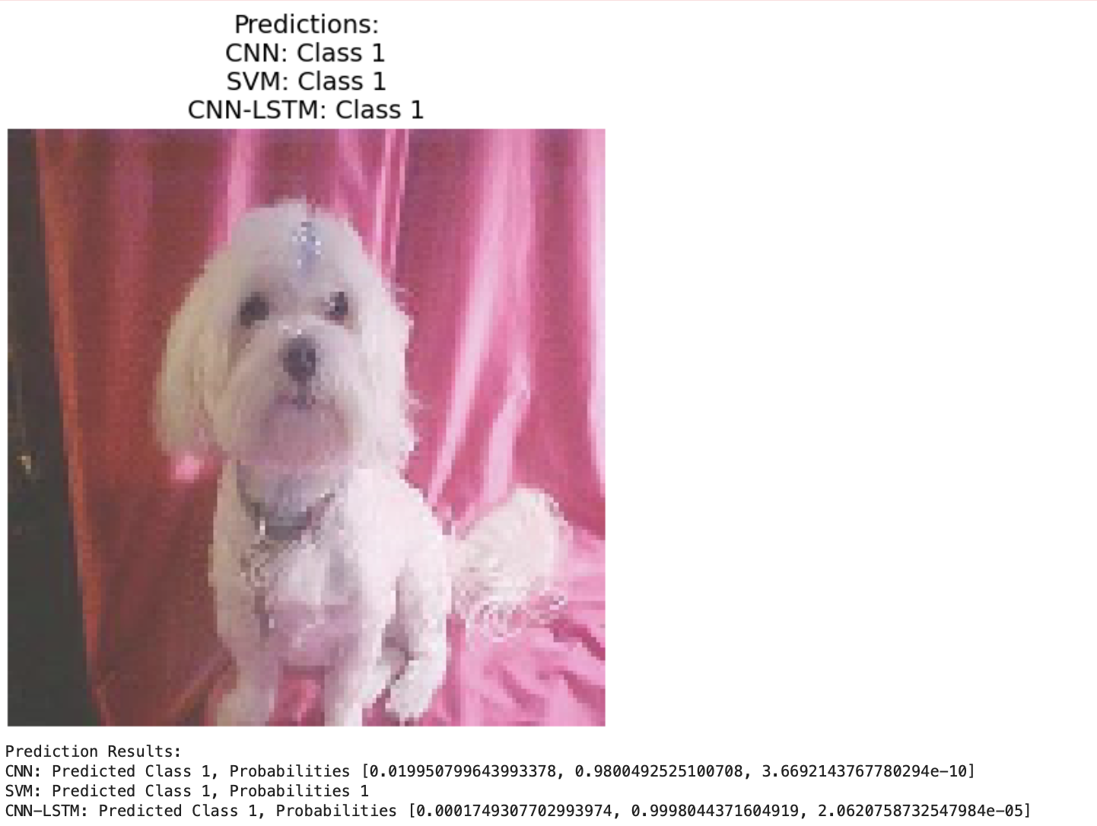
OBSERVATIONS OBTAINED AFTER BUILDING MODEL
The output of our model displays the probability of animal prediction for the respective animal images that were loaded into the model.

Slide 5
Results and Comparison
Evaluation Metrics:
Accuracy: Measure of correct predictions.
Precision, Recall, F1-Score: To evaluate performance on each class.
Comparison:
CNN achieved an accuracy of 99.33% on the test set.
CNN-LSTM outperformed with an accuracy of 97.11%.
SVM performed reasonably but had limitations due to its inability to capture spatial dependencies.
Visualization:
Accuracy comparison graph for CNN, CNN-LSTM, and SVM.
Confusion matrix showing how well each model performs on different classes.

Slide 6
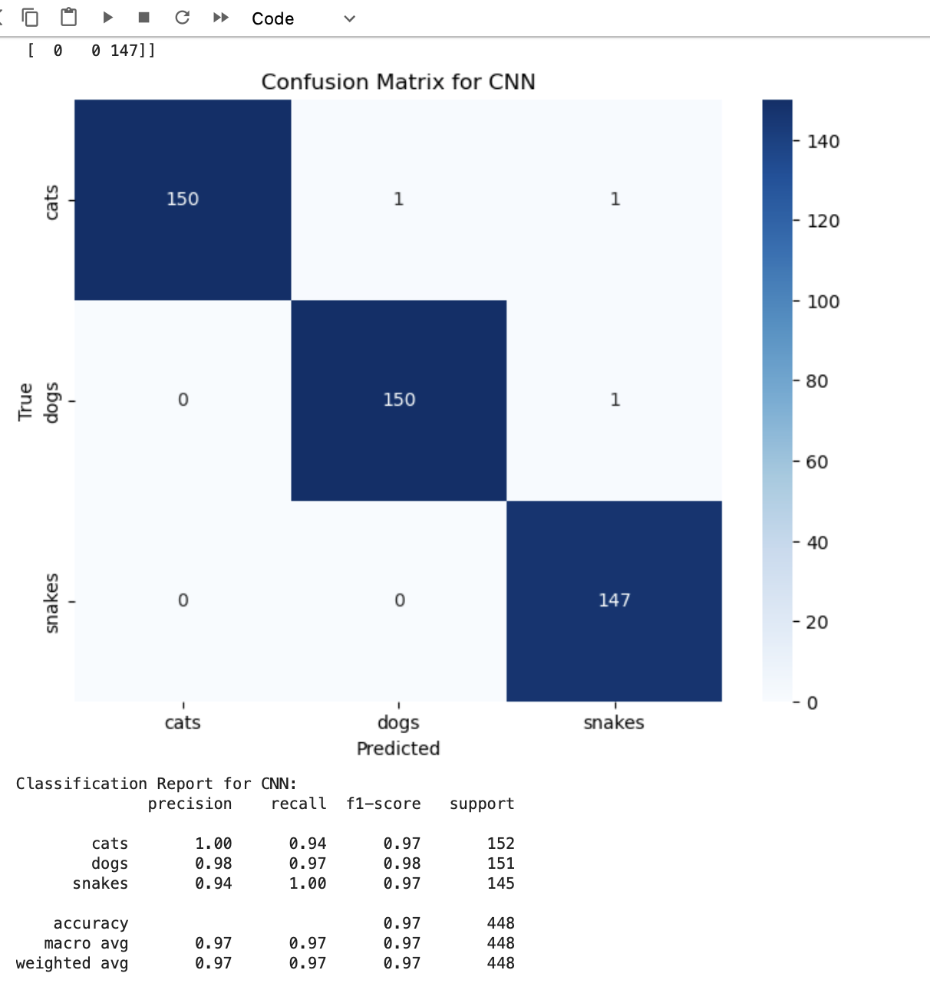
Confusion Matrix: Model Performance Visualization
CNN Confusion Matrix

Slide 7
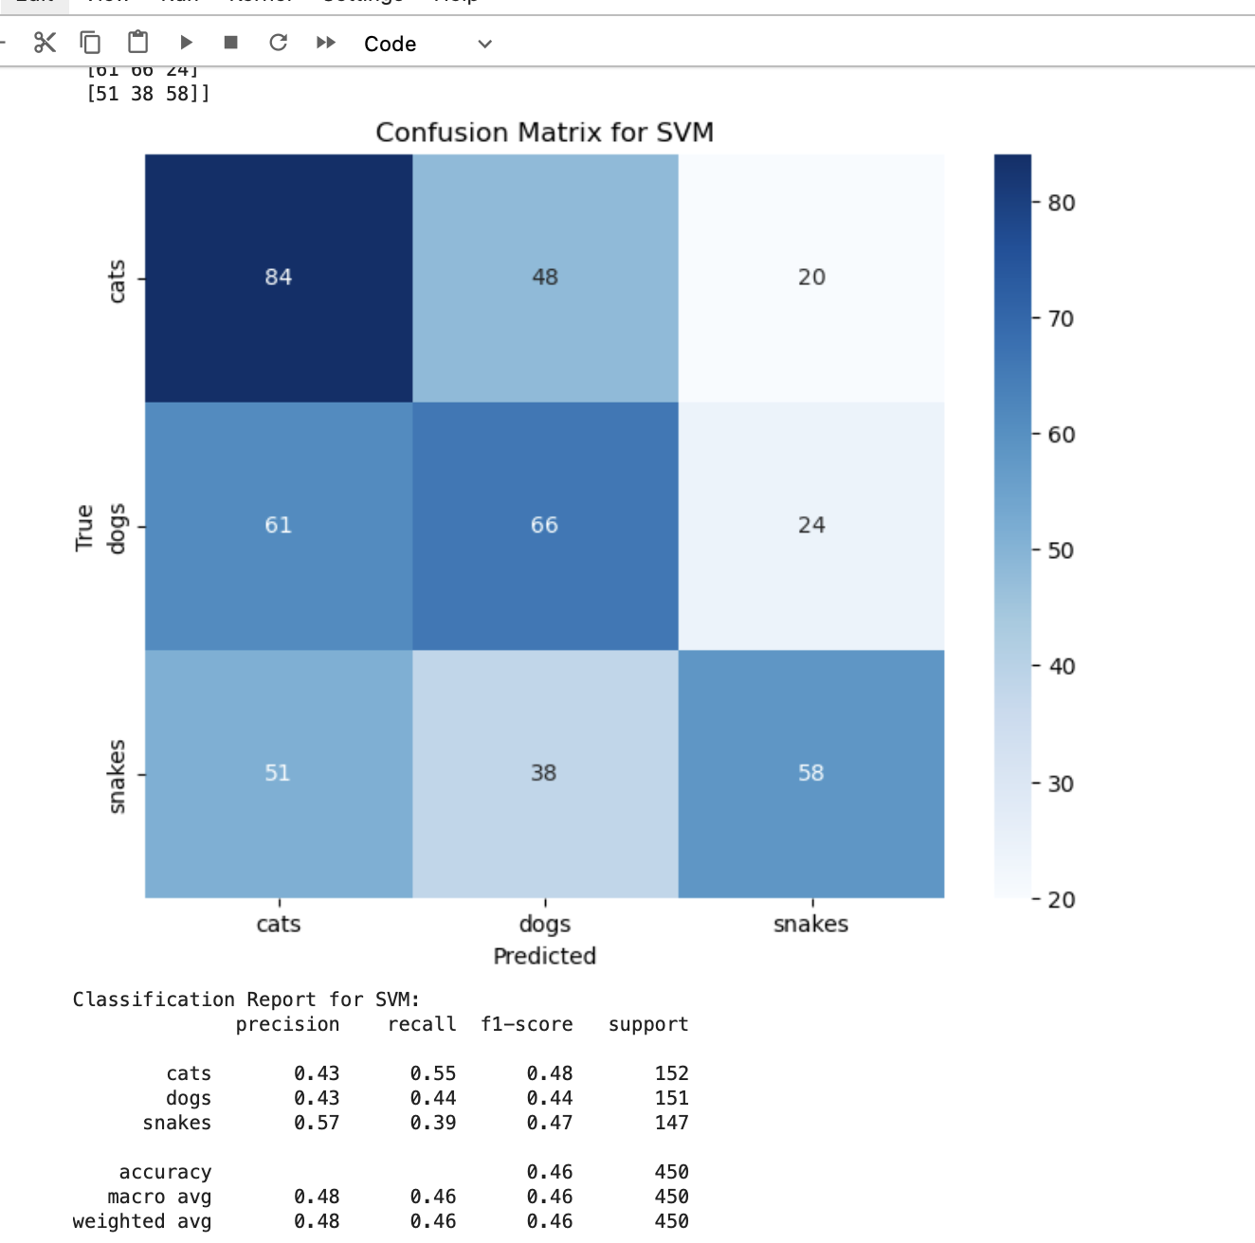
SVM CONFUSION MATRIX

Slide 8
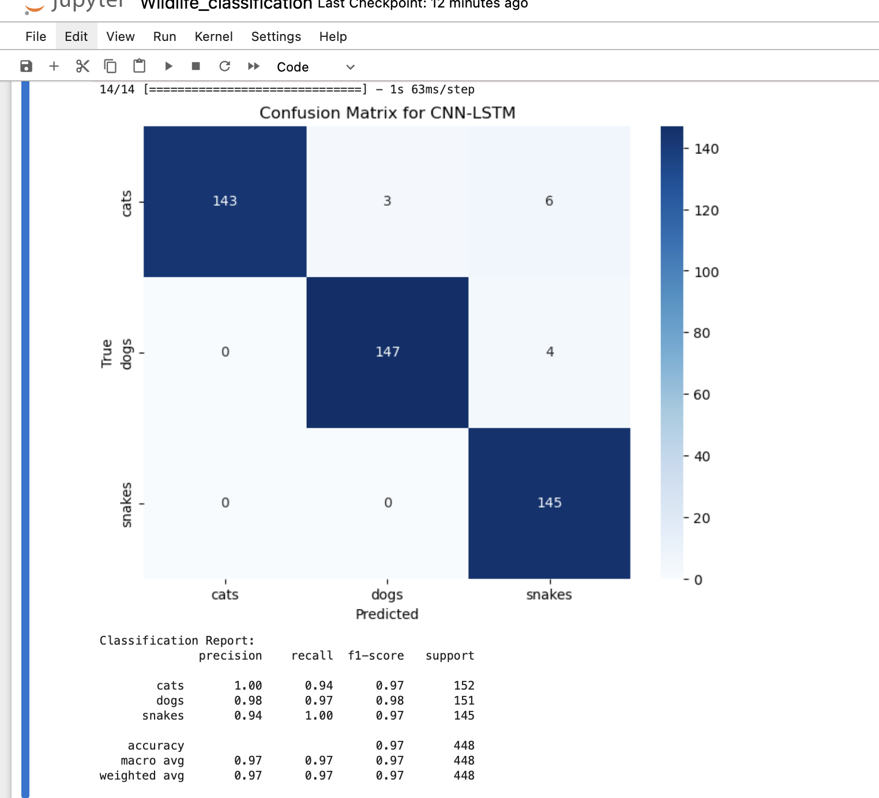
CNN-LSTM CONFUSION MATRIX

Slide 9
Conclusion
This project demonstrates how to build a multi-model image classification pipeline using CNN, SVM, and CNN-LSTM. It leverages TensorFlow and Keras for deep learning and scikit-learn for machine learning to deliver accurate and efficient classification. The models are evaluated using standard metrics like accuracy, confusion matrix, and classification report.

Slide 10
Thank you

