Slide 1

Que pasa ciudad?
Abhay Singh - 1001669333
Aditya Ravikumar - 1001672163
Phani Sree Harsha - 1001670966
Pooja Jeergyal – 1001686373
Sandhya Bhamidipati - 1001663914

Slide 2
Que pasa ciudad?- Agenda
A mobile application where a person can report any irregularity of a public service to contribute towards complaint registration for a city.
Actor: User and Admin
Features:
Google Login
Map Integration
Geolocation handling
Image upload
Bilingual
Statistics Generation

Slide 3
Motivation
To gain the proposed approach to gain information on how to handle all the requests for city maintenance.
This app could help the residents/traveler/workers of the city to communicate with the authority.
Prospective maintenance request could be:
1. Municipal Taxes 2. Economic Activity 3. Formal Employment 4. Informal Employment 5. Education 6. Electric Service 7. Environment 8. Emergency and fire response 9. Government-citizen relationship 10. Health 11. Recreation and Entertainment 12. Security 13. Public Order and Citizen Coexistence | 14. Urban planning 15. Solid waste 16. Telecommunications and innovation services 17. Roads 18. Transportation 19. Wastewater 20. Drains 21. Drinking-Water Service 22. Domestic Gas Service 23. Infrastructure 24. Housing 25. Sports 26. Culture, Traditions, and Identity

Slide 4
Problem Solved
Charts: Pie-chart-> Pure chart->svg charts
image handling-> camera roll->image-picker->FormData
State handling and navigation
Maps integration
Google login
Picker handling
database handling
Admin privileges
Authorization

Slide 5
Greatest Challenge To Solve
Integrating the statistics chart for the admin:
admin access,
passing value to pure-chart, change chart, text display,
Android display.
Integrating maps with 2 major functionality:
fetch the location,dealing with delta value
integrating markers, showing marker color, multiple marker

Slide 6
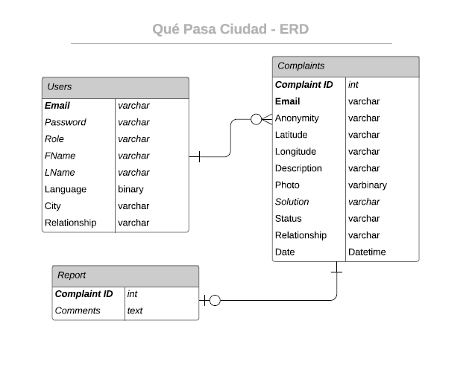
ER Diagram

Slide 7
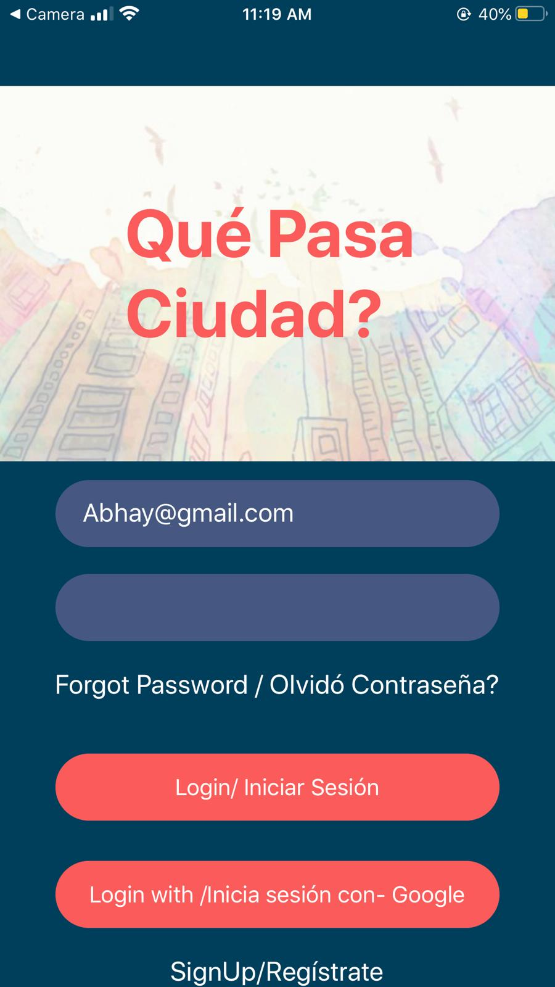
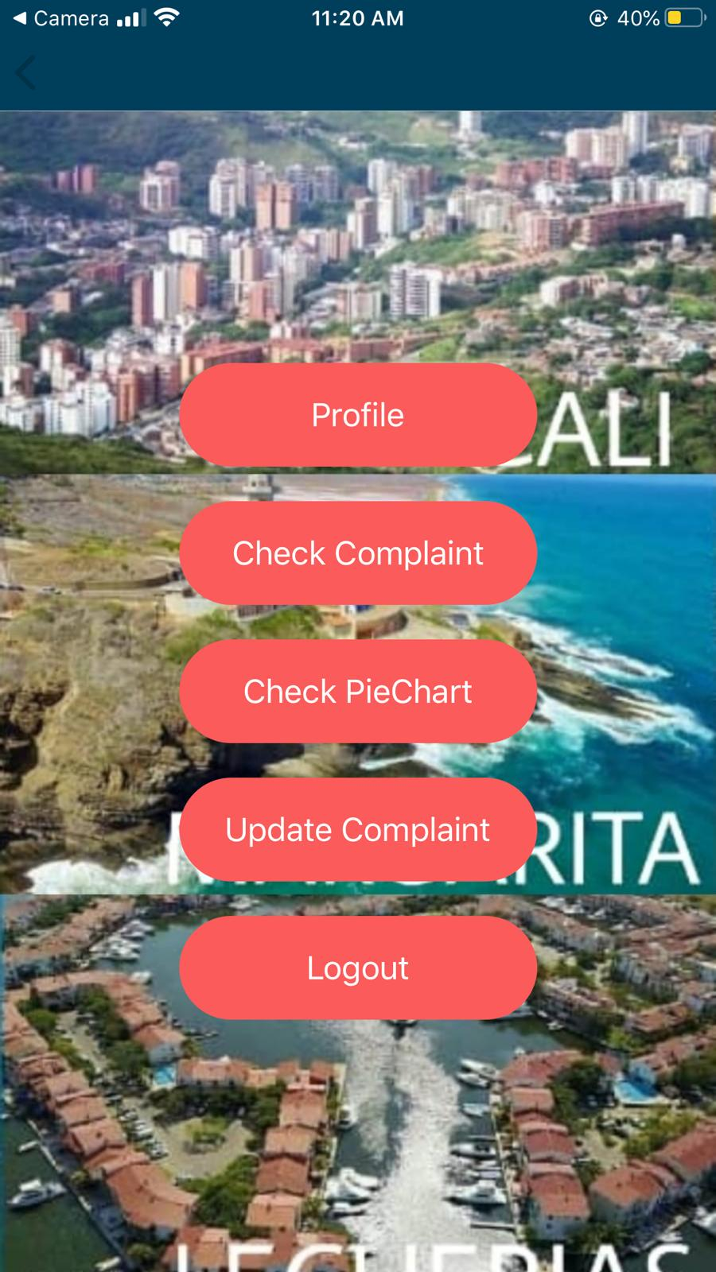
Main Screens

Slide 8
Modules
Modules worked on:
react-native
@react-navigation/native
@react-navigation/stack
react-native-maps
react-native-gesture-handler
react-native-svg
react-native-svg-charts
expo-expressions
expo-google-app-auth
expo-constants
expo-image-picker

Slide 9
Architecture
Backend (UTA Cloud)
UI
(React Native)
API
(PHP)
DATABASE (MySql)

Slide 10
Tasks
Rest Server and API- Pooja, Harsha, Abhay
Google Signin -Pooja
Map Integration- Pooja, Harsha
Geolocation handling- Pooja, Harsha
Image upload- Pooja
Bilingual- Abhay
Statistics Generation-Sandhya, Aditya, Abhay
Sign up/sign in-Pooja, Abhay, Harsha

Slide 11
Tasks
Admin privileges- Abhay
Database- Abhay, Pooja, Sandhya, Harsha
Prototype- Pooja
Video-Pooja
Documentation- Abhay, Aditya, Sandhya
UI and UX- Abhay, Harsha, Aditya, Sandhya
FTP- Pooja

Slide 12
Source Code & Video Link
Source Code:
Link: https://github.com/harshapps/What-s-up-city
Video Link:
Admin Profile: https://youtu.be/Z5I17HhYrOQ
User Profile: https://youtu.be/fTqkqj8DB_I

Slide 13
Prototypes
User Spanish : https://marvelapp.com/10e26d7e/screen/69121500
User English : https://marvelapp.com/10e26d7e/screen/69066417
Admin Spanish: https://marvelapp.com/10e26d7e/screen/69123625
Admin English: https://marvelapp.com/10e26d7e/screen/69124698

Slide 14
Teams Meeting Minutes
We did around 2 meetings/per week.
We spent around 2 hrs/ meeting.

Slide 15
Future Enhancements
Multiple image loader.
Enhanced UI.
Facebook Login.
Hamburger Menu.
Multiple languages.
Strong Feedback support.
Enhanced Admin functionality

Slide 16

Thank you.
Questions?

