Slide 1
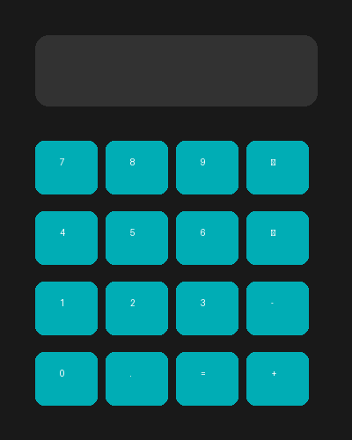
Introduction POOJA’ SMART CALCULATOR
This project is a Scientific Calculator developed using Python Tkinter GUI library.
It performs basic and scientific calculations with a modern interface.

Slide 2
Project Overview
• GUI Based Scientific Calculator
• Developed using Python &
CustomTkinter
• Supports Standard & Scientific
Calculations
• Modern Dark Theme UI

Slide 3
Import Section
• Python Programming
Language
• CustomTkinter Library
• Math Module
• Time Module

Slide 4
Main Features
• DEG/RAD Mode Toggle
• Live Digital Clock
• Scientific Functions
• Keyboard Support
• Safe Expression
Evaluation

Slide 5
User Interface Design
• Dark Theme Modern Design
• Tabbed Layout
(Standard & Scientific)
• Responsive Button Grid
• Stylish Display Panel

Slide 6
Scientific Functions
• sin, cos, tan
• log & square root
• Factorial Function
• Power Functions (x², x³, x^y)
• π and e Constants

Slide 7
Program Logic
Button Click Handling
Keyboard Event Handling
Safe eval() Execution
Error Handling for Invalid
Inputs

Slide 8
Conclusion
• Easy to Use Interface
• Professional Scientific
Calculator
• Fast & Accurate Calculations
• Modern Python GUI Project
▶ Run App
root.mainloop()

Slide 9
THANKYOU!

