Slide 1
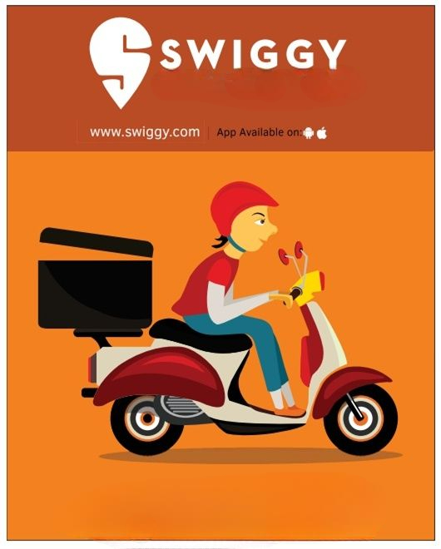
Swiggy
Analytics
BY Pooja Kasar

Slide 2




Project Summary
Objective: To analyze Swiggy’s restaurant, customer, and delivery partner data in order to evaluate operational performance and identify improvements in customer experience, delivery efficiency, and overall business growth.
Data Used: The dataset consists of Swiggy order and operational data collected from 5 restaurant locations—Delhi, Noida, Gurgaon, , Faridabad, and Ghaziabad. The data covers the period from 2024 to 2025 and includes customer details, order transactions, menu information, and delivery partner performance record.
Tools Used:
Key Features of the Dashboard:
Interactive filters [ Filters by location, restaurant, customer type, delivery partner, order status, and cuisine category for drill-down analysis.]
KPIs displayed: [Total Orders, Total Revenue, Total Customers, Active Delivery Agents, Average Delivery Time, Top Food Categories, Top Performing Restaurants etc.]
Visuals used: [Bar chart, Column Chart, Line, Graph, Map, pie Chart etc.]
Outcome: To help Swiggy and restaurant management identify current ordering trends and operational gaps, enabling improvements in customer experience, delivery efficiency, and overall service performance.

Slide 3
KPI List - Key performance indicators and their business relevance
1. Total Orders – Shows the overall number of orders placed across all locations.
2. Total Revenue – Measures total earnings generated from all completed orders.
3. Average Order Value (AOV) – Indicates the average amount spent per order.
4. Customer Retention Rate – Tracks how many customers return to place repeat orders.
5. New vs Returning Customers – Compares first-time customers with repeat users.
6. On-Time Delivery % – Measures how many orders were delivered within the expected time.
7. Average Delivery Time – Shows the average time taken to deliver an order.
8. Order Cancellation Rate – Percentage of orders cancelled due to delay, customer reason, or restaurant issue.
9. Restaurant Rating – Average rating given to restaurants based on customer feedback.
10. Top-Selling Items – Identifies menu items with the highest sales.
11. Delivery Partner Performance Score – Evaluates partner efficiency based on delivery time and customer rating.
12. Location-wise Revenue – Shows revenue contribution from each city (Delhi, Noida, Gurgaon, Faridabad, Ghaziabad).

Slide 4
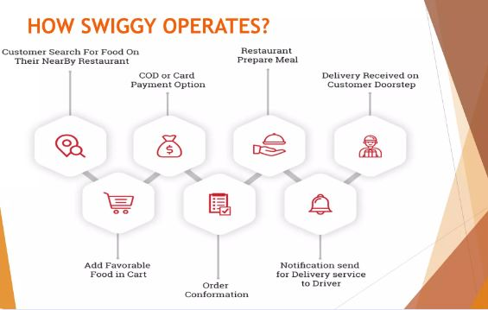

Slide 5
What did in Excel
Data Collection & Preparation
Data Analysis & Visualization
Collected order, customer, restaurant, and delivery partner data from Swiggy datasets for 2024–2025 across locations: Delhi, Noida, Gurgaon, Faridabad, and Ghaziabad.
Performed initial cleaning by removing duplicates, handling missing values, correcting date/time formats, and standardizing dataset fields.
Used Excel formulas and pivot tables to summarize raw data such as total orders, revenue, customer counts, and delivery performance metrics.
Analyzed key metrics such as order trends, customer segments, restaurant performance, and delivery timings.
Created charts to visualize top-selling items, peak order hours, location-wise demand, and cancellation patterns.
Identified preliminary patterns and insights to support deeper analysis in SQL, Power BI, and Tableau..

Slide 6
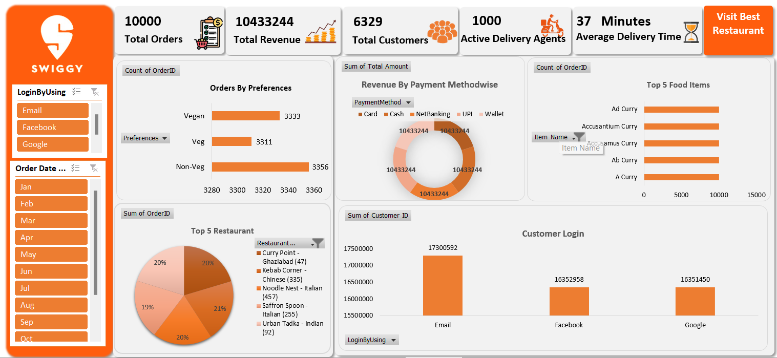
Excel Dashboard 1

Slide 7
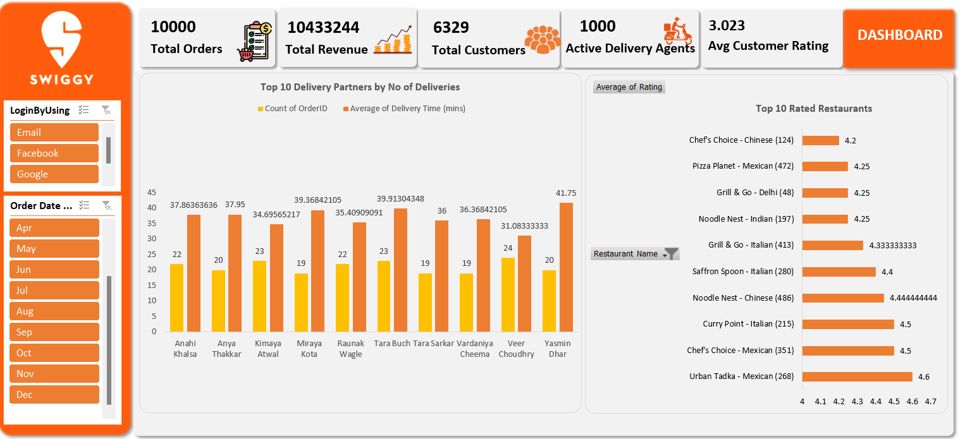
Excel Dashboard 2

Slide 8
Data Visualization & Insights (Tableau)
Connected Swiggy datasets to Tableau for detailed visual analysis of orders, customers, restaurants, and delivery partners.
Built dashboards showing restaurant performance, location-wise order trends, and customer behavior patterns.
Combined data from multiple sources (orders, menu, customers, delivery agents) for real-time, comprehensive analysis.
Calculated Fields has been Created to custom metrics and KPIs without needing extensive coding.

Slide 9
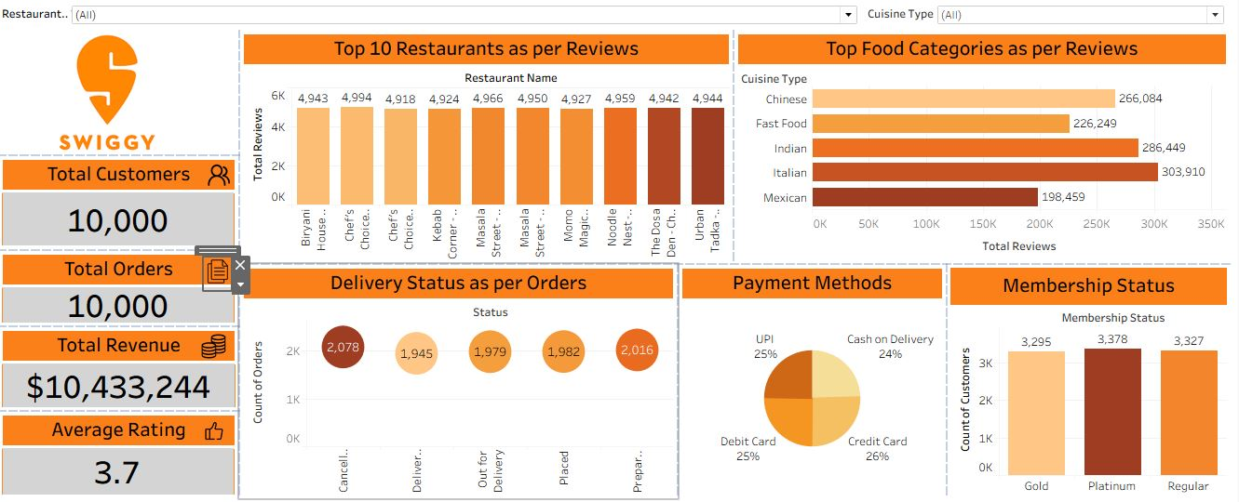
Tableau Dashboard

Slide 10
Data Retrieval & Management (SQL)
Used SQL queries to efficiently extract and analyze large datasets.
SQL streamlined data management and enabled complex analyses.
Data Validation to ensures data integrity by enforcing constraints and validation rules directly in the database.
Imported and structured raw Swiggy datasets into SQL tables for customers, orders, menu, and delivery partners.
SQL queries using joins, aggregations, subqueries, and window functions to extract meaningful insights.
Aggregations & Grouping to perform aggregations such as SUM, AVG, COUNT with GROUP BY clauses to summarize the datasets.

Slide 11
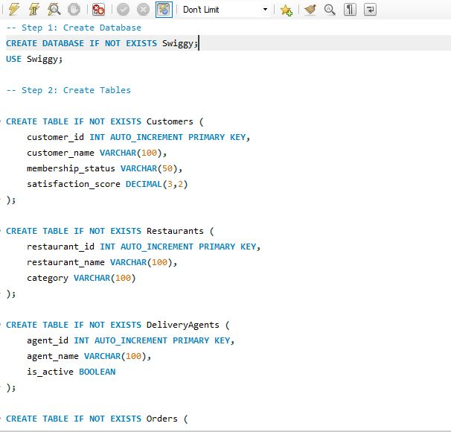
SQL Query Image

Slide 12
Advanced Visualization (Power BI)
Imported cleaned data into Power BI for interactive dashboards.
Dashboards included filters for location, Months, and Orders by Source, providing dynamic insights.
Designed KPIs such as Total Orders, Revenue, AOV, Delivery Time, Cancellation %, and Customer Satisfaction.
Used Data Analysis Expressions (DAX) to create complex calculated columns and measures for advanced analytics.
Enabled drill-down visuals for location-wise demand, peak order hours, and revenue trends.

Slide 13
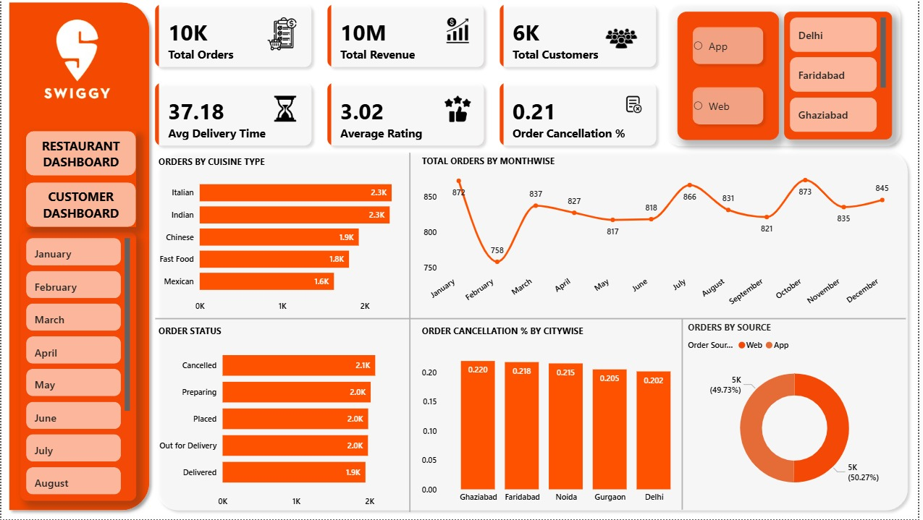
Power BI Dashboard 1

Slide 14
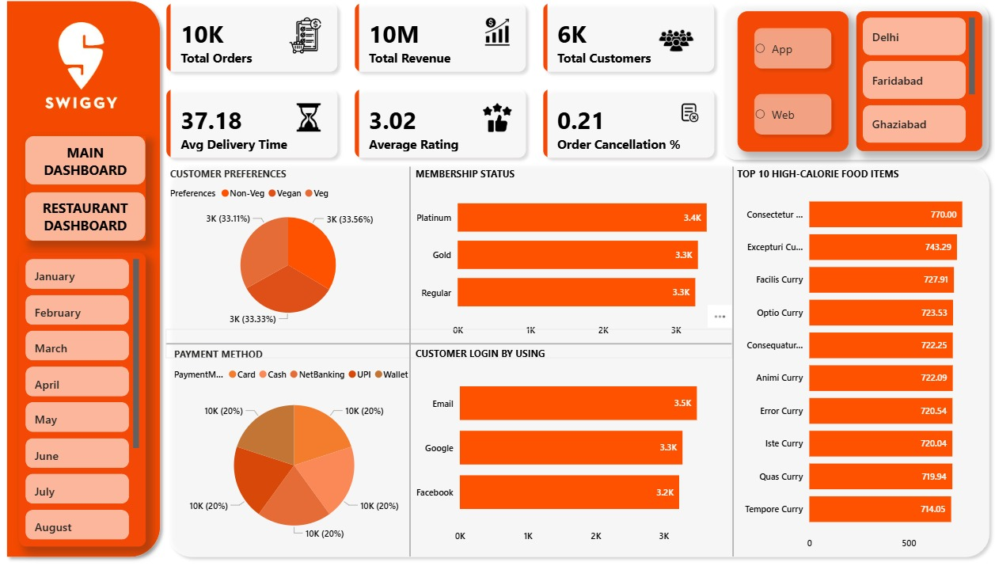
Power BI Dashboard 2

Slide 15
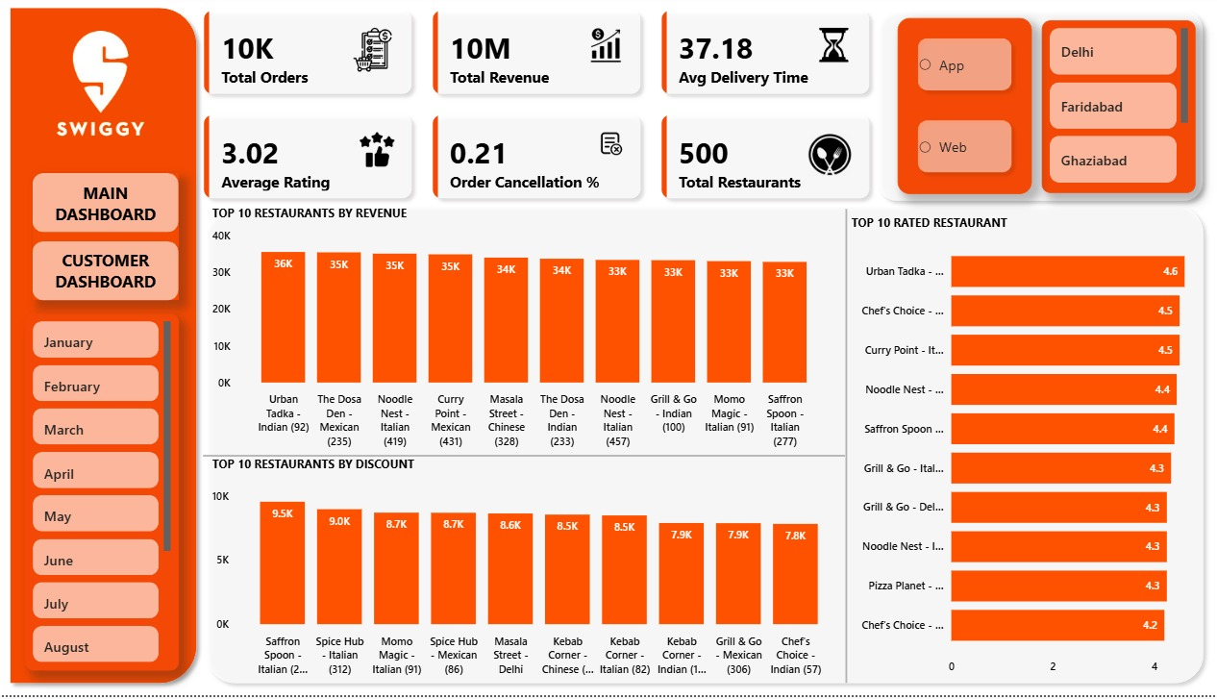
Power BI Dashboard 3

Slide 16
Thank You😊

