Slide 1
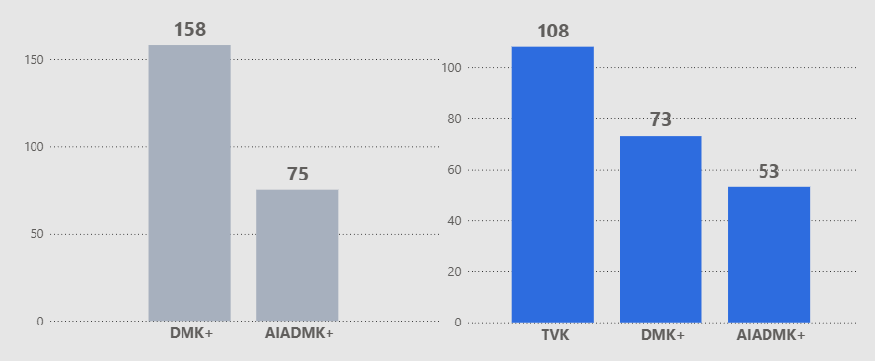
Atliq Media
The Constituencies behind Tamil Nadu 2026 Verdict
234
Assembly Seats
118
Majority Mark
3873
Candidate Count (Down from 3885 in 2021)
The 2026 landscape moved from a traditional bipolar contest between DMK+ and AIADMK+ to a tri-polar environment with the significant entry of TVK
Aggregate Seat Count of Alliances
Editorial Recommendation
Focus the opening of the show on the transition to a tri-polar electoral landscape to set the stage for the statewide shift
This sets the foundation to examine exactly where these new power centers emerged on a regional level
2021
2026
Notes:
Assets:
https://www.freepik.com/free-vector/third-party-logistics-3pl-transport-cargo-export-import_4997379.htm
https://www.freepik.com/free-vector/isometric-line-font-halftone-alphabet-letters_3685415.htm
https://www.freepik.com/free-vector/marketing-e-commerce-data-analysis-tool-isometric-web-banner_4997371.htm
https://www.freepik.com/free-vector/future-smart-technology-smartphone-with-application-self-driving-auto-screen_4997377.htm
https://www.freepik.com/free-vector/finances-isometric-horizontal-web-banner_3824488.htm
https://www.freepik.com/free-vector/fueling-gasoline-diesel-isometric-web-banner-fuel-nozzle-hose-droplet-gas_3586082.htm
https://www.freepik.com/free-vector/fueling-gas-gasoline-diesel-station-isometric-web-banner_4997387.htm
https://www.freepik.com/free-vector/business-partnership-line-art-isometric-banner-corporate-principles-business-team_3685465.htm

Slide 2
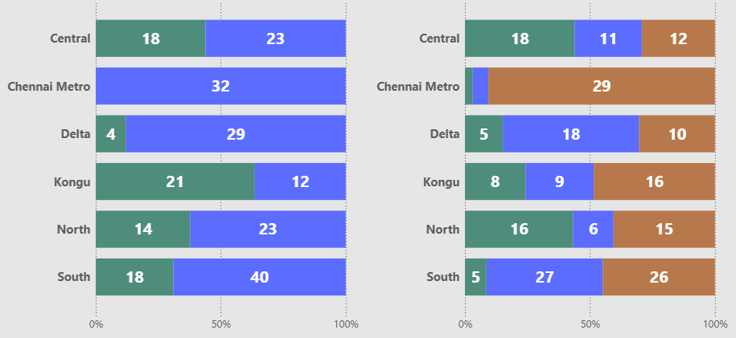
Atliq Media
The Regional Battlegrounds – Mapping 2026 Realignments
2021 Regional Seat Distribution
2026 Regional Seat Distribution
The Most Competitive – Three-way splits evenly distribute vote power
The biggest shift – Visual delta between 2021 and 2026 is most extreme
DMK+
AIADMK+
TVK
Editorial Recommendation
Utilize regional data comparisons to provide geographic context for the shifting seat distribution across alliances
This regional view leads into a deeper look at where established strongholds began to erode
Notes:
Assets:
https://www.freepik.com/free-vector/third-party-logistics-3pl-transport-cargo-export-import_4997379.htm
https://www.freepik.com/free-vector/isometric-line-font-halftone-alphabet-letters_3685415.htm
https://www.freepik.com/free-vector/marketing-e-commerce-data-analysis-tool-isometric-web-banner_4997371.htm
https://www.freepik.com/free-vector/future-smart-technology-smartphone-with-application-self-driving-auto-screen_4997377.htm
https://www.freepik.com/free-vector/finances-isometric-horizontal-web-banner_3824488.htm
https://www.freepik.com/free-vector/fueling-gasoline-diesel-isometric-web-banner-fuel-nozzle-hose-droplet-gas_3586082.htm
https://www.freepik.com/free-vector/fueling-gas-gasoline-diesel-station-isometric-web-banner_4997387.htm
https://www.freepik.com/free-vector/business-partnership-line-art-isometric-banner-corporate-principles-business-team_3685465.htm

Slide 3
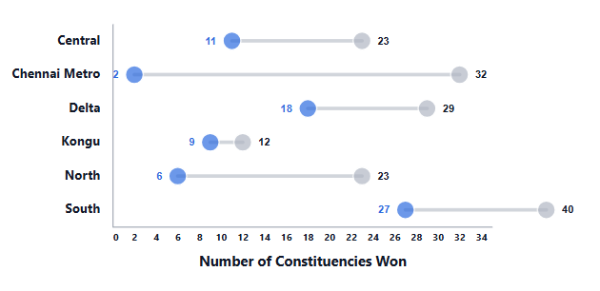
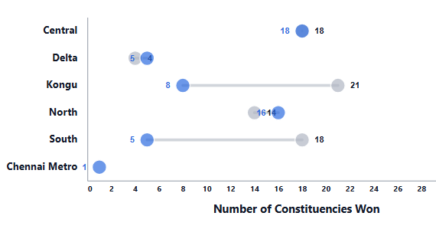
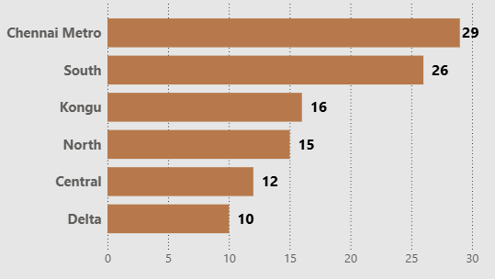
Atliq Media
Regional Seat Erosion in Strongholds
2026
2021
DMK+
AIADMK+
Dropped from 32 to 2 seats in 2026
Dropped from 21 to 8 seats
TVK’s Emergence in 2026
Editorial Recommendation
Position significant seat erosions (e.g Chennai Metro) as the primary editorial hook for the broadcast
After seeing where seats were lost, we will now look at exactly which parties those seats shifted toward
Notes:
Assets:
https://www.freepik.com/free-vector/third-party-logistics-3pl-transport-cargo-export-import_4997379.htm
https://www.freepik.com/free-vector/isometric-line-font-halftone-alphabet-letters_3685415.htm
https://www.freepik.com/free-vector/marketing-e-commerce-data-analysis-tool-isometric-web-banner_4997371.htm
https://www.freepik.com/free-vector/future-smart-technology-smartphone-with-application-self-driving-auto-screen_4997377.htm
https://www.freepik.com/free-vector/finances-isometric-horizontal-web-banner_3824488.htm
https://www.freepik.com/free-vector/fueling-gasoline-diesel-isometric-web-banner-fuel-nozzle-hose-droplet-gas_3586082.htm
https://www.freepik.com/free-vector/fueling-gas-gasoline-diesel-station-isometric-web-banner_4997387.htm
https://www.freepik.com/free-vector/business-partnership-line-art-isometric-banner-corporate-principles-business-team_3685465.htm

Slide 4
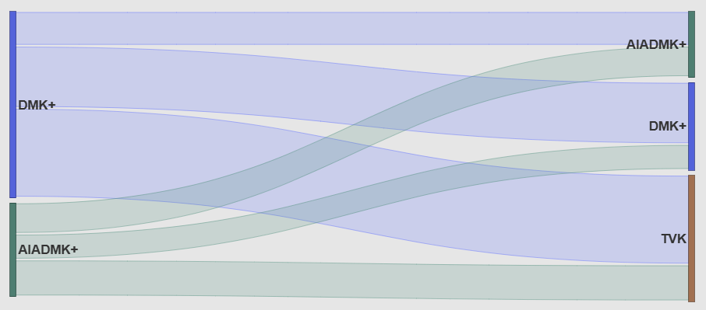
Atliq Media
The Great Flip: Flow of Political Power
28
25
53
2021 Winners
78
2026 Winners
20
30
A large-scale redistribution occurred as seats previously held by DMK+ and AIADMK+ shifted toward TVK
This flow of power indicates that the 2026 verdict was not just a marginal change but a major realignment
Editorial Recommendation
Focus on the structural shift between alliances to show the scale of the state's new tri-polar realignment
This party-level movement sets the stage for our next look at the specific location where these shifts actually happened
Notes:
Assets:
https://www.freepik.com/free-vector/third-party-logistics-3pl-transport-cargo-export-import_4997379.htm
https://www.freepik.com/free-vector/isometric-line-font-halftone-alphabet-letters_3685415.htm
https://www.freepik.com/free-vector/marketing-e-commerce-data-analysis-tool-isometric-web-banner_4997371.htm
https://www.freepik.com/free-vector/future-smart-technology-smartphone-with-application-self-driving-auto-screen_4997377.htm
https://www.freepik.com/free-vector/finances-isometric-horizontal-web-banner_3824488.htm
https://www.freepik.com/free-vector/fueling-gasoline-diesel-isometric-web-banner-fuel-nozzle-hose-droplet-gas_3586082.htm
https://www.freepik.com/free-vector/fueling-gas-gasoline-diesel-station-isometric-web-banner_4997387.htm
https://www.freepik.com/free-vector/business-partnership-line-art-isometric-banner-corporate-principles-business-team_3685465.htm

Slide 5
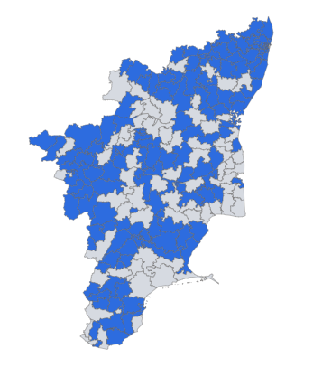
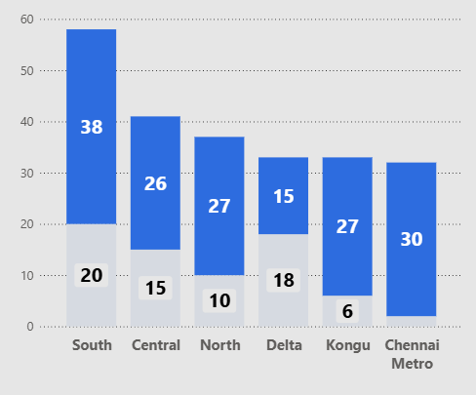
Atliq Media
A New Map: See Which Constituencies Voted Differently
Flipped Constituencies
Region-wise Flips
163
Total Flipped Constituencies
(69.7%)
The geographic map of Tamil Nadu has been redrawn, with massive redistribution of political control across most districts
The South region recorded the highest count of flipped constituencies in the state
No. Constituencies
Flipped
Not Flipped
Editorial Recommendation
Feature a 'Constituency Spotlight' on the most high-impact seat transfers identified in the data. Transition from statewide aggregate statistics to specific high-flip districts to maintain viewer engagement.
With so many seats changing hands, we must next examine the intensity and closeness of these races
Notes:
Assets:
https://www.freepik.com/free-vector/third-party-logistics-3pl-transport-cargo-export-import_4997379.htm
https://www.freepik.com/free-vector/isometric-line-font-halftone-alphabet-letters_3685415.htm
https://www.freepik.com/free-vector/marketing-e-commerce-data-analysis-tool-isometric-web-banner_4997371.htm
https://www.freepik.com/free-vector/future-smart-technology-smartphone-with-application-self-driving-auto-screen_4997377.htm
https://www.freepik.com/free-vector/finances-isometric-horizontal-web-banner_3824488.htm
https://www.freepik.com/free-vector/fueling-gasoline-diesel-isometric-web-banner-fuel-nozzle-hose-droplet-gas_3586082.htm
https://www.freepik.com/free-vector/fueling-gas-gasoline-diesel-station-isometric-web-banner_4997387.htm
https://www.freepik.com/free-vector/business-partnership-line-art-isometric-banner-corporate-principles-business-team_3685465.htm

Slide 6
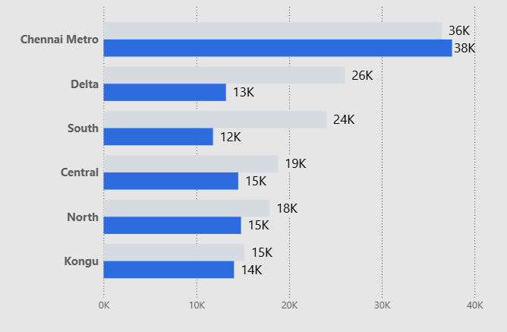
Atliq Media
Close Races: Narrowing Gap Between Winners and Losers
Average Margin
The exception - slight increase in margin
Most dramatic compression of victory margins
Across almost all regions, the buffer between victory and defeat shrank dramatically, signaling highly contested, multi-cornered fights
Editorial Recommendation
Feature a segment on the Delta and South regions to show how collapsed margins ended the "safe seat" era
The thin margins are a direct result of how the vote share was divided, which is our next focus.
2026
2021
22871
16784
Average Margin in 2021
Average Margin in 2026
(26%)
Notes:
Assets:
https://www.freepik.com/free-vector/third-party-logistics-3pl-transport-cargo-export-import_4997379.htm
https://www.freepik.com/free-vector/isometric-line-font-halftone-alphabet-letters_3685415.htm
https://www.freepik.com/free-vector/marketing-e-commerce-data-analysis-tool-isometric-web-banner_4997371.htm
https://www.freepik.com/free-vector/future-smart-technology-smartphone-with-application-self-driving-auto-screen_4997377.htm
https://www.freepik.com/free-vector/finances-isometric-horizontal-web-banner_3824488.htm
https://www.freepik.com/free-vector/fueling-gasoline-diesel-isometric-web-banner-fuel-nozzle-hose-droplet-gas_3586082.htm
https://www.freepik.com/free-vector/fueling-gas-gasoline-diesel-station-isometric-web-banner_4997387.htm
https://www.freepik.com/free-vector/business-partnership-line-art-isometric-banner-corporate-principles-business-team_3685465.htm

Slide 7
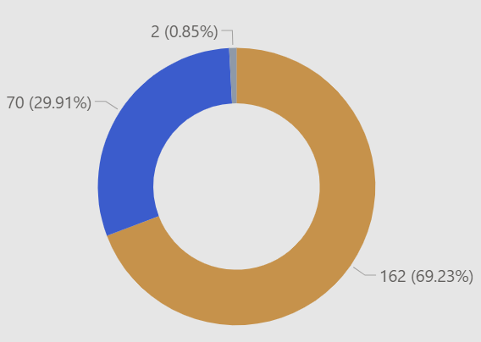
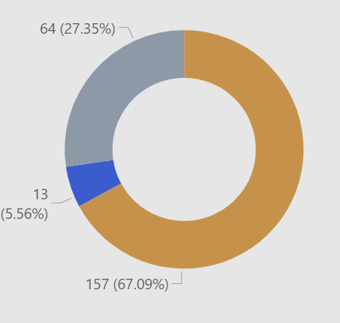
Atliq Media
Era of Fractured Mandates – Vote Share Compression
2021 Mandate Strength
2026 Mandate Strength
The Triangular Contest Effect
Winners secured > 50% vote share
35–50%
<35%
Not only did seats flip, but they were won with lower vote shares. The 50 percent mandate has ruptured
Editorial Recommendation
Launch a 'Fragmented Verdict' segment that specifically spotlights the 64 constituencies where winners secured less than 35% of the vote. Contrast this surge (up from only 2 such seats in 2021) with the collapse of 'Decisive Mandates'—showing that seats won with over 50% vote share plummeted from 70 to just 13
Notes:
Assets:
https://www.freepik.com/free-vector/third-party-logistics-3pl-transport-cargo-export-import_4997379.htm
https://www.freepik.com/free-vector/isometric-line-font-halftone-alphabet-letters_3685415.htm
https://www.freepik.com/free-vector/marketing-e-commerce-data-analysis-tool-isometric-web-banner_4997371.htm
https://www.freepik.com/free-vector/future-smart-technology-smartphone-with-application-self-driving-auto-screen_4997377.htm
https://www.freepik.com/free-vector/finances-isometric-horizontal-web-banner_3824488.htm
https://www.freepik.com/free-vector/fueling-gasoline-diesel-isometric-web-banner-fuel-nozzle-hose-droplet-gas_3586082.htm
https://www.freepik.com/free-vector/fueling-gas-gasoline-diesel-station-isometric-web-banner_4997387.htm
https://www.freepik.com/free-vector/business-partnership-line-art-isometric-banner-corporate-principles-business-team_3685465.htm

Slide 8
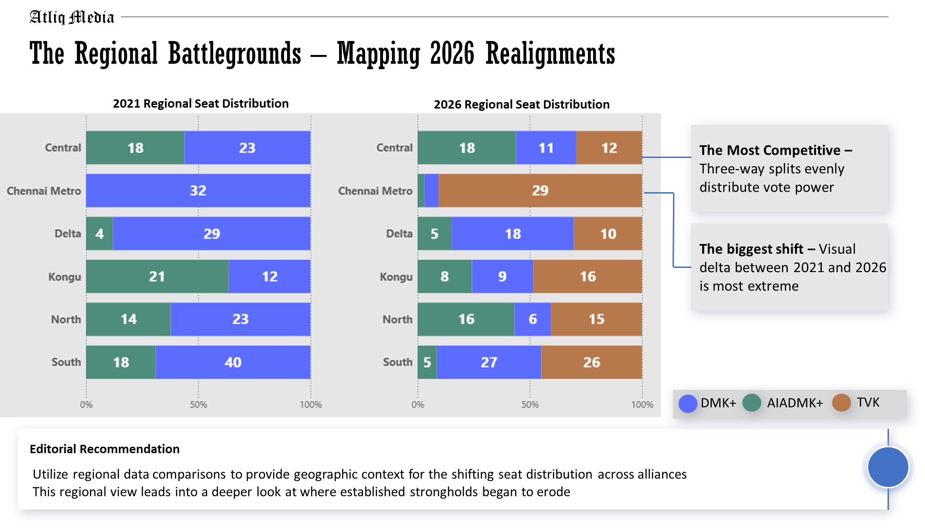
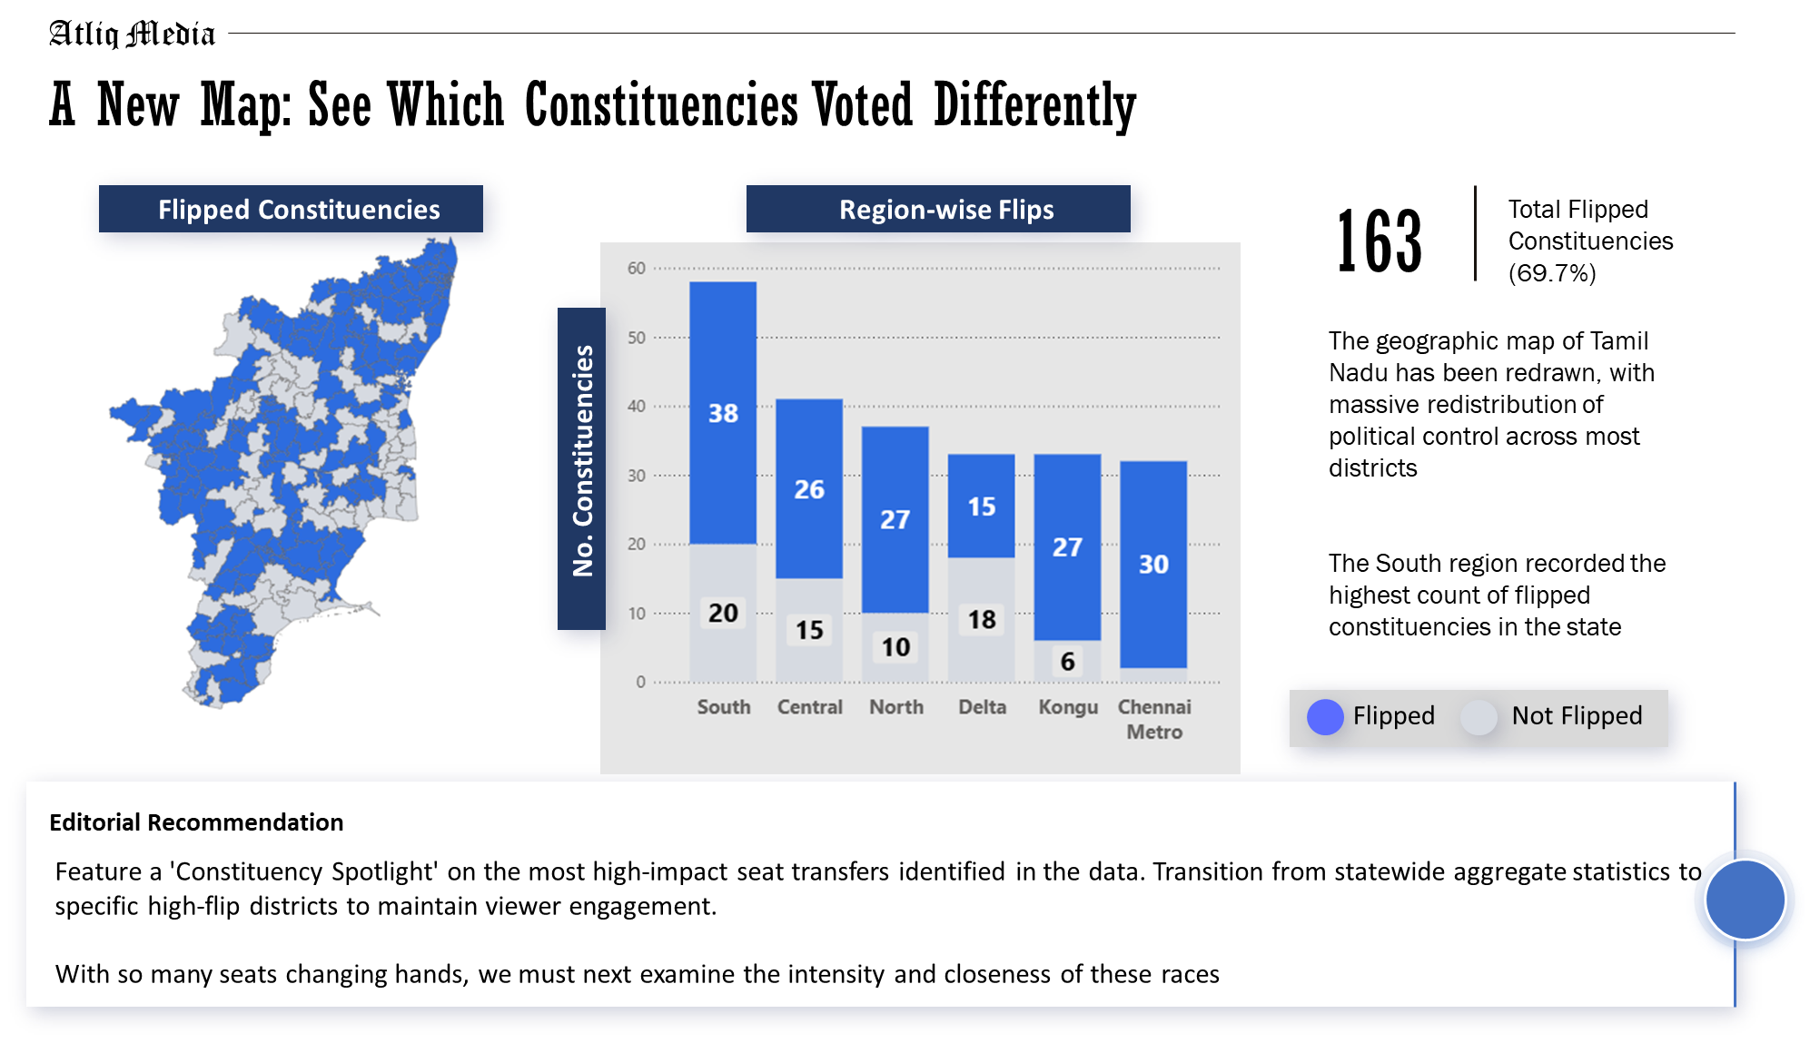
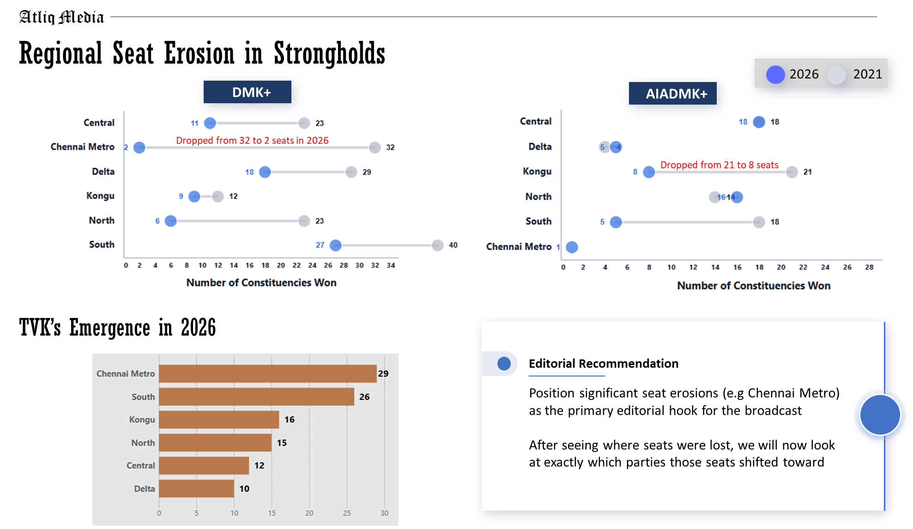
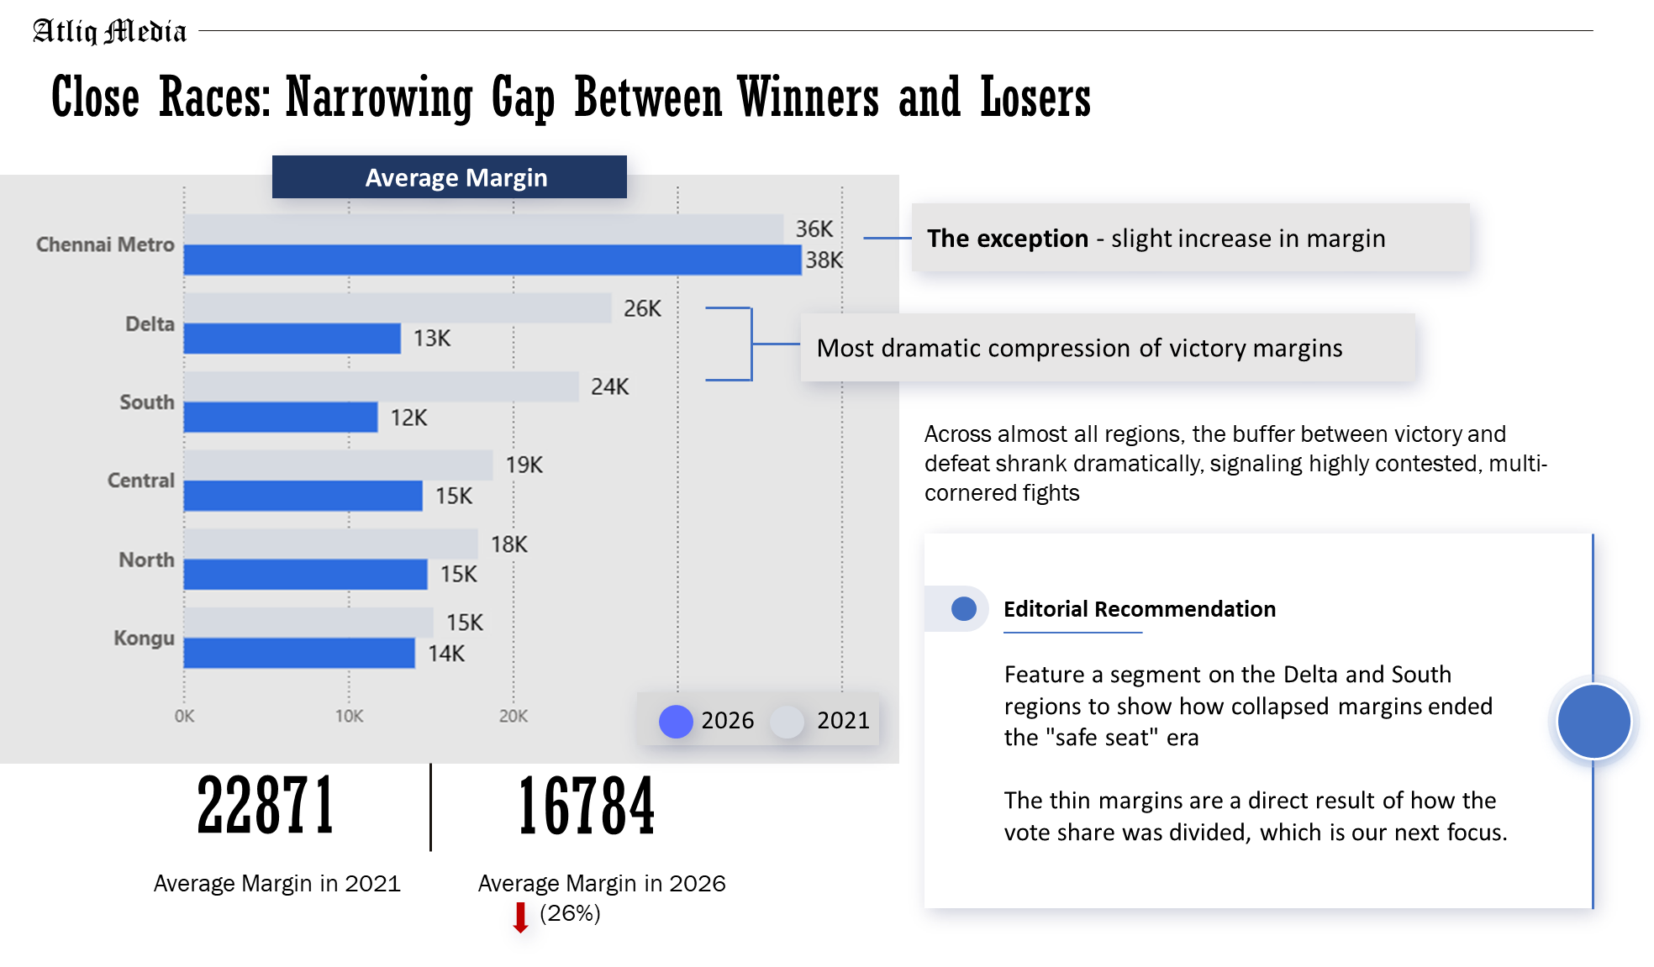
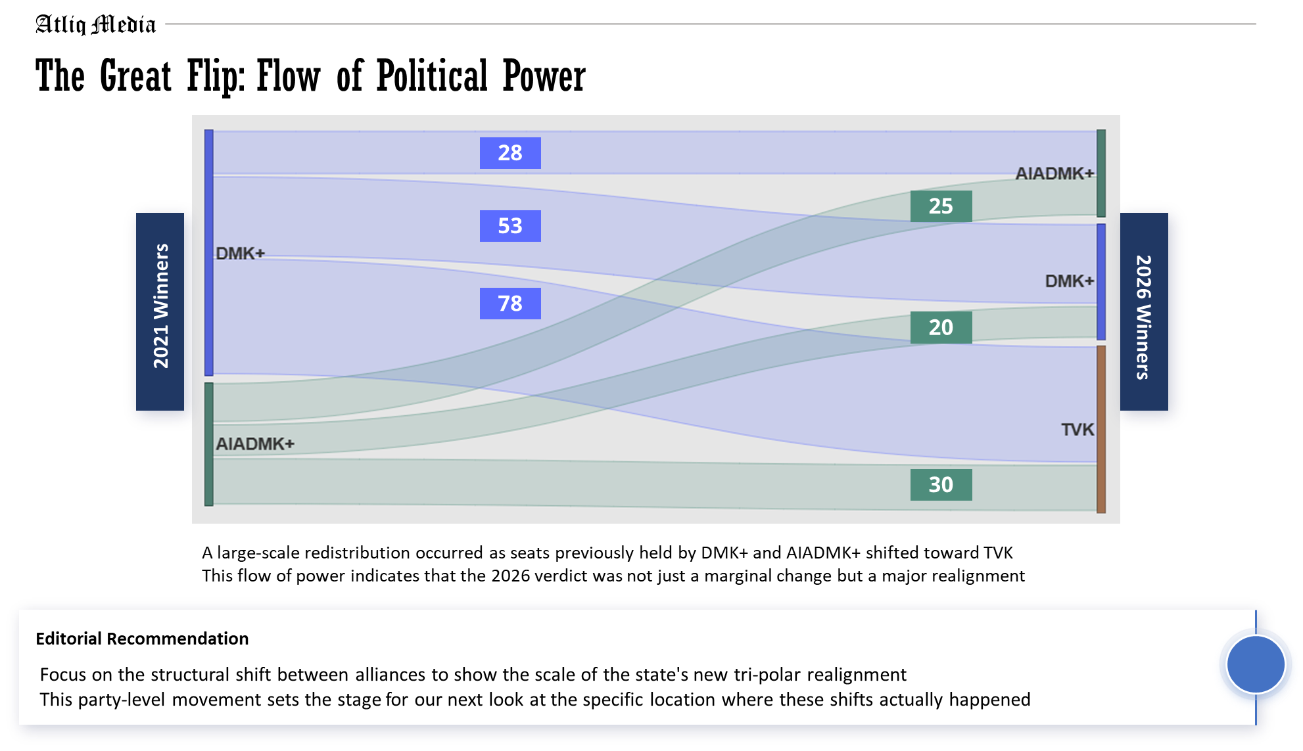
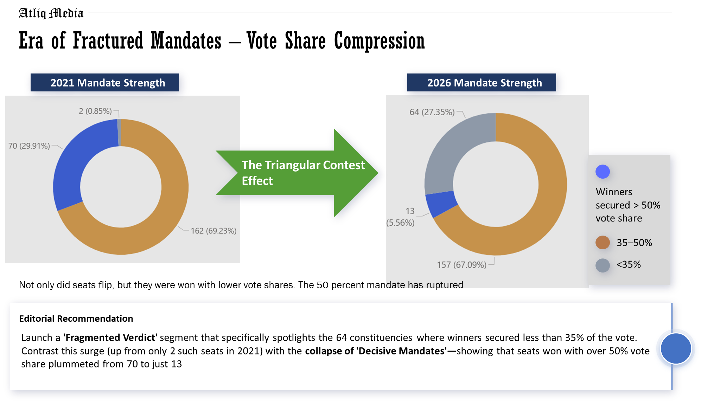
Atliq Media
Storytelling Flow
Growing multi-party competition fragmented vote shares
Fragmentation contributed to narrower victory margins
Tighter contests led to more constituency-level winner changes
Which parties are now leading in each of the six different parts of the state?
Which specific towns and districts changed their minds and flipped to a different party?
Where did the big parties lose their "safe" areas?
How close were the races?
How many seats "flowed" away from the old alliances and into the new one?
Did the winners get a clear majority, or was the vote split too many ways?
Notes:
Assets:
https://www.freepik.com/free-vector/third-party-logistics-3pl-transport-cargo-export-import_4997379.htm
https://www.freepik.com/free-vector/isometric-line-font-halftone-alphabet-letters_3685415.htm
https://www.freepik.com/free-vector/marketing-e-commerce-data-analysis-tool-isometric-web-banner_4997371.htm
https://www.freepik.com/free-vector/future-smart-technology-smartphone-with-application-self-driving-auto-screen_4997377.htm
https://www.freepik.com/free-vector/finances-isometric-horizontal-web-banner_3824488.htm
https://www.freepik.com/free-vector/fueling-gasoline-diesel-isometric-web-banner-fuel-nozzle-hose-droplet-gas_3586082.htm
https://www.freepik.com/free-vector/fueling-gas-gasoline-diesel-station-isometric-web-banner_4997387.htm
https://www.freepik.com/free-vector/business-partnership-line-art-isometric-banner-corporate-principles-business-team_3685465.htm

Slide 9
Atliq Media
Unassailable, fact-based journalism serves as the AtliQ broadcast standard
Credibility Shield
Headline
What we Used (The Foundation)
What we Excluded (The Noise)
The 2026 election marks the end of the decisive mandate in Tamil Nadu, shifting from a bipolar state to a fragmented tri-polar landscape where traditional strongholds have collapsed and seats are now won with record-low vote shares
v
Exclusively public Election Commission (ECI) of India data
X
Zero exit polls, surveys, or punditry
X
Zero predictive analysis or future forecasting
Analysis anchored strictly on ECI Assembly Constituency (AC) numbers as the primary key
X
Zero casual interpretation regarding why voters shifted
Data Limitation –
Constituency names are not strictly unique in the raw dataset.
The dataset captures electoral outcomes but does not explain the underlying social, economic, or political reasons behind voter behavior.
Alliance groupings are editorial classifications created for analysis
Editorial Recommendation
Reinforce the network's commitment to factual reporting by explicitly citing ECI data to maintain 'fact-based' branding.
Notes:
Assets:
https://www.freepik.com/free-vector/third-party-logistics-3pl-transport-cargo-export-import_4997379.htm
https://www.freepik.com/free-vector/isometric-line-font-halftone-alphabet-letters_3685415.htm
https://www.freepik.com/free-vector/marketing-e-commerce-data-analysis-tool-isometric-web-banner_4997371.htm
https://www.freepik.com/free-vector/future-smart-technology-smartphone-with-application-self-driving-auto-screen_4997377.htm
https://www.freepik.com/free-vector/finances-isometric-horizontal-web-banner_3824488.htm
https://www.freepik.com/free-vector/fueling-gasoline-diesel-isometric-web-banner-fuel-nozzle-hose-droplet-gas_3586082.htm
https://www.freepik.com/free-vector/fueling-gas-gasoline-diesel-station-isometric-web-banner_4997387.htm
https://www.freepik.com/free-vector/business-partnership-line-art-isometric-banner-corporate-principles-business-team_3685465.htm

