Slide 1

Code Refactoring and Bug Fixing
NOTE TAKING APP USING FLASK
Presented by Pooja Ekbote

Slide 2
About me
Background :
I Pooja Ekbote currently pursuing a Bachelor's degree in Computer Science, demonstrating a keen interest and dedication to the field of Data Science and Web Development.
Why you want to learn Data Science
I want to learn data science because I'm fascinated by the power of data to uncover insights, solve problems, and drive decision-making.
Any work experience
While I'm currently a student and don't have industry-driven experience, I've gained valuable hands-on experience through personal projects in data science.
Share your linkedin and github profile urls
Linkedin and GitHub

Slide 3
Agenda
Code Review and Understanding
Bug Identification
Bug Fixing Process
Testing and Validation

Slide 4
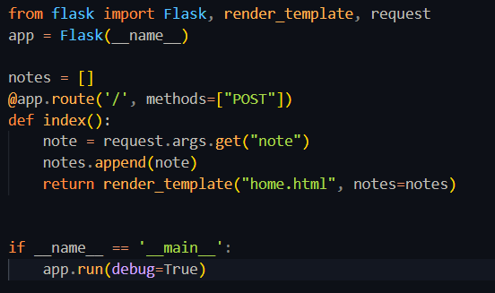
Code Review and Understanding

Slide 5
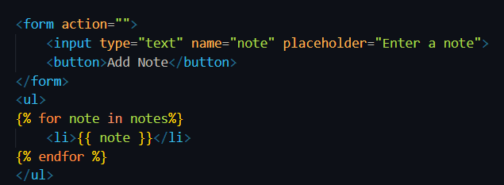
Code Review and Understanding
From the following code it can be observed that the code replicates to be a simple flask app for note taking app, where the notes are stored in ‘notes’ list. The ‘home.html’ page consists an input field from where data is getting loaded or taken.

Slide 6
Bug Identification
Now in the following code there exist some bugs because of which the code is not working. So here are the identified bugs which are causing the errors.
@app.route('/', methods=["POST"])
The app needs both “POST” and “GET” methods to handle the “GET” request as well
note = request.args.get("note")
The ‘args.get’ will access the query parameter, because of which the error may encounter

Slide 7
Bug Identification
In the HTML the form needs a method attribute, but in this given code it is missing
<form action="/" method="POST">
which is causing the another issue.
<button>Add Note</button>
It can be observed that the ‘type=submit’ attribute is also missing in this line, however it is not going to affect that much but as a good practise it should be mentioned

Slide 8
Bug Fixing Process
@app.route('/', methods=["POST","GET"])
With methods=["POST", "GET"], the route decorator will now handle both POST and GET requests. Inside the index function.
note = request.form.get("note")
Using request.args.get() is not suitable for retrieving form data in a POST request because request.args accesses the query parameters in the URL, not form data

Slide 9
Bug Fixing Process
<form action="/" method="POST">
Currently, the form is missing the method attribute, which specifies the HTTP method to use when submitting the form data. Since the Flask route expects a POST request (@app.route('/', methods=["POST"])), we need to set the method attribute of your form to "POST".
<button type="submit">Add Note</button>
Changed <button> to <button type="submit"> to ensure that clicking the button submits the form.

Slide 10
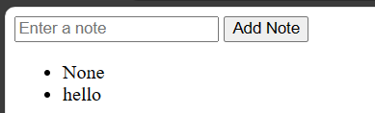
Testing and Validation
Now while testing a logical error can be encountered which can be seen as follows
When the ‘notes’ list is empty we are rendering the page initially so we are getting ‘None’ because at that instance the list is empty and in return it returns ‘None’ as return value which gets appended.
This can be solved by conditional rendering by adding in app.py
if(note):
notes.append(note)

Slide 11

THANK YOU

