Slide 1
Detection and Classification of Plant Leaf Diseases using Deep Learning Algorithm
DOMAIN : DATA_SCIENCE
Under the guidance of
Prof. Manjunath Gonal and Prof. V.S. Biradar
Name | USN
Pooja G Kamble | 01FE16BCS140
Praveen Kundargi | 01FE17BCS418
Saurabh Anbarasan | 01FE17BCS505

Slide 2
PROBLEM STATEMENT
To detect and classify plant leaf disease detection using deep learning algorithms.

Slide 3
Motivation
The detection of disease in plants plays a key role in the field of agriculture, because having diseases in crops are quite natural.
If this is neglected then it can cause serious effects on plants due to which quality, productivity and yield of the plant is affected.
Diseases in plants cause a periodic outbreak of diseases which leads to large-scale death. These problems need to be solved at the initial stage, to save life and money of people.

Slide 4
Objectives
To detect affected area of the leaf.
To identify the disease of a plant and thus increasing yield of the plant.
To obtain the phenotype of a plant without damaging it.

Slide 5
Challenges
To detect complex background that cannot be easily separated from the region of interest.
Deep learning algorithms require large amount of labeled data.
To identify the disease of plant at an early stage.

Slide 6
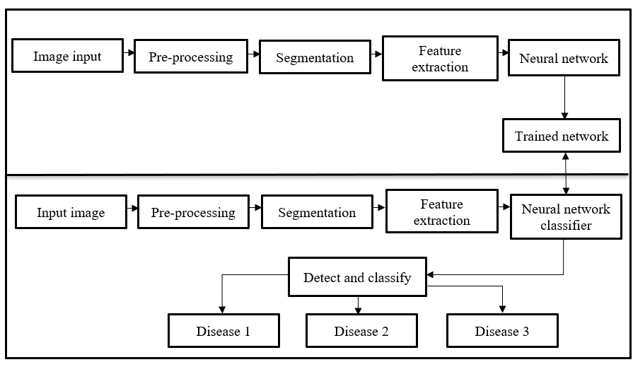
Flow Diagram of proposed System

Slide 7
Advantages/applications of proposed system
Detection of disease at different stages of the plant.
Plants can be relocated to a healthier environment if it is affected by abiotic stress.
Treatment of plants can be done if the plant is affected by biotic stress.

Slide 8
Functional requirements:
System shall be able to detect the leaf from the captured image.
System shall be able to eliminate image distortion.
System shall be able to predict the disease.
Non-functional requirements:
Accuracy of the model should be greater than 70%.
System shall require a minimum of 4 GB RAM.

Slide 9
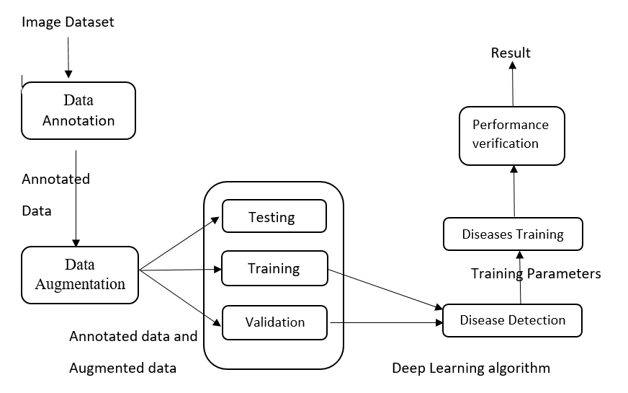
System Architecture

Slide 10
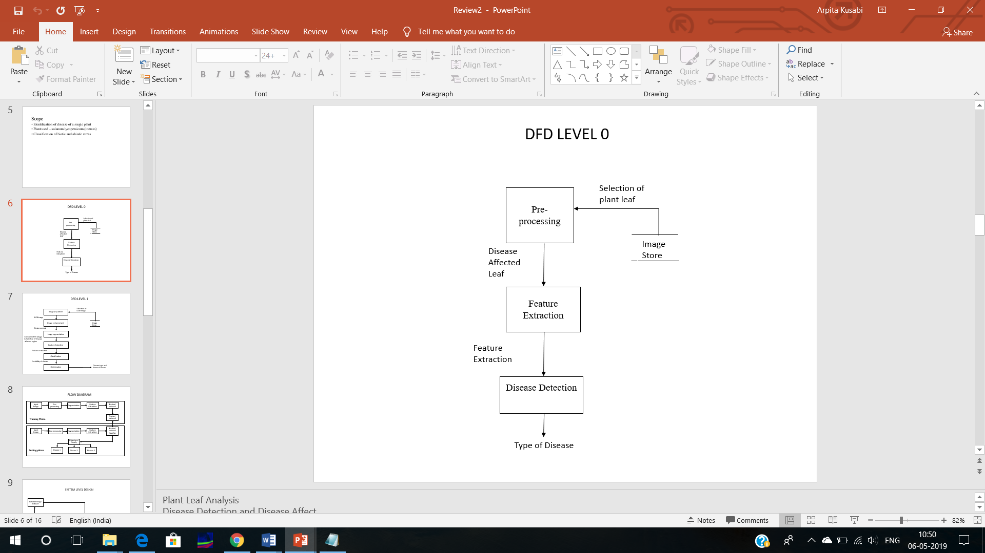
Data Flow Diagram Level 0

Slide 11
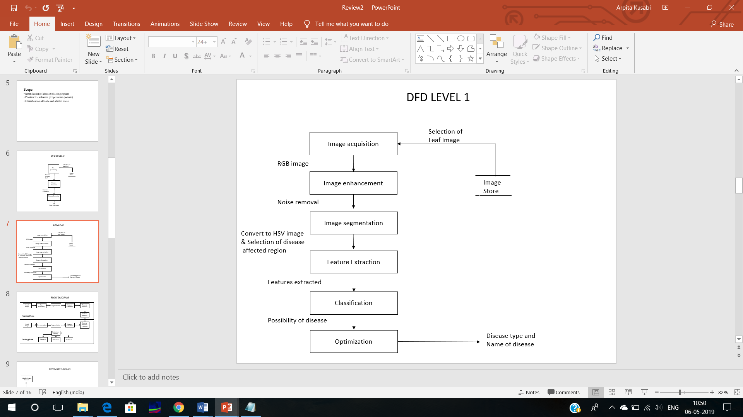
Detailed DFD for proposed system

Slide 12
Proposed Methodology
The diseases detected are:
Bacterial Spot
Septoria
Late Blight
Tomato Mosaic
Yellow curve
The stresses classified are:
Biotic
Abiotic

Slide 13
Feature Extraction Methods
GrayScale :
Grayscale is a range of monochromatic shades from black to white. Therefore, a grayscale image contains only shades of gray and no color.
Colour features:
Mean: Average value of the pixels in the image.
Standard deviation: It shows how much variation or "dispersion" exists from the average (mean, or expected value).
Choice of deep learning architecture:
AlexNet
GoogleNet

Slide 14
Choice of training mechanism:
Transfer Learning
Training From Scratch
Choice of training-testing set distribution:
Train: 80%, Test: 20%
Train: 60%, Test: 40%
Train: 50%, Test: 50%
Train: 40%, Test: 60%
Train: 20%, Test: 80%
Classification Techniques:
KNN (K-nearest neighbour)
ANN (Artificial Neuron Network)

Slide 15
References
https://www.ijert.org/research/detection-and-classification-of-plant-leaf-diseases-by-using-deep-learning-algorithm-IJERTCONV6IS07082.pdf
https://www.researchgate.net/publication/321587357_Detection_and_Classification_of_Plant_Leaf_Diseases_in_Image_Processing_using_MATLAB
https://link.springer.com/chapter/10.1007/978-981-15-1384-8_16
https://www.ijarcce.com/upload/2016/november-16/IJARCCE%2044.pdf

