Slide 1











Presentation
Columbia
Asia Hospital
Analysis
Pooja Gurumurti Tamragouri

Slide 2

About
Columbia Asia Hospital
A well-known healthcare facility, Columbia Asia Hospital is a shining example of patient-centered care and medical expertise. The hospital is well-known for its dedication to offering top-notch medical care and has a global presence in several nations. Modern infrastructure, state-of-the-art medical technology, and a staff of highly qualified and caring healthcare professionals define Columbia Asia. In order to address the many requirements of the communities it serves, the hospital's ethos is centered on providing complete and individualized healthcare solutions. Columbia Asia Hospital is committed to providing excellent medical care and promoting a healthy and prosperous society. It has achieved this by adopting a patient-centric approach.

Slide 3
Project Aim
To evaluate the hospital's revenue generation, identify departments for potential new hires, and propose strategies for patient discounts to enhance efficiency and satisfaction.

Slide 4
Data Overview
Date: This column contains date and time information without specifying AM or PM. The format is DD-MM-YYYY HH:MM.
Patient ID: Each patient is assigned a unique identifier, which seems to be in the format 124-62-3289.
Patient Gender: This column records the gender of the patient, denoted by 'M' for male and 'F' for female.
Patient Age: The age of the patients is listed in years.
Patient Sat Score: It seems to represent a satisfaction score given by or for the patient. However, the scores are single-digit, and it's not clear what the scale is.
Patient First Initial: This column contains the first initial of the patient's first name.
Patient Last Name: The surname of the patient is listed in this column.
Patient Race: The racial or ethnic background of the patient is recorded here, with categories such as 'White', 'African American', 'Asian', 'Native American/Alaska Native', and 'Two or More Races'.
Patient Admin Flag: This column contains boolean values ('TRUE' or 'FALSE') which might indicate whether the patient was admitted or some other administrative flag.
Patient Wait Time: Appears to indicate the time the patient waited, possibly in minutes, before being seen or processed.
Department Referral: This column lists the department to which the patient was referred, with entries such as 'General Practice', 'Orthopaedics', 'Gastroenterology', or 'None' indicating no referral.
Doctor Name: Identifies the doctor who attended each patient.
Appointment Fees: The cost charged for a doctor's consultation.
Total Bill: The overall amount billed to the patient, including all services and charges.

Slide 5
Summary
A dataset from Columbia Asia Hospital was carefully analyzed and guaranteeing data integrity. We looked at popular departments, typical wait times, and patient groups' patterns of healthcare use. We looked at patient trends and determined many different types of aspects by using DAX functions. We looked at how wait times and satisfaction levels relate to one another, how departmental visits are affected by demographics, and how to handle discrimination complaints. We examined the General Practice department's profitability, waiting time variations, recommended discount assignment, and doctor shift alignments. We demonstrated our technical expertise in adding columns to Power Query using M-query and Power BI Gateway. The hospital's strategic decision-making, patient experience advancements, and operational improvements are informed by the insights obtained.

Slide 6


Analytical Approach and Tools
Data Transformation and Cleaning
Used Power Query Editor in Power BI to transform and clean data. Handled missing values and inconsistencies to ensure data integrity.
Power Query Editor
Used Power Query Editor to shape and clean the Data. Carried out tasks including sorting, filtering and merging to improve the quality of Dataset.
DAX Functions
Employed DAX Functions for numerical measurements, such as Average, Sum, IF, IFBlank, Calculate, Switch, Max, Count.
Visualizations
Created interactive dashboards and reports using Power BI's visualizations. Implemented charts, tables, and tabular views for effective data presentation.
Strategic Decision-Making
Helped with strategic decision-making by offering useful insights and conducting patient demographic analysis. Computed departmental revenues and average waiting times using DAX tools.

Slide 7
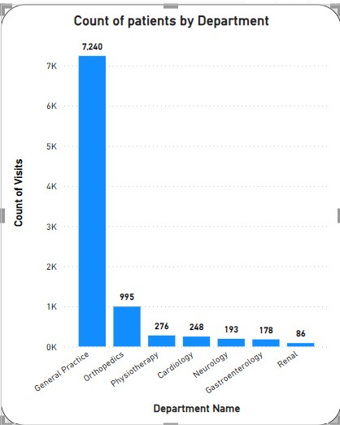
Total Visits by Department
The distribution of patient visits across the various departments can be seen in the bar chart, which makes the following visit counts visible: With 7240 visits, general practice is the most popular, followed by orthopedics (995), physiotherapy (276), cardiology (248), neurology (193), gastroenterology (178), and Renal (86). With General Practice getting the most visits and Orthopedics coming in second, this graph clearly illustrates the relative popularity of each department and offers insightful information for the hospital's resource allocation and strategic planning.

Slide 8
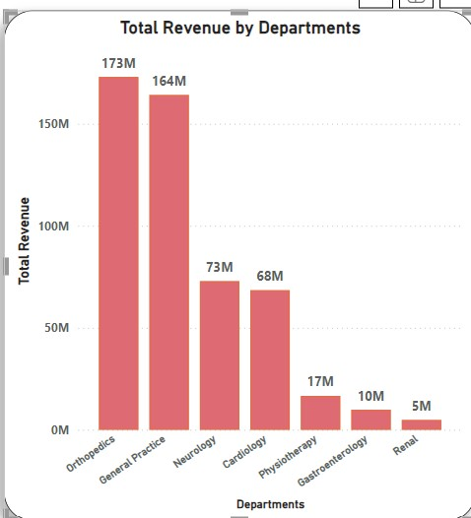

Total Revenue
Overall Revenue Earned
$509.3M
The departmental revenue appears in a column chart that highlights significant contributions. With $172.9M, Orthopedics is the largest, closely followed by General Practice at $164.1M. Contributions from cardiology and neurology are $72.8M and $68.4M, respectively. Gastroenterology, physiotherapy, and renal come next with $16.6M, $9.8M, and $4.8M, respectively. Within the hospital, this succinct depiction facilitates resource allocation and strategic decision-making.

Slide 9

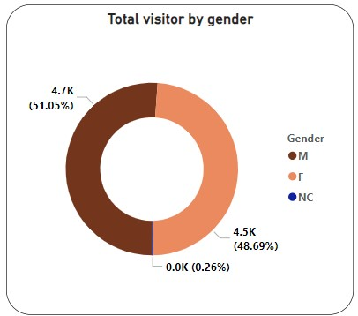

Gender Preference
The gender distribution of hospital visits appears to be equal in the pie chart, with 51.1% (4705) of hospital visits being made by men and 48.9% (4487) by women. This fair representation highlights the hospital's welcoming atmosphere that serves a wide spectrum of patients.
4705
4487

Slide 10
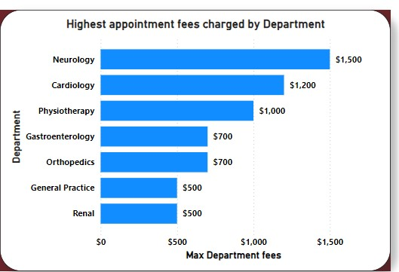

Appointment Fees
Total Doctors in Hospital
22
The appointment fees that doctors charged varied depending on the departments in which they worked.
Let's review the fees that these departments charge. The department with the highest fee of all is neurology, which charges $1,500. The departments with the lowest fees were General Practice and Renal ($500), Gastroenterology ($700), Orthopedics ($700), Cardiology ($1200), and Physiotherapy ($1000).

Slide 11

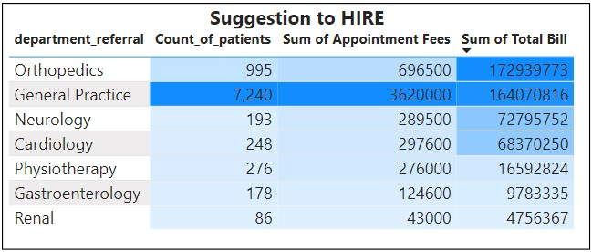
Suggestion to Hire
General Practice: With the highest demand of 7,240 patients, 3.62M in appointment fees, and 164.07M total bill, this department is the primary choice for new hires.
Orthopedics: If General Practice is not prioritized, the next best option is Orthopedics, with 995 patients, 696.5K in appointment fees, and 172.94M total bill, indicating strong revenue potential.

Slide 12
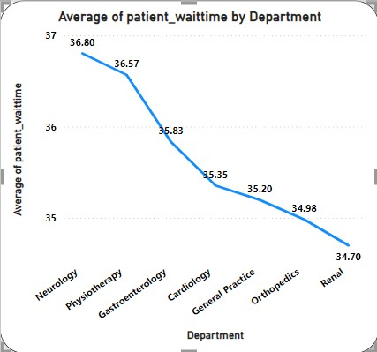
DEPARTMENT-WISE AVERAGE WAITING TIME
The Neurology Department has the highest average waiting time of 36.80 minutes, followed closely by Physiotherapy with 36.57 minutes. The Renal Department has the lowest average waiting time of 34.70 minutes.

Slide 13
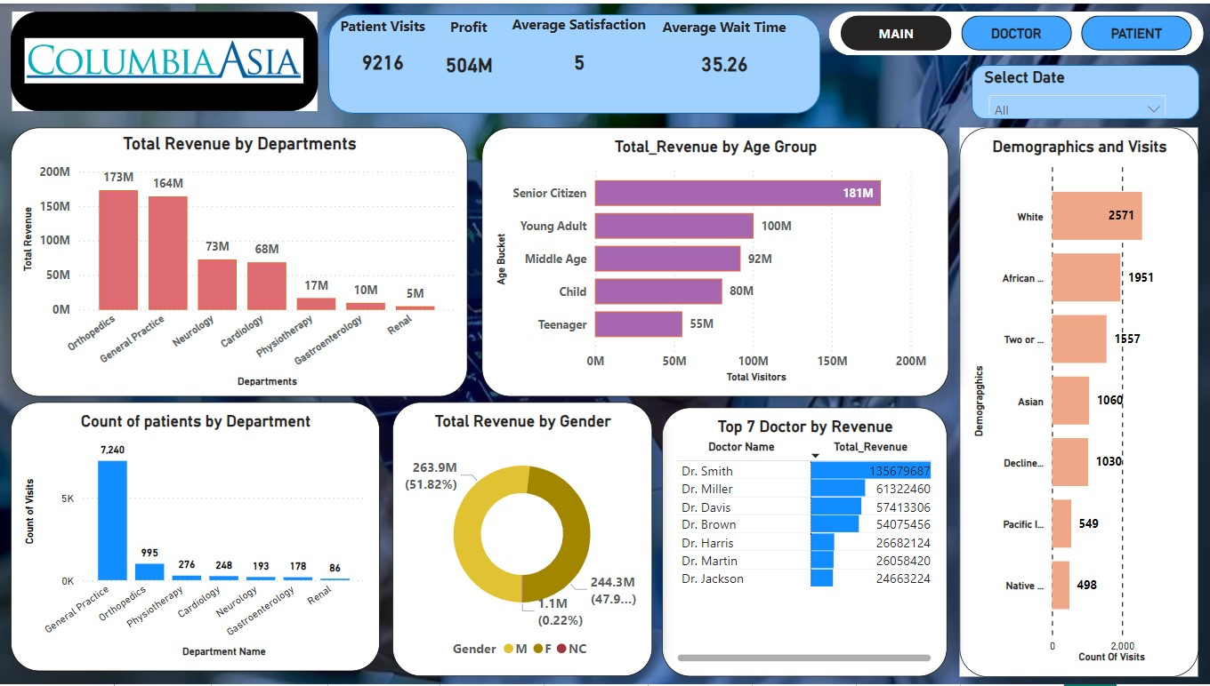
Dashboard and Visualizations
Main Tab

Slide 14
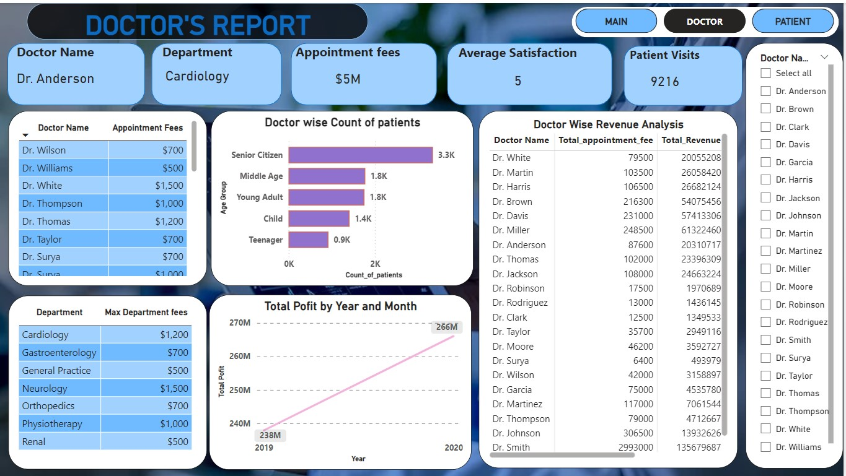
Doctor’s Tab

Slide 15
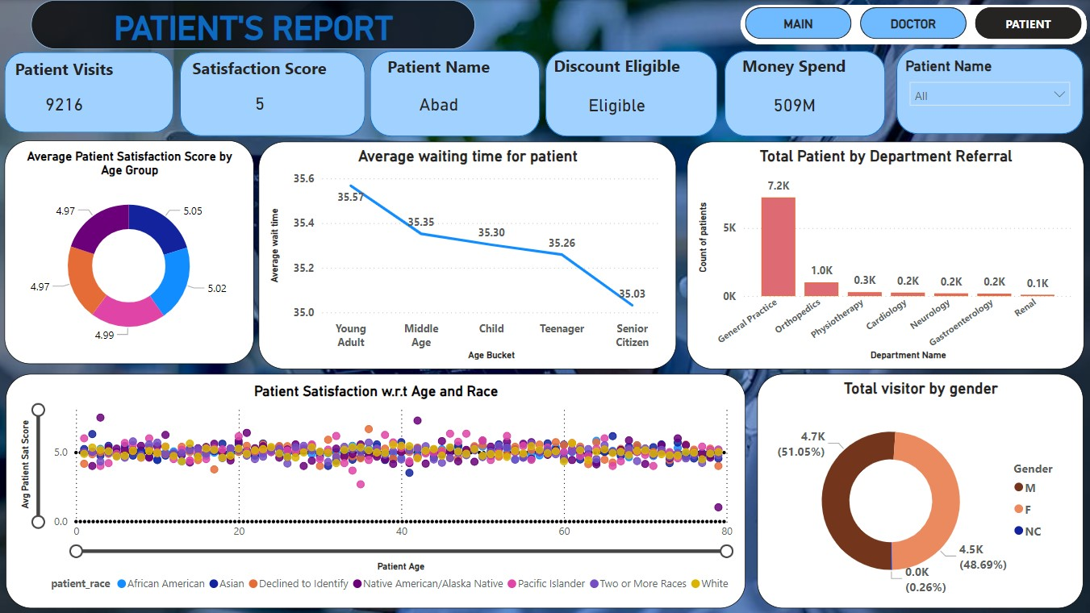
Patient’s Tab

Slide 16
CONCLUSION
The analysis of Columbia Asia Hospital identifies key revenue drivers, with Orthopedics leading in revenue and General Practice as the top choice for new hires. Additionally, there is potential to increase patient discount eligibility, currently at 12.46%, to enhance patient satisfaction.

Slide 17

Thank You

