Slide 1

REDUCING CARBON FOOTPRINT IN IOT DEVICES
Team name: ProTech IOT
College : SSN College of Engineering
Industry : Ericsson

Slide 2
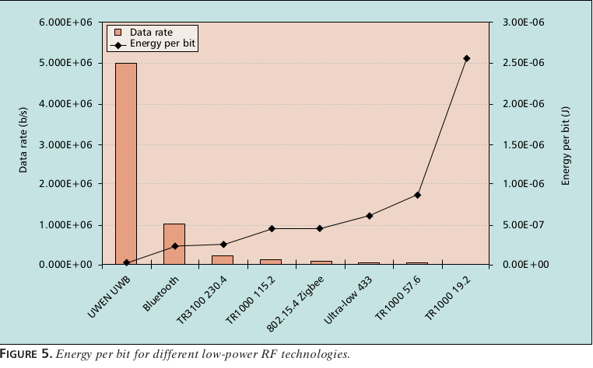
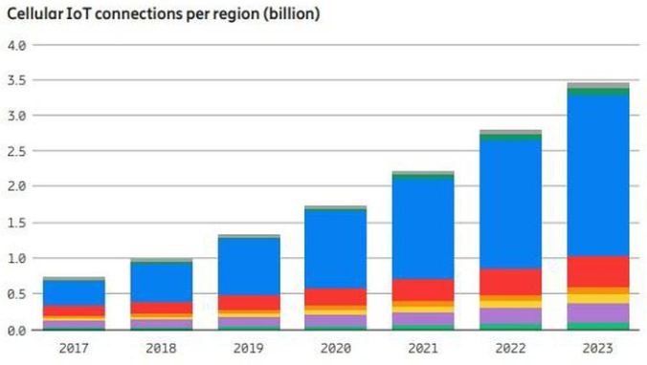
Introduction
Energy consumed per bit varies for each protocol. On an average, the energy used is at 0.2 to 5 µ J per bit. [1]
Relating electrical energy to the carbon footprint emission [2] is a vital reference used throughout this presentation. This value is estimated as,
Carbon footprint Emission = 0.82 kgCO₂e/kWh
No.of IoT devices in major cities as of 2018 is approximated at 1 billion by Ericsson [3], Forbes estimates 11 billion devices all over the world. [4]
Source: [1]
Source: [3]

Slide 3
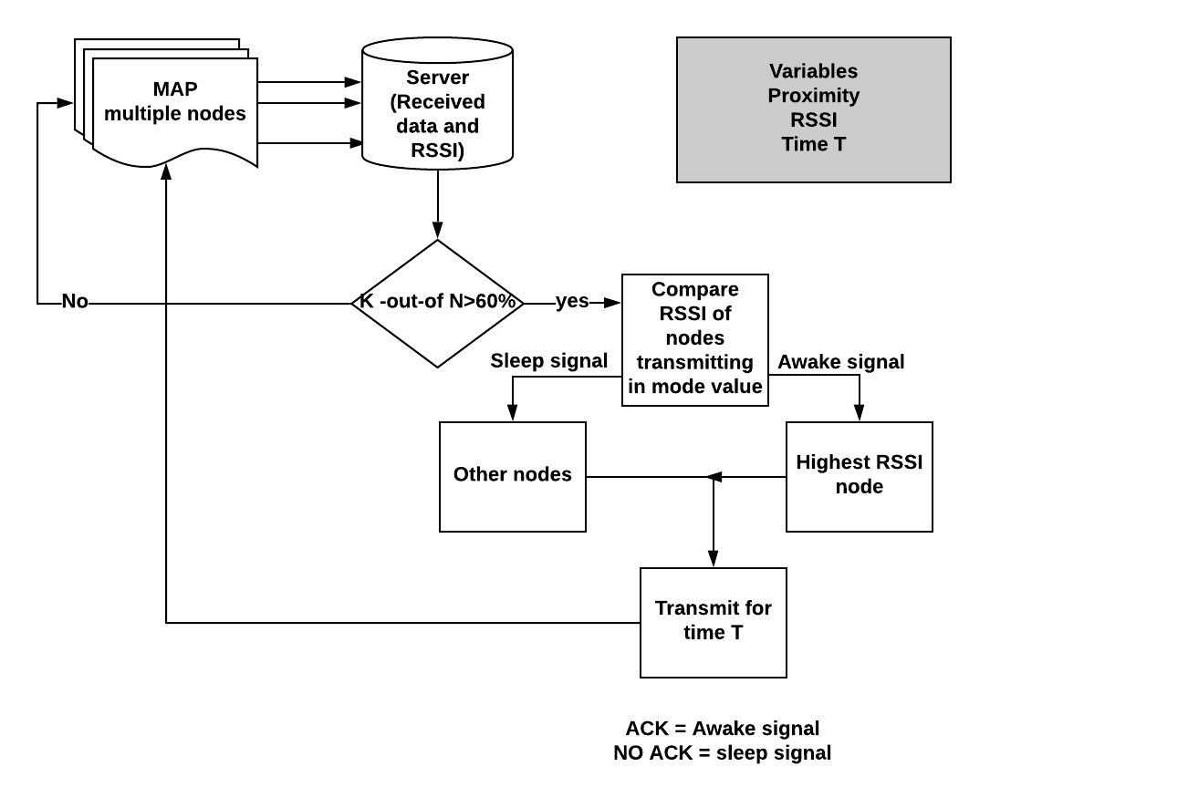
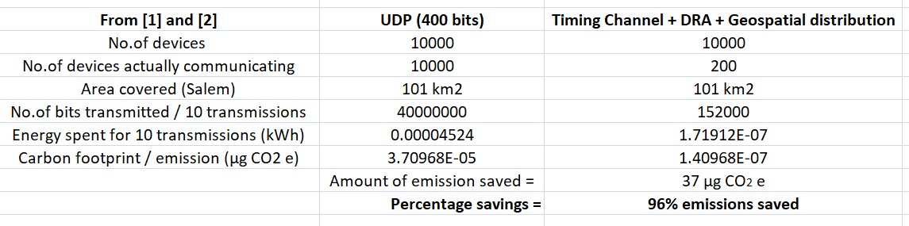
Implementation Step 1 : Geospatial distribution use case and GUI
Let us consider 10,000 devices in a city, say, Salem. Let us assume each device transmits data 10 times every hour.

Slide 4
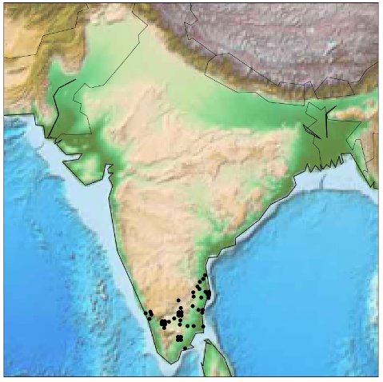
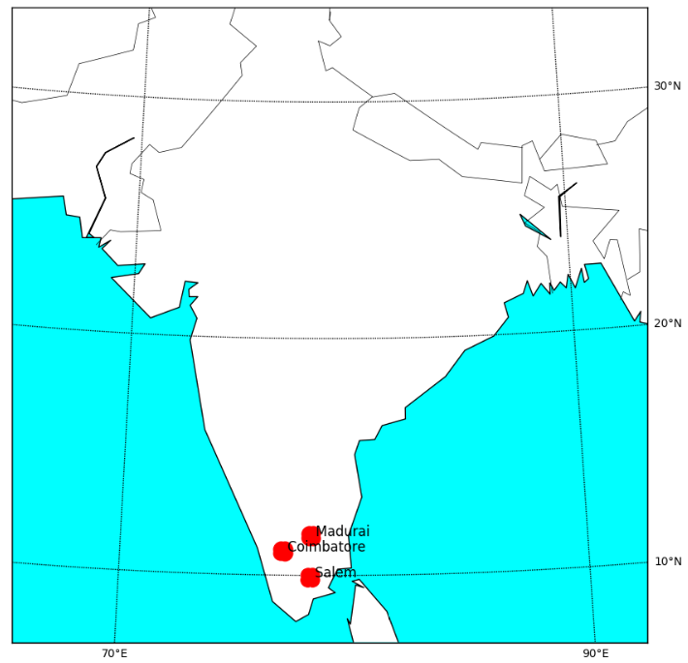
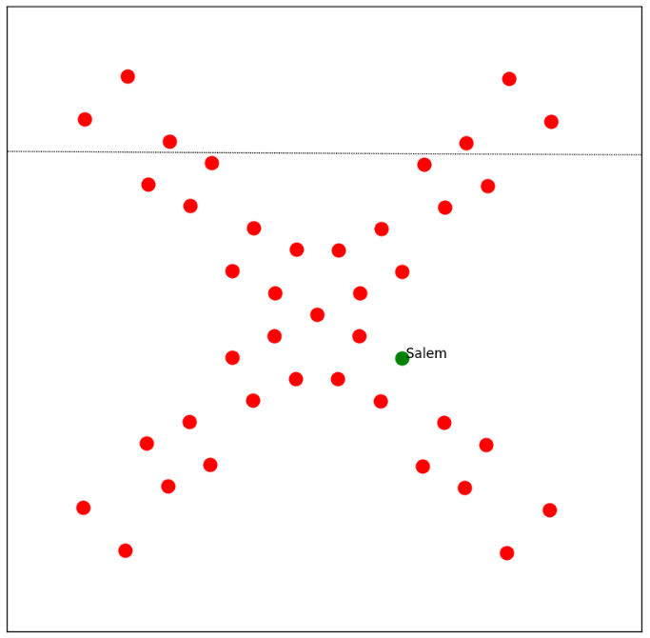
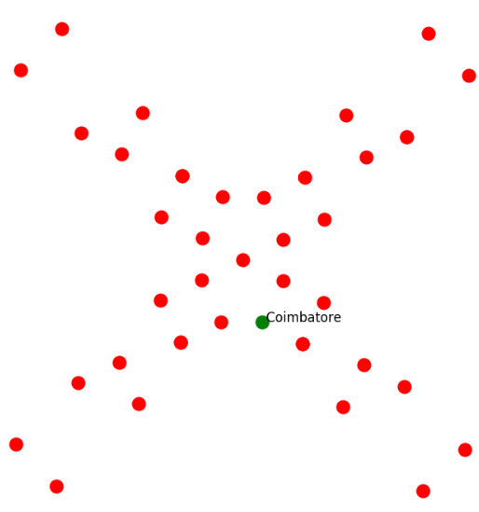
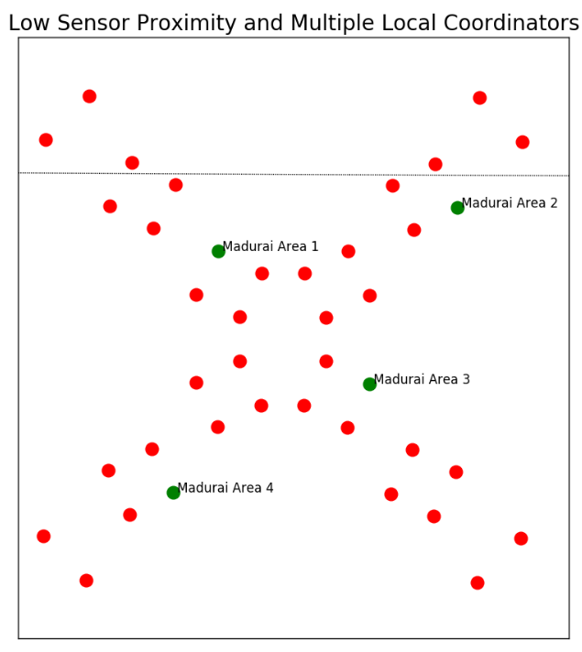
Implementation Step 1 : Geospatial distribution and GUI (contd.)
Focusing on 3 major cities,
Salem, Kovai and Madurai
Assuming a cross-road junction
with air quality sensors placed
as shown
SALEM
KOVAI
MADURAI

Slide 5
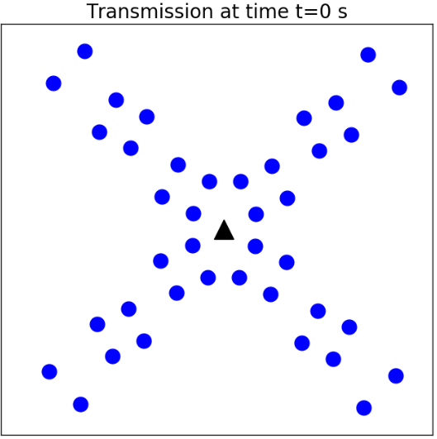
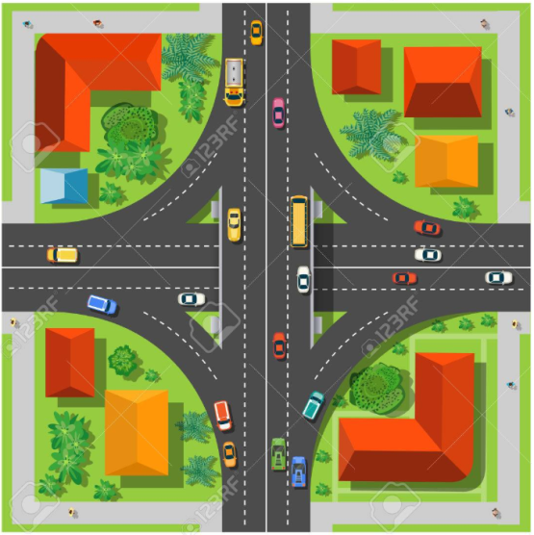
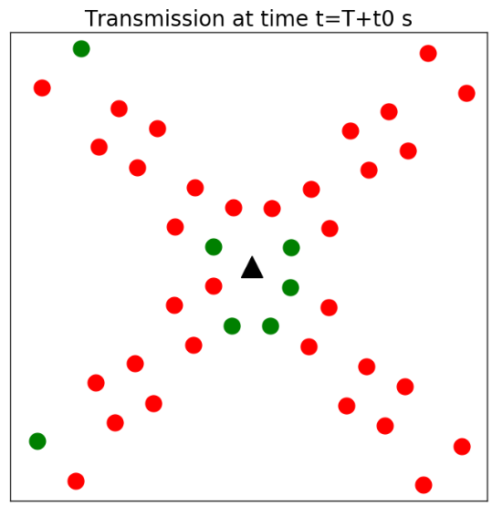
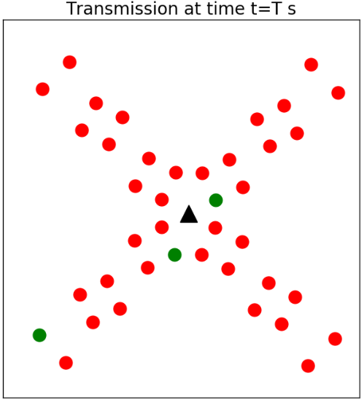
Implementation Step 2 : Dynamically switching the sensors using KNN classification

Slide 6
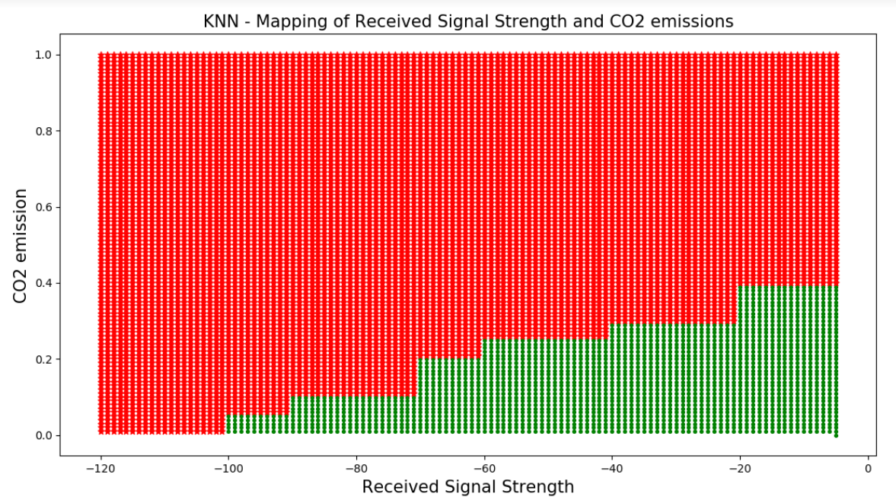

Features of KNN Mapping
The mapping is done using variables Receiver Signal Strength Index(RSSI) and carbon footprint of the node device.
It is superior when compared to other classification algorithms such as decision trees and Support Vector Machine (our algorithm).
Gives an accurate deployment of the nodes.
Objectives to emphasize
Base station / Sink node presence
The optimum location for a base station is where the energy between the base and the sensor is minimum[9].
Wait till draining of client
Solution : Have a count mechanism in the server that keeps a count on the no. of transmissions by a single node and limit this number corresponding to the initial received signal strength.

Slide 7
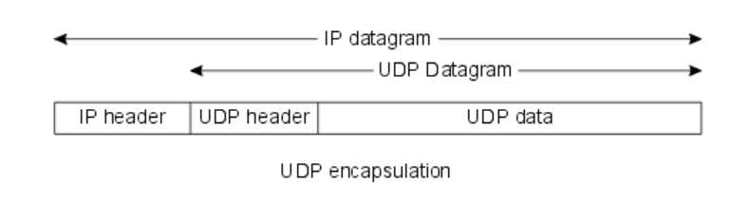

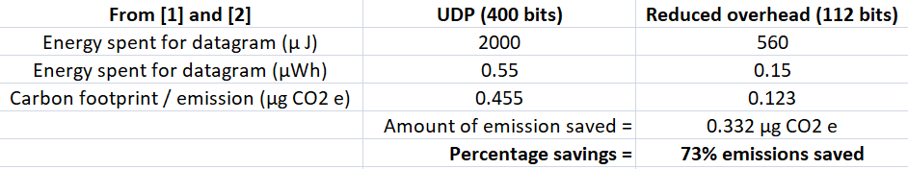
Implementation Step 3 : Protocol Overhead Reduction
Sample UDP datagram
IPv6 packet overhead = 40 bytes UDP packet overhead = 8 bytes
Let Data = 2 bytes
Total datagram size = 50 bytes = 400 bits
Reduced Overhead example : SigFox [5]
Reduced packet overhead = 12 bytes Let Data = 2 bytes
Total datagram size = 14 bytes = 112 bits

Slide 8
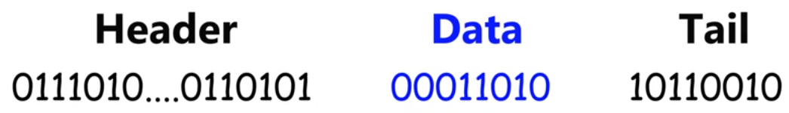

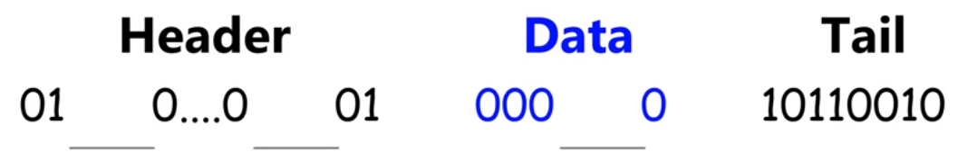
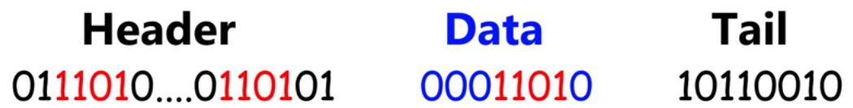
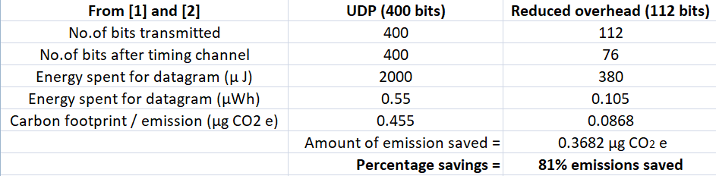
Implementation Step 4 : Timing Channel
Transmitter
LET DATA = 26
Transmitter
Receiver
Receiver
DATA = 26

Slide 9

Implementation Step 5 : Compressive sensing
Memory requirement Reduction
Cost reduction
Power consumption Reduction
CO2

Slide 10
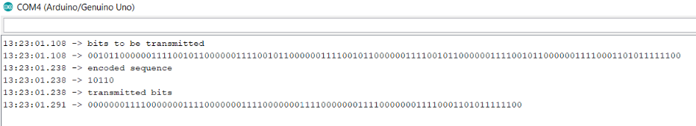
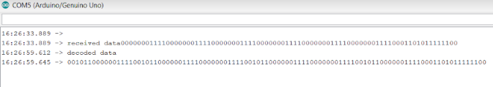
Implementation Step 6 : Hardware Implementation
Transmitter
Receiver
Transmitter
Xbee Communication
Receiver

Slide 11
Efficiency of our system:
Protocol Overhead: reduction from 48bytes to 12 bytes.
Image and multimedia transmission.
New, research solution of timing channel implemented in the physical layer to enable maximum efficiency.
Dynamic switching on and off of nodes based on parametric values of data, distance between nodes, RSSI and total CO2 emitted by the node.
Use Cases
Smart cities
Smart buildings
Manufacturing chains
Any Low-Power Wide Area Networks (LPWAN)

Slide 12
Reference
Ian Oppermann; Lucian Stoica; Alberto Rabbachin; Zack Shelby; Jussi Haapola; “UWB wireless sensor networks: UWEN - a practical example”, IEEE Communication Magazine, Vol. 42, Issue 12, Dec. 2004.
Jing Ke; Michael McNell; Lymn Price; Nina Zheng Khanna; Nan Zhou; “Estimation of CO2 Emissions from China’s Cement Production: Methodologies and Uncertainties”, Energy Policy, Vol. 57, pp. 172-181, June 2013.
https://www.forbes.com/sites/louiscolumbus/2018/12/13/2018-roundup-of-internet-of-things-forecasts-and-market-estimates/#2527c1b17d83
https://www.forbes.com/sites/bernardmarr/2018/01/04/the-internet-of-things-iot-will-be-massive-in-2018-here-are-the-4-predictions-from-ibm/#1857ec37edd3
S. Sadowski and P. Spachos, "RSSI-Based Indoor Localization With the Internet of Things," in IEEE Access, vol. 6, pp. 30149-30161, 2018.

Slide 13
Reference (contd.)
Nandhini, S.A., Radha, S., Nirmala, P. et al. J Real-Time Image Proc (2016).https://doi.org/10.1007/s11554-016-0658-z
6. Jawahar, A., Radha, S., & Sharath Kumar, R. (2012). Capacity-Preserved, Energy-Enhanced Hybrid Topology Management Scheme in Wireless Sensor Networks for Hazardous Applications. International Journal of Distributed Sensor Networks. https://doi.org/10.1155/2012/280932
7. Nandhini, S.A., Radha, S., Nirmala, P. et al. J Real-Time Image Proc (2016).https://doi.org/10.1007/s11554-016-0658-z
8. Jer-Shyan Wu; Rong-Jaye Chen; "Efficient algorithms for k-out-of-n and consecutive-weighted-k-out-of-n:F system"; IEEE Transactions on Reliability (Volume: 43 , Issue: 4 , Dec 1994)
9. Rajiv Kumar Tripathi; “Base Station Positioning, Nodes’ Localization and Clustering Algorithms for Wireless Sensor Networks” . Thesis, IIT Kanpur – Chapter 2, Oct 2012

