Slide 1
Bank Customer Churn Analysis
Uncovering insights regarding customer churn from 10,000 customers’ data.

Slide 2
About the Dataset
10,000
Customers’ Records
Comprehensive Retention Data
18
Columns
Customer demographics, Bank relationship, Financial Profile, etc.
0
Missing Values
There are no missing values in the dataset.

Slide 3
Data Loading and Preparation
1. Data Loading
Imported dataset into Python using Pandas.
2. Initial Exploration
Checked the structure of the dataset and the summary statistics.
3. Null Check
Checked for any null values within the dataset, there weren’t any.
4. Standardizing Columns
Standardized the column names for better readability and documentation.
5. Feature Engineering
Created 2 new columns from age_group and credit_score_range.
6. Database Connection
Connected Python to PostgreSQL for further analysis.

Slide 4
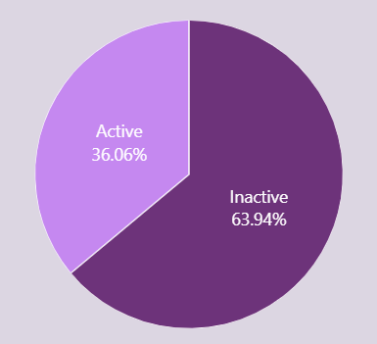
Churned Customers by Activity
Key Insights
The churn rate for inactive customers is a lot higher, 63.94% as compared to that of active customers, 36.06%.
A reactivation campaign can be started to try and get these customers back.

Slide 5
Product Depth
Customers who buy 3 or 4 products tend to churn more
2 products:-
Customers who buy 2 products tend to have the lowest churn rate, 7.6%.
3 or 4 products:-
Customers who buy 3 or 4 products tend to have the highest churn rate, 82.71% and 100%. It is worth looking into the cause for this before promoting any strategies for selling more than 2 products.

Slide 6
Top 3 Age Groups by Churn Rate in each Country
France
Senior: 38.7%
Middle-Aged: 17.02%
Adult: 8.33%
Germany
Senior: 61.63%
Middle-Aged: 32.15%
Adult: 19.4%
Spain
Senior: 35.31%
Middle-Aged: 16.36%
Young-Adult: 8.47%
In all the countries mentioned, the churn rate for senior customers tends to be higher when compared to the rest of the age groups (France – 38.7%, Germany – 61.63%, and Spain – 35.31%)

Slide 7
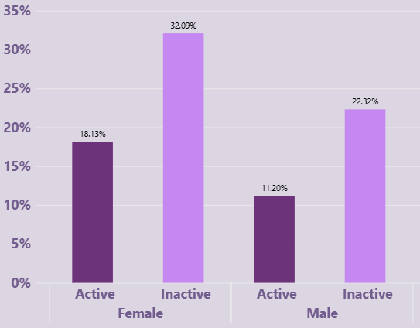
Churn Rate by Age Group and Activity
Female Customers:-
The churn rate for active female customers (18.13%) is lower than that of inactive customers (32.09%).
Male Customers:-
Similarly for male customers, the active customers have a lower churn rate (11.20%) compared to inactive customers (22.32%).

Slide 8
Business Recommendations
i) Gender Targeted Efforts – Female customers make up 60.35% of all churners vs 39.65% for male customers, investigate the reason for it and apply some targeted retention schemes based on customer behavior and needs.
ii) Product Depth Strategy – Customers with 2 products tend to have the lowest churn rate, 7.6%, while those who purchase 3 or 4 products have the highest churn rate, 82.71% and 100%. Though the last 2 categories have lesser amount of customers, it is still worth investigating the cause behind this (for example – price, fees, product fit etc.), before promoting any selling further than 2 products.
iii) Region Based Efforts – Germany’s churn rate is 32.44% as compared to Spain and France’s 16.67% and 16.17%, look into the reasons for it and rectify it using some targeted retention strategies, and track the churn rate quarterly.

