Slide 1
Customer Shopping Behavior Analysis
Making business decisions based on insights uncovered from 3,900 purchases.

Slide 2
About the Dataset
3,900
Total Purchases
Comprehensive Transaction Data
19
Columns
Customer demographics and purchase behaviors
37
Missing Values
Only in the Review Rating Column

Slide 3
Data Loading and Preparation
1. Data Loading
Imported the dataset into Python using Pandas
2. Initial Exploration
Checked the structure and summary statistics
3. Handled Missing Data
Checked for and Imputed Missing values in Review Rating column
4. Feature Engineering
Created 2 new columns, age_group and purchase_freq_days
5. Redundancy Check
Checked for redundancy among the columns
6. Data Integration
Connected to PostgreSQL for further analysis

Slide 4
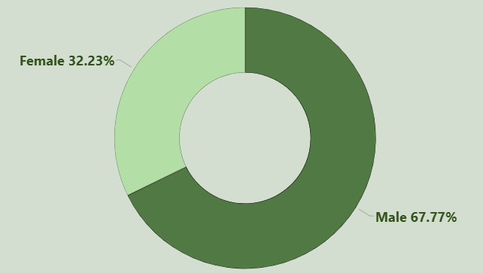
Revenue by
Gender Analysis
Key Insights
Male customers generate an a lot more significant amount of revenue as compared to female customers.
Gender-based marketing strategies could be used to increase the sales more.

Slide 5
Discount Shoppers
Discount shoppers tend to spend above the average
Smart Shoppers:-
Some customers optimize their purchase value by using discount codes.
Offer Exclusive benefits:-
In order to maximize these profits, we can provide some exclusive benefits to the premium shoppers.

Slide 6


Top Rated Products
Coat
The highest rated product, it has 3.92 star rating.
T-shirt
Another product with consistently high reviews.
Jeans
Highly loved product by customers.

Slide 7
Subscription: Likely to or not?
Subscribed Customers
Out of a total of 3,480 customers who have more than 4 purchases, 27% were subscribed.
Unsubscribed Customer
In comparison customers who haven’t subscribed but have more than 5 previous purchases are significantly higher, at 73%.
This implies that there isn’t enough incentive for customers to subscribe, if even the most loyal and returning customers aren’t subscribing.

Slide 8
Customer Segmentation
New Customers:-
Out of the total customers, 2% are new, we should focus on converting these to returning customers.
Returning Customers:-
18% are returning customers, we should focus on converting these to loyal customers.
Loyal Customers:-
Lastly, the majority of the customer base, 79% are all loyal customers, we should keep tem satisfied by good products and incentives.
2%
18%
79%
New Customers
Returning Customers
Loyal Customers

Slide 9
Business Recommendations
1. Better Subscription Plans:-
Improve the subscription plan, give better benefits to encourage more people to get subscriptions.
2. Incentives for Loyal Customers:-
Introduce some kind of incentives for returning customers to move them into the “Loyal” category.
3. Best Seller Products:-
Promote the best-selling/ highest rated products in marketing campaigns.
4. Targeted Marketing:-
Focus on the highest revenue age groups and express-shipping users

