Slide 1
Modernizing a Banking System with SOA
Case Study-Secure Bank
Name : Pooja
17th July 2024

Slide 2
Introduction
- Introduction to the problem:
Secure Bank's current monolithic application is struggling with performance issues and maintenance challenges.
- Objective:
Modernize the system using SOA to improve scalability and integration.

Slide 3
Current System Challenges
- Performance issues during peak transaction periods
- Difficulty in integrating new services
- Maintenance of the existing codebase is increasingly difficult

Slide 4
Objectives
-*Scalability:*
Ensure the system can handle a growing number of transactions and users.
- *Integration:*
Simplify the integration process for new financial services and third-party systems.
-*Maintainability:*
Improve the maintainability of the codebase by decoupling services

Slide 5
Introduction to SOA
- Definition of SOA
Service Oriented Architecture.
It is a method of software development that uses software components called services to create business applications.
- Key principles: Loose coupling, reusability, interoperability, and flexibility.

Slide 6
Identified Services
- Customer Service
- Account Service
- Transaction Service
- Loan Service
- Notification Service
- Reporting Service

Slide 7
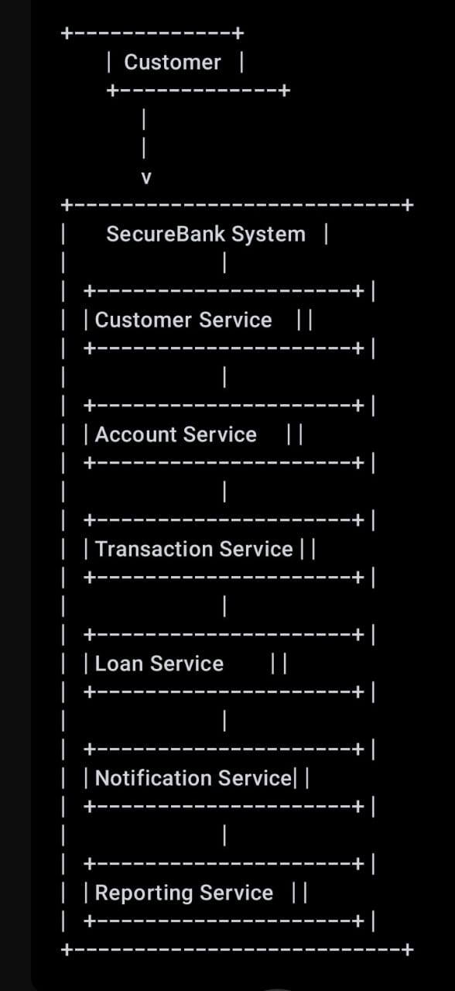
Use Case Diagram

Slide 8
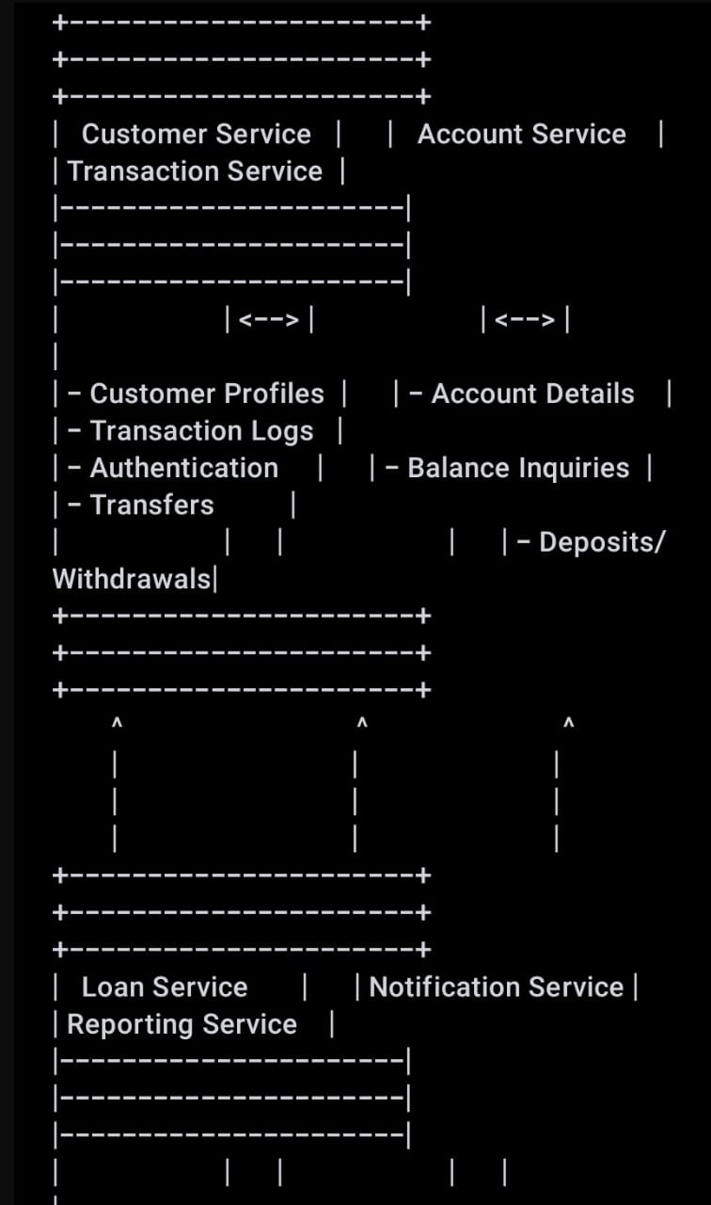
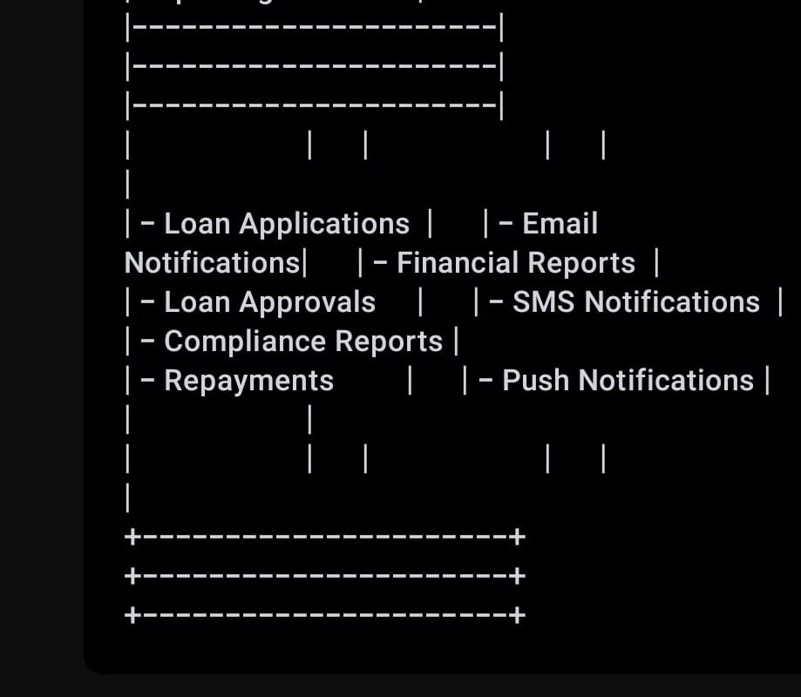
Component Diagram

Slide 9
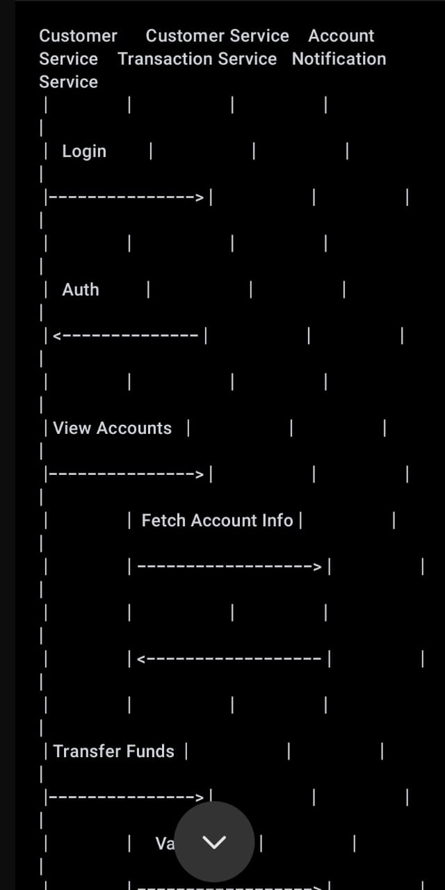
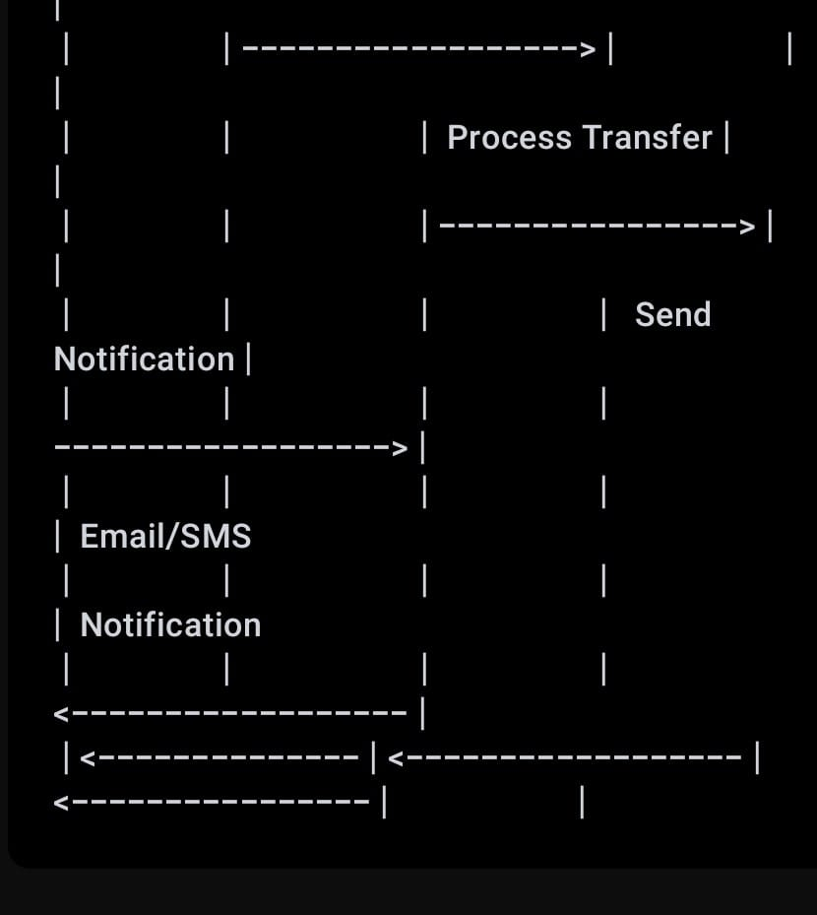
Sequence Diagram

Slide 10
Benefits of SOA &Implementation Plan
Improved scalability and performance
- Easier integration with new and third-party services
- Enhanced maintainability and flexibility
- Assess the current system and identify components for migration
- Design the new system architecture based on SOA principles
- Develop and test individual services
- Integrate services and perform end-to-end testing
- Deploy the new system in phases

Slide 11
Conclusion
The decoupled services allow for independent development, deployment, and scaling, resulting in faster release cycles and better overall system performance.
This modernization effort positions Secure Bank to handle future growth and integrate new services with minimal disruption.

Slide 12
Thank You

