Slide 1
Memory Management Strategies

Slide 2
Objectives and Outline
Objectives
Describe ways of organizing memory hardware
discuss various memory-management techniques, including paging and segmentation
Description of the Intel Pentium, which supports both pure segmentation and segmentation with paging
Outline
Background
Address space
Logical address space
MMU
Contiguous Memory Allocation
Paging
Structure of the Page Table
Segmentation
Example: The Intel Pentium

Slide 3
Background
Program must be brought (from disk) into memory and placed within a process for it to be run
Main memory and registers are only storage CPU can access directly
Register access in one CPU clock (or less)
Main memory can take many cycles
Cache sits between main memory and CPU registers
Protection of memory required to ensure correct operation

Slide 4
Background
Main Memory
CPU
cache
instructions
Registers
Process
data
program image
in memory
Operating System
Disk

Slide 5
Multiple programs
Multiple programs may share memory. We need protection.
Programs should not access each other's memory and OS memory
OS can access everything.
A program is allowed to touch a portion of physical memory.
Each program should touch its own physical memory.
Hardware support needed for protection (ensure process is accessing OK places)
Base and limit registers at CPU (hw support) can be used for that purpose.
Base register: contains the start phy address of the program running.
Limit register: contains the size of the program.
Hardware checks every address to be in the range.
If program relocated, base value changed.

Slide 6
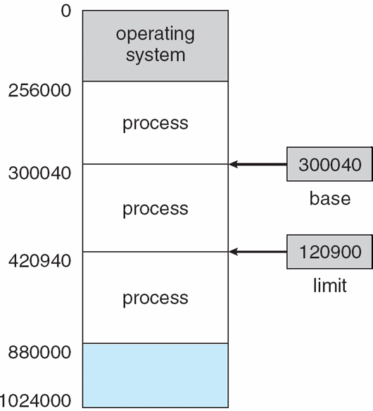
Protection: Base and Limit Registers
A pair of base and limit registers define the physical address space of a process
A process should be accessing and using that range.
Protection can be
provided in this way.
Each physical address should be in range [base, base+limit]

Slide 7
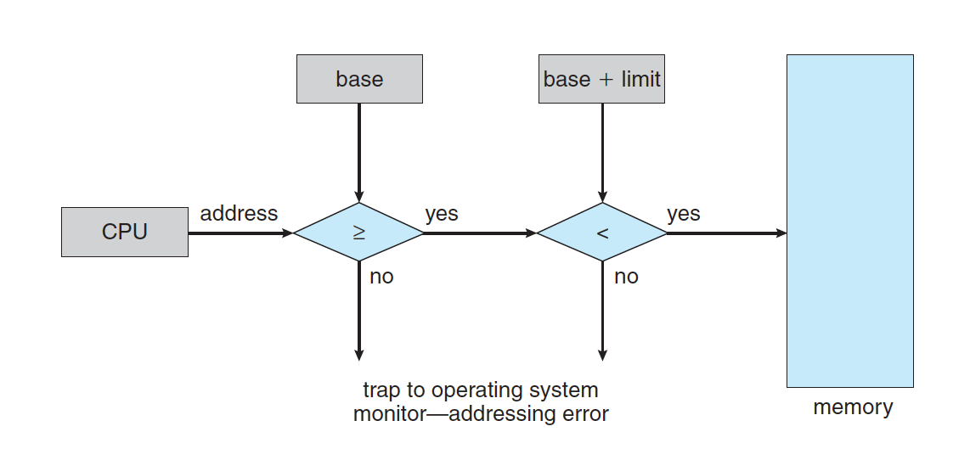
Protection
Hardware address protection with base and limit registers

Slide 8
Binding of Instructions and Data to Memory
Address binding of instructions and data to (physical) memory addresses can happen at three different stages
Compile time: If memory location known a priori, absolute code can be generated; must recompile code if starting location changes
Load time: Must generate relocatable code if memory location is not known at compile time.
Execution time: Binding delayed until run time if the process can be moved during its execution from one memory segment to another. Need hardware support for address maps (e.g., base and limit registers).
RAM
Program
a program
?
data
instructions

Slide 9
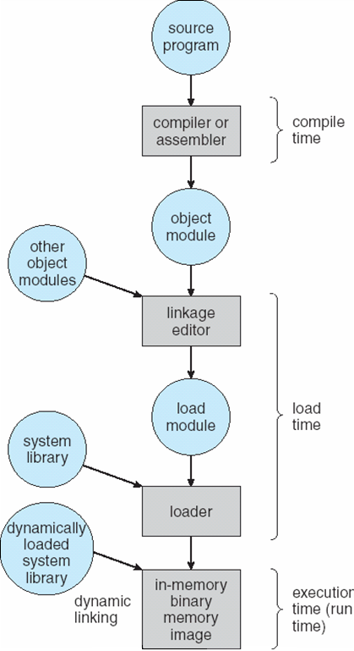
Multistep Processing of a User Program
Addresses may be represented in different ways during these steps

Slide 10
Program addresses and memory
When code is generated (or assembly program is written) we use memory addresses for variables, functions and branching/jumping.
Those addresses can be physical or logical memory addresses.
In very early systems they are just physical memory addresses.
A program has to be loaded to that address to run.
No relocation
func
variable
func
variable
func
variable
main
program

Slide 11
Program addresses and memory
RAM
physical addresses
of RAM
Assume they are physical addresses
44
40
Program
36
32
Add
12
28
Mov
8
24
…
4
20
Jump 8
0
16
Add
12
Mov
8
…
4
Jump 8
0

Slide 12
Program addresses and memory
RAM
physical addresses
of RAM
44
40
36
32
Cmp
28
Program 2
Sub
24
Program 1
Program 2
…
20
Add
12
Cmp
12
Jump 12
16
Add
12
Mov
8
Sub
8
Program 1
Mov
8
…
4
…
4
…
4
Jump 8
0
Jump 12
0
Jump 8
0

Slide 13
Logical address space concept
We need logical address space concept, that is different that the physical RAM (main memory) addresses.
A program uses logical addresses.
Set of logical addresses used by the program is its logical address space
Logical address space can be, for example, [0, max_address]
Logical address space has to be mapped somewhere in physical memory
RAM
phy_max
Program
logic_max
limit
Program
logical address space
base
0
0

Slide 14
Logical vs. Physical Address Space
The concept of a logical address space that is bound to a separate physical address space is central to proper memory management
Logical address – generated by the CPU; also referred to as virtual address
Physical address – address seen by the memory unit
Logical and physical addresses are the same in compile-time and load-time address-binding schemes;
Logical (virtual) and physical addresses differ in execution-time address-binding scheme

Slide 15
Logical and physical addresses
CPU
Main Memory (RAM)
base limit
60
56
52
48
44
40
36
32
28
24
20
16
12
08
04
00
24
32
int x
int y;
cmp ..
mov r1, M[28]
mov r2, M[24]
add r1, r2, r3
jmp 16
mov ..
PC
M[28+base]
IR
mov r1, M[28]
M[28+24]
M[52]
physical addresses
a relocatable program
28
24
20
16
12
08
04
00
int x
int y;
cmp ..
mov r1, M[28]
mov r2, M[24]
add r1, r2, r3
jmp 16
mov ..
logical addresses

Slide 16
Memory-Management Unit (MMU)
Hardware device that maps logical (virtual) to physical address
In MMU scheme, the value in the relocation register (i.e., base register) is added to every address generated by a user process at the time it is sent to memory
The user program deals with logical addresses; it never sees the real physical addresses

Slide 17
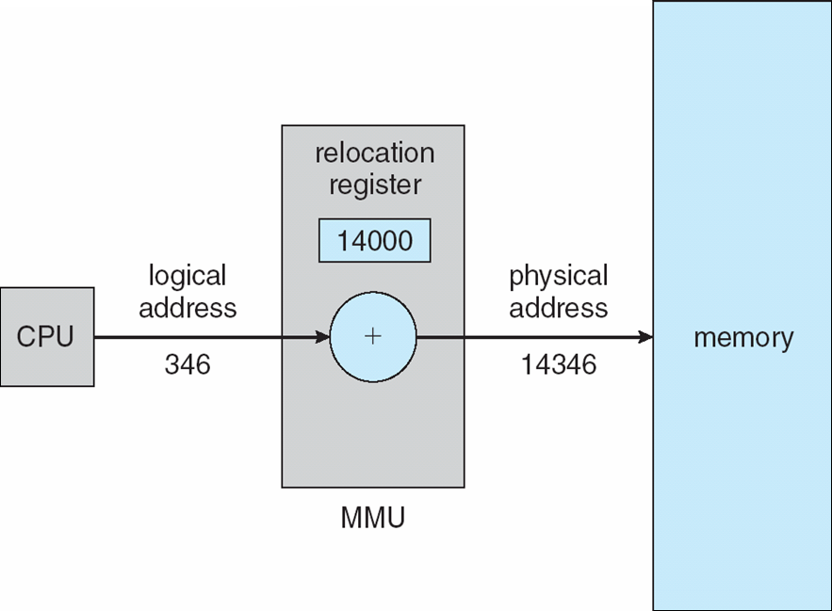
Dynamic relocation using a relocation register

Slide 18
Dynamic Loading
Routine is not loaded until it is called
Better memory-space utilization; unused routine is never loaded
Useful when large amounts of code are needed to handle infrequently occurring cases
No special support from the operating system is required,
implemented through program design

Slide 19
Dynamic Linking
Linking postponed until execution time
Small piece of code, stub, used to locate the appropriate memory-resident library routine
Stub replaces itself with the address of the routine, and executes the routine
Operating system needed to check if routine is in processes’ memory address
Dynamic linking is particularly useful for libraries
Standard C library is shared library that is dynamically linked, not statically linked.
You can link statically if you want.
System also known as shared libraries

Slide 20
Swapping
A process can be swapped temporarily out of memory to a backing store, and then brought back into memory for continued execution
Backing store – fast disk large enough to accommodate copies of all memory images for all users; must provide direct access to these memory images
Roll out, roll in – swapping variant used for priority-based scheduling algorithms; lower-priority process is swapped out so higher-priority process can be loaded and executed
Major part of swap time is transfer time; total transfer time is directly proportional to the amount of memory swapped
Modified versions of swapping are found on many systems (i.e., UNIX, Linux, and Windows)
System maintains a ready queue of ready-to-run processes which have memory images on disk

Slide 21
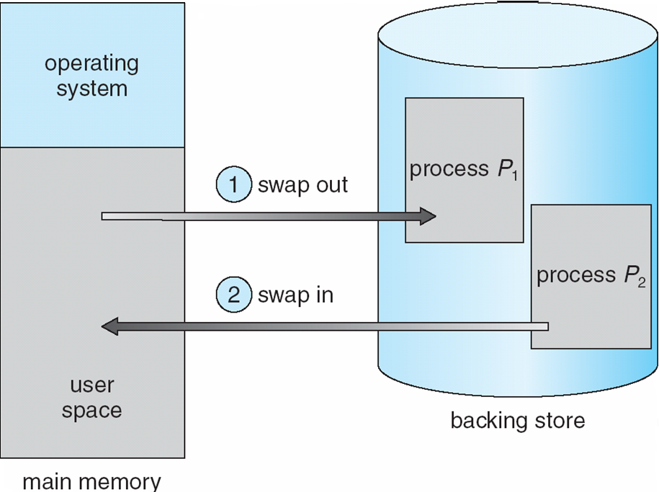
Schematic View of Swapping

Slide 22
Contiguous Memory Allocation (Dynamic Memory Allocation Problem)

Slide 23
Contiguous Allocation
Main memory is partitioned usually into two partitions:
Resident operating system, usually held in low memory with interrupt vector
User processes then held in high memory
Relocation registers used to protect user processes from each other, and from changing operating-system code and data
Base register contains value of smallest physical address
Limit register contains range of logical addresses – each logical address must be less than the limit register
MMU maps logical addresses dynamically

Slide 24
Basic Memory Allocation Strategies
In this chapter, we will cover 3 basic main memory allocation strategies to processes
1) Contiguous allocation
2) Paging
3) Segmentation

Slide 25
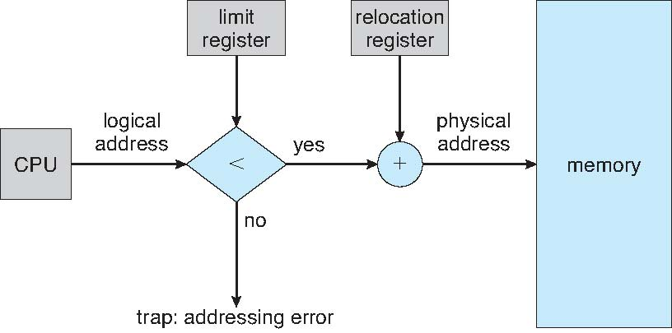
Hardware Support for Relocation and Limit Registers

Slide 26
Contiguous Allocation (Cont)
Multiple-partition allocation
Hole – block of available memory; holes of various size are scattered throughout memory
When a process arrives, it is allocated memory from a hole large enough to accommodate it
Operating system maintains information about: a) allocated partitions b) free partitions (hole)
OS
OS
OS
OS
process 5
process 5
process 5
process 5
process 9
process 9
process 8
process 10
process 2
process 2
process 2
process 2

Slide 27
Dynamic Storage-Allocation Problem
How to satisfy a request of size n from a list of free holes
First-fit: Allocate the first hole that is big enough
Best-fit: Allocate the smallest hole that is big enough; must search entire list, unless ordered by size
Produces the smallest leftover hole
Worst-fit: Allocate the largest hole; must also search entire list
Produces the largest leftover hole
First-fit and best-fit better than worst-fit in terms of speed and storage utilization

Slide 28
Fragmentation
External Fragmentation – total memory space exists to satisfy a request, but it is not contiguous
Internal Fragmentation – allocated memory may be slightly larger than requested memory; this size difference is memory internal to a partition (allocation), but not being used
Reduce external fragmentation by compaction
Shuffle memory contents to place all free memory together in one large block
Compaction is possible only if relocation is dynamic, and is done at execution time

Slide 29
Paging

Slide 30
Paging
Physical address space of a process can be noncontiguous; process is allocated physical memory whenever the latter is available
Divide physical memory into fixed-sized blocks called frames (size is power of 2, a typical size: 4096)
Divide logical memory into blocks of same size called pages
Keep track of all free frames
To run a program of size n pages, need to find n free frames and load program
Set up a page table to translate logical to physical addresses
Internal fragmentation

Slide 31
Paging
RAM (Physical Memory)
a program
0
0
1
a frame
(size = 2^{x})
1
2
2
logical address space
3
3
4
physical memory:
set of fixed sized
frames
4
5
5
7
program: set of pages
6
8
Page size = Frame size
9

Slide 32
Paging
RAM
a program
0
0
0
1
1
2
2
2
3
3
load
1
4
4
5
5
0 mapped_to 1
1 mapped_to 4
3
7
2 mapped_to 2
5
6
3 mapped_to 7
4 mapped_to 9
8
5 mapped_to 6
4
9
page table

Slide 33
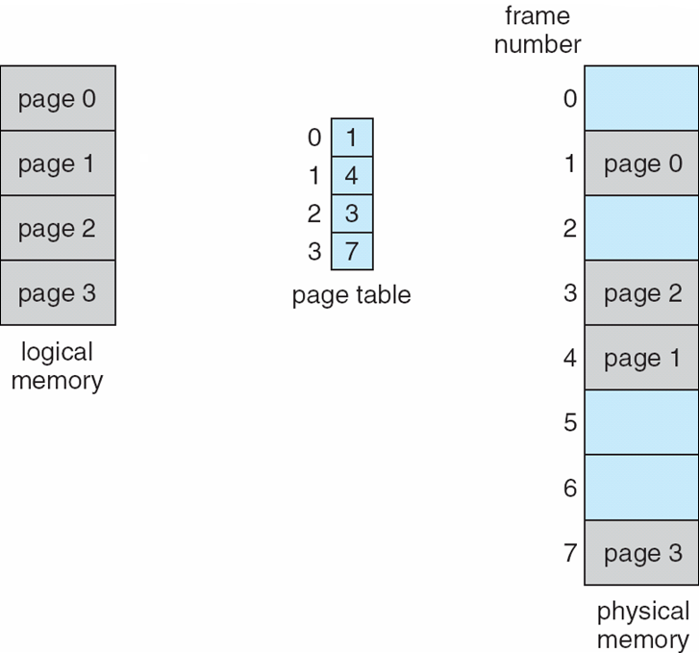
Example

Slide 34
Address Translation Scheme
Assume Logical Addresses are m bits. Then logical address space is 2^{m} bytes.
Assume page size is 2^{n} bytes.
Logical Address generated by CPU is divided into:
Page number (p) – used as an index into a page table which contains base address of each page in physical memory
Page offset (d) – combined with base address to define the physical memory address that is sent to the memory unit
page number
page offset
p
d
(m – n) bits
n bits
m bits

Slide 35
Simple example
Assume m is 3 and n is 2
Logical addresses
000
001
010
011
100
101
110
111
000
001
010
011
100
101
110
111
page0
page1

Slide 36
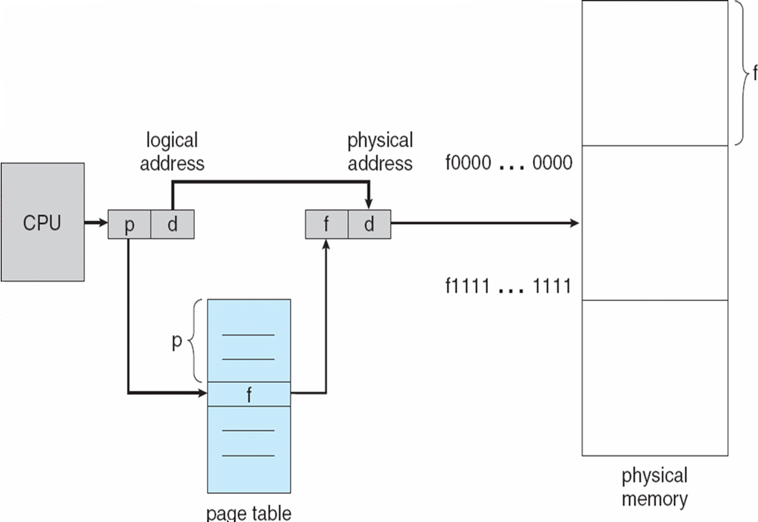
Paging Hardware: address translation

Slide 37
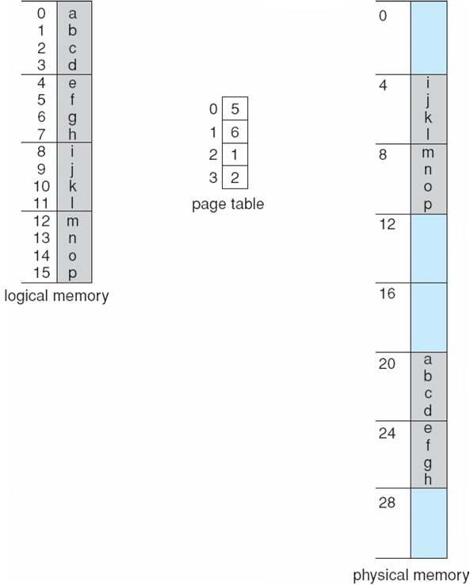
Paging and Address Translation Example
page size = 4 bytes
= 2²
LA = 5
PA = ?
5 is 0101
PA = 11001
4 bit logical address
LA = 11
PA = ?
32 byte memory
11 is 1011
PA = 00111
offset (dispacement)
inside page
page
number
LA = 13
PA = ?
13 is 1101
PA = 01001

Slide 38
Address translation example 2
15
000
0
16 bit logical address
14
000
0
0010000000000100
13
000
0
page size = 4096 bytes
(offset is 12 bits)
12
000
0
p#
offset
11
111
1
10
000
0
9
101
1
8
000
0
mapping
7
000
0
6
000
0
5
011
1
frame number
4
100
1
valid/invalid bit
f#
offset
3
000
1
2
110
1
110
000000000100
1
001
1
15 bit physical address
0
010
1
page table

Slide 39
Address translation example 3
m=3; 2³ ⁼ 8 logical addresses
2 bits for offset
0000
0001
0010
0011
0100
0101
0110
0111
1000
1001
1010
1011
1100
1101
1110
1111
n=2; page size = 2² = 4
frame 00
000
001
010
011
100
101
110
111
A
B
C
D
page 0
frame 01
E
F G H
1 bit for page#
page 1
E F G H
frame 10
Logical Memory
page table
A B C D
0
11
frame 11
1
10
each entry is used to map 4 addresses
2 bits for frame#
Physical Memory

Slide 40
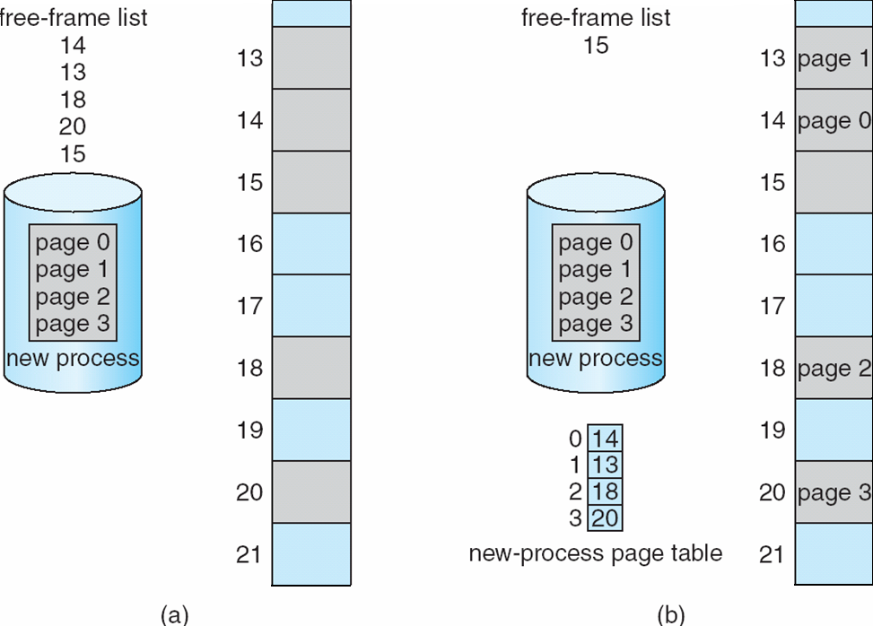
Free Frames
OS keeps info about the frames in its frame table
Before allocation
After allocation

Slide 41
Implementation of Page Table
Page table is kept in main memory
Page-table base register (PTBR) points to the page table
Page-table length register (PTLR) indicates size of the page table
RAM
Program P1
Program
P2
CPU
PC
PT1
PT2
Kernel Memory
Page
Table
of
P1
Page
Table
of
P2
PTBR
PTLR
Currently running
process is process 1 (P1)
PCB1
PCB2

Slide 42
TLB
In this scheme every data/instruction access requires two memory accesses.
One for the page table
One for the data/instruction.
The two memory access problem can be solved by the use of a special fast-lookup hardware cache called associative memory or translation look-aside buffers (TLBs)
Learned (p#, f#) mappings can be cached in TLB.
TLB: a set of entries (limited size); each entry storing a different mapping
Can be accessed very fast

Slide 43
TLB Associative Memory
Associative memory – parallel search
Address translation (p, d)
If p is in TLB, get frame # out
Otherwise get frame # from page table in memory
Page #
Frame #
Some TLBs store address-space identifiers (ASIDs) in each TLB entry – uniquely identifies each process to
provide address-space protection for that process

Slide 44
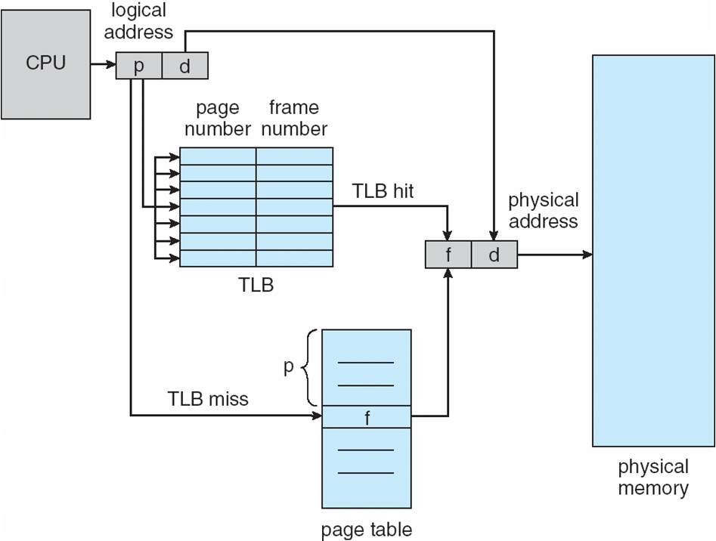
Paging Hardware With TLB

Slide 45
Effective Memory Access Time
TLB (associative registers) Lookup = ε time unit
Assume memory cycle time is 1 microsecond
Hit ratio – percentage of times that a page number is found in the TLB; ratio related to the TLB size
Hit ratio = α
Effective Access Time (EAT)
EAT = (1 + ε) α + (2 + ε)(1 – α)
= 2 + ε – α

Slide 46
Memory Protection
Memory protection implemented by associating a protection bit with each page
Read only page
Executable page
Read-write page
Valid-invalid bit attached to each entry in the page table:
“valid” indicates that the page is in the process’ logical address space, and is thus a legal page
“invalid” indicates that the page is not in the process’ logical address space

Slide 47
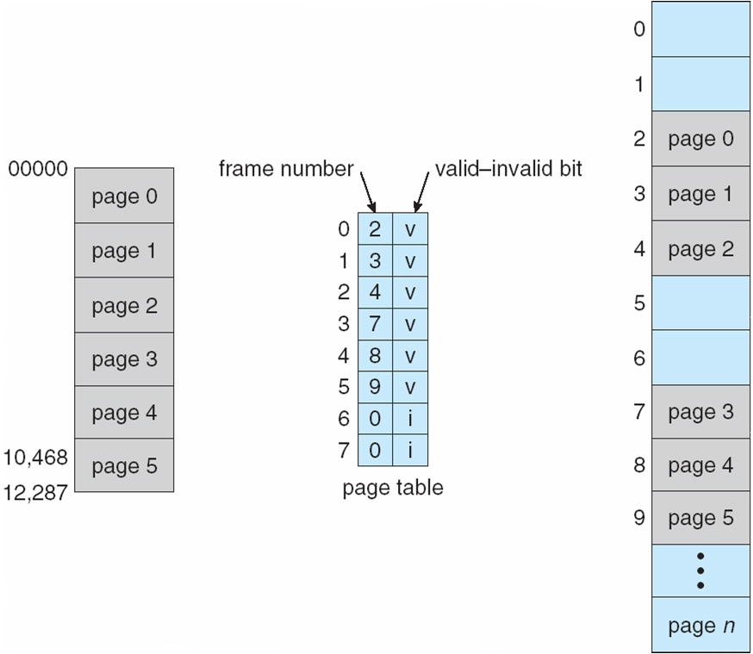
Valid (v) or Invalid (i) Bit In A Page Table

Slide 48
Page Table Entry Structure
A typical size of a page table entry can be 32 bits. Depends on the architecture
Typically we have the following fields in a page table entry.
Referenced
bit
Protection bits (read, read-write, execute)
Reserved
Page Frame Number
Caching
Disabled
bit
Modified (Dirty)
bit
Valid/Invalid
(Present/Absent) bit

Slide 49
Shared Pages
A program can be started multiple times (same program executed by multiple process)
Code pages can be shared
Shared code
One copy of read-only (reentrant) code shared among processes (i.e., text editors, compilers, window systems).
Shared code must appear in same location in the logical address space of all processes
Private code and data
Each process keeps a separate copy of the code and data
The pages for the private code and data can appear anywhere in the logical address space

Slide 50
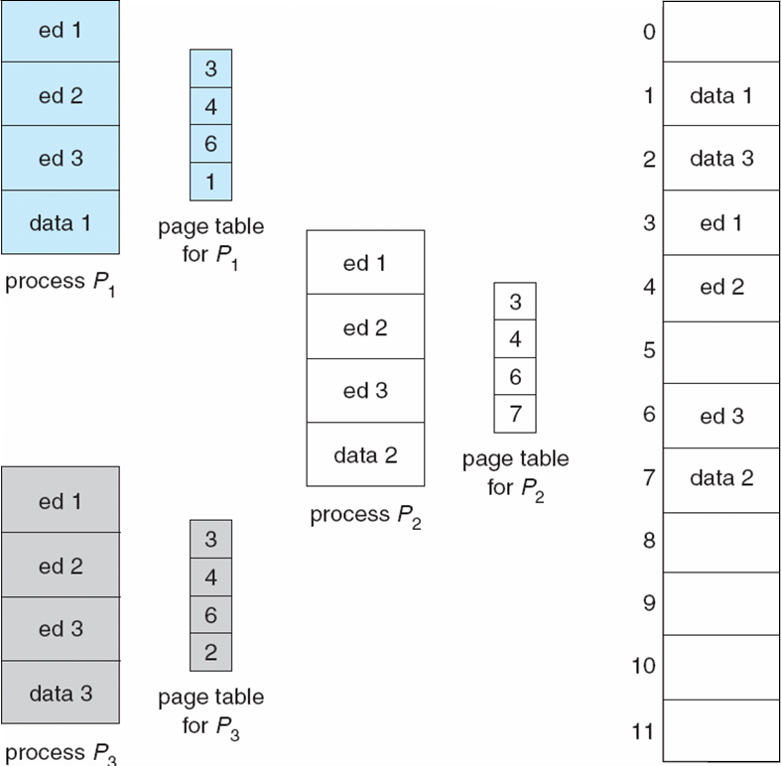
Shared Pages Example

Slide 51
Segmentation

Slide 52
Segmentation
Memory-management scheme that supports user view of memory
A program is a collection of segments (logical contiguous units)
A segment is a logical unit such as:
main program
procedure
function
method
object
local variables, global variables
common block
stack
symbol table
arrays

Slide 53
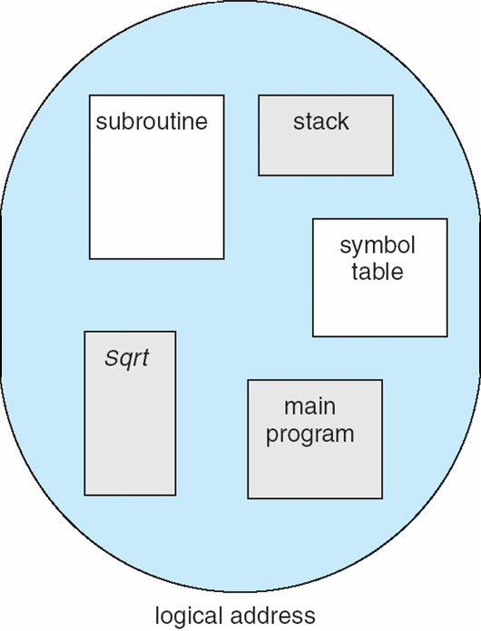
User’s View of a Program

Slide 54
Logical View of Segmentation
segment
1
1
4
2
3
4
2
3
user space
physical memory space

Slide 55
Segmentation Architecture
Logical address consists of a two tuple:
<segment-number, offset>
Segment table – maps two-dimensional logical addresses; each table entry has:
base – contains the starting physical address where the segments reside in memory
limit – specifies the length of the segment
Segment-table base register (STBR) points to the segment table’s location in memory
Segment-table length register (STLR) indicates number of segments used by a program;
segment number s is legal if s < STLR

Slide 56
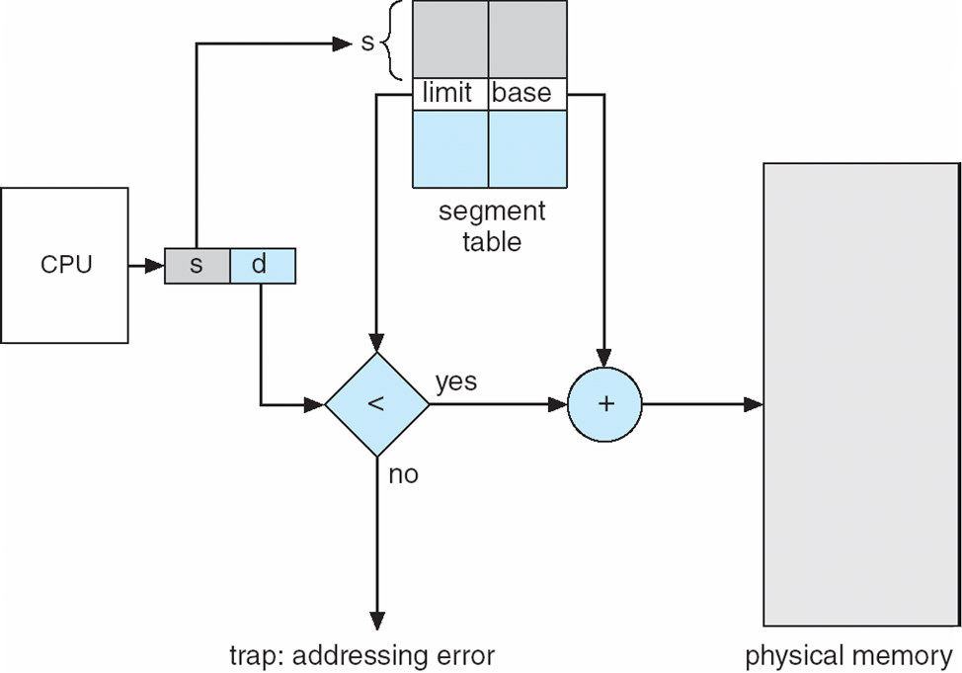
Segmentation Hardware

Slide 57
Segmentation Architecture (Cont.)
Protection
With each entry in segment table associate:
validation bit = 0 ⇒ illegal segment
read/write/execute privileges
Protection bits associated with segments; code sharing occurs at segment level
Code segment: READONLY; sharable; …
Data segment: RED-WRITE; not-sharable
Since segments vary in length, memory allocation is a dynamic storage-allocation problem

Slide 58
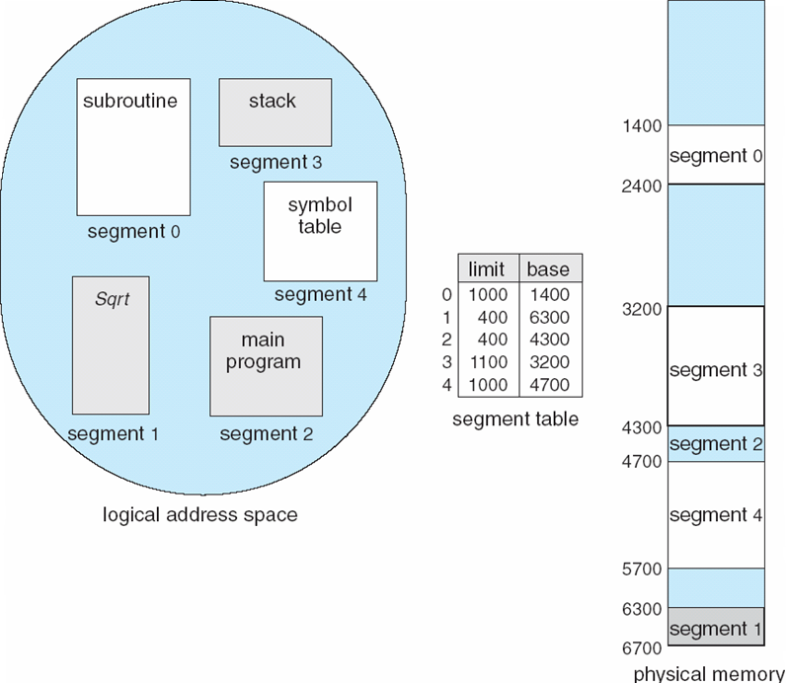
Example of Segmentation

