Slide 1

Black-Scholes-Merton Model: Pricing Options with Precision
A foundational framework that transformed modern derivatives markets — and earned a Nobel Prize.
A complete guide to understanding, applying, and evaluating the Black-Scholes-Merton model for modern finance professionals.
Presentation Outline
1. Introduction to Options Pricing — Why derivatives pricing matters in modern finance.
2. The Origins of Black-Scholes-Merton — The theory, contributors, and market context.
3. Core Assumptions of the Model — The conditions that make the framework work.
4. The Black-Scholes-Merton Formula — Inputs, variables, and pricing mechanics.
5. Understanding Option Greeks — How value changes with market conditions.
6. Volatility and Its Role — Why volatility is central to option valuation.
7. Dividend Effects and Adjustments — Extending the model for real-world assets.
8. Practical Applications in Finance — Use cases in trading, hedging, and risk management.
9. Limitations of the Model — Where assumptions break down in practice.
10. Model Evaluation and Sensitivity Analysis — Testing reliability across scenarios.
11. Key Takeaways and Final Review — What to remember and how to apply it effectively.

Slide 2

What Is the Black-Scholes-Merton Model?
1
A Mathematical Formula for Options Pricing
Calculates the fair value of European-style call and put options before they expire.
2
Developed in 1973
Created by Fischer Black, Myron Scholes, and Robert Merton — pioneers of quantitative finance.
3
Nobel Prize-Winning Work
Scholes and Merton received the 1997 Nobel Prize in Economics for this breakthrough model.

Slide 3



Why Does It Matter?
Accuracy
Risk Management
Valuation
Estimates the fair value of options before expiration, giving traders a principled benchmark rather than guesswork.
Helps traders hedge positions and manage exposure — limiting downside while preserving upside.
Widely used in corporate finance, M&A, and employee stock options to assign fair economic value.

Slide 4

The Core Formula
Call Option Price
C = S₀N(d₁) − Ke−rTN(d₂)
Put Option Price
P = Ke−rTN(−d₂) − S₀N(−d₁)
Where d₁ and d₂ are calculated from the stock price, volatility, and time to expiration — capturing both probability and risk adjustment in a single elegant expression.

Slide 5
Key Variables Explained
S₀ — Current Stock Price
The market price of the underlying stock today. The starting point of every calculation.
K — Strike Price
The agreed exercise price at which the option can be bought or sold.
r — Risk-Free Rate
The theoretical return of a zero-risk investment, typically approximated by government bond yields.
T — Time to Expiration
How long until the option expires, expressed in years (e.g., 3 months = 0.25).
σ — Volatility
The standard deviation of the stock's returns — a measure of how wildly prices swing.

Slide 6
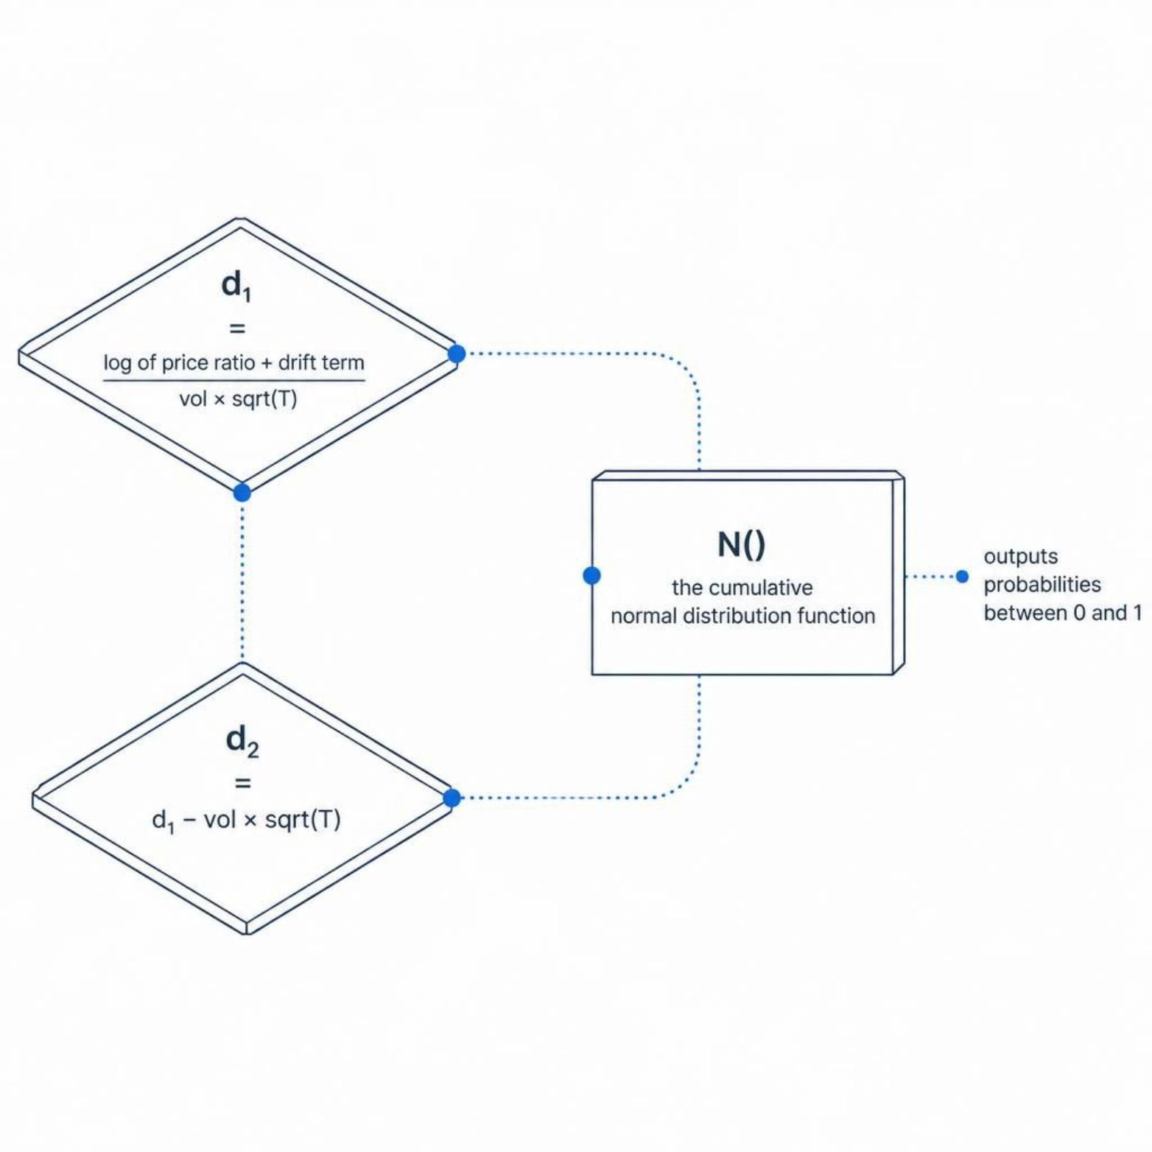
The d₁ and d₂ Calculations
The Formulas
d₁ = [ln(S₀/K) + (r + σ²/2)T] / (σ√T)
d₂ = d₁ − σ√T
N(d₁) reflects the sensitivity of the option price to the stock price
N(d₂) represents the probability that the option expires in-the-money under risk-neutral measure
Both use the cumulative normal distribution — values always fall between 0 and 1

Slide 7

Practical Example: Pricing a Call Option
S₀ = $100
K = $105
T = 0.25 yrs
Current stock price
Strike price
3 months to expiry
r = 5%
σ = 20%
Risk-free rate
Annualized volatility
Result: Plugging these values into BSM yields a call option price of approximately $2.70 — a precise, model-driven fair value derived purely from market fundamentals.

Slide 8




Real-World Applications
Options Trading
Corporate Finance
Risk Management (The Greeks)
M&A Deals
Determine fair prices for buying and selling options on exchanges worldwide, reducing information asymmetry.
Assess embedded options in acquisition structures — from earn-outs to contingent consideration clauses.
Value employee stock options and warrants for compensation reporting and financial statements.
Calculate Delta, Gamma, and Vega to build precise hedging strategies and control portfolio exposure.

Slide 9
Key Assumptions & Limitations
What the Model Assumes
Where It Falls Short
No dividends paid during the option's life
European-style options only (exercised at expiry)
Constant volatility throughout the period
Efficient markets with no arbitrage opportunities
Struggles with American options (early exercise)
Breaks down during extreme market events (fat tails)
Inaccurate for highly volatile or illiquid assets
Alternative: Binomial models or Monte Carlo simulations for complex scenarios

Slide 10

Key Takeaways
A Systematic Pricing Framework
Variables Drive Decisions
The Foundation of Modern Finance
Understanding how price, volatility, time, and interest rates interact empowers smarter, more informed trading choices.
BSM gives traders and analysts a rigorous, consistent method to value options based on observable market inputs — not intuition.
BSM underpins derivatives pricing, portfolio hedging, and risk management across global markets — making it essential knowledge for any finance professional.

Slide 11




Conclusion: From Theory to Practice
Transformative Impact
The BSM model revolutionized options pricing, bringing mathematical rigor to a once speculative market.
Foundational, Yet Evolving
Despite its assumptions, BSM remains a cornerstone, with adaptations and advanced models built upon its principles.
Essential for Professionals
Mastering BSM is crucial for anyone involved in derivatives, risk management, or corporate valuation.
Continue to explore its nuances and apply its powerful framework to navigate complex financial markets.

