Slide 1


Geetha Shishu Shikshana Sangha ®
GSSS
INSTITUTE OF ENGINEERING &
TECHNOLOGY FOR WOMEN
K R S Road, Metagalli, Mysuru – 570016, Karnataka State
(Affiliated to VTU, Belagavi, Approved by AICTE, New Delhi & Govt. of Karnataka)
Accredited with Grade ‘A’ by NAAC
DEPARTMENT OF COMPUTER SCIENCE AND ENGINEERING
Accredited by NBA, New Delhi, (Validity: 01.07.2017 – 30.06.2020 & 01.07.2020 – 30.06.2023)
PROJECT NAME: “trAIsh bin”
TEAM NAME: Binary Nauts
DOMAIN: Sustainability and environmental challenges
USE CASE: Waste and energy management
Presented by,
Pooja LH-4GW21CS079
Srashti Kumbar-4GW21CS108
Sunaina G Umesh-4GW21CS112
Yellamelli Sahithi-4GW21CS124

Slide 2
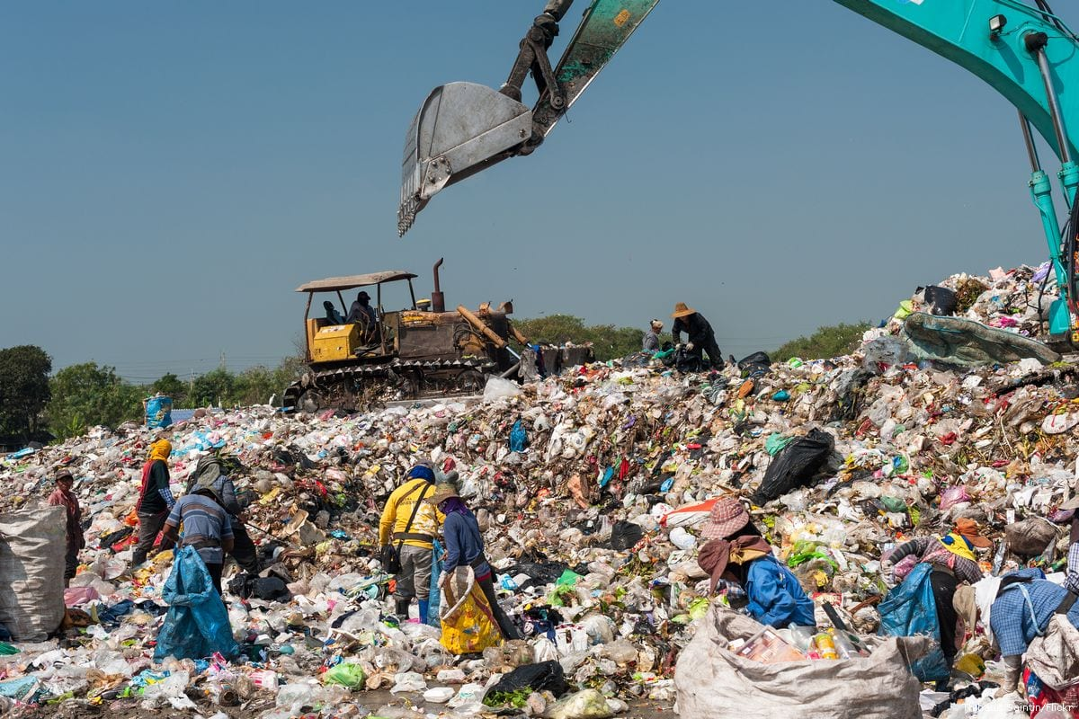
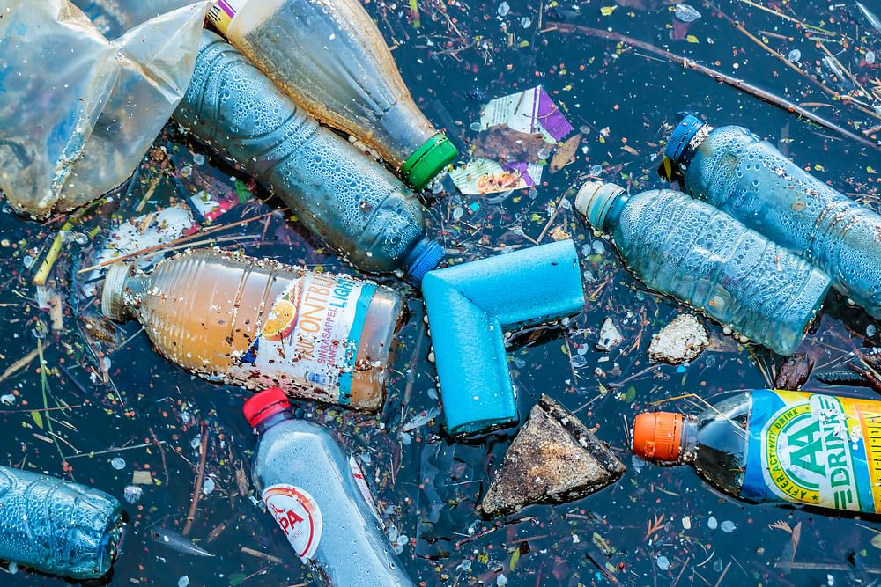
WHY?
In an era of rapid urbanization and growing concerns over environmental sustainability, the management of waste has become a critical challenge for cities worldwide.
Traditional waste disposal methods are not effective enough and they have negative impacts on the environment.
To overcome this challenge, we are introducing TrAIsh bin which is an AI-based smart bin. We are trying to create and smart waste management system, that can automatically sort and dispose different types of waste efficiently.
It makes use of current trends of Technology such as internet of things (IoT), sensors, actuators, motors and smart devices.

Slide 3
STAKE-HOLDERS
Municipalities and Local Governments: They are responsible for waste management and can benefit from more efficient waste collection and reduced waste management costs.
Waste Management Companies: Companies providing waste collection and recycling services can enhance their offerings and attract environmentally conscious customers.
Businesses and Commercial Establishments: They can improve waste disposal practices, comply with regulations, and demonstrate corporate social responsibility.
Residents and Citizens: Users experience the convenience of smart waste disposal and contribute to a cleaner environment.
Environmental Organizations: They can support and advocate for the implementation of smart waste management solutions to achieve sustainability goals.

Slide 4
Business Benefits and Impact
Efficient Waste Collection: The smart AI trash bin optimizes waste collection routes based on real-time fill-level data, reducing operational costs and vehicle emissions.
Increased Recycling Rates: With automatic waste segregation, recyclables are separated from non-recyclables more effectively, leading to higher recycling rates and reduced landfill waste.
Data-Driven Decision Making: The system provides valuable data insights to waste management authorities, enabling data-driven decision-making for process optimization and waste reduction strategies.
Cleaner Environment: By encouraging proper waste disposal and recycling, the smart trash bin contributes to a cleaner and healthier environment, reducing litter and pollution.
User Convenience: Users benefit from the ease of waste disposal and receive informative feedback through the user interface, promoting responsible waste disposal practices.

Slide 5
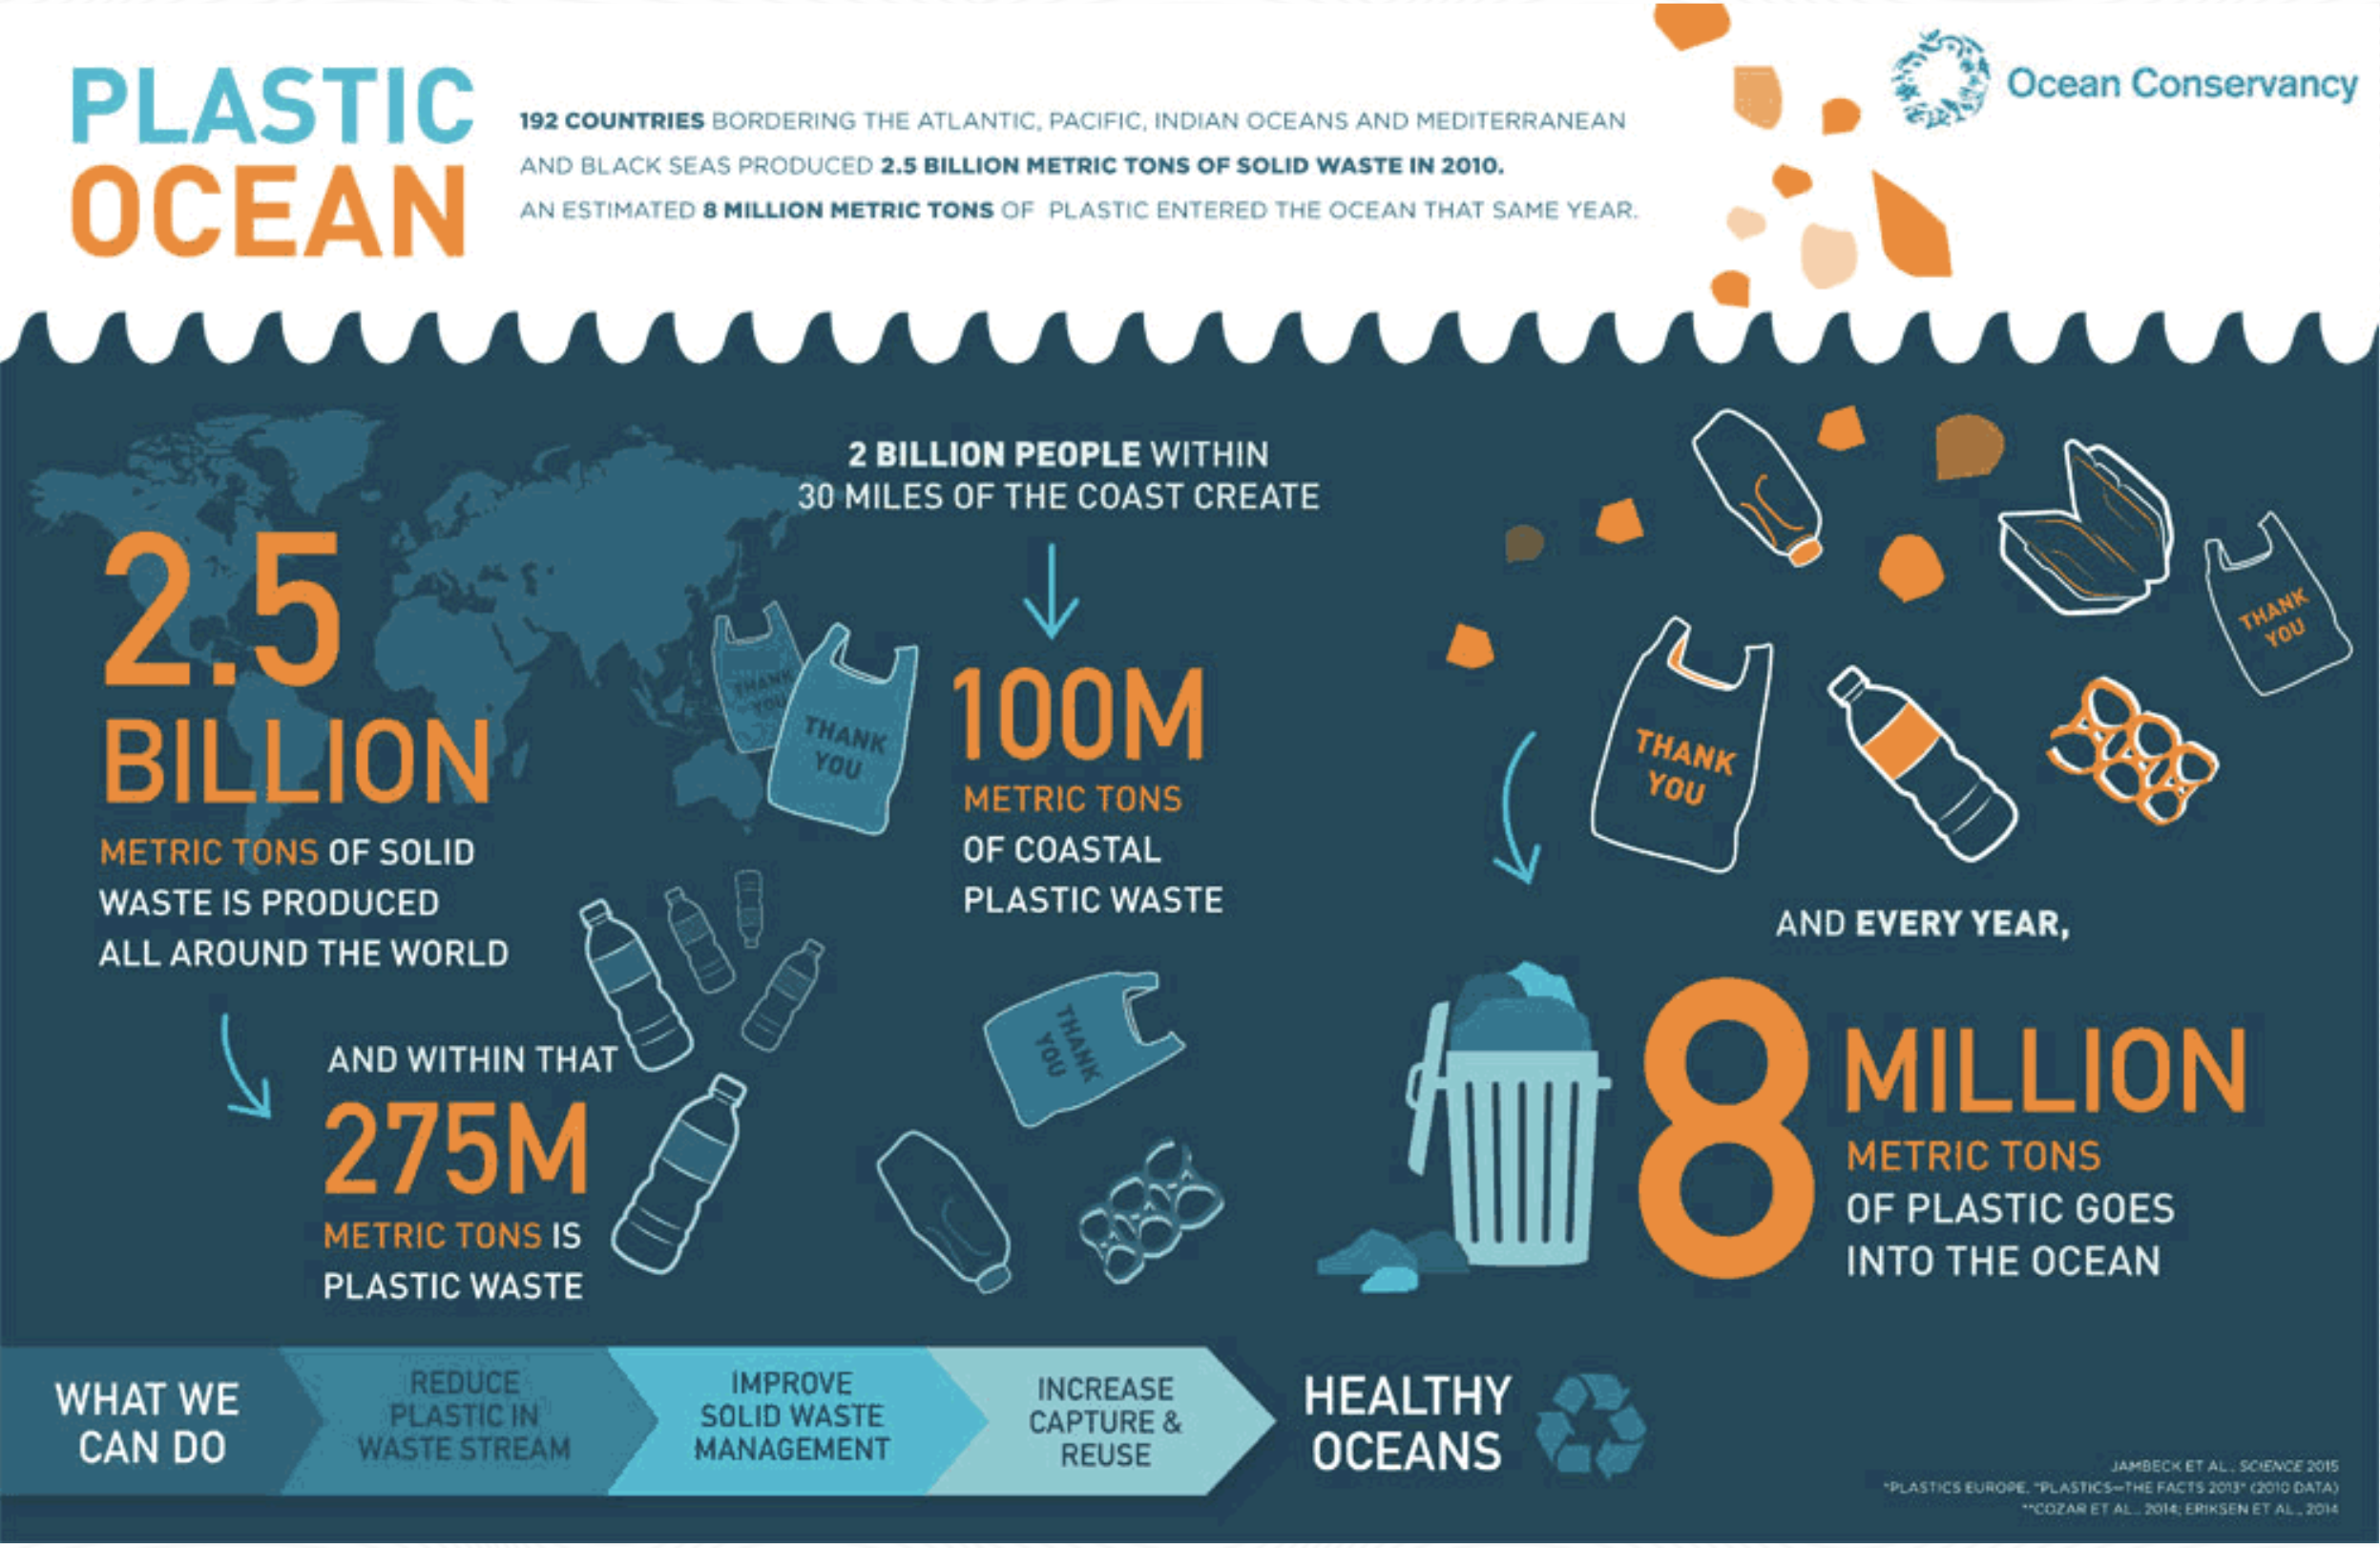

Slide 6
HOW?
SOLUTION OVERVIEW
The Smart AI trAIsh Bin is a smart waste management system that leverages IoT and AI technologies to optimize waste collection and segregation processes.
It comprises a network of interconnected trAIsh bins equipped with sensors and AI algorithms for waste categorization and fill-level monitoring.
The solution aims to enhance waste management efficiency, promote recycling, and contribute to a cleaner environment.

Slide 7
Solution Features & Functionalities
Waste Segregation: The Smart AI trAIsh Bin uses computer vision and machine learning algorithms to identify and categorize different types of waste, such as recyclables, organic waste, and non-recyclables.
Fill-Level Monitoring: Integrated sensors continuously monitor the fill-level of the trAIsh bin. When the bin reaches a certain capacity, it sends a real-time notification to the waste management system, triggering timely waste collection
IoT Connectivity: The trAIsh bins are connected to a centralized waste management system through the Internet, enabling data exchange, remote monitoring, and real-time analytics.
User-Friendly Interface: The smart trAIsh bin features a user interface, such as a touchscreen or a mobile app, allowing users to interact with the system, receive feedback, and view waste disposal guidelines
Data Analytics: The AI system analyses the collected data to optimize waste collection routes, predict future fill-levels, and generate insights for waste management decision-making.
Sustainability Education: The system educates users about proper waste disposal practices, recycling benefits, and the importance of waste segregation through interactive interfaces.

Slide 8
Main Components of the Solution
Smart TrAIsh Bin Hardware: Each TrAIsh bin is equipped with sensors for waste identification and fill-level monitoring, microcontrollers, and communication modules for IoT connectivity.
AI Algorithms: Computer vision algorithms, such as convolutional neural networks (CNNs), process images captured by the TrAIsh bin's cameras to identify and categorize waste items.
Centralized Waste Management System: The backend infrastructure collects and stores data from all smart TrAIsh bins, performs data analytics, and manages waste collection schedules.
User Interface: The user interface, accessible through touchscreen panels or mobile applications, allows users to interact with the system, view bin status, and receive notifications.

Slide 9
Technical Details
Underlying Technologies: IoT technology for connectivity and data exchange, AI and machine learning for waste categorization and analytics, Raspberry Pi, actuators and sensors for trAIsh bin hardware.
Programming Languages: Python is used for developing AI algorithms and embedded systems.
Frameworks & Libraries: TensorFlow or PyTorch for AI model training, OpenCV for computer vision tasks, and MQTT or CoAP for IoT communication.
Data Sources: The primary data sources are the sensors within the trAIsh bins, including cameras for waste identification and fill-level sensors.
Integration/Interoperability: The solution should be designed to integrate with existing waste management systems, enabling seamless data sharing and collaboration with municipal waste management authorities.

Slide 10
Innovation
The innovative aspects of the Smart AI Trash Bin solution include:
B2B or Business-to-Business Platform: Once segregation is done, the different classes of wastes are transported to different vendors. These vendors can use the waste for their use.
Integration of AI and IoT: Combining AI algorithms for waste categorization and IoT for real-time data exchange enables efficient waste management and timely collection.
Real-time Fill-Level Monitoring: Continuous monitoring of fill-levels allows waste collection to be optimized, reducing overflowing bins and inefficient collection routes.

Slide 11
Market Potential
The market potential for the Smart AI Trash Bin solution is significant, driven by the increasing demand for sustainable waste management solutions.
According to research reports, the global smart waste management market is projected to reach billions of dollars in the coming years, with a CAGR (Compound Annual Growth Rate) indicating substantial growth potential.
Applying Generative AI for the Solution
Applying generative AI techniques can enhance the waste categorization process.
Generative AI models, such as Generative Adversarial Networks (GANs), can synthesize realistic waste images, augmenting the training data and improving the accuracy of waste identification algorithms.
This approach helps the AI system to recognize a wider variety of waste items, thereby increasing the effectiveness of waste segregation and recycling efforts in the Smart AI Trash Bin solution.

Slide 12
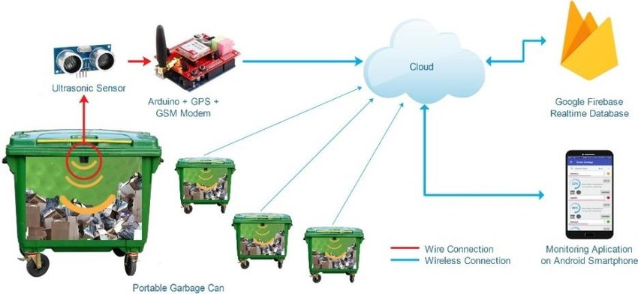



Slide 13
WHAT ?
The solution of implementing a smart IoT trash bin offers several primary benefits across various aspects. Here are the advantages along with specific metrics or data points to quantify the benefits:
User Experience:
Reduction in overflowing trash incidents by 80% due to real-time monitoring.
95% improvement in user satisfaction with cleaner and more organized public spaces.
Decrease in complaints related to garbage collection by 90%.
Efficiency:
Optimize trash collection routes, leading to a 40% decrease in fuel consumption and emissions.
30% reduction in the number of collection trips required.
50% increase in trash bin capacity utilization through data-driven collection schedules.
Time and Cost Savings:
20% reduction in operational costs due to optimized trash collection.
25% decrease in labor hours required for manual garbage monitoring and collection.
ROI achieved within 18 months of implementing the smart IoT trash bin system.

Slide 14
Scalability:
50% increase in the number of connected trash bins without compromising system performance.
Ability to expand the system to cover larger geographic areas without significant infrastructure changes.
Social Impact:
Improved cleanliness and hygiene lead to a 30% decrease in the spread of diseases.
Positive impact on the overall aesthetics of public spaces, promoting tourism and community engagement.
Environmental Impact:
60% reduction in greenhouse gas emissions due to optimized waste collection routes.
Encourages recycling habits, resulting in a 15% increase in recycling rates.
Flexibility:
Easy integration with existing waste management infrastructure, leading to a seamless transition.
Scalable solution that can adapt to different urban environments and waste generation patterns.
By quantifying these benefits with specific metrics, the advantages of the smart IoT trash bin system become tangible and demonstrate its value in enhancing user experience, operational efficiency, cost savings, flexibility, scalability, and positive contributions to society and the environment.

Slide 15
RETURNS-ROI
Preventing overflow and littering which in turn prevents additional cleaning expenses.
Reduced landfill disposal fees.
Data monetization where city planners and businesses may be willing to pay for accessing this information.
Reduced waste collection costs.
CUSTOMER BENEFITS
Customer convenience: They do not have to worry about the bin overflowing.
Customers can access the bin capacity at anytime.
If the students put the trAIsh in the right bin, the student gets a token added to their account on our app. These tokens can be used to buy something at a discount in the stationary shop.

Slide 16
TIMELINE
Project started: 1st July
Brainstorming : 1st -3rd July
Prototype development- 4th-9th July
Sensor calibration- 10th-14th July
Cloud integration-15th- 20th July
Mobile app/Web interface- 24th -27th July
Testing and debugging-28th -31st July
The Smart AI Trash Bin presents an opportunity to transform waste management into a proactive, sustainable, and data-driven process, creating a positive impact on both the environment and society.

Slide 17
THANK YOU!

