Slide 1
InPace Android App
For Seidenberg School of Computer Sciences

Slide 2
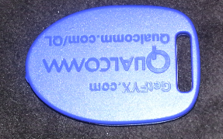
Overview
Beacons Devices
Gimbal SDK
Coding – Java using Eclipse ADT
InPace App Details

Slide 3
Beacons

Slide 4
Beacons
An intentionally conspicuous device designed to attract attention to a specific location
IBeacons born from Apple iOS7
Used with Bluetooth enabled Android devices
Battery Life – 1 year or more
Sensing Range – Maximum of 30 feet to 200 feet

Slide 5
Beacons
Offered by – Estimote, Qualcomm, Gimbal
Advantages of Gimbal Beacons
Access to API which includes GeoFencing, Proximity and Interest Sensing

Slide 6
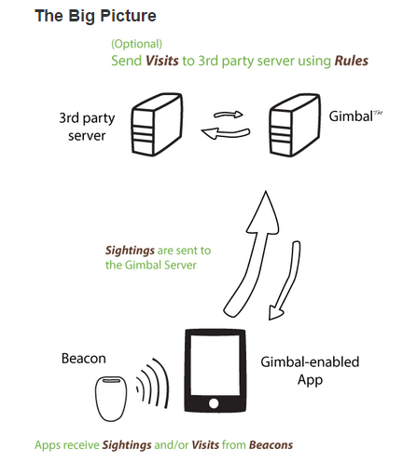
Beacons
Proximity
Close range at
which application
detect Beacons

Slide 7
Beacons
GeoFence
Represents a geographical region
Alert generated after crossing the boundary of a Geofence
Interest Sensing
Collects and analyzes mobile device data
Make inferences based on contextual data

Slide 8
Beacons
Sighting
Proximity enabled application receives a BLE packet from beacon
Depending on visibility of the application Gimbal proximity SDK notifies the application of sighting
App then reacts to sighting by dispaying information about current location

Slide 9
Beacons
Lifecycle of Visits
Arrival (First Sighting )
Sighted (One or more Sightings)
Departure (No longer sighted)

Slide 10
Gimbal Beacons

Slide 11
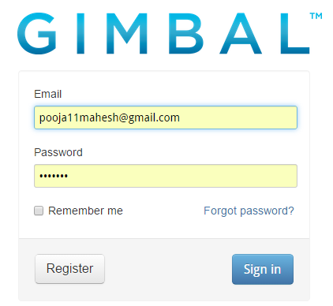
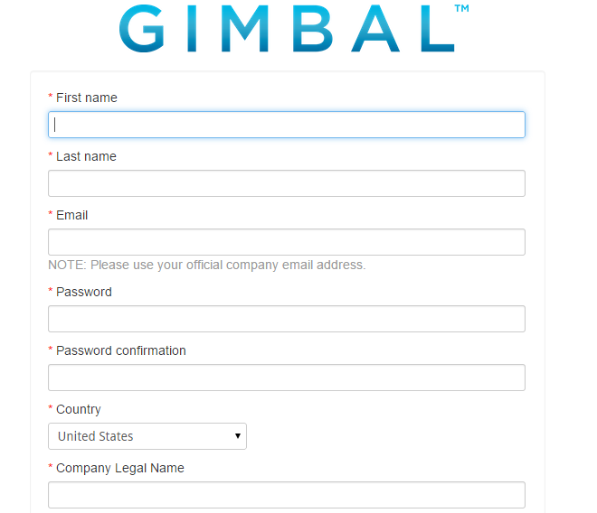
Gimbal Manager Registration

Slide 12
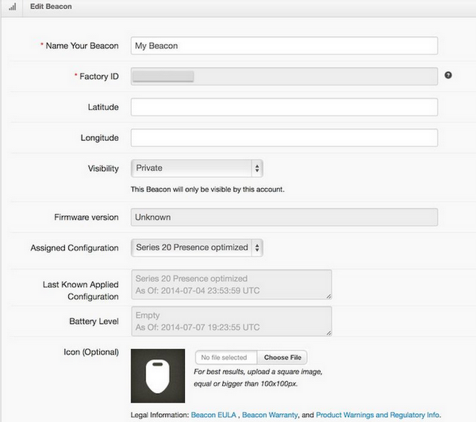
Beacons – Default Configuration

Slide 13
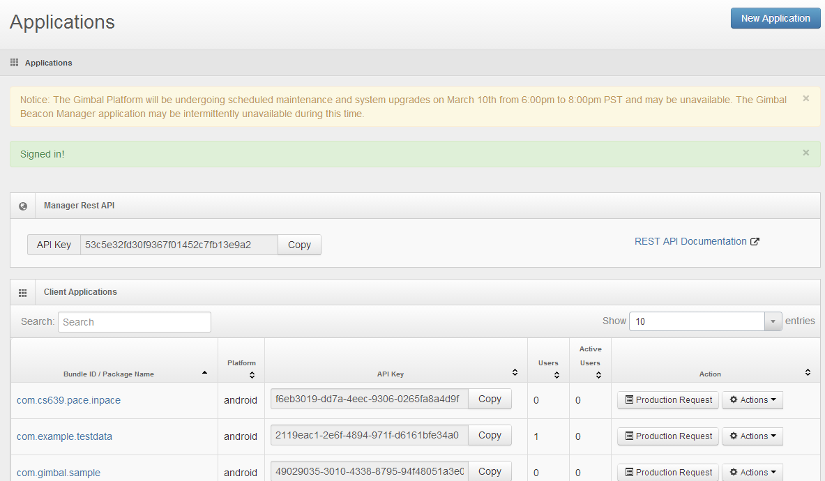
Create Gimbal Application

Slide 14
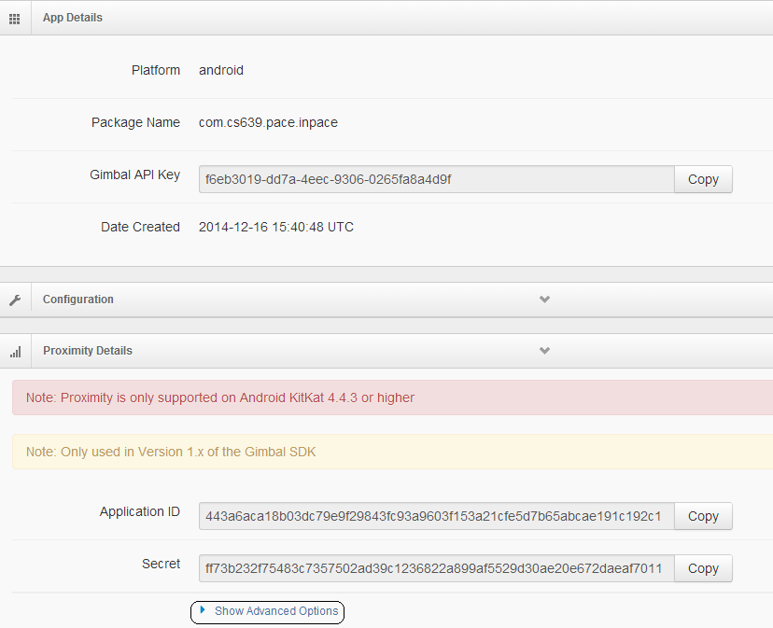
Beacons – Visibility

Slide 15
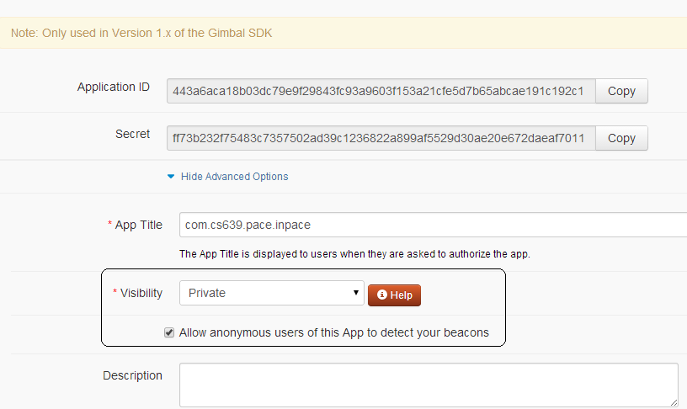
Beacons – Visibility

Slide 16
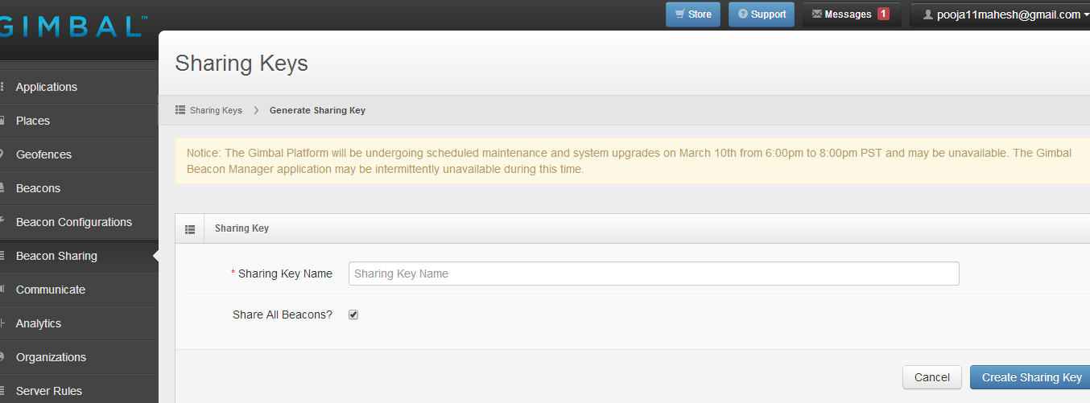
Beacons – Sharing

Slide 17
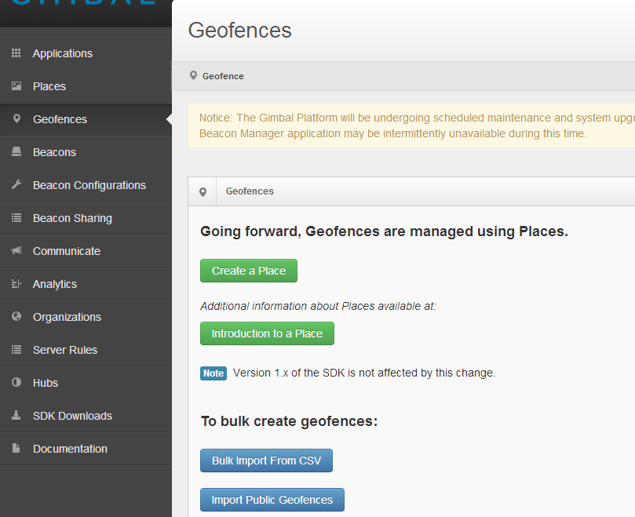
Create GeoFence

Slide 18
Android App Development with Beacons

Slide 19
Requirements
Beacons Devices
Bluetooth enabled Android device minimum version 4.4.3 (for Proximity)
Gimbal Developer Account
Gimbal SDK for Android
Eclipse Indigo (3.7) or higher
Install Eclipse Android ADT Plugin
Use ADT Plugin to download Android version = API8:Android2.2
Technologies – Java, XML, SQLite, JSON

Slide 20
Using Eclipse Android ADT

Slide 21
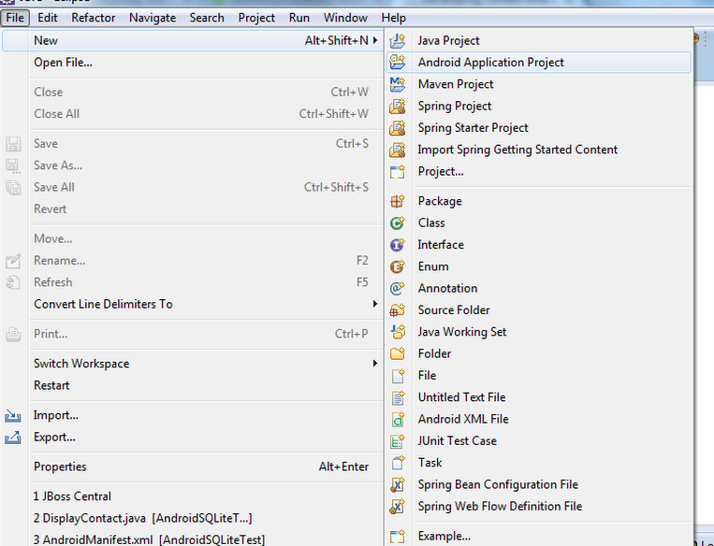
Android App Creation

Slide 22
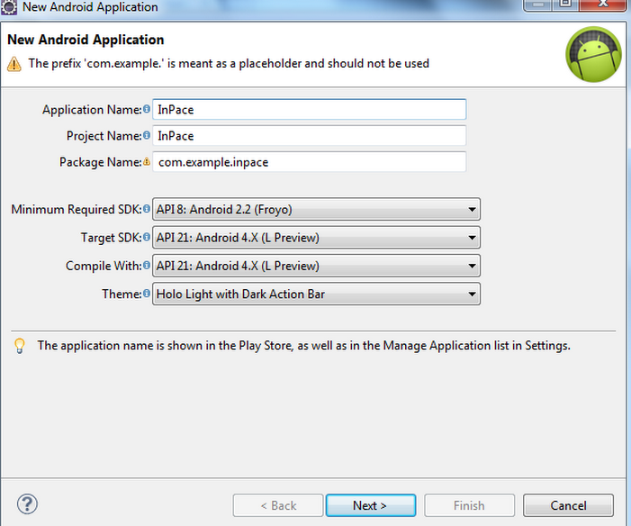
Android App Creation

Slide 23
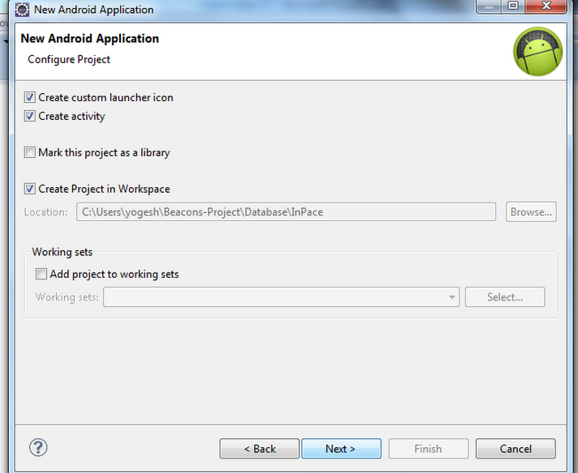
Android App Creation

Slide 24
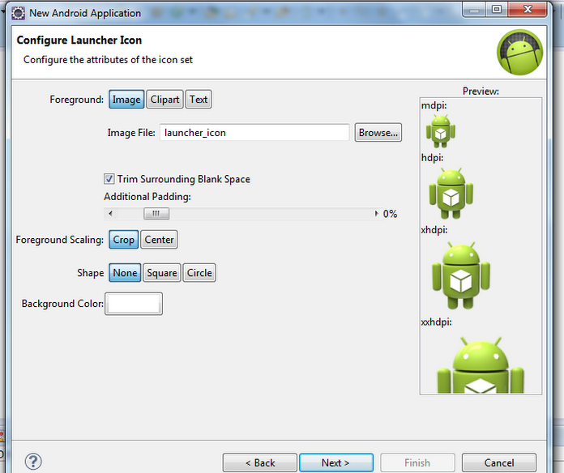
Android App Creation

Slide 25
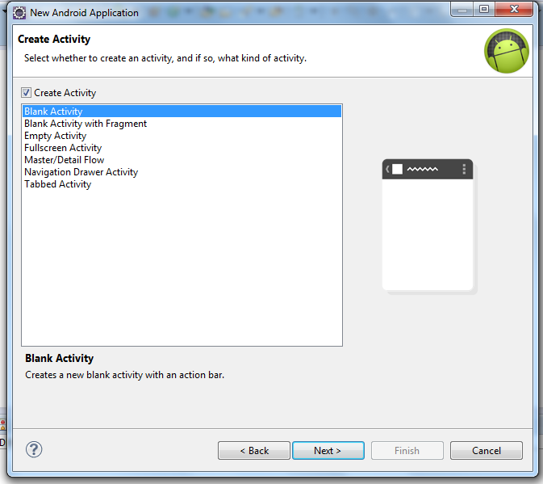
Android App Creation

Slide 26
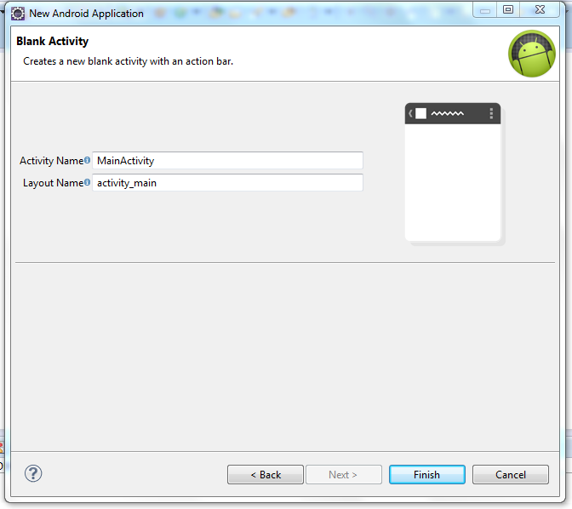
Android App Creation

Slide 27
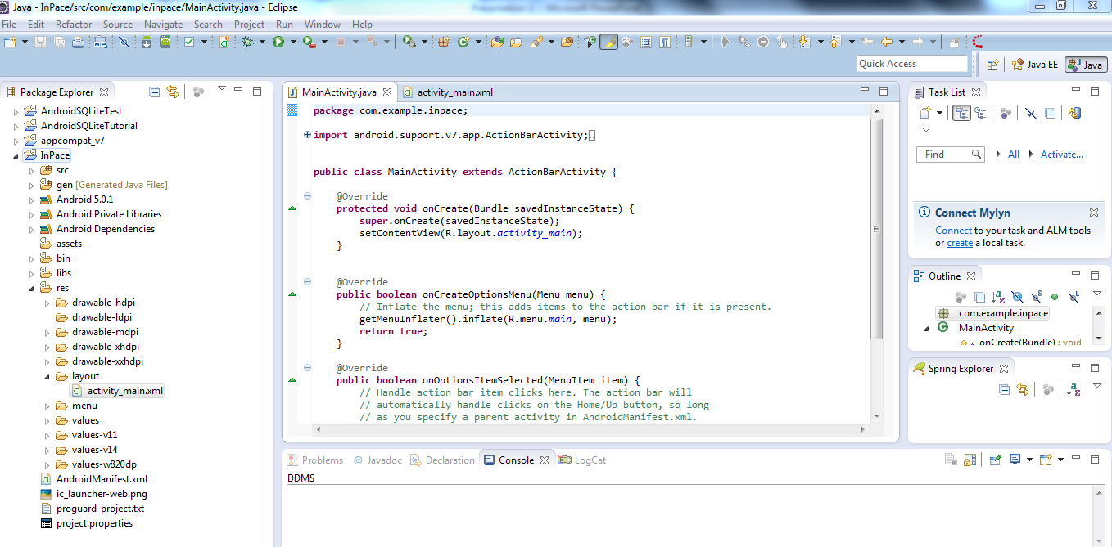
Android App Creation

Slide 28
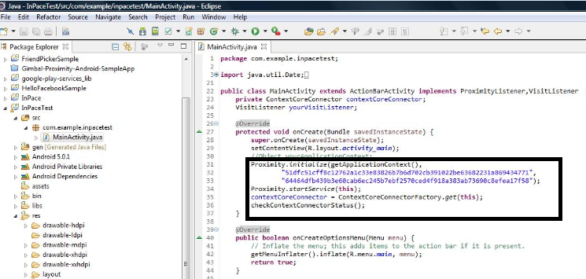
MainActivity for Proximity

Slide 29
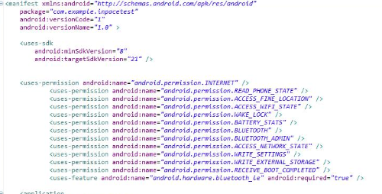
Manifest

Slide 30
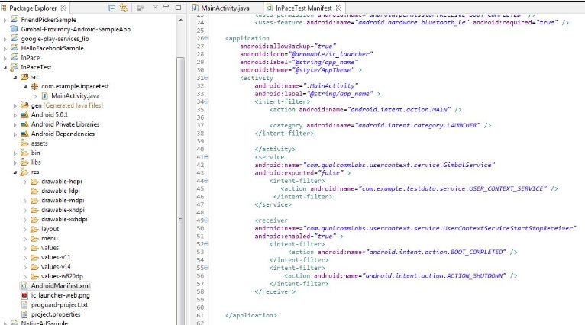
Manifest

Slide 31
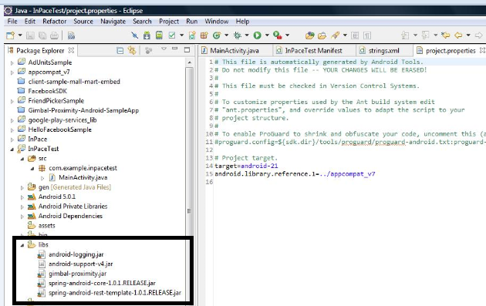
Jars

Slide 32
Android App Creation
Add jars to your project
Context-Core.jar
Context-Location.jar
android-logging.jar
spring-android-rest-template-1.0.1.RELEASE.jar
spring-android-core-1.0.1.RELEASE.jar

Slide 33
Gimbal SDK

Slide 34
Create Gimbal Application

Slide 35
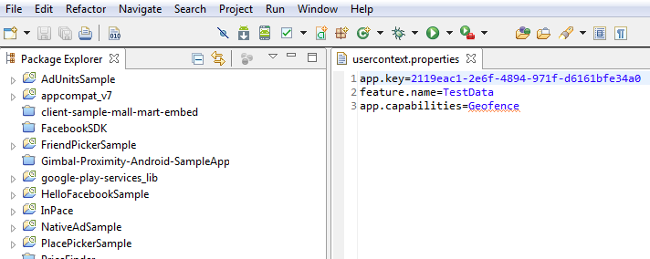
Configure App for Gimbal SDK

Slide 36
Running The App
In Eclipse
Right click on the project and click Run as → Android Application
In Android Studio
Click on green triangle button

Slide 37
InPace App

Slide 38
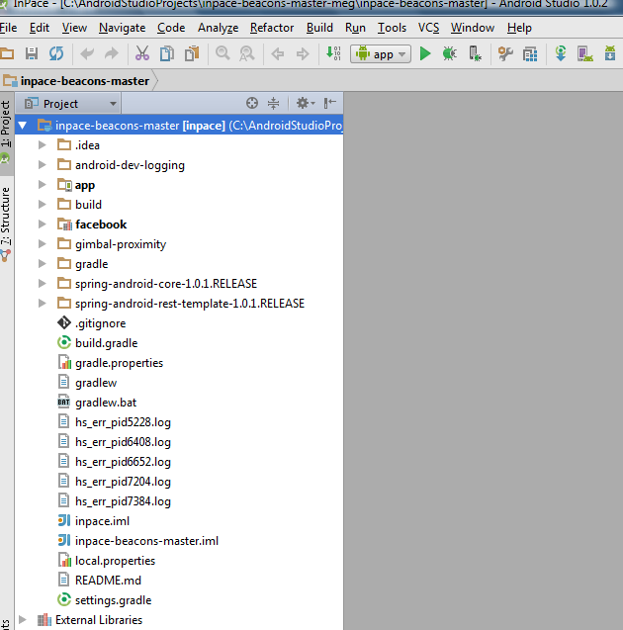
Android Studio

Slide 39
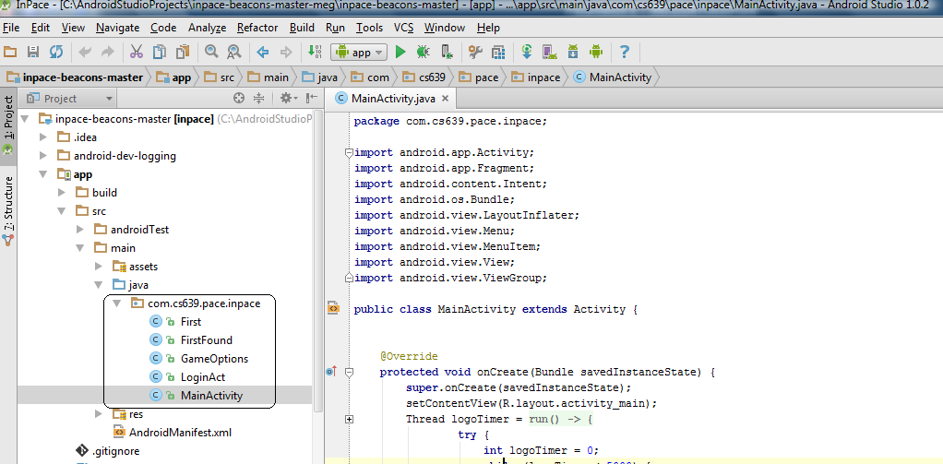

Slide 40
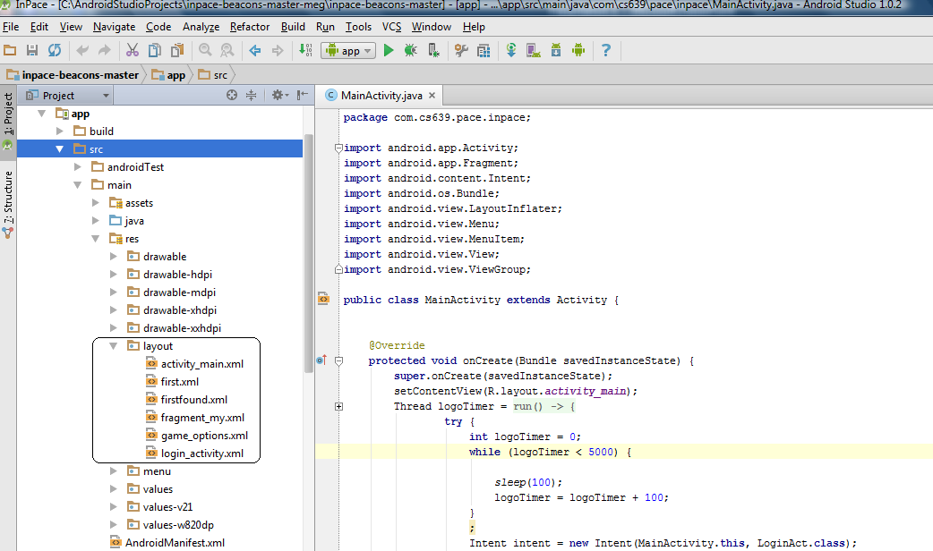

Slide 41
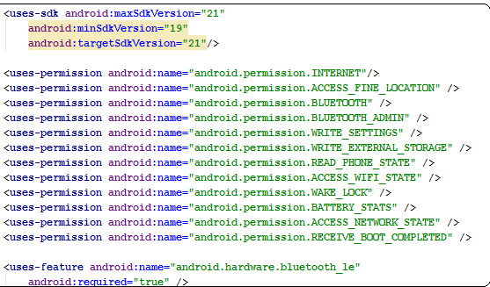
Manifest file

Slide 42
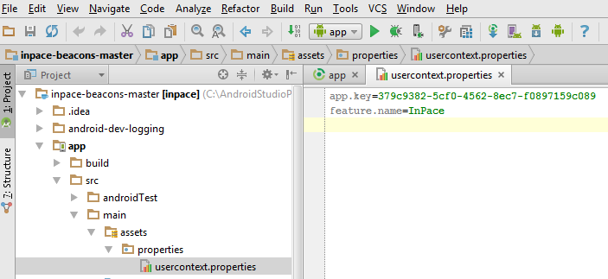
Configure App for Gimbal SDK

Slide 43
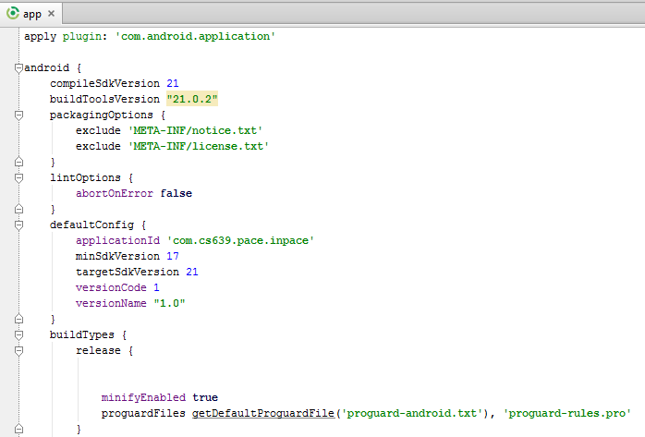
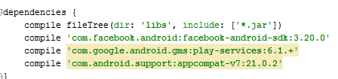
Gradle File

Slide 44
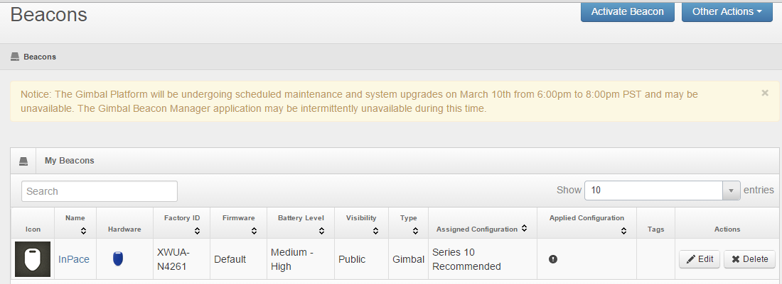
InPace Beacon Configuration

Slide 45
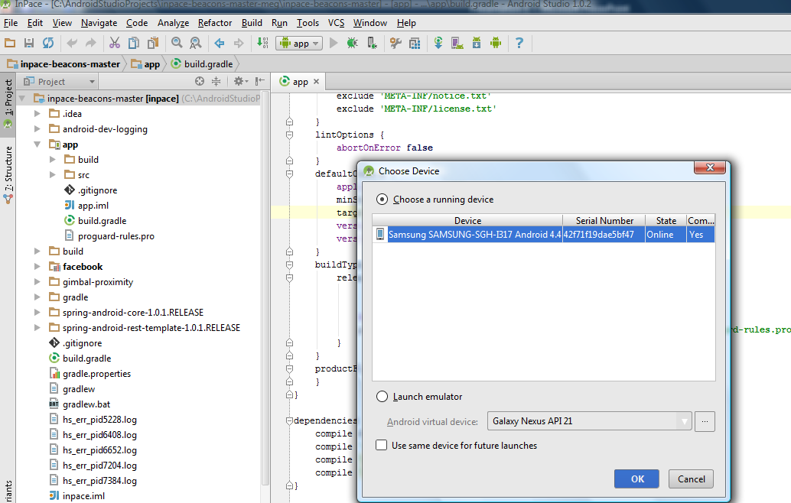
Running The App

Slide 46
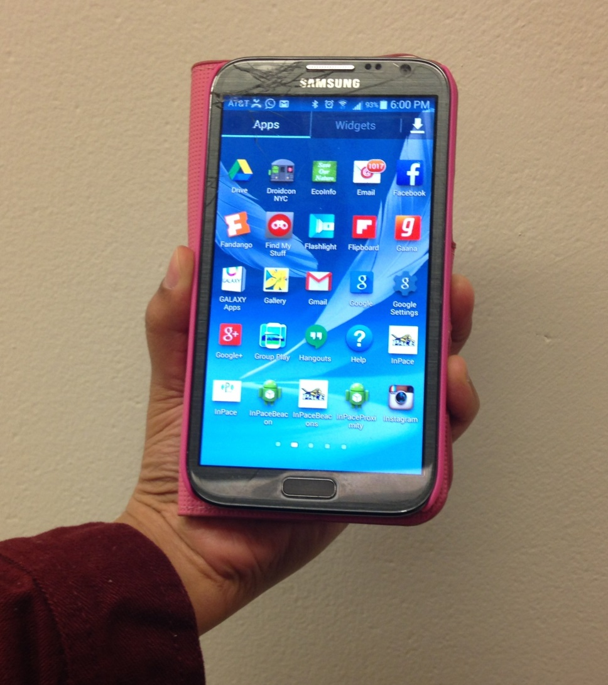
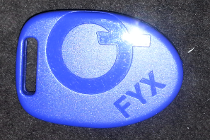
InPace – A Look

Slide 47

InPace – A Look

Slide 48
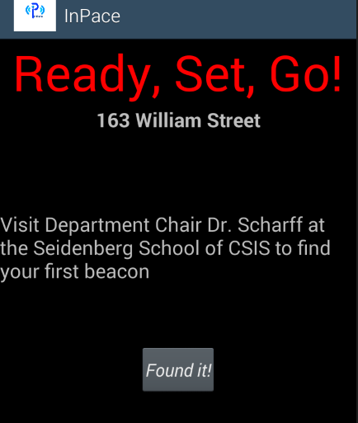
InPace – A Look

Slide 49

InPace – A Look

Slide 50
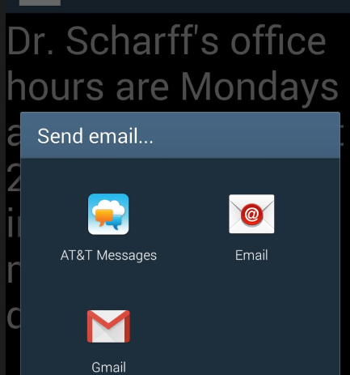
InPace – A Look

Slide 51
InPace Database- SQLite
Name | Location | Score
Steve | Gym | 1
- | Cafeteria | 3
- | - | 6
- | - | 10
- | Professor | 15

Slide 52
Name | Score
Steve | 15
Mike | 10
Eve | 6
John | 3
Ana | 1

Slide 53
Thank You

