Slide 1

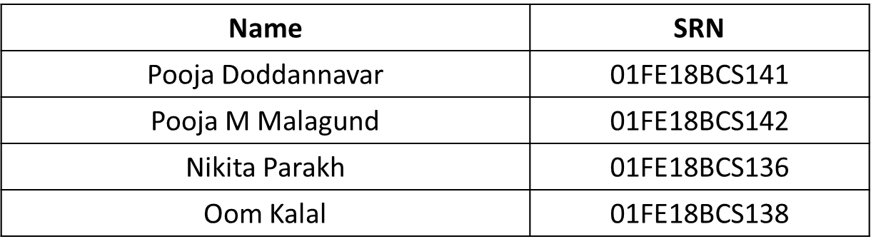
Data Mining & Analysis Course Project On Energy Prediction From Smart Meter Data
DMACP01 Presented by -Team no. :14
Under the Guidance of: Dr. P G Sunita Hiremath

Slide 2

Introduction
Predicting energy consumption is currently a key challenge for the energy industry as a whole.
Predicting the consumption in a certain area is massively complicated due to the sudden changes in the way that energy is being consumed and generated at the current point in time.
This prediction becomes extremely necessary to minimize costs and to enable adjusting automatically the production of energy and better balance the load between different energy sources.
Smart meters will not only play an increasingly large role in the way customers consume energy but also in the way they choose a supplier.

Slide 3
Motivation
The motivation to do this project is primarily an interest in undertaking a challenging project that is helpful for the society.
The proposed model is helpful for the energy industry as a whole as it enables to minimize costs and to enable adjusting automatically the production of energy and better balance the load between different energy sources.
Therefore the motivation is to build a model that will be able to predict the future energy consumption from the smart meter data available.

Slide 4
Problem Statement
Energy Prediction From Smart Meter Data
Build a model that predicts the monthly electricity consumption for 3248 households in the coming year (January to December) from the given previous year Smart Meter Data.

Slide 5
Literature Survey
Will Koehrson demonstates Time-Series Analysis on the Tesla Financial Dataset^{[1]}.
Jason Brownlee proposed Auto-Regressor model for household electricity consumption forecast^{[2]}. The Auto-Regressor model was trained on the ‘Household Power Consumption’ dataset. The missing values in the dataset were filled by copying the observation from the same time the day before. The model was evaluated by walk-forward validation.
Selva Prabhkaran builds ARIMA model from scratch for Time-Series Forecasting and then extends the model to Seasonal ARIMA (SARIMA) and SARIMAX models^{[3]}.
Sean J. Taylor and Ben Lentham proposed a model for Time-Series Forecasting, called Prophet that makes it much more straightforward to create a reasonable, accurate forecast^{[4]}. At its core, Prophet is an additive regression model.

Slide 6
Data Description
Size of the dataset : 44.6 MB
We are provided with the following files :
consumption.csv – half hourly consumption data for 3248 smart meters.
weather-avg.csv – average daily temperature associated to the 3248 smart meters.
weather-min.csv – Minimum daily temperature associated to the 3248 smart meters.
weather-max.csv – Maximum daily temperature associated to the 3248 smart meters.
addInfo.csv – Additional information available for the 1859 smart meters.
Among these files, we have given higher weightage to consumption.csv file.
Train Test Split :
Train: Consists of data of 10 months from January to October.
Test: Consists of data of 2 months November and December.

Slide 7
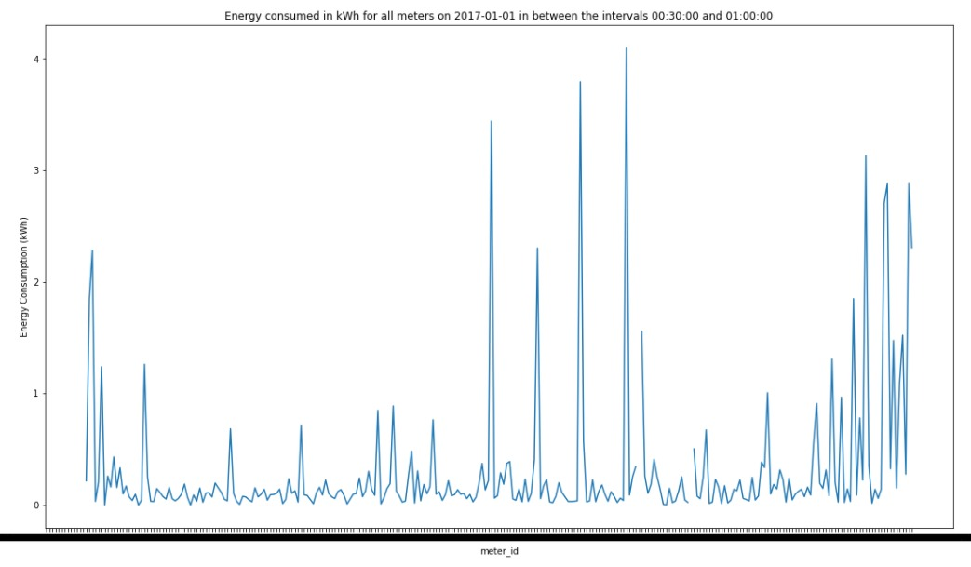
Exploratory Data Analysis
Few of the inferences drawn from Exploratory Data Analysis are:
Energy consumed by a household can be as less as 0.01 kWh to as high as 4 kWh.
The energy consumption of a household is independent of other households.
Figure 1: Energy Consumed in kWh for all meters on 2017-01-01 in between the interval 00:30:00 and 01:00:00

Slide 8
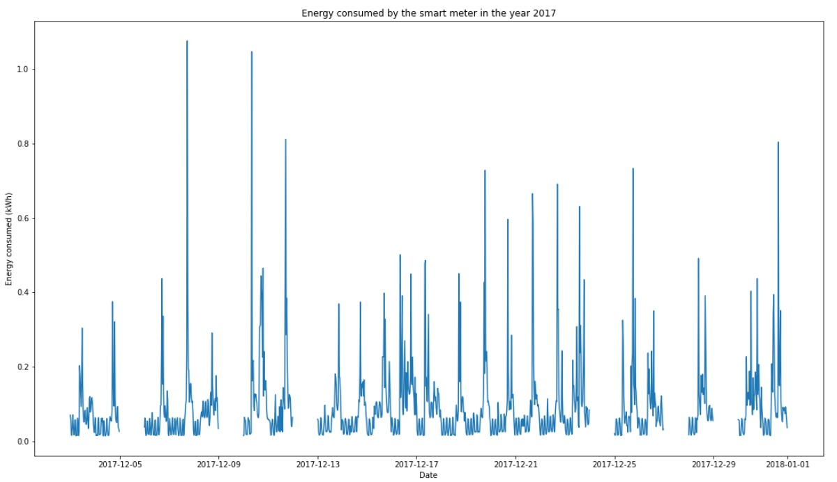
3. The energy consumption by the household is not even throughout the year.
Figure 2: Energy consumption of the meter '0xa62b9f23553ff183f61e2bf943aab3d5983d02d7' in the year 2017

Slide 9
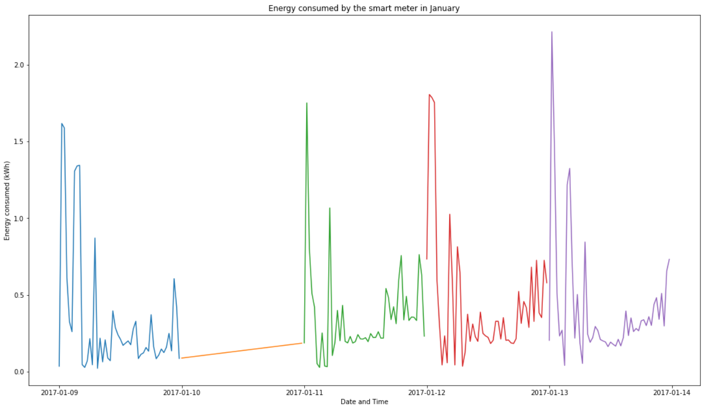
Data Pre-processing 1
The consumption data is having 51.63% missing values.
Linear Interpolation : It is a technique used to estimate unknown values that lie between known values.
Figure 3. The missing values for the consumption data of a smart meter filled by linear interpolation. (X-axis: Date-Time, Y-axis: Energy(kWh))

Slide 10
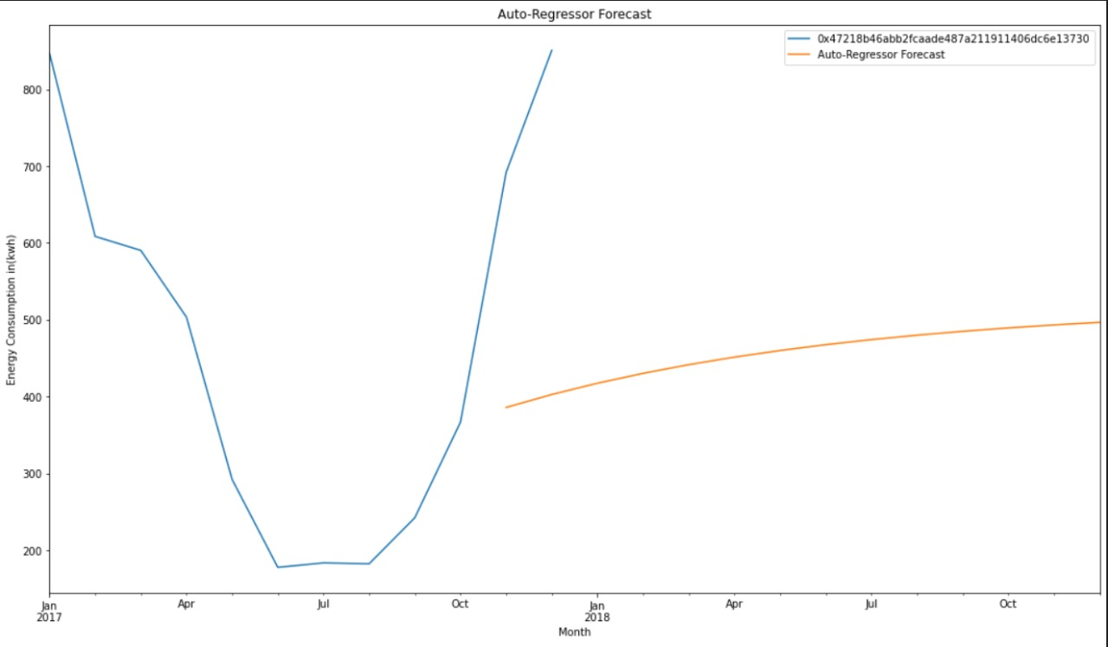
Auto-Regressor Model
A forecasting algorithm based on the idea that previous values of time series can alone be used to predict the future values.
: History of energy consumed by a smart meter in the year 2017.
: Energy consumption forecast by AR Model for the year 2018.
Figure 4. Predictions for a smart meter for the year 2018 using the Auto-Regressor model. (X-axis: Date, Y-axis: Energy(kWh))

Slide 11
Bias-Variance Trade-Off
The balance between the bias error and the variance error is the bias-variance trade-off.
Evaluation Metric: Relative Absolute Error (RAE)
Relative Absolute Error for the year: Year_RAE = 0.5655
Relative Absolute Error for months: Month_RAE = 5.3595
Total Relative Absolute Error: Total_RAE = 2.9625

Slide 12
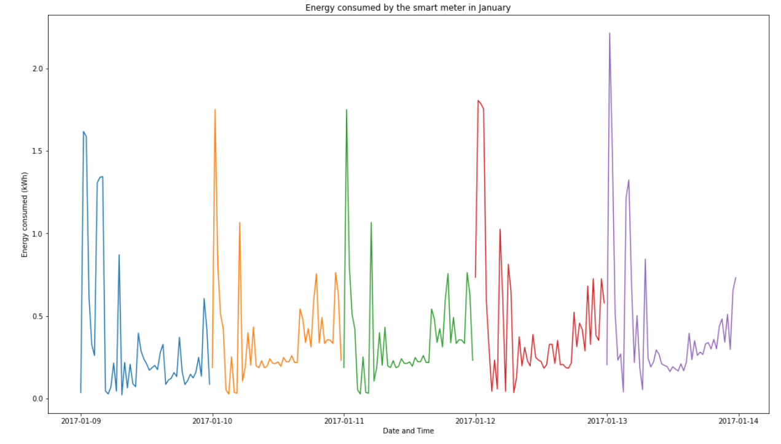
Data Pre-processing - 2
1. fill_missing :The missing values are filled by locally defined function definition fill_missing().
The missing data is filled by energy consumed by the same meter during the same interval of next day
Figure 5. The missing values for the consumption data of a smart meter filled by fill_missing(). (X-axis: Date, Y-axis: Energy (kWh).

Slide 13
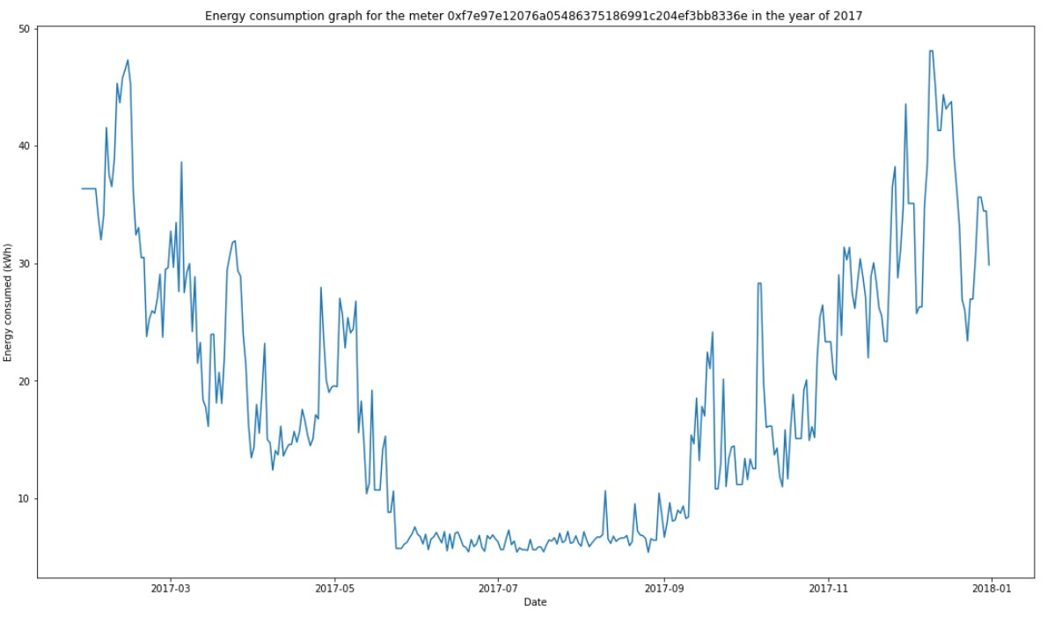
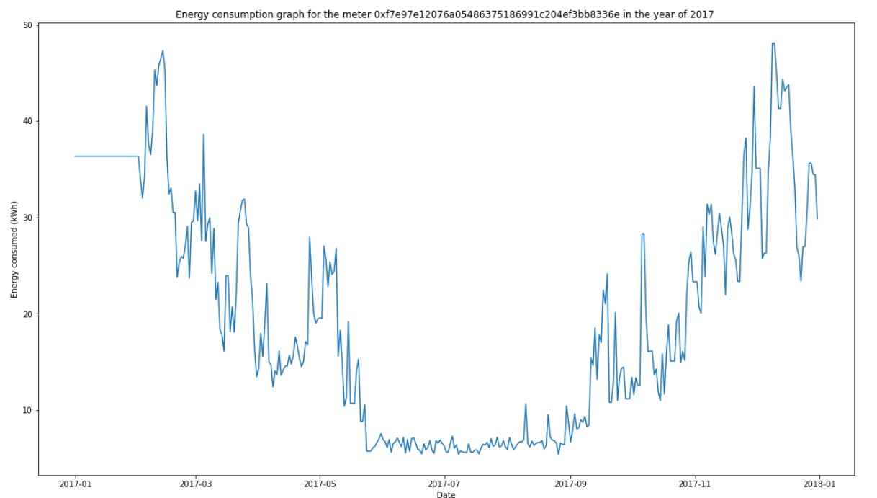
2. Backward Filling:
44.57% missing values remained after filling the missing data using fill_missing() method.
The consumption data is then resampled to obtain daily consumption data.
The remaining missing values are then filled by backward filling.
Figure 6: Energy consumption graph for the meter in the year of 2017 (before backward filling)
Figure 7: Energy Plotting the energy consumption graph for the meter (after backward filling)

Slide 14
1. ARIMA Model
Auto-Regressive Integrated Moving Average (ARIMA) Model.
It takes time-series data as input, performs statistical analysis to interpret the data and make future predictions.
The model involves three parameters: AR + I + MA.
Auto-Regressive (p): Number of Auto-Regressive terms.
Integrated (d): Number of non-seasonal differences needed for stationarity.
Moving Average (q): Number of lagged forecast errors in the prediction equation.

Slide 15
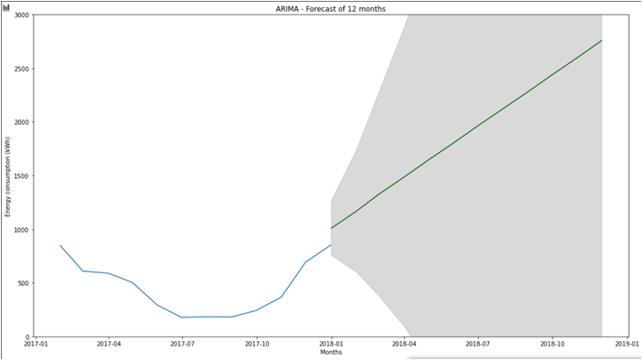
Result and Analysis
The trend and seasonality observed in the energy consumption data in the year 2017 is not carried forward in the forecast for the year 2018.
: History of energy consumed by a smart meter in the year 2017.
:Energy consumption forecast by ARIMA Model for the year 2018.
Figure 8. Energy consumption forecast for a smart meter for the year 2018 using ARIMA Model. (X-axis: Date, Y-axis: Energy (kWh).

Slide 16
2. Prophet Model
Prophet forecasting works best for the data having following characteristics:
(i) hourly, daily, or weekly observations with at least few months of history.
(ii) trends that are non-linear growth curves.
Prophet procedure is an additive regression model with three main components:
(i) A piecewise linear or logistic growth curve trend.
(ii) A yearly seasonal component modeled using Fourier Series.
(iii) A weekly seasonal component modeled using dummy variables.

Slide 17
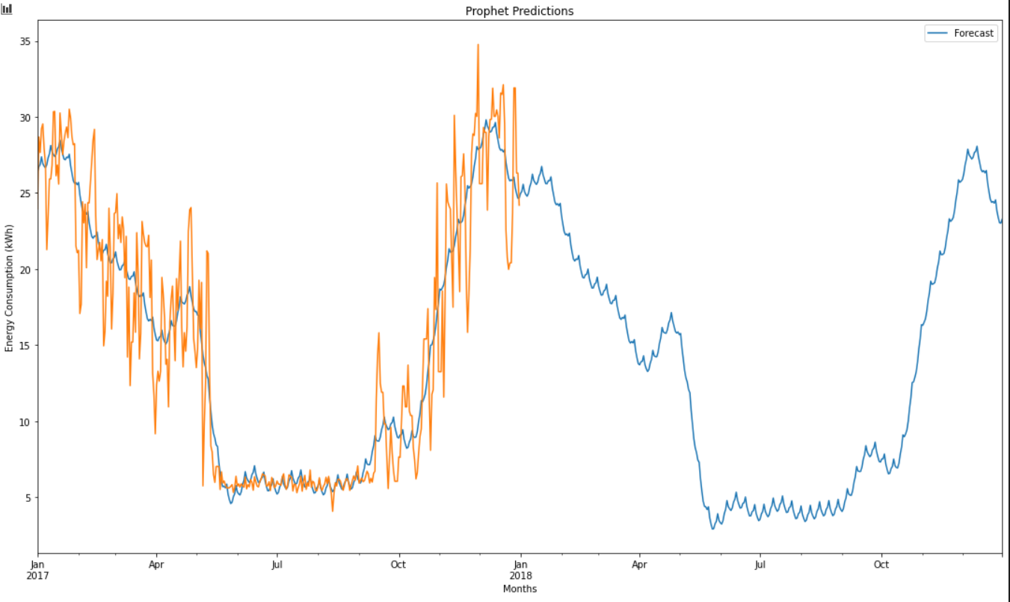
Results and Analysis
The smoothing parameters for seasonality allows to adjust closely to fit historical cycles and trend allows to adjust aggressively to follow historical trend.
: History of energy consumed by a smart meter in the year 2017.
: Energy consumption forecast by Prophet Model for the year 2017 and 2018.
Figure 9 : Energy consumption forecast for a smart meter for the year 2017 and 2018 using Prophet Model. (X-axis: Date, Y-axis: Energy (kWh).

Slide 18
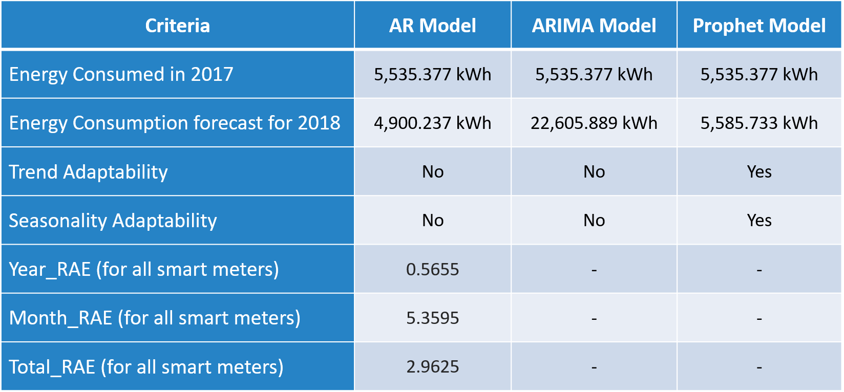
Results
Figure 10 : Comparison of the three models for a smart meter

Slide 19
Conclusion:
Conclusion
AR and ARIMA forecasts do not adapt to the trend and seasonality.
The Prophet model follows historical trends and seasonality while forecasting.
Hence we drive the conclusion that the Prophet Model Forecasts the best.
Figure 11 : Energy consumption forecast for AR, ARIMA and Prophet models respectively

Slide 20
References
[1] https://towardsdatascience.com/time-series-analysis-in-python-an-introduction-70d5a5b1d52a Will Koehrson, “Time Series Analysis in Python: An Introduction” Jan 13, 2018 [accessed on Oct 24, 2020]
[2] https://machinelearningmastery.com/how-to-develop-an-autoregression-forecast-model-for-household-electricity-consumption/ Jason Brownlee, “Autoregression Forecast Model for Household Electricity Consumption” Oct 3, 2018 [accessed on Nov 10, 2020]
[3] https://www.machinelearningplus.com/time-series/arima-model-time-series-forecasting-python/ Selva Prabhakaran, “ARIMA Model – Time Series Forecasting in Python” [accessed on Nov 25, 2020]
[4] https://research.fb.com/blog/2017/02/prophet-forecasting-at-scale/ Sean J. Taylor, Ben Letham, “Prophet: Forecasting at Scale” February 23, 2017 [accessed on Dec 10, 2020]
[5] https://facebook.github.io/prophet/docs/quick_start.html “Prophet: Quick Start Documentation” [accessed on Dec 10, 2020]

